Slide 1
LLRF Operator Training for XFEL
Introduction and Guide Lines
Mathieu Omet
DESY, 27.02.2018

Slide 2
Contents
Introduction
What an operator should know
Expert only features
Exceptional cases and how to react
Summary

Slide 3
Introduction
What does LLRF stand for? What is it about?
  Low Level Radio Frequency
  Our task: digital LLRF control of accelerating fields within cavities
  RF frequency in gun cavity and superconducting cavities: 1.3 GHz (3.9 GHz at AH1)
  Frequencies too fast for ADCs → Mixing with 1.354 GHz and by this downconversion to 54 MHz → Sampling with 81 MHz
  Low level of frequency and amplitude, BUT original amplitude and phase information is preserved
  Digital signal processing and control
  Generation of drive signal (DAC + upconversion to 1.3 GHz or 3.9 GHz)

Slide 4
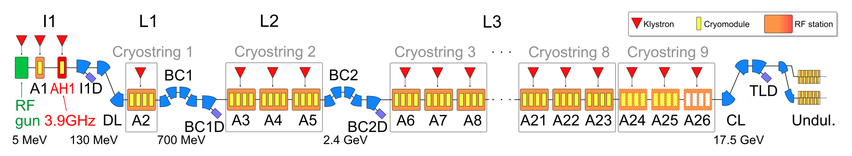
Introduction
Where are we involved?
  In every RF station
  For now 28 LLRF systems
  More to come with injector 2

Slide 5
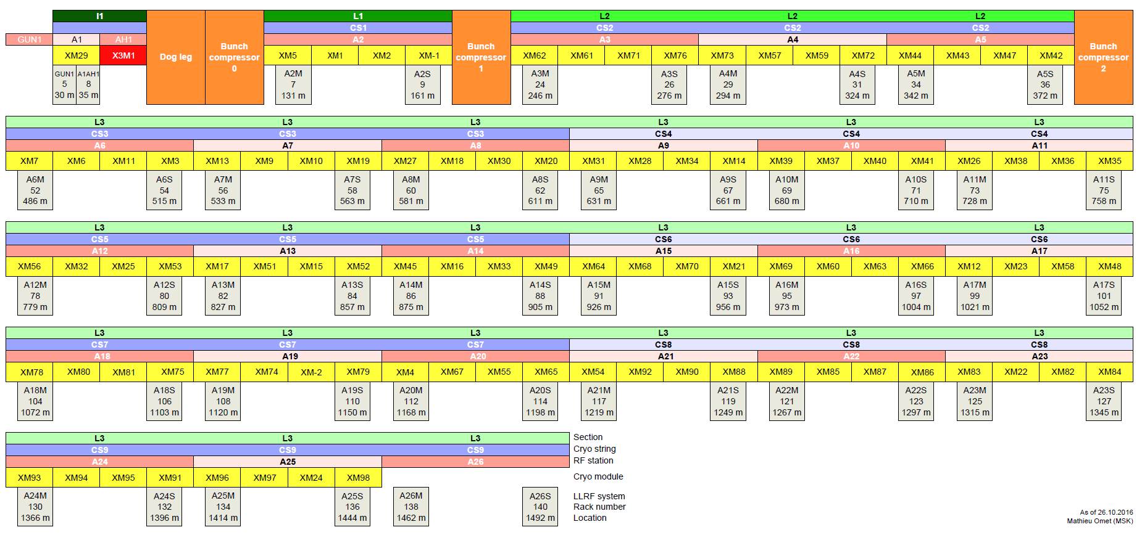
LLRF Station Overview

Slide 6
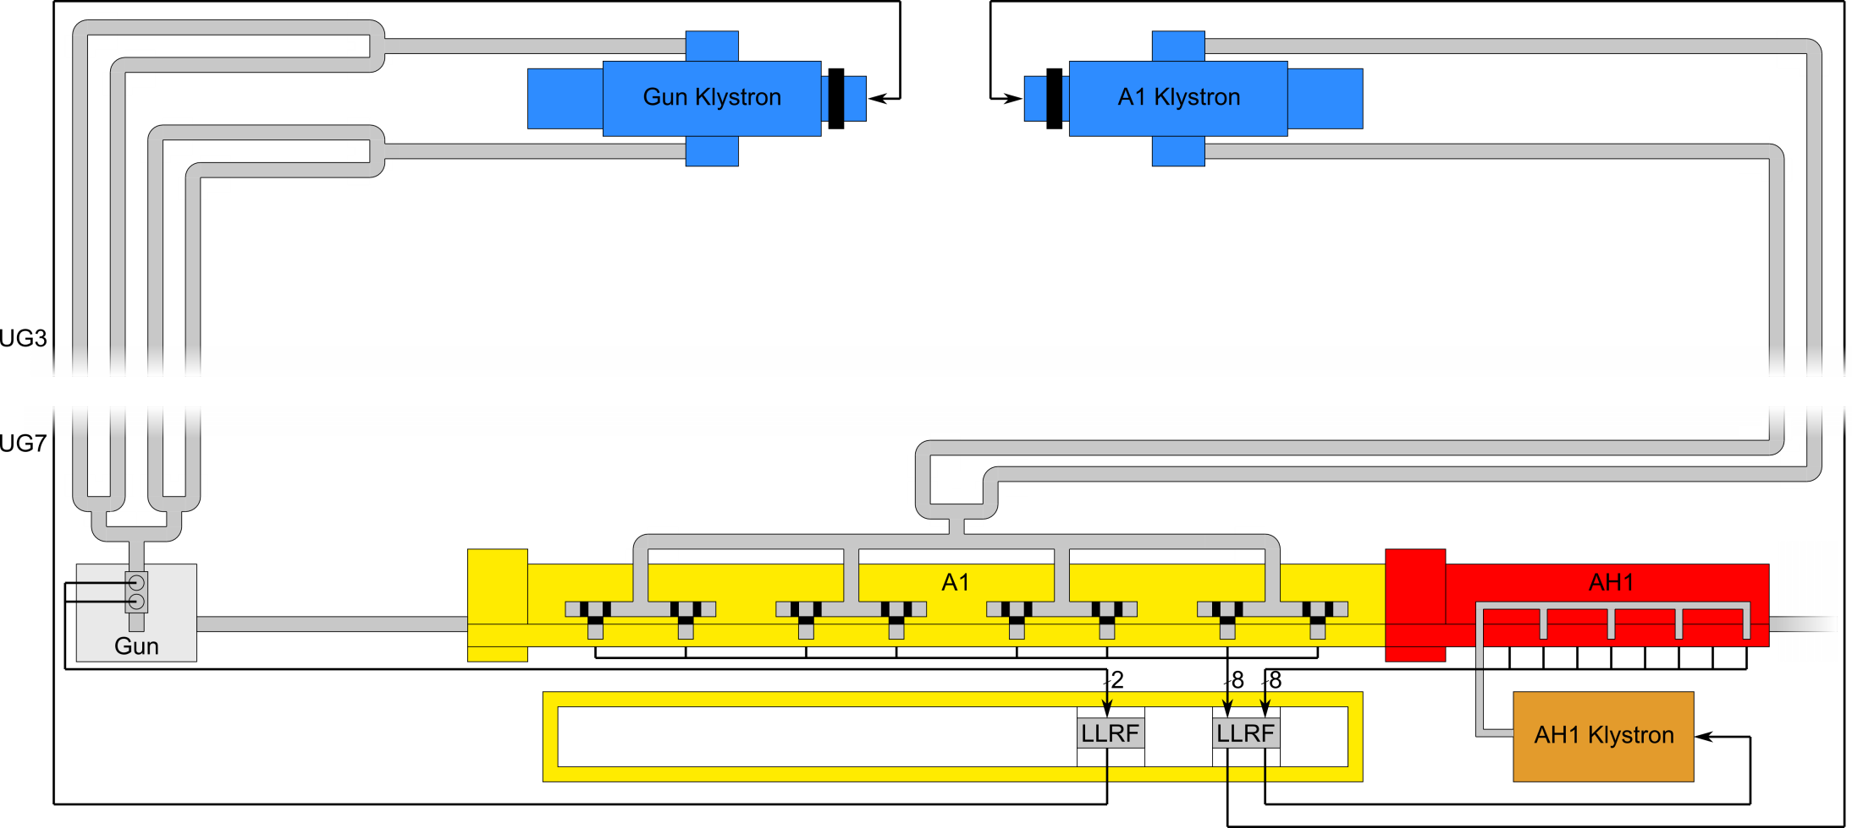
Introduction
RF Stations of the Injector 1

Slide 7
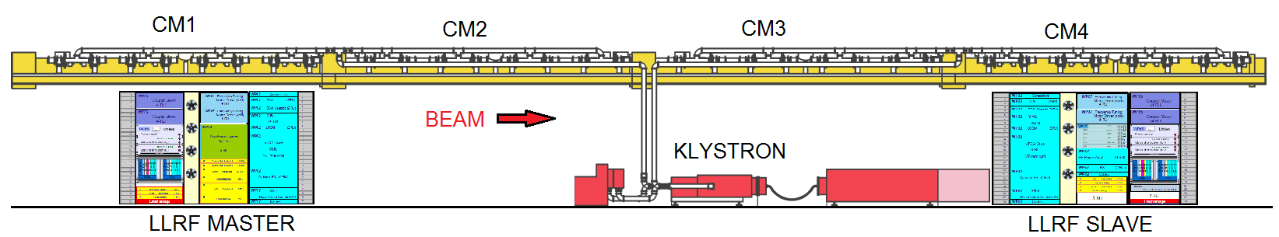
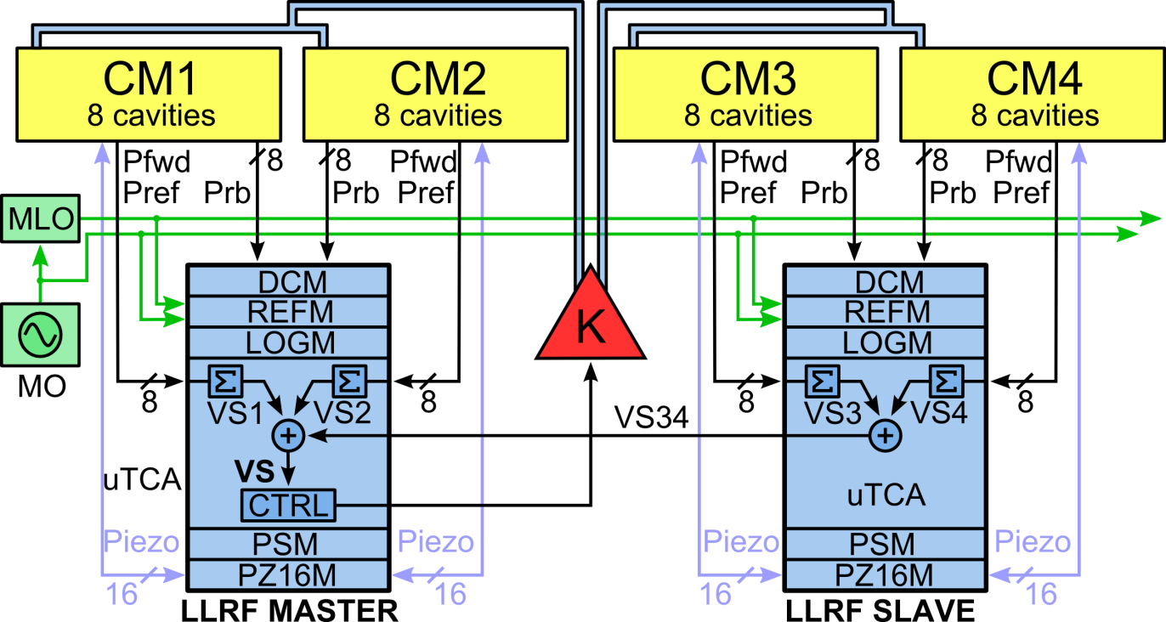
LLRF System Description
XTL RF station: semi-distributed LLRF system
DCM
Drift Compensation Module
REFM
RF Reference Module
LOGM
Local Oscillator Generation Module
PSM
Power Supply Module
PZ16M
Piezo Driver Module

Slide 8
What an operator should know
For now let‘s focus on the injector
Tasks of the XFEL operator:
  Turn on an RF station
  Adjust the vector-sum voltage
  Adjust the vector-sum phase
  Tune cavities, if necessary
  Adjust output vector correction and ratio, if necessary
  Set a certain phase as on-crest phase
  Turn off an RF station

Slide 9
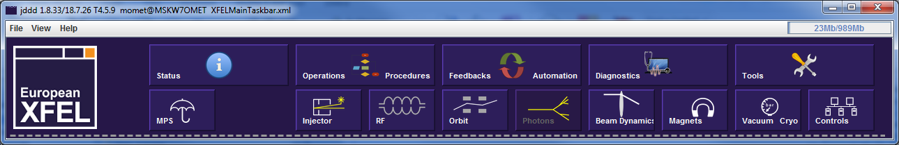
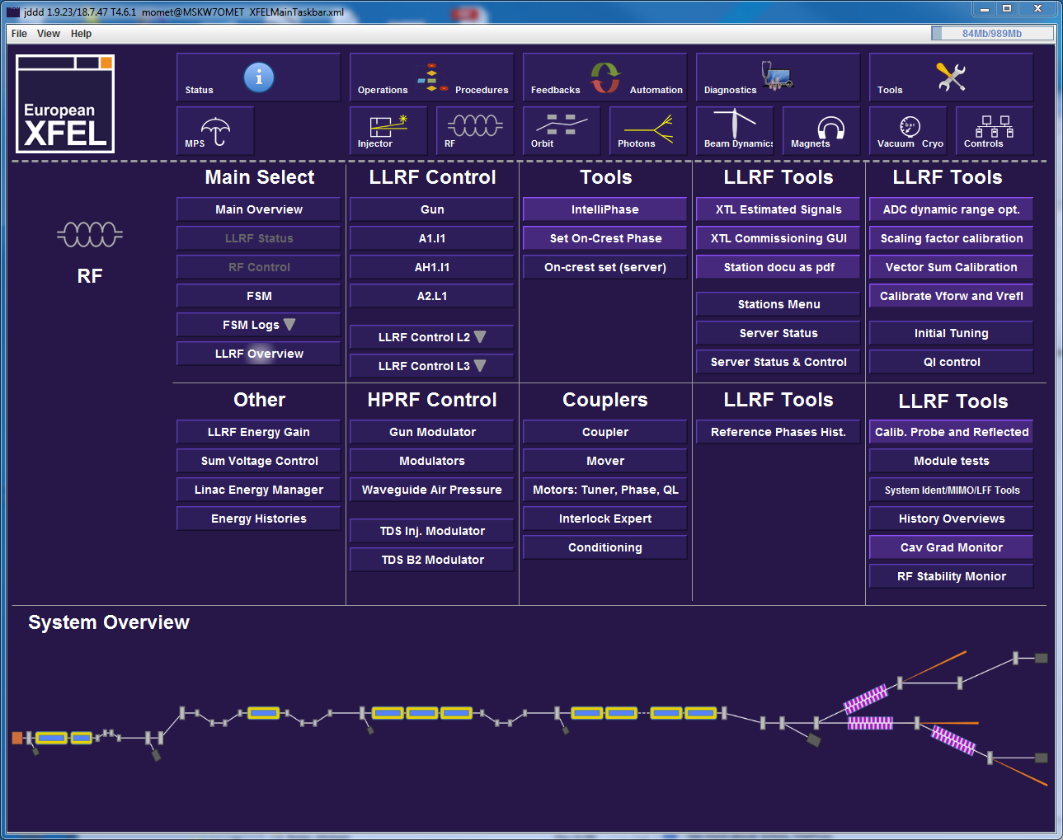
What an operator should know
Where to find the LLRF panels

Slide 10
What an operator should know
LLRF overview panel

Slide 11
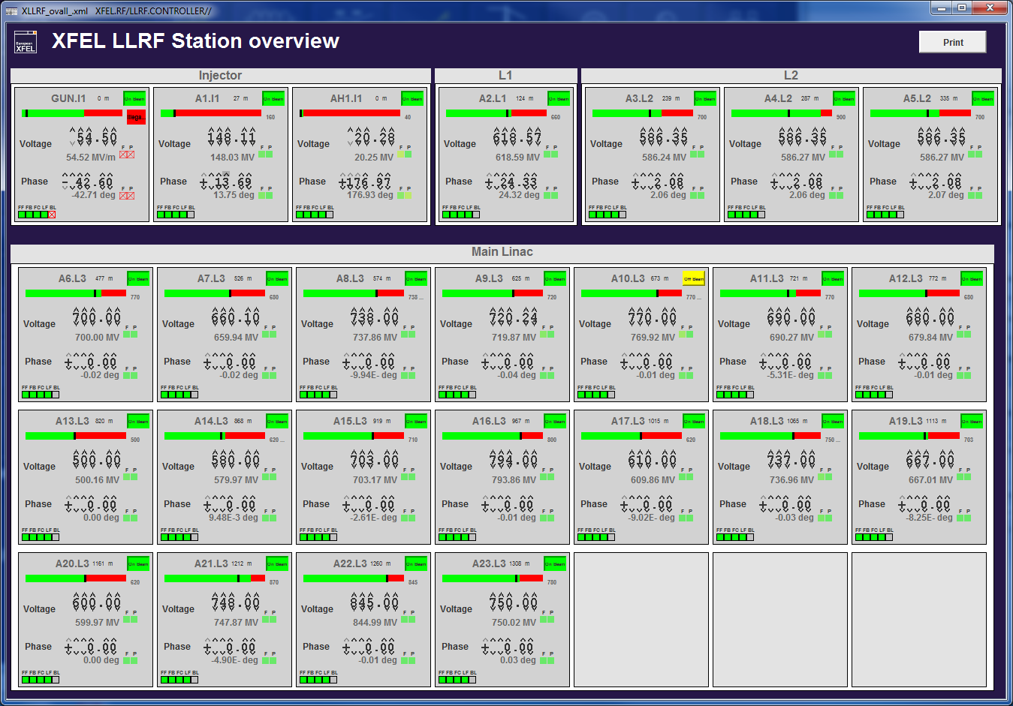
What an operator should know
LLRF overview panel

Slide 12
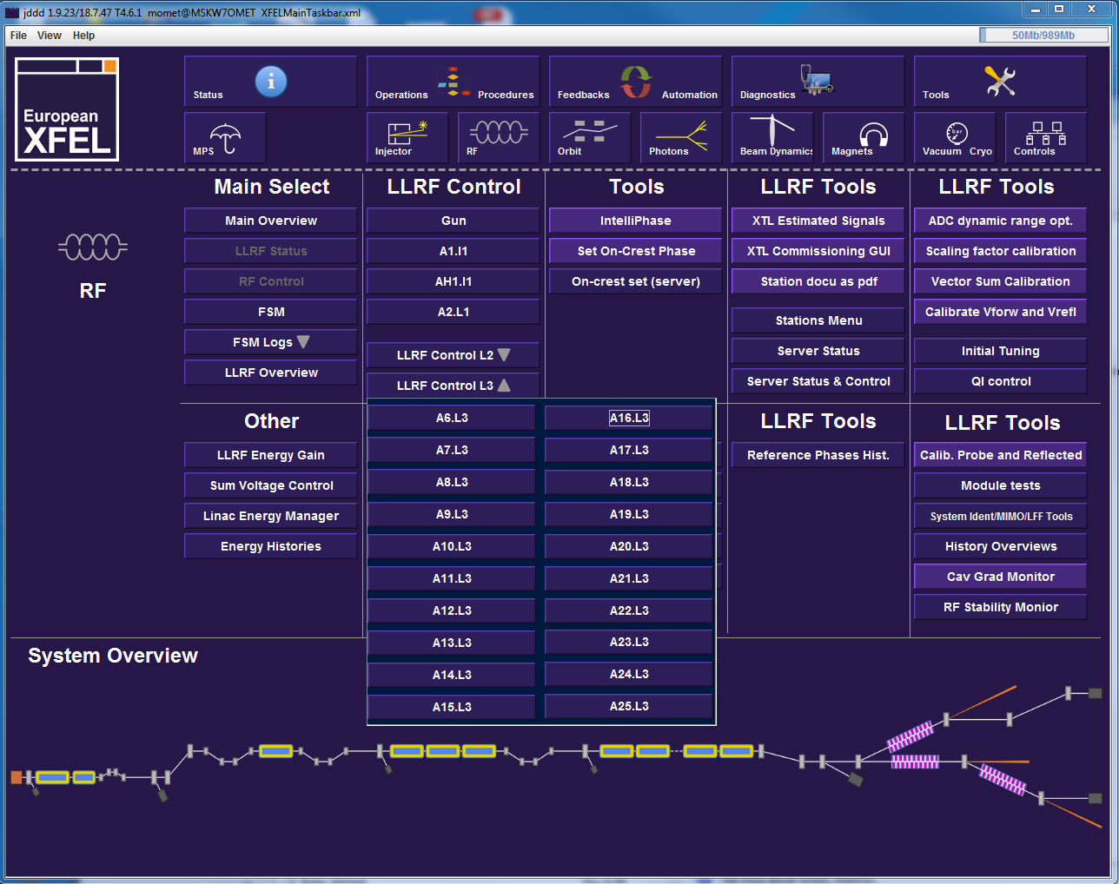
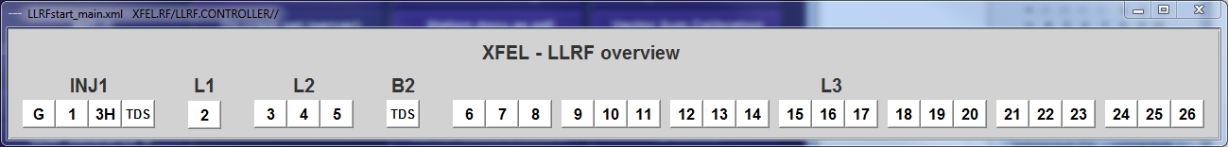
What an operator should know
Opening LLRF station panel

Slide 13
What an operator should know
Gun
*Turn on with FSM
*Turn on manually
Voltage setpoint 2) 1)
Phase setpoint 5) 11)
Pulse Width Modulation 4) 10)
Gun fast protection 3) 9)
FSM RF on/off 1)
Feed-Forward 2)
Output Vector Correction 4)
Feedback 5)
Feed-Forward Correction 7)
Learning Feed-Forward 8)
Turn off
Turn on*
Reset correction tables 6)
(LLRF Expert -> LFF -> Reset)
Ramp up gun 3)
(voltage & flattop length)
Setpoint amplitude and phase
Reconstructed cavity amp. and pha.

Slide 14
What an operator should know
Gun Pulse Width Modulation
  Use only after stable
  gun operation is achieved
  Use only during stable
  valve situation

Slide 15
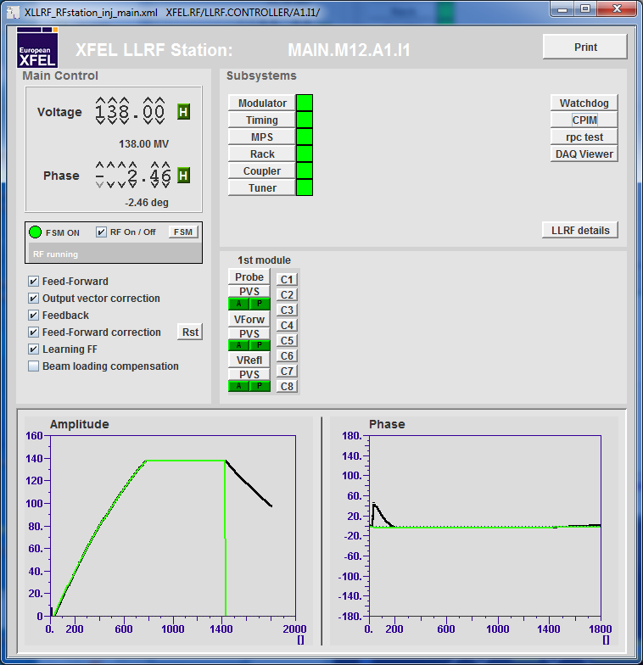
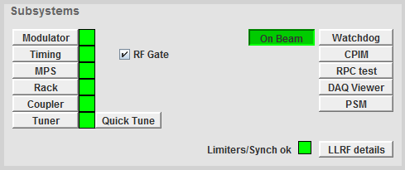
What an operator should know
A1.I1
*Turn on with FSM
*Turn on manually
Voltage setpoint 2) 1), 3)
Phase setpoint 2) 3)
FSM RF on/off 1)
Feed-Forward 2)
Tune cavities 4)
OVC, Ratio 5)
Feedback 6)
Feed-Forward correction 8)
Correction Table Reset 7)
Learning Feed-Forward 9)
Beam Loading Compensation 10)
Turn off
Turn on*
Setpoint amplitude and phase
Vector sum amplitude and phase

Slide 16
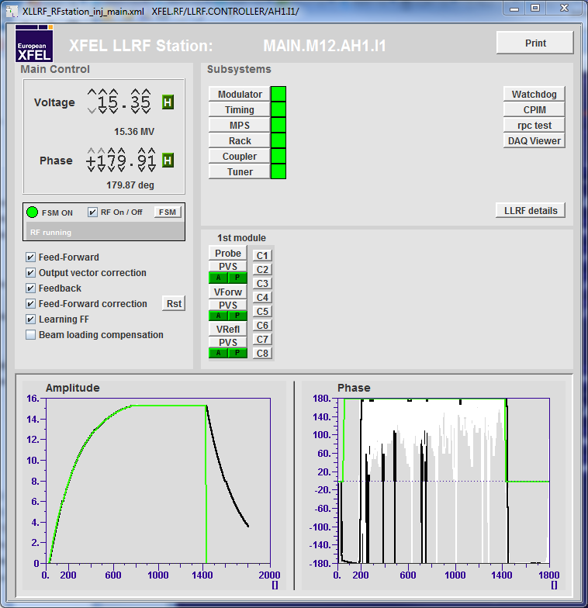
What an operator should know
AH1.I1
*Turn on with FSM
*Turn on manually
Voltage setpoint 2) 1), 3)
Phase setpoint 2) 3)
FSM RF on/off 1)
Feed-Forward 2)
Tune cavities 4)
OVC, Ratio 5)
Feedback 6)
Feed-Forward correction 8)
Correction Table Reset 7)
Learning Feed-Forward 9)
Beam Loading Compensation 10)
Turn off
Turn on*
Setpoint amplitude and phase
Vector sum amplitude and phase

Slide 17
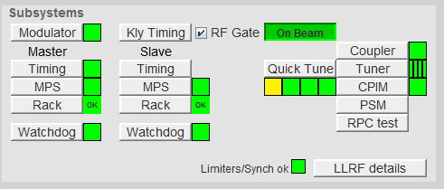
What an operator should know
In Feed-Forward operation vector sum gradient does not reach SP after filling and/or curved flattop (not possible to close FB)
Huge phase roll off (several ten degrees)
  Cavities are detuned → Document event with screen shots
  Tune cavities
Detuning

Slide 18
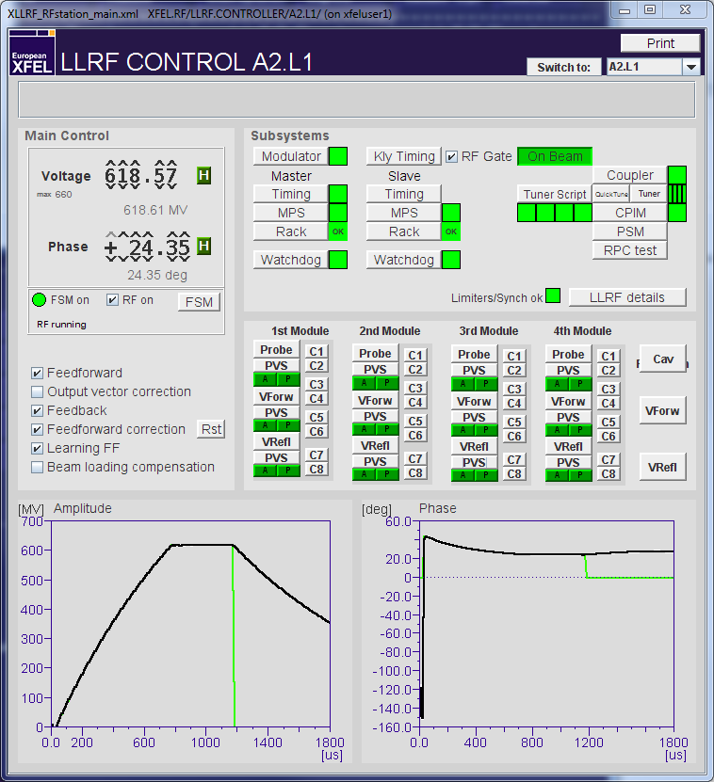
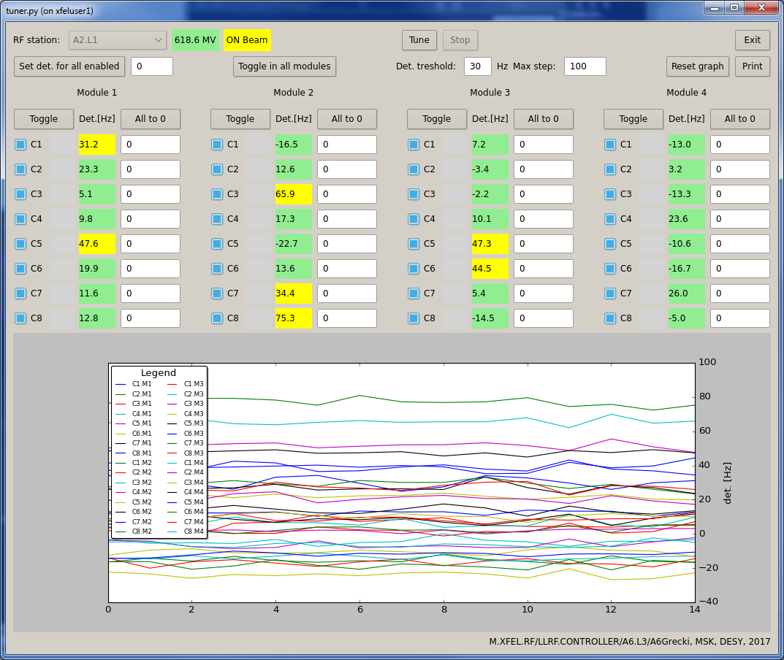
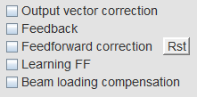
What an operator should know
Tuner script
Tune cavities only in open loop operation
In case of problems hit stop

Slide 19
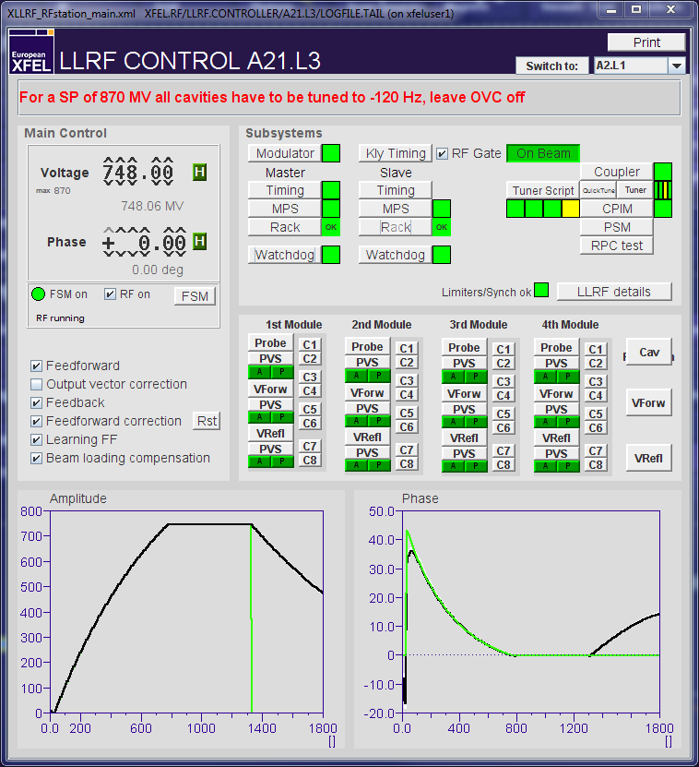
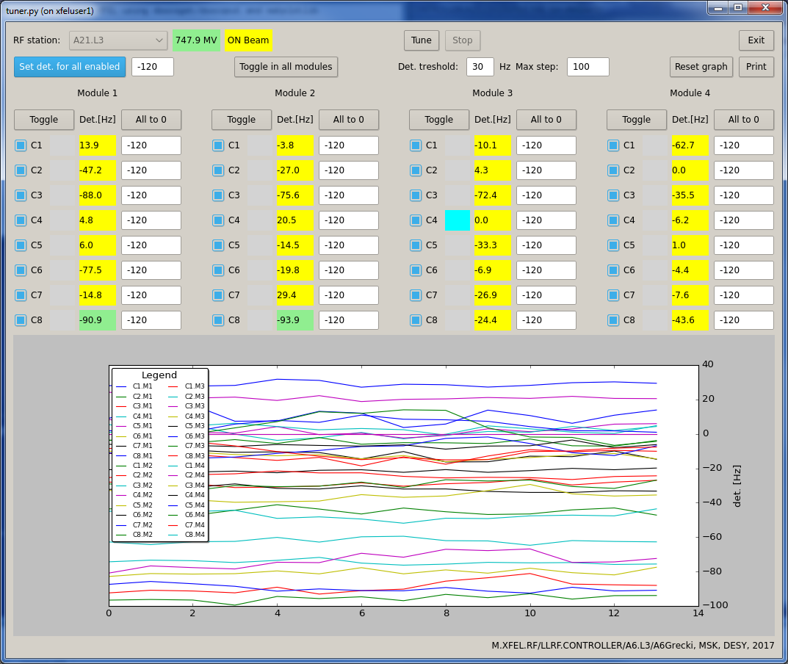
What an operator should know
Tuner script, don‘t forget to check panel comment!
Never ever change panel comment!
Tune cavities only in open loop operation

Slide 20
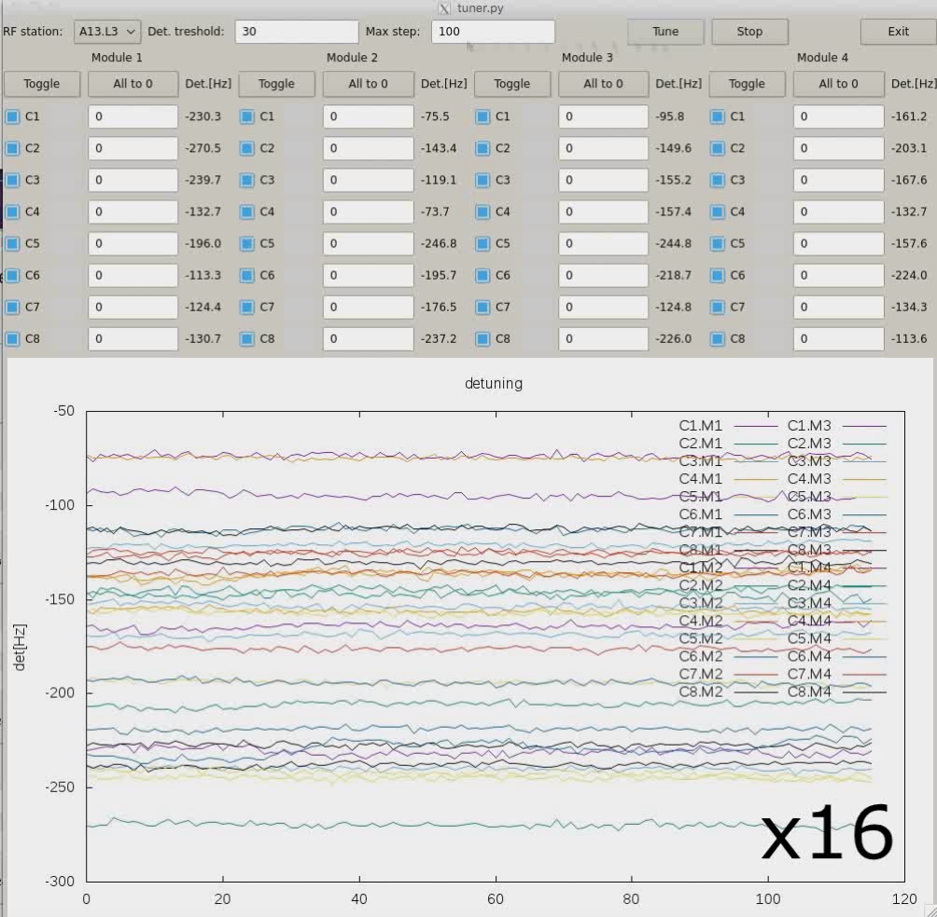
What an operator should know
How the tuning should look like

Slide 21
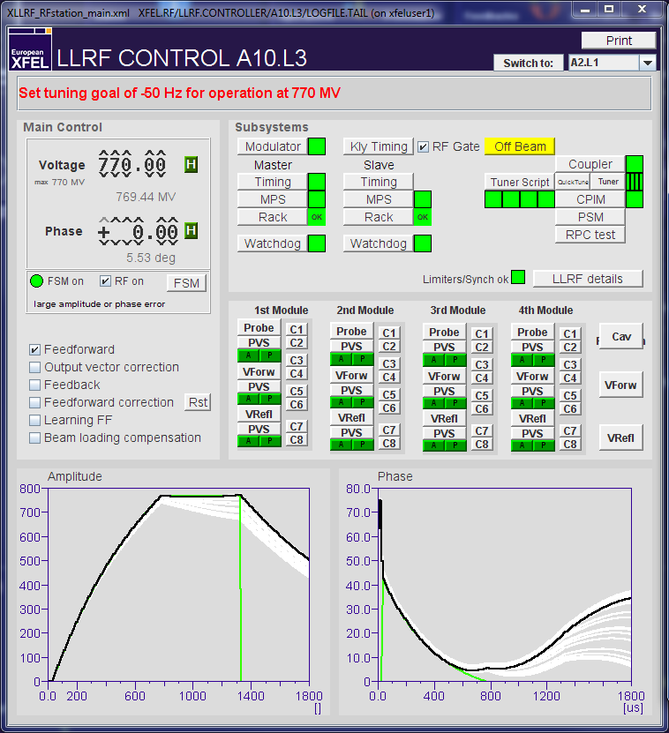
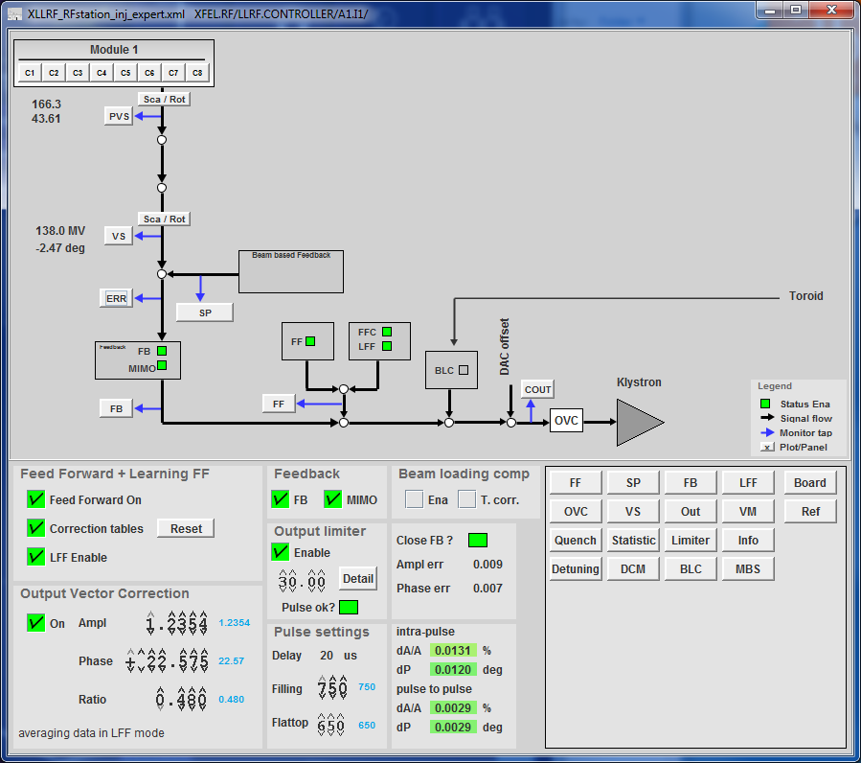
What an operator should know
OVC (Output Vector Rotation)
  Adjustment of VS amplitude and phase in order to minimize the deviation from the SP
Ratio
  Adjustment of amplitude slope over flattop

Slide 22
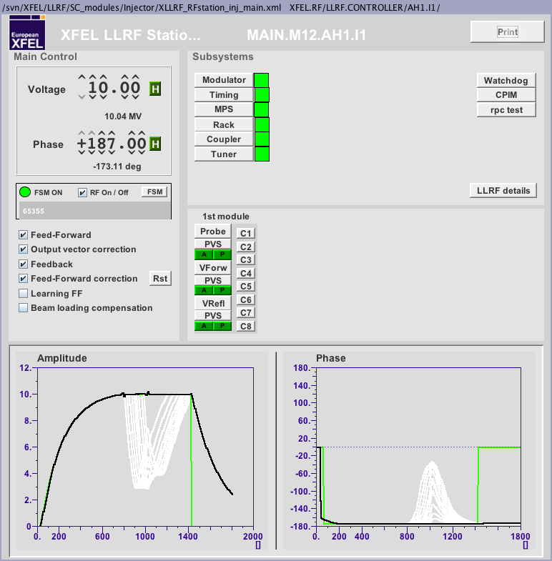
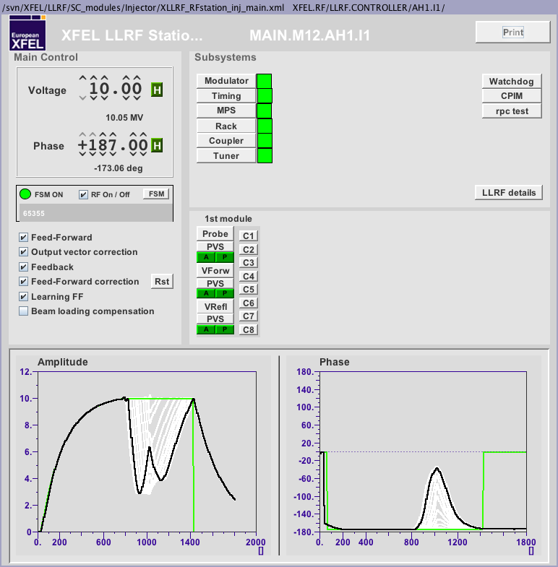
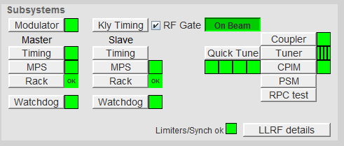
What an operator should know
LFF (Learning-Feed Forward)
  Is modifying the Feed-Forward Correction tables in order to compensate for repetitive errors (differences between VS amplitude and phase and the corresponding SP)
BLC (Beam Loading Compensation)
  Compensates for beam loading depending on number of bunches and charge
  Currently under commissioning → LFF takes over the job, but is slow (needs 1~2 minutes for learning)
  When switching from long bunch trains to short bunch trains, resetting the Feed-Forward Correction helps to gain appropriate correction tables quicker

Slide 23
What an operator should know
Changing the voltage more than 100 MV:
  Open the loop (disable Learning FF, Feedforward correction, Feedback)
  Change the voltage setpoint
  Adjust output vector correction and ratio to match set point (under LLRF details)
  Tune the cavities (note message in the LLRF panel in case a tuning goal different to 0 Hz is specified)
  For large voltage changes the two above steps might have to be interated, since different gradient ⬄ different detuning
  Close the loop (reset Feedforward correction, enable Learning FF, Feedforward correction and Feedback)
Using the XFEL Energy Manager might lead to detuned cavities, which can lead to trips

Slide 24
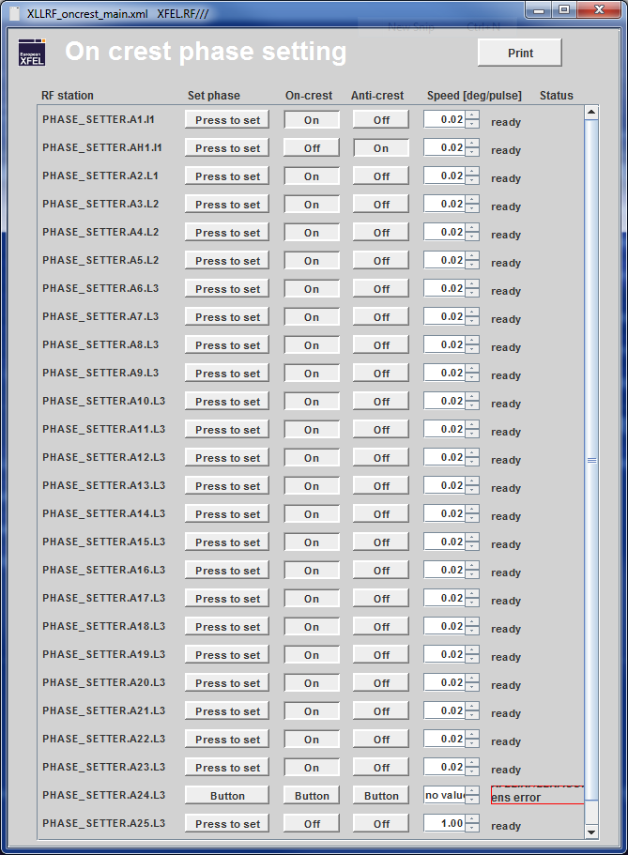
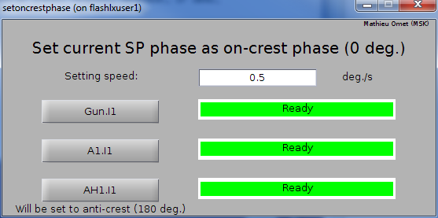
What an operator should know
Set current phase as on-crest phase
  After the on-crest (anti-on-crest phase) was determined, set it as the SP phase and select the station in panel below for setting it to 0 deg.
  For the gun ↓,for the rest →

Slide 25
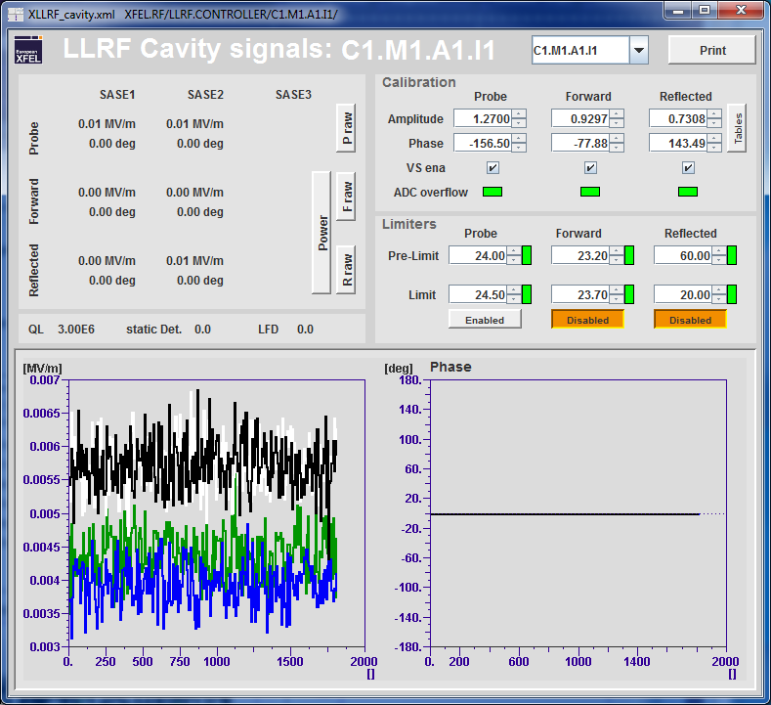
Expert Only Features
Limiters, DON‘T EVER TOUCH!

Slide 26
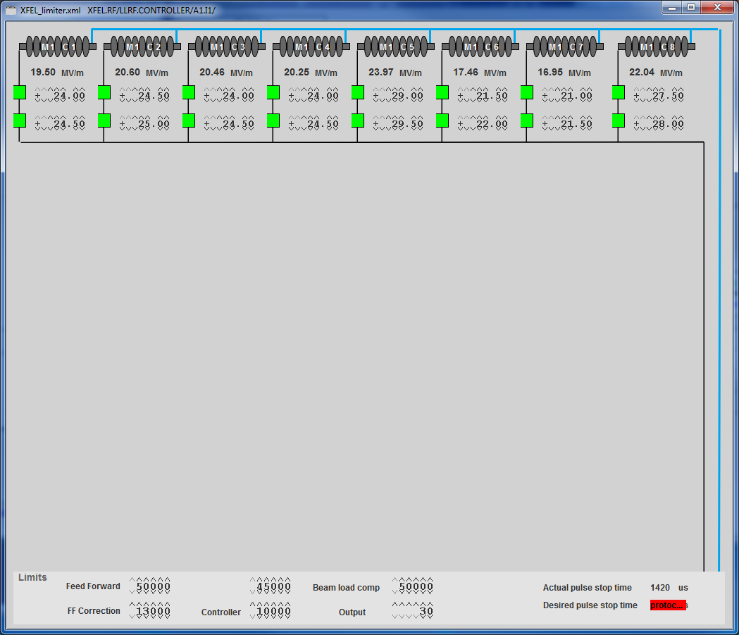
Expert Only Features
Limiters, DON‘T EVER TOUCH!
Pre-limiters
Limiters

Slide 27
Exceptional cases and how to react
Pulse cuts due to active limiters
  Document event with screen shots
  Decrease the setpoint amplitude, until cuts disappear
  Call the LLRF expert (5588)
Limiter

Slide 28
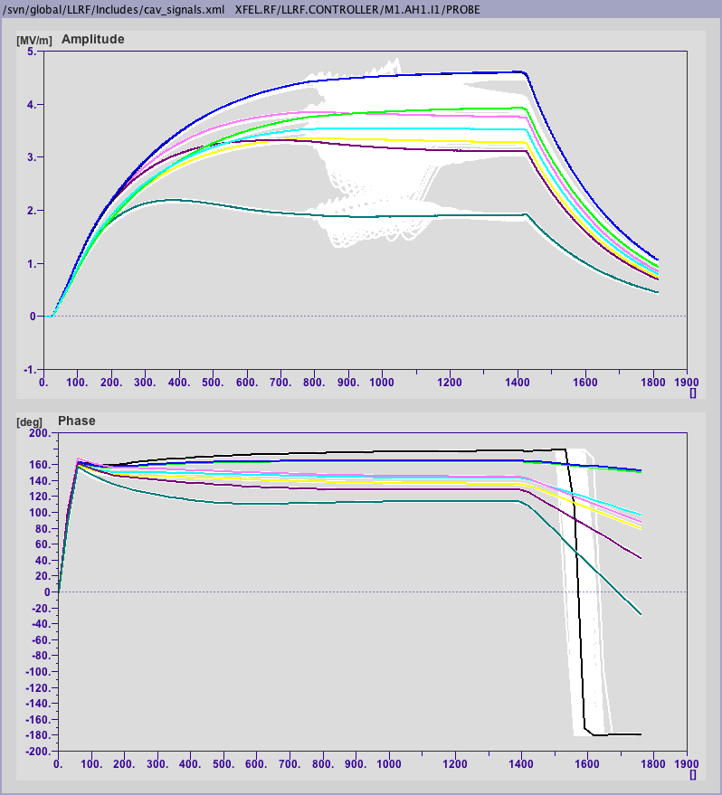
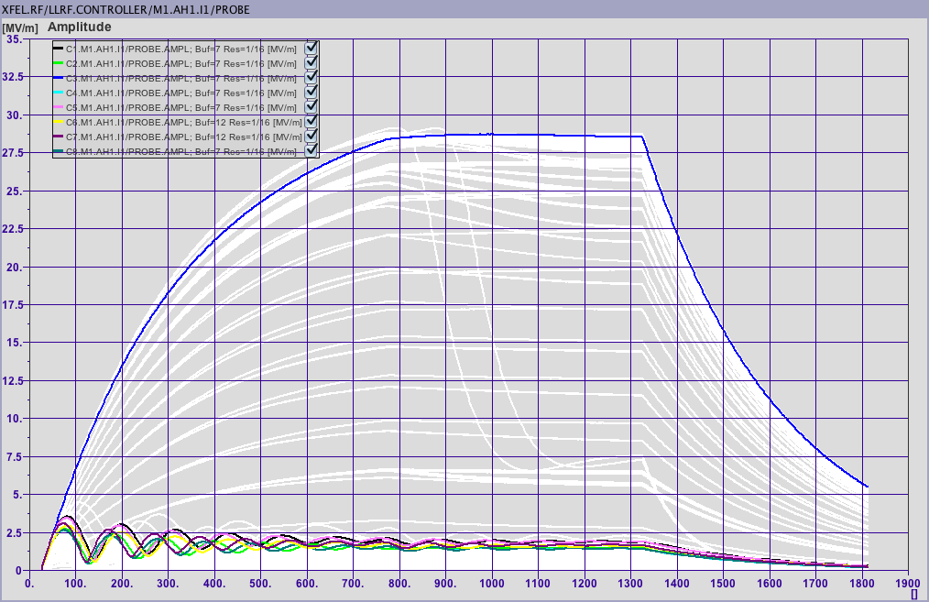
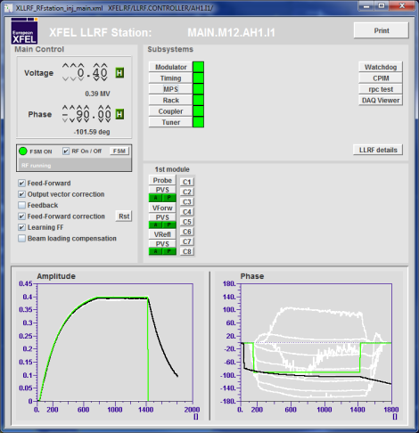
Exceptional cases and how to react
Pulse cuts by forward limiter
Cavity gradients are low and show damped sinusoidal shape
  Document event with screen shots
  Cavities are detuned → Call the LLRF expert (5588)
(example panel)

Slide 29
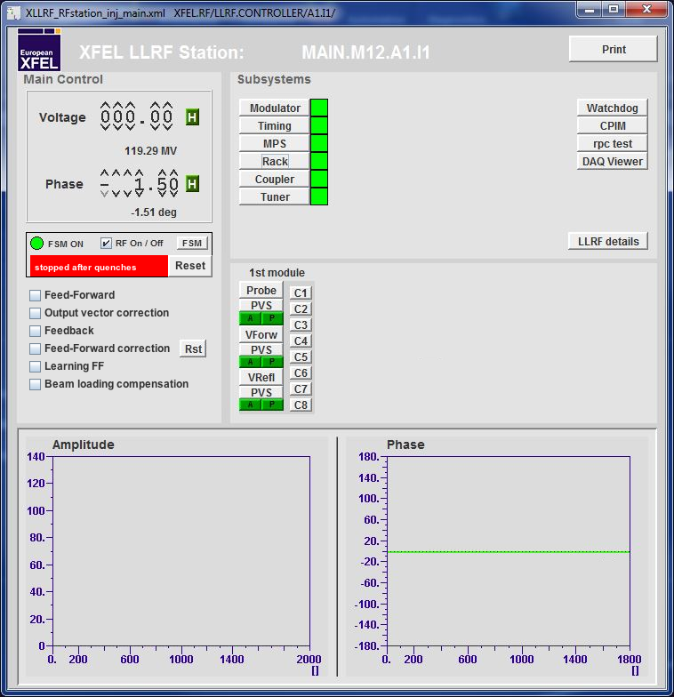
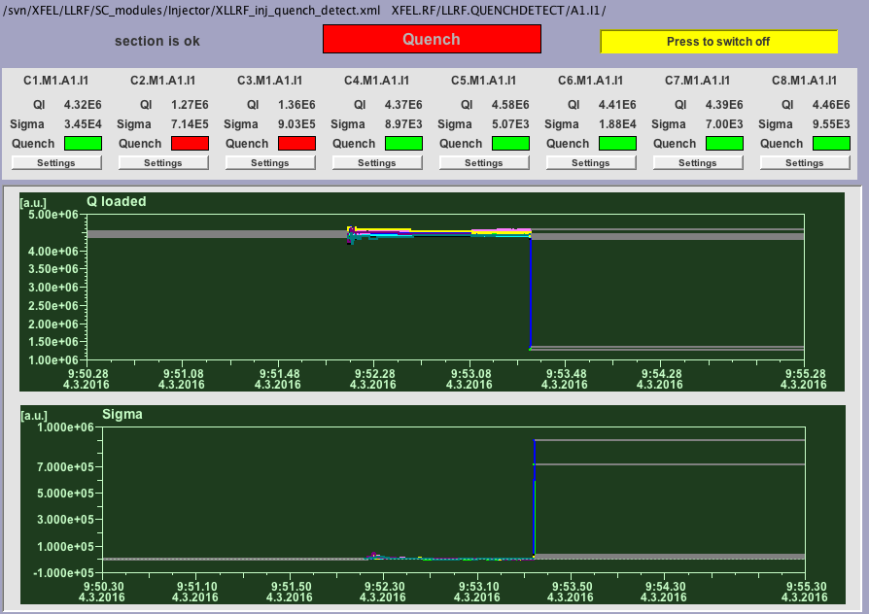
Exceptional cases and how to react
Quench event → Quench detection turns off RF
  Document event with screen shots
  Reset event, try to ramp up again
  If cavities quench again → Call the LLRF expert (5588)
Quench

Slide 30
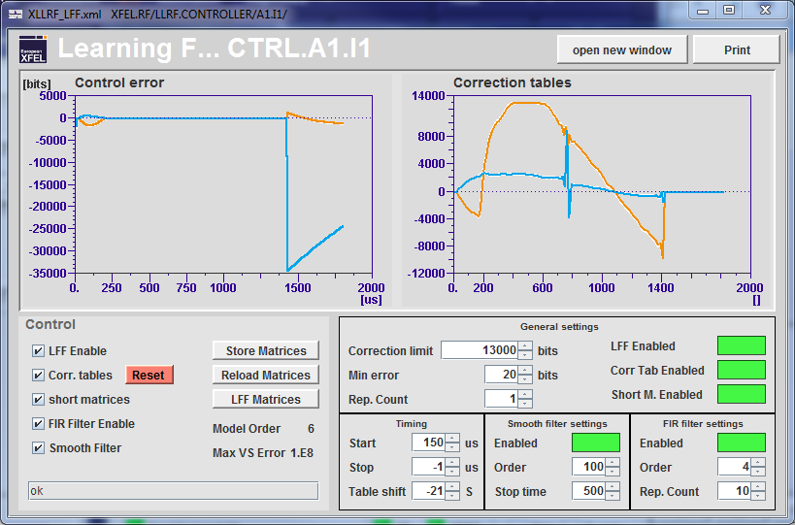
Exceptional cases and how to react
Weird shape of amplitude (or phase)
  Try to reset the Feed-forward correction tables and wait for a minute
  If it does not help or acts up again → Call the LLRF expert (5588)
LFF

Slide 31
Exceptional cases and how to react
LLRF controls not working
  If this is the case only for a short period of time → Communication issue, LLRF can‘t do anything
  If this state is persistent LLRF server might be down → Call the LLRF expert (5588)

Slide 32
Comments & Summary
Tasks of the XFEL operator:
  Turn on an RF station
  Adjust the vector-sum voltage
  Adjust the vector-sum phase
  Tune cavities, if necessary
  Adjust output vector correction and ratio, if necessary
  Set a certain phase as on-crest phase
  Turn off an RF station
Operation via the LLRF main panels
Document anything you think is not normal
  Add your name so that we can respond to you!!!
  Set location of respective RF station in your logbook entry!!!
If there are problems you need assitance with call the LLRF expert (5588)

Slide 33
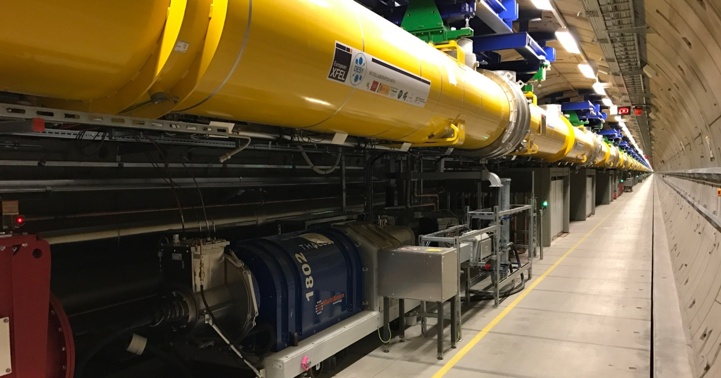
Questions?
Thank you very much for your attention!

