Slide 1
OCELOT orbit correction and optimizer
Sergey Tomin

Slide 2
Outline
OCELOT orbit correction tool
  Orbit correction
    Dispersion measurement
    Twiss Monitor
    Golden Orbit Adviser
  Adaptive Feedback
OCELOT Optimizer
  Dispersion minimization
  SASE optimization

Slide 3
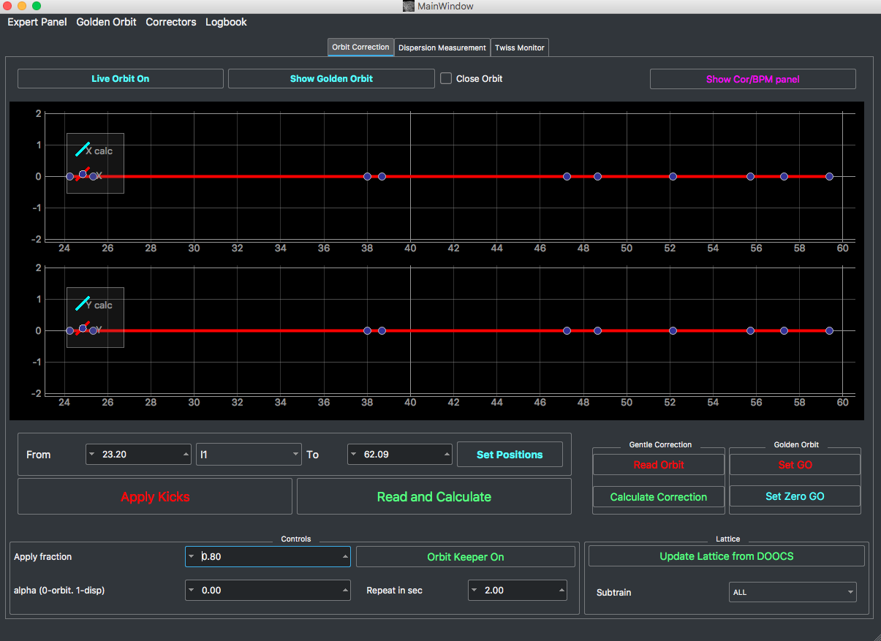
Orbit Correction Tool
Choice of the accelerator section

Slide 4
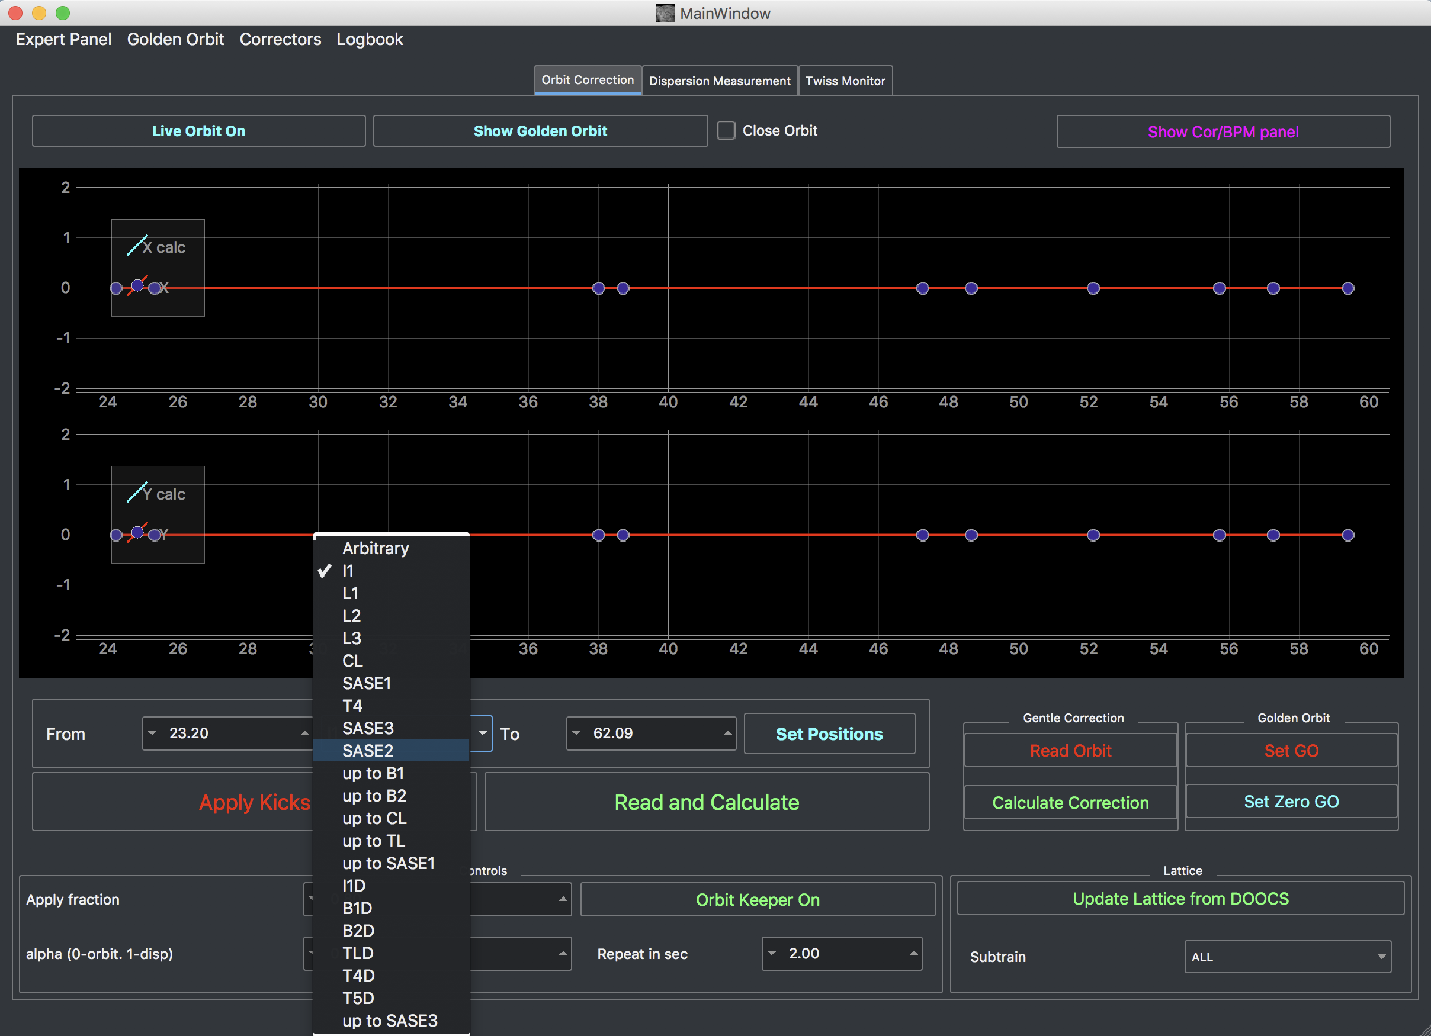
Orbit Correction Tool
Choice of the accelerator section

Slide 5
Orbit Correction Tool
Normal operation (w/o switching the beam off): Read and calculate,
Apply Kicks

Slide 6
Orbit Correction Tool
Switch on/off:
“Live orbit“ – orbit wrt the golden orbit
„Show GO“ – show GO if one was store

Slide 7
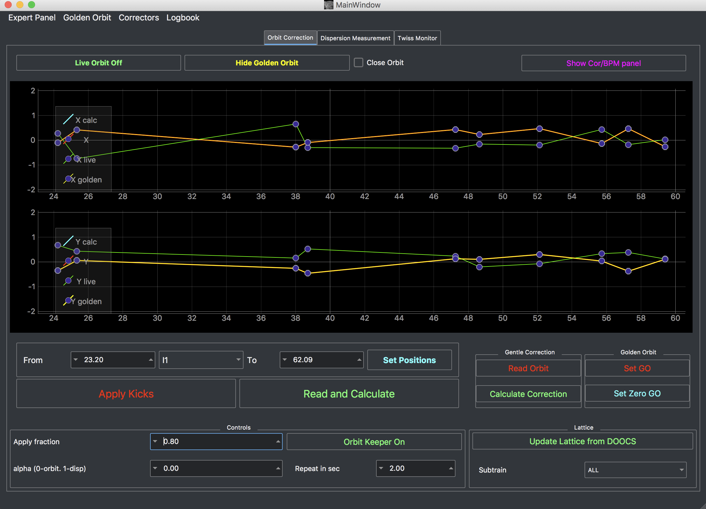
Orbit Correction Tool
Switch on/off:
“Live orbit“ – orbit wrt the golden orbit
„Show GO“ – show GO if one was store

Slide 8
Orbit Correction Tool
Close Orbit – calculates the kicks in such a way to prevent distribute oscillation from correction to downstream sections. By default, only for 5 last BPMs takes into account to calculate closed correction (can be changed in Settings).
“Gentle Correction“:
“Read Orbit“: switch beam on, read orbit, switch beam off, and calculate correction.
“Calculate Correction“ can be used to recalculate kicks w/o orbit reading
Note: The first reading is rather slow.
“Apply Fraction“: The fraction of the kicks to be applied – by default 0.8

Slide 9
Orbit Correction Tool
Sometimes you need to repeat correction for the same section many times. This option can save you from routine.

Slide 10
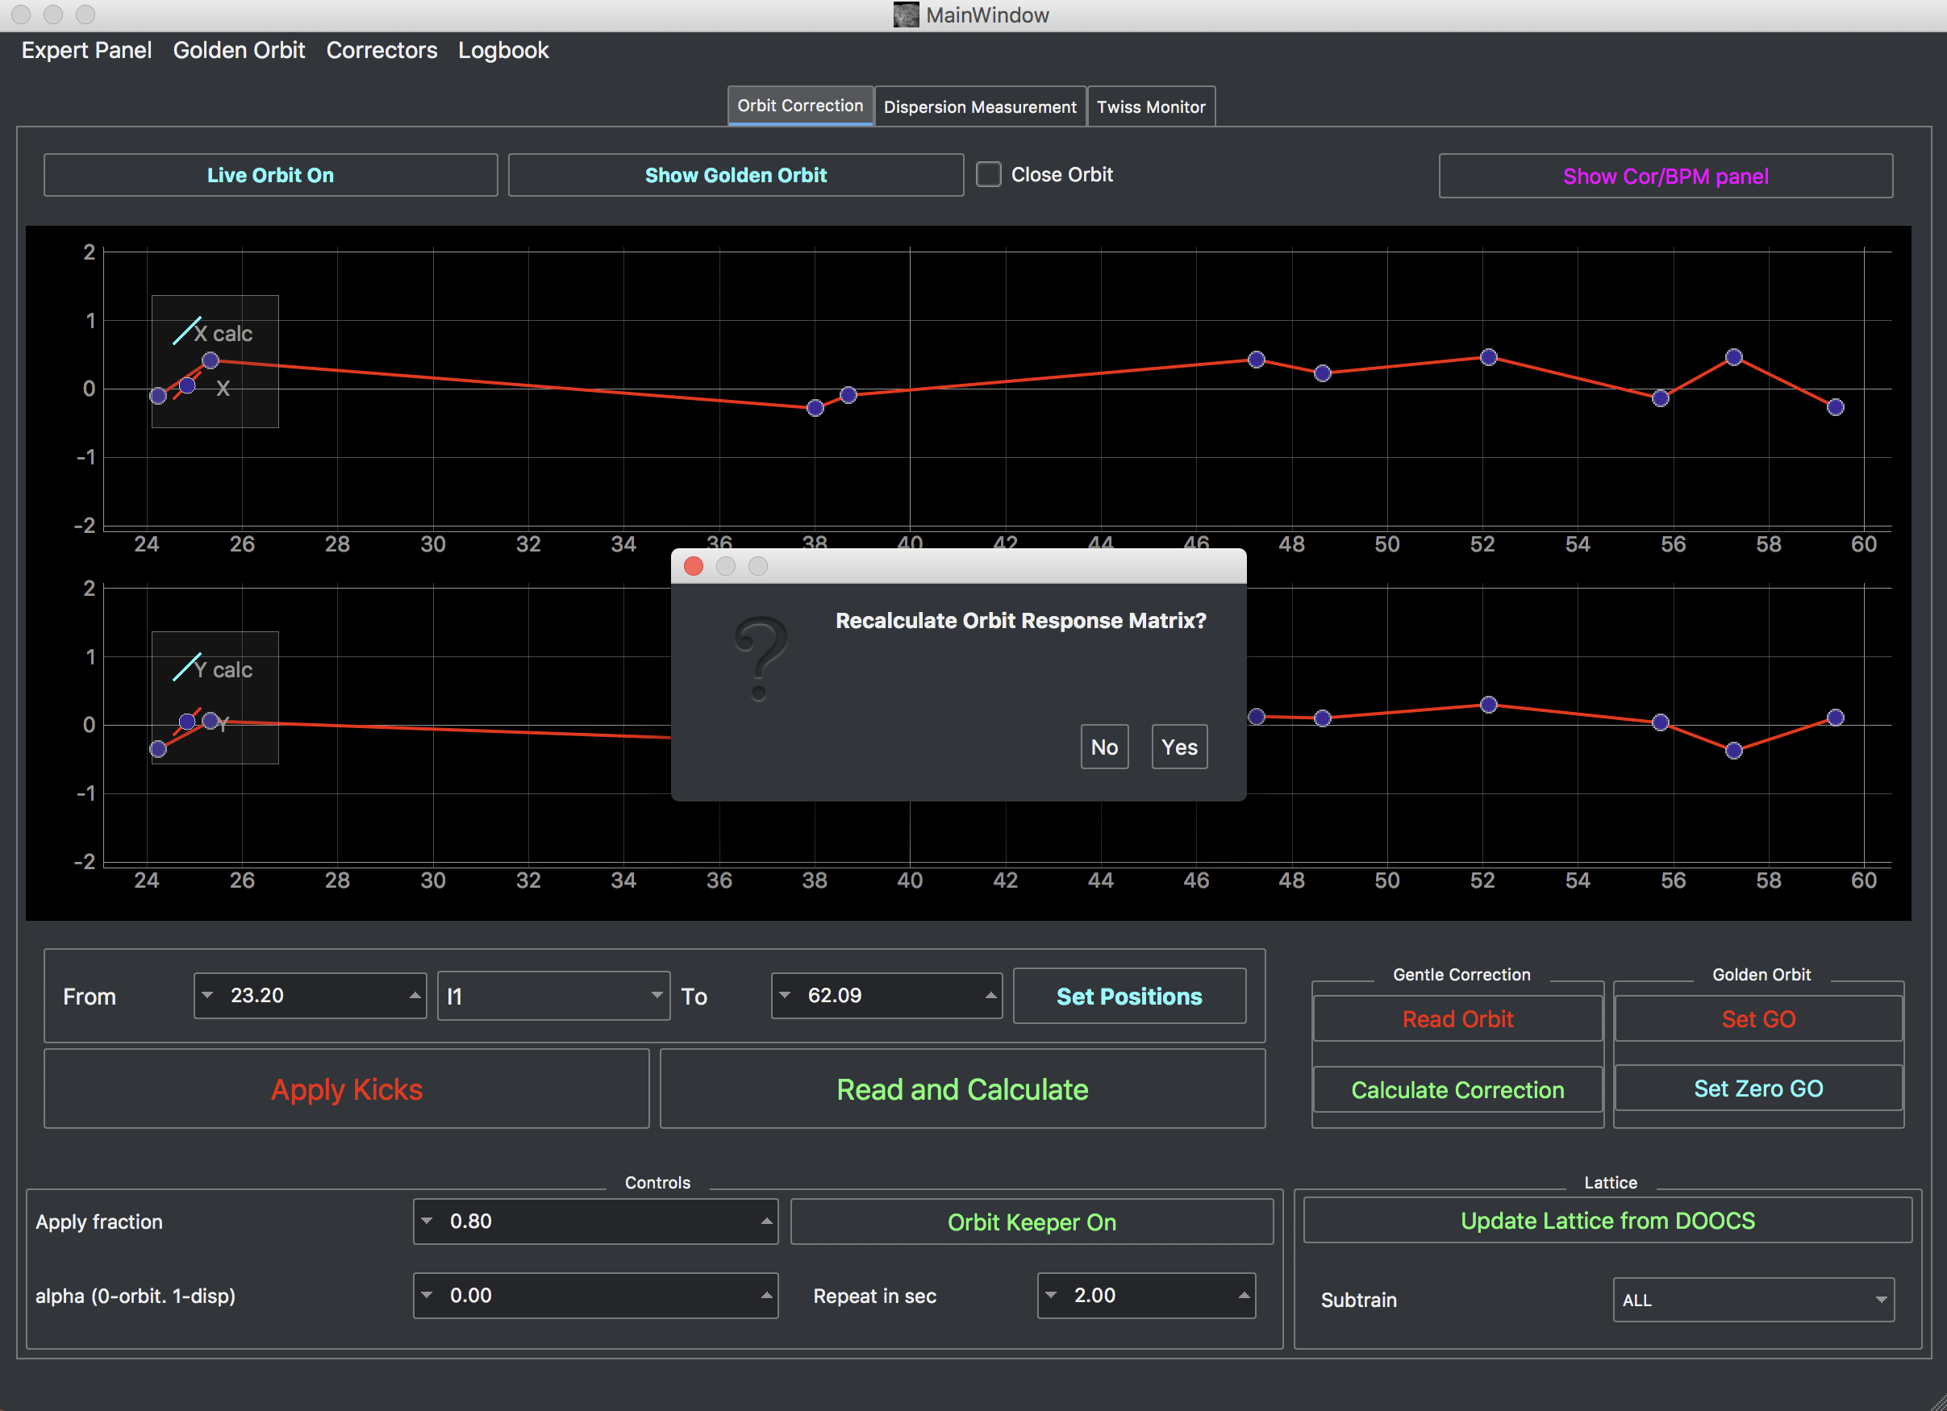
Orbit Correction Tool
If you change the quad settings a lot or the energy profile in linacs without touching quads you might need to update the lattice and recolculate RM
Note: You also can see result of the lattice updating in „Twiss Monitor“ tab

Slide 11
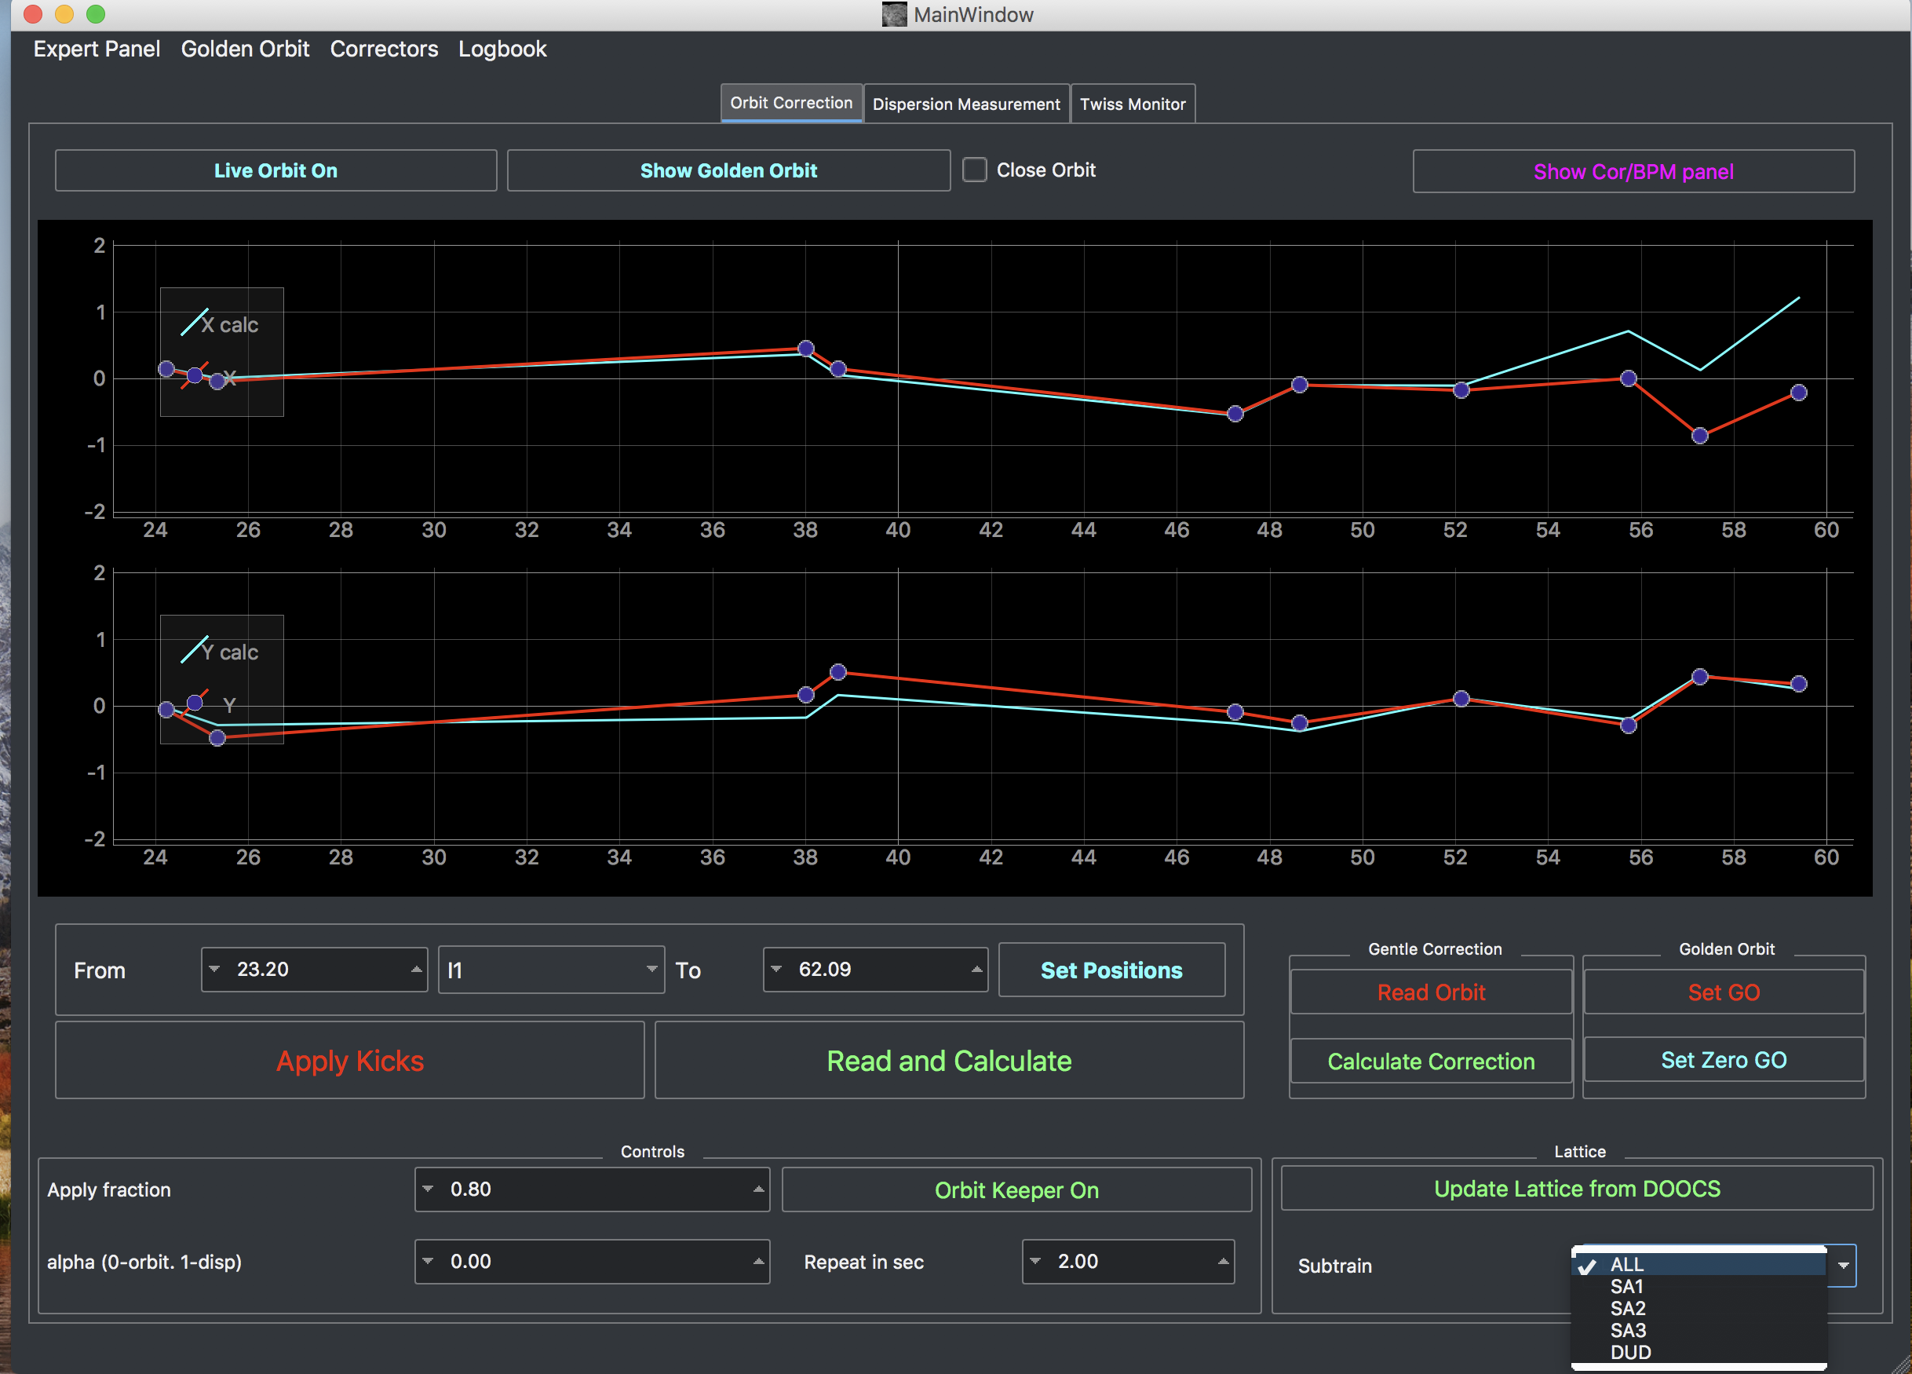
Orbit Correction Tool
Subtrain choice

Slide 12
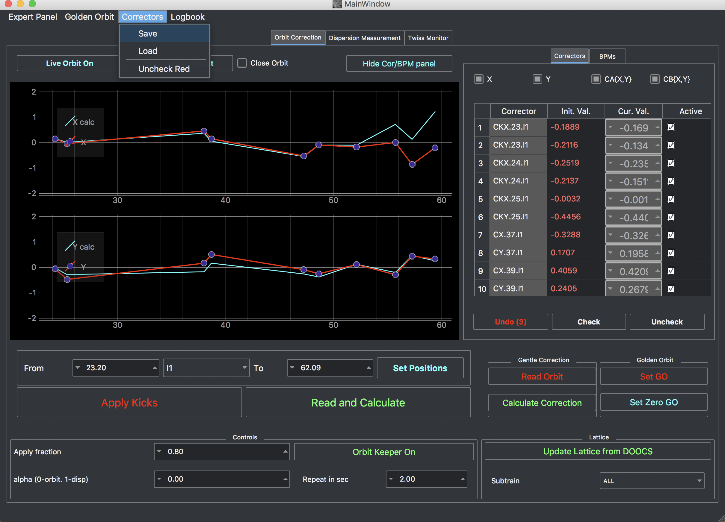
Orbit Correction Tool
This option is to save correctors current kicks to file, which means you can restore kicks even you close the tool. For restoring press „Load“ and than „Apply Kicks“.
Every time, when you press „Apply Kicks“ button the kicks saved in a temporal variable (will be lost in case of the tool closing). To make undo -> press „Undo“ as many times as you need (it sends kicks to „Cur. Val“ column) and then you have to press „Apply Kicks“.

Slide 13
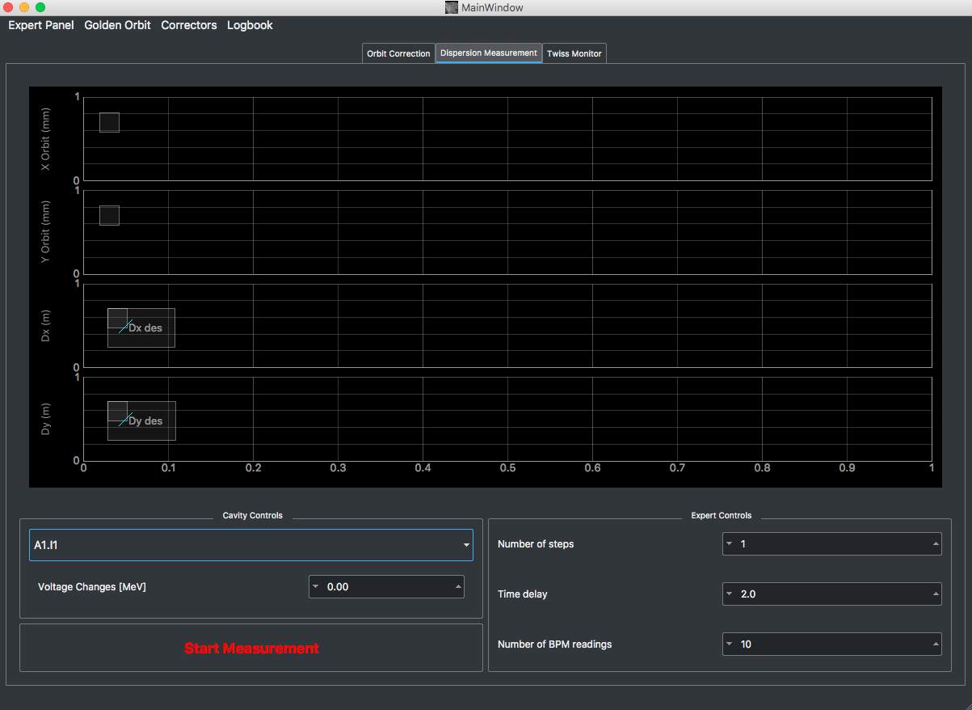
Orbit Correction Tool. Dispersion measurement
How it works
  Choose RF station
  Set up Voltage changes: e.g. - 2MV
  Press “Start Measurement”
The Longitudinal FB should be switched off

Slide 14
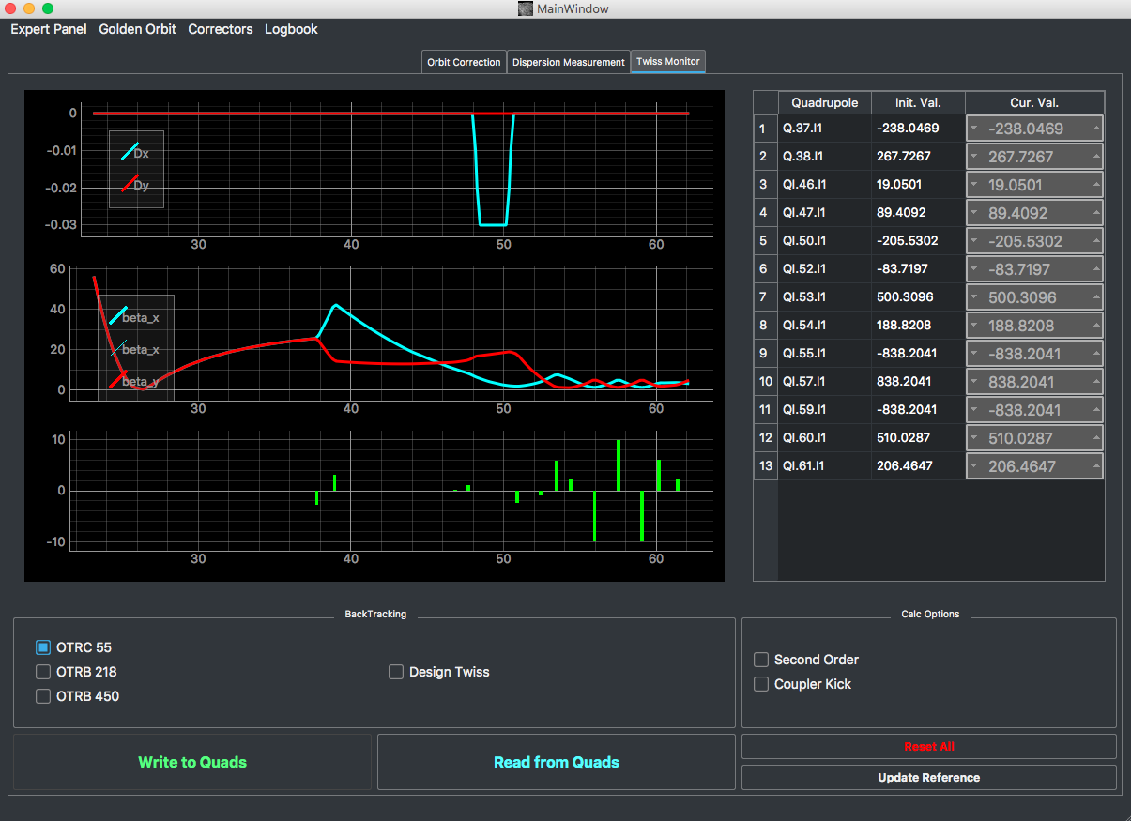
Orbit Correction Tool. Twiss Monitor
To check design settings with current setup.

Slide 15
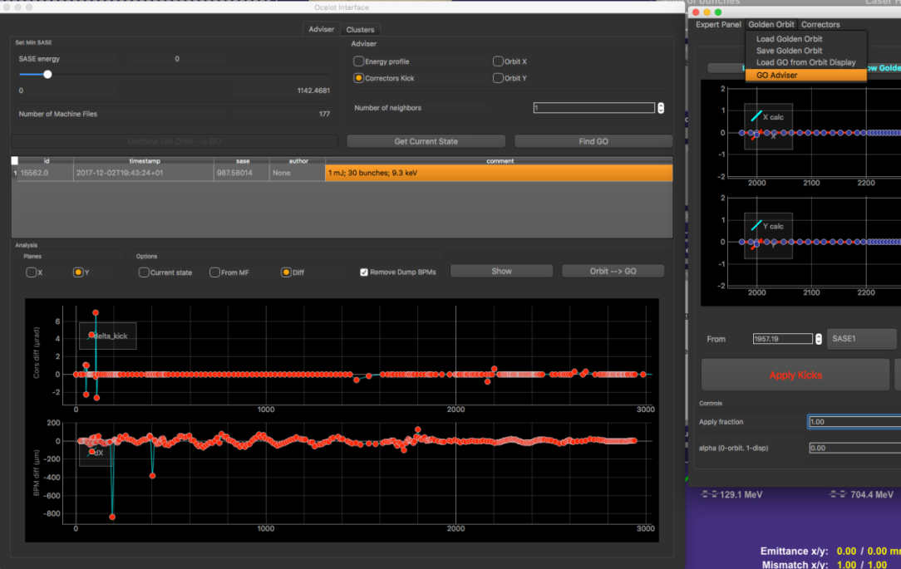
Golden Orbit Adviser
Recently we introduced to the Ocelot orbit correction tool a "Golden orbit adviser" (in test mode).
The idea is to find the machine file in the database that is as close as possible to the current machine setup.
For instance, you can select as a reference vector the corrector kicks (or beam orbit in X/Y plane) and ML method (Nearest Neighbors) will find the machine file with the corrector kicks (or orbit) closest to the current conditions.

Slide 16
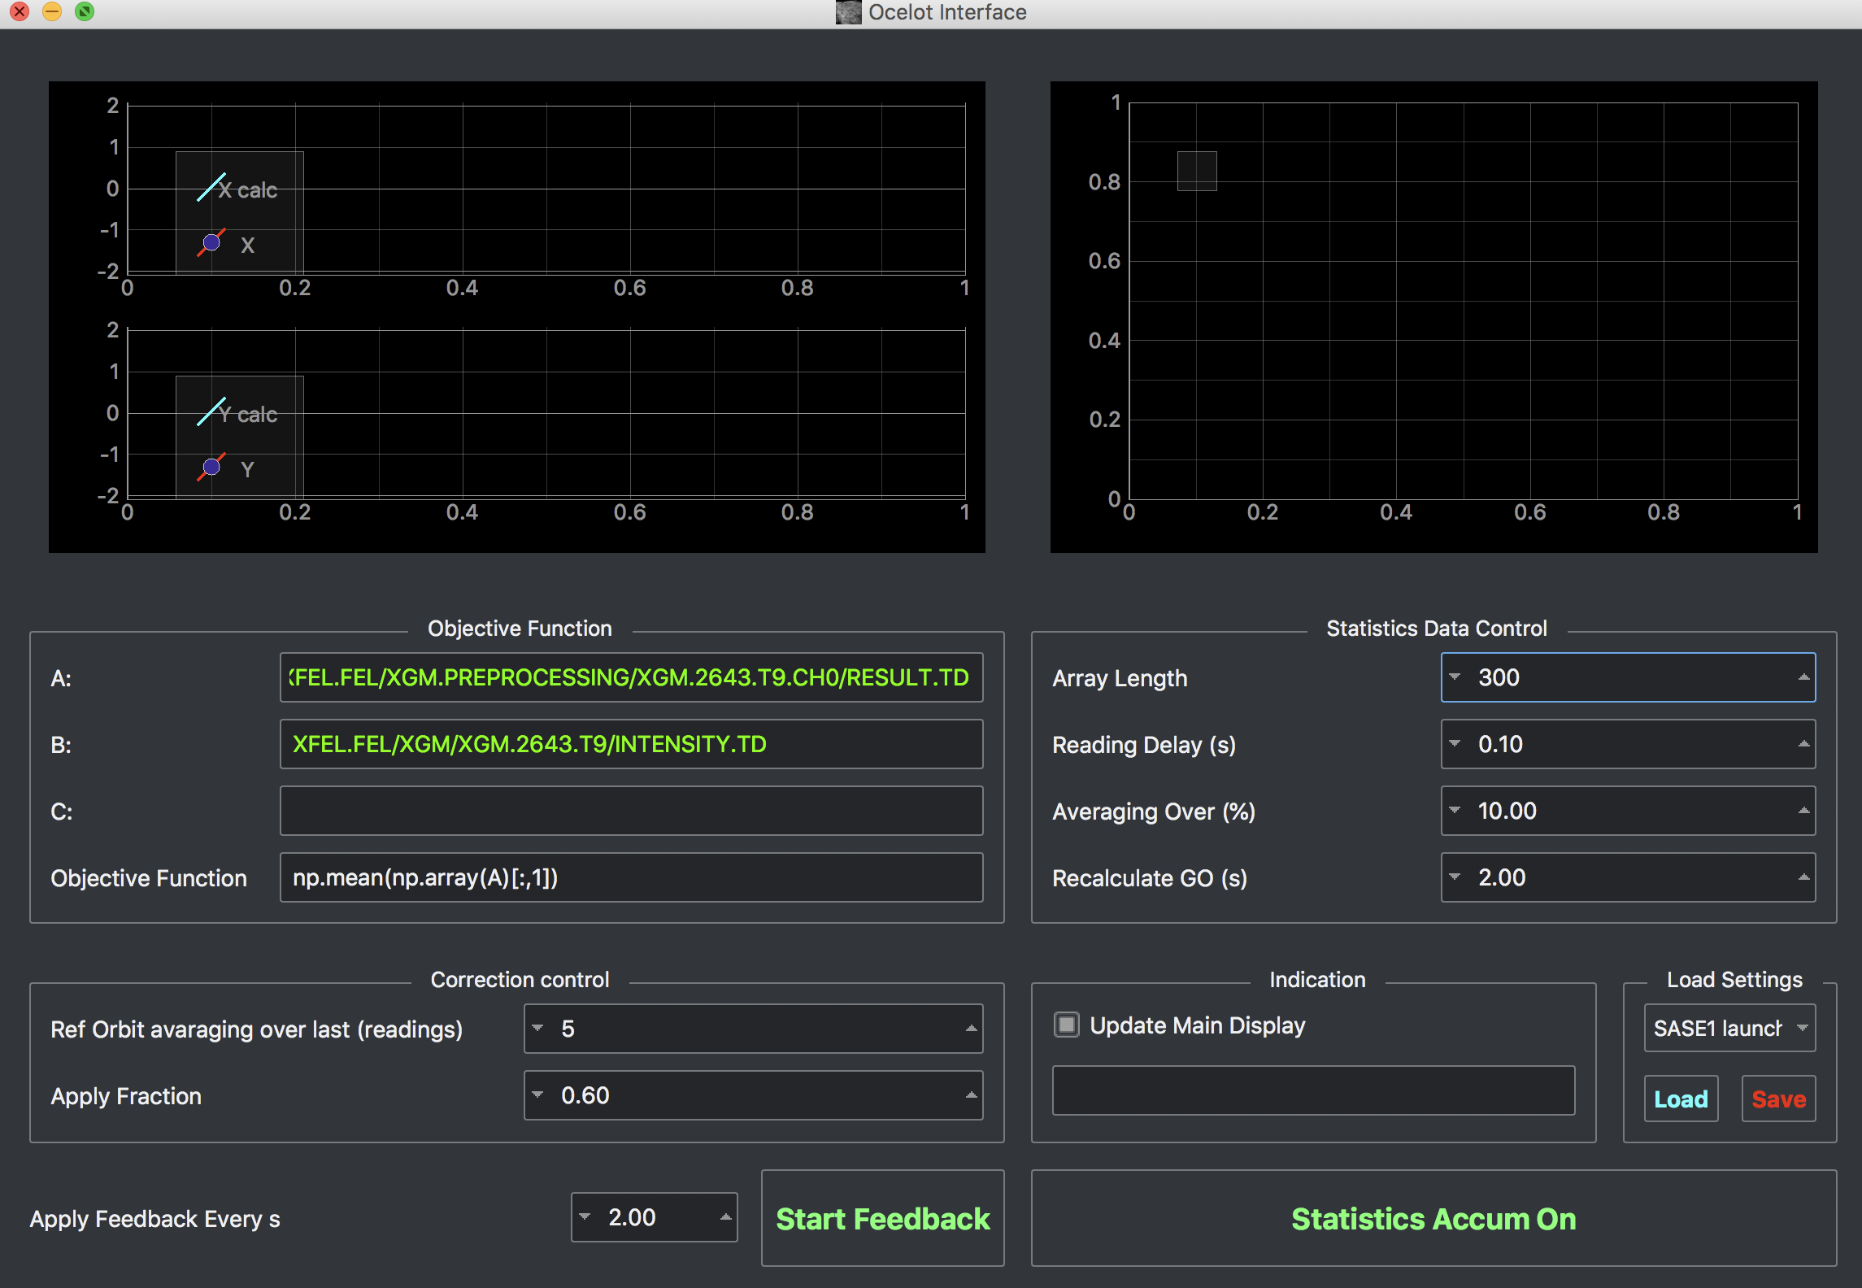
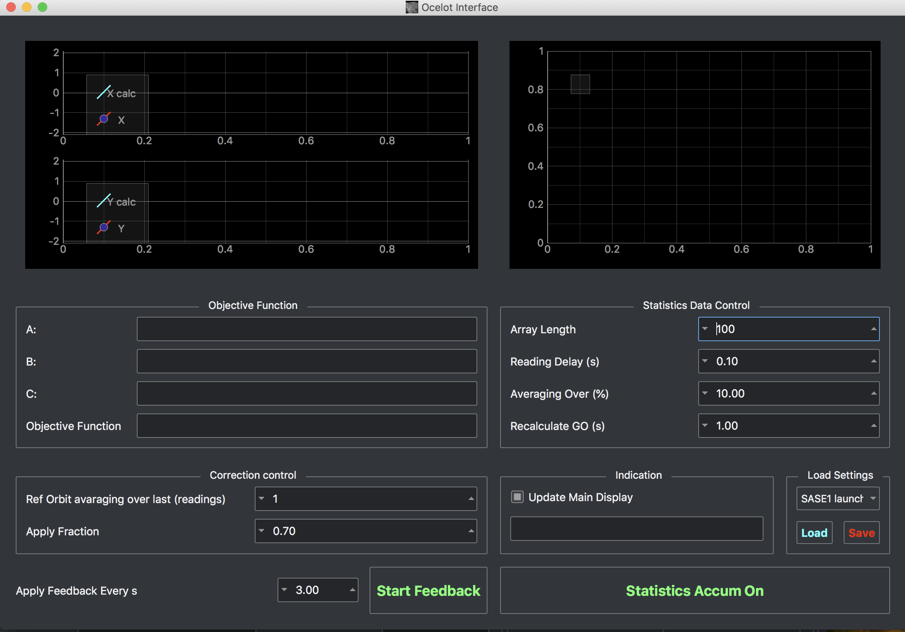
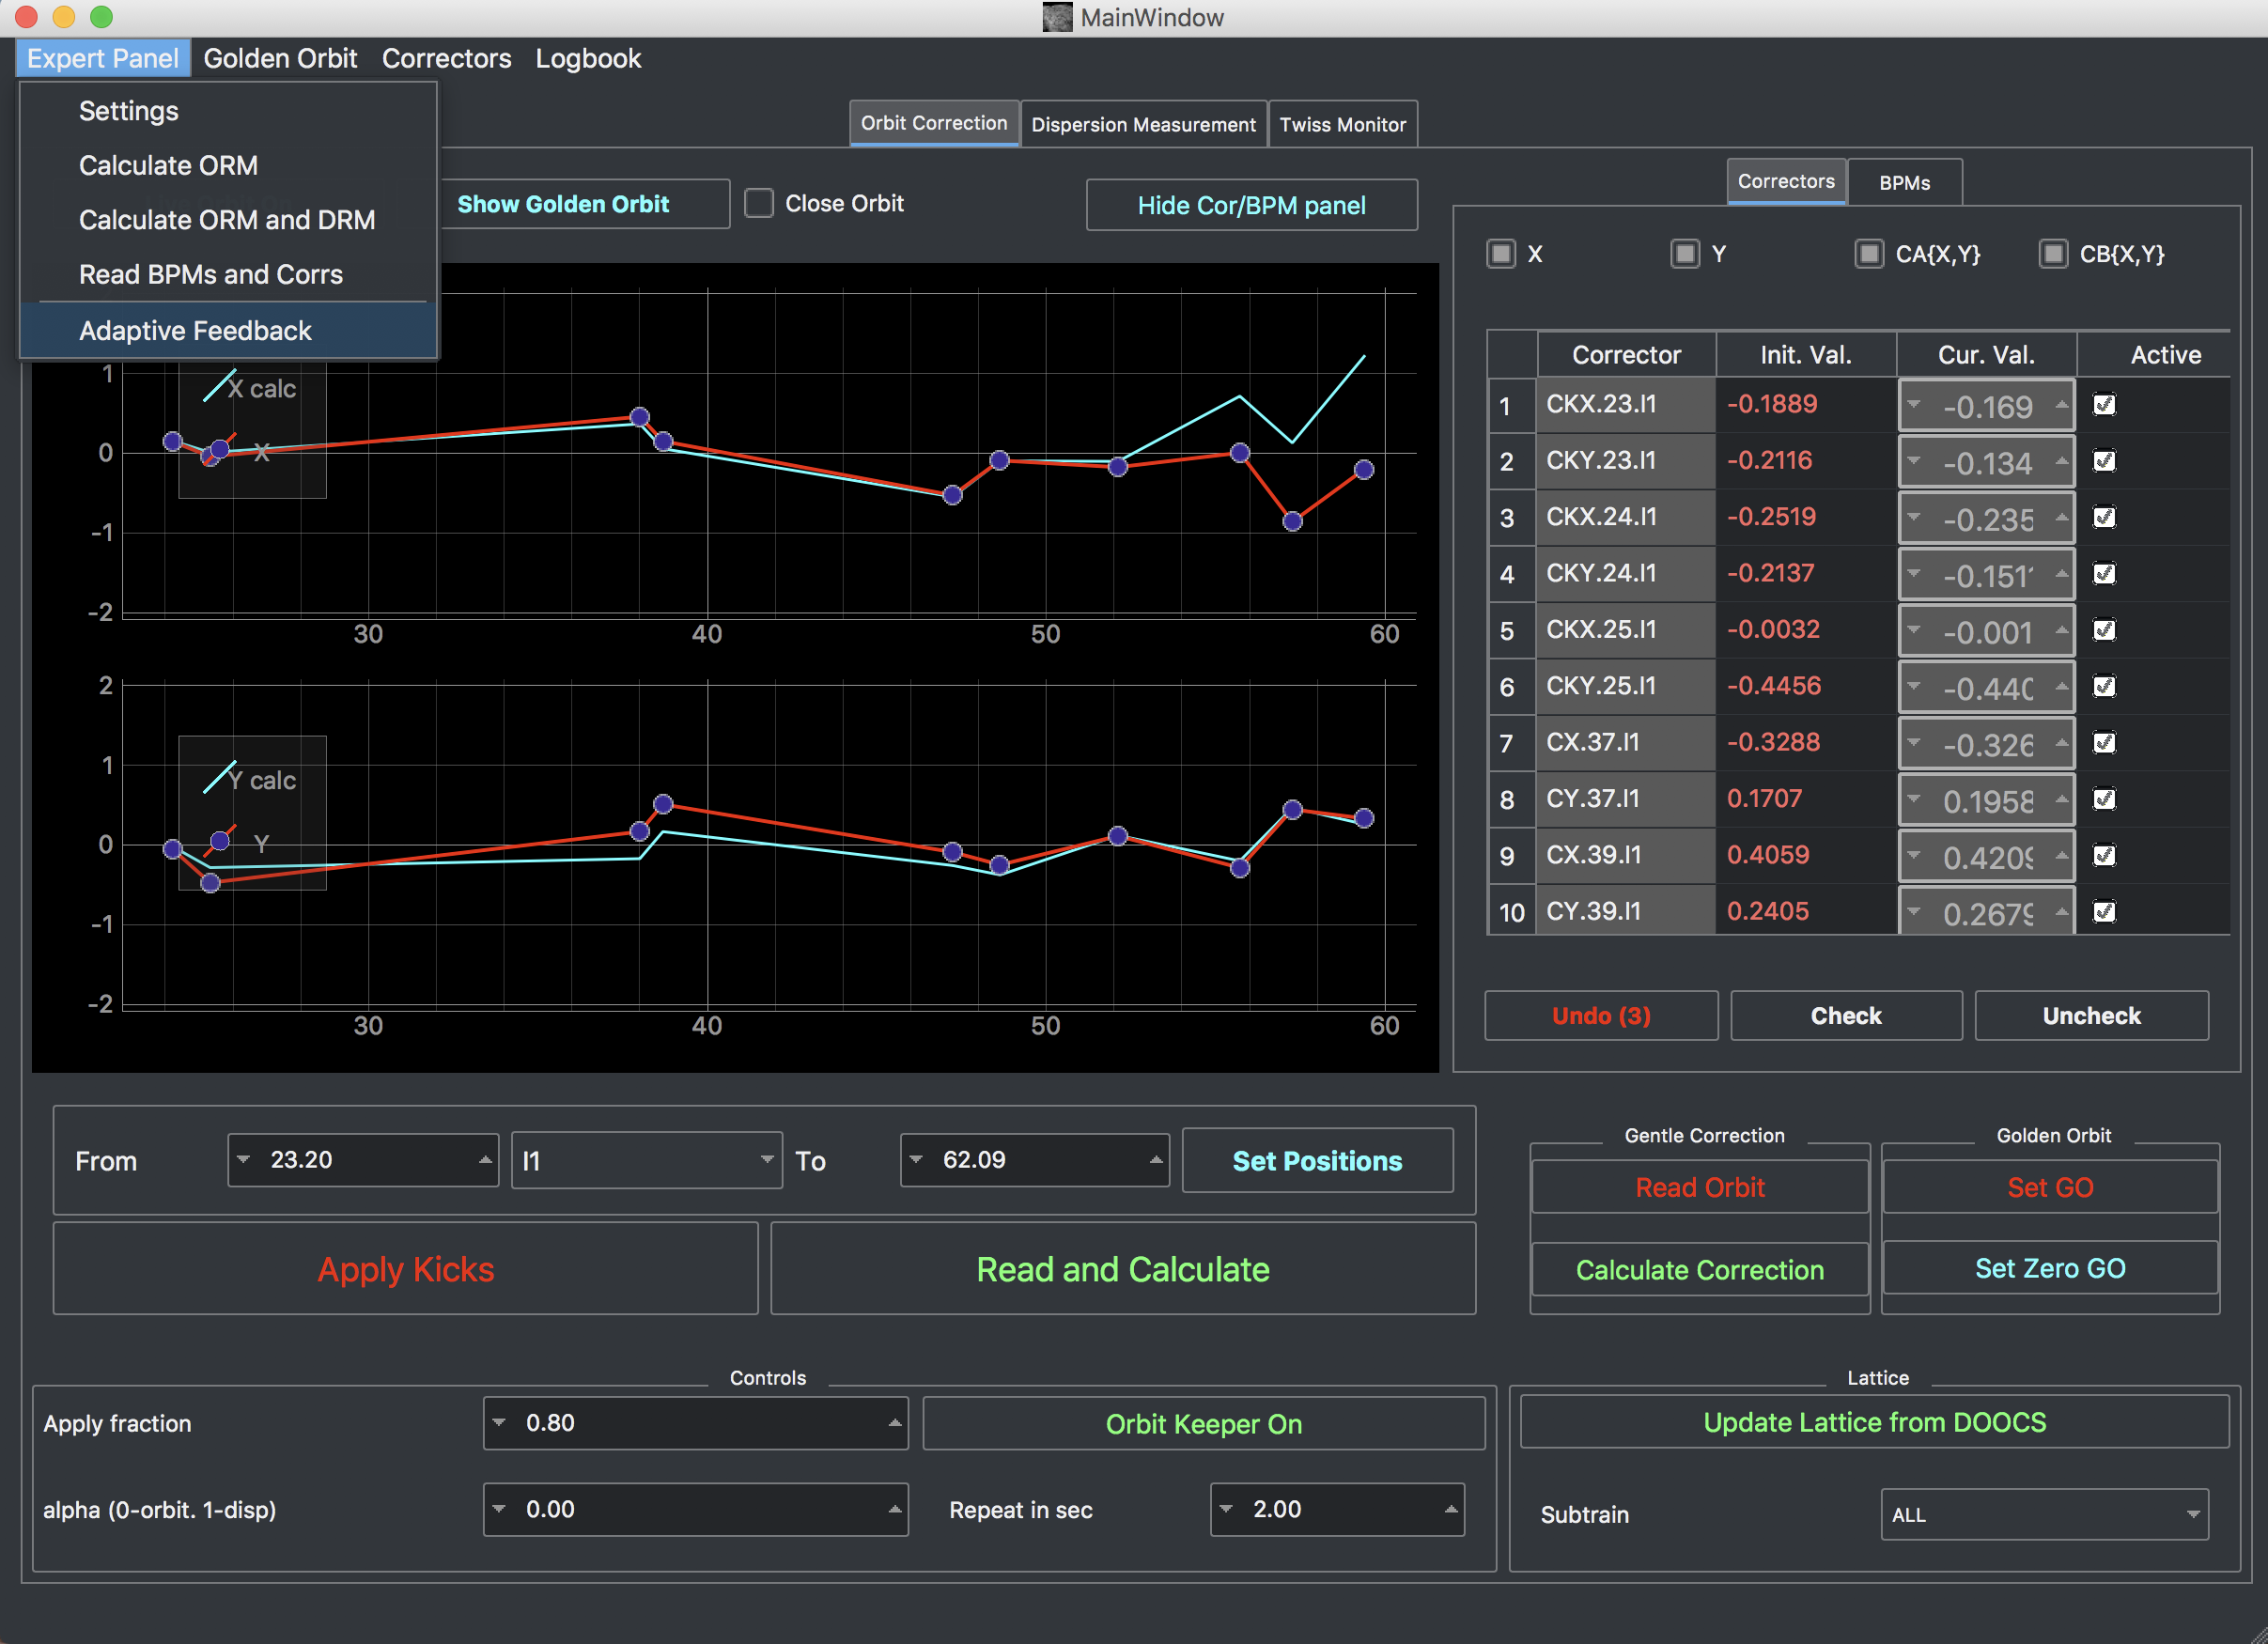
Adaptive Feedback
Adaptive FB also checks if the stadard FB is running. And if you switch the standard FB on the Adaptive FB will be stoped

Slide 17
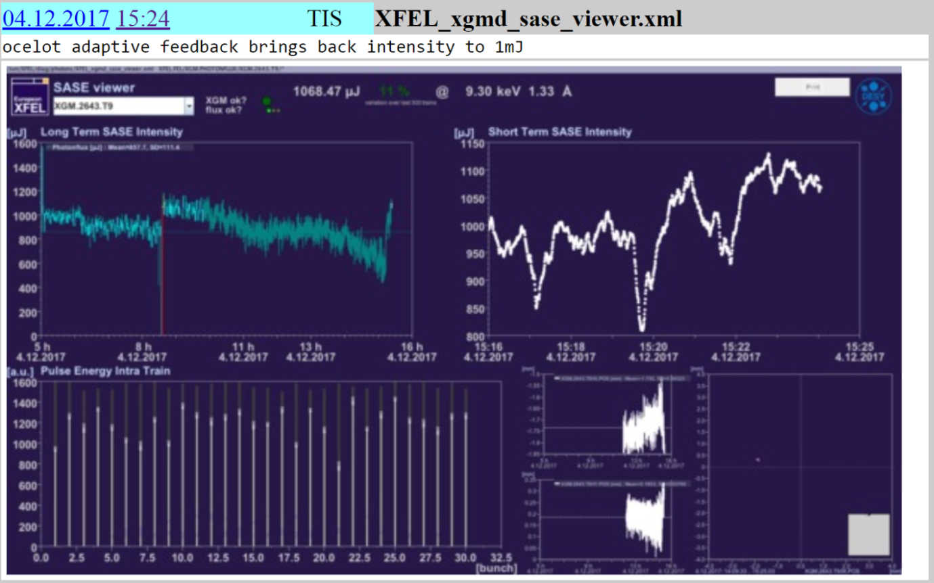
Adaptive feedback (SASE1)
Algorithm of Adaptive Feedback*
  Shot-to-shot collection of orbits (~ 300 - 700) and the corresponding SASE pulse energy.
  Sorting orbits according to SASE energy.
  Taking 10-20% of the orbit with highest SASE and calculating new golden orbit for the feedback.
AF starts

Slide 18
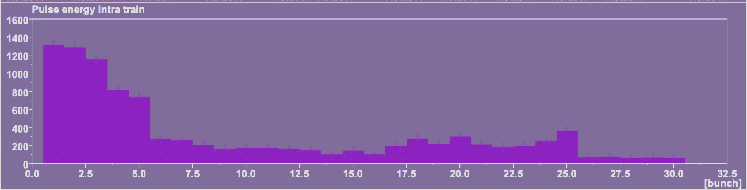
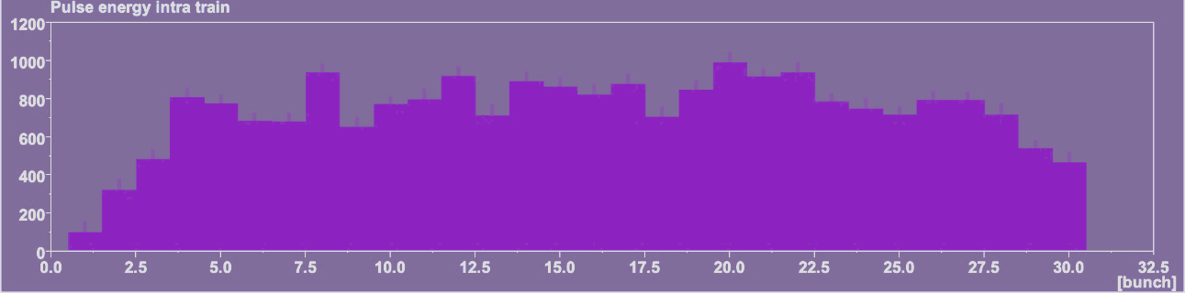
Adaptive feedback (SASE1)
Optimization of the orbit upstream the undulator. Only first three bunches were lasing before optimization. The IBFB was not commissioned at that time. Thus not all bunches were on the same orbit.
The adaptive feedback optimizes by default the averaged SASE signal over all bunches in one bunch train. However, it is also possible to optimize for dedicated bunches if required.
The lasing of the first bunches was suppressed but all following bunches contributed to the SASE level after the optimization with the adaptive feedback.
Before optimization
After optimization

Slide 19
OCELOT Optimizer

Slide 20
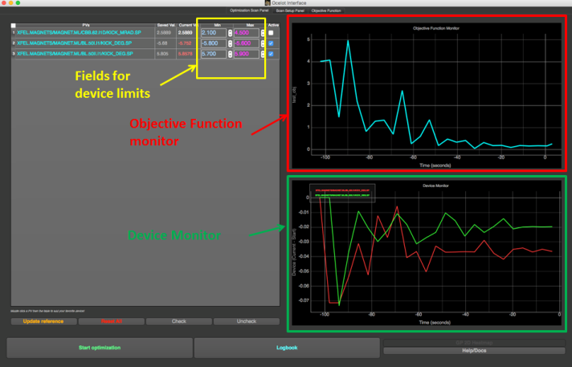
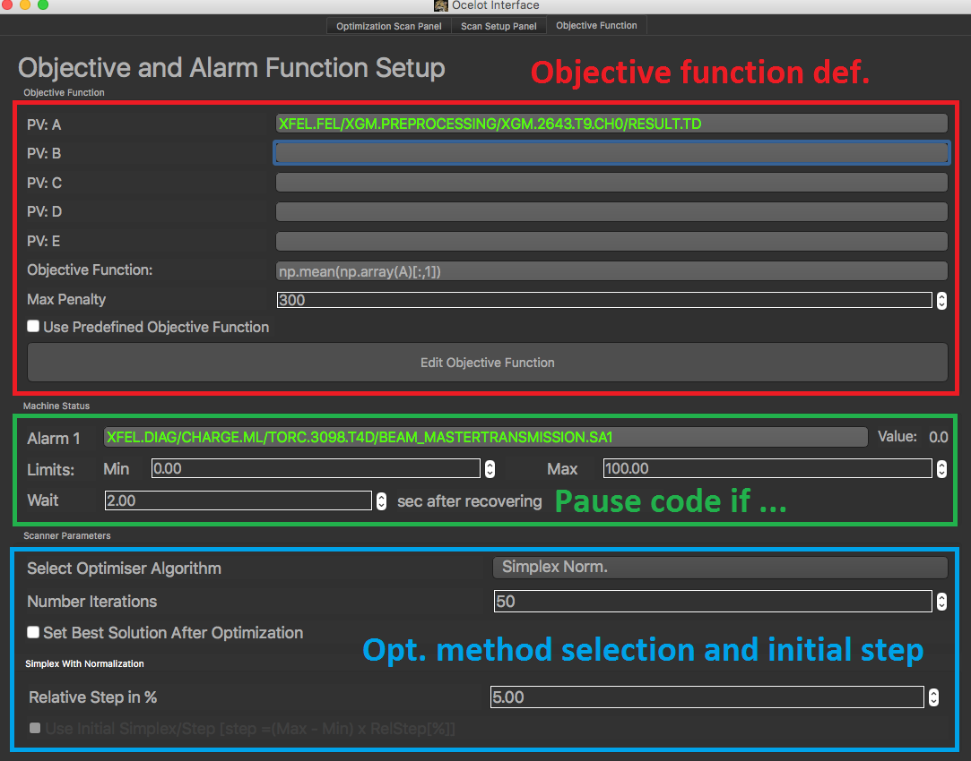
OCELOT Optimizer

Slide 21
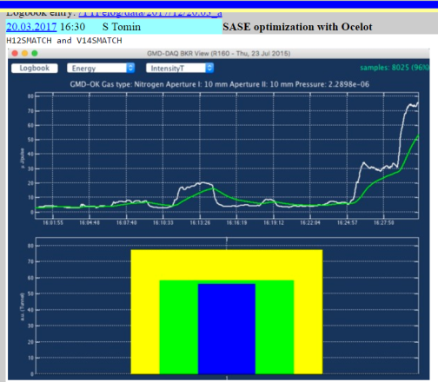
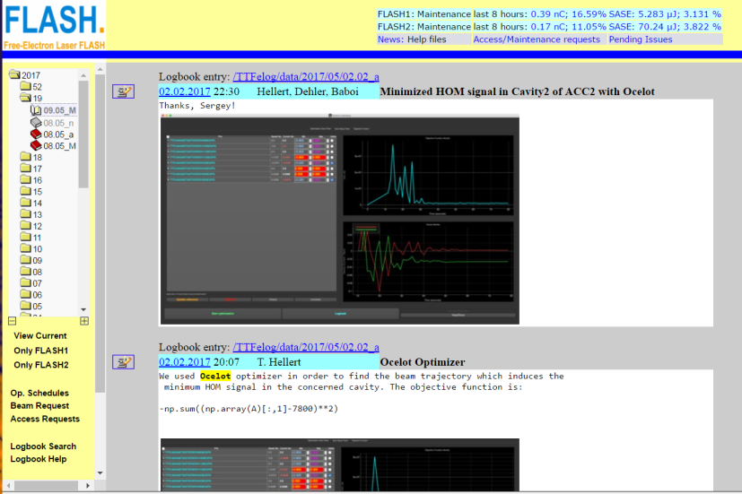
OCELOT Optimizer
Several different customized variants of the optimizer were used only a few times for different tasks.
Examples for earlier customized setups:
  Minimization of beam losses while keeping a reasonable orbit in the main dump beamline.
  Orbit distortion compensation with air coils in an undulator section.
  Minimization of HOM (higher order mode) signal in an accelerator module (FLASH).
  SASE maximization (FLASH).
  Dispersion correction (FLASH)

Slide 22
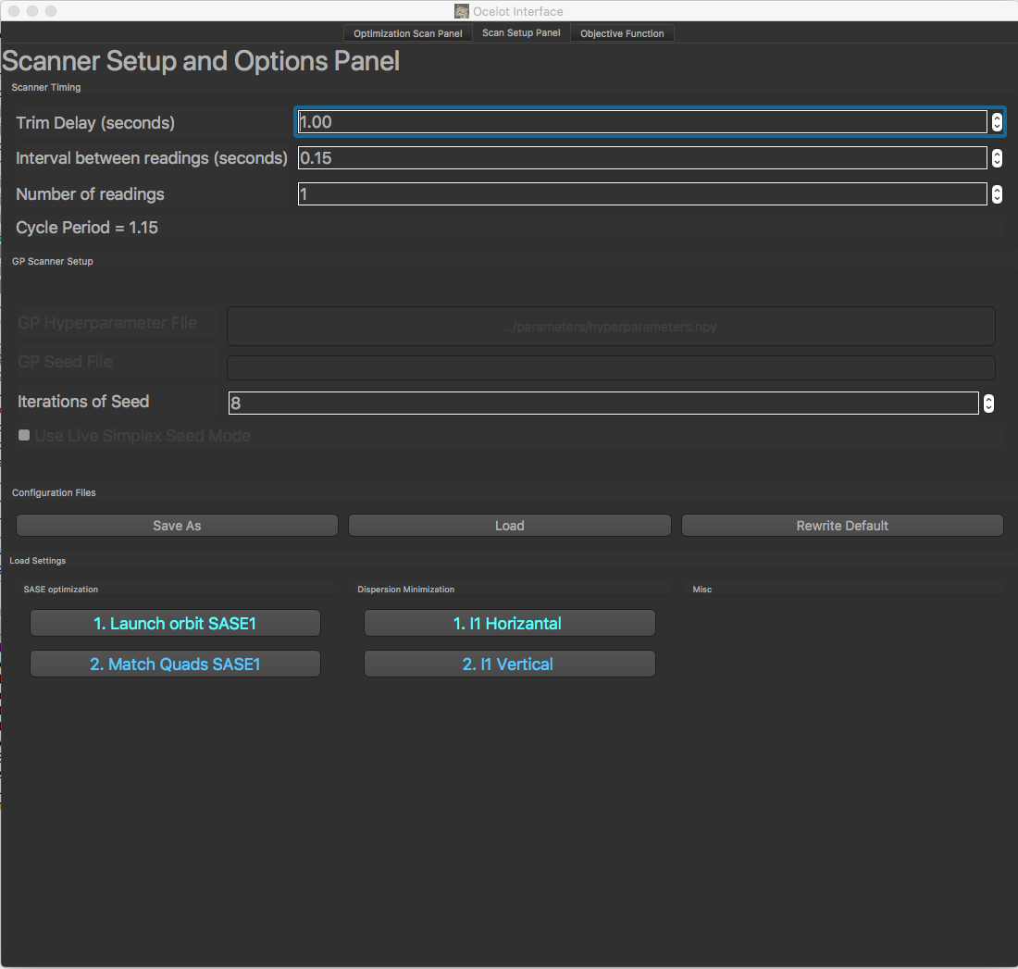
OCELOT Optimizer
Trim delay: delay between setting new values to the devices and start reading the Target function.
Some noisy signals like SASE might need averaging. For that, you can use “Number of readings” and Interval between readings”
Any configuration can be saved and loaded.
There are 4 standard configs: 2 for SASE1 optimization and 2 for dispersion minimization
During dispersion minimization the Longitudinal FB should be switched off

Slide 23
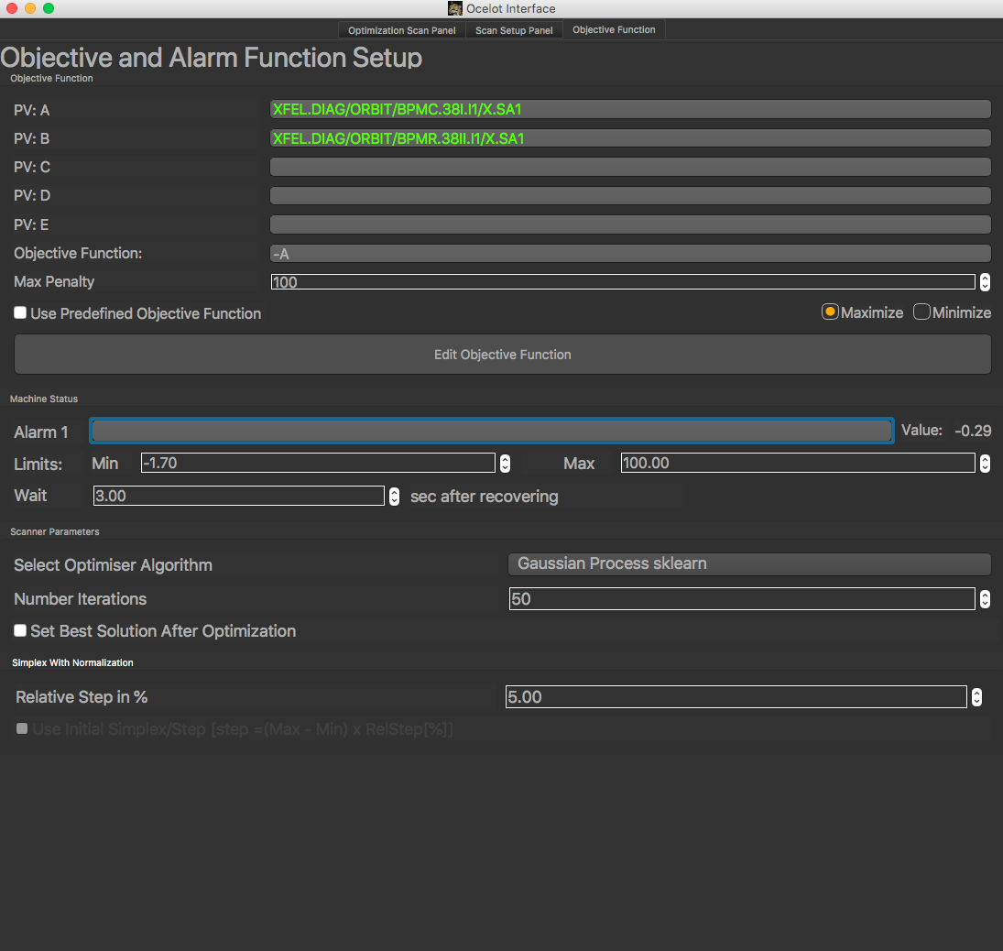
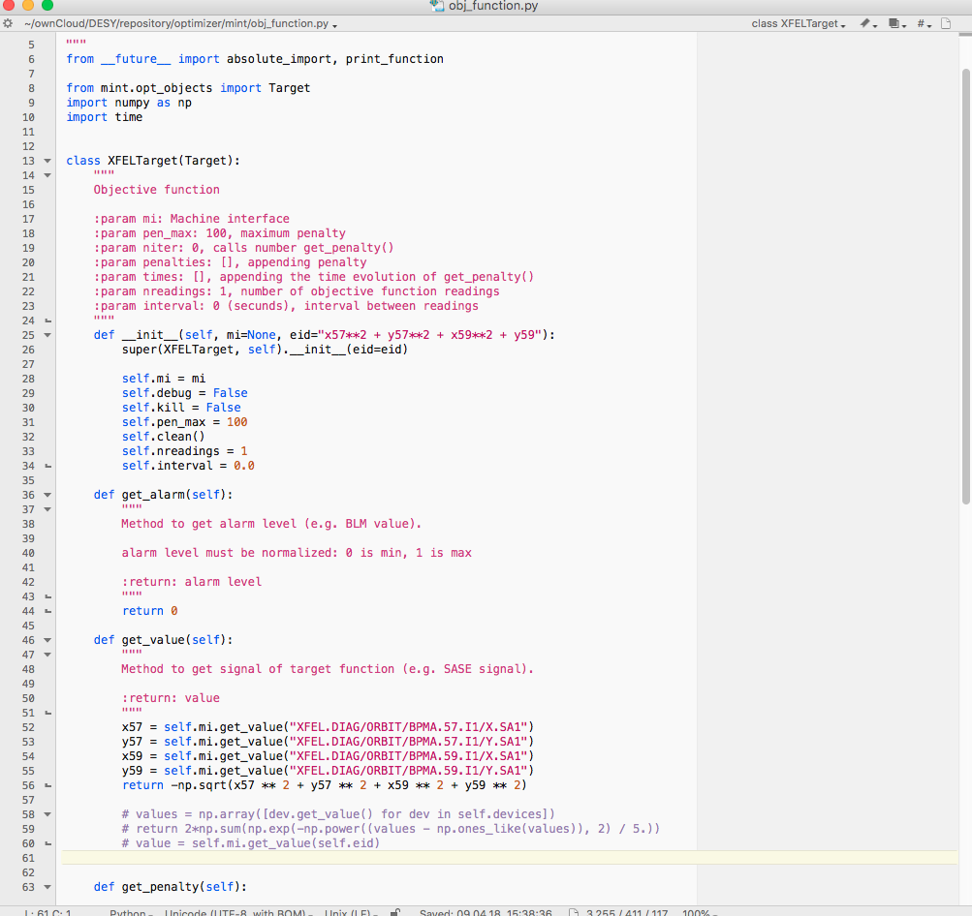
Objective Function

Slide 24
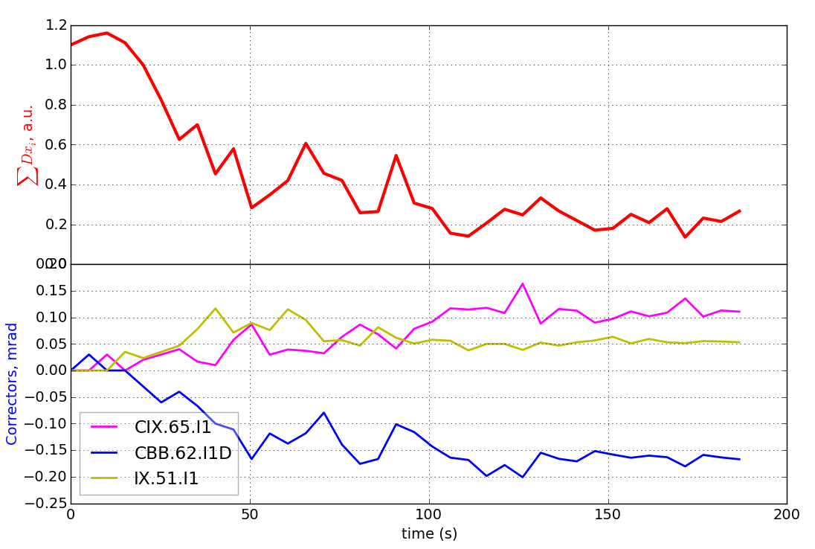
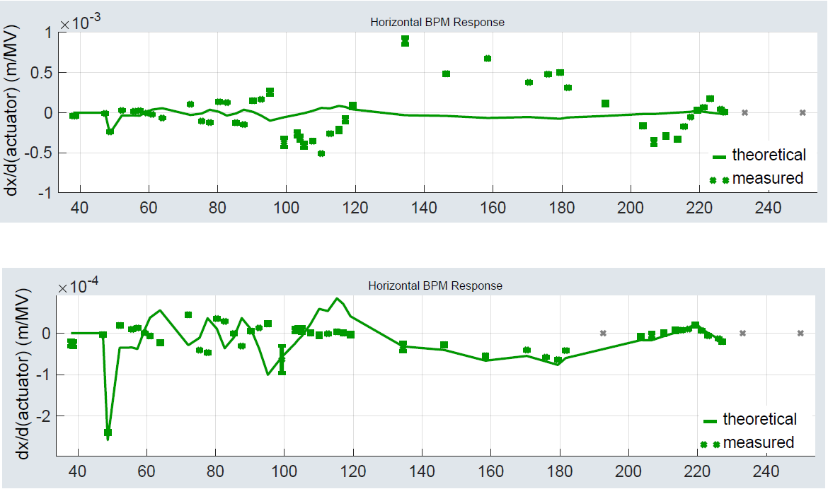
OCELOT Optimizer: local dispersion correction
Horizontal spurious dispersion correction with 3 corrector magnets.
Before correction
η_{x}=130 mm
After correction
η_{x}=13 mm
Laser Heater chicane

Slide 25
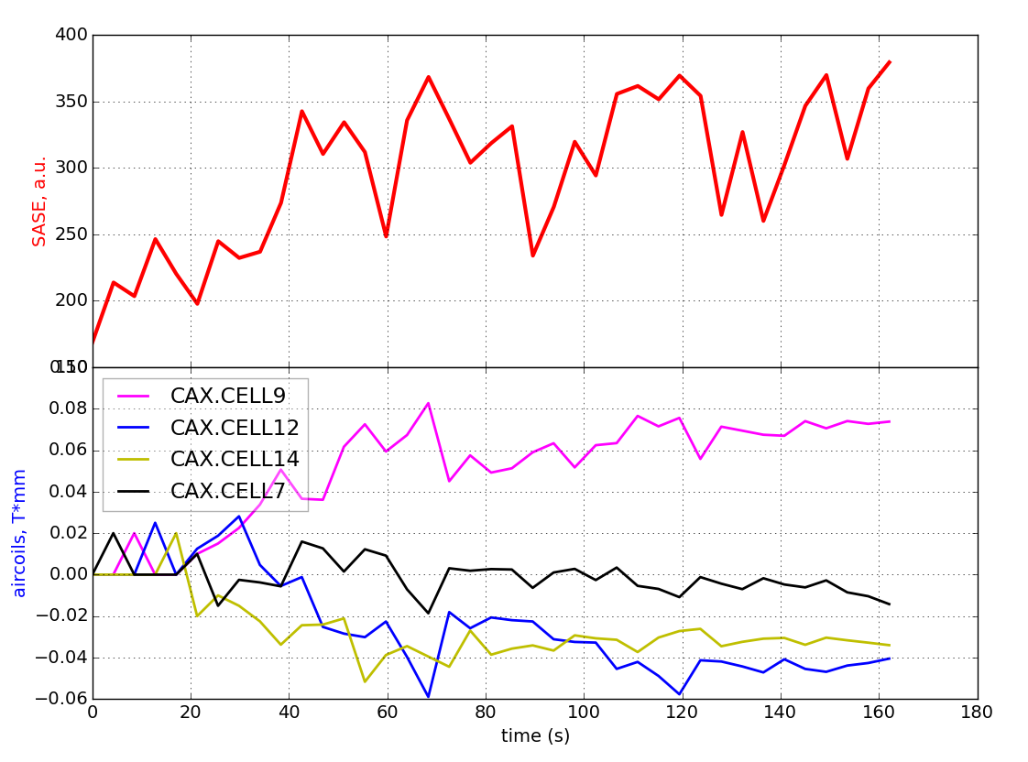
OCELOT Optimizer: SASE optimization
Air coils between the undulator cells were used to optimize the SASE signal
Up to 6 air coils are typically used at the same time.

