Slide 1
Open ID Connect
Big Data Seminar WiSe17/18
Notes:
https://cdn-images-1.medium.com/max/2000/1*PzbHsNXqfibB7WNcyj6Zmw.jpeg Zuletzt aufgerufen am 10.06.17

Slide 2
Agenda
I
What is Open ID Connect?
II
Basic concept - ID Token, Claims & Scopes
III
Advantages
IV
Where to start
V
Discussion

Slide 3
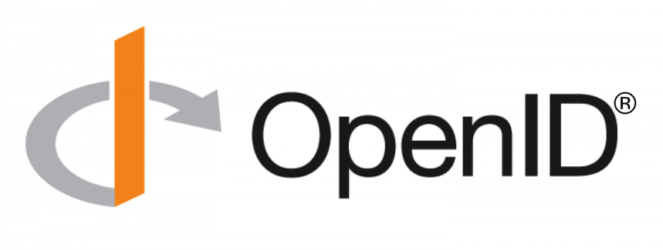
I. What is Open ID Connect?
Notes:
https://abovethelaw.com/wp-content/uploads/2013/12/thumbs-up.jpg Zuletzt aufgerufen am 10.03.18

Slide 4
What is Open ID Connect?
„OIDC provides authentication and basic profile information about the end user via REST APIs“
Delegated
OIDC (Authentication)
OAuth 2.0 (Authorization)
Sources: [Ora17], [OID18]
Notes:
OIDC provides Authentication and basic profile information about the end user via REST API

Slide 5
II. Basic concept
Notes:
https://abovethelaw.com/wp-content/uploads/2013/12/thumbs-up.jpg Zuletzt aufgerufen am 10.03.18

Slide 6
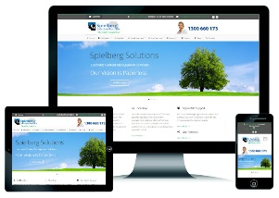
Basic concept
I. Access Request
Client Application (Relying Party)
End User
IV. Authentication &
Authorization
III. User provides credentials and
receives token
II. Authorization Request
ID Token
Identity Provider
Access Token
Sources: [Bha15], [Esp17]
Notes:
IV. Sendet Identity und Access Token
Message flow im JSON Format

Slide 7
ID Token, Claims & Scope
Claims
Scopes
name
family_name
given_name
nickname
email
address
phone
gender
birthdate
gender
website
…
openid
profile
email
address
phone
ID Token
Subject username Issuing Authority google.com
Audience great-website.com
Issue Date
Expiration Date
Name
Emailadress
+ Signature
Quellen: [Ora17], [OID18]

Slide 8
IV. Advantages
Notes:
https://emilyjo9907.files.wordpress.com/2013/09/mocking_bird_argument.jpg Zuletzt aufgerufen am 10.06.17

Slide 9
OIDC has several advantages…
No need for client applications to store and manage user passwords
User information can be accessed easily via REST APIs (with their consent)
Pre-existing libraries and implementation guides
It is free, no IP claims
For users, it adds convenience
Unlike SAML, OIDC is designed to support native apps and mobile applications
Sources: [OID18], [Ora17]
Notes:
Whiteboard: Daten Highway und Normale Datenstraße
Diskriminieren heißt hierbei: Priorisieren und unterschiedlich behandeln
Unterschiedliche Ausgestaltung zwischen den beiden Formen

Slide 10
IV. Where to start…
Notes:
https://emilyjo9907.files.wordpress.com/2013/09/mocking_bird_argument.jpg Zuletzt aufgerufen am 10.06.17

Slide 11
Where to start…
Open ID Connect website: http://openid.net
Implementation guide:
http://openid.net/specs/openid-connect-basic-1_0.html
Libraries for many languages:
http://openid.net/developers/libraries/
C, C++, Java, Javascript,…
Source: [OID18]
Notes:
Whiteboard: Daten Highway und Normale Datenstraße
Diskriminieren heißt hierbei: Priorisieren und unterschiedlich behandeln
Unterschiedliche Ausgestaltung zwischen den beiden Formen

Slide 12
Thank you for your attention

Slide 13
Sources
[Bha16] Bhadriraju V (2016) WebSphere Liberty makes it easier to build OpenID Connect security services. https://webspherecompetition.wordpress.com/2016/02/04/websphere-liberty-makes-it-easier-to-build-openid-connect-security-services/. Zuletzt aufgerufen am: 03.03.18
[Esp17] Espinoza A (2017) Deep Dive into D8: Single Sign-On (SSO) Example Module. https://www.chapterthree.com/blog/deep-dive-into-d8-single-sign-on-sso-example-module. Zuletzt aufgerufen am 11.03.18
[Ora17] Oracle (2017) Introduction to OpenID Connect. https://apexapps.oracle.com/pls/apex/f?p=44785:24:102866049644444::NO:RP,24:P24_CONTENT_ID,P24_PREV_PAGE:19655,2 . Zuletzt aufgerufen am 11.03.18
[OID18] Open ID Foundation (2018) OpenID Connect Core 1.0 incorporating errata set 1. http://openid.net/specs/openid-connect-core-1_0.html. Zuletzt aufgerufen 05.03.2018

Slide 14
Questions & discussion
Notes:
https://emilyjo9907.files.wordpress.com/2013/09/mocking_bird_argument.jpg Zuletzt aufgerufen am 10.06.17

Slide 15
Diskussionspunkte

