Slide 1
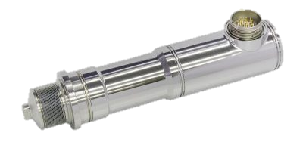
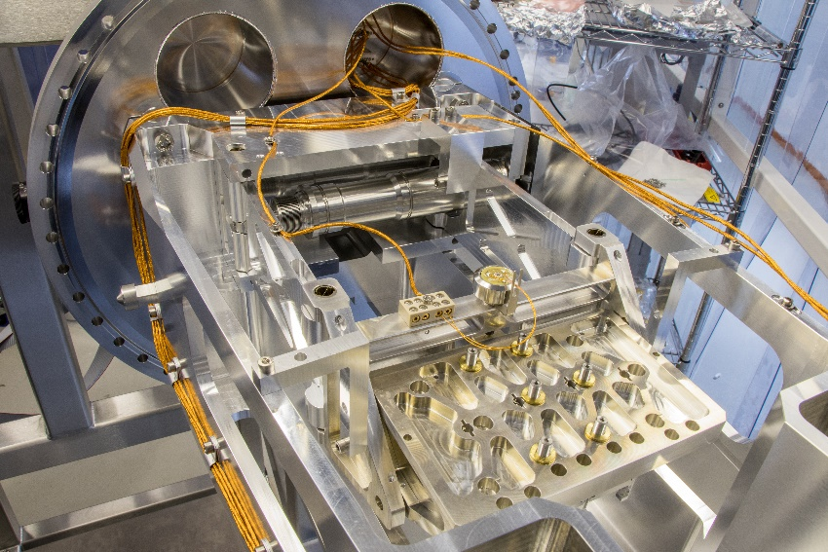
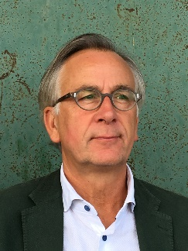
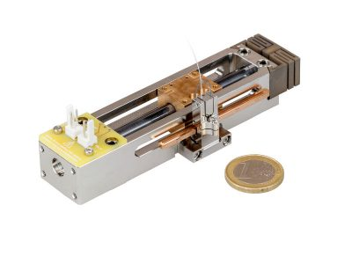
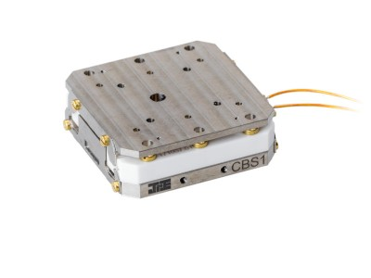
Janssen Precision Engineering
Development of Instrumentation for Pioneering Research
Leading Expert in Precision Engineering
Applications with high stability demands
High dynamic positioning
Positioning in vacuum, cryogenic and magnetic environments
Huub Janssen
Founder & CEO

Slide 2
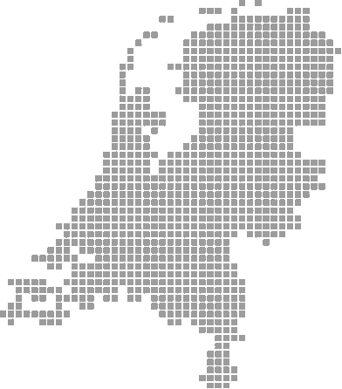
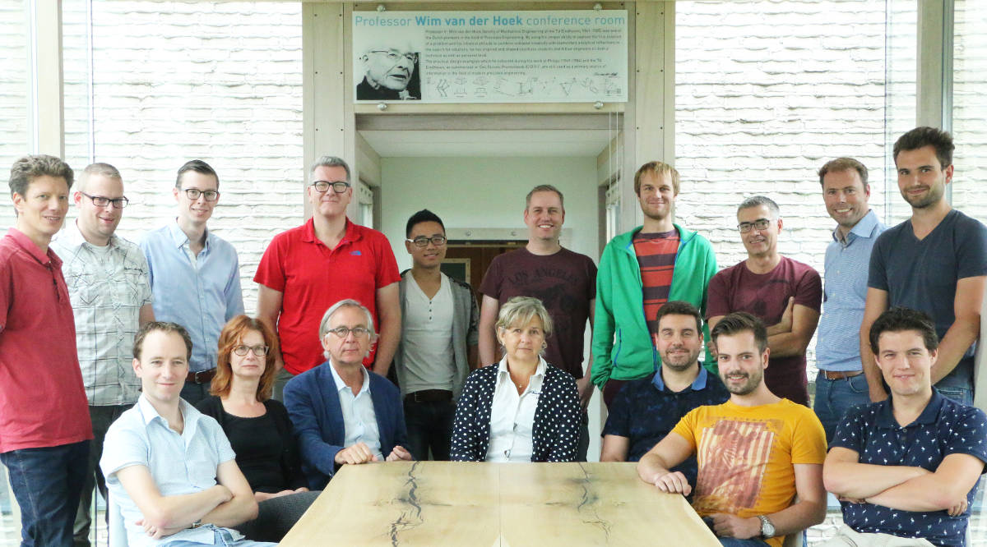
Background
Location
Maastricht – Airport
Founded
1991
Team background
Mechanics, Electronics, Mechatronics
Bsc, Msc, PhD
Market areas
High Tech OEM
Scientific research

Slide 3
Our customers

Slide 4
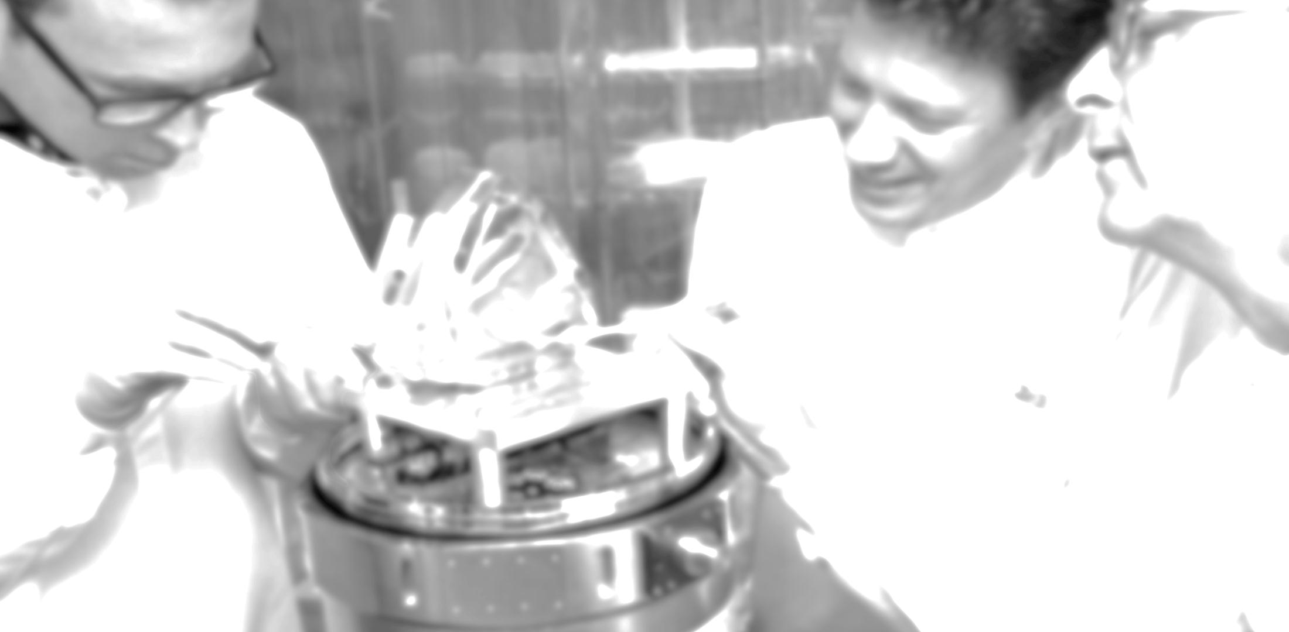
Our business areas
We develop mechatronic systems for any high precision application
Maastricht-Airport The Netherlands www.JPE.nl

Slide 5
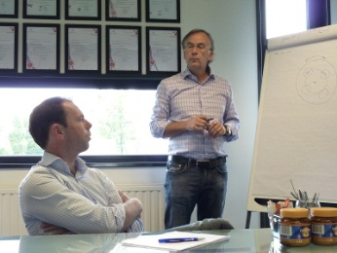
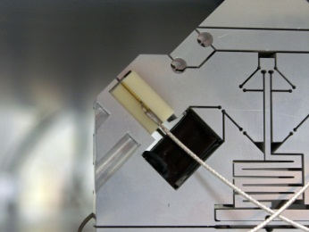
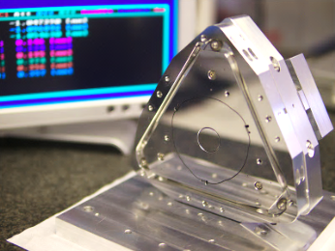
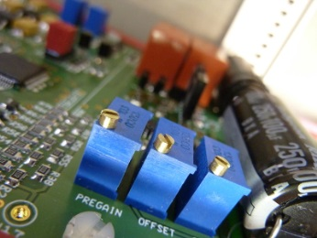
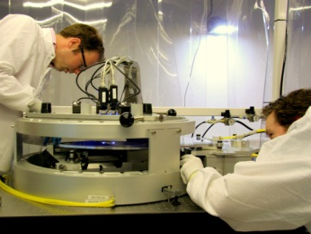
High-Tech Engineering – Our service
Question
Specification
Concept
Design
Realization
Qualification
SYSTEM
ARCHITECTURE
We treat your problem as if it is our own
ANALYSIS & FEASIBILITY
It is in our nature to search for the essence of a problem
PRECISION ENGINEERING
Design for stiffness for extreme accuracies and stabilities
MECHATRONICS & CONTROL
Smart solutions by creative balancing mechanics, electronics and software
ELECTRONICS & SOFTWARE
High performance of systems through dedicated electronics and software
INTEGRATION & TESTING
Integration and testing in cleanroom / vacuum / cryo

Slide 6
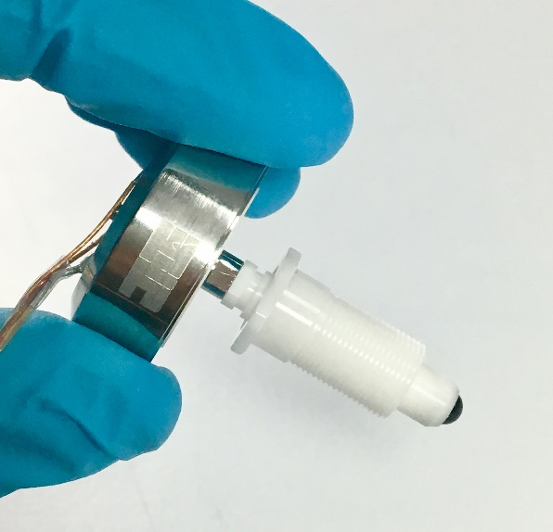
Cryo & Nano positioning products

Slide 7
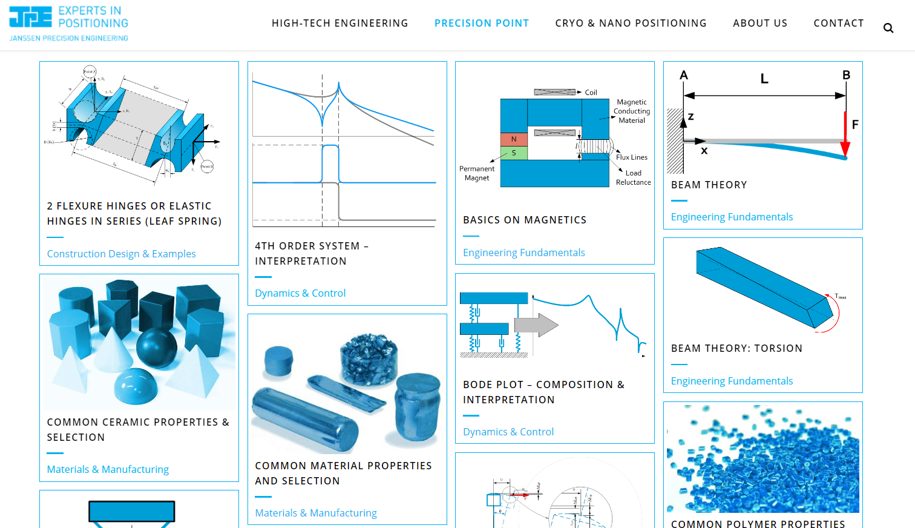
Precision Point

Slide 8
Thank You!
Ready to support YOUR developments
High-tech engineering
Precision
Point
Cryo positioning products

