Slide 1
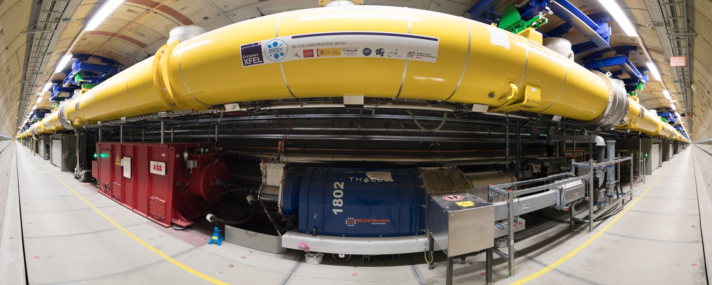
XFEL Operation – Radiation Issues
D. Nölle
Betriebsseminar Travemünde, Feb. 2018
Notes:
How to edit the title slide
Upper area: Title of your talk, max. 2 rows of the defined size (55 pt)
Lower area (subtitle): Conference/meeting/workshop, location, date,
your name and affiliation,
max. 4 rows of the defined size (32 pt)
Change the partner logos or add others in the last row.

Slide 2
Undulator Group:
55 Gy -> Damage level get bigger
than measurement accurary
Time evolution of Absorbed doses – SASE1, subsequent weeks
Positive development over time
Overall but non monotone improvement
Doses are still too high at end
Operate with open undulators from cell#31
CW44 Oct 30
CW38 Sep 25
CW45 Nov 8
CW40 Oct 9
CW47 Nov 27
Curtesy: F. Wolff-Fabris, XFEL

Slide 3
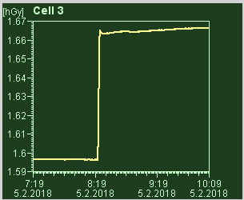
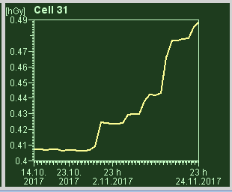
There are two typical Pattern in the Undulator Dose
Single Impact
  Step-like Increase of the Dose, clearly correlated to failure or operational issues.
  First pass steering
  Component Failure
  Might later also occur on MPS events due to latency
Continuous Irradiation
  Slow creeping up dose levels in the last 1/3 of the undulator
  Appearing only with undulators closed
  BLMs show high levels simultaneously (if undulators closed)
  Vacuum increases simultaneously
Trip of the SASE1 quad circuit (7 Gy)
Dose increase during user run (8 Gy)

Slide 4
Typical Dose pattern along the Undulator
Exponential Decay in Cells 0 -8
  Collimation of particle loss
Bump in last 1/3rd of the Undulator
  Synchrotron Radiation?
  How much particle loss is hidden under the bump?
  Does the bump move when last row of undulators are closed?

Slide 5
User operation mode, typical picture – dose rate per transported charge rate
No difference due to operational mode: dose rate scales linear to transported charge.
Remark:
Data taken during user runs, and special runs with increased number of bunches.
Machine “lossless” !
Remark:
250 fC, 2700 bunches, 10 Hz
-> 0.583 Q/d
(LCLS would need 225 days)
Curtesy: F. Wolff-Fabris, XFEL

Slide 6
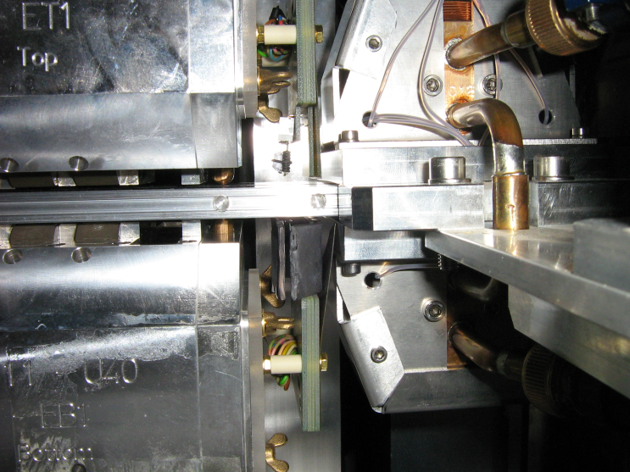
Try to identify Synchrotron Radiation as the Source
Remark: LCLS shields all sensors with 5 mm lead
Shielding efforts started, by 2 mm of lead
- Understand radiation origin (high energy electrons vs. synchrotron radiation) using 2mm Lead Shield (test on Cell#31/SASE1).
- Develop systematic study and shielding protection to each undulator.
- Shielding leads to 60% less dose
Curtesy: F. Wolff-Fabris, XFEL

Slide 7
Curtesy: H.D. Nuhn, SLAC

Slide 8
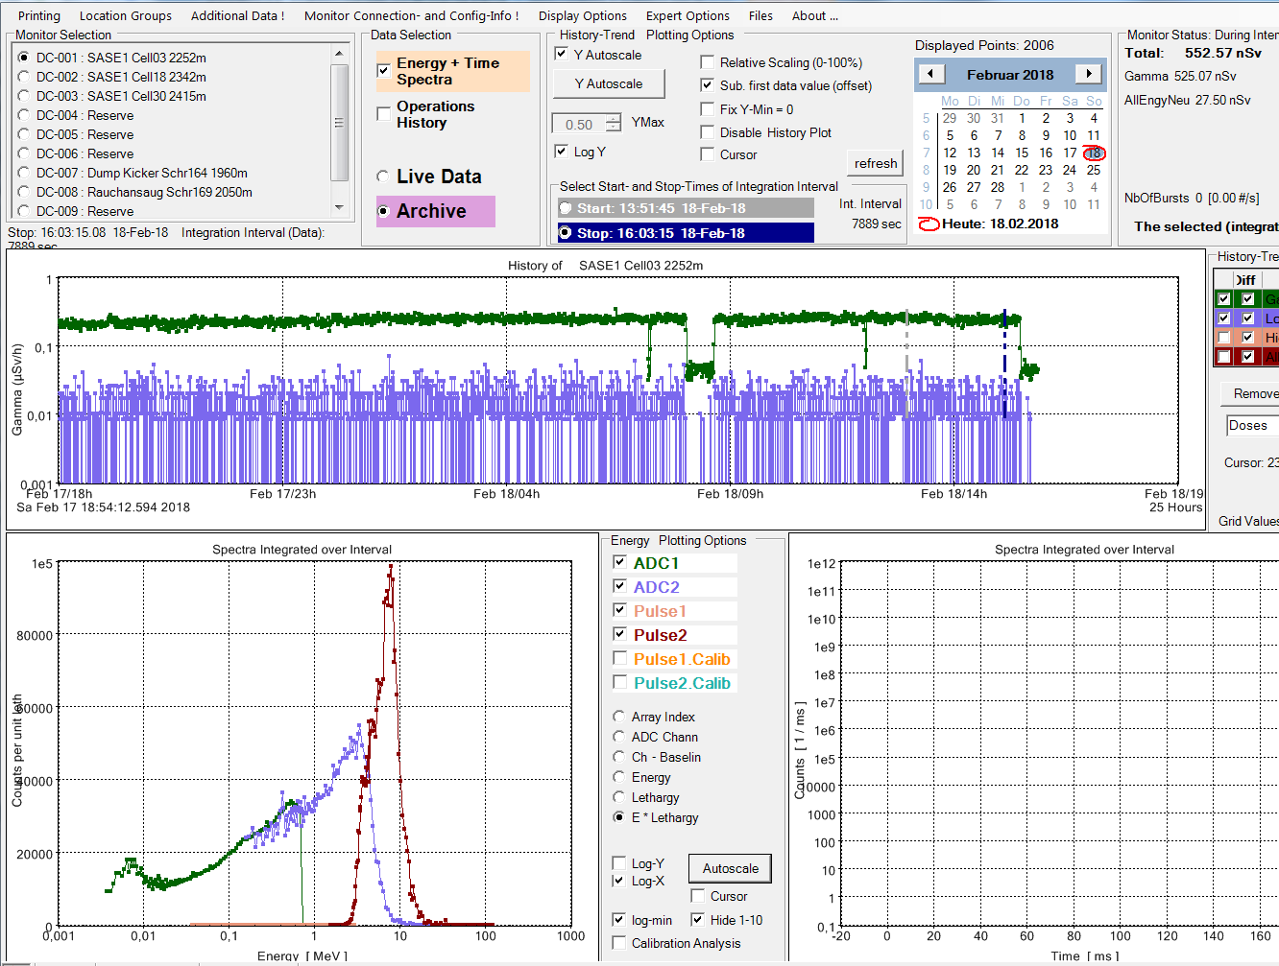
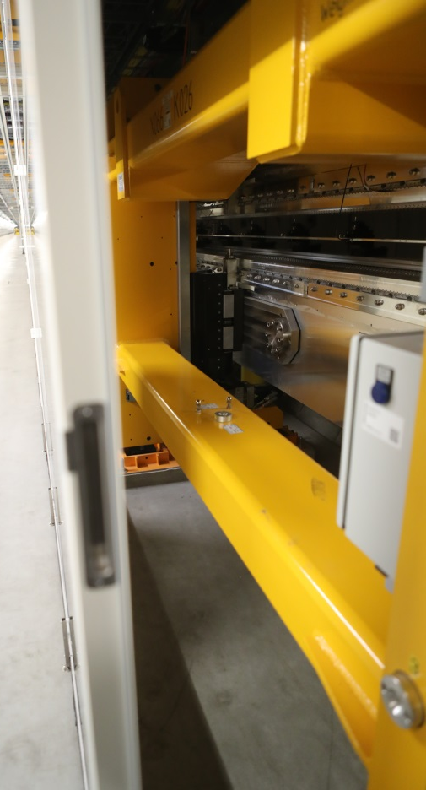
New Tool: Pandora 2252 m (Cell 3) SASE Run 500 µJ (Support by A. Leuschner)
Neutrons slightly higher than noise
Gamma at about 0.1 µSv/h
Gamma peak not very sharp (wider energy distribution)
Get Hands on the Spectrum

Slide 9
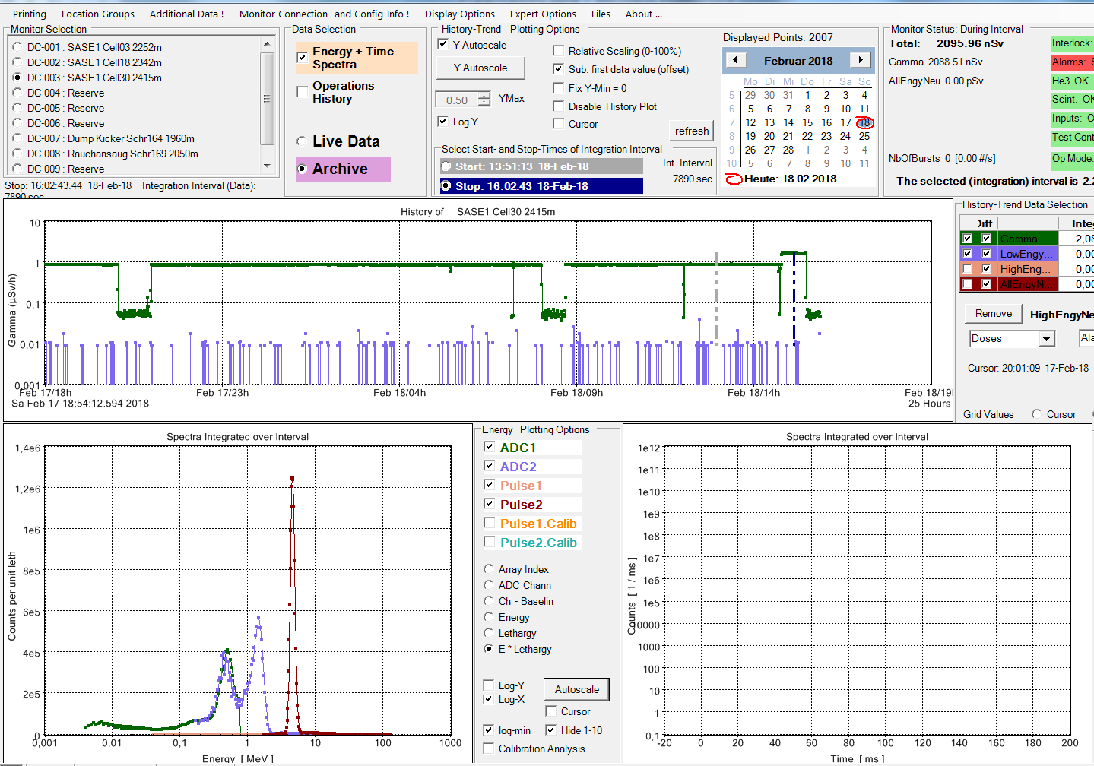
New Tool: Pandora 2415 m (Cell 30) SASE Run 500 µJ
Neutrons at noise level
Gammas at about 1 µSv/h (10 x Entrance)
Gamma peak very sharp (many small energy portions well in time)
A. Leuschner: looks like Synchrotron Radiation

Slide 10
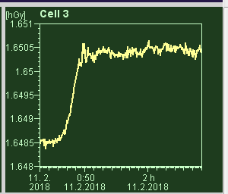
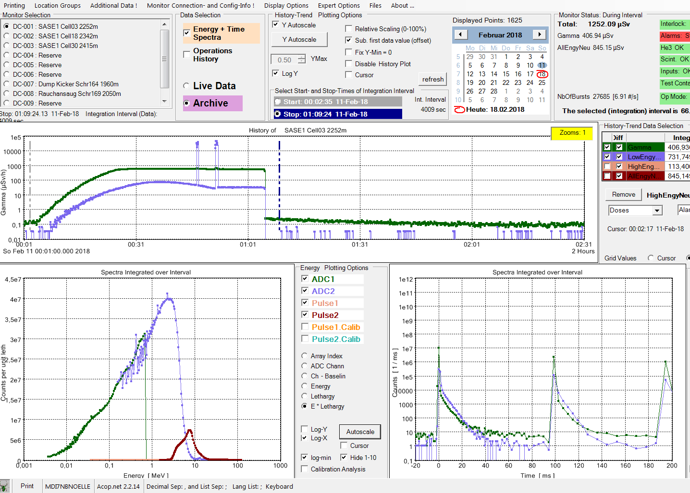
New Tool: Pandora 2252 m (Cell 3) Beam Loss L3 Feedback going mad
Neutrons: Strong Increase
Gamma at about 1 Sv/h
Gamma peak not sharp (wider energy distribution)
Strong particle loss
200 mGy

Slide 11
Some Conclusions: Direct hits due to miss-steering
Immediate measures
  MPS slow protection based on transmission interlock
  First BLMs in each undulator and (few) Cherenkov BLMs in SASE1 activated in Fast and Slow protection
    Functionality verified (check interlock levels, check reset conditions)
  All BLMs to be added in February after installation of Cerenkov radiators as replacement for scintillators
  First passage steering
    Open undulators for first passage steering
    use ‘single-shot’ capability of orbit correction tool
    use low charge beams
    Take care of dark current, when using kickers to go to TLD
      Use BL for proper setup of beamline up to TLD
      T2 permanent magnet can stop dark current, while setting up the kickers
  Operator awareness has been increased, continue training on this issue
Mid-term measures
  Install low power beam stop (30 cm Wolfram) in front of undulator including additional shielding around beam pipe after beam stop
  Install additional shielding around 40 to 8 mm transition in empty cell before ‘sacrificial’ undulator

Slide 12
Some Conclusions: Radiation Dose Peak at 2nd half of undulator
Immediate measurements
  Determine Radiation field:
    Placement of 3 Pandoras (cell 3, cell 15, cell 30)
    additional RadFets at cell 15 and cell 30 fixed to vacuum chamber (data to be evaluated)
    GafChrom films around RadFets with& without lead shielding (to be evaluated)
    Marvin robot to measure n,γ at arbitrary positions
  Spontaneous radiation influence: Close cell 5-35 instead of 1-30 (results in the next slides)
  Local obstacle: Scan apertures ( done, to repeated some indications found)
  Halo transport: Vary focusing in undulator and observe motion of dose peak
  Collimation: Operate with different collimator apertures
Intermediate measures
  Replace scintillators
  Put lead shields on RadFets (Who?, When?)
  Simulations: collimation on 40 to 8 transition, halo transport, add spontaneous radiation, more accurate model, beam-gas scattering (ongoing)

Slide 13
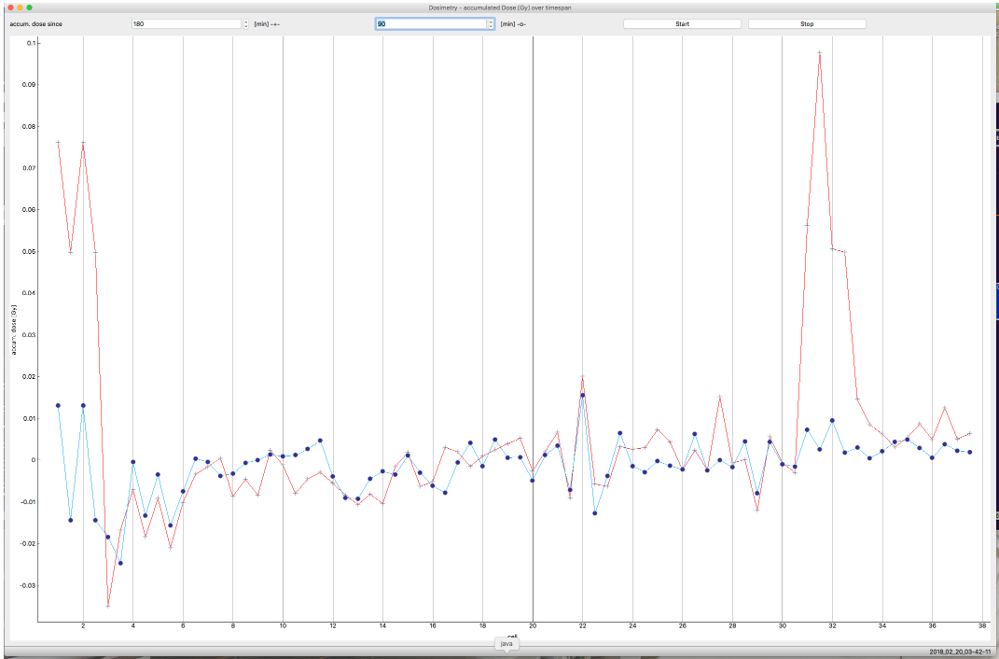
Recent Results: Logbook 20.02.2018
Orbit is independent, if undulators are closed or open
With open undulators at the entrance we can fight the peak
  This is an indication for Synchrotron Radiation
But: The peak does not move!
  Indication for an aperture limitation?
displayed are the Rad Fets for Undulators Cell 30 ( left ) to cell 34 ( right )
upper row : top sensors
lower row : bottom sensors
full scale is 0.5 Gy in all cases
time scale:
charge : 0.25 pC/bunch
30 bunches from 0:21 to 6:40
0:22 - 2:05 all cells closed
2:05 - 3:43 cell 17 to cell 37 closed cell 3 to cell 16 at park
4:14 - 4:40 cell 10 to cell 37 closed cell 3 to cell 9 at park
5:17 - 6:40 cell 6 to cell 37 closed cell 3 to 5 at park
conclusion:
cell 31-33 show an increase of the RADFET readings when they are closed.
Cell31 shows the highest rate, cell32 about half of it and cell 33 even less.
The cells behind 33 don't show an rate increase with 30 bunches.
The rate can be reduced by 50% by opening the first 3 undulators and it vanishes completely when opening the first 14 undulators.
Peak
31-33
Dose
Cell Number

Slide 14
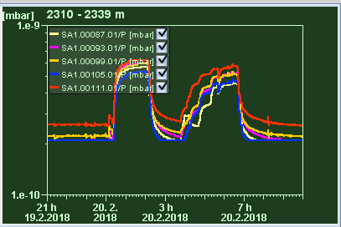
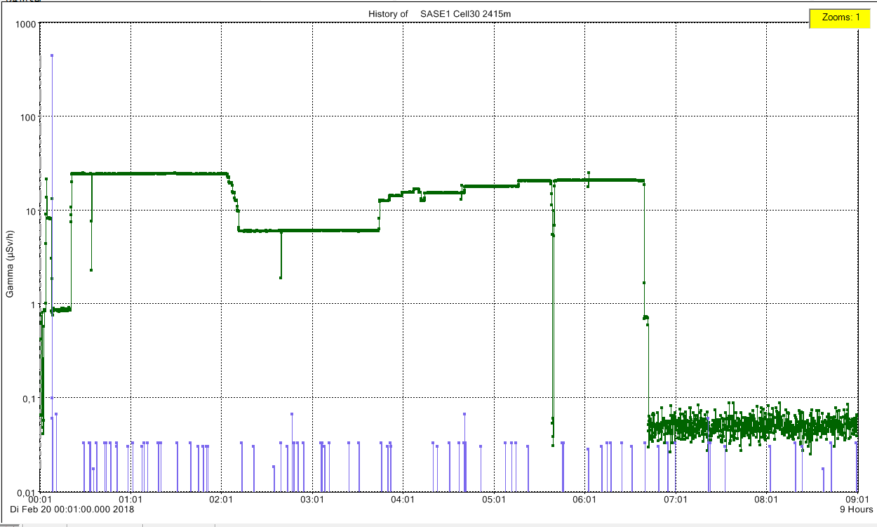
Look into Pandoras Box … Data
All Cells Closed
3-5 in park
3-16 in park
Gammas
Clear Peak
Smaller Peak
No Peak
ZZ in XTD10, no beam
Neutron underground

Slide 15
Some Conclusions: … but there is not only the Undulator
More general Aspects
  Operation with care
    Switch off the beam, if not really needed
    Think, if you are stopped by BLMs (permanent reset of slow protection is a NoGo!)
    Take care, also of the dark current. (e.g. use permanent magnets to stop DC in XS1)
    Stop and call Run Coordinator in case of difficulties and doubts.
  Single Shot Tools
    Use the “few shot” feature of Ocelot
    Develop real “single shot” possibilities for “steering”, “phasing” and “beam size measurements”
      This needs quite some work for the controls

