Slide 1
Shutdown April
Notes:
How to edit the title slide
Upper area: Title of your talk, max. 2 rows of the defined size (55 pt)
Lower area (subtitle): Conference/meeting/workshop, location, date,
your name and affiliation, max. 4 rows of the defined size (32 pt)

Slide 2
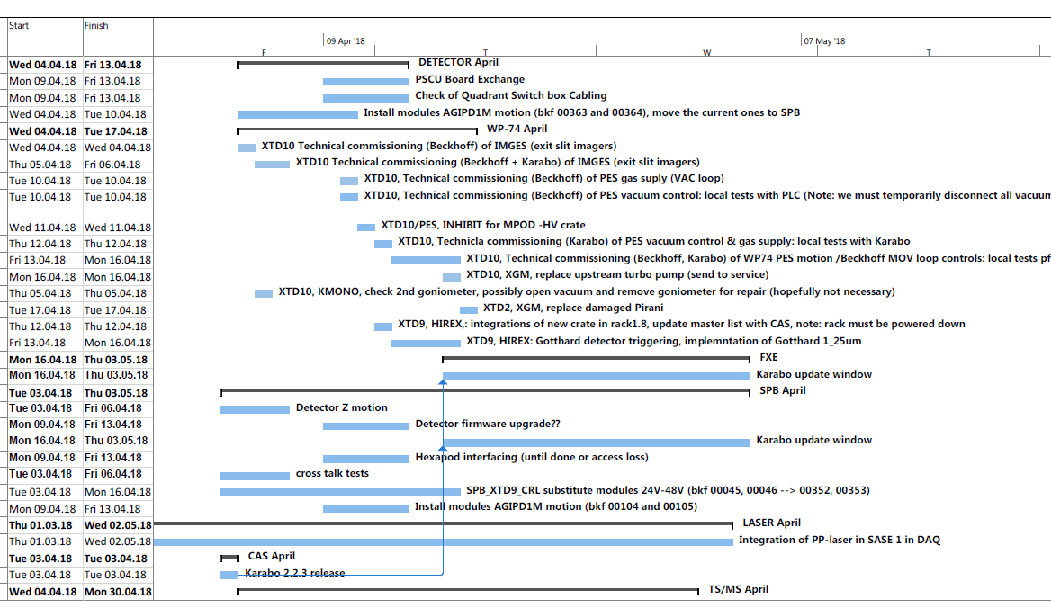
Task list April Shutdown
There is still time until the shutdown, check the list and send the missing tasks!!!

Slide 3
XTD1
Tasks in XTD1 are coordinated by C. Youngman, tasks will resume the 4th until the 19th April.
XTD1 CRL Cables will arrive CW15, the modules are already produced. Installation during April Shutdown.

Slide 4
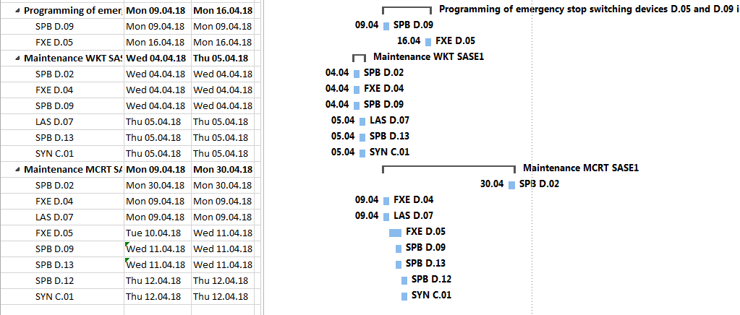
TS
Emergency power-off test D.09 and D.05
  D.09 SPB → 9th April
  D.05 FXE → 16th April
A full description of the intended effect on each rack / interlock / power distribution system is requested.

Slide 5
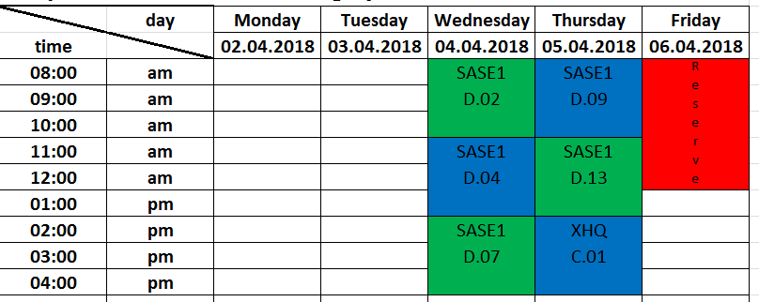

TS
Maintenance of air-conditioning system WKT
D.07
SASE1
D.09
WKT will not have to enter the hutches / rooms! All work performed during maintenance is exclusive on the device itself.
For this purpose, a device is switched off for about 1 hour. Then it takes about 1.5 hours until the temperature in the room stabilized again. Total time of maintenance per unit about 3 hours.

Slide 6
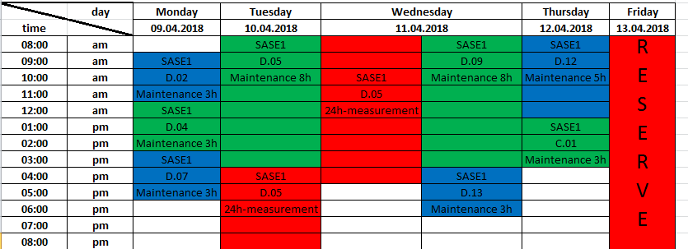
TS
For D.02 only possible from the 30th April onwards
Maintenance of air-conditioning system MCRT
X
Move D.07 → 9:00 to 11:00
3h/8h maintenance MCRT has to work in the hutches / rooms for this work!
  Filters in the plenums are checked for damage and wear / contamination.
  Plenums must be measured (air velocity + temperatures) and qualification according to ISO classes (particle measurement).
  Cooling unit units must be checked and readjusted. -> this takes the most time, e.g. in D.05 there are 19 pieces!
24h maintenance in D.05, only measuring devices in the room not access to the room during this time!

Slide 7
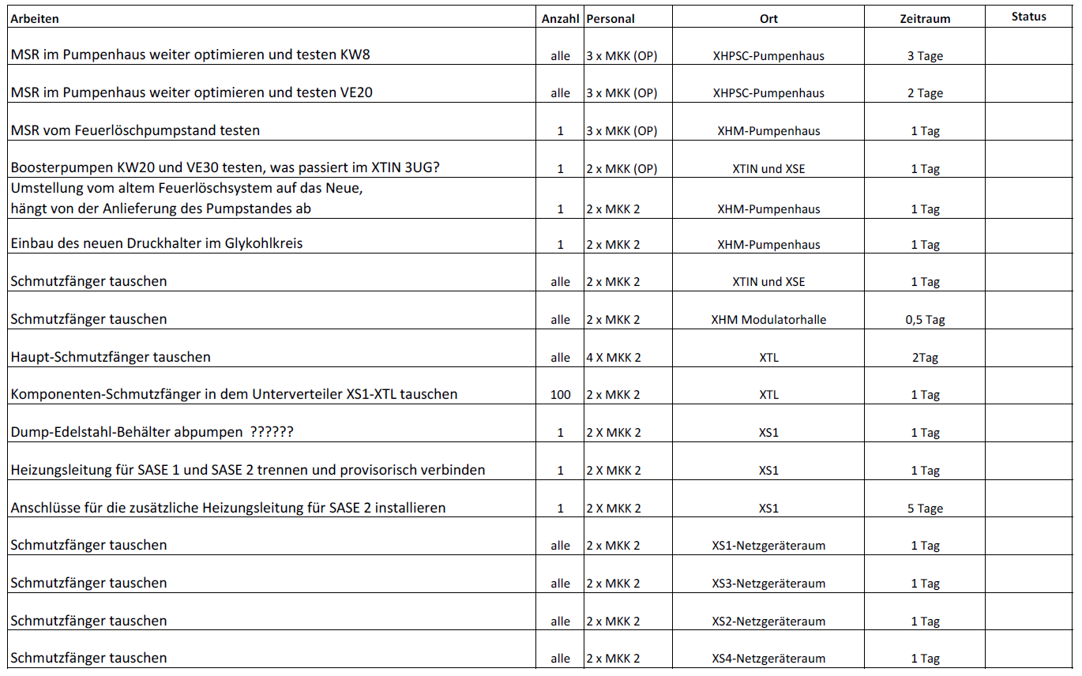
MKK2

Slide 8
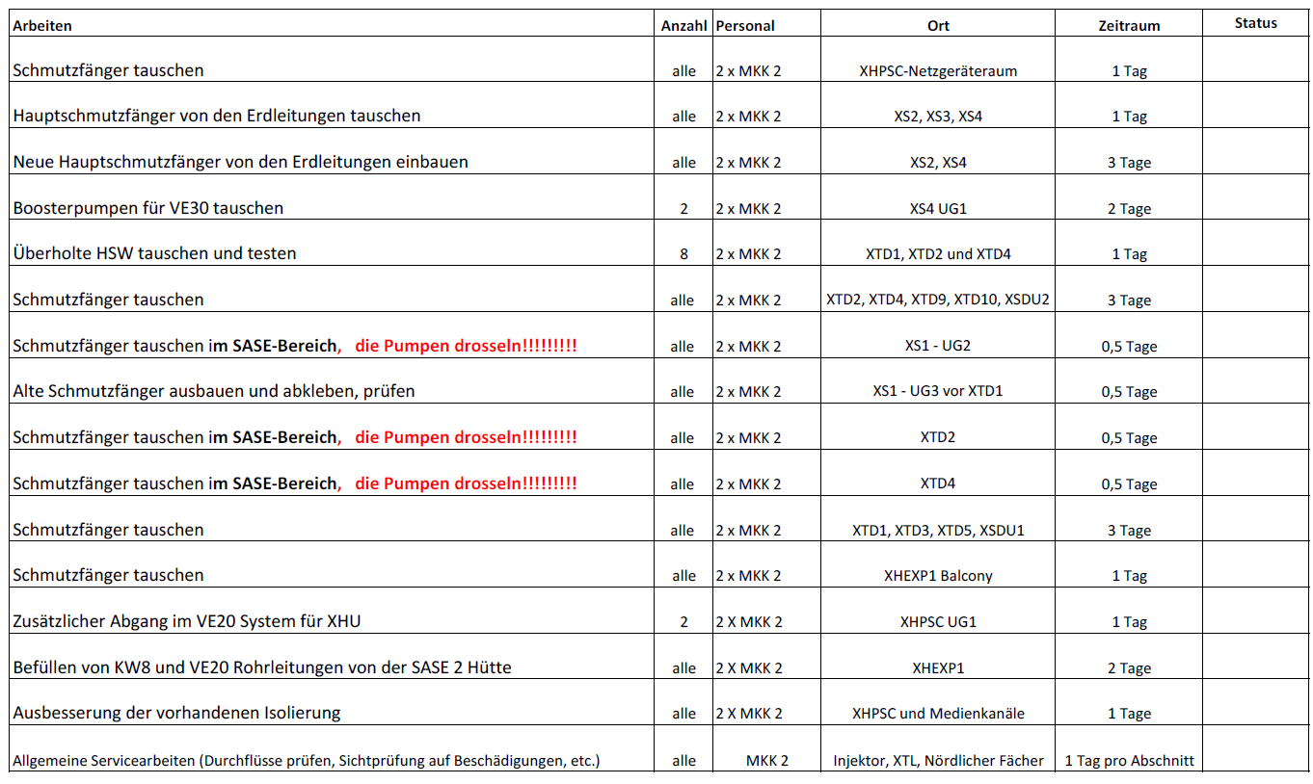
MKK2

