Slide 1
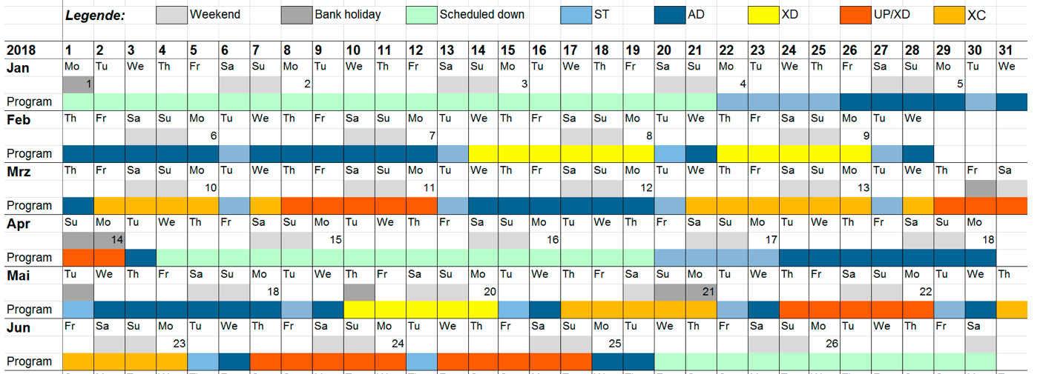

Karabo (2.2.3) Rollout Process
Santos, Hugo
CAS, Agile Project Manager
Schenefeld, 16/03/2018

Slide 2
Users are expected by the 24th of May
HOW DO WE PROVIDE STABLE CONTROL CONDITIONS?

Slide 3
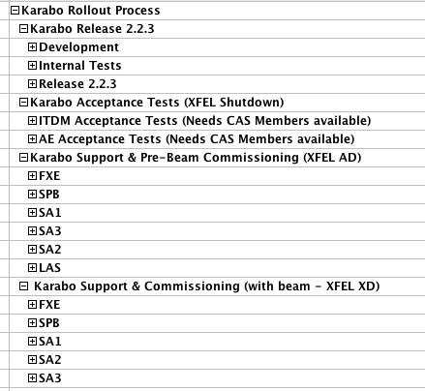

Slide 4
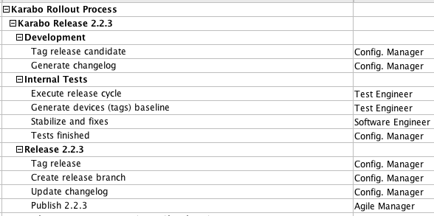
Karabo 2.2.3 internal tests starting next week
Karabo 2.2.3 will be released at 04/04 (first days of the shutdown)
  ONLY FOR: AE, ITDM and DET
    We have to validate interfaces with PLC, DAQ and Detectors
    before move to Tunnel and Instruments

Slide 5
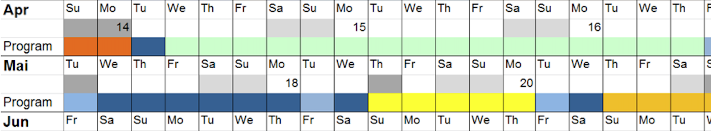
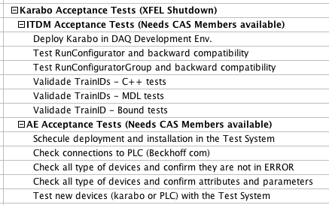

Slide 7
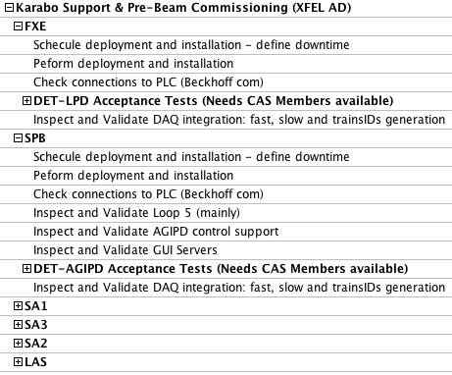

Slide 8
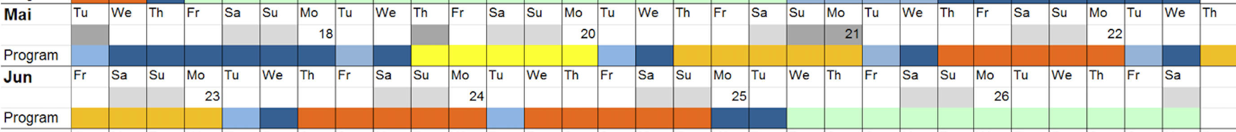
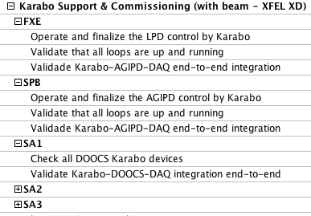

Slide 9
In summary, what we (CAS) think as important…
Karabo 2.2.3 release and feature freeze at the beginning of the shutdown (04/04).
After that, ONLY HOTFIXES (urgent corrections) – Karabo 2.2.3.x
Can we (CAS, ITDM and AE) have timeslots to test Karabo-DAQ-PLC (4-19 April)?
Integrated tests are needed: AE (PLC), ITDM (DAQ) and DET (AGIPD, LPD, Calibration) and DA
  Only after AE, ITDM and DET integrated tests with Karabo we will be able to move to SAs and Instruments.
In order to allocate CAS members properly, operational maintenance/downtime dates of DAQ and PLC (loops) are needed.
  Negotiate downtime with the Instruments and Tunnel
  Re-establish services as fast as possible
Pair-testing AGIPD and LPD with DET. Especially AGIPD because of the previous Karabo-performance incidents.
FUTURE: Integrated tests (PLC + Karabo + DAQ) Environment for every new release.

