Slide 1
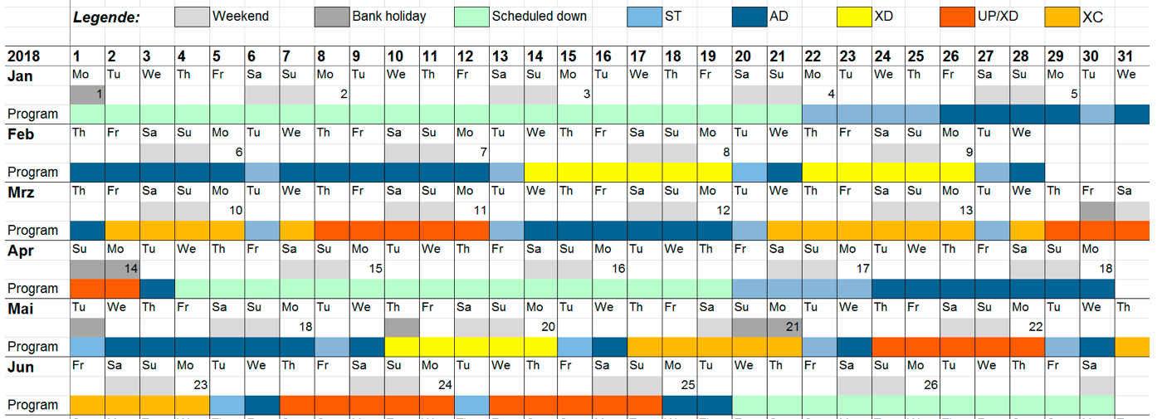

Karabo Rollout Process
Santos, Hugo
CAS, Agile Project Manager
Schenefeld, 23/03/2018

Slide 2
Users are expected by the 24th of May
HOW DO WE PROVIDE STABLE CONTROL CONDITIONS?

Slide 3
Where we are in the Karabo 2.2.3 rollout…

Slide 4
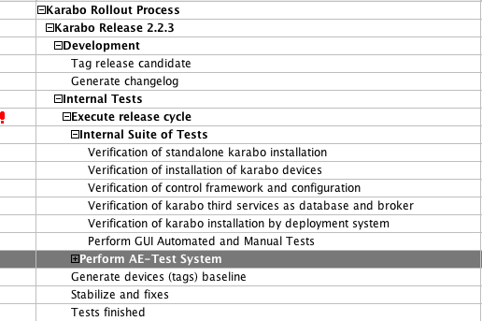

Slide 5
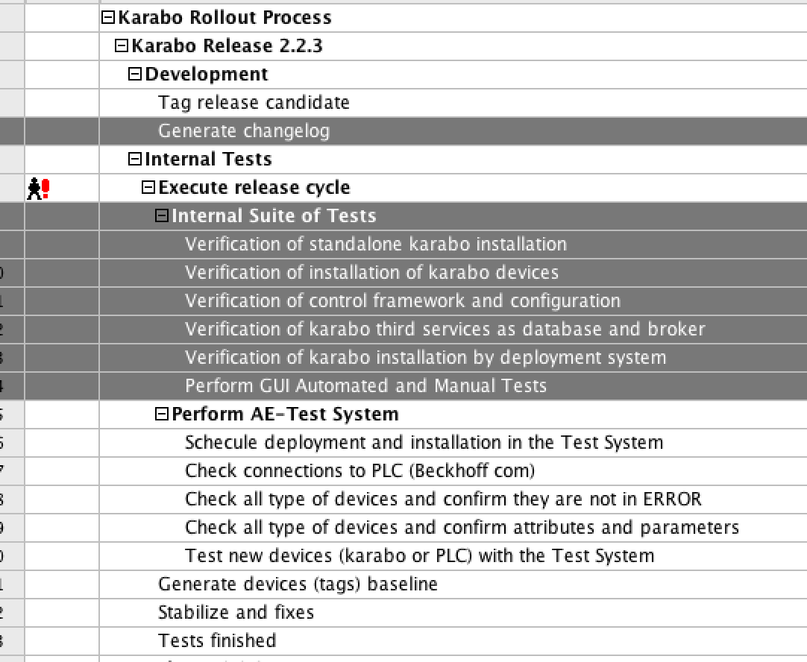
Karabo 2.2.3 internal tests started
Karabo 2.2.3 still will be released at 04/04 (first days of the shutdown)
  ONLY FOR: AE, ITDM and DET

Slide 6
Where we are in the Karabo 2.2.3 rollout…
To be more efficient regarding the XFEL Operational Schedule, we could deploy already at the beginning of the shutdown...

Slide 7
No impact and changes in the Instruments and Tunnels
Perfect timeslots to deploy and setup new versions
We can have a consolidated version of Karabo already before the shutdown
  If not delayed, and;
  Has to be tested with AE, ITDM and DET
  Use the shutdown to deploy and start the setup (without beam - green)

