Slide 1
Using Maxwell
HPC Seminar Series Part 2
Maxwell Team
Hamburg, 23.04.2018

Slide 2
Agenda
Basic Information
Resources & Lists
What is Maxwell?
Getting access
Maxwell specialities
What is slurm
Getting started
Submission hosts
Login to Maxwell
My first slurm jobs
Importance of setting limits
SLURM User commands
Getting infos about the cluster
Advanced jobs
Constraints
Installing your own software
Parallel jobs
Running …
Organizing jobs
Preemption & signals
Array jobs
Chaining jobs
Topics - if time permits. If not - we could continue at a later point
Please ask whenever you’ve got a question etc
Please complain if progress is too fast or too slow etc

Slide 3
Basic Information

Slide 4
Basic Information
Resources & Lists
Type of information | Resource
General Information | https://confluence.desy.de/display/IS/Maxwell
Information about available software | https://confluence.desy.de/display/IS/Software
Slides from the last user meeting | https://indico.desy.de/indico/event/19753/
Maxwell question from Users to IT to Users – no subscription | maxwell.service@desy.de
Maxwell announcements from IT to Users – subscribe! Users to Users – moderated! | maxwell-user@desy.de
Seminar announcements from IT – self subscription | hpc-seminar-announce@desy.de
Feedback/Request for seminar from users – no subscription | hpc-seminar@desy.de
Any questions or issues you might have, or if in doubt | uco@desy.de
Some of the (trivial) scriplet used in the tutorial | /software/slurm/tutorial/
Man pages! | man sinfo …
Hint: Subscribing to lists
https://lists.desy.de/sympa and subscribe via web. Some lists are only visible upon login
Send email to sympa@desy.de with empty subject and body subscribe hpc-seminar-announce@desy.de;
mailto:sympa@desy.de?body=subscribe hpc-seminar-announce@desy.de
Use hyperlinks in the table above

Slide 5
Basic Information
What is the Maxwell cluster?
A bunch of computers named max-something sharing common features
connected via infiniband (fast low latency network) as well as 10GE
with the same GPFS home-directory
with access to GPFS storage infrastructures
with access to BeeGFS storage
with access to dCache instances (on demand)
with access to identical software stacks
with (unusually) high memory/core counts
SLURM controlled and/or serving as a SLURM submission host
max-p3a* aka max-fsc, max-fsg, aka desy-ps-cpu, desy-ps-gpu are here NOT considered a part of Maxwell here

Slide 6
Basic Information
What does it mean?
 | Maxwell | Bird
Bandwidth (2 nodes) | ~4000 MB/s | ~1800 MB/s
0kb msg latency | ~3 usec | ~20 usec
4kb msg latency | ~6 usec | ~17 usec
64kb msg latency | ~35 usec | ~83 usec
4mb msg latency | ~1000 usec | ~2200 usec
jobs / node | 1 | ~ #of cores
max # of nodes / job | 100‘s | ~1
max # of cores / job | 1000‘s | Typical 1
max GB / core | 1500 | 8
# of GPUs | ~70 | 0
costs per node | 6-25k€ | <5k€
# of concurrent jobs | 100‘s | 10000‘s

Slide 7
Basic Information
What does it mean?
We require that jobs on Maxwell to utilize at least one of the special features
fast, low latency interconnect
multi-core capabilities
memory utilization
[GPUs]
This does not apply to group owned maxwell resources
Do whatever you like – but you’ll get “monitored” anyway

Slide 8
Basic Information
Getting access
You would like to use general (IT) resources in Maxwell (the maxwell and all partitions)
Drop a message to maxwell.service@desy.de briefly explaining your use case, so we have an idea that you really need maxwell resources (rather than bird, grid, etc)
You would like to use group owned resources in Maxwell
None of our business!
Drop a message to your groups administrators. Only the group admins can grant the resources!
See next slide
You are uncertain if the maxwell cluster is useful and would like to make some tests
Drop a message to maxwell.service@desy.de briefly explaining your use case. We can provide temporary access using dedicated functional accounts.
You intend to run hands-on tutorials, schools, etc on maxwell
Drop a message to maxwell.service@desy.de briefly explaining your use case. We can provide temporary access using dedicated functional accounts.
Note: reservation of substantial resources might be difficult.
You need software only available on maxwell, or access to GPFS, or BeeGFS
Not good enough a reason.
You need group owned resources in such cases
Not an option at all
Any commercial/industrial use. This includes services for industry
Any commercial/industrial user
Crypto coin mining
Illegal/cracked software

Slide 9
Partitions
 | Nodes | Cores | GPUs | Resource[-users] | Admin | #Jobs | #Nodes/Job | Time Limit | PreEmption
Maxwell | 86 | 3720 | 12(+) | maxwell | IT | 4 | 6 | 7 days | no
all | 0 | 22280 | 71(+) | any resource | all | 10 | 32 | 14 days | yes/reque
cfel | 20 | 864 | 6 | cfel-wgs | CFEL | - | 6 | 14 days | no
cms | 8 | 320 | 8 | max-cms-* | CMS-* | - | - | 24 hours | yes/chkpt
cms-desy | 4 | 160 | 4 | max-cms-desy | CMS-DESY | - | - | 24 horus | no
cms-uhh | 4 | 160 | 4 | max-cms-uhh | CMS-UHH | - | - | 24 hours | no
cssb | 12 | 554 | 6 | max-cssb | FS/CSSB | - | - | - | no
exfel | 183 | 13104 |  | exfel-wgs | EXFEL | - | 16 | 14 days | no
exfel-spb | 4 | 288 | 4 | exfel-theory | EXFEL | - | 4 | 7 days | no
exfel-theory | 31 | 1728 | 6 | exfel-theory | EXFEL | - | 6 | 14 days | no
exfel-th | 9 | 384 | 2 | exfel-theory | EXFEL | - | 6 | 14 days | no
exfel-wp72 | 18 | 1056 | 0 | exfel-theory | EXFEL | - | 6 | 14 days | no
ferrari | 24 | 960 | 0 | max-ferrari | MPY | - | - | - | no
fspetra | 1 | 40 | 1 | max-fspetra | FS | - | 1 | 14 days | no
p10 | 1 | 64 | 1 | p10 staff+users | automatic | - | - | unlimited | no
ps | 20 | 800 | 6 | max-ps | FS/IT | 3 | 1 | 14 days | no
psx | 6 | 240 | 0 | max-psx | FS/IT | 3 | 1 | 7 days | no
petra4/p4 | 2 | 80 | 0 | p4(*) | M | - | - | 14 days | no
uke | 16 | 1024 | 0 | max-uke | FS/IT | - | 16 | 21 days | no
upex | 183 | 9224 | 18 | upex | EXFEL | - | 16 | 14 days | no

Slide 10
Basic Information
Getting access
Verifying access to partitions
ssh to max-wgs. If that doesn’t work you certainly don’t have any of the maxwell resources
IF it works, you have at least one of the resources
getent netgroup maxwell-users | grep $USER # if empty you don’t have access to maxwell partition. Likewise for all other partitions (except all)
module load maxwell tools; my-partitions # lists all partitions you are entitled to use
Access to max-fsc, max-fsg
As mentioned: not considered part of maxwell for this seminar
Not a partition, so my-partitions won’t tell
getent netgroup hasy-users | grep $USER # if empty you can’t user max-fsc, max-fsg
getent netgroup psx-users | grep $USER # for external users. if empty, you can’t use desy-ps-cpu, desy-ps-gpu

Slide 11
Basic Information
Maxwell specialties
tokens and tickets
Very limited support of KRB5 and AFS on maxwell
No tickets or tokens in jobs!
No automatic ticket or token renewal
NOT needed usually
Interactive sessions will inherit tickets, tokens. No automatic renewal

Slide 12
Basic Information
Maxwell specialties
tokens and tickets
Very limited support of KRB5 and AFS on maxwell
No tickets or tokens in jobs!
No automatic ticket or token renewal
NOT needed unless accessing /nfs/fs or /afs/
Interactive sessions will inherit tickets, tokens. No automatic renewal
Viewing, obtaining, renewing, destroying
Command | Effect
klist | view KRB5 tickets
tokens | view AFS tokens
kinit -f | obtain renewable KRB5 ticket
k5log -tmp | obtain KRB5 ticket & AFS token
kinit –Rf | renew existing KRB5 ticket
aklog | get new AFS token from KRB5 ticket
kdestroy | destroy KRB5 ticket
unlog | destroy AFS token

Slide 13
Basic Information
Maxwell specialties - Storage
Several group specific storage locations (gpfs, beegfs, nfs, …)
Talk to your admins!
generic options
$HOME – GPFS hosted, 20GB hard quota
/beegfs/desy – BeeGFS scratch space
/data/netapp – NFS space
/pnfs/desy.de – dCache space
desyCloud – unlimited cloud storage
/afs/ – simply avoid it on maxwell
Storage | Location | Features | Purpose | Policy
GPFS | /home/$USER | fast, snapshots | Personal data | remove after account expired
BeeGFS | /beegfs/desy/user | fast, no backup, no snapshots | temporary data | remove after account expired. remove aged data
NFS | /data/netapp | slow, secure, no backup, no snapshots | software | removed after account expired
dCache | /pnfs/desy.de/ | slow | scientific data | permanent
desycloud | via gvfs | slow, world-wide accessible, sharable, disaster-recovery in preparation | documents | removed after account expired(?)
afs | /afs/desy.de/ | very slow, world-wide accessible, sharable, backup & snapshot (.OldFiles) | documents | archived after account expired

Slide 14
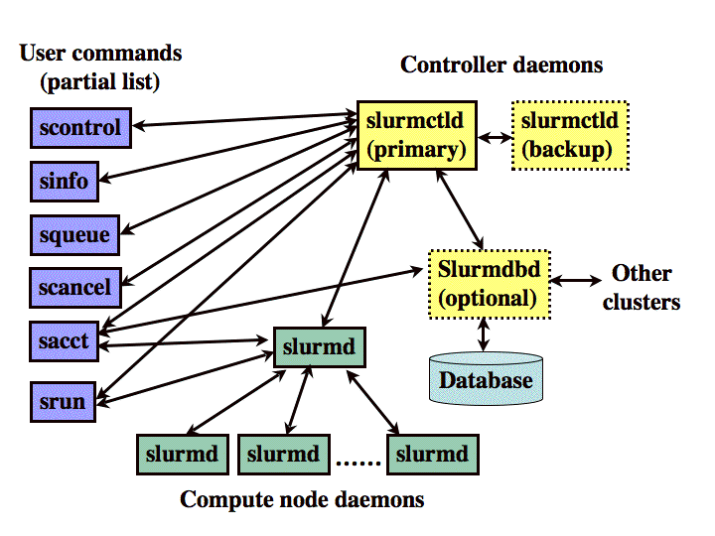
Basic Information
What is slurm
In simple word, SLURM is a workload manager, or a batch scheduler
SLURM stands for Simple Linux UTlity for Resource Management
SLURM unites the cluster resource management (such as Torque) and job scheduling (such as Moab) into one system. Avoids inter-tool complexity.

Slide 16
Getting Started
Submission / Login nodes
Several group specific login & submission hosts
Check the documentation
Talk to your admins!
generic options
ssh max-wgs.desy.de - connect to WGS
https://max-display.desy.de:3443/ - graphical session in your browser
fastx2_client - graphical session in FastX2 client
what are they good for
composing & submitting jobs! - all nodes.
compiling, testing, debugging profiling - use max-wgs
graphical applications requiring GPU acceleration - use max-display
NOT: multi-core, high-memory, long-running production jobs
max-display favorable features
load balanced
persistent sessions (up to a reboot)
GPU accelerated sessions
open from outside world (no ssh-tunnel, vpn-client etc)

Slide 17
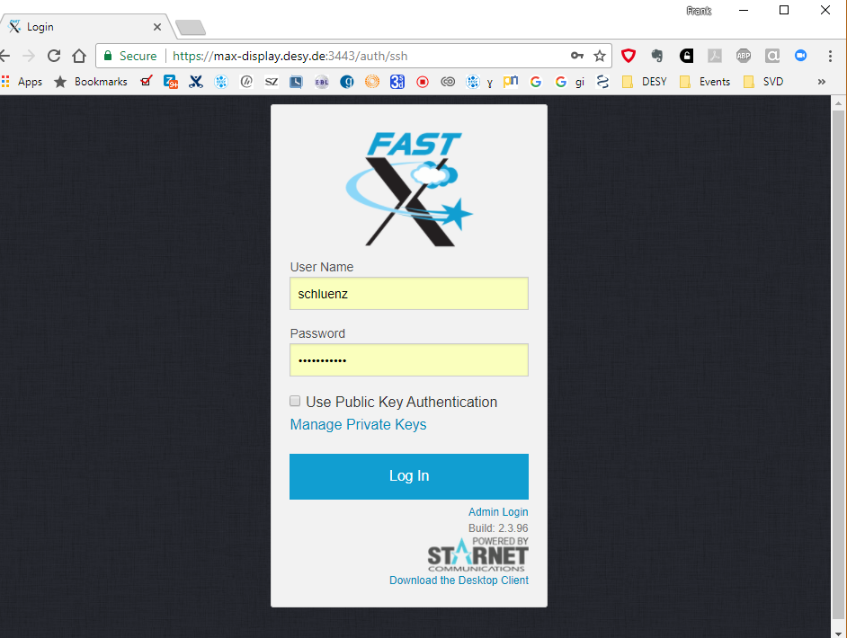
Getting Started
Submission / Login nodes
myuserid
************

Slide 18
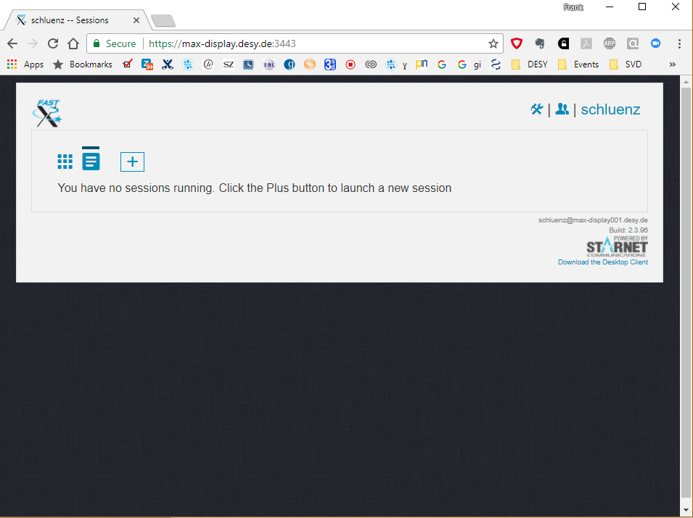
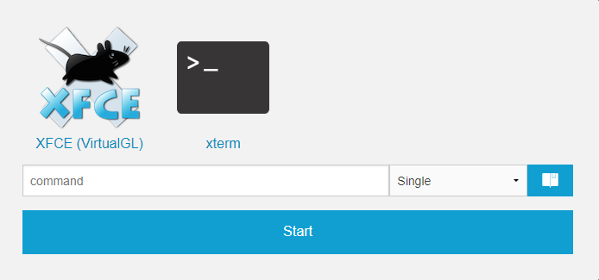
Getting Started
Submission / Login nodes

Slide 19
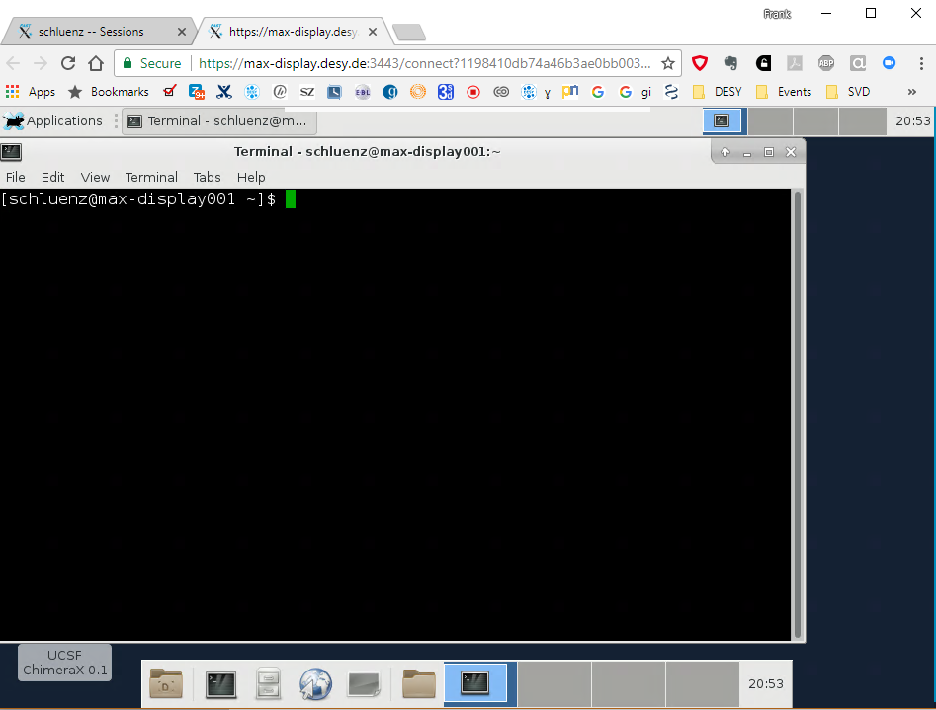
Getting Started
Submission / Login nodes

Slide 20
Getting Started
Hands-On – Getting Overview of the Cluster
Login to the cluster
ssh max-wgs.desy.de (maybe ssh bastion.desy.de before that)
Look at the partitions
sinfo
sinfo –a (all partitions)
sinfo –p <name> (specific partition)
Look at the nodes
sinfo -N --long
sinfo -a -o "%R %.40N %c %m %f %g" (you can try something else, see SLURM sinfo format help)
Look at the current queue
squeue
squeue –u <username>
sview graphical view -- nothing for „purists“

Slide 21
Getting Started
First Job Script
#!/bin/bash
#SBATCH --time 0-00:01:00
#SBATCH --nodes 1
#SBATCH --partition maxwell
#SBATCH --job-name slurm-01
export LD_PRELOAD="„
source /etc/profile.d/modules.sh
echo "my first job„
echo "SLURM_CLUSTER_NAME $SLURM_CLUSTER_NAME"
echo "SLURM_JOB_NAME $SLURM_JOB_NAME"
echo "SLURM_JOB_PARTITION $SLURM_JOB_PARTITION"
echo "SLURM_SUBMIT_HOST $SLURM_SUBMIT_HOST"
echo "SLURM_JOB_NUM_NODES $SLURM_JOB_NUM_NODES"
echo "SLURM_JOB_RESERVATION $SLURM_JOB_RESERVATION"
echo "SLURM_JOB_NODELIST $SLURM_JOB_NODELIST"
sleep 300
exit
#!/bin/bash
#SBATCH -t 0-00:01:00
#SBATCH -N 1
#SBATCH –p maxwell
#SBATCH –J slurm-01-short
export LD_PRELOAD="„
source /etc/profile.d/modules.sh
echo "my first short job"
sleep 300
Exit
See the sbatch manual for flags, environments, etc
we mostly use the long form
easier to remember; matter of taste really

Slide 22
Getting Started
First Job Script
#!/bin/bash
#SBATCH --time 0-00:01:00
#SBATCH --nodes 1
#SBATCH --partition maxwell
#SBATCH --job-name slurm-01
export LD_PRELOAD=""
source /etc/profile.d/modules.sh
echo "my first short job"
sleep 30
exit
Specify which shell to use – recommend to use bash

Slide 23
Getting Started
First Job Script
#!/bin/bash -l
#SBATCH --time 0-00:01:00
#SBATCH --nodes 1
#SBATCH --partition maxwell
#SBATCH --job-name slurm-01
export LD_PRELOAD="„
source /etc/profile.d/modules.sh
echo "my first short job"
sleep 30
exit
Set the environment
Don’t rely on the host environment
Define what you need for the job

Slide 24
Getting Started
First Job Script
#!/bin/bash -l
#SBATCH --time 0-00:01:00
#SBATCH --nodes 1
#SBATCH --partition maxwell
#SBATCH --job-name slurm-01
export LD_PRELOAD="„
source /etc/profile.d/modules.sh
echo "my first short job"
sleep 30
exit
Job directives: instructions for the batch system
Always specify time, partition, number of nodes
partition determines limits
time & number of nodes determine time of execution

Slide 25
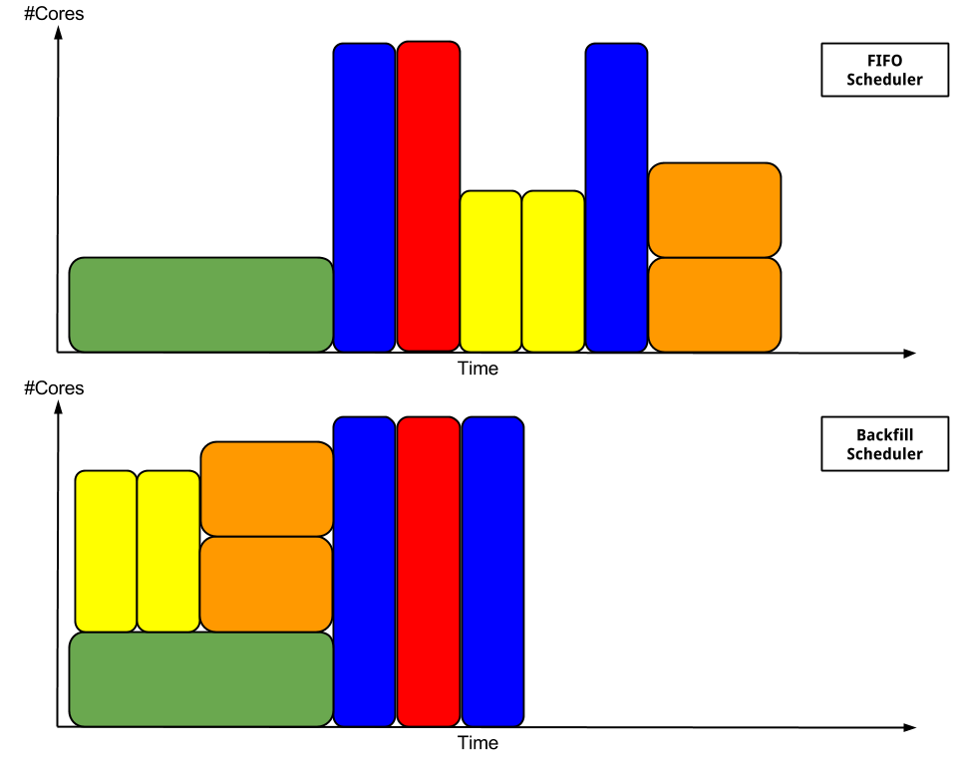
Getting Started
#Nodes
Job executed in order of submission
Job2
Job3
Job6
Job8
Job4
Job5
Job1
Job7
#Nodes
Job8
Job executed in order of submission
Vacant queues are backfilled with jobs –
If queued jobs don’t get delayed.
That’s what we have in maxwell
Job4
Job5
Job2
Job3
Job6
Job7
Job1

Slide 26
Getting Started
#Nodes
#Nodes
Longer time than needed
might delay execution

Slide 27
Getting Started
#Nodes
#Nodes
More nodes than needed
might delay execution

Slide 28
Getting Started
#Nodes
max
#Nodes
max
More nodes than allowed
will delay execution indefinitely

Slide 29
Getting Started
Jobs not fitting into will be
delayed until after e.g. maintenance
#Nodes
maintenance
#Nodes
maintenance

Slide 30
Getting Started
First Job Script
[@max-display002 tutorial]$ sbatch --partition maxwell --time 30-0 slurm-02-no-resources.sh
[@max-display002 tutorial]$ sbatch --partition maxwell --nodes 20 --time 30-0 slurm-01.sh
[@max-display002 tutorial]$ sbatch --partition all --time 30-0 slurm-01.sh
[@max-display002 tutorial]$ sbatch --partition all --nodes 1 --time 1-0 slurm-01.sh \
--constraint has-no-effect
[@max-display002 tutorial]$ sbatch --partition all --nodes 1 --time 0-00:02:00 slurm-01.sh
[@max-display002 tutorial]$ squeue -u $USER
JOBID PARTITION NAME USER ST TIME NODES NODELIST(REASON)
977794 maxwell slurm-02 myuserid PD 0:00 20 (PartitionNodeLimit) 977798 maxwell slurm-01 myuserid PD 0:00 20 (PartitionNodeLimit) 977795 maxwell slurm-02 myuserid PD 0:00 1 (PartitionTimeLimit) 977799 all slurm-01 myuserid PD 0:00 1 (PartitionTimeLimit) 977828 all slurm-01 myuserid PD 0:00 1 (Priority)
977827 all slurm-01 myuserid R 0:18 1 max-wn009
Status: PD pending, R running.
SLURM tells why a job is pending (at least one of the reasons)!

Slide 31
Getting Started
First Job Script
[@max-display002 tutorial]$ sbatch --partition maxwell --time 30-0 slurm-02-no-resources.sh
[@max-display002 tutorial]$ sbatch --partition maxwell --nodes 20 --time 30-0 slurm-01.sh
[@max-display002 tutorial]$ sbatch --partition all --time 30-0 slurm-01.sh
[@max-display002 tutorial]$ sbatch --partition all --nodes 1 --time 1-0 slurm-01.sh \
--constraint has-no-effect
[@max-display002 tutorial]$ sbatch --partition all --nodes 1 --time 0-00:02:00 slurm-01.sh
[@max-display002 tutorial]$ squeue -u $USER
JOBID PARTITION NAME USER ST TIME NODES NODELIST(REASON)
977794 maxwell slurm-02 myuserid PD 0:00 20 (PartitionNodeLimit) 977798 maxwell slurm-01 myuserid PD 0:00 20 (PartitionNodeLimit) 977795 maxwell slurm-02 myuserid PD 0:00 1 (PartitionTimeLimit) 977799 all slurm-01 myuserid PD 0:00 1 (PartitionTimeLimit) 977828 all slurm-01 myuserid PD 0:00 1 (Priority)
977827 all slurm-01 myuserid R 0:18 1 max-wn009
[@max-display002 tutorial]$ sbatch --test-only -p maxwell -N 20 -t 30-0 slurm-01.sh
allocation failure: Requested node configuration is not available
[@max-display002 tutorial]$ scontrol update jobid=977794 NumNodes=1-2
# OR
[@max-display002 tutorial]$ scancel -u $USER
You can test a job without submission using --test-only
Modify a pending job using scontrol
Simply cancel all your jobs using scancel

Slide 32
Getting Started
First Job Script
[@max-display002 tutorial]$ sbatch --partition maxwell --time 30-0 slurm-02-no-resources.sh
[@max-display002 tutorial]$ sbatch --partition maxwell --nodes 20 --time 30-0 slurm-01.sh
[@max-display002 tutorial]$ sbatch --partition all --time 30-0 slurm-01.sh
[@max-display002 tutorial]$ sbatch --partition all --nodes 1 --time 1-0 slurm-01.sh \
--constraint has-no-effect
[@max-display002 tutorial]$ sbatch --partition all --nodes 1 --time 0-00:02:00 slurm-01.sh
[@max-display002 tutorial]$ squeue -u $USER
JOBID PARTITION NAME USER ST TIME NODES NODELIST(REASON)
977794 maxwell slurm-02 myuserid PD 0:00 20 (PartitionNodeLimit) 977798 maxwell slurm-01 myuserid PD 0:00 20 (PartitionNodeLimit) 977795 maxwell slurm-02 myuserid PD 0:00 1 (PartitionTimeLimit) 977799 all slurm-01 myuserid PD 0:00 1 (PartitionTimeLimit) 977828 all slurm-01 myuserid PD 0:00 1 (Priority)
977827 all slurm-01 myuserid R 0:18 1 max-wn009
[@max-display002 tutorial]$ sbatch –-test-only -p maxwell -N 20 -t 30-0 slurm-01.sh
allocation failure: Requested node configuration is not available
[@max-display002 tutorial]$ scontrol update jobid=977794 NumNodes=1-2
# OR
[@max-display002 tutorial]$ scancel -u $USER
Options on the command line override settings in the script!
Be aware: options after the job-script have no effect!

Slide 33
Getting Started
First Job Script
#!/bin/bash -l
#SBATCH -t 0-00:01:00
export MAX_NODES=8
#SBATCH -N 1-$MAX_NODES ← this and the following are ignored!
#SBATCH –p maxwell
#SBATCH –J slurm-01-short
export LD_PRELOAD=""
source /etc/profile.d/modules.sh
echo "my first short job"
sleep 30
exit
Likewise:
any options after the first SHELL command will be ignored
BIRD/SGE in contrast will scan the entire file for job directives

Slide 34
Getting Started
Hands-On – Create Job Script and Submit a Job
Login to the cluster
ssh max-wgs.desy.de (maybe ssh bastion.desy.de before that)
create a script example1.sh
Submit the job: sbatch example1.sh
Check it is running: squeue –u <yourname>, job id will be shown
Check job output
ssh into node allocated to job and check process list; log out
Kill the job on the submit host: scancel <jobid>
#!/bin/bash
#SBATCH --time 0-00:01:00
#SBATCH --nodes 1
#SBATCH --partition maxwell
#SBATCH --job-name slurm-01-yourname
echo "my first job“
sleep 12000

Slide 35
Getting Started
Hands-On –Submit a Job To a Node with a Specific Feature
Use --constraint parameter
create a script example2.sh
Submit the job: sbatch example2.sh
Check job output
#!/bin/bash
#SBATCH --time 0-00:01:00
#SBATCH --nodes 1
#SBATCH --partition maxwell
#SBATCH --job-name slurm-02-yourname
#SBATCH --constraint E5-2640
lscpu
#!/bin/bash
#SBATCH --time 0-00:01:00
#SBATCH --nodes 1
#SBATCH --partition all
#SBATCH --job-name slurm-02-yourname
#SBATCH --constraint GPU
nvidia-smi

Slide 36
Getting Started
Hands-On –Submit a Job To a Node with a Specific Feature
# to list all valid combinations of features
[@max-display002 bin]$ sinfo -p all -o "%10c %10m %45f"
# To know how many nodes with P100 and other features are available
[@max-display002 bin]$ sinfo -p all -o "%30n %10c %10m %45f" | grep P100 | \
awk '{print $4}' | sort -k 1 | uniq -c
# -----------------------------------------------------------------------------
-p all --constraint="P100" # will get you a node with 1-4 P100 GPUs
-p all --constraint="P100|K40X" # either P100 or K40X. If both are available,
# it will be a K40X.
-p all --constraint="P100&GPUx2" # one of the nodes with dual P100
# -----------------------------------------------------------------------------
[@max-display002 bin]$ sbatch --test-only -p all --constraint="P100&K40X" [...]
# would tell you if your combination of constraints is valid
# and when to expect execution

Slide 37
Getting Started
Hands-On – Load module with MPI and start an MPI job
Check available modules: module avail
Load module in the script
Check job output
Check your email
#!/bin/bash
#SBATCH --time 0-00:01:00
#SBATCH --nodes 2
#SBATCH --partition maxwell
#SBATCH --job-name slurm-01-yourname
#SBATCH --mail-type ALL
#SBATCH --mail-user <my-mail@desy.de>
module load mpi/openmpi-x86_64
mpirun hostname

Slide 38
Getting Started
Hands-On – Install Your Own Software
module load maxwell; module avail # lots of software pre-installed. If not:
Python
create requirements.txt file containing the modules you need
pip install --user -r requirements.txt
C/C++ and Co
downloads sources
unpack, configure (--prefix $HOME/opt/…), compile, install
set paths to binary/libraries
Try to install zlib: https://zlib.net/zlib-1.2.11.tar.gz
Check job output
argparse>=1.2.1
datetime
dill

Slide 39
Software – Engineering & other major products
Product | Location | Initialize | License | Versions
ansys | /software/ansys | module load ansys | concurrent | 18.2
avizo/amira | /software/avizo | module load avizo | concurrent | 9.0-9.4
comsol multiphysics | /software/comsol | module load comsol | concurrent | 5.2-5.3a
jetbrains | /software/jetbrains | - | concurrent
maple | /opt/maple | module load maple | conc./standal. | 2016-2018
matlab | /opt/matlab | module load matlab | concurrent | 2014b-2018a
mathematica | /opt/mathematica | module load mathematica | conc./home | 7.0-11.3
OpenFOAM | /software/openfoam | module load openfoam | academic | 5.0
Orca | /software/orca | module load orca | academic | 3.0-4.0
Paraview | /software/paraview | module load pv/pvgui | academic | 5.4
quantum espresso | /software/qe | module load qe | academic | 6.0
salome | /software/salome | module load salome | GPL | 8.4.0
tensorflow | /software/tensorflow | module load tf14/GPU | academic | 1.2-1.4
vgstudio | /software/vgstudiomax | module load vgstudiomax | concurrent | 3.1
vtk/itk | /usr | - | GPL | 6.1/3.4

Slide 40
Advanced Topics

Slide 41
Advanced topics
Hands-On – Requeue and catching signals
all partition offers much more than any other partition
more concurrent jobs
more nodes per job
Many more nodes
but jobs might be killed (preempted)
Your choice
preempted jobs first get a SIGHUP, then a SIGKILL (use kill –l to list SIGNALS)
Your job gets 5 minutes before it’s being terminated
if you’re able to catch the signal!
# do not restart a job
#SBATCH --no-requeue
# restart a job, the default
#SBATCH --requeue

Slide 42
Advanced topics
Hands-On – Requeue and catching signals
Find an idle node in the maxwell partition (sinfo)
Submit a job to an idle node using the all partition
Submit a job to the same node using the maxwell partition
Watch squeue…

Slide 43
Advanced topics
Hands-On – Requeue and catching signals - bash
#!/bin/bash
function sighup {
echo "signal HUP received"
mkdir -p /scratch/$USER
echo "trapped" > /scratch/$USER/trapped
}
trap sigquit QUIT
trap sigint INT
trap sighup HUP
echo "test script started. My PID is $$"
sleep 30
Start the script in a terminal
Open another terminal and send the HUP signal to that process
Wait for the sleep to finish

Slide 44
Advanced topics
Hands-On – Requeue and catching signals - C
#include<stdio.h>
#include<signal.h>
#include<unistd.h>
void sig_handler(int signo)
{
if (signo == SIGHUP)
printf("received SIGHUP\n");
}
int main(void)
{
if (signal(SIGHUP, sig_handler) == SIG_ERR)
printf("\ncan't catch SIGHUP\n");
// A long long wait so that we can easily issue a signal to this process
while(1)
sleep(1);
return 0;
}
Stolen from: https://www.thegeekstuff.com/2012/03/catch-signals-sample-c-code/

Slide 45
Advanced topics
Hands-On – Requeue and catching signals - python
#!/usr/bin/env python
import signal
import sys
def signal_handler(signal, frame):
print(' HUP received!')
sys.exit(0)
signal.signal(signal.SIGHUP, signal_handler)
print(' Waiting for HUP')
signal.pause()

Slide 46
Advanced topics
Hands-On – Requeue and catching signals
Find an idle node in the maxwell partition (sinfo)
Submit a signal-catching job to an idle node using the all partition
Submit a job to the same node using the maxwell partition
Watch squeue…

Slide 47
Advanced topics
Hands-On – Job arrays
#!/bin/bash
#SBATCH --time 0-00:01:00
#SBATCH --nodes 1
#SBATCH --partition all
#SBATCH --array 1-10
#SBATCH --job-name job-array
#SBATCH --output array-%A_%a.out
export LD_PRELOAD=""
source /etc/profile.d/modules.sh
echo "SLURM_JOB_ID $SLURM_JOB_ID"
echo "SLURM_ARRAY_JOB_ID $SLURM_ARRAY_JOB_ID"
echo "SLURM_ARRAY_TASK_ID $SLURM_ARRAY_TASK_ID"
echo "SLURM_ARRAY_TASK_COUNT $SLURM_ARRAY_TASK_COUNT"
echo "SLURM_ARRAY_TASK_MAX $SLURM_ARRAY_TASK_MAX"
echo "SLURM_ARRAY_TASK_MIN $SLURM_ARRAY_TASK_MIN"
sleep 10
exit
--array 1-0 # run through 1-10
SLURM_JOB_ID # increments for each job
SLURM_ARRAY_JOB_ID # job id of the parent job == %A
SLURM_ARRAY_TASK_ID # interates over –array == %a
# use squeue and check the output files!

Slide 48
Advanced topics
Hands-On – Job dependencies
#!/bin/bash
#SBATCH --time 0-00:01:00
#SBATCH --nodes 1
#SBATCH --partition all
# wait for all jobs with the same name to finish before running this one
#SBATCH --dependency singleton
#SBATCH --job-name singleton
export LD_PRELOAD=""
source /etc/profile.d/modules.sh
sleep 10
exit
[@max-display001 ~]$ for i in {1..10}; do sbatch singleton.sh; done
[myuserid@max-display001 ~]$ squeue -u $USER
JOBID PARTITION NAME USER ST TIME NODES NODELIST(REASON)
979510 all singleto myuserid PD 0:00 1 (Dependency)
979511 all singleto myuserid PD 0:00 1 (Dependency)
979512 all singleto myuserid PD 0:00 1 (Dependency)
979513 all singleto myuserid PD 0:00 1 (Dependency)
979514 all singleto myuserid PD 0:00 1 (Dependency)
979515 all singleto myuserid PD 0:00 1 (Dependency)
979516 all singleto myuserid PD 0:00 1 (Dependency)
979517 all singleto myuserid PD 0:00 1 (Dependency)
979509 all singleto myuserid R 0:09 1 max-exfl079

Slide 49
Advanced topics
Hands-On – Running mathematica, matlab, consol … in parallel
In most cases quite trivial, check the documentation. Some examples
Matlab: https://confluence.desy.de/display/IS/Parallel+Matlab+on+Maxwell
Comsol: https://confluence.desy.de/display/IS/Parallel+COMSOL+on+Maxwell
Mathematica:
#!/bin/bash
#SBATCH --time 0-00:01:00
#SBATCH --nodes 1
#SBATCH --partition all
#SBATCH --job-name mathematica
export LD_PRELOAD=""
source /etc/profile.d/modules.sh
module load mathematica
export nprocs=$((`/usr/bin/nproc` / 2)) # use half of available cores (HT)
math -noprompt -run '<<math-trivial.m'
exit
tmp = Environment["nprocs"]
nprocs = FromDigits[tmp]
LaunchKernels[nprocs]
Do[Pause[1];f[i],{i,nprocs}] // AbsoluteTiming >> "math-trivial.out"
ParallelDo[Pause[1];f[i],{i,nprocs}] // AbsoluteTiming >>> "math-trivial.out"
Quit[]

Slide 50
- Fin – any feedback highly appreciated!
hpc-seminar@desy.de

