Slide 1
Tests on Chess 2 ASIC
Dionisio Doering, Yubo Han_{IHEP} , Pietro Caragiulo, Larry Ruckman, Camillo Tamma, Mazin Khader_{UIUC}, Murtaza Safdari, Su Dong

Slide 2
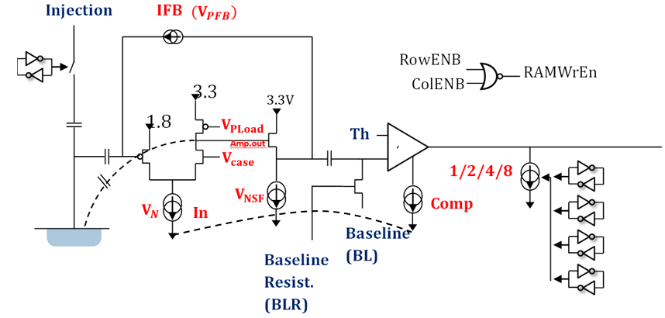
Pixel description

Slide 3
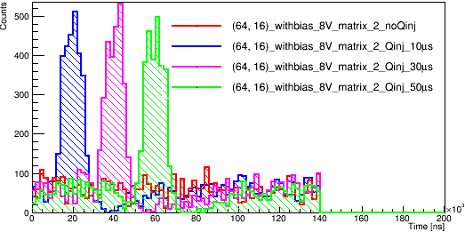
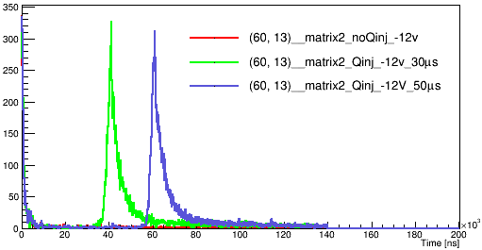
Outline
Review
Mechanical setup upgraded for testing with laser.
Tests with laser diode at 650nm (red) have been done -> large signal, “shadow hits” on the other 2 matrix
Tests
Check the data from the 3 matrix. (similar time information from 3 matrix)->new problem
Checking the board and try to get the results with Qinj
Some tests regard to different Laser intensity and peltier module power supply
Results using LED
(1500 events)
Results using laser (100 events)

Slide 4
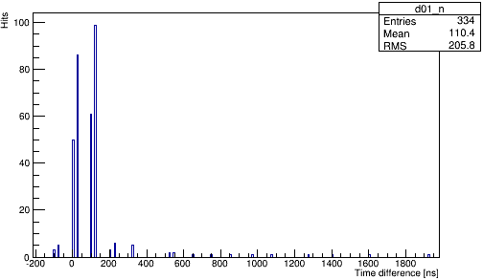
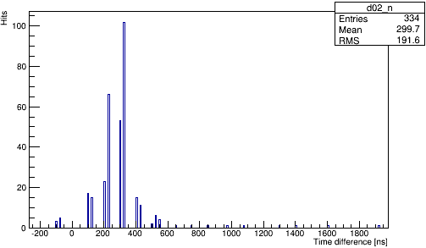
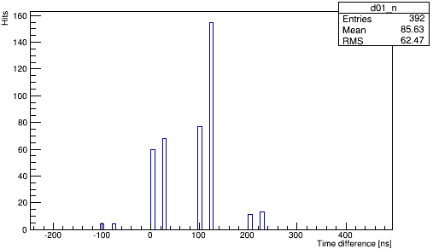
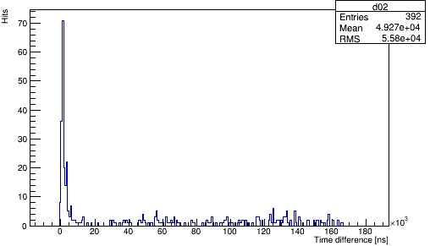
Checking the Data
Carrier board 28
Daughter board 19
(High resistance)
Time_matrix0 – time_matrix1
Time_matrix0 – time_matrix2
Only pointing the laser at Matrix 2.
Find the pixel targeted which is: (127,24)
BL=0.75V
Threshold: 0.9V
2000 events
The fraction of each kind of result & the different between time information from Matrix 0 and Matrix 1, Matrix 0 and Matrix2. (same event)
 | -1.0(no hits) | -2.0(from other pixel) | time
Matrix0 | 0 | 0.979125 | 0.020875
Matrix1 | 0 | 0.9785 | 0.0215
matrix2 | 0 | 0.9785 | 0.0215
 | -1.0 | -2.0 | time
Matrix0 | 0 | 0.9755 | 0.0245
Matrix1 | 0 | 0.975 | 0.025
matrix2 | 0 | 0.237 | 0.763
The time caused by noise have related time readout->cross talk?
Large amount of -2.0.(time 0 from pixel (0,0))
No -1.0 and time 0 will not prevent us from seeing the signal.
-> Check the board and step back to use Qinj.

Slide 5
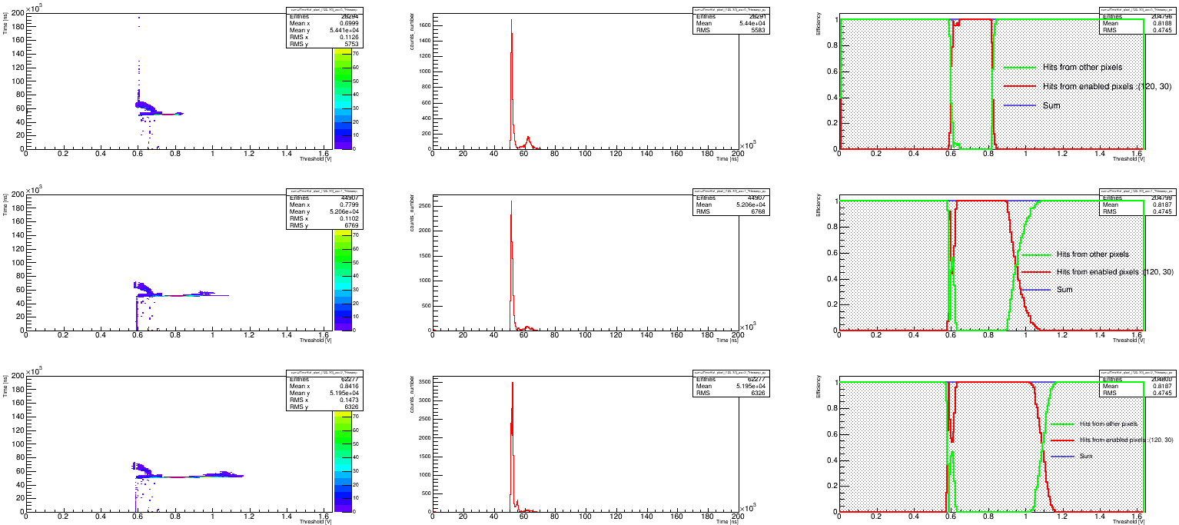
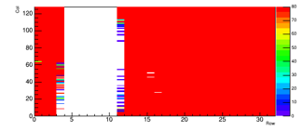
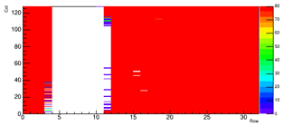
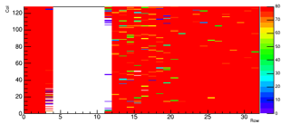
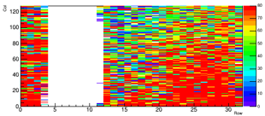
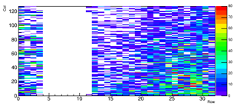
Tests using Qinj
Threshold sweeping tests:
No bias
the current will increase from 0.4mA to 1.02mA -> a resistance between the Qinj and the sensor forms the path of leakage current.
Pulse size: 1V (negative pulse, 50μs delay, 10 μs width)
BL:0.6V
On 3 pixels : (20,20),(120,30),(10,20)
The number of each kind of data and the sum of them.
Could get similar results
Hitmap using Qinj:
Threshold: 0.7V,0.8V,0.9V,1.0V,1.1V
Different hitmap with different Threshold
Similar results
Time 0: no hits.
This board still works.
Th=0.7V
Th=0.8V
Th=0.9V
Th=1.0V
Th=1.1V

Slide 6
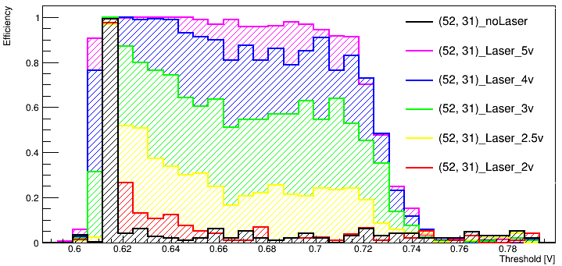
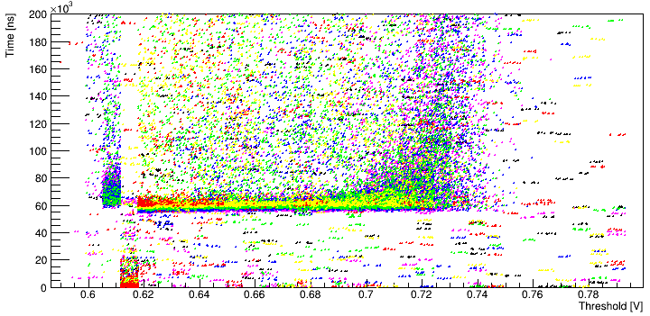
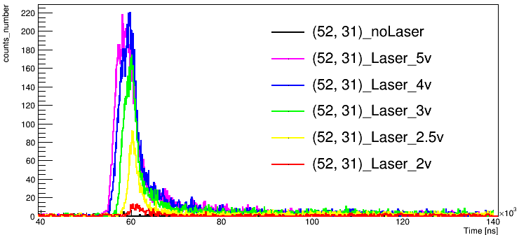
Tests with the Laser
Find the target pixel: (52,31)
Pointing Laser at Matrix2.
BL=0.6V.
Threshold sweeping
Different Voltage to trigger the Laser
2V 2.5V 3V 4V 5V
Different efficiency observed with different Pulse size.
Similar threshold response range (0.6V-0.73V)

Slide 7
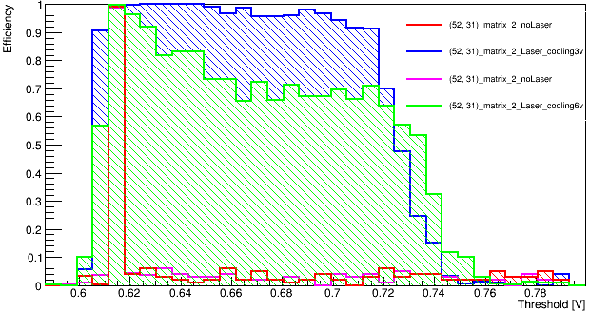
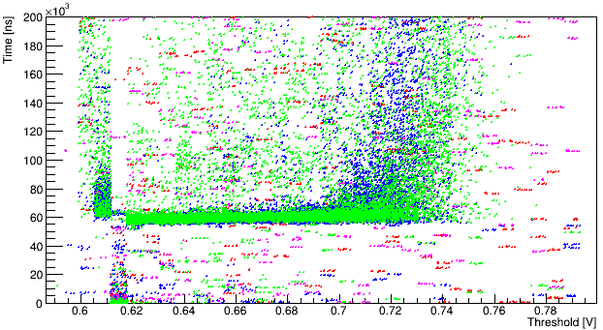
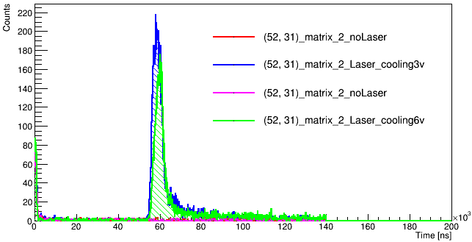
Tests with the Laser
On pixel (52,31)
BL=0.6V.
Threshold sweeping.
Different cooling condition.
Efficiency decreased
Big effect observed.

Slide 8
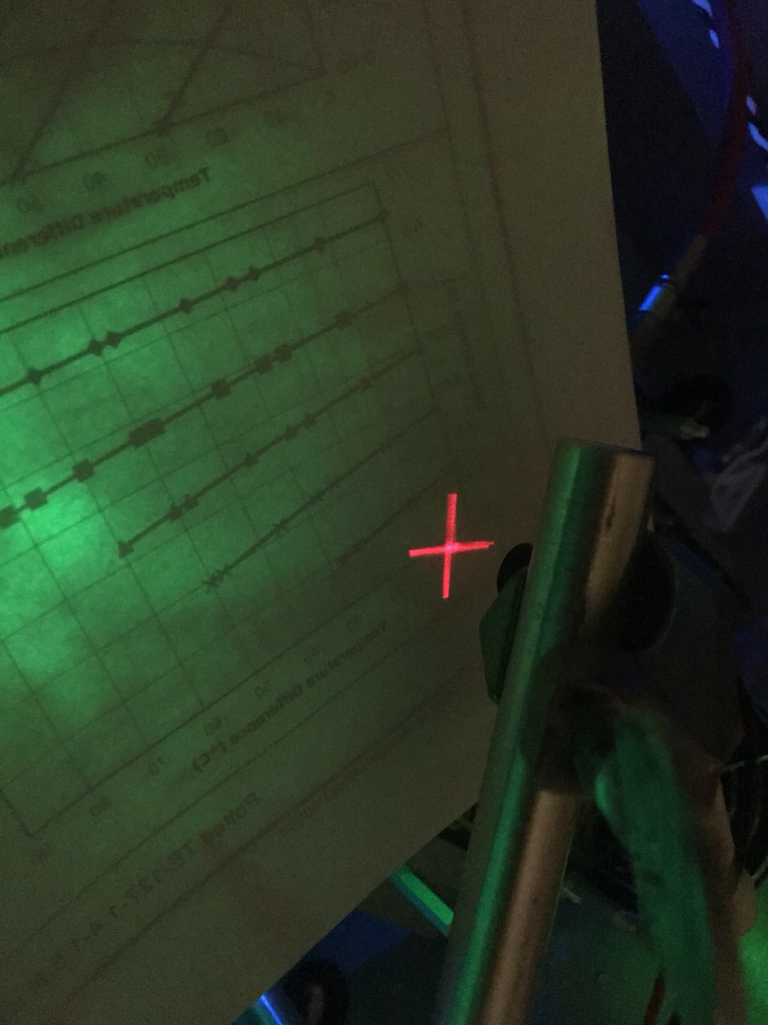
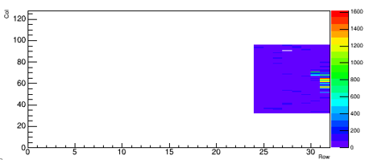
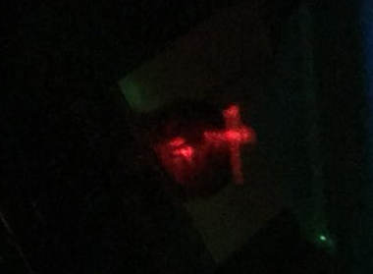
Tests with the Laser
Crossing Laser
The size of the crossing structure depending on the distance.
Could not focus manually.
Bigger than the matrix size.
Still unclear about seeing the crossing structure.
Change to use a point Laser. Enable to focus manually.
Matrix 2
Hitmap of Matrix2 (tests on the pixels around the target pixel)

Slide 9
Summary and Next
Summary
The High resistance board still works.
Lost efficiency using Lower Laser intensity.
Temperature effect the efficiency a lot.(why that big)
Still didn’t find the crossing structure.
Next
Implement stream readout to speed up the test.
Implement temperature sensor on the peltier’s cold side to better control the temperature.
Real time event display.(location and time)
Tests with the point laser.

