Slide 1
Photon Run Coordinator
Photon system activities
FEL delivery parameters see Summary by accelerator RCs
Mon: preparation/experiment set-up for user experiments (SPB day, FXE night),
commissioning of hard X-ray monochromator in FXE branch Tue: Morning: reboot of several PLC loops
Afternoon: HIREX calibration with FEL beam (SA1) Wed: SA1: HIREX calibration, FXE experiment set-up

Slide 2
Photon Run Coordinator
Photon system activities
SA3: parasitic measurements with GATT, XGM, and several imagers Thu till Tue morning (3.April): successful SA1 User operation at FXE (day) and SPB (night)
no parasitic measurements possible in SA3 (undulator open) Tue (3.April): "300 bunches test", up to 500 bunches per train in the photon system and up to 300 bunches per train in the FXE experiment hutch, ~1mJ per each pulse, 4.5 MHz. Material tests - drilling into Cu,...
From Wednesday 4.4.2018: shutdown period with open tunnels, no operation

Slide 3
Photon Run Coordinator
Problems
Mon/Tue night 4h30: Beam stopped by EPS interlock from FXE tunnel vacuum (known issue, reoccuring)
Mon-Wed: Beam pointing stability issues reported by SPB+FXE, investigated over several days by accelerator and coordinator team. Stability improved for the user run (example: SPB elog entries #48 of 30.3. and #57 of 2.4.)
Wed: EPS interlock logic error: SPB tunnel valve did not trip beam even though closed and SPB/SFX
shutter open.
Fri: Beam permission lost at 9:45h due to broken interlock at the FXE hutch (interference between laser interlock and radiation safety interlock)
Sun: Beam permission lost at 6:25h due to broken interlock in beamline 9.2 (SPB). Machine took
6 hours to recover. Parasitic work in SASE3 not possible due to losses in BLM.3098.T10
(undulator had to be reopened after a short test, if parasitic operation is possible)

Slide 4
SPB/SFX
The 2012 users measured a bunch of stuff, a structure has already been determined during beamtime, movies of the liquid jets exploding have been made, and (new) paper drafts are already circulating in the collaboration
Observed alarm from smoke sensors in the SPB control room on 5.4.2018 at ~11:00 . Safety is investigating what was the reason.
The next two mirrors, to complete the installation of the micron-scale set, go in from next week. No access to the optics hutch.

Slide 5
FXE

Slide 6
Laser
SASE 1:
Front-End failure:
  on Mo. 19th March we had an internal failure in the Front-End amplifier
Several subsequent damages to FE done
We could repair all but one, which requires a factory service.
Status:
  Front-End was exchanged and will be sent to factory.
  PP-laser realignment is in progress.
  Aim: back up in operation at start of May.

Slide 7
CAS

Slide 8
Detectors
no feedback concerning tasks planned by other groups affecting or related to LPD (except for CAS)
2 LPD supermodules under investigation in detector lab

Slide 9
Advanced Electronics

Slide 10
ITDM
Broken Infiniband connection on one GPFS server - need to be investigated
one draw of disks (11 disks) in GPFS server not visible. Technician from IBM expected on Friday.
Cooling problem on 04/04/2018 at around 6am. Fixed by MKK but not communicated to us. Lost two power supplies.
One router in the Control Network was showing some errors on Tuesday, due to redundancy it was not affecting network performance, now fixed by replacing some transceivers.
additional servers (2 per sase) were added (sa1 and sa3 since more than a week, sa2 today will be installed)
the increasing number of requests for servers for cameras needs to be tackled

Slide 11
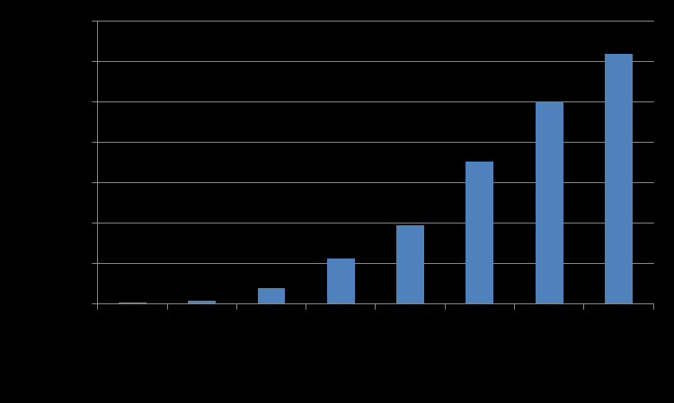
ITDM
- User operation last week. See the attached plot for the recorded data statistics over the user week. Data collection using all types of data 2D detectors, pipeline data slow data including detectors.

Slide 12
ITDM - Observations/possible improvements:
Stability of the DAQ system much better than in the last user operations.
sample names require further protection
How to deal with runs which were forgotten to be stopped (few thousand of files generated)
Few times configuration was changed for slow cameras and not propagated to DAQ (I think this requires more information and training)
Monitoring of data sources with respect to trainIds is crucial for DAQ and require further improvement by CAS

