Slide 1
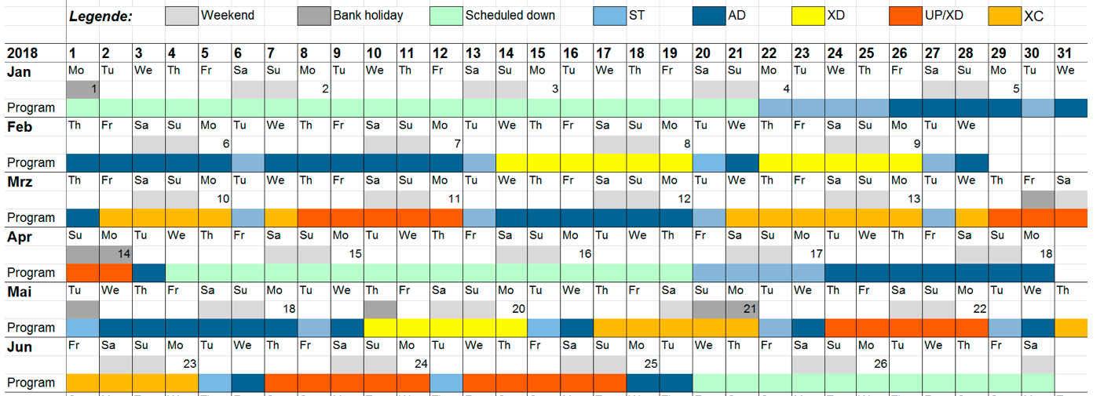

Karabo 2.2.3 Rollout (Status Update)
Brockhauser, Sandor
CAS, Group Leader
Schenefeld, 06/04/2018

Slide 2
Users are expected by the 24th of May
HOW DO WE PROVIDE STABLE CONTROL CONDITIONS?

Slide 3
Where we are in the Karabo 2.2.3 rollout…

Slide 4
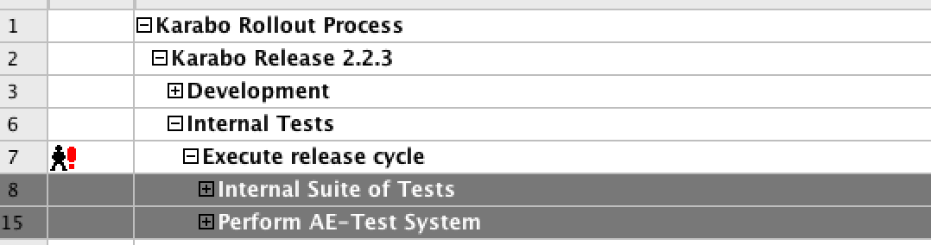
Done!
Karabo 2.2.3 tested against AE Test System with PLC:
  Old: 1.26.3 (most of the systems)
  New: 1.27.8 (SASE2 MOV1 and VAC, SASE3 XGM and SASE3 SCS)

Slide 5
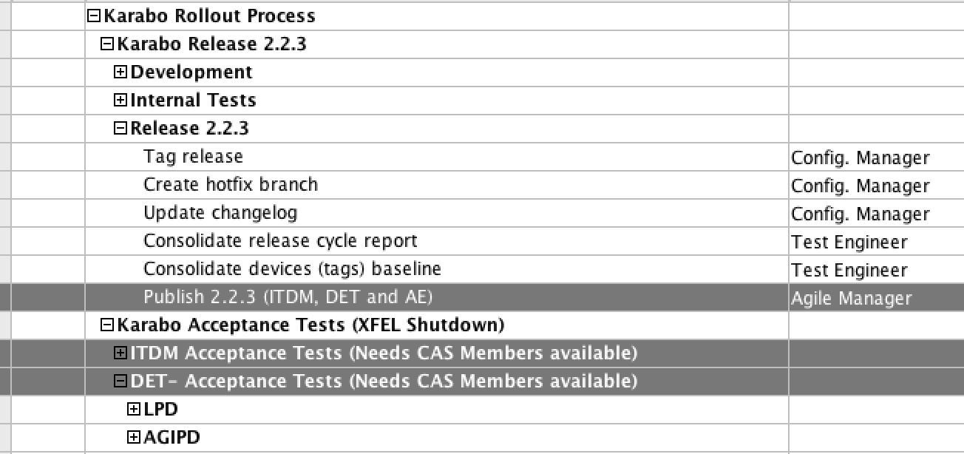
Done!
Karabo 2.2.3 published for DET and ITDM Acceptance Tests

Slide 6
Next steps…

Slide 7
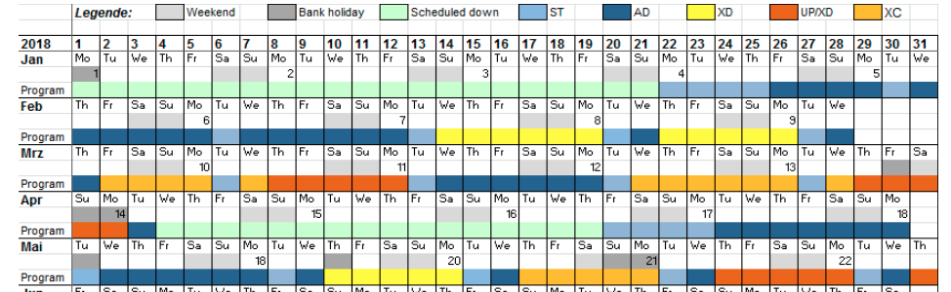
Tunnel Closure (?)

Slide 8
QUESTIONS FROM PSPO:
When (and maybe how long) will the test of ITDM / DAQ be? (ITDM’s)
When (and maybe how long) will the test with the detectors be? (DET)
When do the instruments have to decide whether they want to still deploy? (SPB: 07/05, FXE: ?)
Can we still deploy in the tunnel before the tunnel closes? (Depends of CAS-ITDM and CAS-DET tests)
When would the deployment and the tests at the beamline then take, including the detectors?
  Still depends of 1, 2 and 4. However, should happen during the ST and AD phases.
  Indeed, CAS, ITDM and DET need time to setup things properly!

