Slide 1
DAQ software testing strategy
Krzysztof Wrona
ITDM
Schenefeld, 13.04.2017

Slide 2
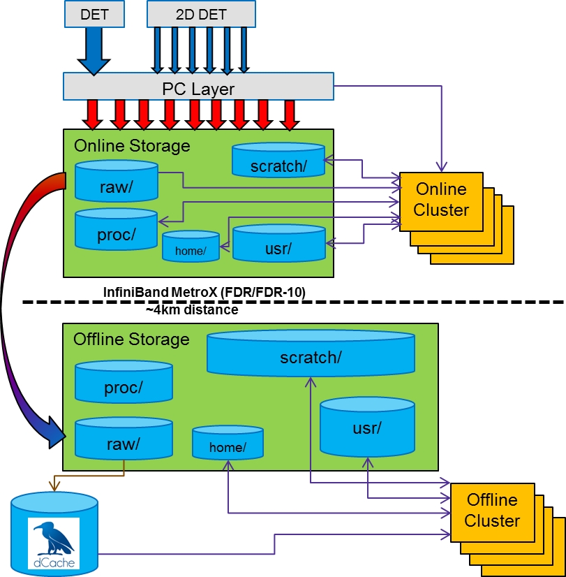
DAQ architecture
PC Layer
  Data aggregation from multiple sources
  Pixel reordering for 2D detectors
  Optionally data reduction
  Writing data to HDF5 files on the online storage
Online cluster
  CPU and GPU nodes
  Online data analysis (fast feedback)
  Calibration and data correction
Long-Haul Infiniband Metro-X
  Supports 6 long haul ports (FDR-10 40Gb/s)
  Scalable by multiple switches
Transfer online to offline storage
  Custom scripts with policy runs
  GPFS AFM
Offline storage
  Shared across experiment stations
  Data migrated to offline storage after quality checks
  Copy data to dCache, ACLs
  Raw data access only from dCache
  Calibrated data stored on GPFS
  User analysis based on calibrated data

Slide 3
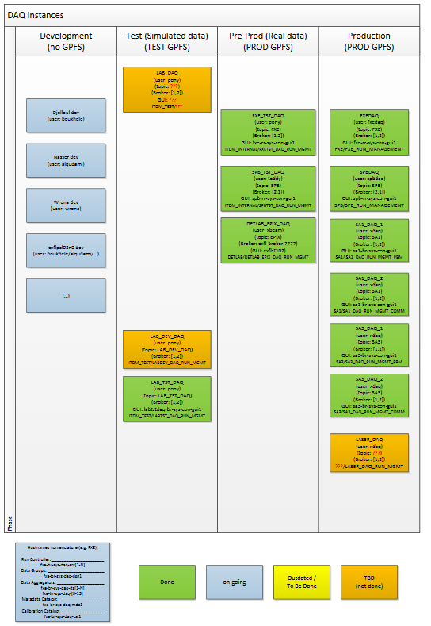
Software running on PC layer
DAQ software uses Karabo framework
DAQ instance consists of a set of Karabo devices running in the Karabo environment (e.g. requires gui server, timeserver)
  Run Control, Data Manager – orchestration
  MDCRemote – interface to the metadata catalogue
  DataConfigurationGroups, Configurator devices – configuration
  Data Aggregators – receive data and write to files on disk storage
  Auxiliary tools – macros, validators
DAQ software consists of ~26000 lines of code
DAQ software runs on multiple servers
  Currently the biggest installation uses 20 servers
DAQ software is optimized for high data rates transfers
  With current detectors the typical rates are up to 4 GB/s
  Slow data with 5k parameters per data aggregator updated with 10Hz

Slide 4
Testing DAQ software
DAQ software version
  pcLayer 1.5.13 - 2.2.3
Testing the existing DAQ software against new Karabo release
Testing the new DAQ software release against existing Karabo version
DAQ version
Karabo version

Slide 5
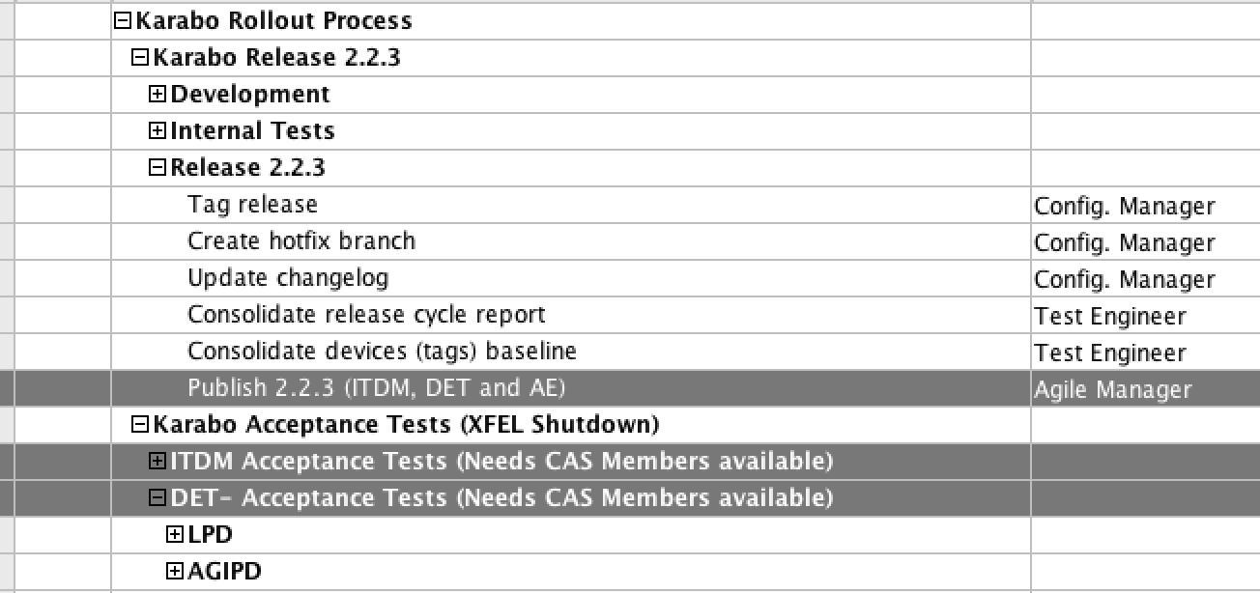
ITDM Acceptance tests (from CAS presentation last week)
This means: Testing the existing DAQ software against new Karabo release
Next steps…

Slide 6
DAQ testing strategy
Release Candidate
Release
Instruments/
parasitic/full deployment procedure
Instruments/
production
system
Dev. workstation
Test Stand
adding regression tests

Slide 7
DAQ testing strategy - catch issues as soon as possible
Developer environment
  Easy to check basic functionality
Test stand
  Using hardware as close as possible to the production
  Isolated Karabo environment and simulated data sources
Pre-production
  Requires working Karabo version in production environment i.e. deployed at instrument/tunnel
  Dedicated DAQ setup in the production environment allows us to use real data sources but without touching production DAQ instance
  This is how we can test AGIPD and LPD or simple devices in tunnel e.g. XGM, Bassler camera
  Here we can test also data source configurations
Production environment (without and with the beam)
  Last step before we switch to new version of DAQ or Karabo
  Minimizing the downtime of the production DAQ

Slide 8
Current test activities
Testing DAQ against Karabo 2.2.3
  Completed developer and test stand phases
  No major issue found so far
  Next phase - pre-production environment
    Next week after Karabo upgrade in the tunnels
Testing new DAQ version with 2.2.3
  So far only 2 bug fixes as detected during the last user operation period
  Few small improvements on the way
Test report for Karabo 2.2.3:
1) Shutdown a device from a GUI or Macro has problem when connection from OLD GUI 2.2.2
while the guiServer is 2.2.3. Not always but I have seen some devices could not be shutdown
and enter in endless waiting.
2) Buttons allowed states visibilities are varied between scene and configuration Editor (handled by Denis).
3) Renaming the device name on the project will clear the old configuration.
4) Instantiating the devices a bit slower than before, not much but I can notice in sometime.

