Slide 1
Tests on Chess 2 ASIC
Dionisio Doering, Yubo Han_{IHEP} , Pietro Caragiulo, Larry Ruckman, Camillo Tamma, Su Dong

Slide 2
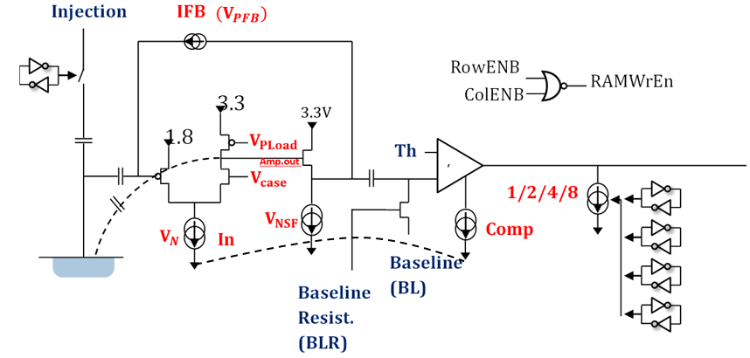
Pixel description

Slide 3
Outline
Testing with a new laser:
->rectangle Laser.
->could be focused manually.
New issues and results:
Board #19 (high resistivity): new issue.
Tests using Laser on Board #02 (std resistivity).
Some updates on the software.

Slide 4
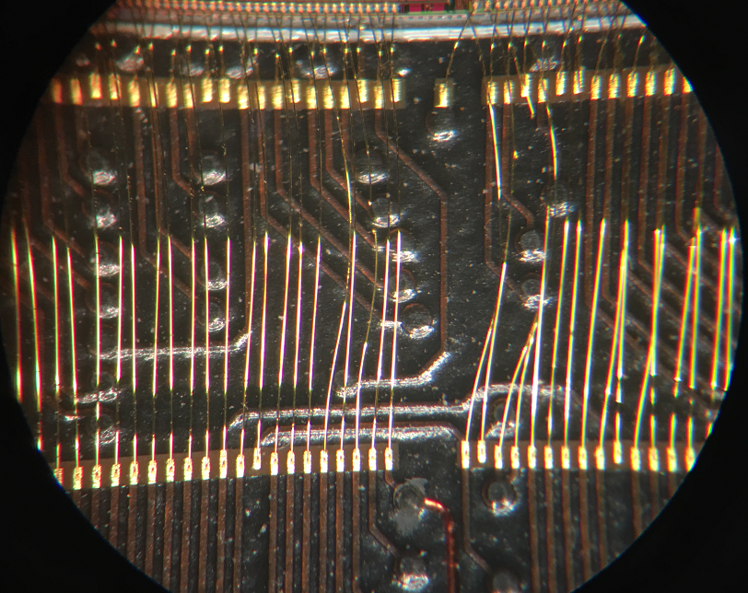
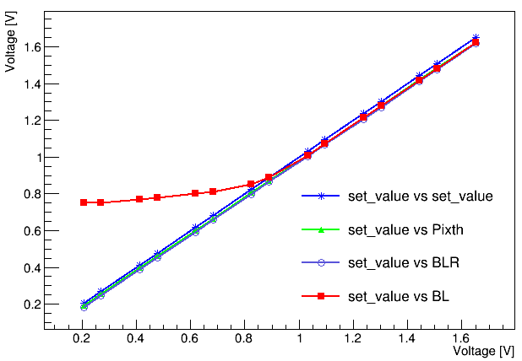
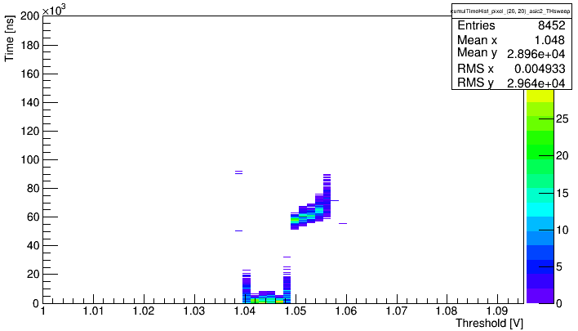
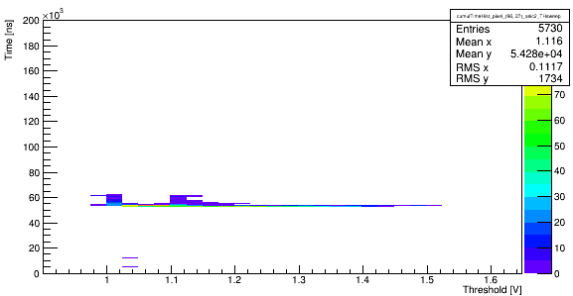
New issues on Board #19
Board #19 (high resistivity) was the board giving all the results we used to have.
Works fine till last week.
Problems came out:
-> cannot control BL lower than 0.8V
-> broken wires observed ( vdda! on Matrix 1)
-> no response from Matrix 1
-> only noise report from part of Matrix 0
-> Matrix 2 response correct time and position information but acting different than before.
Caused by the broken wires? Or damaged asic?
Measured value vs setted value
Results of one pixel from Matrix 2 using Qinj
Results of one pixel from Matrix 2 using Laser

Slide 5
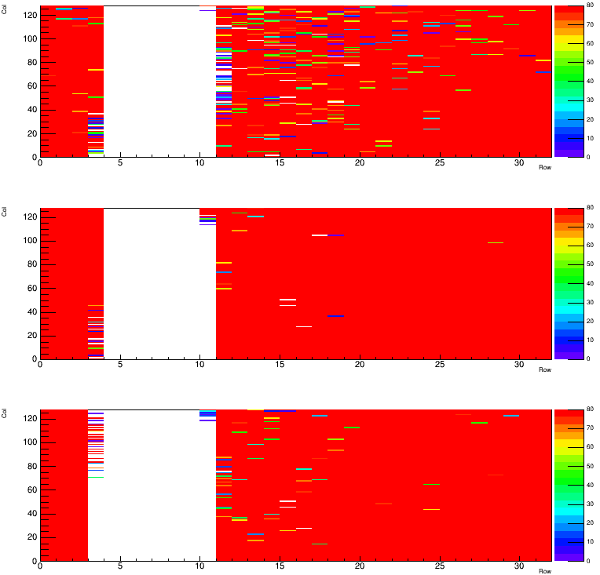
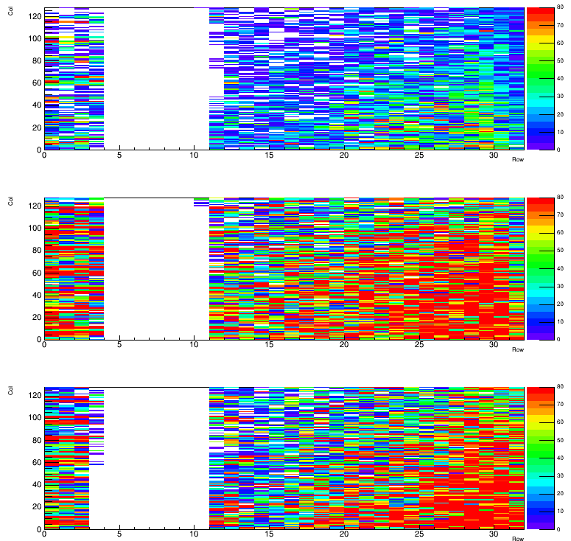
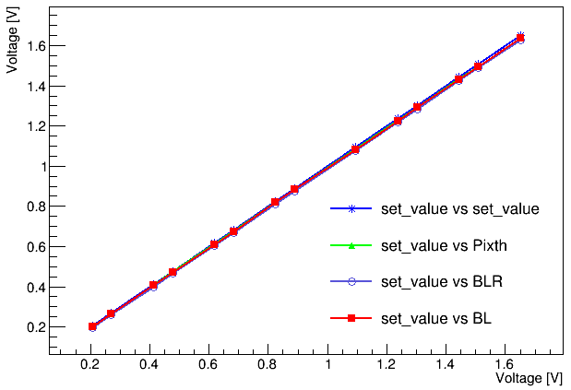
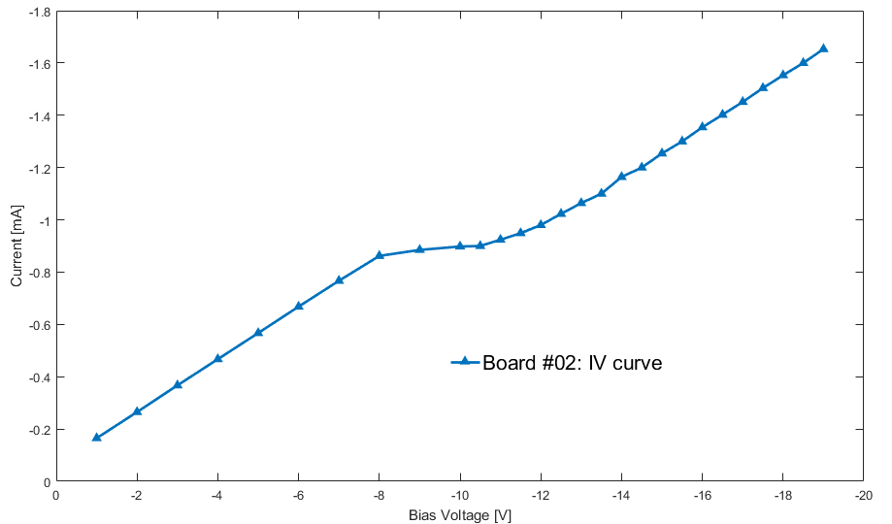
Test results on Board #2
Board #2 : std resistivity
Only used to do the test with Qinj
Before testing:
—Wire bond: didn’t see any obvious broken wire.
—Threshold, BL, BLR could be controlled.
—hitmap using Qinj: constant with the results we used to have.
—IV curve: a small plateau.
Hitmap: BL:0.6V Th: 0.9V
Hitmap: BL:0.6V Th: 1.1V
Measured value vs setted value
IV curve of Board #02

Slide 6
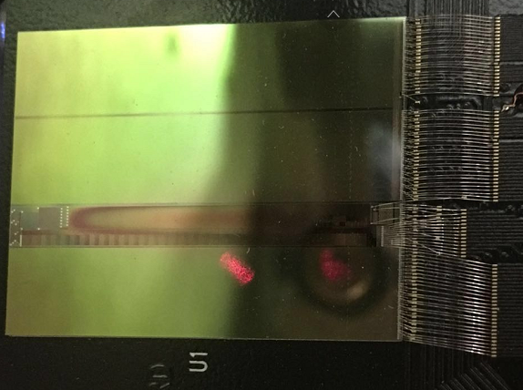
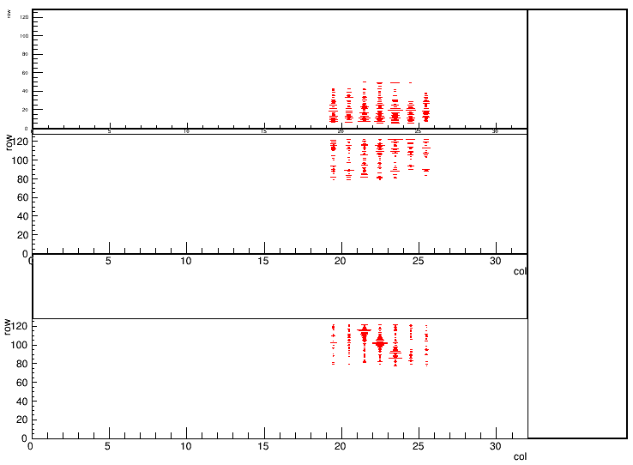
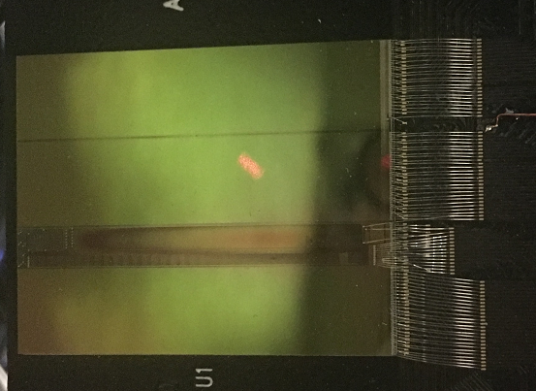
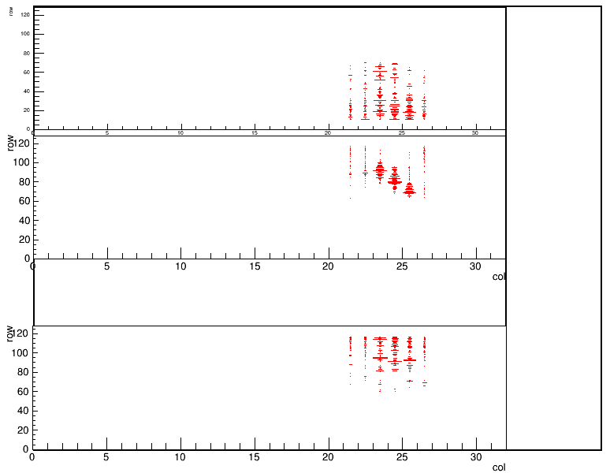
Test results on Board #2
Tests with Laser:
Using a rectangle laser (could be focused manually)
No bias voltage.
Laser delay: 50μs.
BL=0.6V
Threshold sweeping from 0.6-1V (step:0.2V)
Moving Laser to pointing at different Matrix.
From top matrix to bottom: Matrix 0,1,2
Only enable small region of pixels of each matrix.
To prevent the pixels in one row from blocking each other.
-> enable and read from the pixels row by row and combine those results.
(after tests which enabling a large region of the matrix to roughly locate the laser)
The laser’s location could be seen by the sensor.
Could see the shape of the laser.
Also see small peak from the time distribution results of the matrix without Laser-> scattering or cross talk?

Slide 7
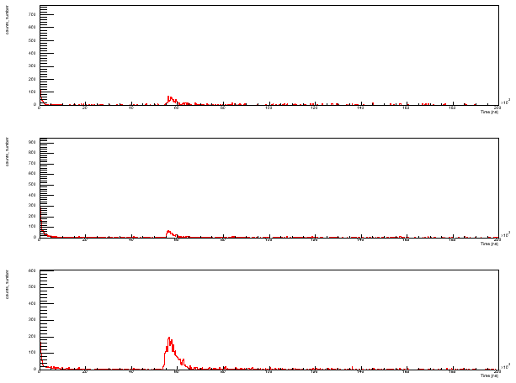
Test results on Board #2
Tests with Laser:
Using a rectangle laser (could be focused manually)
No bias voltage.
Laser delay: 50μs.
BL=0.6V
Threshold sweeping from 0.6-1V (step:0.2V)
Moving Laser to pointing at different Matrix.
From top matrix to bottom: Matrix 0,1,2
Only enable small region of pixels of each matrix.
To prevent the pixels in one row from blocking each other.
-> enable and read from the pixels row by row and combine those results.
(after tests which enabling a large region of the matrix to roughly locate the laser)
The laser’s location could be seen by the sensor.
Could see the shape of the laser.
Also see small peak from the time distribution results of the matrix without Laser-> scattering or cross talk?

Slide 8
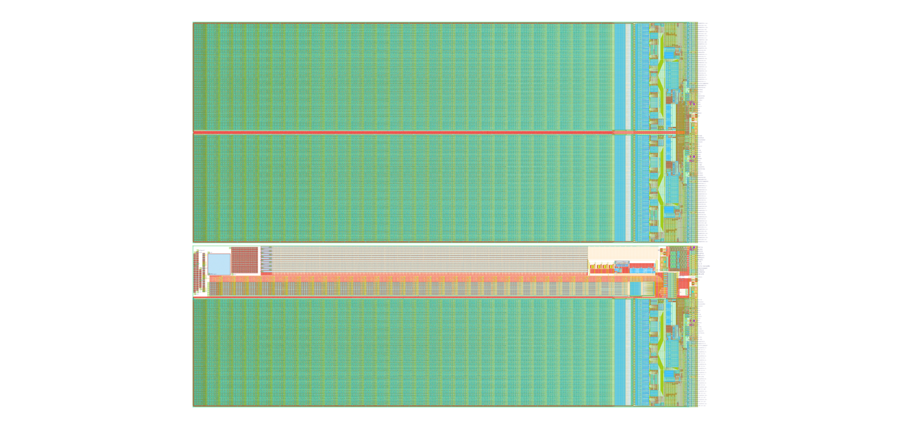
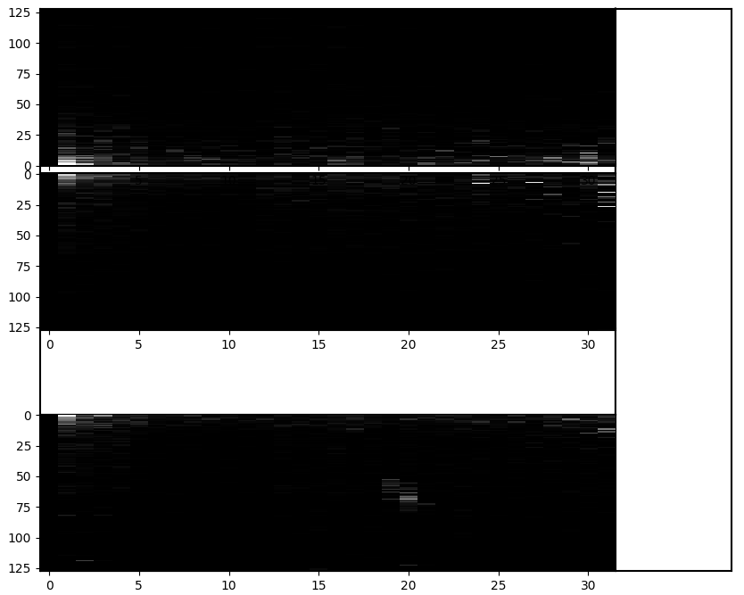
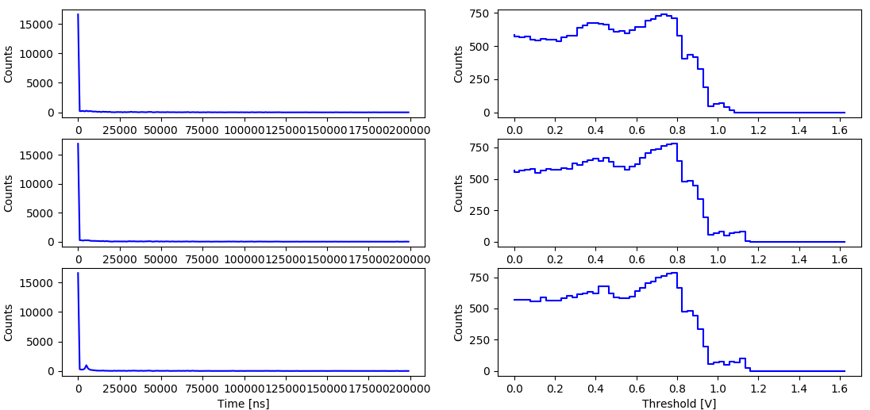
Updates of the software
Implement real time and similar size hitmap display into the scripts.
The time distribution and hit number vs Threshold will be shown and updated as well.
offline plotting scripts were also updated.

Slide 9
Summary and Next
The board #19 acting differently than before
->BL out of control.
->Broken wire and no response from Matrix 1.
->Matrix 2 responses but in a confused way.
Board #02 works fine till now.
-> response the time and location of the Laser but have a lot of noise.
Board #01: at least 6 broken wires observed.
->should we fix the wires on board #01 and board #19 and give them a try?
Next:
Look into the cross talk issue on Board #02.
Stream readout to speed up the tests.
Implement temperature sensor on the peltier’s cold side to better control the temperature.

