Slide 1
Tests on Chess 2 ASIC
Dionisio Doering, Yubo Han_{IHEP} , Pietro Caragiulo, Larry Ruckman, Camillo Tamma, Su Dong

Slide 2
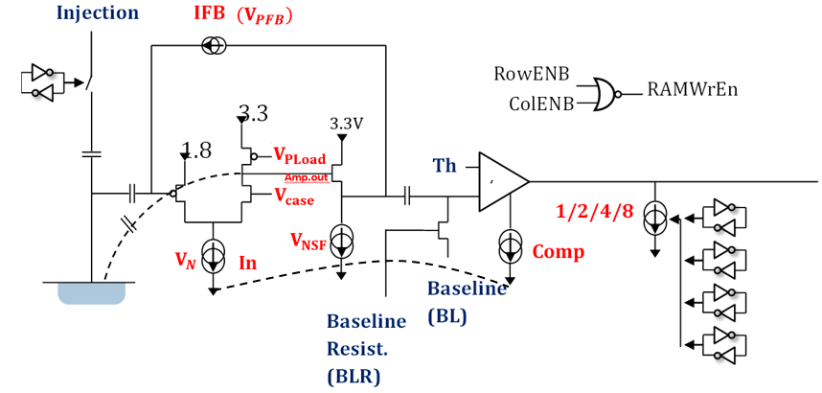
Pixel description

Slide 3
Outline
Review:
Tests with new Laser
New issues on Board #19
First time looking at board #02 using Laser
Tests:
Proper Threshold value + more statistic -> cross talk or not?
Stream readout
Status about stream readout.

Slide 4
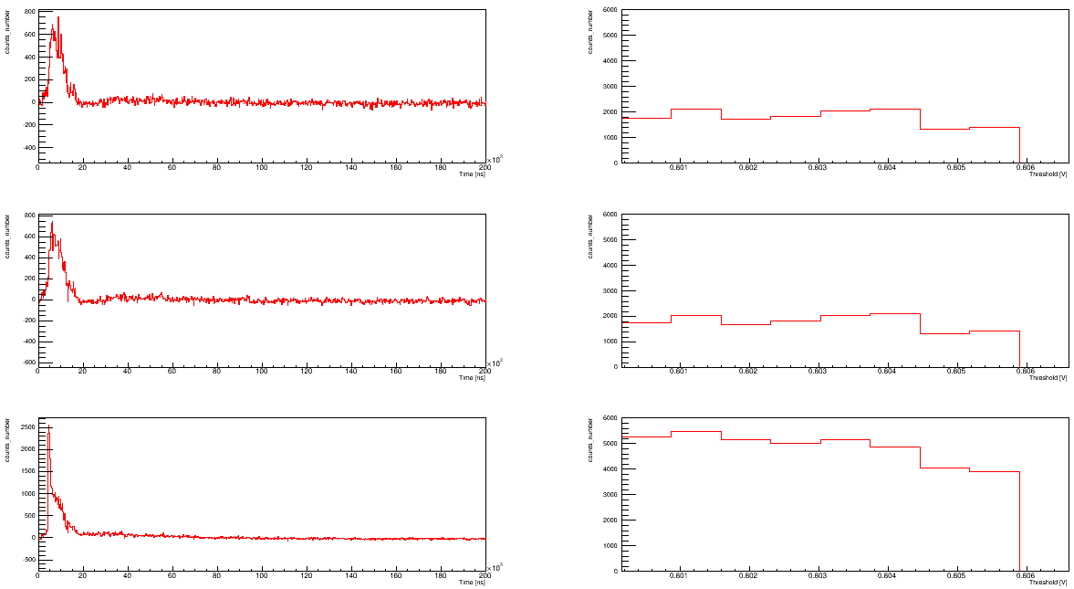
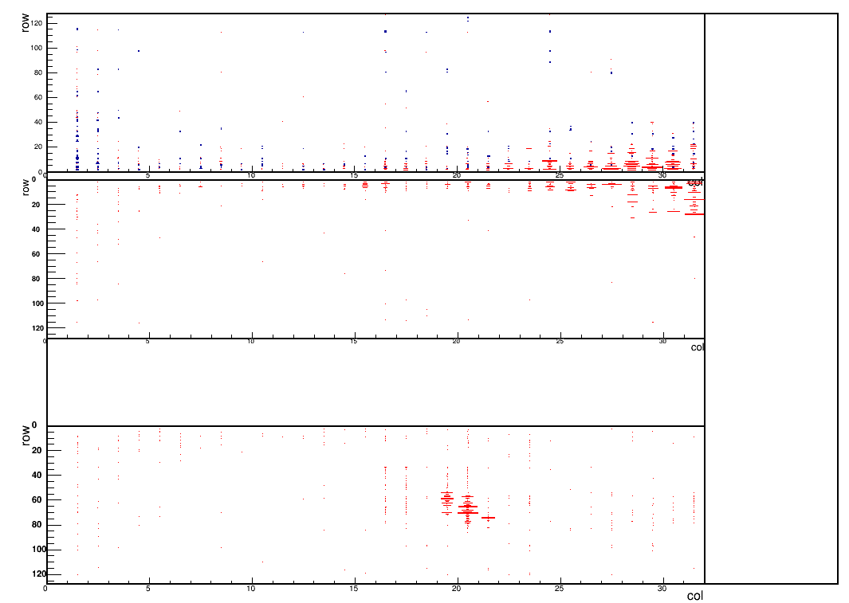
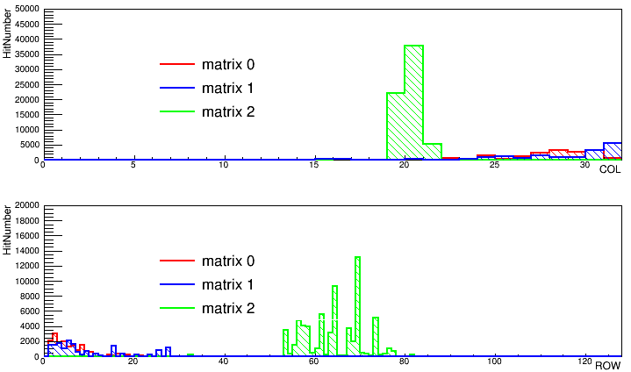
Tests
Board #02
Laser pointing at Matrix 2.
Delay: 500ns (less noise)
With Laser – without Laser. (no time cut)
Scan several Threshold to find the proper testing point: 0.802V
1000 event every Threshold.
The very fast noise (time <1000ns) disappear after subtracting.

Slide 5
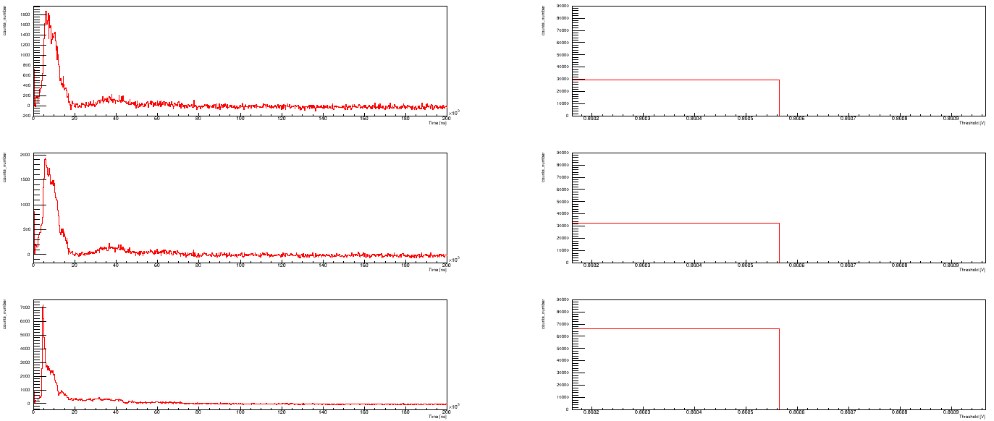
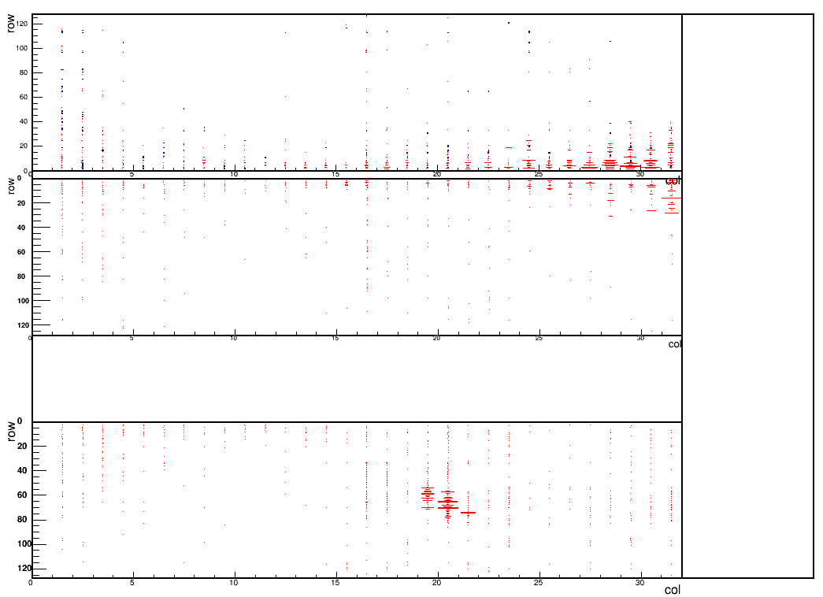
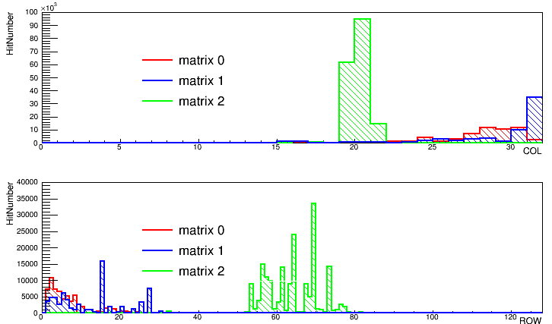
Tests
Board #02
Laser pointing at Matrix 2.
Delay: 500ns (less noise)
With Laser – without Laser. (no time cut)
Only run at Threshold : 0.802V
Similar results: Matrix 2 has high hit number at targeted area.

Slide 6
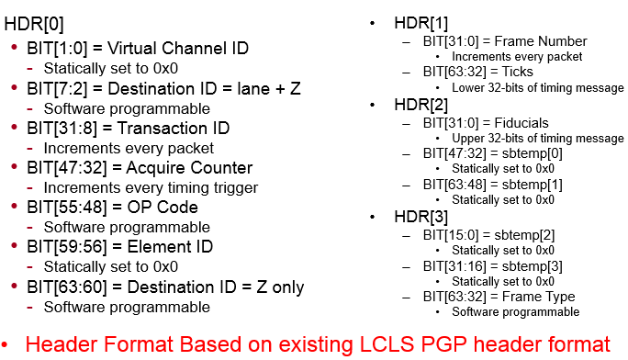
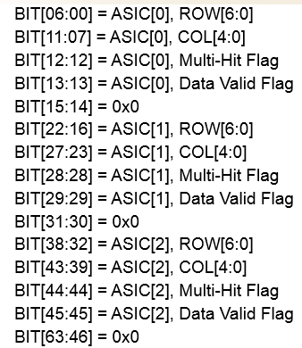
Stream readout
Could get data using stream readout by GUI.
Could get the decode the data part of the stream readout data file.
Working on getting the data via scripts and data viewer.
Frame Header: 4x64bit
Data: 4 x 16bit (many data)

Slide 7
Summary
No cross talk about signal on 3 matrix.
Start investigating stream readout.
Next:
Decide how to deal with the header data.
Data viewer and getting the results using script.

