Slide 1
SASE3

Slide 2
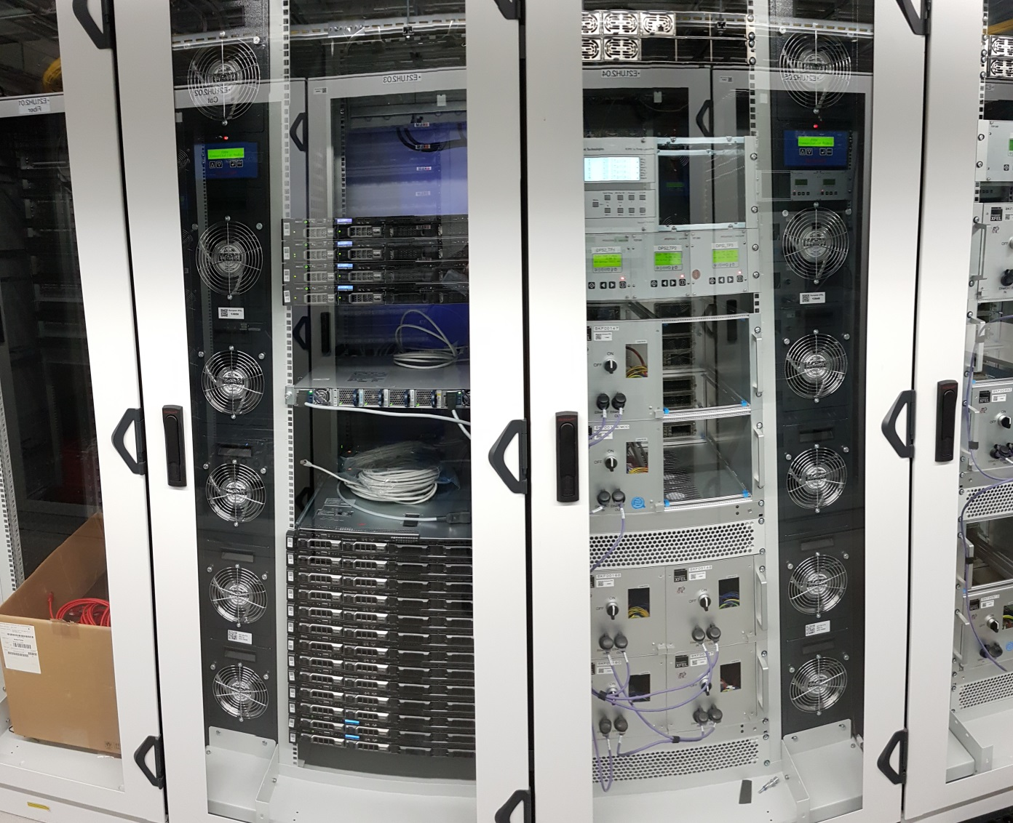
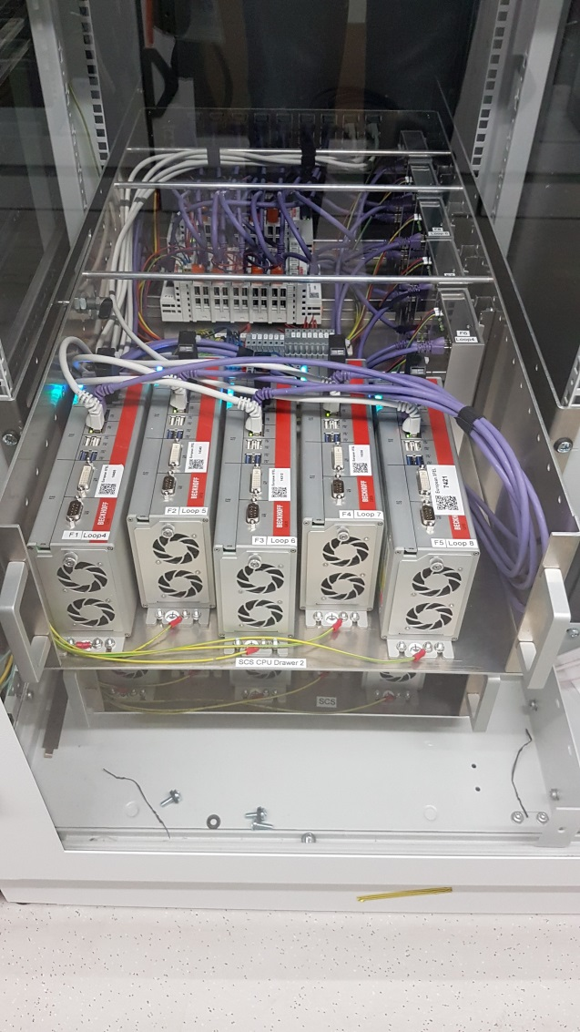
25.04.: SCS: IT & 1st loop running

Slide 3
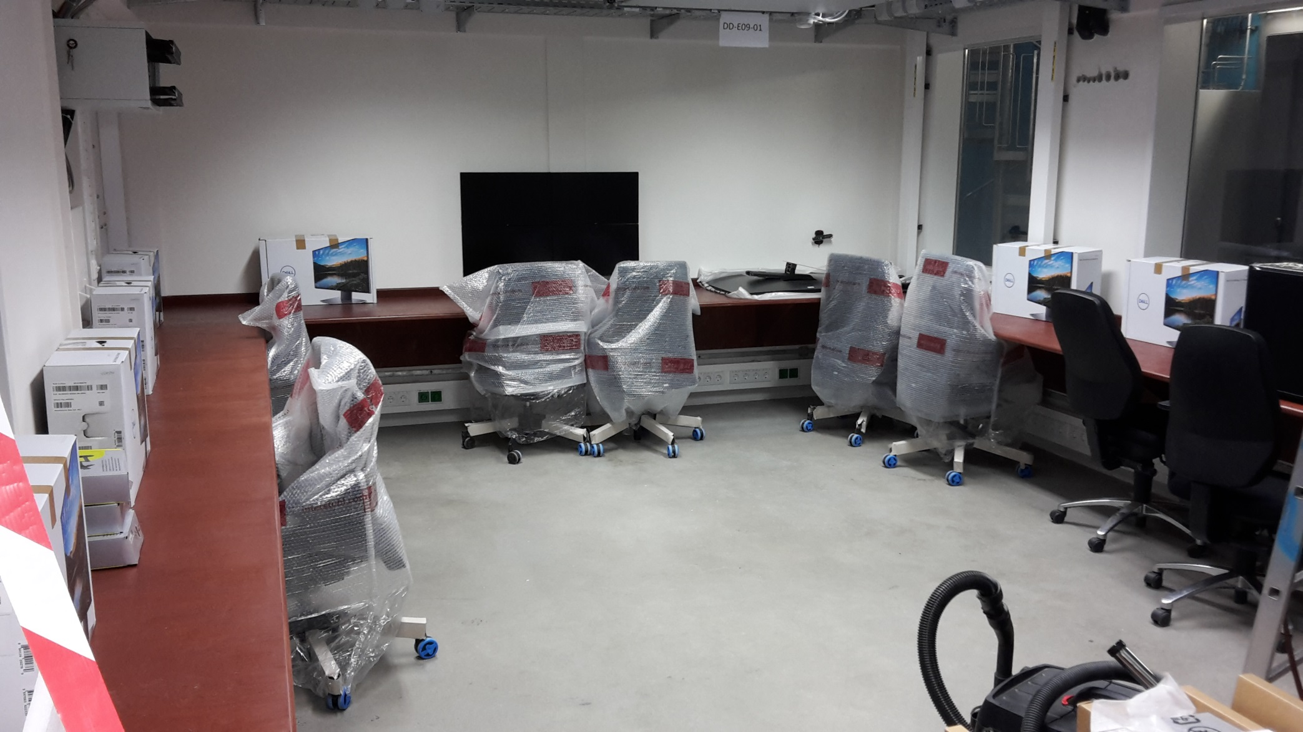
17.04.: SQS Control room being equipped

Slide 4
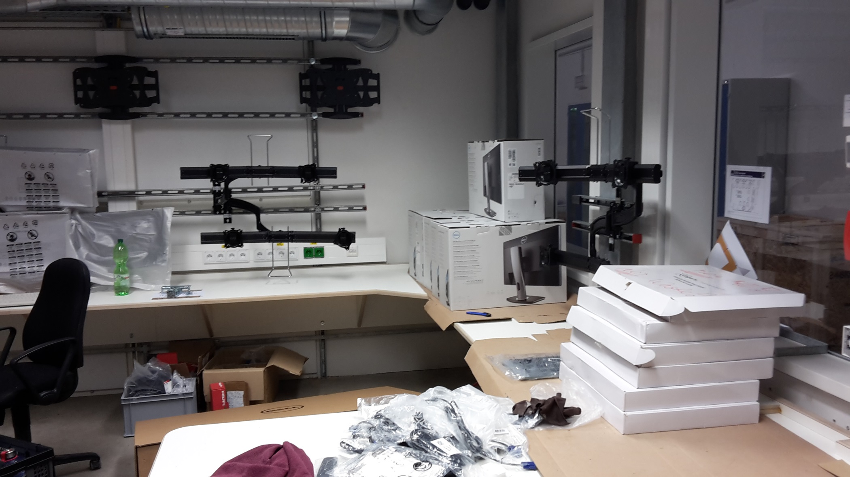
17.04.: SCS Control room being equipped

Slide 5
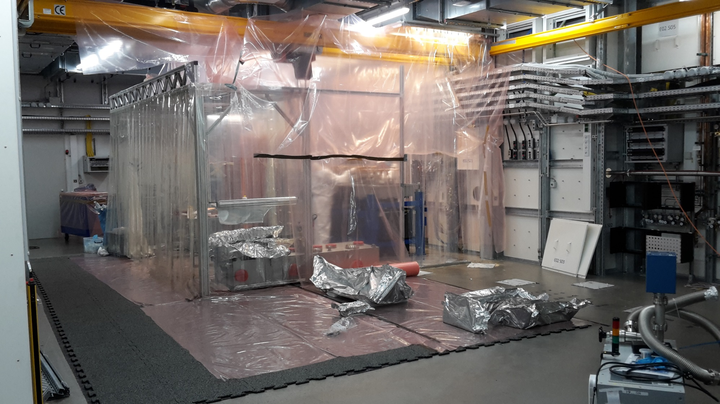
17.04.: SCS KB mirrors tank being installed

Slide 6
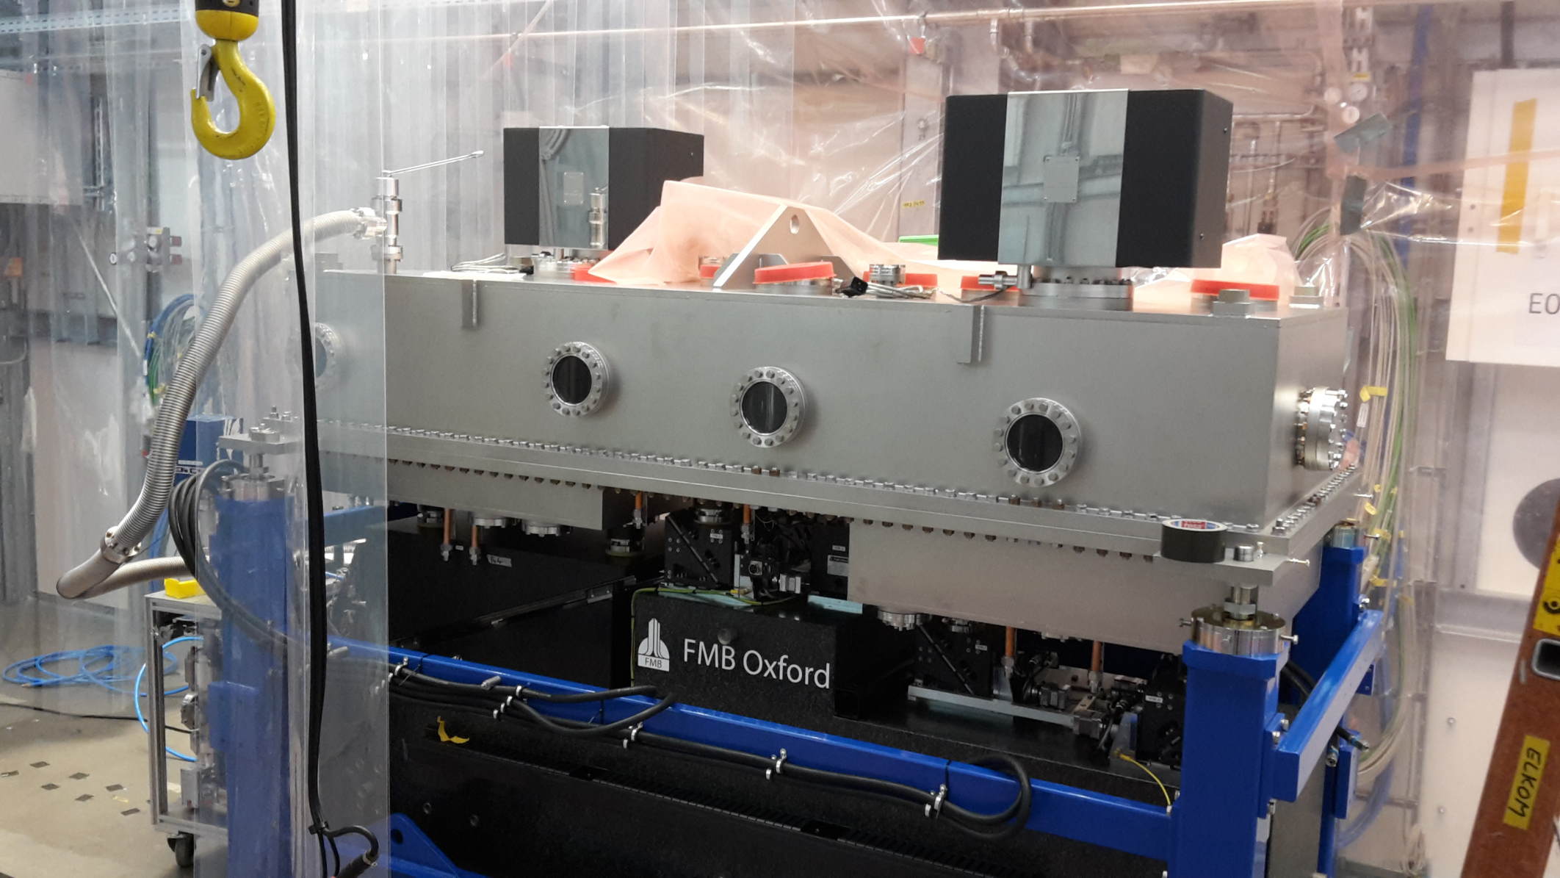
25.04.: SCS tank closed, installation finished.

Slide 7
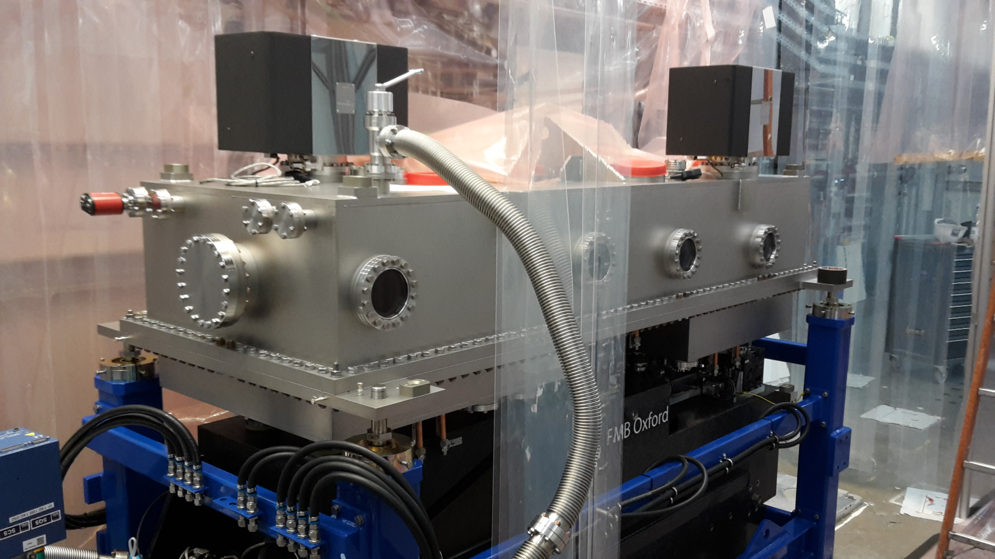
25.04.: SCS tank closed, installation finished.

Slide 8
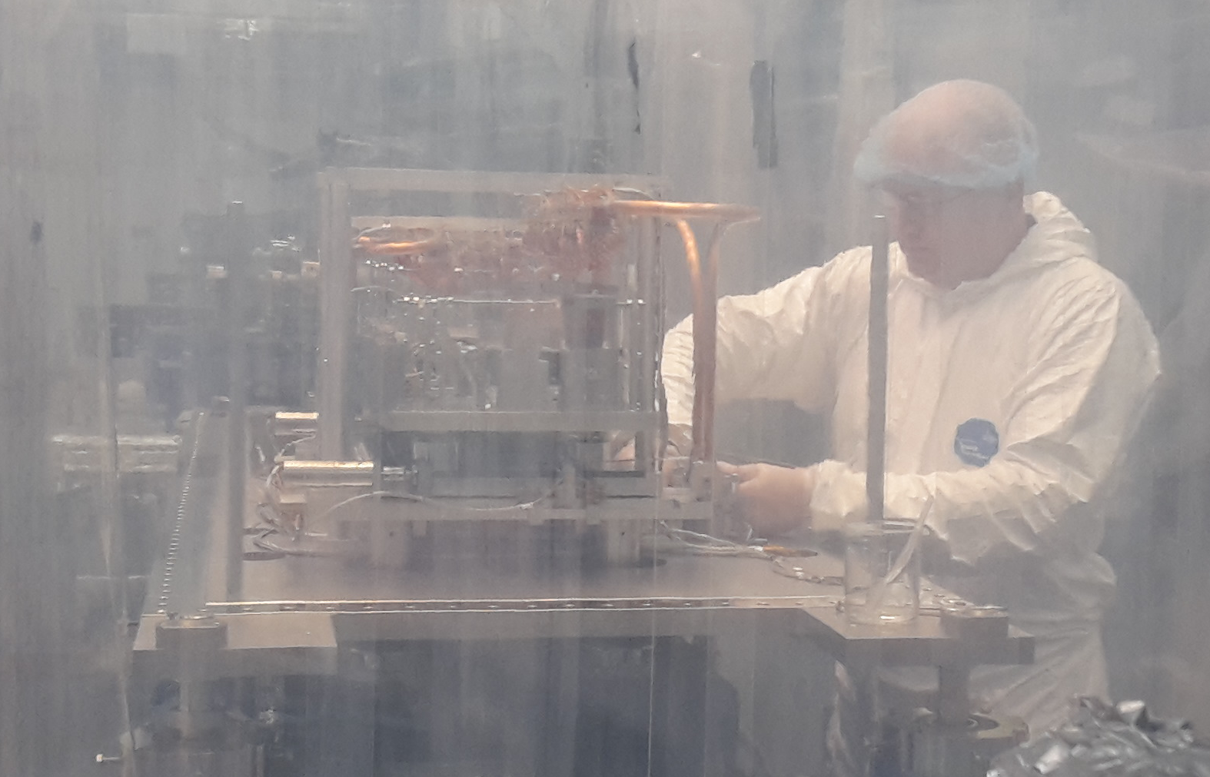
25.04.: SQS mirror tank being installed

Slide 9
SASE2

Slide 10
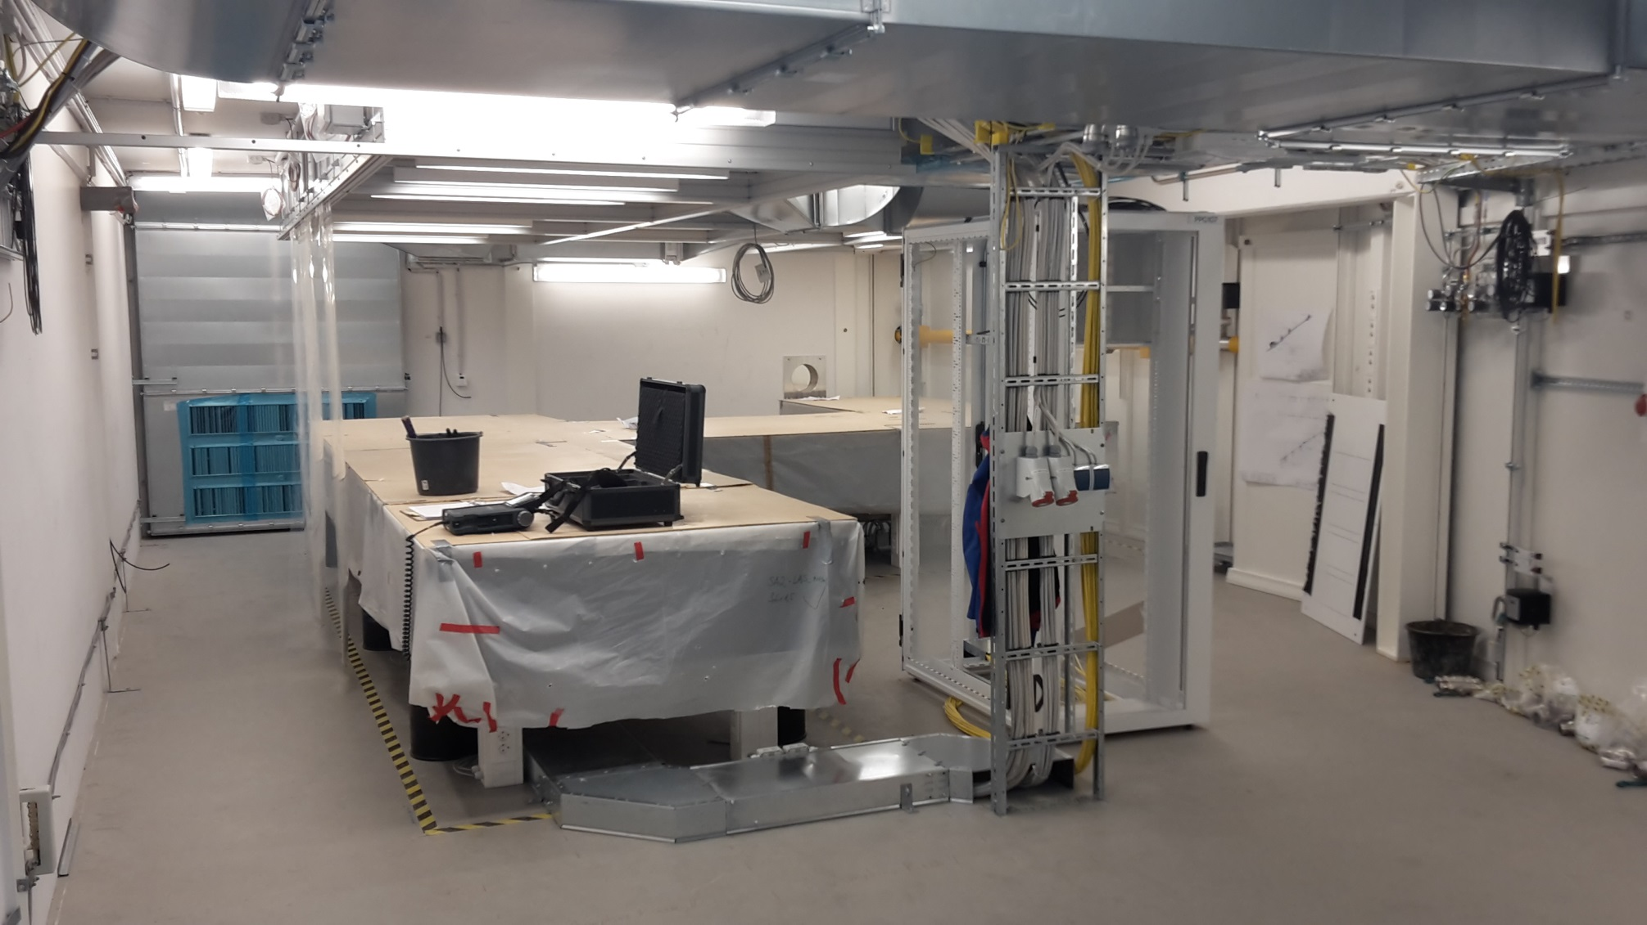
17.4.: PP Laser tables installed

Slide 11
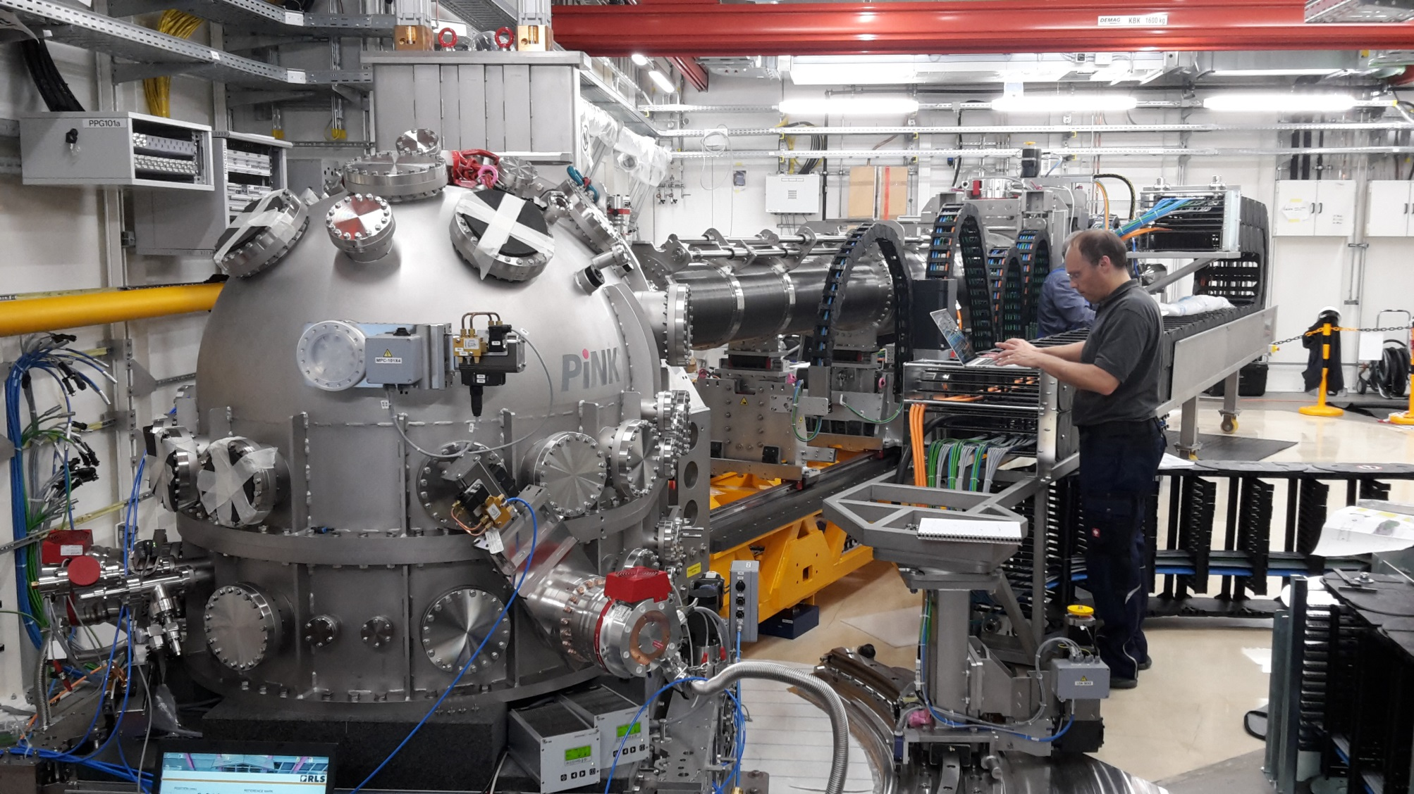
17.4.: MID experiment installation continues…

Slide 12
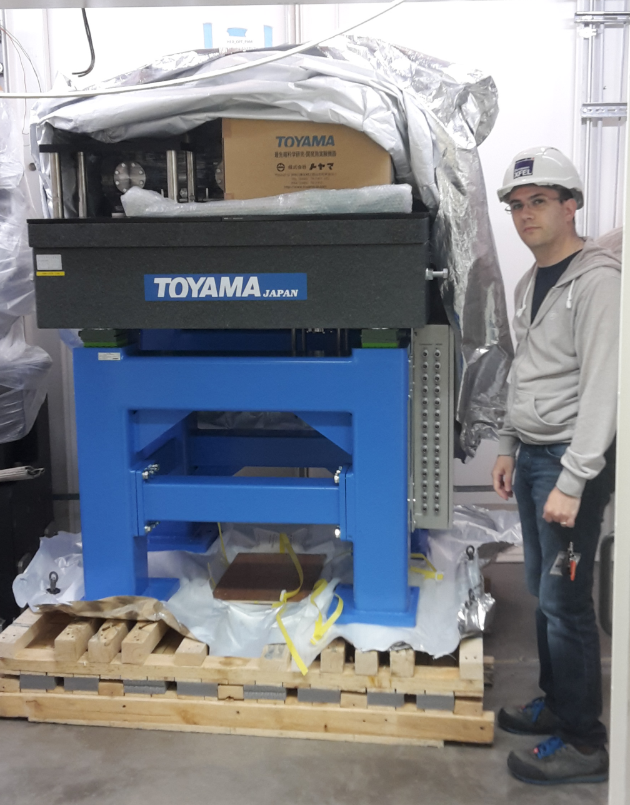
17.4.: HED Optics hutch photon arrival monitor being installed

Slide 13
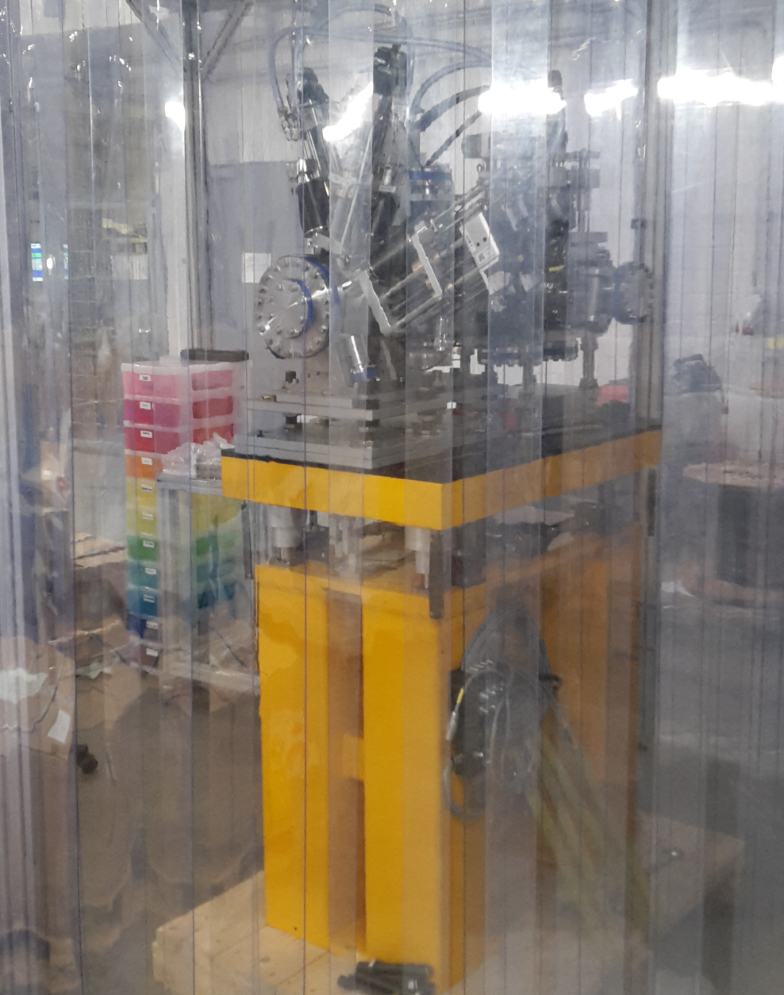
25.4.: Preparing for installations in clean-room tent in front of MID-Optics

Slide 14
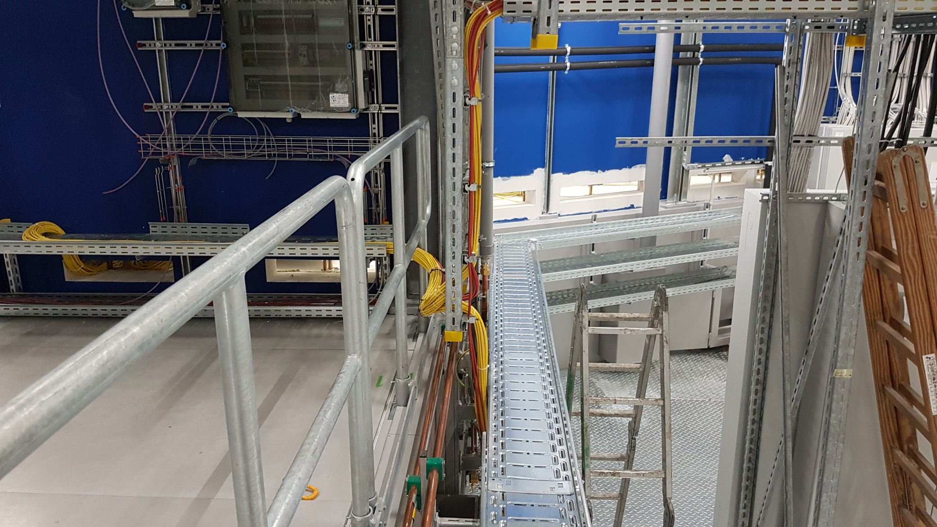
25.4.: Cutouts MID Rackroom enlarged / new

