Slide 1
Lead shields on RadFets
Dedicated measurement points for investigation of lead-shielding of dosimetry sensors at undulator cells #15 and #31 in the SASE 1 section
(A contribution to the Radiation Damage Task Force Meeting, 24.04.2018)

Slide 2
SASE 1 - undulator cell #15 (2322m) )- the “quiet” reference
Mobile dosimetry sensors on upstream front of (every) upper undulator girder, (normal) position nearest to beam pipe - 1 RadFet - 1 TLD-800
Fixed dosimetry sensors on chamber (prototype setup) - 1 sensor-pair upstream, aligned with undulator front → 1 RadFet + 1 TLD-800 - 1 sensor-pair downstream, aligned with undulator front → 1 RadFet + 1 TLD-800
Mobile dosimetry sensors on upstream front of lower undulator girder (normal) position nearest to beam pipe, - 1 RadFet - 1 TLD-800 (+ temporary Alanine SU-”payload” dosimeters as piggyback) - GafChromic film dosimeters (2mm-lead-shielded film on one side, unshielded film on opposite side of RadFet/TLD)

Slide 3
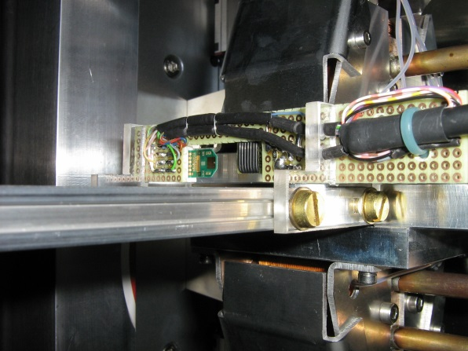
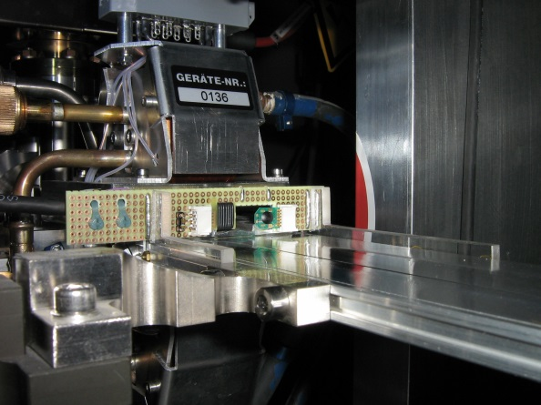
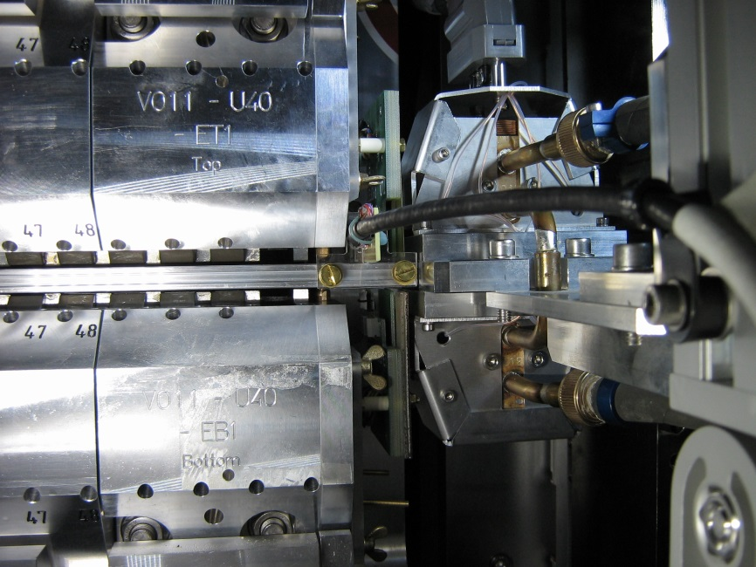
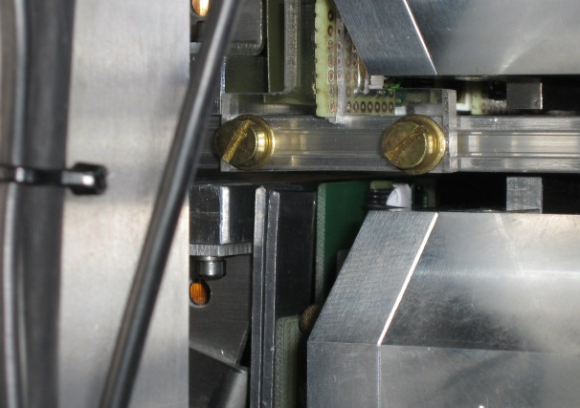
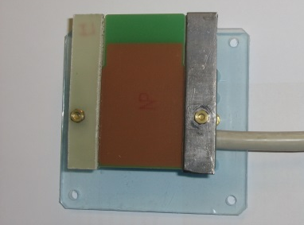
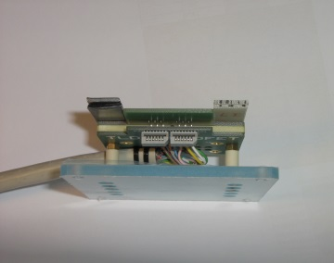
SASE 1 - undulator cell #15 (2322m)- the “quiet” reference
← e-
Fixed dosimetry sensors on chamber (prototype setup) 1 sensor-pair aligned with undulator downstream front (1 RadFet + 1 TLD)
Mobile dosimetry sensors on upstream front of (every) upper undulator girder, (normal) position nearest to beam pipe (1 RadFet + 1 TLD)
Fixed dosimetry sensors on chamber (prototype setup) 1 sensor-pair aligned with undulator upstream front (1 RadFet + 1 TLD)
Mobile dosimetry sensors (1 RadFet + 1 TLD + Alanine “payload”)
on upstream front of lower undulator girder +
GafChromic film dosimeters, one 2mm-lead-shielded film on one side, one unshielded film on opposite side of RadFet/TLD-pair

Slide 4
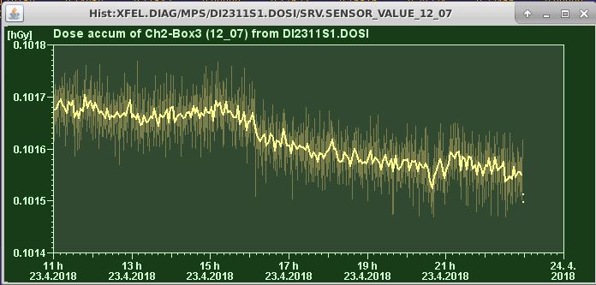
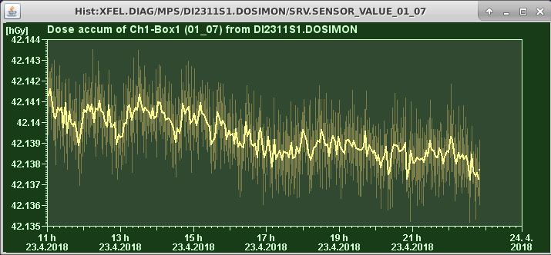
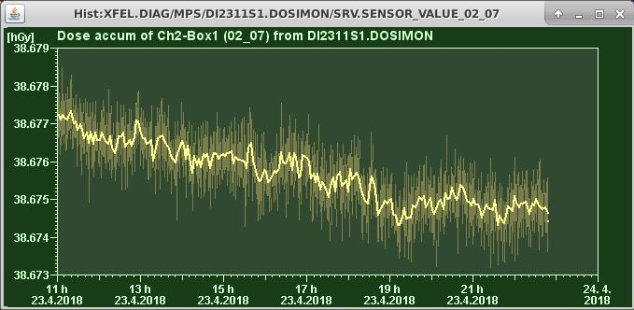
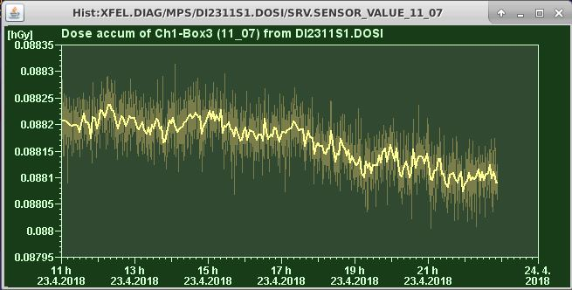
SASE 1 - undulator cell #15 (2322m)
Fixed dosimetry sensors on chamber (prototype setup) 1 sensor-pair aligned with undulator upstream front (1 RadFet + 1 TLD)
← e-
Fixed dosimetry sensors on chamber (prototype setup) 1 sensor-pair aligned with undulator downstream front (1 RadFet + 1 TLD)
Mobile dosimetry sensors on upstream front of (every) upper undulator girder, (normal) position nearest to beam pipe (1 RadFet + 1 TLD)
Mobile dosimetry sensors (1 RadFet + 1 TLD + Alanine “payload”)
on upstream front of lower undulator girder +
GafChromic film dosimeters, one 2mm-lead-shielded film on one side, one unshielded film on opposite side of RadFet/TLD-pair

Slide 5
SASE 1 - undulator cell #31 (2420m) – the foremost(?) heavily irradiated cell
Mobile dosimetry sensors on upstream front of (every) upper undulator girder, (normal) position nearest to beam pipe - 1 RadFet - 1 TLD-800
Fixed dosimetry sensors on chamber (prototype setup) - 1 sensor-pair upstream, aligned with undulator front → 1 RadFet + 1 TLD-800 - 1 sensor-pair downstream, aligned with undulator front → 1 RadFet + 1 TLD-800
Mobile dosimetry sensors on upstream front of lower undulator girder, 1 position step apart from beam pipe, shielded by 2 cascaded lead-caps - 1 RadFet - 1 TLD-800

Slide 6
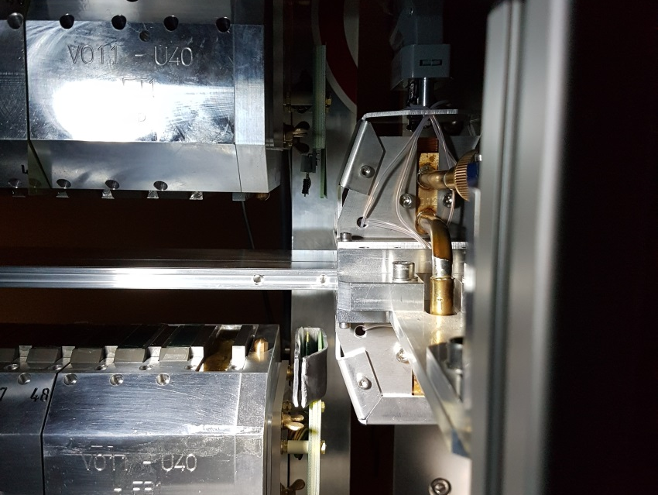
SASE 1 - undulator cell #31 (2420m) – the foremost(?) heavily irradiated cell
(The situation up to end of 2017!)
← e-
Mobile dosimetry sensors on upstream front of (every) upper undulator girder, (normal) position nearest to beam pipe (1 RadFet + 1 TLD)
Mobile dosimetry sensors (1 RadFet + 1 TLD)
on upstream front of lower undulator girder, (normal) position nearest to beam pipe, One 2mm-lead-shield-belt, open to the top and one side, patially surroundin the RadFet/TLD-pair on the upper hemisphere (not manutacturable in series – just for an orientational test)

Slide 7
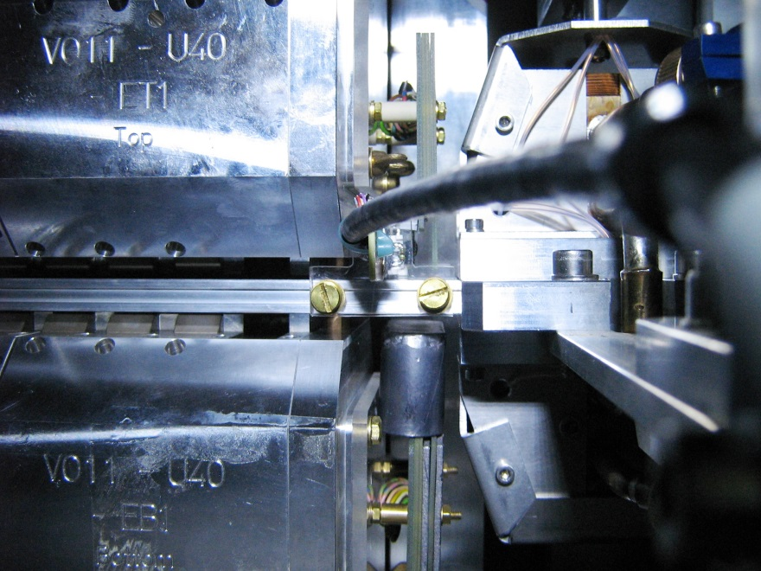
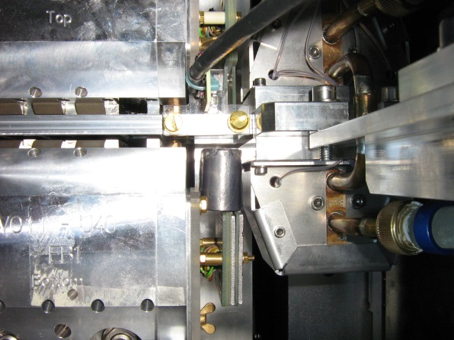
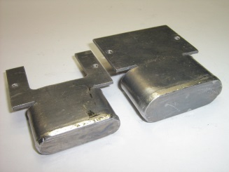
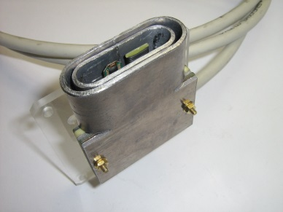
SASE 1 - undulator cell #31 (2420m)
Fixed dosimetry sensors on chamber (prototype setup) 1 sensor-pair aligned with undulator upstream front (1 RadFet + 1 TLD)
← e-
Fixed dosimetry sensors on chamber (prototype setup) 1 sensor-pair aligned with undulator downstream front (1 RadFet + 1 TLD)
Mobile dosimetry sensors on upstream front of (every) upper undulator girder, (normal) position nearest to beam pipe (1 RadFet + 1 TLD)
Mobile dosimetry sensors (1 RadFet + 1 TLD)
on upstream front of lower undulator girder, 1 position step apart from beam pipe, Two 2mm-lead-shield-caps, one inside the other surround the RadFet/TLD-pair on the upper hemisphere (manufacturable in series)

Slide 8
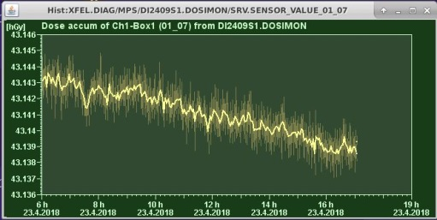
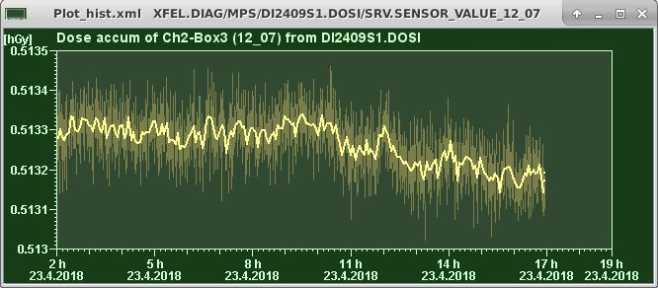
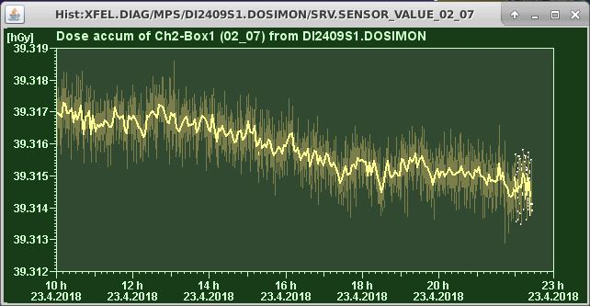
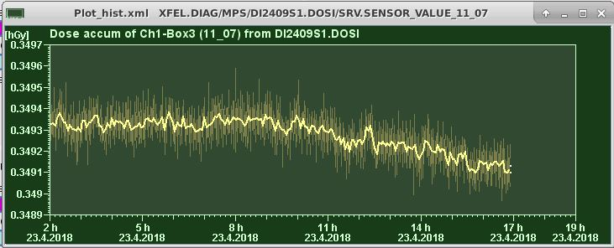
SASE 1 - undulator cell #31 (2420m)
Fixed dosimetry sensors on chamber (prototype setup) 1 sensor-pair aligned with undulator upstream front (1 RadFet + 1 TLD)
← e-
Fixed dosimetry sensors on chamber (prototype setup) 1 sensor-pair aligned with undulator downstream front (1 RadFet + 1 TLD)
Mobile dosimetry sensors on upstream front of (every) upper undulator girder, (normal) position nearest to beam pipe (1 RadFet + 1 TLD)
Mobile dosimetry sensors (1 RadFet + 1 TLD)
on upstream front of lower undulator girder, 1 position step apart from beam pipe, Two 2mm-lead-shield-caps, one inside the other surround the RadFet/TLD-pair on the upper hemisphere (manufacturable in series)

Slide 9
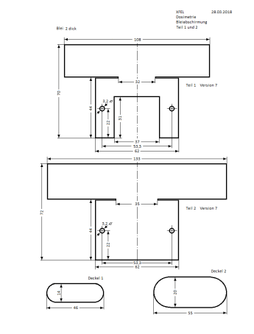
Thank you!
Questions?

