Slide 1
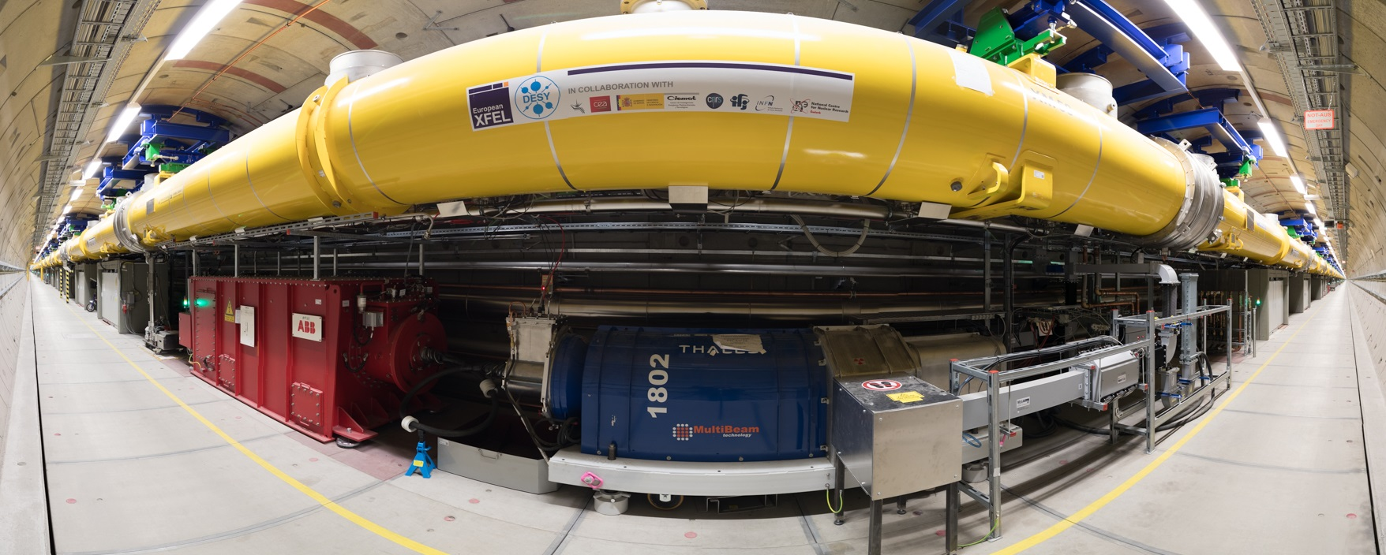
Radiation Issues; Pandora Readings
D. Nölle
Radiation Task Force, Meeting 1, April 24th, 2018
Notes:
How to edit the title slide
Upper area: Title of your talk, max. 2 rows of the defined size (55 pt)
Lower area (subtitle): Conference/meeting/workshop, location, date, your name and affiliation, max. 4 rows of the defined size (32 pt)
Change the partner logos or add others in the last row.

Slide 2
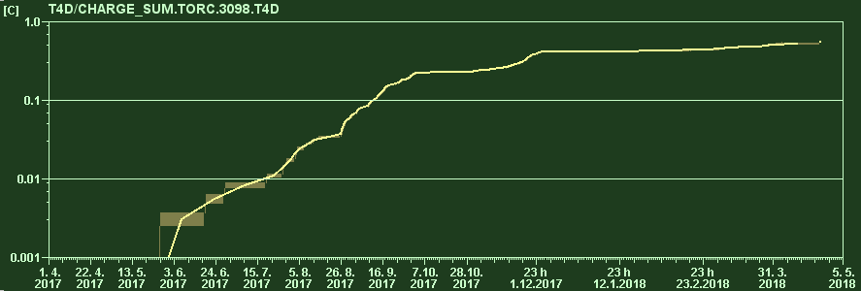
All log scale in Y
Plot by Frederik
Integrated charge of 1 year

Slide 3
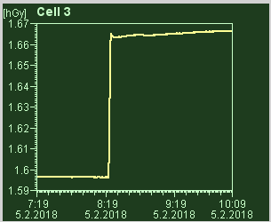
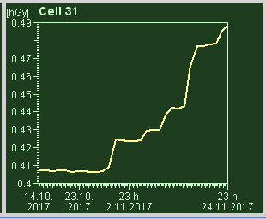
There are two typical Pattern in the Undulator Dose
Single Impact
Step-like Increase of the Dose, clearly correlated to failure or operational issues.
First pass steering
Component Failure
Might later also occur on MPS events due to latency
Continuous Irradiation
Slow creeping up dose levels in the last 1/3 of the undulator
Appearing only with undulators closed
BLMs show high levels simultaneously (if undulators closed)
Vacuum increases simultaneously
Trip of the SASE1 quad circuit (7 Gy in Minutes)
Dose increase during user run (8 Gy in Weeks)

Slide 4
Hypothesis from the Typical Dose pattern along the Undulator
Exponential Decay in Cells 0 -8
Collimation of particle loss
Bump in last 1/3rd of the Undulator
Synchrotron Radiation?
How much particle loss is hidden under the bump?
Does the bump move when last row of undulators are closed?

Slide 5
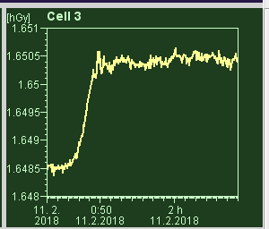
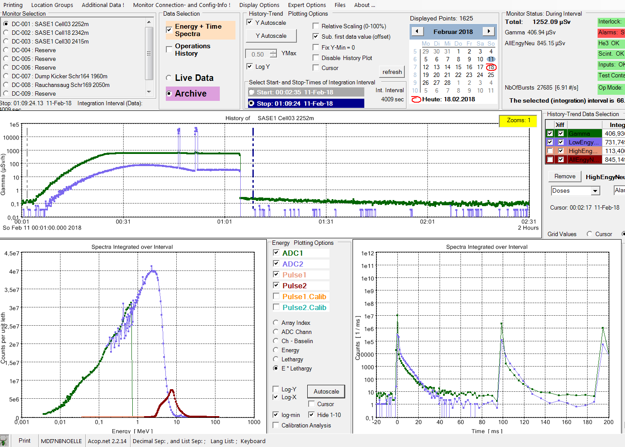
New Tool: Pandora 2252 m (Cell 3) ; Here: Beam loss due to L3 feedback going mad
Neutrons: Strong increase
Gamma at about 1 Sv/h
Gamma peak not sharp (wider energy distribution)
Strong particle loss
200 mGy

Slide 6
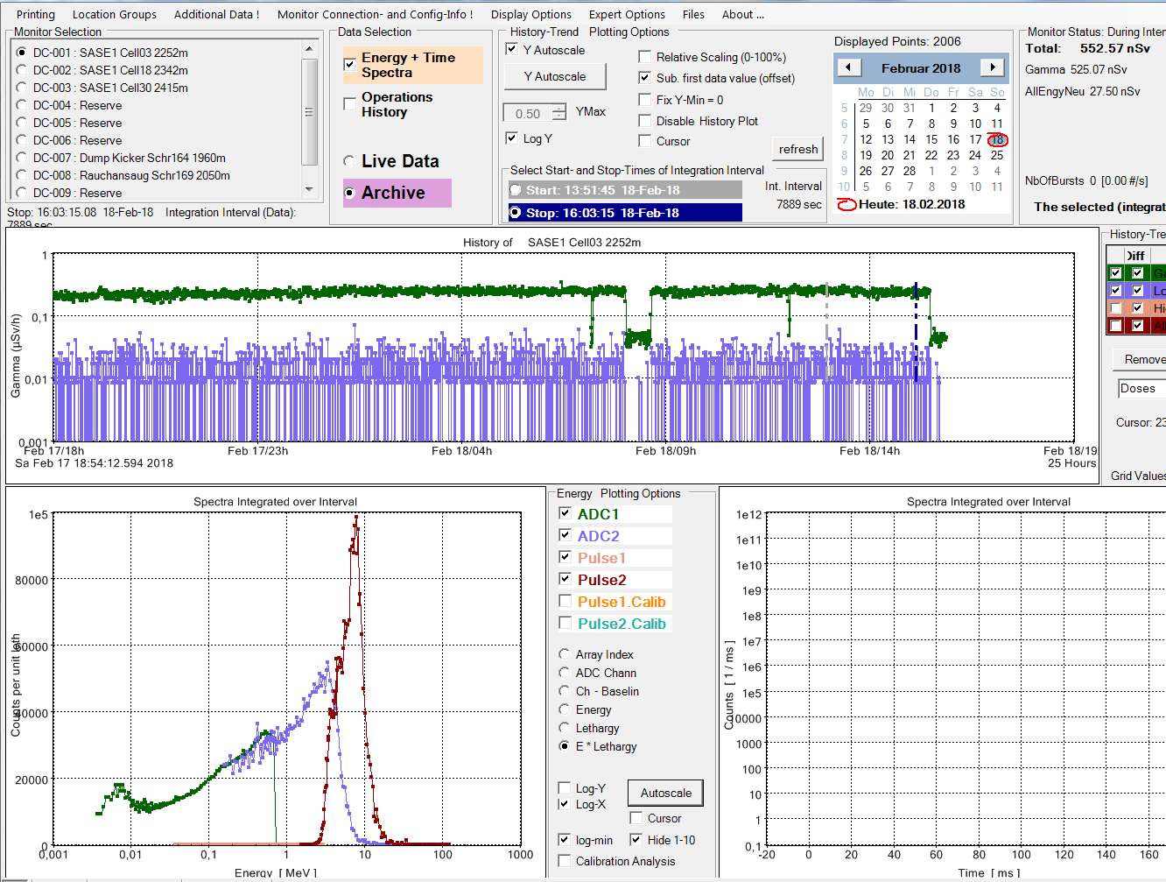
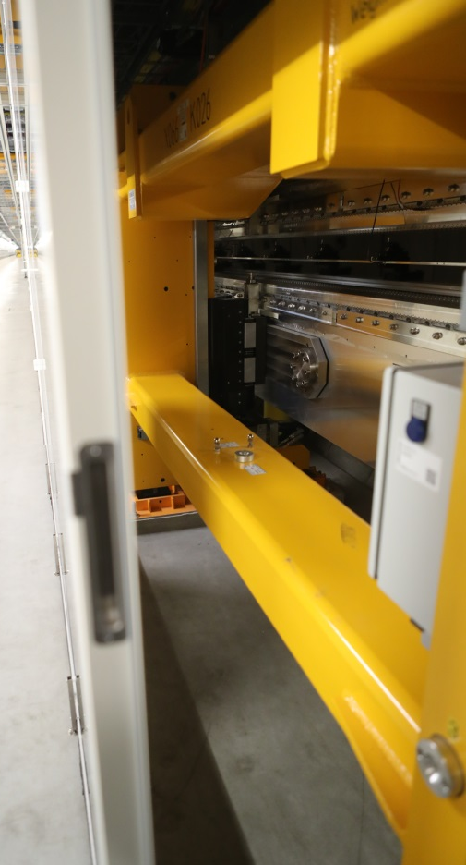
New Tool: Pandora 2252 m (Cell 3) SASE Run 500 µJ, Single Bunch
Neutrons slightly higher than noise
Gamma at about 0.1 µSv/h
Gamma peak not very sharp (wider energy distribution)
Get Hands on the Spectrum

Slide 7
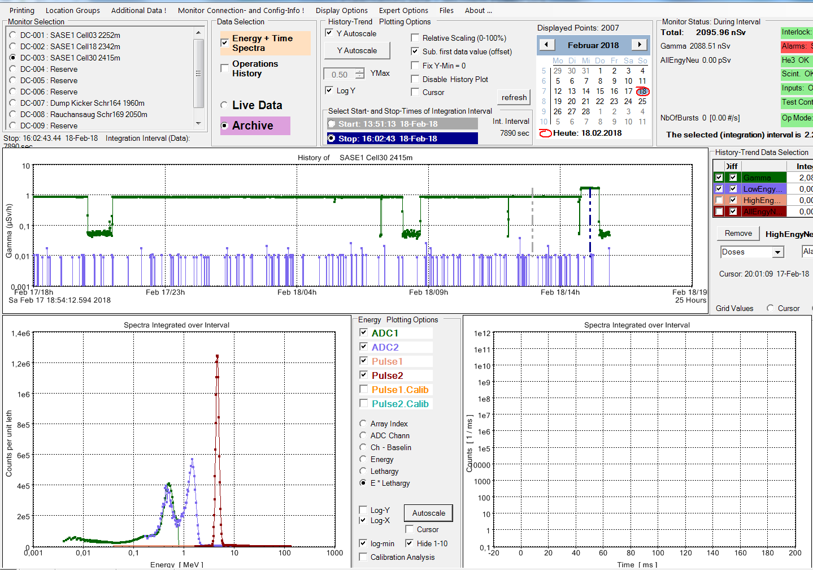
New Tool: Pandora 2415 m (Cell 30) SASE Run 500 µJ, Single Bunch
No Beam
Neutrons at noise level
Gammas at about 1 µSv/h (10 x Entrance)
Gamma peak very sharp (many small energy portions well in time)
A. Leuschner: looks like Synchrotron Radiation

Slide 8
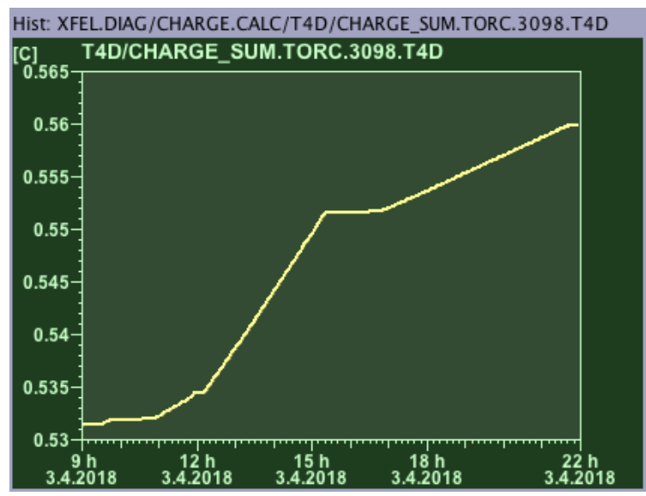
Look to some runs with high bunch numbers
Accumulated Charge
Data taken under SASE conditions, 1.2 mJ at 9.3 keV
Machine well set up with low losses after user run.
170 bunches
500 bunches
300 bunches
500 bunches
Bunch Numbers vs. time
170 bunches
Maintenance

Slide 9
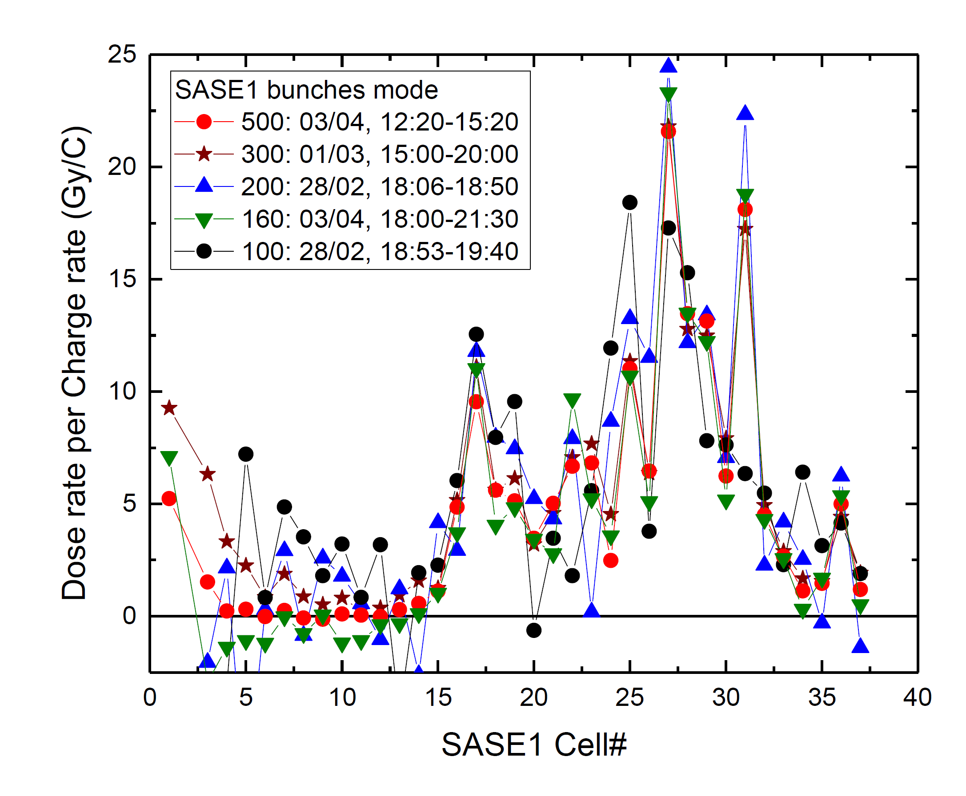
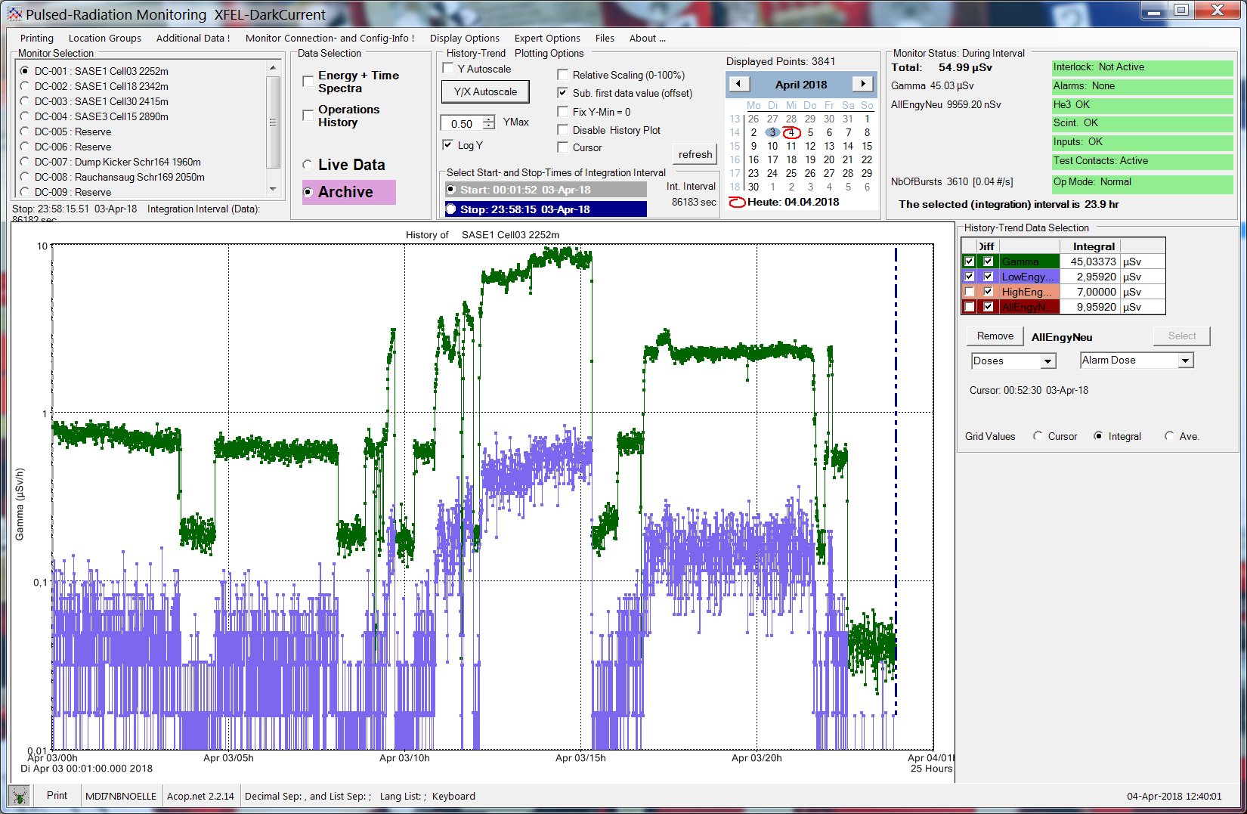
Pandora Data from Cell 3 (Entrance) in High Current Run
Neutron Level significantly higher than noise O(50)
Gamma level moderate
Small reading from the RadFet system
300
500
170
30
1
30
Gammas
1
0
Neutrons

Slide 10
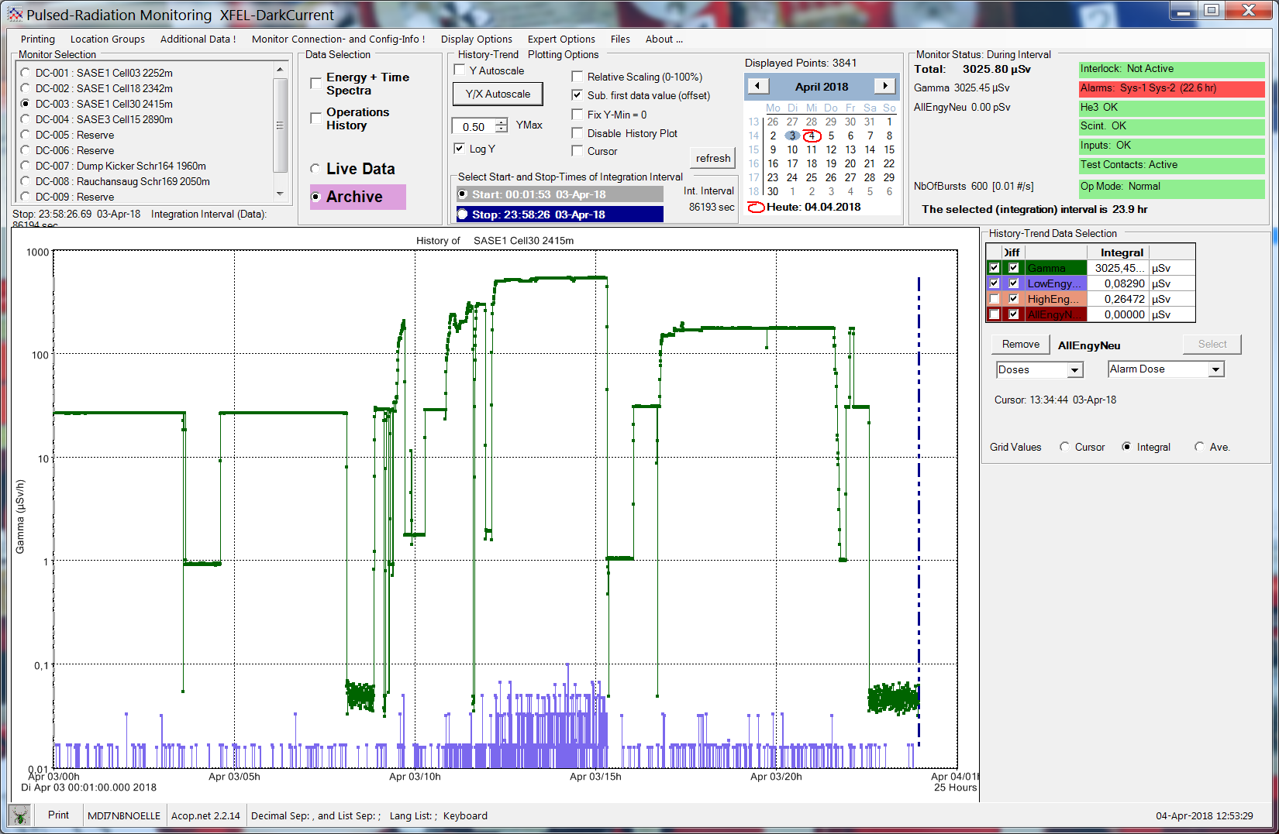
Pandora Data from Cell 30 in High Current Run
Neutron Level almost on Noise Level (O(2-5))
Gamma level high (O(1000))
Significant reading from the RadFet system
RadFets blinded by Synchrotron Radiation
But Neutrons indicate small real particle loss, that is usually hidden.
300
500
170
30
1
30
Gammas
1
0
Neutrons

Slide 11
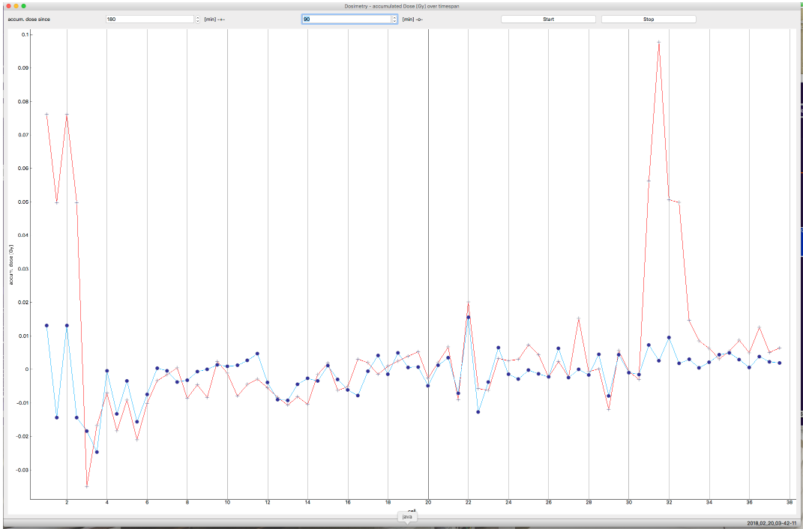
Systematic Study: Logbook 20.02.2018
Orbit is independent, if undulators are closed or open
With open undulators at the entrance we can fight the peak
This is an indication for Synchrotron Radiation
But: The peak position does not move!
Indication for an aperture limitation?
Quotation from Logbook:
charge : 0.25 pC/bunch, partly SASE conditions
30 bunches from 0:21 to 6:40 0:22 - 2:05 all cells closed 2:05 - 3:43 cell 17 to cell 37 closed cell 3 to cell 16 at park 4:14 - 4:40 cell 10 to cell 37 closed cell 3 to cell 9 at park 5:17 - 6:40 cell 6 to cell 37 closed cell 3 to 5 at park conclusion: cell 31-33 show an increase of the RADFET readings when they are closed. Cell31 shows the highest rate, cell32 about half of it and cell 33 even less. The cells behind 33 don't show an rate increase with 30 bunches. The rate can be reduced by 50% by opening the first 3 undulators and it vanishes completely when opening the first 14 undulators.
Peak
31-33
Dose
Cell Number
Dose with undulator cell 3 to 37 closed for 90 minutes (red) and with cell 3 to 16 parked and 17 to 37 closed 90 minutes (blue)

Slide 12
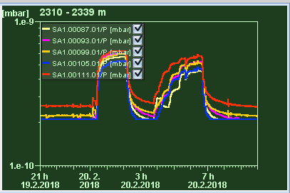
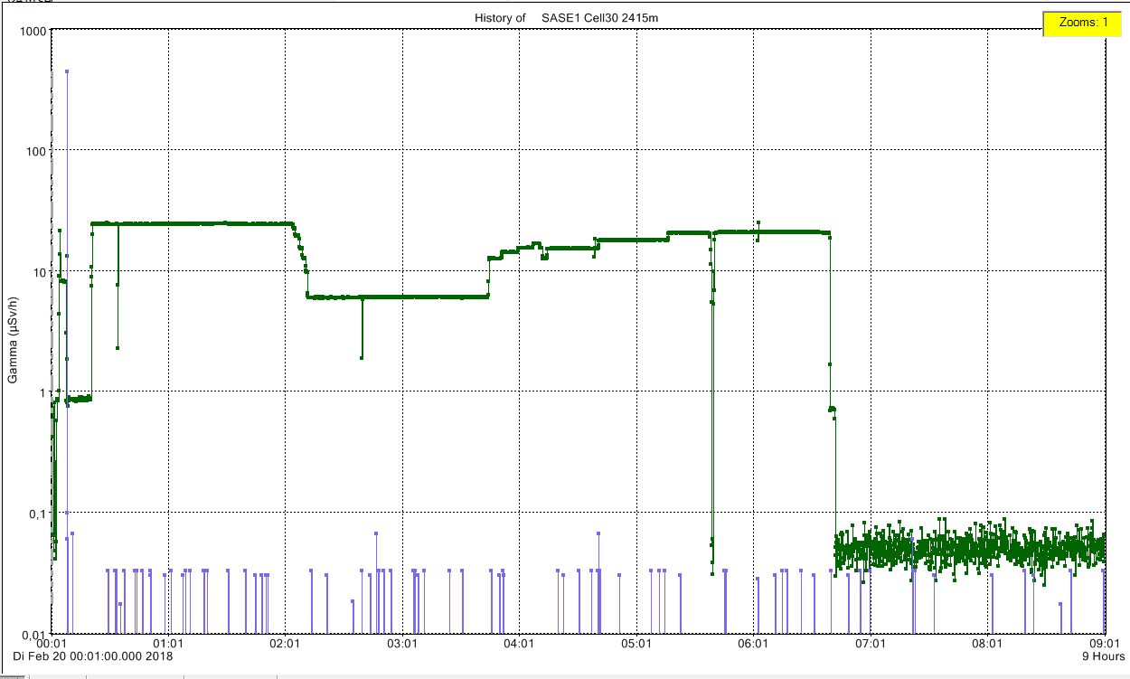
Look into Pandoras Box … Data
All Cells Closed
3-5 in park
3-16 in park
Gammas
Clear Peak
Smaller Peak
No Peak
ZZ in XTD10, no beam
Neutron underground

