Slide 1
How does the Pandora respond to the XFEL radiation
Author
Albrecht Leuschner, DESY, D3

Slide 2
PANDORA
Wikipedia:
In Greek mythology, Pandora (from Greek: Πανδώρα, "giver of all, all-endowed"[1]) was the first woman.[2] As Hesiod related it, each god helped create her by giving her unique gifts. Zeus ordered Hephaestus to mould her out of Earth (Γαîα – Gaia) as part of the punishment of mankind for Prometheus' theft of the secret of fire, and all the gods joined in offering this "beautiful evil" seductive gifts. Her other name, inscribed against her figure on a white-ground kylix in the British Museum (illustration, right), is Anesidora, "she who sends up gifts."[3] According to the myth, Pandora opened a jar (pithos) in modern accounts referred to as "Pandora's box", releasing all the evils of mankind— although the particular evils are not specified in detail — leaving only Hope inside once she had closed it again.[4] She might have opened the jar out of simple curiosity and not as a malicious act.[5]

Slide 3
PANDORA
Photon And Neutron Dose Rate meter
for Accelerators
Dose-Measurement of Photons- and Neutrons in continuous and pulsed fields.
Monitoring via Ethernet.
Interlock-Functionality by 2 Relays.

Slide 4
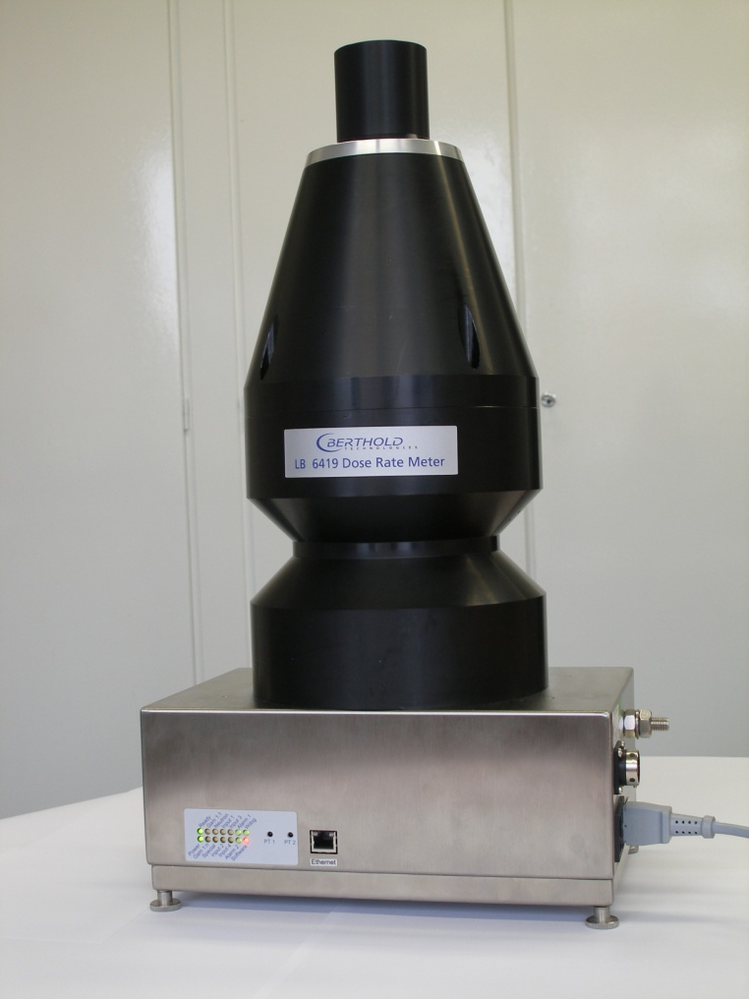
Short Term History
Photons
Radiation
Bursts
2001 First tests of a plastic scintillator in pulsed fields
2007 Design of the Pandora for PETRA III
2018 more than 100 devices in use at DESY
Neutrons

Slide 5
LB 6419
Plastik - Scintillator
in a 1 cm PE cover
³He - Counter
rem – counter type
(moderator: polyethylene)
Electronics- Box
Power supplies
FADCRMON board (SIS)

Slide 6
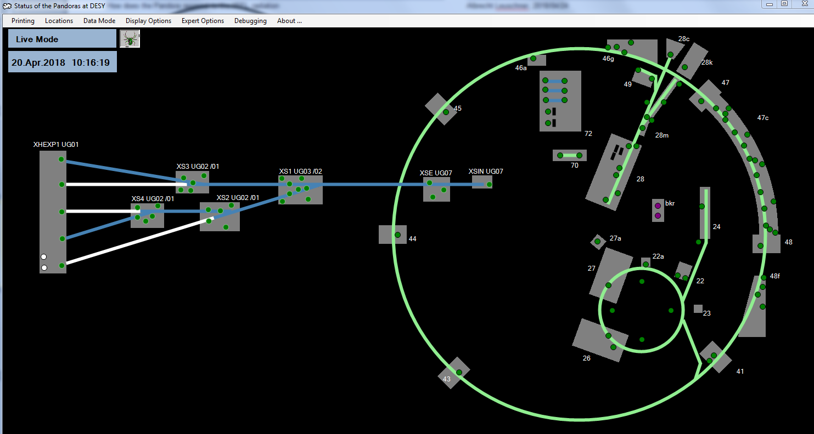
PANDORAS at DESY

Slide 7
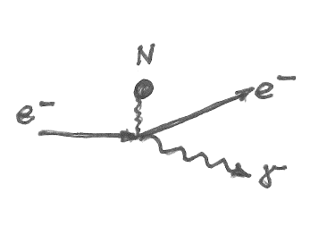
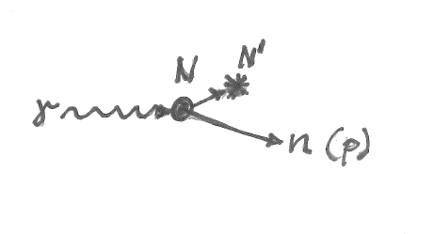
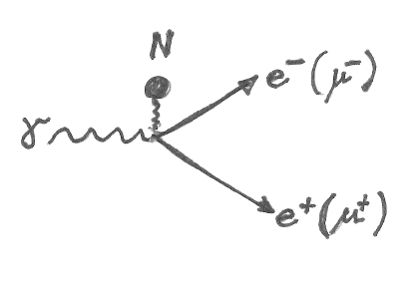
Basics: Beam interaction with matter
Elastic scattering
Inelastic scattering
Bremsstrahlung effect
-forward emission (1/γ)
Nuclear photo effect
-isotropic neutron emission
Pair production
-forward emission (1/γ)

Slide 8
Basics: Electromagnetic cascade (in copper)
Elastic scattering
Pair production threshold: 2 electron masses
Critical energy
dE/dx
Ionization
Energy
10 GeV
1 GeV
100 MeV
10 MeV
1 MeV
100 keV
10 keV

Slide 9
Basics: Electromagnetic cascade (in copper)
dE/dx
Neutron production threshold
Energy
10 GeV
1 GeV
100 MeV
10 MeV
1 MeV
100 keV
10 keV

Slide 10
Basics: Electromagnetic cascade (in copper)
Elastic scattering
Pair production threshold: 2 electron masses
Critical energy
dE/dx
Neutron production threshold
Ionization
Energy
10 GeV
1 GeV
100 MeV
10 MeV
1 MeV
100 keV
10 keV
Response of the ³He-counter due to neutrons
Response of the scintillator due to ionization

Slide 11
Basics: Electromagnetic cascade (in copper)
Synchrotron radiation
Elastic scattering
Pair production threshold: 2 electron masses
Critical energy
dE/dx
Neutron production threshold
Ionization
Energy
10 GeV
1 GeV
100 MeV
10 MeV
1 MeV
100 keV
10 keV
Response of the ³He-counter due to neutrons
Response of the scintillator due to ionization
Beam loss:
Scintillator and neutrons
Synchrotron radiation:
Scintillator only, no neutrons

Slide 12
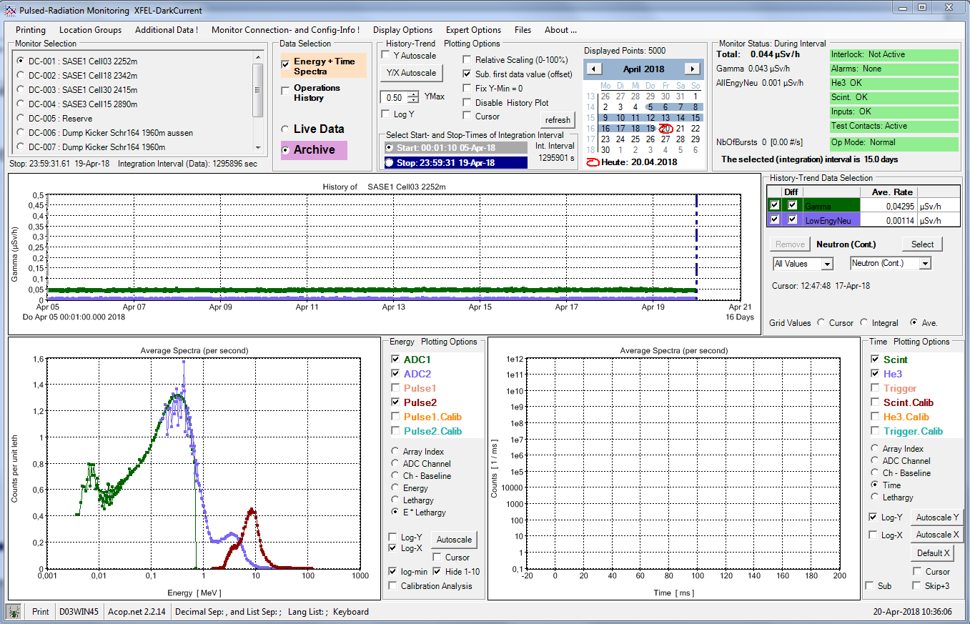
SASE1
No beam:
Background
⁴⁰K in concrete
No bursts
Cosmic Muons
“muon peak” by
minimum ionizing particles

Slide 13
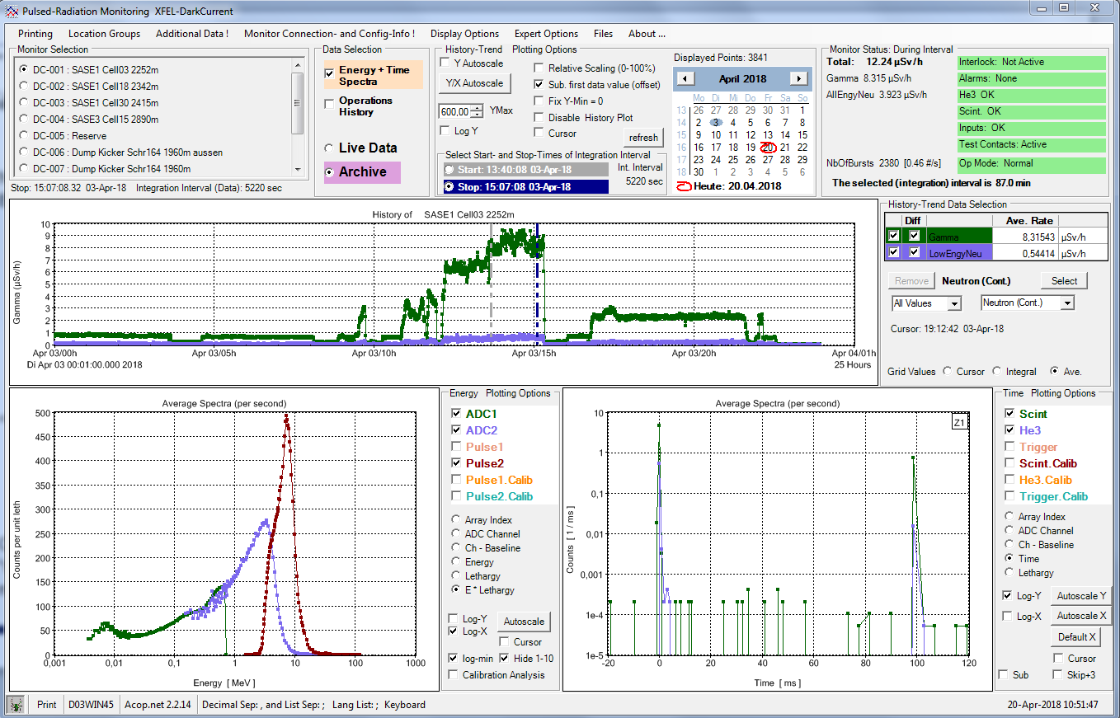
SASE1, cell 3
1.4 GeV, 0.28 nC
10 Hz
500 bunches
9.15 keV, 1 mJ
few bursts
trigger efficiency low
“muon peak” by
minimum ionizing particles

Slide 14
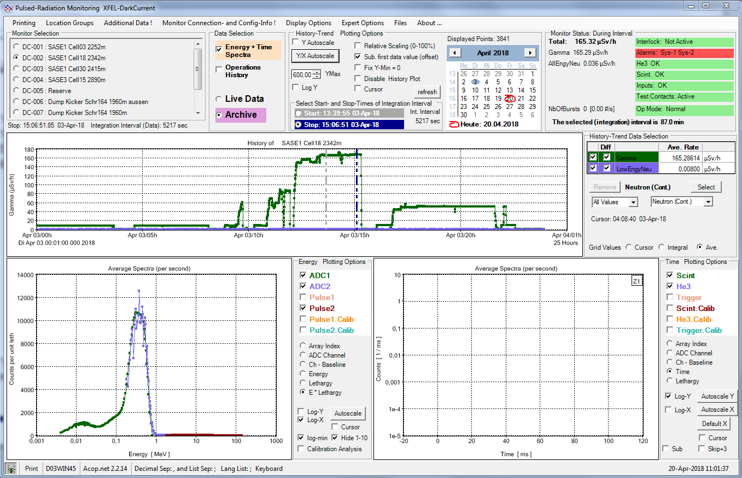
SASE1, cell 18
1.4 GeV, 0.28 nC
10 Hz
500 bunches
9.15 keV, 1 mJ
Synchrotron
photon pile up
within the PM
output pulse width
20 ns
no bursts
neutrons are required
for trigger
no
“muon peak” by
minimum ionizing particles

Slide 15
SASE3, cell 15
1.4 GeV, 0.28 nC
10 Hz
500 bunches
??? keV, ???mJ
Synchrotron
photon pile up
within the PM
output pulse width
20 ns
no bursts
neutrons are required
for trigger
no
“muon peak” by
minimum ionizing particles

Slide 16
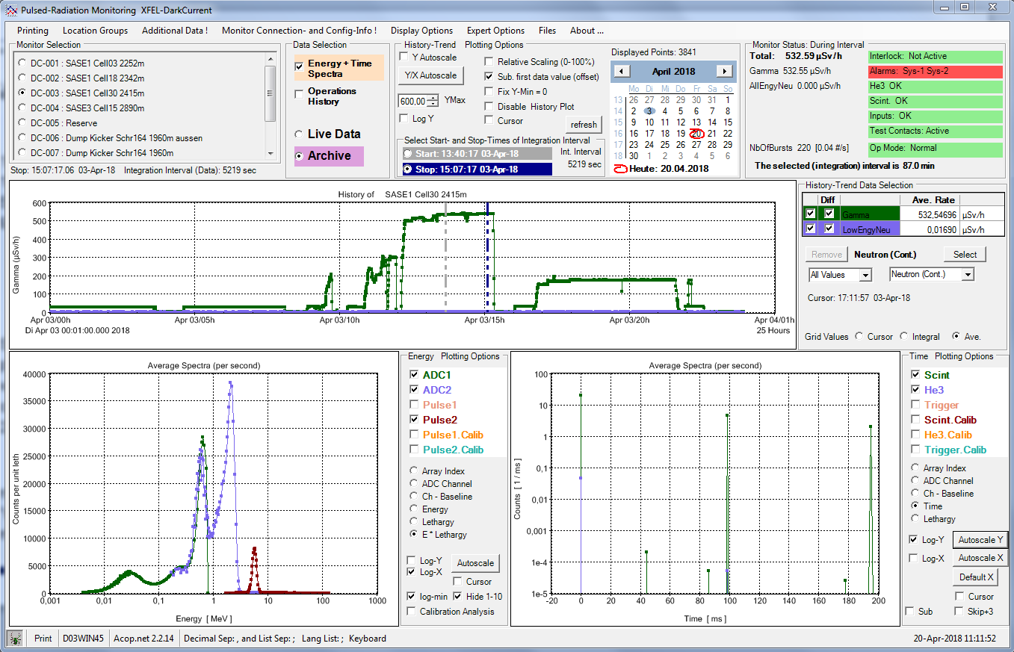
SASE1, cell 30
1.4 GeV, 0.28 nC
10 Hz
500 bunches
9.15 keV, 1 mJ
2 or more
synchrotron
photon pile up peaks
How does it work ?
few bursts
trigger efficiency low
no
“muon peak” by
minimum ionizing particles

Slide 17
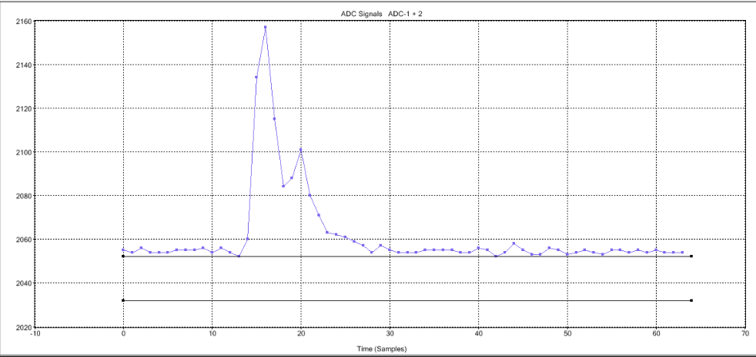
More than one Pile up peaks
Photomultiplier output on a oscilloscope
Where we are?
The PANDORA may sit
somewhere in between
2 point sources!
ADC sample
16 ns × 30 cm/ns = 480 cm flight path difference
Time increments [4 ns]

Slide 18
Response vs number of bunches
driven by synchrotron radiation
driven by gas bremsstrahlung
Synchrotron radiation increases vacuum pressure
- To be checked.

Slide 19
Summary
Beam condition: 1.4 GeV, 0.28 nC, 10 Hz, 500 bunches, 9.15 keV, 1mJ
SASE1 cell 3: Radiation dominated by electron beam losses, very low intensities
SASE1 cell 18: Radiation dominated by synchrotron radiation, moderate intensities
SASE1 cell 30: Radiation dominated by synchrotron radiation, high intensities
SASE3 cell 15: like SASE1 cell 18
PANDORA responses were checked for saturation: non.
Response due to synchrotron radiation depends on the number of bunches, linearly.
Response due to neutron radiation do not ! Quadratic. Increase of the vacuum pressure ?

