Slide 1
Update on BDSIM simulations
Shan Liu, DESY
Radiation task force meeting, 24.04.2018

Slide 2
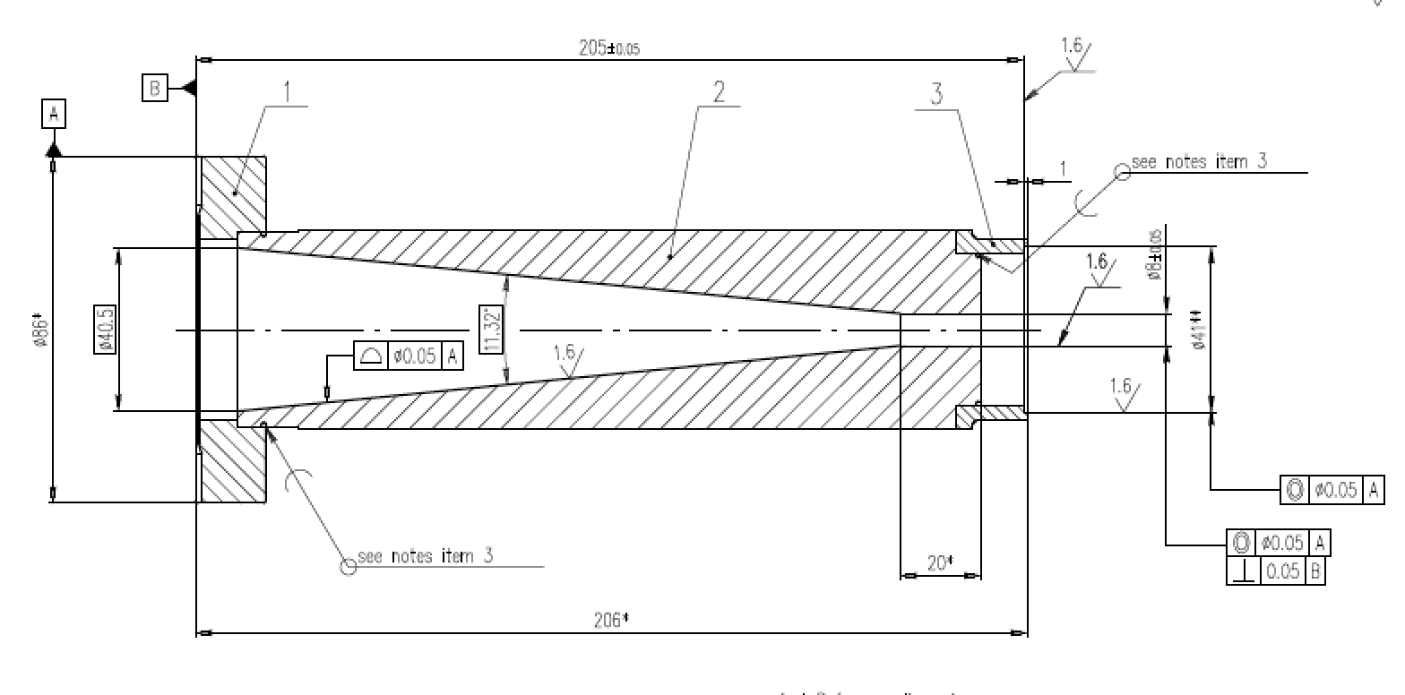
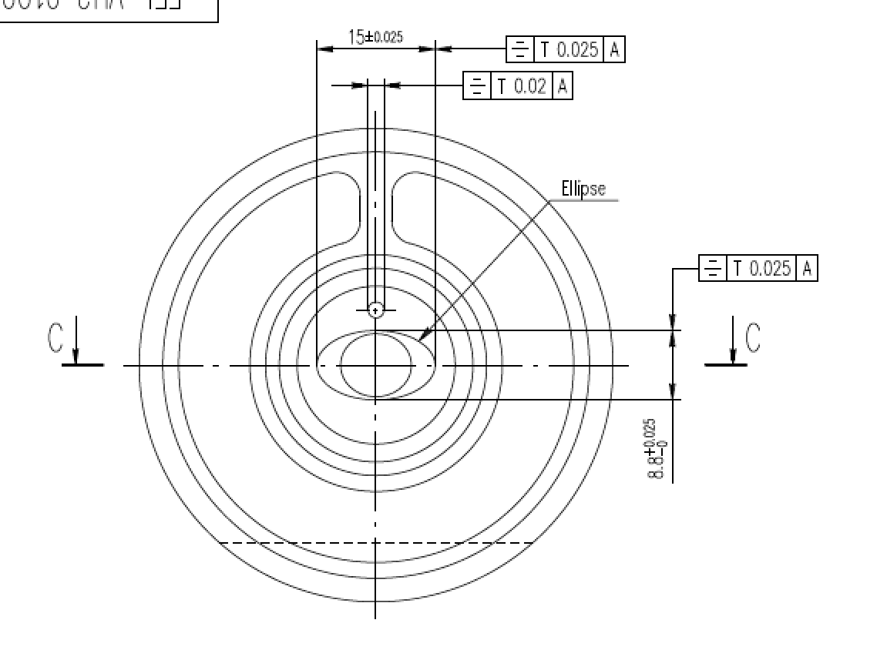
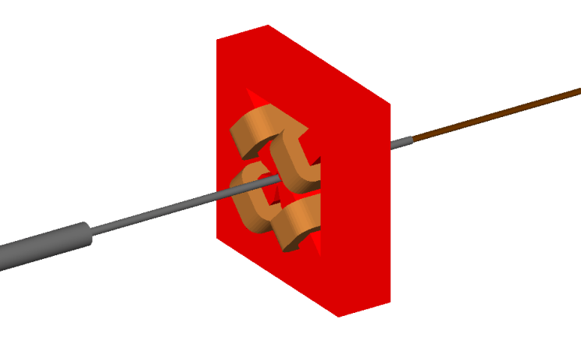
Vacuum chamber transition near undulator
Drawings from T. Wohlenberg
Actual transition sequences:
ø 40.5 mm -> ø 8 mm -> ø 10 mm (BPM, quad) -> undulator chamber (2a=15, 2b=8.8 mm ellipse) with absorber (2a=9, 2b=8 mm ellipse)
Used in simulation: ø 40 mm -> ø 10 mm (BPM, quad) -> undulator chamber (2a=9, 2b=8 mm ellipse)
undulator chamber
40 to 10 mm transition
In simulation

Slide 3
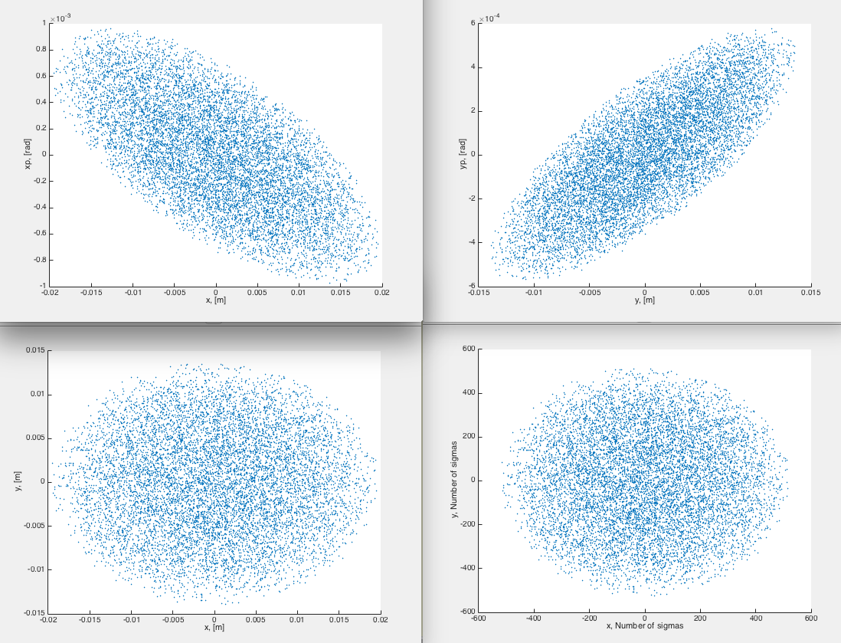
Halo distribution
x-xp
y-yp
Uniform halo in phase space generated to fill in the 40 mm vacuum chamber (~ +/- 530σ)
Total number of e- is 10⁴
undulator chamber
x-y (in m)
x-y ( in number of sigmas)
40 to 10 mm transition
In simulation

Slide 4
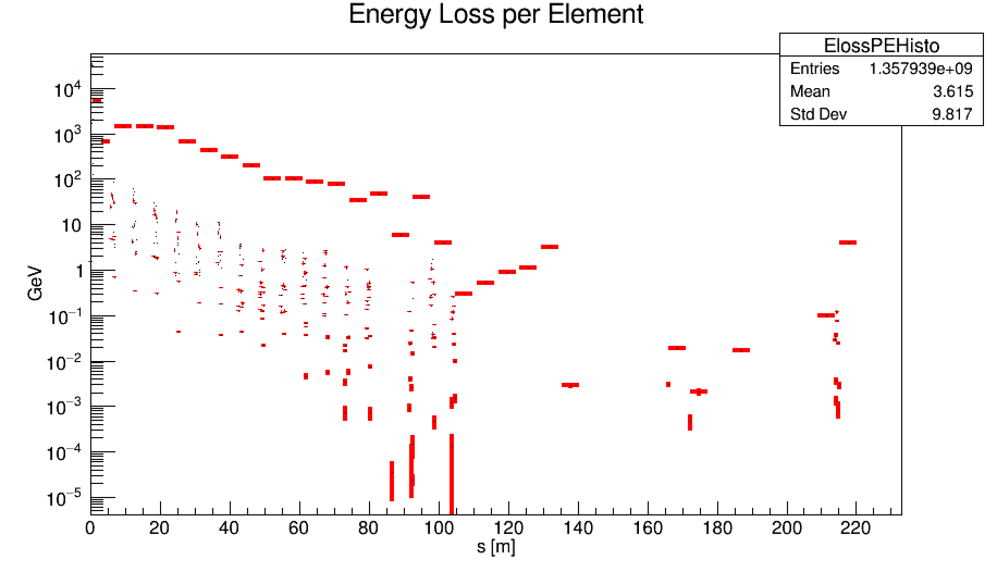
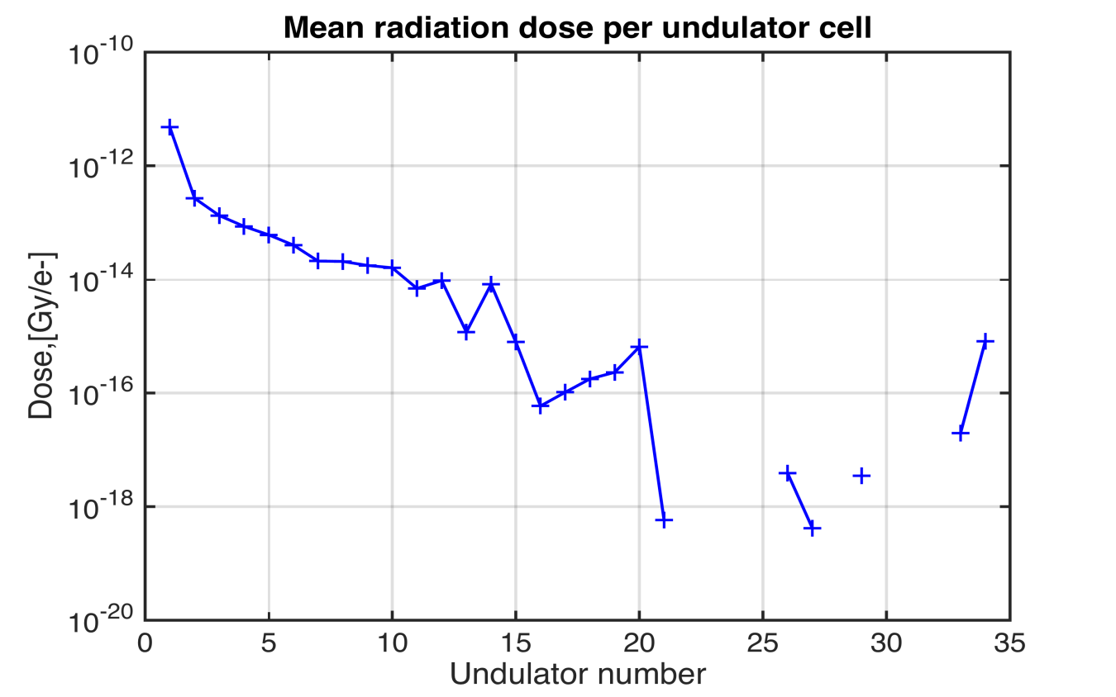
Tracking results
undulator chamber
40 to 10 mm transition
First cell is the sacrificial undulator
Doses normalized to Gy/e-
sacrificial undulator
1st undulator
1st undulator
sacrificial undulator

Slide 5
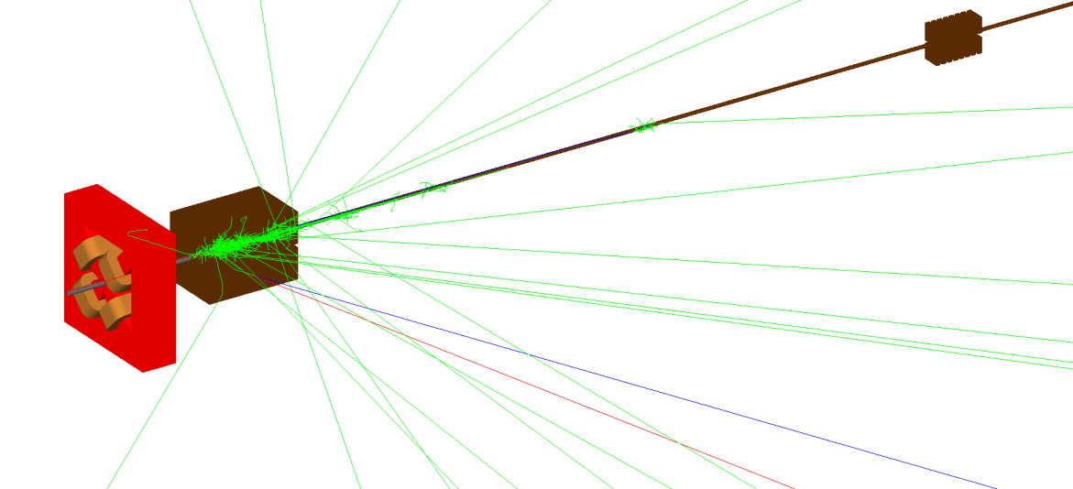
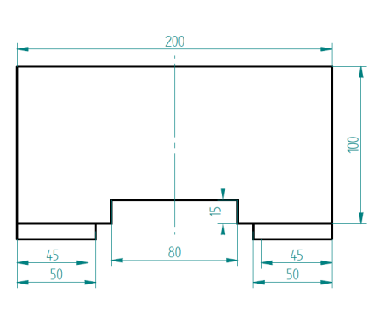
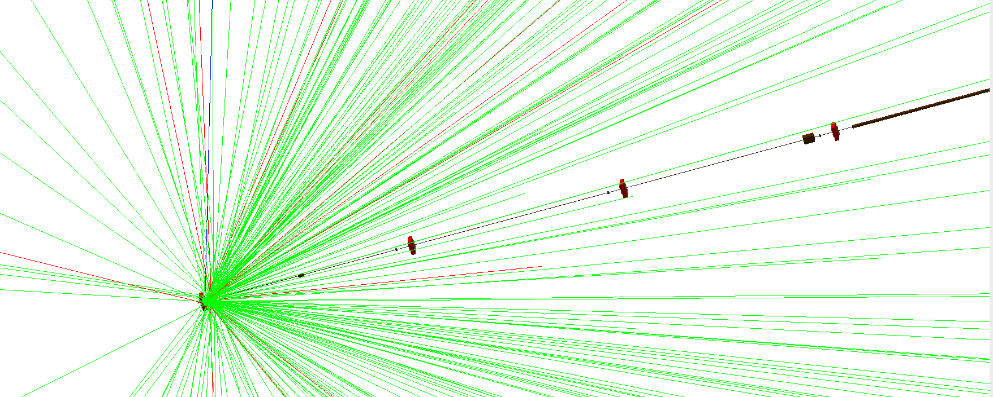
Lead shielding positions
Shielding with 300mmX200mmX200mm lead block
Position 1 (blue case): after the 1st quad downstream of the 40To10 transition
Position 2 (red case): before the quad in front of the 1st undulator
40 to 10 mm transition
sacrificial undulator
shielding position 1
shielding position 2
1st undulator
sacrificial undulator

Slide 6
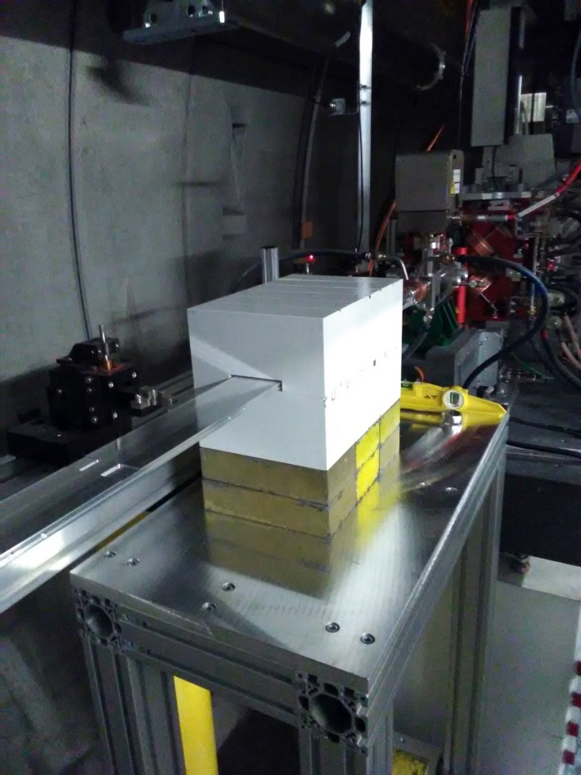
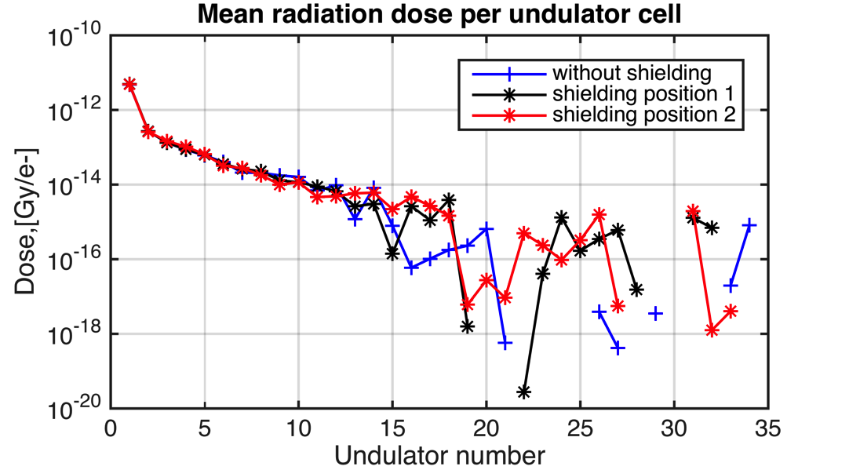
Dose distribution along SASE1
Almost no different with and w/o shielding
Losses mainly come from scattered e- with very small angle
Position 2 (upstream of the quad before the first undulator) is chosen for test
Shielding with thinner lead just in front of the undulator (downstream of the quad) will be considered

Slide 7
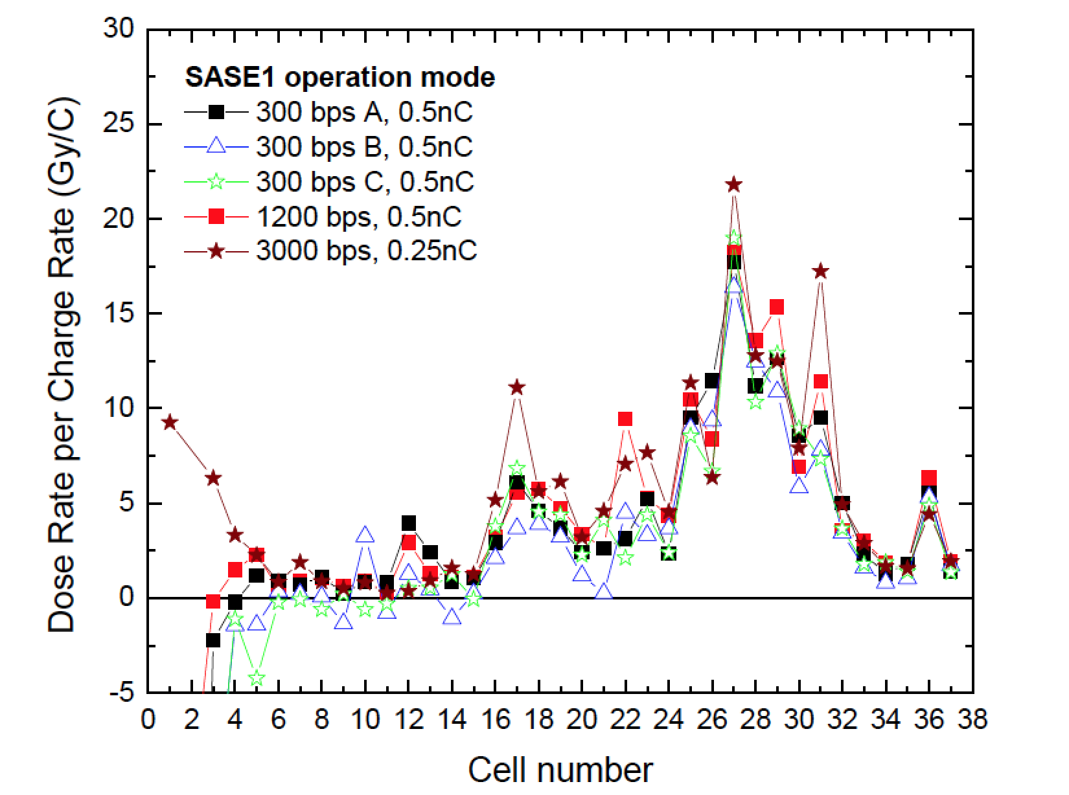
Dose distribution during normal operation
Plot from F. Wolff-Fabris
Dose distribution during the normal user operation, is quite different from the ones shown before.
The dose distribution can not be explained by the beam halo hitting the vacuum chamber transition.
Can it be caused by the optics mismatch?

Slide 8
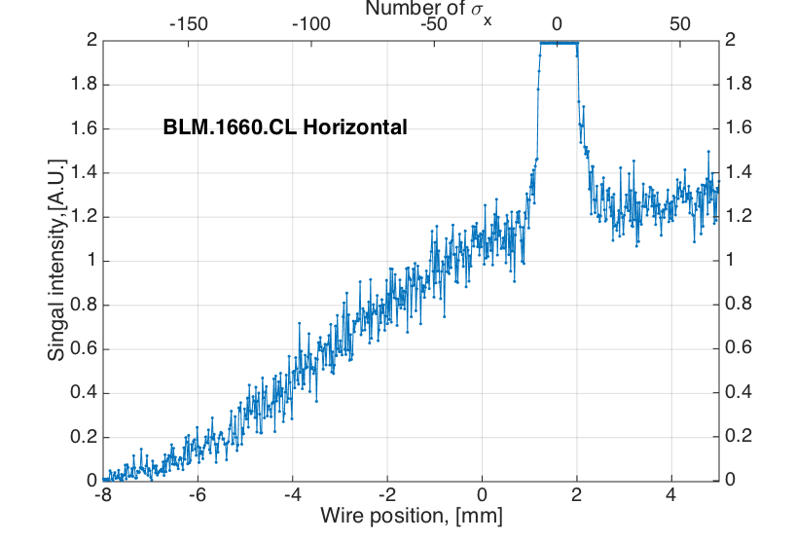
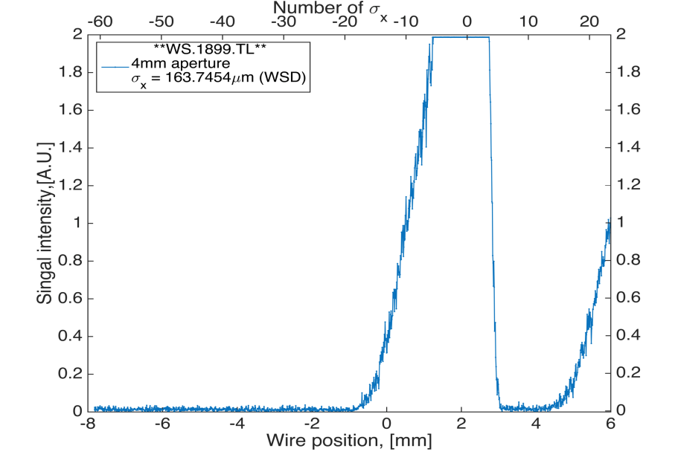
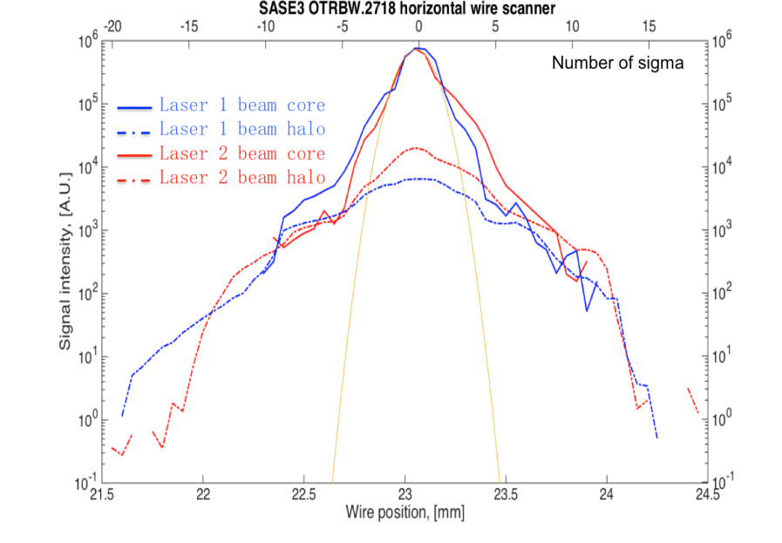
Reminder: beam halo distributions measured so far
WS. L3
WS. TL
1597
1899
WS. TL
WS. T4
CL
1929
SASE1
2718
2775
2779
L3
BLM
1660
No measurable beam halo outside 20σ after CL section (upstream and downstream of SASE1)
BLM
1982
SASE3
±20σ_{x}
halo
±20σ_{x}
±20σ_{x}
Beam halo intensity : ~15% (outside ±3σ) and ~10% (outside ±10σ)

Slide 9
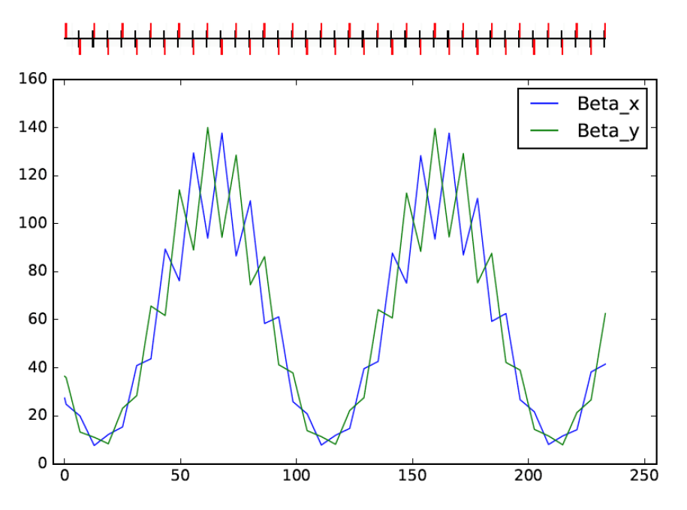
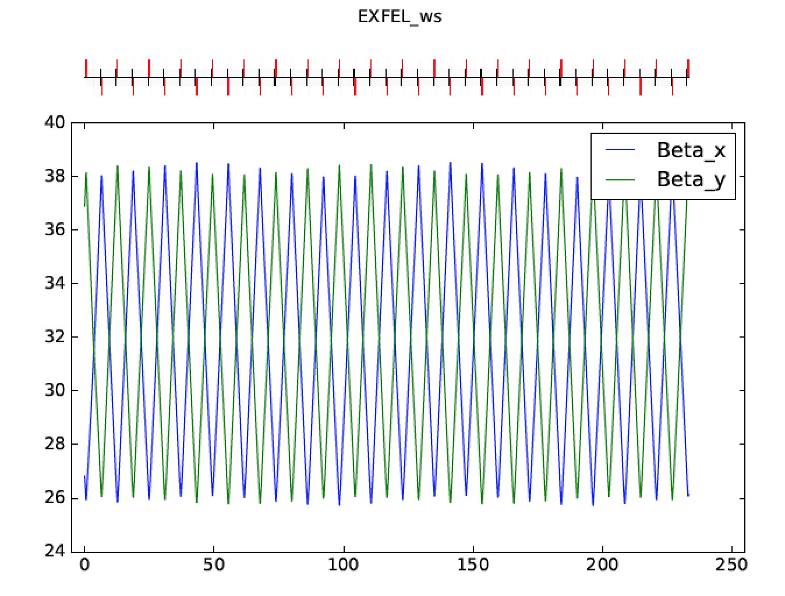
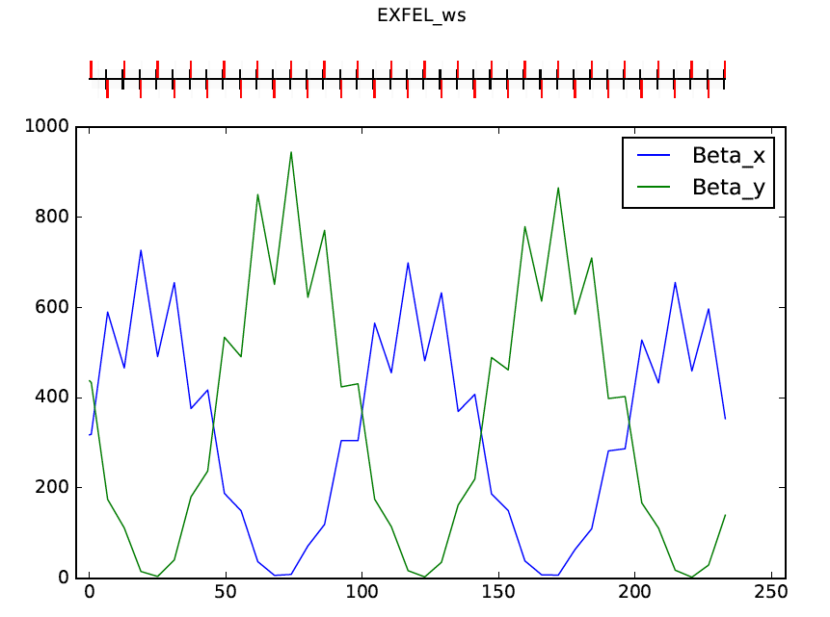
Optics mismatch study
Mismatched optics (B_{mag}≈2) :
betx=26.830 m,
alfx=0.865 +√2,
bety=36.987 m,
alfy= -1.187 +√2
180° phase advance
~ 100 m
Design optics:
betx=26.830 m,
alfx=0.865,
bety= 36.987 m,
alfy= -1.187
40 to 10 mm transition
undulator chamber
Mismatched optics (B_{mag}≈13) :
betx=26.830x12 m,
alfx=0.865,
bety=36.987x12 m,
alfy= -1.187
~ 100 m
180° phase advance

Slide 10
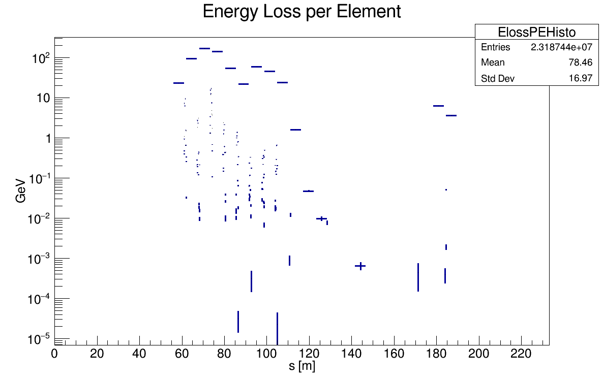
Optics mismatch study
With large optics mismatch, 20σ halo can generate losses.
However, the loss distribution is different from the measured one: 1st peak is higher than 2nd one and separated by ~100 m (16 cells)
Mismatched optics (B_{mag}≈13) :
betx=26.830x12 m,
alfx=0.865,
bety=36.987x12 m,
alfy= -1.187
~ 60 m (10 cells)
~ 100 m
~ 100 m
180° phase advance

Slide 11
Conclusions and future plan
The probability of beam halo hitting the undulator vacuum chamber is very small, it can only happen with very large optics mismatch (BMAG>10) or orbit offset (>2mm).
One of the most possible sources is the spontaneous synchrotron radiation (SR), which has an opening angle of 1/γ (first dose peak at ~ cell #17).
We will put the SR calculated for each cells into BDSIM to simulate the corresponding radiation doses and compare it with the measured values -> work on-going together with Yuhui.

Slide 12
You are welcome to join! Thank you!
Meeting with BDSIM developers on 28-29th May 2018:
introduction to BDSIM (seminar on 29th May)
discussions on 28th May:
update of BDSIM version
add hadronic process (damage due to neutrons)
event biasing and output space saving
add more components in the intersection of undulator (e.g. phase shifter, bpm)
simulation with SR, wakefield, beam-gas scattering, orbit offset or vacuum chamber misalignment

