Slide 1
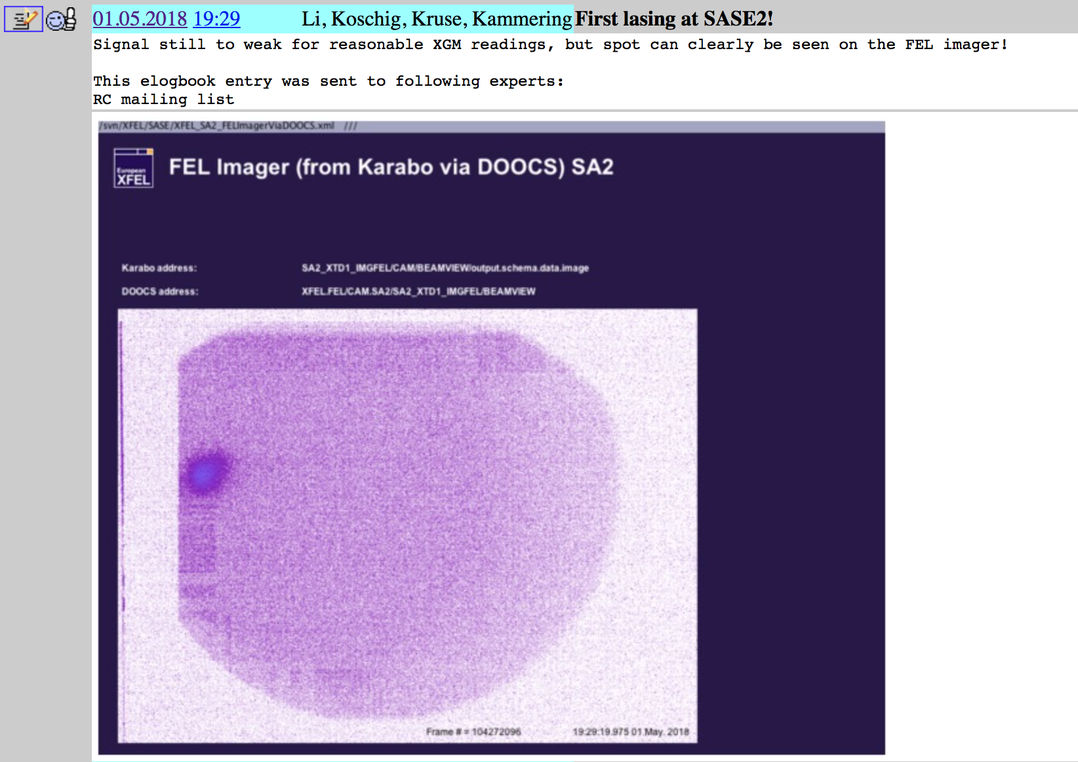
SASE2 First lasing: 1.5.2018

Slide 2
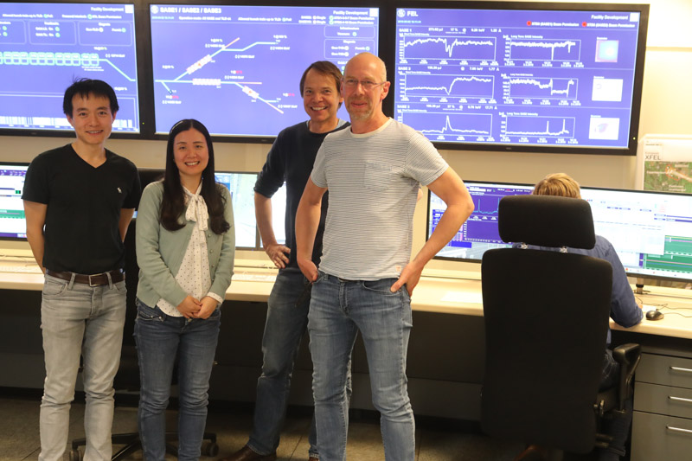
SASE2 lasing heros

Slide 3
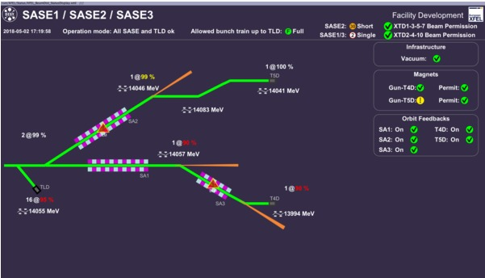
All three SASEs lasing

Slide 4
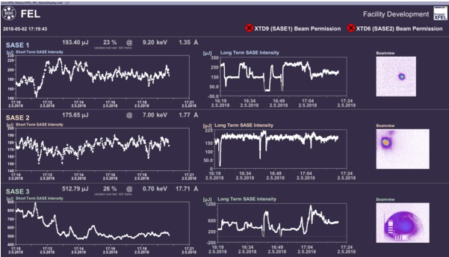
All three SASEs lasing

Slide 5
Next steps
Implement steady bunch distribution for ‘summer’:
30 pulses for SASE1+ about 5 fresh bunches SASE3 + 1 SASE2
Get SASE1 lasing back to 1 mJ levels, optimize SASE3+2 in parallel
Photon Comm. Team: Commissioing SASE2 XTD1: Make all XTD1 devices running + DAQ + Gain curve measurements + …
Other ‘tunnel‘ activities: SASE1+3 monos, etc...
Later (mid July?): Commissioning of SASE2 XTD6 tunnel + later instruments

