Slide 1
Beam Optics and Emittance
Bolko Beutner
22.05.2018
Notes:
How to edit the title slide
Upper area: Title of your talk, max. 2 rows of the defined size (55 pt)
Lower area (subtitle): Conference/meeting/workshop, location, date,
your name and affiliation, max. 4 rows of the defined size (32 pt)
Change the partner logos or add others in the last row.

Slide 2
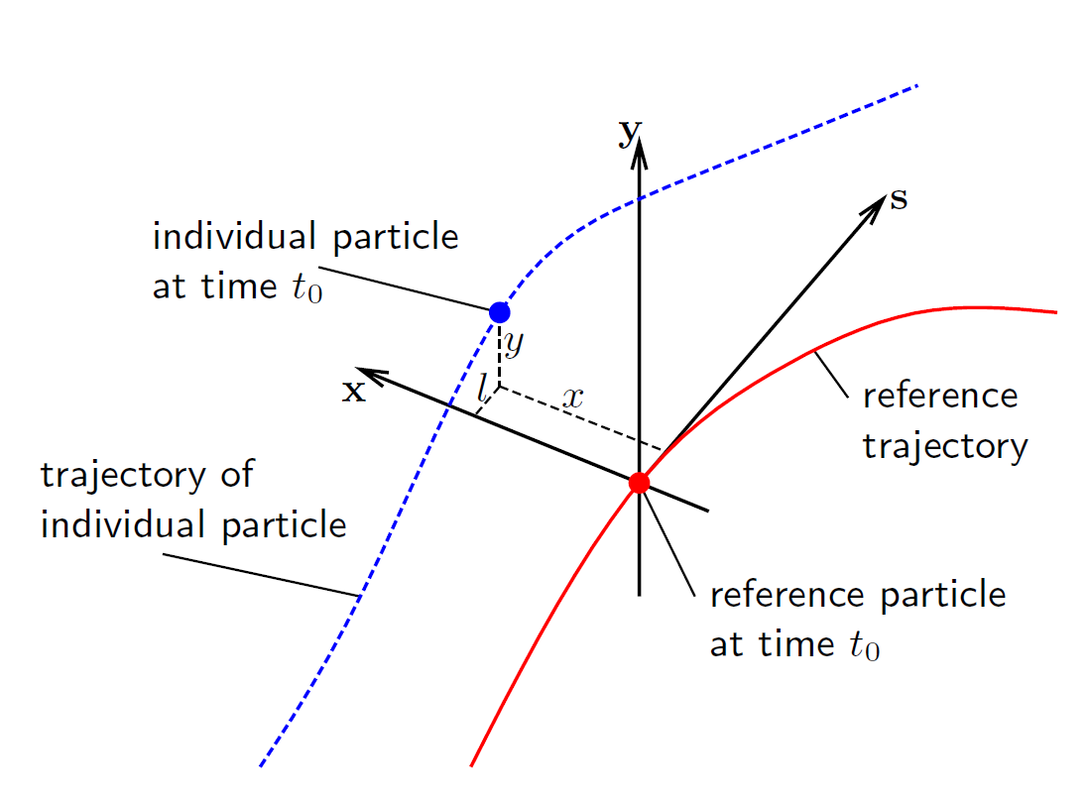

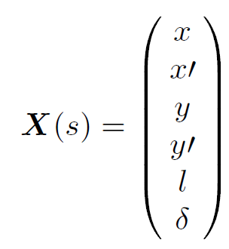
Beam Dynamics Coordinates
horizontal phase space
Co-moving coordinate system with respect
to design trajectory (right-handed-system
at XFEL)
Phase space is generated between distance and angle to the design orbit in each plane

Slide 3
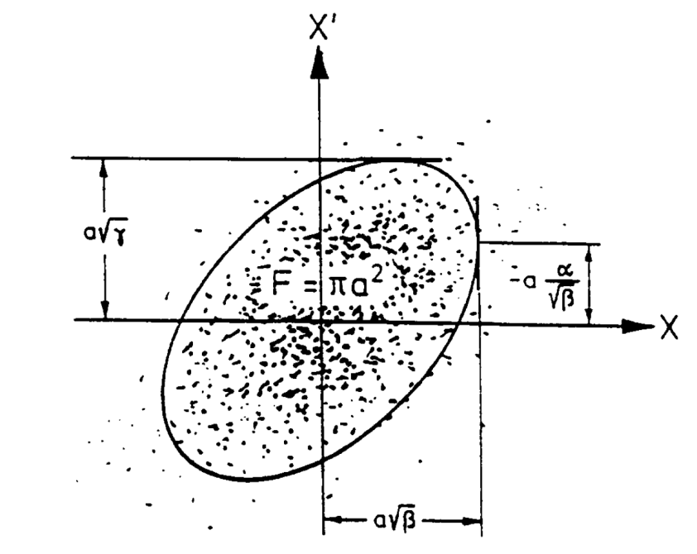
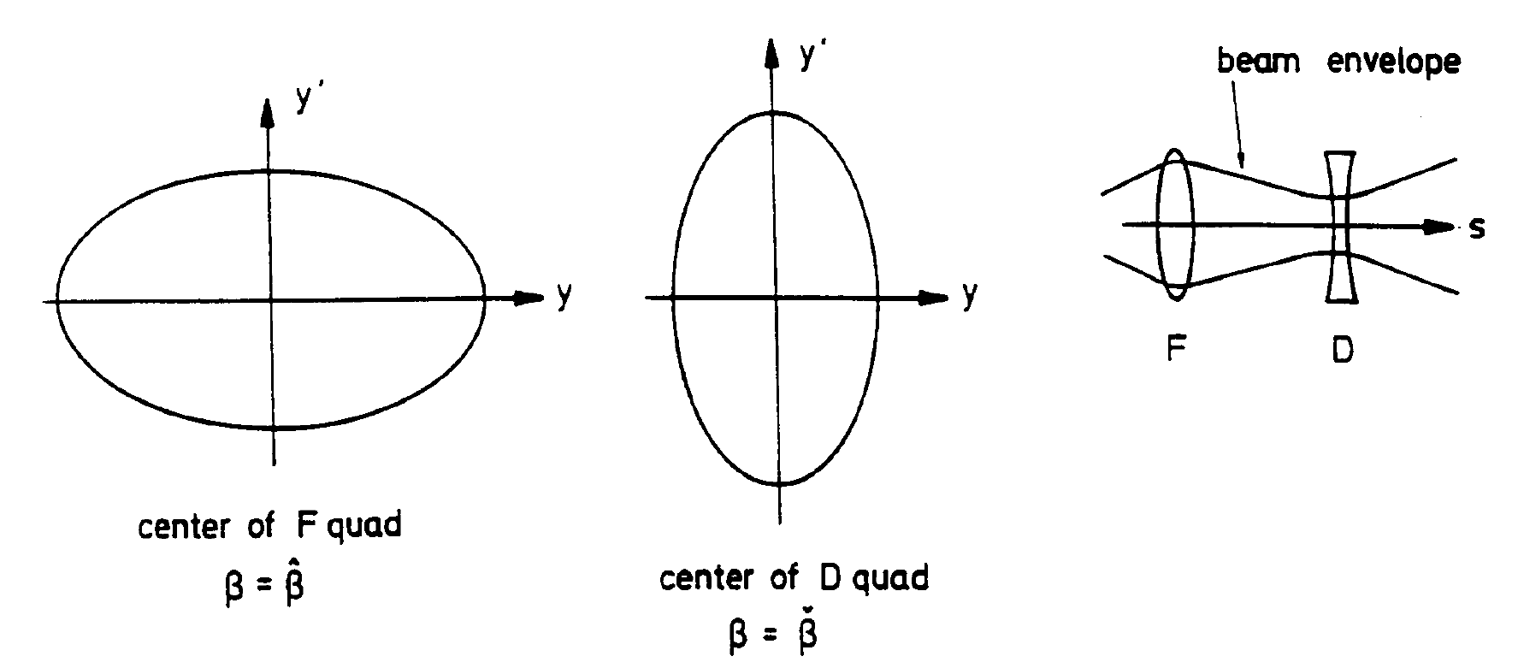
Emittance
Area covered by particles in phase space is
called emittance
We can assume an elliptical distribution
Emittance is conserved in linear optics
(Liouville’s theorem)
=> focusing the beam will increase its
divergence
Small beams with little divergence as required
for SASE lead to small emittance requirements

Slide 4

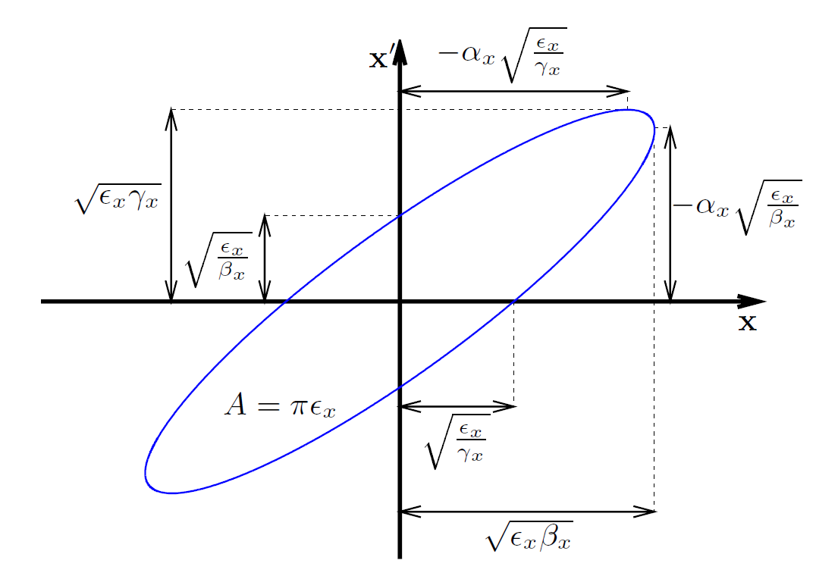
Beam Optics
While the area is conserved the orientation of the phase space ellipse is not
Beam orientation is measured with the “twiss” parameters
“slope” of such ellipses are a signature of convergent or divergent beams
A beam which does not have the same orientations
is called “mismatched” (with respect to design optics)
even if the emittance is the same
smaller emittance and no mismatch
same emittance with mismatch

Slide 5
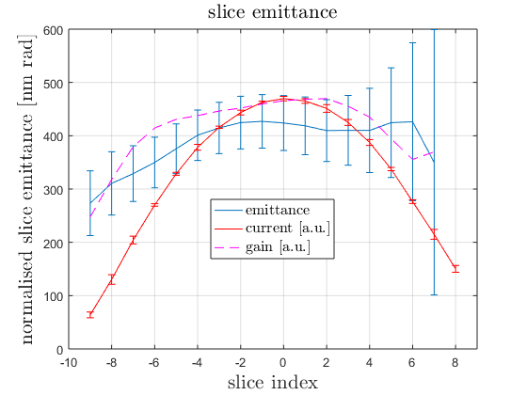
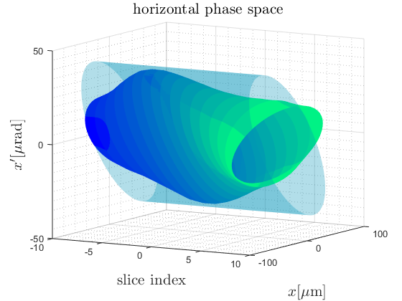
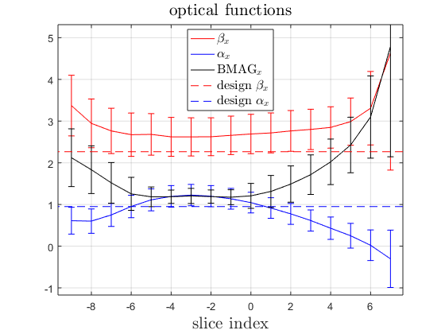
Slice Emittance
FEL Process acts in a “slice” much shorter then the bunch length
Projected emittance would underestimate the phase space density of each slice
Longitudinal resolved measurements using a transverse deflecting structure (TDS)

Slide 6
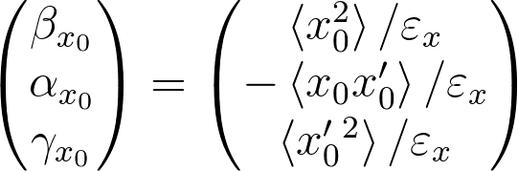

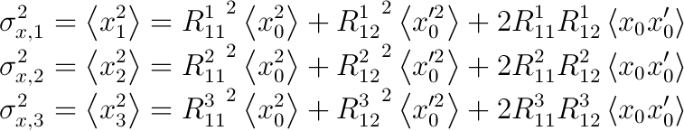
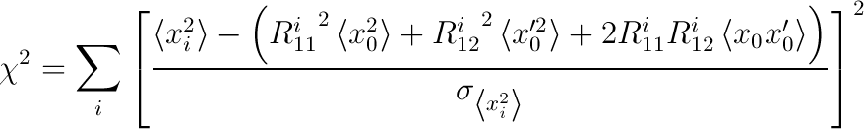
Measurement Theory
Beam size at point i as a function of initial beam moments:
From the beam moments emittance (and twiss parameters) are determined:
In an ideal measurement three data points are sufficient:
In a real measurement more
then three data points are taken and
the beam moments are determined
by a least square fit:
unknowns to be determined by the measurement
determined by diagnostics (screens / Image Analysis Server)
provided by beam dynamics (Optics Server)

Slide 7
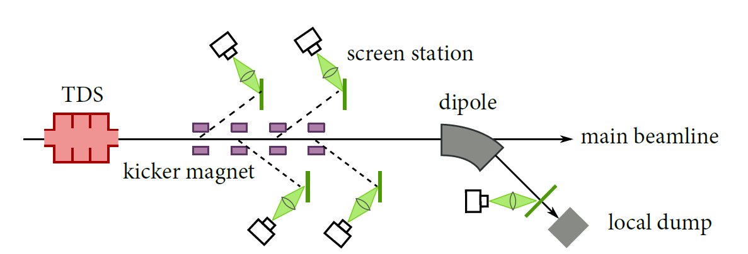
Optics-/Emittance Measurements
Optics and Emittance is determined from beam size measurements:
Beam moments are determined at a reference point using either:
  one screen while varying the quadrupole settings
  at multiple positions along a constant lattice (FODO)
Slice resolved measurements in combination with a transverse deflecting RF-structure (TDS)
Screen
Quadrupole
reference point

Slide 8
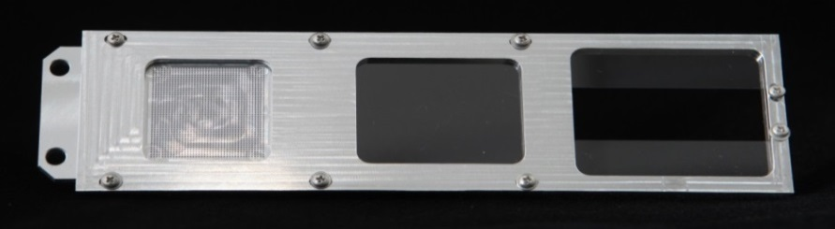
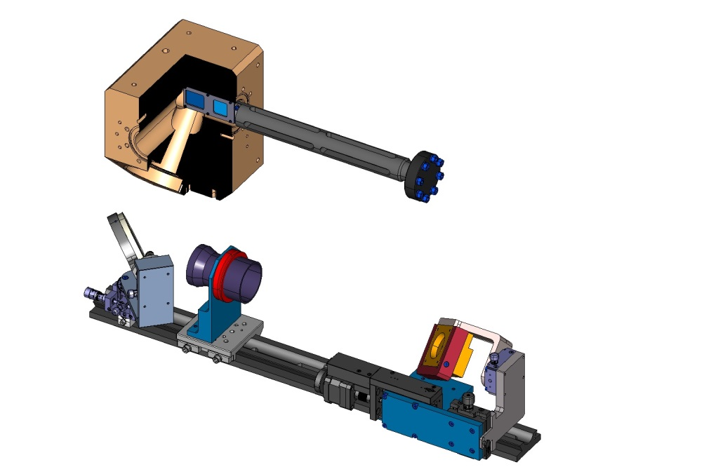
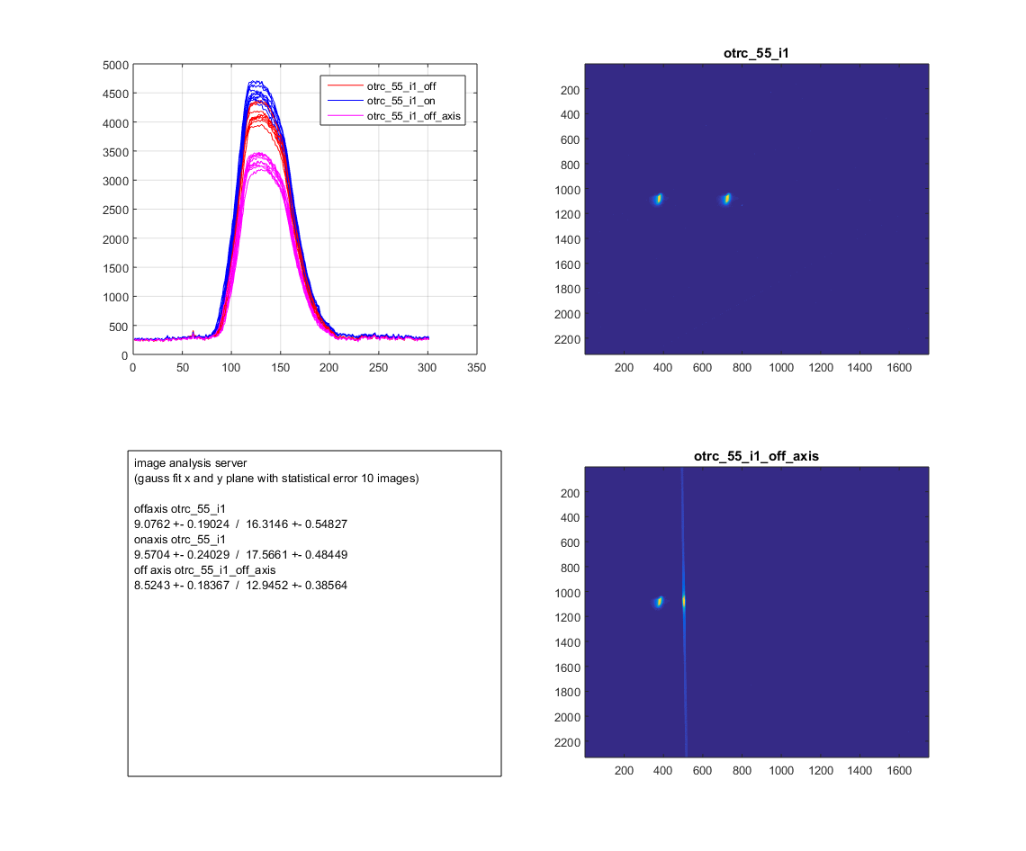
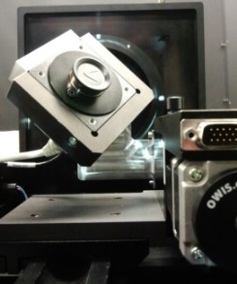
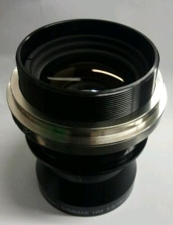
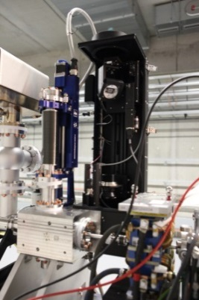

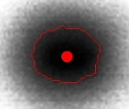
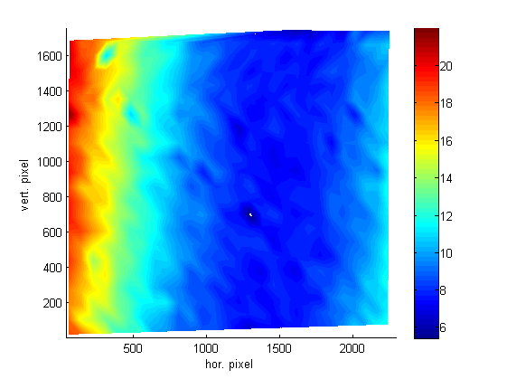

Screen Station for European XFEL
monitor setup
dot grid target(spot Ø .50mm)
BEAM
f = 180mm for 1:1
200µm thick LYSO screen (on-axis)
f = 120mm for 1:2
2 half 200µm thick LYSO screens (off-axis)
Optical Axis
FLASH II installation
Example: 2 bunch operation second bunch is kicked
Optics Axis
optical Resolution
BEAM
on-axis screen
off-axis screen
Scheimpflug observation geometry
10.5 μm average resolution
(dot → optical „step“ function)
Slide thanks to G. Kube
Ch. Wiebers et al. Proceedings of IBIC2013, Oxford, UK

Slide 9
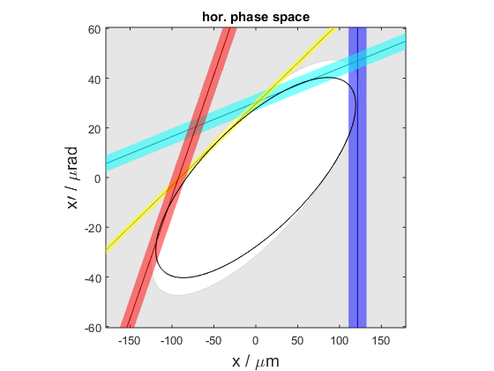
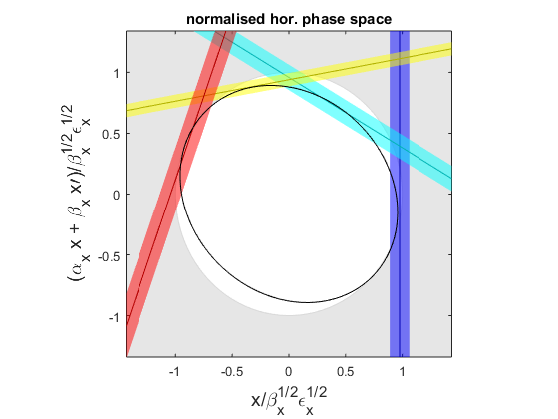
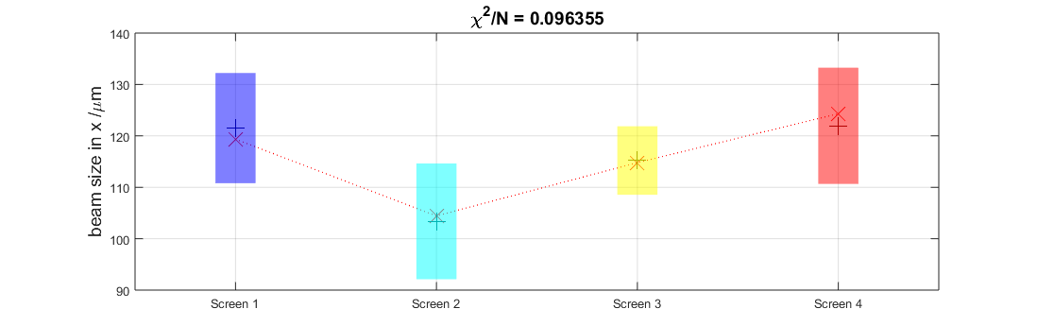
Measurement Fit Summary
Different visualizations of the fit are displayed to judge measurement quality
The design (white) and measured (black) ellipse should agree
Measured ellipse (black) should touch all beam size measurement lines (colors)
In normalised phase space the ellipse should be a circle

Slide 10
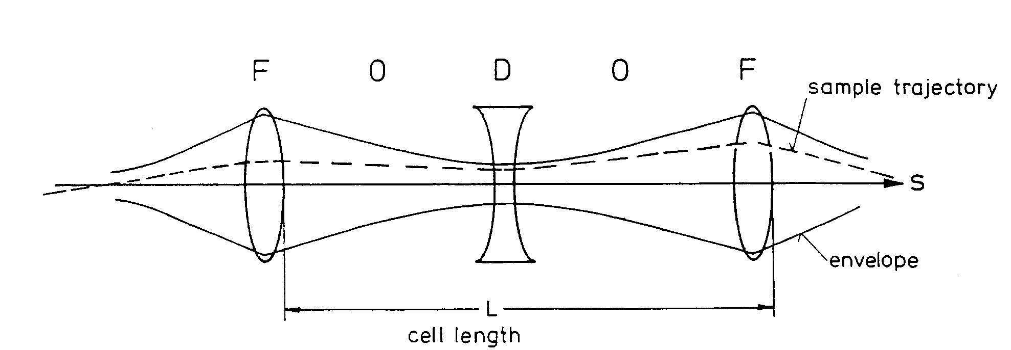
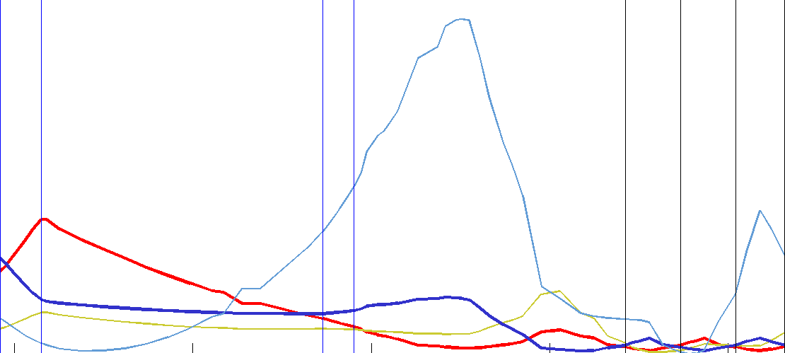
Design Optics
Design optics in the Diagnostic Sections are defined by the periodic FODO lattice
  Unique periodic solution
Example: XFEL Injector
  Quads QI.55.I1, QI.57.I1,
  and QI.59.I1 (same strength as QI.55.I1) define the periodic solution
  Upstream quads match the beam from gun section to the periodic solution
  Downstream quads are set assuming the periodic solution as a start e.g. transport to the I1D dump.
Matching
FODO

Slide 11
Optics Matching
Screen
Quadrupole
reference point
matching quads
A mismatched beam at a reference point can be “matched” by tuning upstream quads
Results from a optics measurement are used from a matching tool to calculate a quad setup
Another measurement is required to confirm improved BMAG
Iterate until desired mismatch is reached

Slide 12
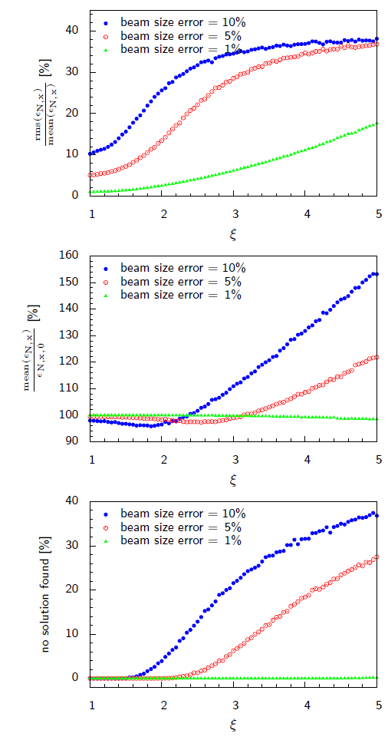
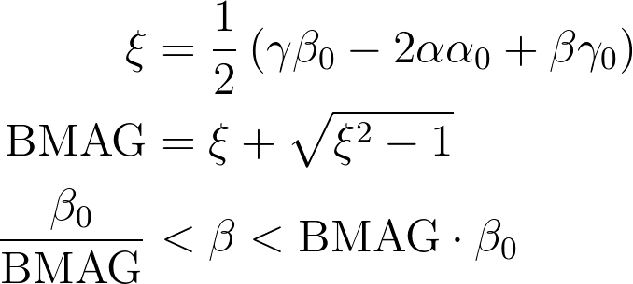
Measurement errors
A mismatched beam (with respect to design optics) is not only bad because of the resulting unknown beam transport – a mismatched beam makes the measurement itself unreliable
If the beam is well matched in a periodic measurement lattice statistic beam size errors contribute with equal weights and partially compensate each other
Do not trust measurements with mismatch higher than BMAG = 2
Beam should be
matched to
BMAG < 1.1
rms error
deviation
failed fits

Slide 13
Matching or NOT Matching?
Set machine (injector) on-crest (zero chirp and zero curvature)
If a file is loaded try to match without changing the quads – assuming the quads are set correctly before
  vary gun phase
  Vary main solenoid
Try matching with quads if gun phase and solenoid do not improve matching

Slide 14
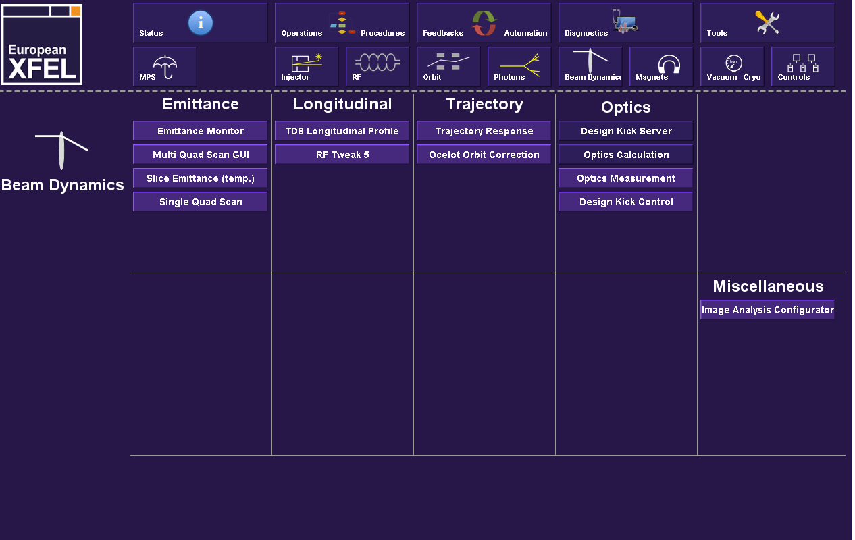
XFEL Tools

Slide 15
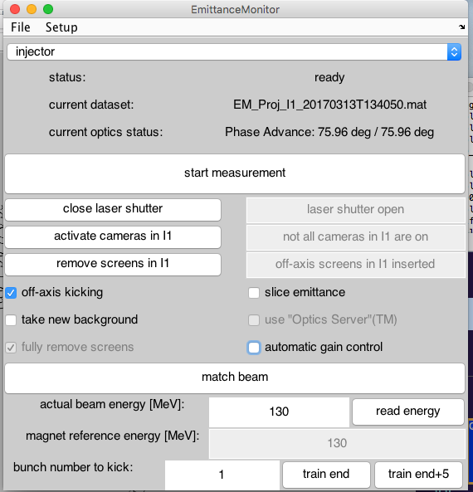
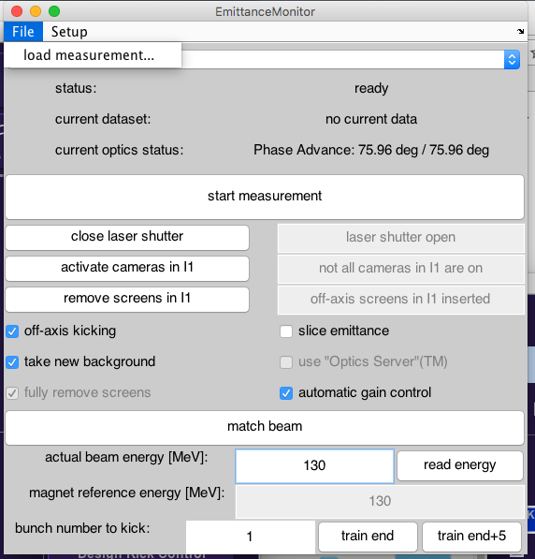
Emittance Monitor Tool
Unified Emittance and Optics Tool:
  Projected Emittance
  Slice Emittance (not in B1)
  on-axis measurements
  off-axis (presently only in I1)
  Optics Matching
  Can load old measurement data

Slide 16
Image Acquisition Preparation
If activated:
  Background is acquired
  Gain is automatically set
This takes time and is in general
only required ones per
measurement session.
Checkboxes automatically
deactivate after first use –
reactivate if needed.

Slide 17
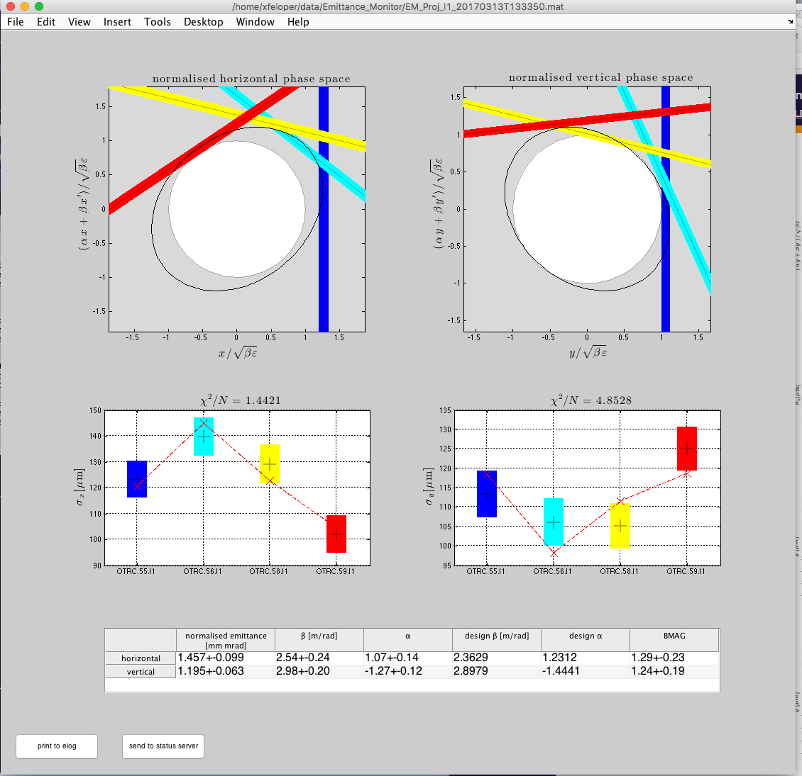
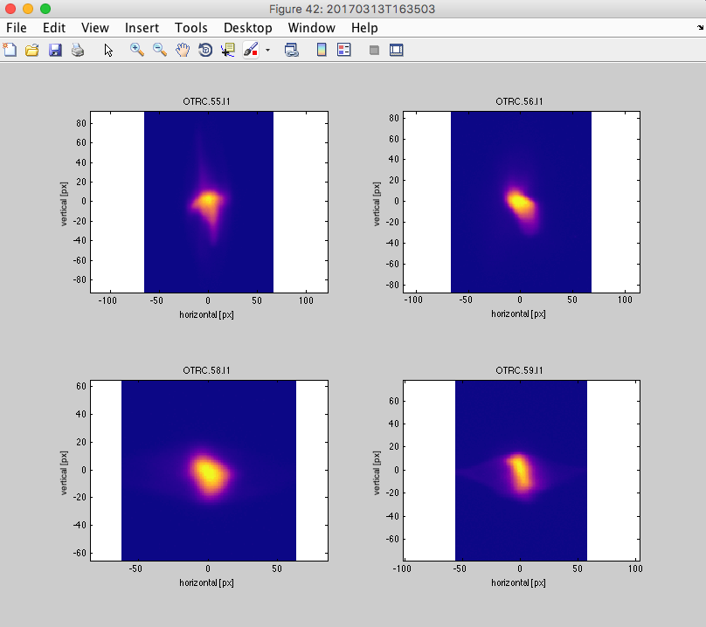
Measurement Summary

Slide 18
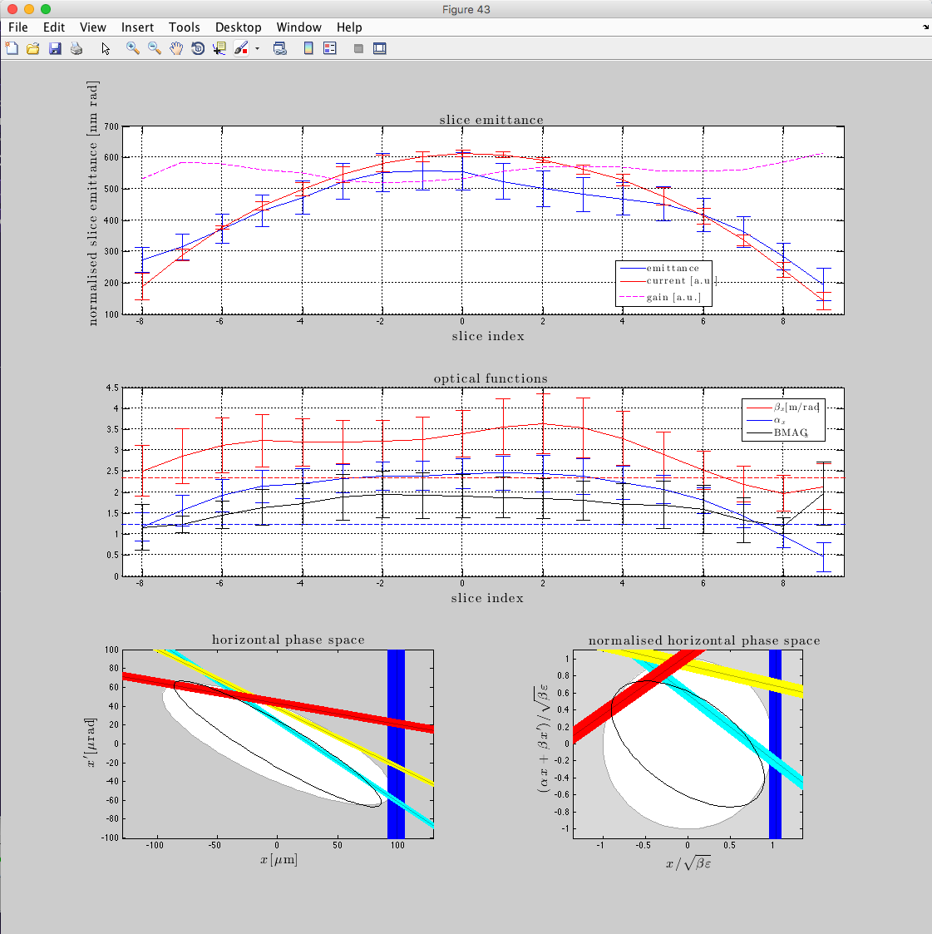
Slice Emittance
Using the TDS slice emittance
can be measured
TDS needs to be in operation
  TDS phase and voltage
TDS optics (76/45) deg has to be
set in machine (use tool to set)
Still somewhat an expert tool
No automised elog entries

Slide 19
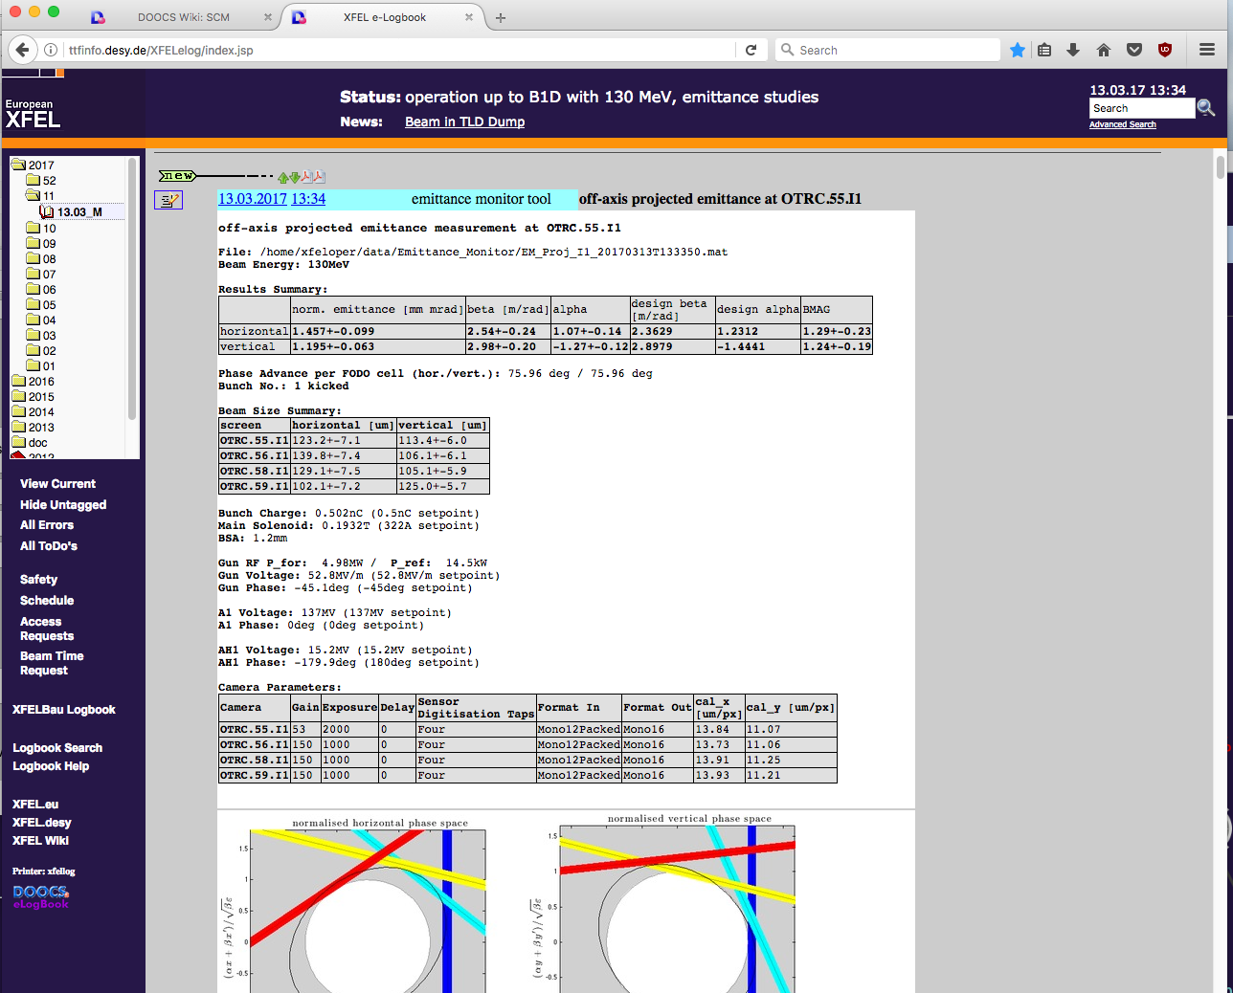
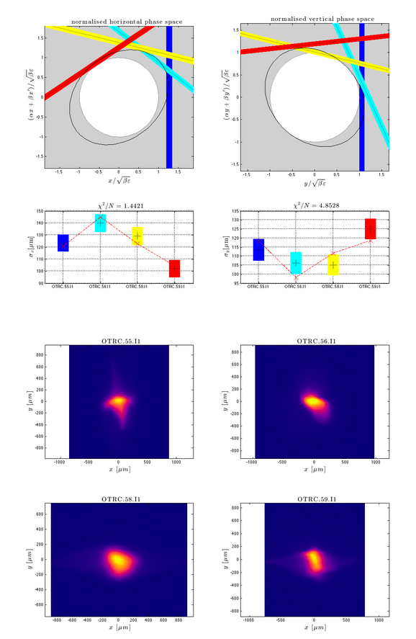

Slide 20
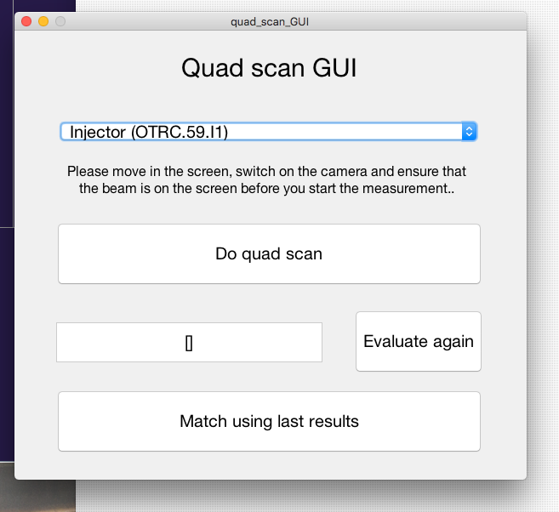
Multi Quad Scan
Simple GUI for multi-quad measurement
  select section
  Press “Do quad scan”
  Select matching if desired
  (is the same code as in the
  Emittance monitor)

Slide 21
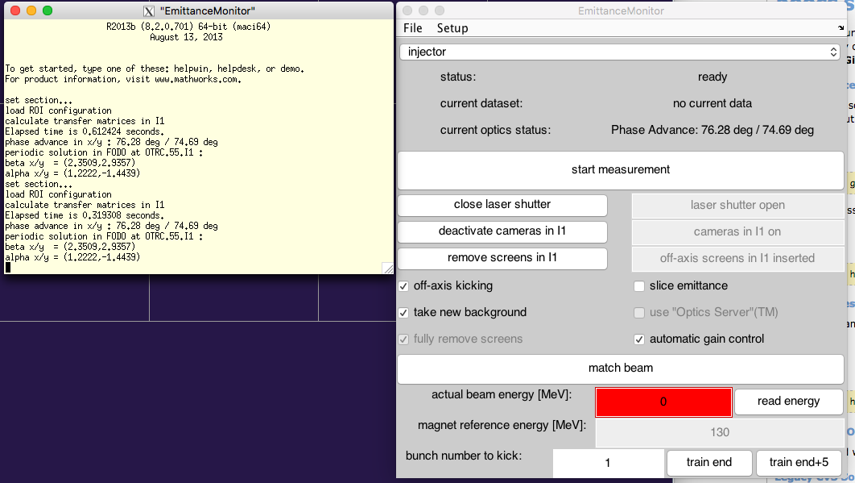
Tool at Start-up

Slide 22
Problems
Screens Inserted correctly / Cameras activated / …
  Use buttons on the tool
Is the Orbit good?
  Check if beam is on screen?
  In case of off-axis measurement try on-axis
  or start kickers manually
Are the magnets properly set?
  Strength and magnet energy
  => check phase advance
        projected emittance: (76/76) deg
        slice emittance: (76/45) deg
Are the cameras working properly?
Is the Image Analysis Server in operation?
  ROI configuration?

Slide 23
Orbit Problems
Area of off-axis screens is smaller
  Make sure the kicked beam
  hits them
Screens in B1 and B2 are of the same
size but the imaging on the chip is 1:1
(factor 2 in each plane compared to I1)
  Field-of-view is 2.54 cm in diagonal
  If beam is not visible insert screen in question and move beam with orbit correctors
B1 and B2
field-of-view
I1
field-of-view

Slide 24
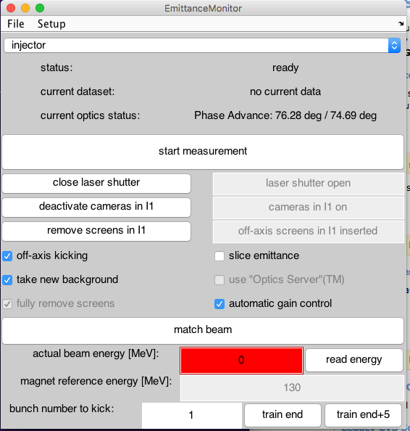
Energy Setup

Slide 25
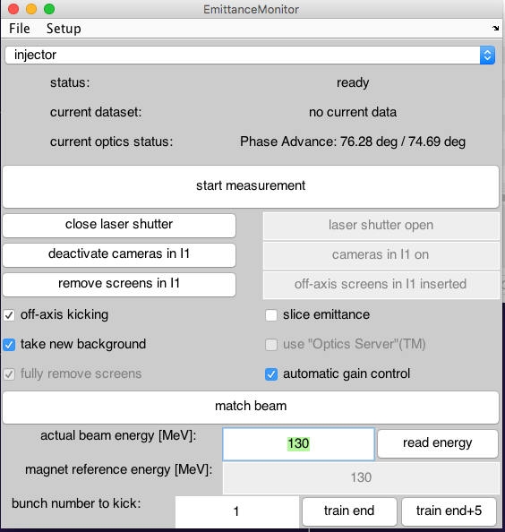
Manual Setting of energy

Slide 26
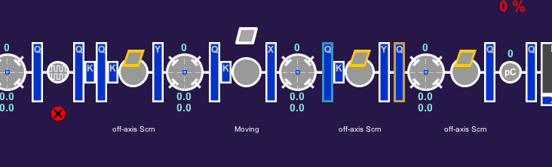
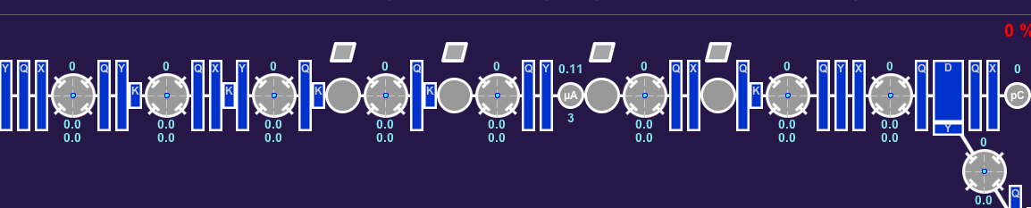
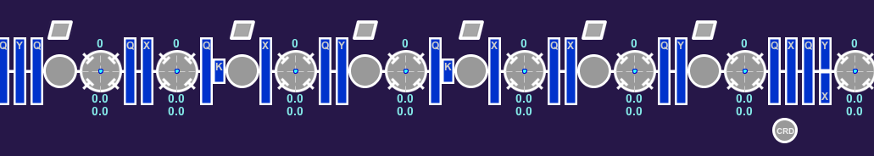
FODO Configurations
I1 from 55 to 59m (horizontal kick)
  Projected: (76/76) deg
    Gen. kick = (-0.8382, +0.8382, -0.8382) rad/m
  Slice: (76/45) deg
    Gen. kick = (-0.6271, +0.7792, -0.6271) rad/m
B1 from 219 to 226m (vert. kick)
  Projected: (76/76) deg
    Gen. kick = (+0.6769, -0. 6769, +0. 6769) rad/m
B2 from 444 to 459m (vert. kick)
  Projected: (76/76) deg
    Gen. kick = (+0.3310, -0.3310, +0.3310) rad/m
If phase advance values are not correct check magnets and energy – and recalculate optics model in tool!

Slide 27
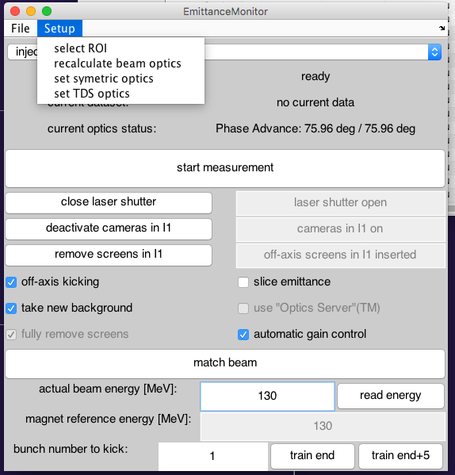
Optics Options

Slide 28
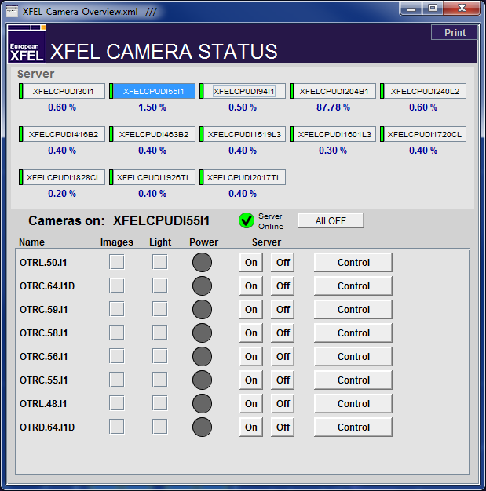
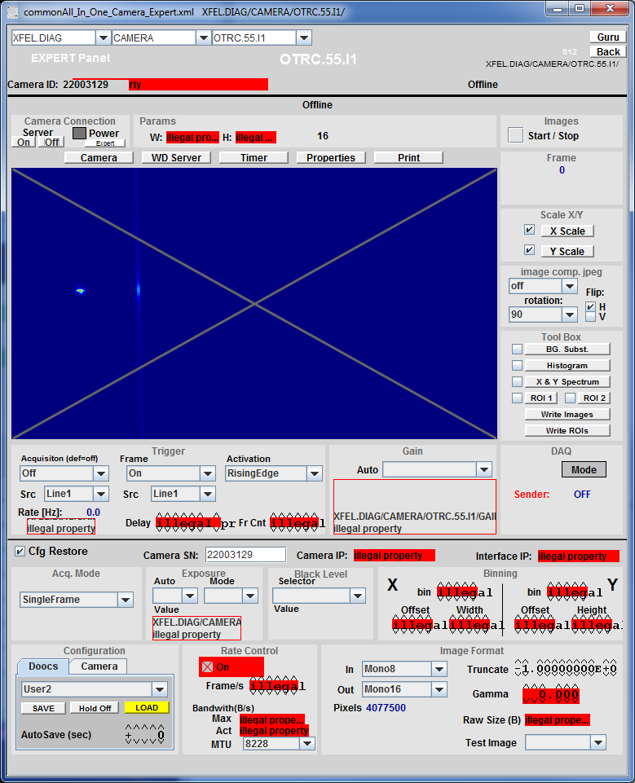
Camera Server Issues
Check CPU load
Only the 4 cameras in the section
should be powered
Deactivate image acquisition

Slide 29

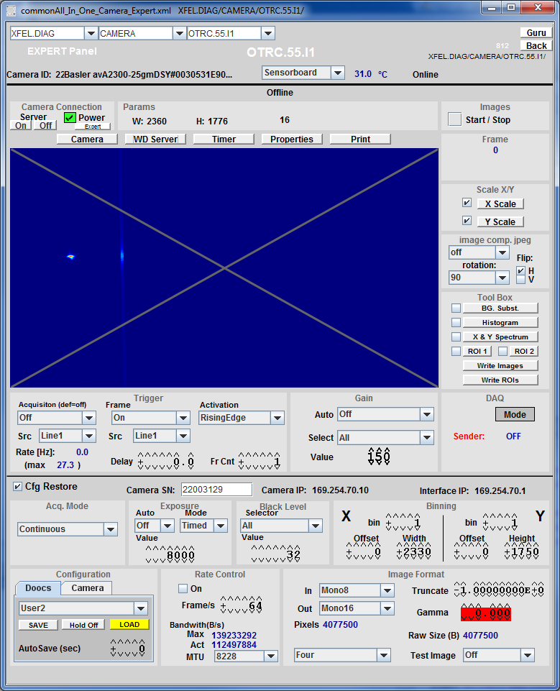
Camera (Server) Startup

Slide 30
Camera Default Values
Default Values of cameras are set
if Emittance Monitor is used to
activate them
Proper settings:
  IN: Mono12Packed
  OUT: Mono16
  Truncate: -1
  Exposure: maximum 1000
  Acquisition: off
  Frame: on
  “Tool Box” checkboxes: off

Slide 31
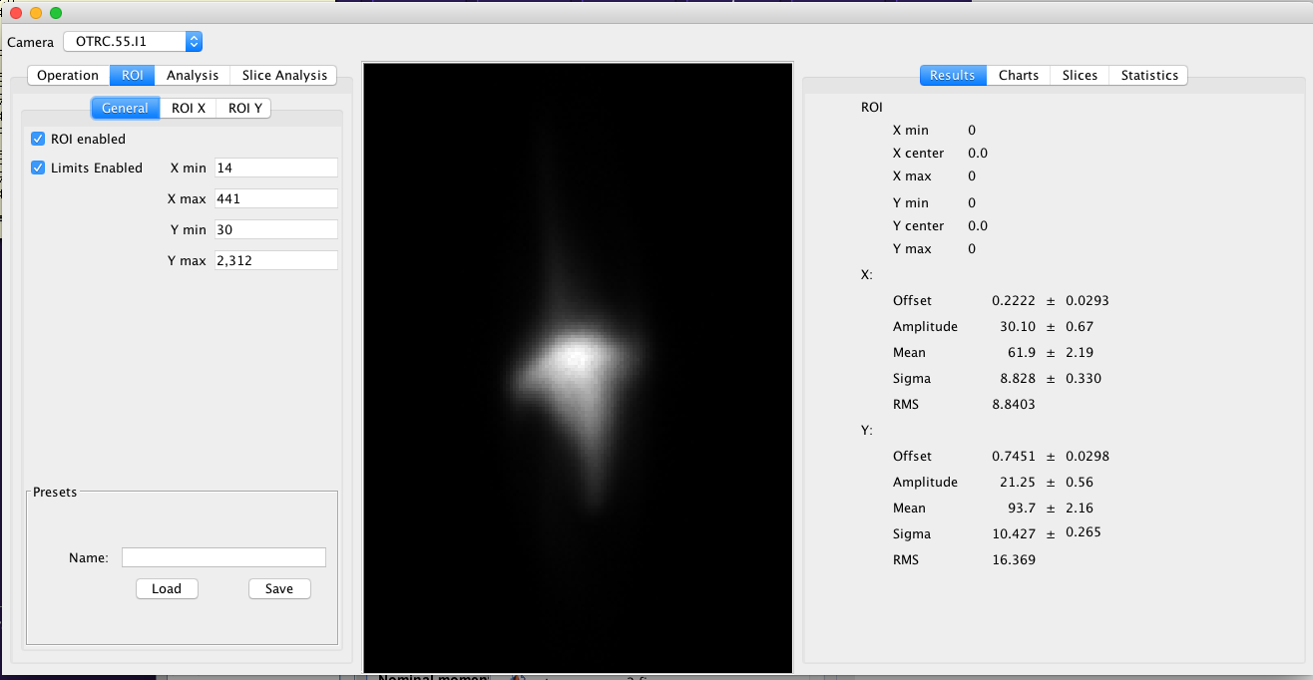
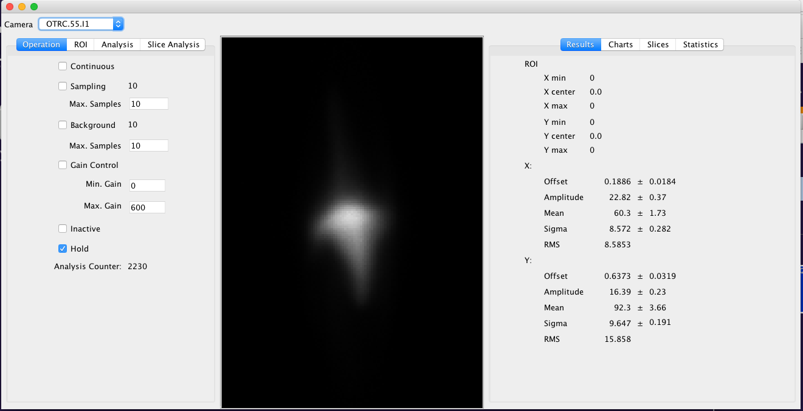
Image Analysis Server Expert Tool
Check if you can see images updating in “Continuous” mode
Check how images behave if ROI modes are deactivated

Slide 32
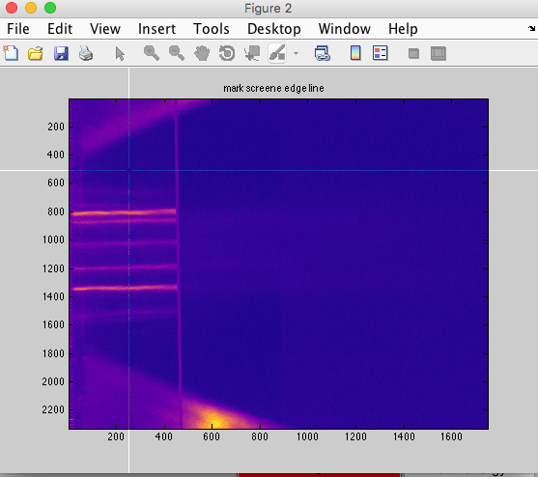
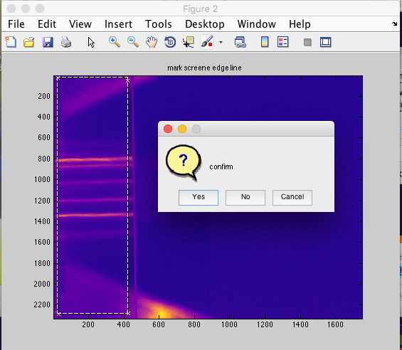
ROI Configuration Tool

Slide 33

Camera Lifetime
Cameras die fast!
  On average each camera was
  exchanged once during the injector run
  Deactivate not needed cameras every
  time you don’t need them for a
  foreseeable time
  Emittance Monitor Tools gives a list off
  all activated emittance cameras at
  shutdown and offers to close them
  Do it….

Slide 34


Slide 35
Thank You for Your Attention…
Literature:
F. Loehl, “Measurements of the Transverse Emittance at the VUV-FEL”,
DESY-THESIS 2005-014, TESLA-FEL 2005-03
M. Minty and F. Zimmermann, “Measurements and control of charged particle beams”,
Springer, Berlin, Heidelberg, New York, 2003.
J. Rossbach and P. Schmueser, “Basic Course on Accelerator Optics”

Slide 36
Principle of Optics Measurements
momentum
position

Slide 37
Principle of Optics Measurements
normalised
momentum
normalised
position

Slide 38
Principle of Optics Measurements
normalised
momentum
normalised
position
beam size

Slide 39
Principle of Optics Measurements
normalised
momentum
normalised
position

Slide 40
Principle of Optics Measurements
normalised
momentum
Phase Advance
normalised
position

Slide 41
Principle of Optics Measurements
normalised
momentum
normalised
position

Slide 42
Principle of Optics Measurements
normalised
momentum
normalised
position

Slide 43
Principle of Optics Measurements
normalised
momentum
normalised
position

Slide 44
Principle of Optics Measurements
normalised
momentum
normalised
position

Slide 45
Principle of Optics Measurements
normalised
momentum
normalised
position

Slide 46
Principle of Optics Measurements
normalised
momentum
normalised
position

Slide 47
Principle of Optics Measurements
normalised
momentum
normalised
position

Slide 48



On-Axis Projected Measurements
Most reliable
Takes more time than other methods (~ 5 minutes)
Does not require kickers or TDS systems operational
Only first bunch
Should be the first choice for startup after shutdown etc.

Slide 49





Off-Axis Projected Measurements
Use of kickers allows for much faster measurements (about 20s)
Orbit and optics mismatch
needs to be good
Allows for measurements of
other than the first bunch
Make sure that the energy
chirp is removed
Main tool for tuning of
projected emittance

Slide 50


Slice Emittance Measurements

Slide 51


Combined Tool Results

Slide 52


