Slide 1
Schedule and Priorities
2018 / 2019

Slide 2
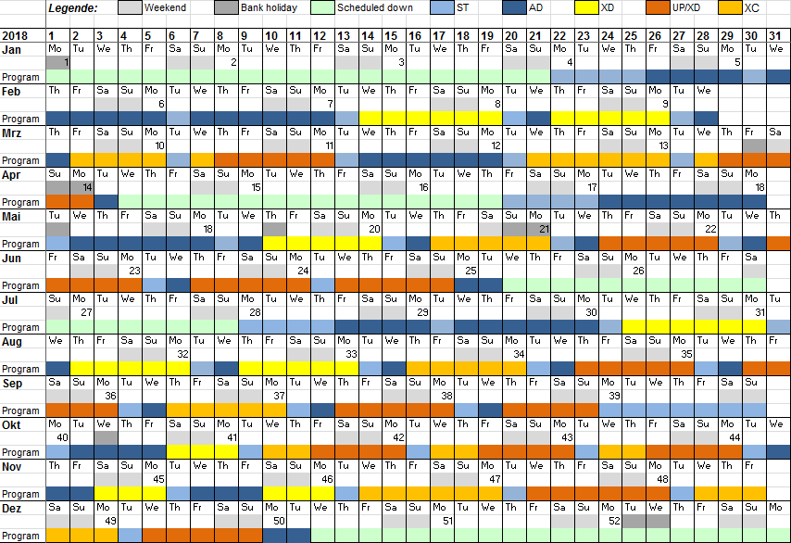
Updated 2018 schedule rev. 4

Slide 3
Updated 2018 schedule with overlay from an overall perspective
Acc. And XTD installation & commissioning; start-up
start-up
SASE1 tuning
SASE3 1st lasing
Setup
Beam thr. SASE2
Shutdown for CS9 + SASE2 completion
SASE2 1st lasing
SASE2 comm.
Setup
1st EUE
Setup
1st EUE
1st EUE
Shutdown for Interlock
Shutdown
Und. gap tuning + incr. bunches
Comm. SASE1+3
Comm. SASE1 + 3
2nd EUE
2nd EUE
Acc. buffer
AD + XD?
2nd EUE
AD + XD?
3rd EUE
3rd EUE
Winter shutdown

Slide 4
Updated 2018 schedule from the SASE1 perspective
SASE1 main activities; start-up
start-up
SASE1 tuning
comm. w. beam?
Setup
1st EUE
Setup
1st EUE
1st EUE
1st EUE
1st EUE
Commissioning
Commissioning
2nd EUE
2nd EUE
2nd EUE
Commissioning – no user experiments
Commissioning
Winter shutdown

Slide 5
Updated 2018 schedule from the SASE3 perspective
XTD4+10 installation & commissioning
start-up
SASE3 1st lasing
SASE3 instr. interlock tests
Electronics Comm.
Electronics Commissioning (BH Modules, Loops & Firmware)
Electronics Commissioning (Beckhoff Loops & Firmware, E2E)
Control System Commissioning (Karabo & E2E)
Comm. SASE 3
Commissioning of XTDs and Instruments with X-rays
Commissioning of XTDs and Instruments with X-rays
Setup & conduct very first experimental trials
3rd EUE
3rd EUE
Winter shutdown

Slide 6
Updated 2018 schedule from the SASE2 perspective
Acc. And XTD installation & commissioning; start-up
start-up
Beam thr. SASE2
Shutdown for CS9 + SASE2 completion
SASE2 1st lasing
SASE2 comm.
SASE2 instr. interlock tests
SASE2 instr. interlock tests
XTD6 finishing / closes
Electronics & Control System Commissioning MID + HED Opt.
Electronics & Control System Commissioning MID + HED Opt.
Electronics & Control System Commissioning MID + all HED
Elec.+Contr.Sys.
Commissioning of MID with X-rays
MID X-ray Comm.

Slide 7
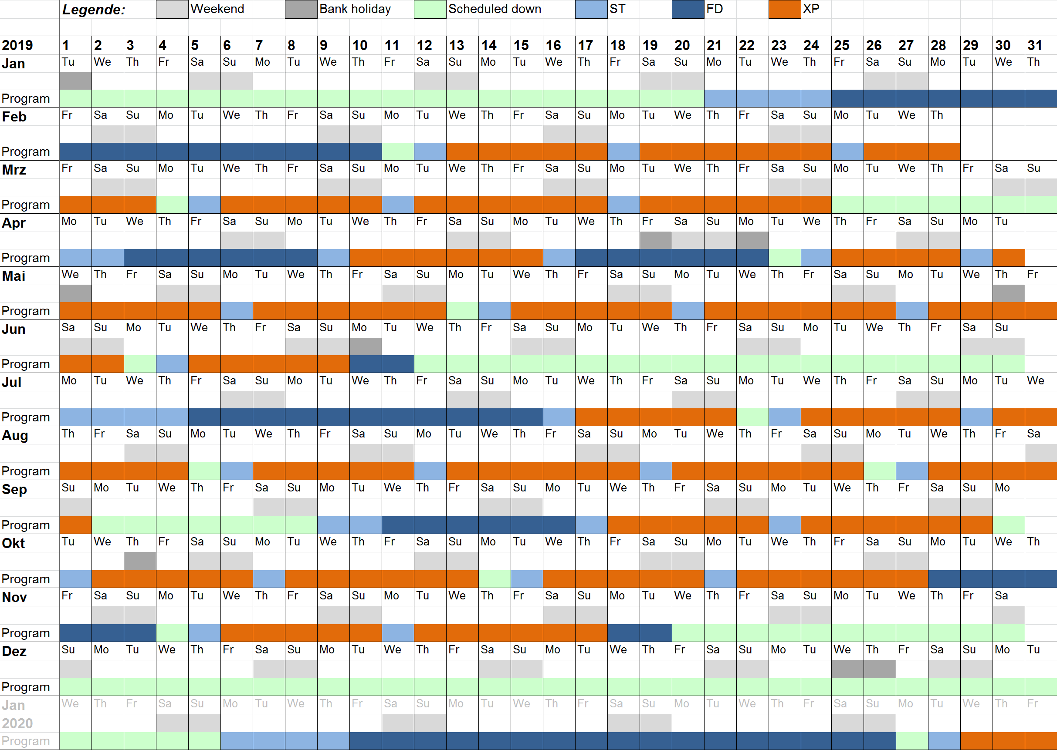
Draft Schedule 2019 final

Slide 8
Updated 2019 schedule with overlay from an overall perspective
Winter shutdown: SASE2 self seeding
Startup
Startup
3rd EUE
3rd EUE
Shutdown
3rd EUE
3rd EUE
3rd EUE
Shutdown: yearly interlock test

Slide 9
Scope 2018/19 / Order of priorities
SASE1 tunnel operation
SASE1 instrument operation
SASE3 tunnel operation
SASE2 tunnel readiness ➔ SASE2 tunnel operation
SASE3 instrument readiness ➔ SASE3 instr. operation
SASE2 instrument readiness ➔ SASE2 instr. operation
SASE1 tunnel & instrument completion
SASE3 tunnel & instrument completion
SASE2 tunnel & instrument completion

Slide 10
1. SASE1 tunnel operation
Tasks & effort required to operate the tunnel:
(including items for Day-1 or required to meet promises in Call for Proposals)
Accelerator: Achieve >0.5 mJ and good pointing stability (matching our optics)
Accelerator / XFEL: Improve undulator controls & adjustments / reduce losses / PBBA
(K-mono-based undulator segment tuning and analysis ➔ scripts under developement)?
Accelerator: Good understanding of the FEL gain curve (only 1 attempt) ➔ done
Accelerator: Working kicker magnets (picking of pulses)
Accelerator / Diagnostics: Measurement of the spectral jitter and bandwidth
Optics: Installation & commissioning of distribution mirror cooling (2nd half 2018)
Diagnostics commissioning of MCP, Hirex, K-Mono (now 50% → 75% ➔ done)
(required for improvements of the accelerator)
CAS & ITDM: Tunnel DAQ reliability / commissioning (66% done)
Diag/FXE: reliable XGM readout ➔ provides arbitrary numbers only, calibration needed
Vacuum & CAS: Final implementation of vacuum controls (80% done ➔ 85%).
FXE: Installation & commissioning of diamond grating ➔ done apart from commissioning w/beam
FXE: Commissioning of 4 bounce monochromator
(AE+CAS-support required, basic functionality has to be achieved in April shutdown!) ➔ not yet done!
AE & SPB: Pulse picker has to be comissioned (35%) with beam (0%) ➔ must be completed in July
SPB/SFX: Update attenuator foils (scheduled for June/July)
CAS/FXE: Improvement of BKR-controls, Karabo-DOOCS bridge to access camera data for tuning
SPB/SFX: Optimising CRL B4C apertures (in XTD9 during June/July)

Slide 11
2. SASE1 instrument operation
Tasks & efforts required to operate the instruments:
(including items for Day-1 or required to meet promises in Call for Proposals)
SPB/SFX: CSS & vacuum works partially done
CAS: Improve Control Software: Scan tool being tested @ FXE ➔ still not working
➔ operational, but still not working as instrument desires (work in progress…)
Accelerator & SPB/SFX: Improvement of the focal properties
SPB/SFX: KB-mirror installation, integration & commissioning (25% ➔ 50%), more installation in June/July, comm. in August (requires pulse picker and usual controls support CAS, AE, etc)
FXE: Installation, commissioning and integration of two-tile LPD (req. in August)
SBP/SFX: Achieve full MC2 motors functionality / find PLC-interface issues
SPB/SFX: Combined motions for Mirrors, CSS and more (required before June/July shutdown)
SBP/SFX: Motion in sample chamber region (Hexapod, Smaract stages)
SBP/SFX: Microscopes (diagnosis and remedy of dangerous spontaneous motion behaviour)
FXE: Transition from simple motor → MC2 motors for all motors

Slide 12
3. SASE3 tunnel operation
Tasks & effort required to operate the tunnel:
(including items for Day-1 or required to meet promises in Call for Proposals)
Vacuum & Optics:
  Beam shutter cabling MPS to XFEL ➔ cabling done, but not connected to PLC (June)
  Installation of mirror M5 (April) ➔ done
  Installation, test and commissioning of mirror cooling (after SASE1 cooling)
  Soft monochromator (synchronous movement required, lacks Karabo-Interface, required for instrument commissioning & user experiments
  ➔ needs to run in July, to allow proper commissioning with beam)
  Photon beam loss monitors (required for long pulse trains ➔ Sep. 2018)
  ➔ installed, ready for PLC and Karabo local tests
Diagnostics:
  Exit Slit imagers and Exit Slits: tech. commissioning (-April) ➔ now commissioning with beam - June
  PES: commissioning (Rem. tech. com., e.g. Beckhoff-loops VAC and MOV in April shutdown ➔ done Commissioning with beam in May)
  K-mono: resolve in-vacuum issues (in April shutdown)
  MCP: Replacement of one device (MCP1) needed ➔ to be replaced in June/July shutdown
  Simultaneous operation of SASE1+3: Suppression of pulses from SASE1 in SASE3 required

Slide 13
4. SASE2 tunnel readiness
Achieve first lasing: 1st attempt in Mar. 18 → Apr.-May ➔ done
  Beam shutter only XS2, XGM in XTD1, FEL-&SR-Imager, Vacuum in XTD1 with controls, interlock, DAQ until start, latest end of April shutdown
  (consider workload during April shutdown!)
Major works finished XTD1+6: Apr. 18 → End of Q2 2018 → 20th of July
  Vacuum & Optics: Mirrors, CRL-1, Vacuum + beamshutter + DAQ in XTD6
  Diagnostics: K-Mono, XGM in XTD6, MCP, Pop-Ins and other Imagers
  Split&Delay Unit (to be closed by June/July ➔ to be technically commissioned in Winter)
  MID: MID-CRL-2, Solid Att. ➔ installed, almost cabled, Slits ➔ installed, to be cabled,
  further Imagers ➔ being assembled, to be installed,
  2-bounce 111-Si-mono ➔ installed, but cables and electronics missing!
  HED: HED-CRL-2 ➔ installed, further Imagers ➔ to be installed until July,
  High resolution monochromator ➔ arrives in September, PLC & cables in
  production)
  4-bounce standard 111-Si-mono ➔ installed, but cables and electronics missing!
Simultaneous operation of SASE1+3+2: End of Q2 2018 ➔ done (1 bunch),
collimation of bunches for SASE1 vs SASE2 + independent bunch patterns
First beam in XTD6: Goal: After 20th of July
Access times XTD6 ➔ schedule has to be clarified!

Slide 14
5. SASE3 instrument readiness
TGA
  AC ready until Feb. / Apr. 18, Elec. ready until Mar. 18 ➔ AC being commissioned, done
  IT ready until end of March 18 ➔ done
Beckhoff electronics
  Cabling Phase II done until Jan.18 → beg. of May 18 → beg. June 18 (SCS: 60% / SQS: 90%)
  Day 1 hardware BH done until Feb. 18 (90%) ➔ done
  Beckhoff electronics E2E done until Jul. 18 ➔ SCS 1st loop up & running
Instrument installation
  Installation of large/heavy instrument components: Feb. – Apr. 18 ➔ SQS: LasInCoupl. in May
  Installation of KB-systems SCS + SQS: April 2018 ➔ done, being leak-tested
  SQS: AQS-chamber ➔ June
  SQS: Commissioning of SQS fiber laser (Sep.-Oct. 2018)
  SCS: Installation, integration and comissioning of FastCCD
  (arrives at the beamline in Oct. 2018 ➔ Sep. 2018)
  ITDM: Installation / Configuration / Commissioning of DAQ ➔ h/w available in May
Instrument commissioning without beam
  Installation of Rad. Saf. Interlocks in Apr. 18 ➔ Test 20th June, TÜV 5th of July
  Installation of Laser Interlock until April, commissioning in May ➔ Test of LI until beg. of June

Slide 15
6. SASE2 instrument readiness
TGA
  AC ready until Mar. / Apr. 18, Electricity ready until Apr. 18 ➔ delayed until May 18
  IT ready end of April 2018 ➔ end of May 18 (documentation missing)
Beckhoff electronics (MID Opt. / HED Opt. / MID / HED)
  Cabling Phase II → July / Sep / mid. Aug / Q1 19 → July / Sep. / Nov. / March 19
  Day 1 hardware BH → June / Aug. / July / Q4 18 → June / July / June / Oct. 18
  Beckhoff electronics E2E → Sep. / Q4 18 / Oct. / first half 2019 → Sep. / Oct. / Q4 18 / Q2 2019
Instrument installation
  Installation of large/heavy instrument components: Q4 2017 - Q1 2018 ➔ - Q2 / Q4 2018 (MID / HED)
  MID: AGIPD ready for installation in Feb. 18 ➔ cabling done, AGIPD delivery in May 2018 to HERA, or directly to MID (different cables, power supplies, closer access…)???
  ➔ common goal to have AGIPD up&running in Nov. & take 1st diffraction
  HED: Integration of Jungfrau-/ ePIX-detectors ➔ to be delivered, FAT passed / passed SAT
  ITDM: Installation / Configuration / Commissioning of DAQ
Instrument commissioning without beam
  Installation of Rad. Saf. Interlocks in July 18
  Installation of Laser Interl. in Mar.-Apr., commissioning in May ➔ mobile LI 11.5., LI earliest in August
Start of beam delivery for instrument commissioning possibly in November (Exp), in parallel to SASE3 user operation

Slide 16
7. SASE1 tunnel & instrument completion
Tunnel:
  HiRex: Gotthard v2 – 25 required for resolution / MHz rate DAQ (shot2shot spectra!)… (to arrive in earliest July 2018)
  Upgrade to gated imager (for picking a pulse image in the train)
  PES + DPS for PES
FXE:
  Jungfrau + Gotthard v2 detector planning, cabling, integration & commissioning
  Additional cabling (I/O, more motors from JJ…) ➔ Nov/Dec 2018
  Improvement of Data Analysis, e.g. analysis of LPD images, figure of merits… (not possible in 2018 without affecting the commissioning of SASE3/SASE2 day 1 detectors)
SPB/SFX:
  Jungfrau + Gotthard v2 + AGIPD4M detector planning, cabling, integration & commissioning
  Additional work for downstream region (day 2 / SFX)
  Additional rackroom D.23 (Q1 2019)

Slide 17
8. SASE3 tunnel & instrument completion
Tunnel:
  Undulators: Self-seeding, Circular polarization undulator, Helical afterburner
  Diagnostics: Full PES operation, Exit-Slit Imagers ➔ 1st prototype to be commisioned now
SCS:
  Additional rackspace beyond day 2 required?
  Setup of PP-Laser system incl. the instrument laser hutch (early 2019)
  2nd user endstation XRD (Q2 2019)
  hRIXS + chemistry station (2nd half 2019)
  Installation, integration and comissioning of DSSC mini-SDD / pnCCD
  (arrives at SCS at the end of 2018 / Jan. 2019)
SQS:
  Additional rackspace beyond day 2 required?
  NQS + REMI-chambers (for later 3rd EUE user proposals in early 2019)
  Refocussing optics for spectral and timing diagnostics (2nd half 2019)
  Installation, integration and comissioning of DSSC DEPFET (2020) and
  NQS-chamber pnCCD (Jan. 2019)
Third experiment (TR-XPES):
  No power + cable trays, lighting, rad. shielding, chicanes, air conditioning, rackroom, rad. safety interlocks… ➔ concept to be written by M. Izquierdo / L. Batchelor

Slide 18
9. SASE2 tunnel & instrument completion
Tunnel:
  Undulators: Self-seeding ➔ Winter shutdown 2018/19, HED: 400 fs delay chicane…?
  Diagnostics: Hirex 2
MID:
  Integration of Jungfrau-, ePIX-, Gotthard v2 detectors…
  Split&Delay Unit in MID-Opticshutch ➔ to be installed in May 2019
  Setup of PP-Laser system incl. the instrument laser hutch ➔ middle of 2019?
HED / HIBEF-UC:
  Setup of HIBEF AGIPD, Gotthard v2 and smaller detectors
  Installation & commissioning of Amplitude (April-Nov.) and DiPOLE (Nov. 2018 -)
  Setup of PP-Laser system incl. the instrument laser hutch
  Interaction area 2: Rails (MEA), cabling phase 2b (IA2 HIBEF components)
Third experiment:
  No hutch and no infrastructure planned…

