Slide 1
Undulator radiation doses caused by synchrotron radiation
Shan Liu (DESY), Yuhui Li (European XFEL)
Radiation task force meeting, 17.05.2018

Slide 2
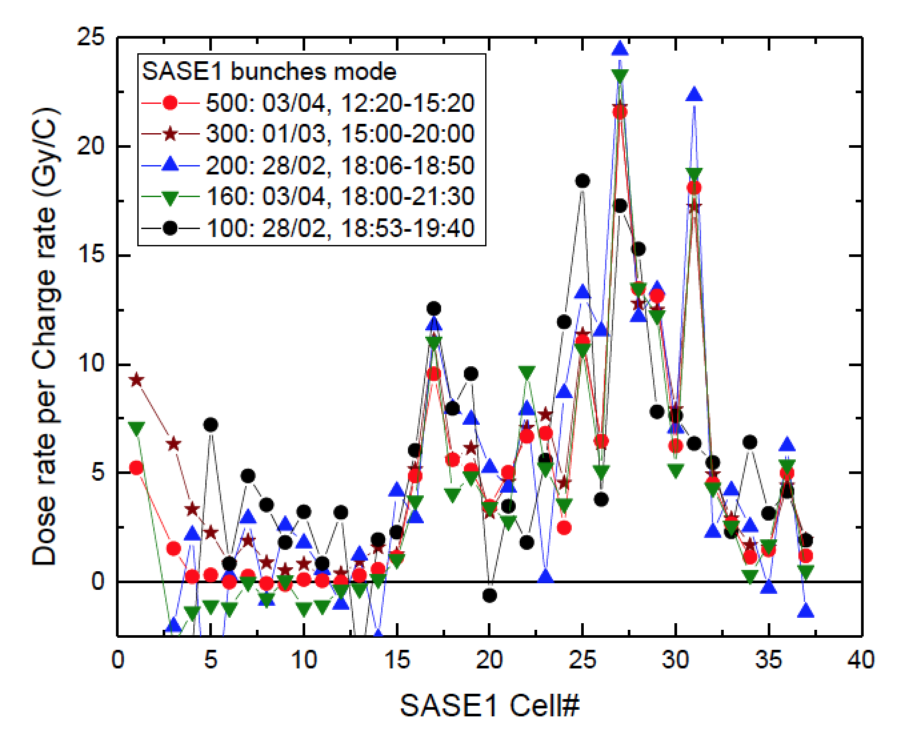
Calculation of the Undulator SR properties for the input to BDSIM simulation
The 5D phase space (x, x’, y, y’, E_{ph}) of the photons generated from each undulator is needed for BDSIM.
Basic ideas
The simulation is done for a single undulator segment instead of one continuous structure
The photon space is assumed identical to all undulators with 6m longitudinal shift

Slide 3
Spectra simulation parameters
Optics is matched
100pC

Slide 4
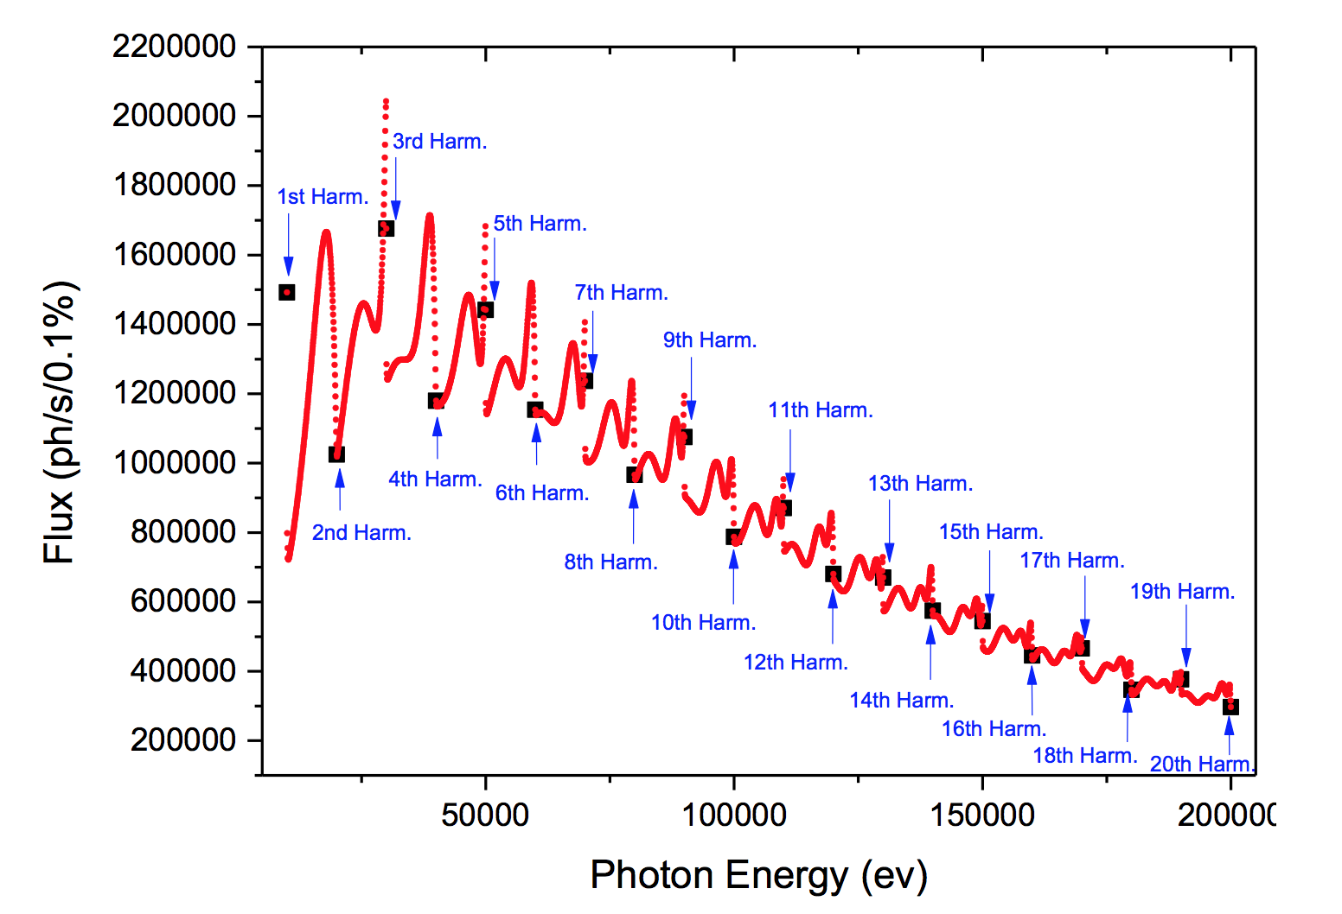
Energy dependent total flux --- Undulator Mode
SR Flux with respect to the photon energy
1D space distribution instead of 5D
For each harmonic the spatial distribution of the flux density is simulated: F.Density as function of (x’,y’)
F.Density distribution of (x,y) is constructed by the distribution of (x’,y’)

Slide 5
3D Angular distribution --- examples
1st Harm.
11th Harm.
12th Harm.
2nd Harm.

Slide 6
Far zone: phase space (x’,y’) is proportional to (x,y)
The angular distribution along axis
The distribution is the same at 20m and 50 m from the source

Slide 7
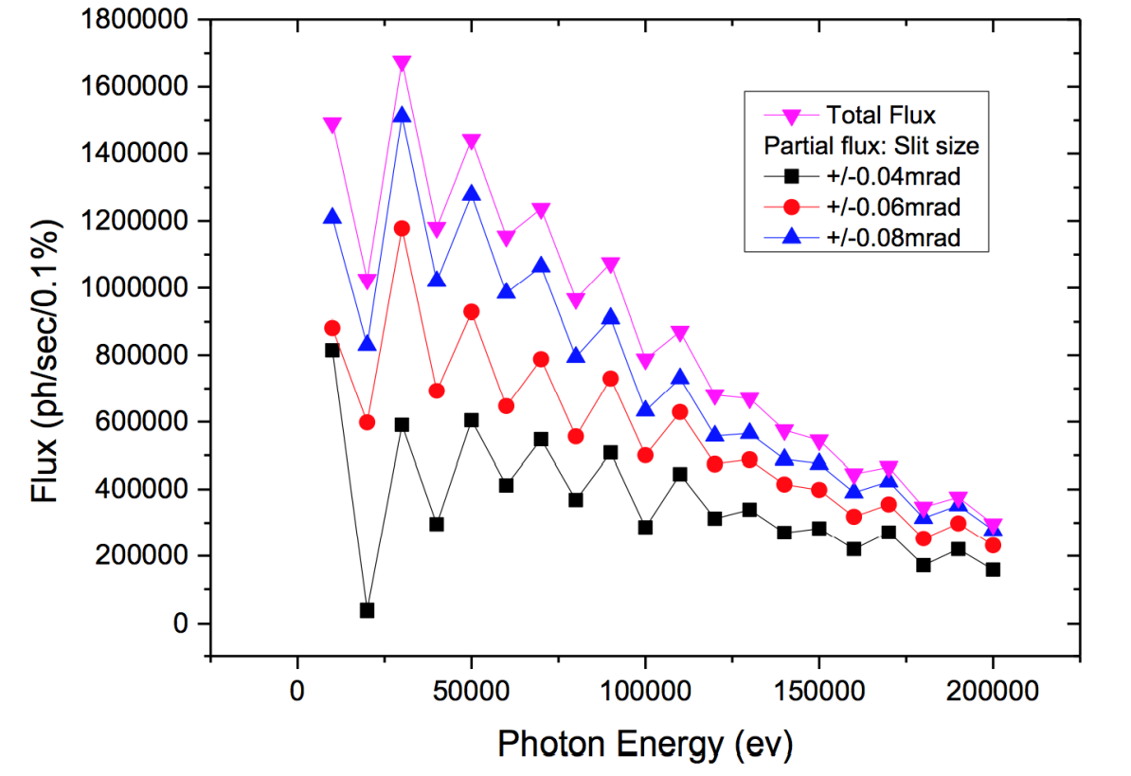
Investigation for the proper size and distance
0.08 mrad is chosen as observation angle
50 m is chosen as observation distance: 0.08mrad*50m = 0.4mm < radius of SR absorber

Slide 8
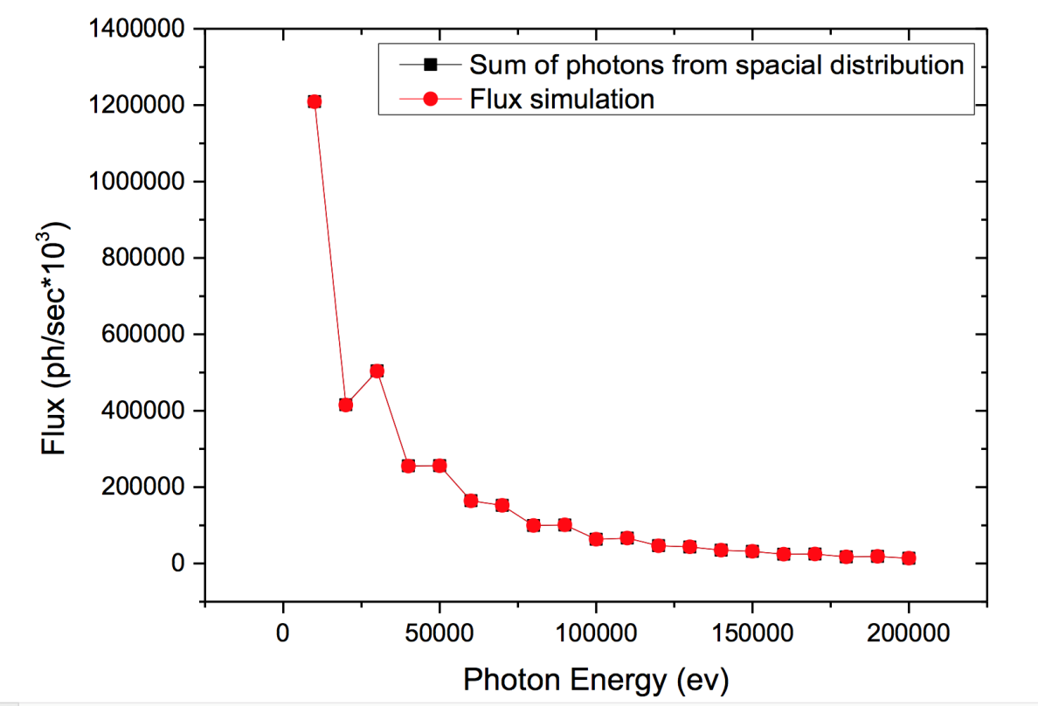
SR output for BDSIM and the self consistence
4D Photon Phase space file format: for each harmonics
Flux sum from spatial distribution of each harmonics agrees with the simulation of energy dependent flux

Slide 9
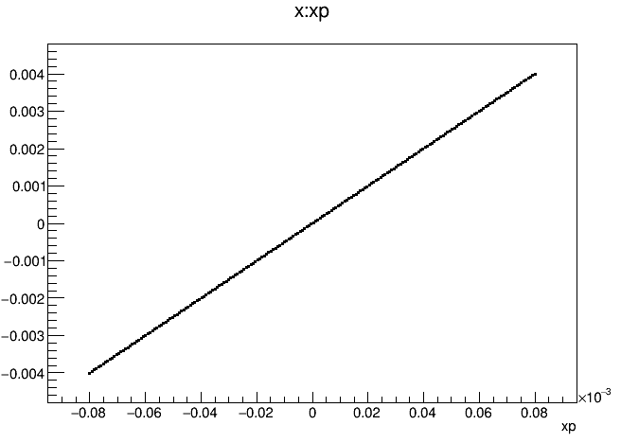
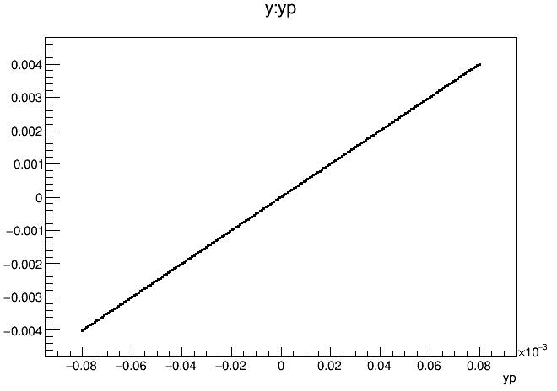
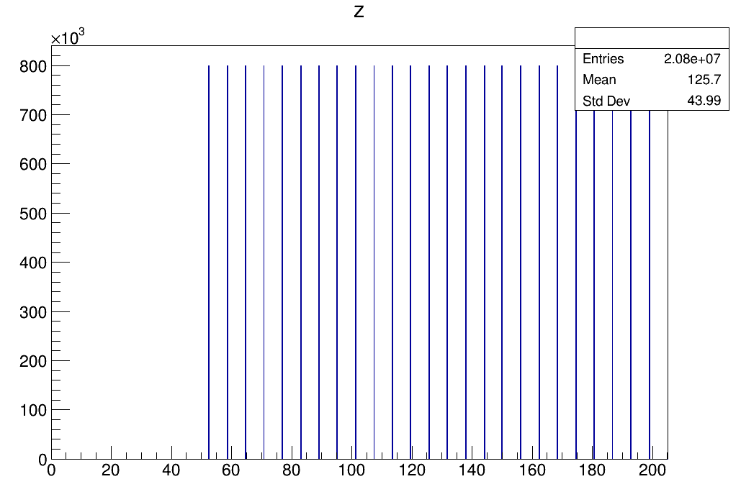
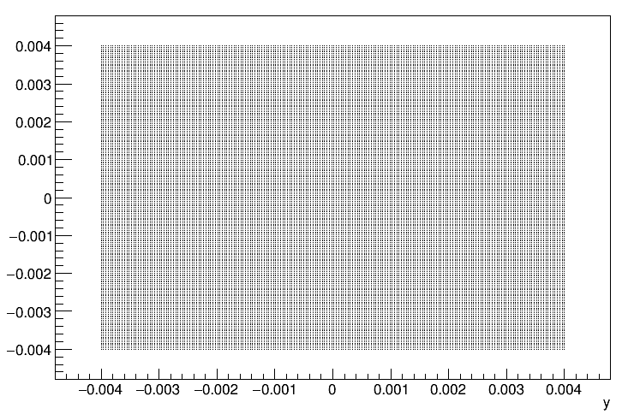
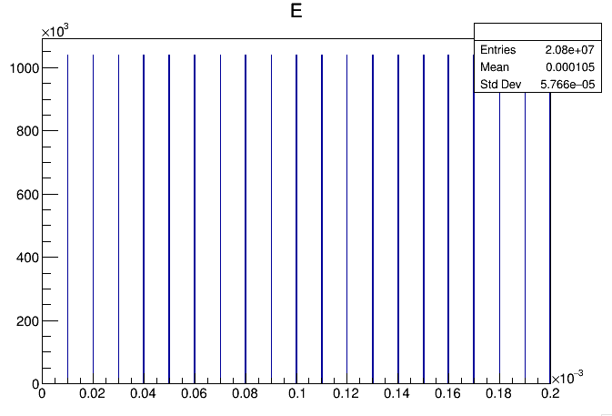
Input parameters for simulation in BDSIM
x:y
Start point is at 52.5m and the same SR distribution is added after each undulator section (6.1 m long)
Photon number for different photon energy is applied as “weight” factor in the simulation

Slide 10
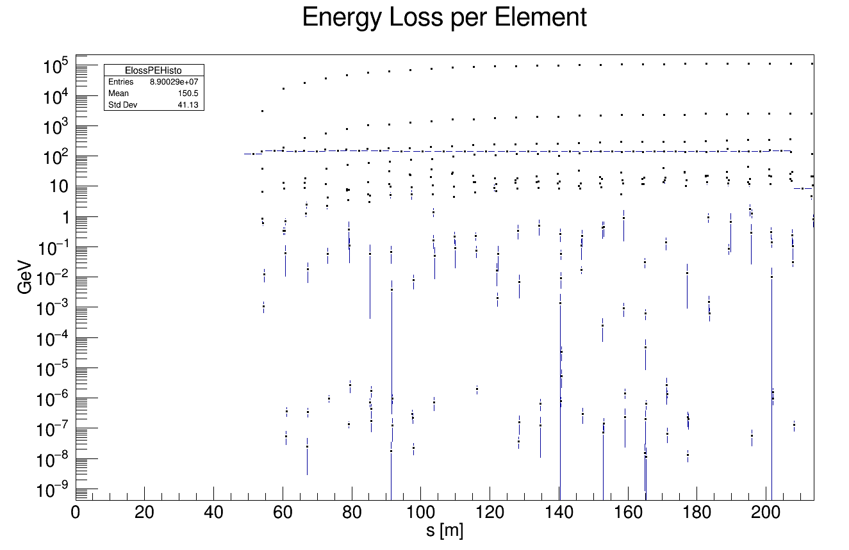
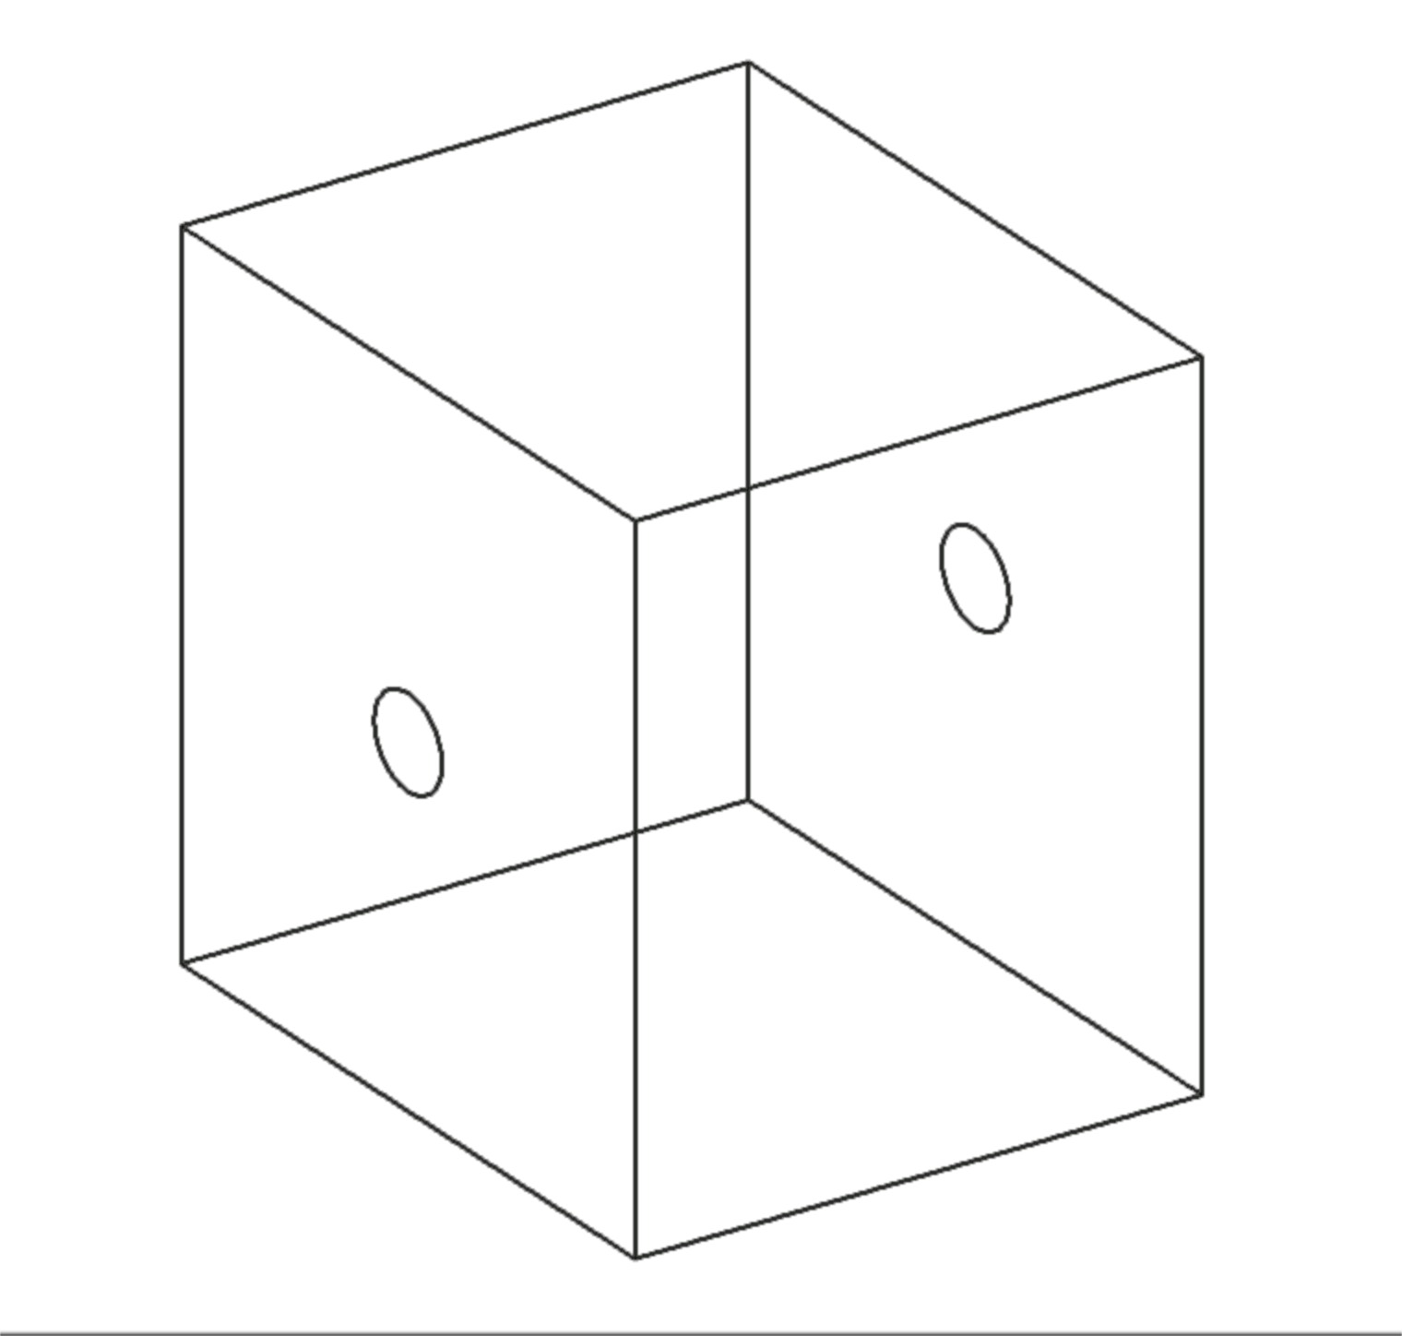
Simplified absorber geometry and simulated energy loss from SR
absorber
undulator
absorber aperture
(2a=9, 2b=8 mm ellipse, L=50mm)

Slide 11
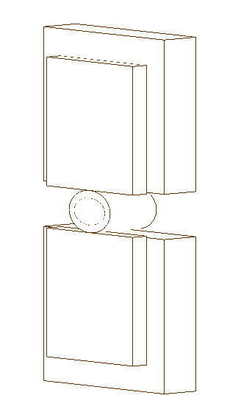
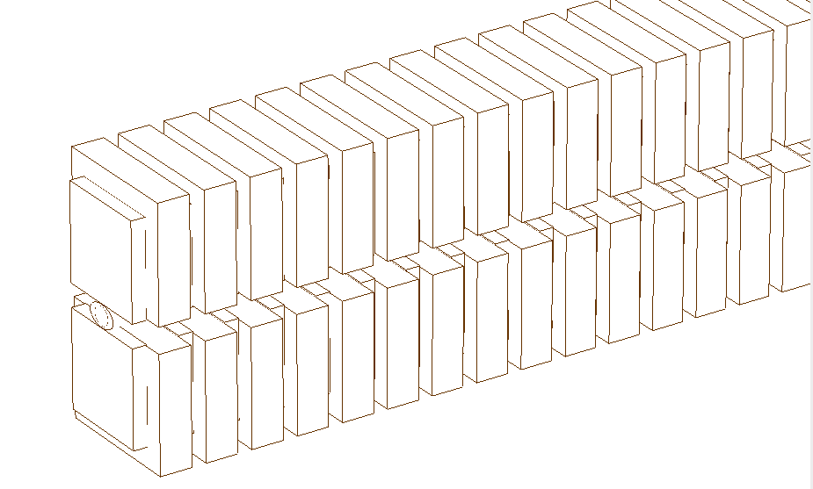
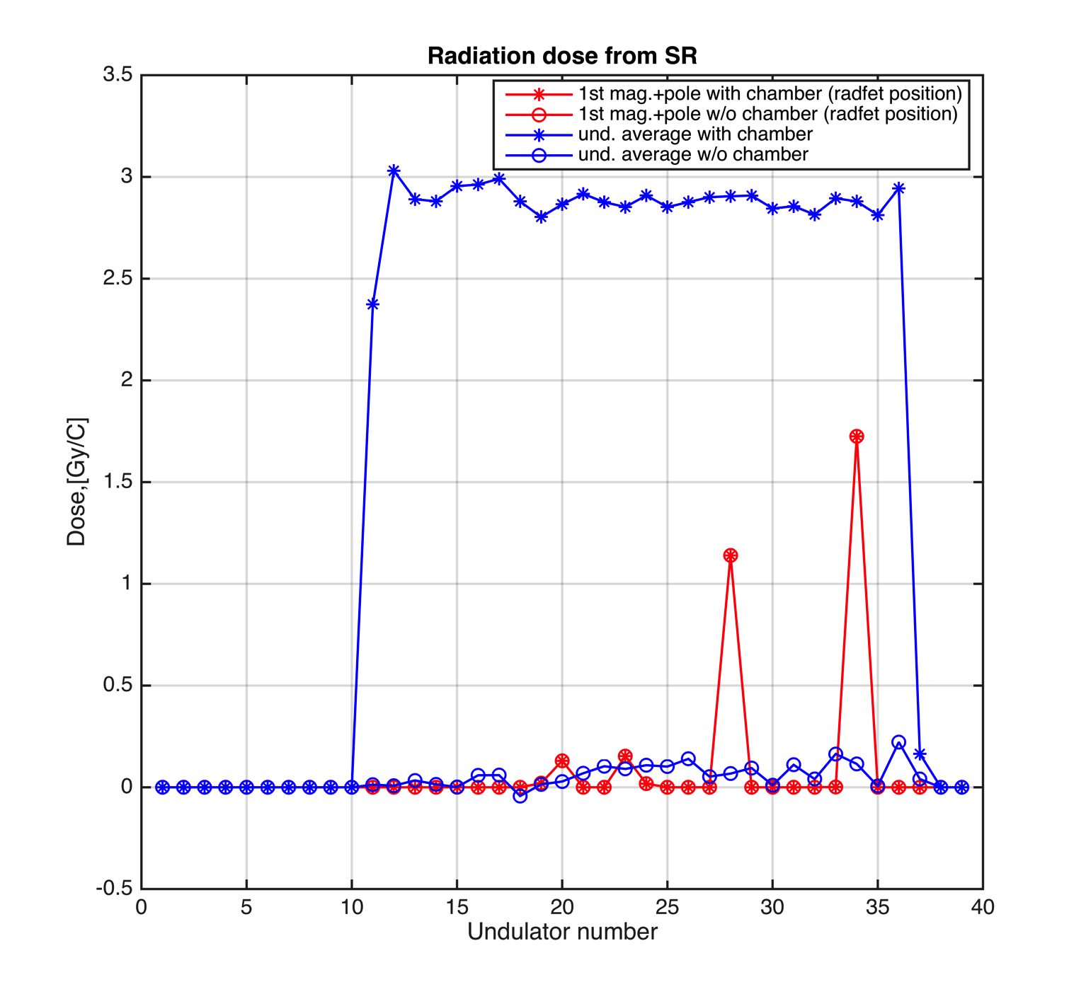
Simulated radiation dose from SR
1st mag. & pole with vacuum chamber (taken as Radfet)
undulator with vacuum chamber
Magnets and poles are put into BDSIM together with vacuum chamber as a single element (might be able to decouple them in the future)
Two simulations have been performed with and w/o magnets and poles (with same seed number)
Doses absorbed by vacuum chamber is subtracted afterwards
Dose level at the radfet location is rather low with the simplified absorber geometry (<2 Gy/C) comparing with the measured values (10-20 Gy/C)

Slide 12
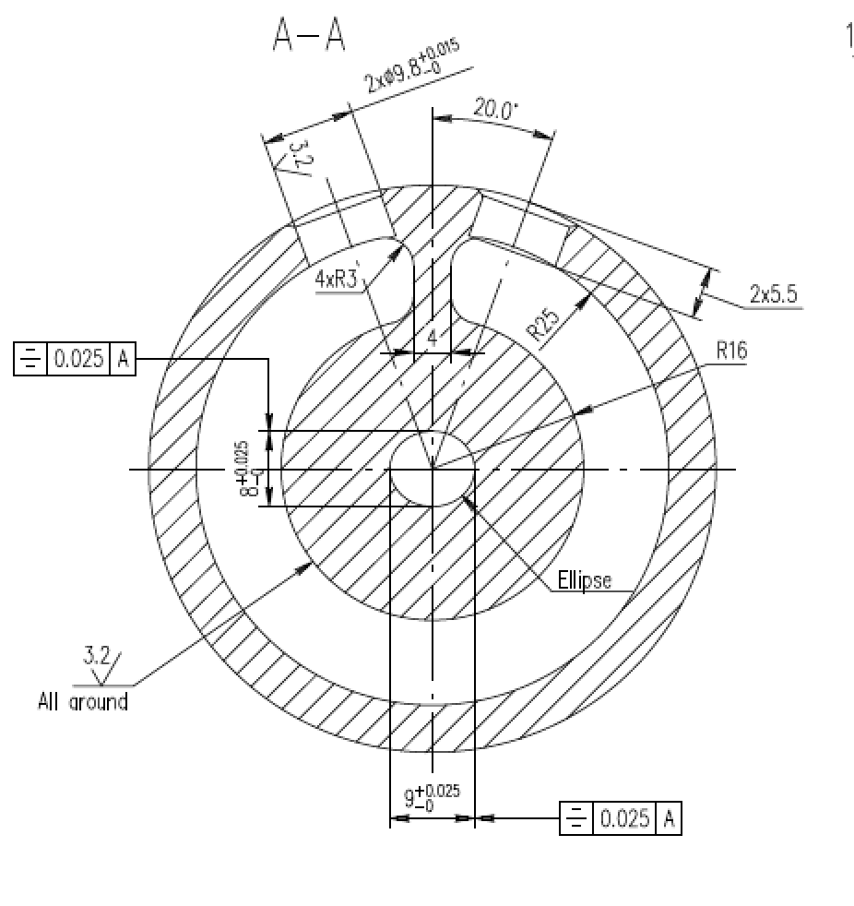
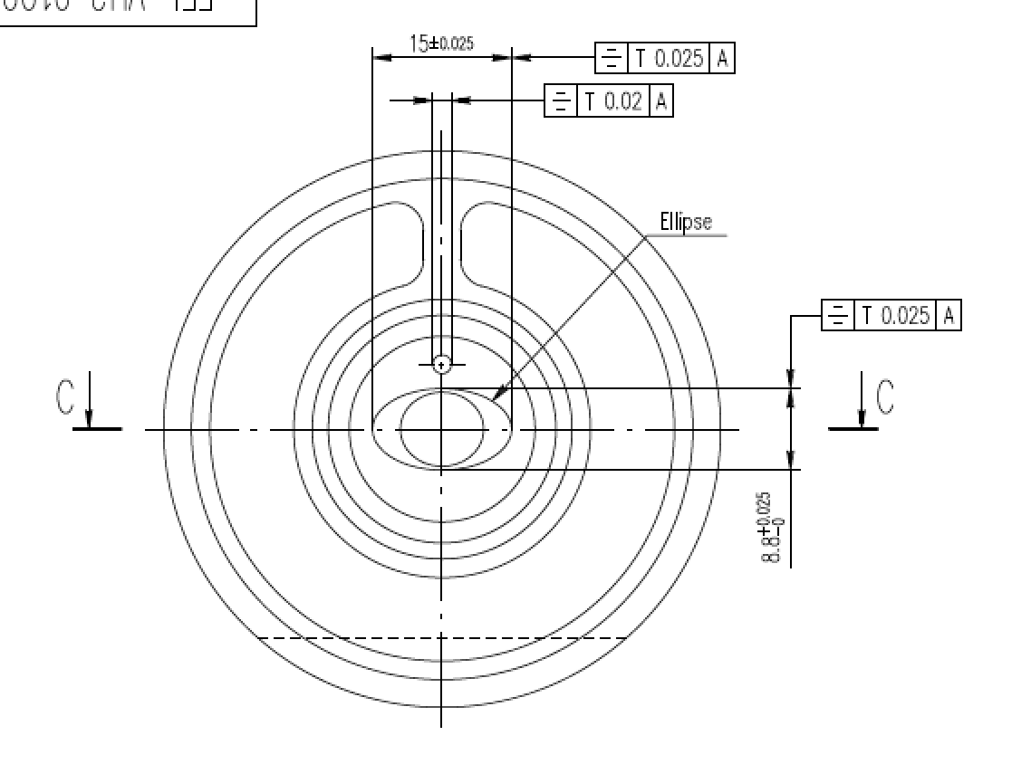
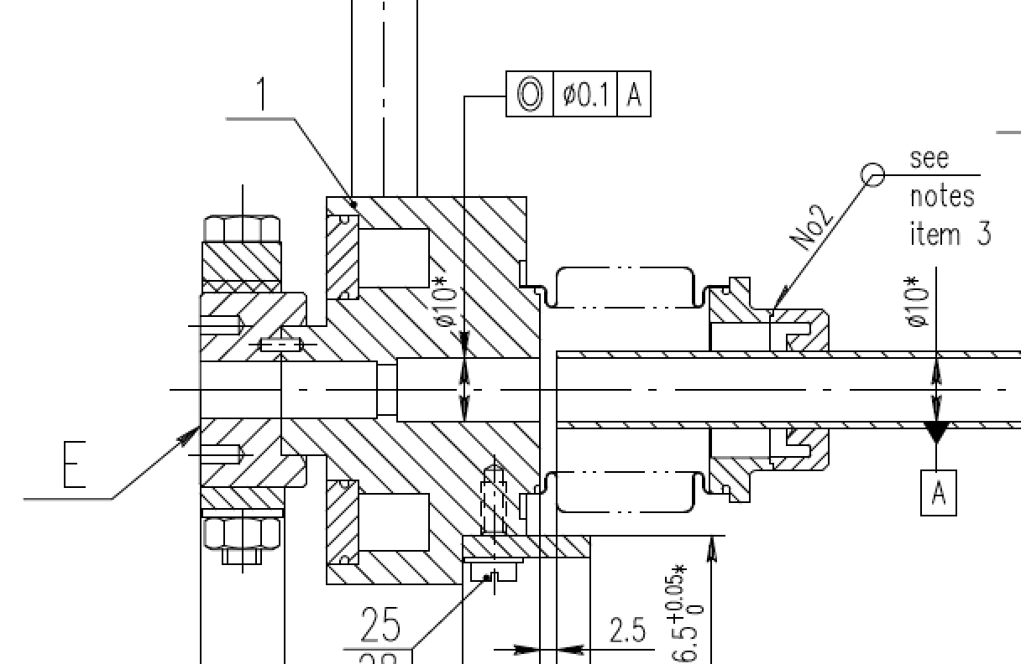
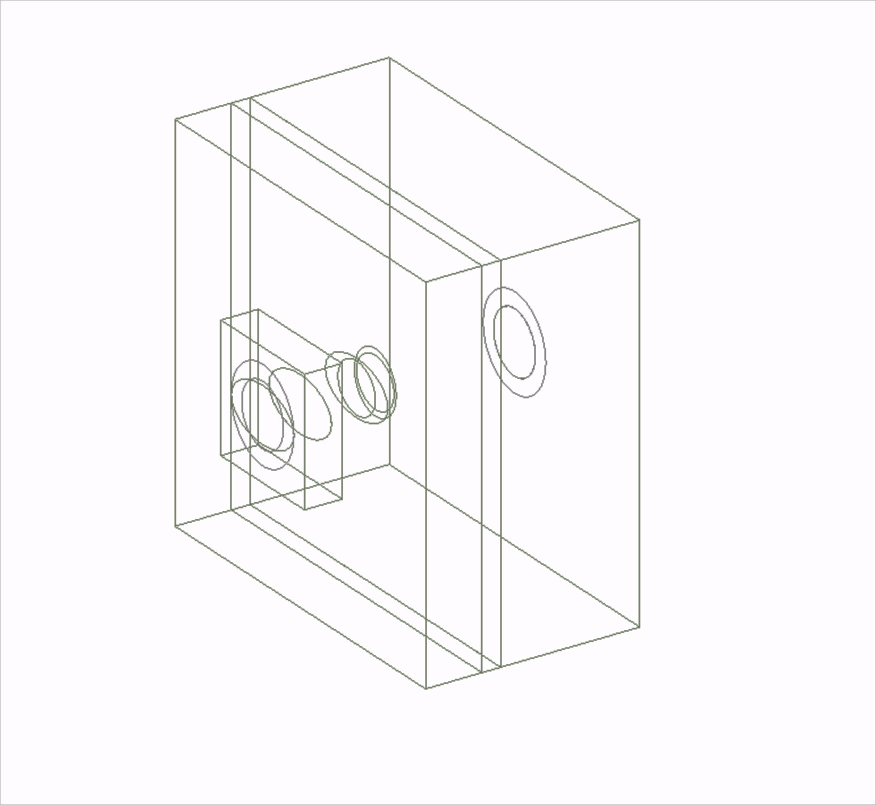
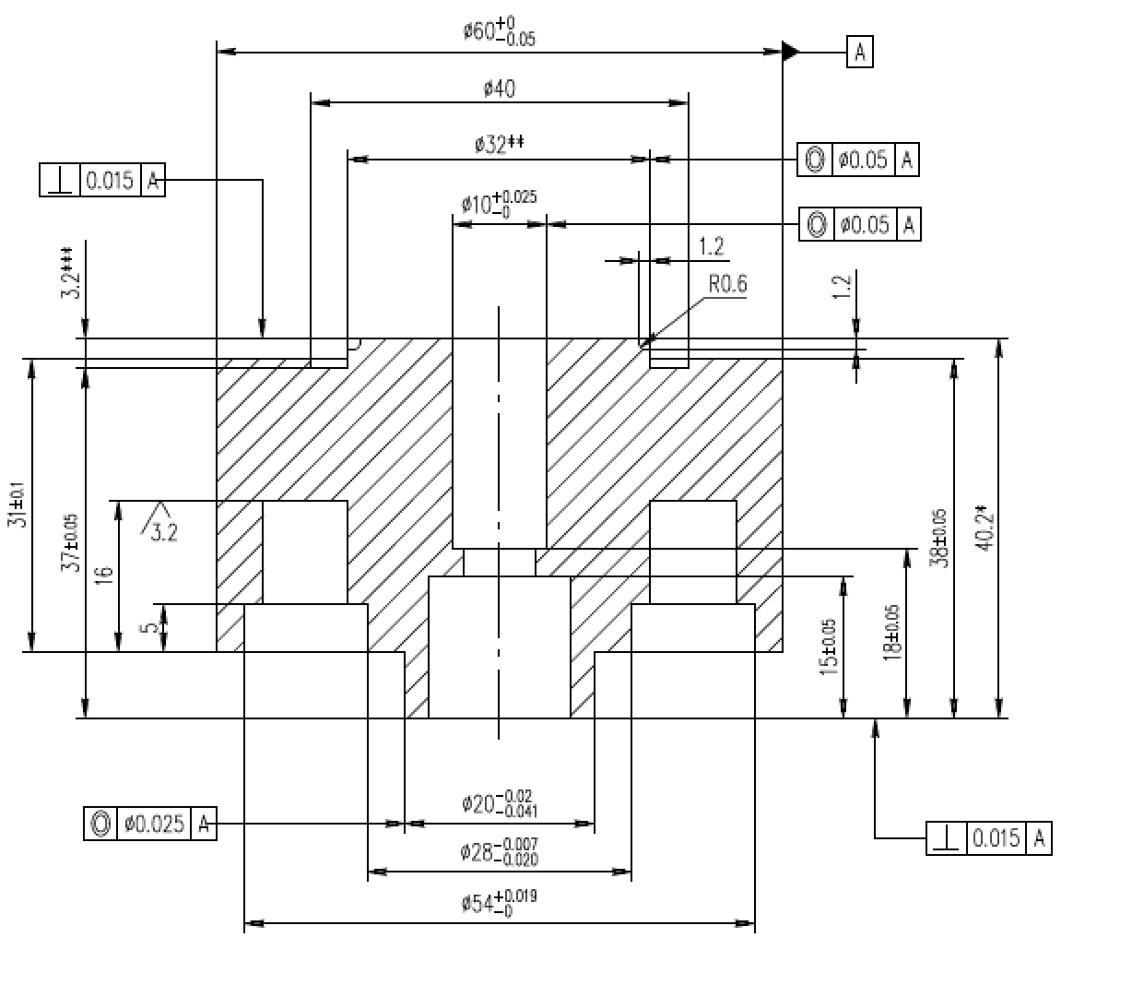
Absorber geometry update
Drawings from T. Wohlenberg
Upadated absorber in BDSIM
BPM and Quad. aperture
(ø 10 mm, L=22.2 mm)
absorber aperture
(2a=9, 2b=8 mm ellipse, L=3mm)
undulator chamber aperture
(2a=15, 2b=8.8 mm ellipse, L=6+9 mm)
L= 6+9+3+22.2 mm

Slide 13
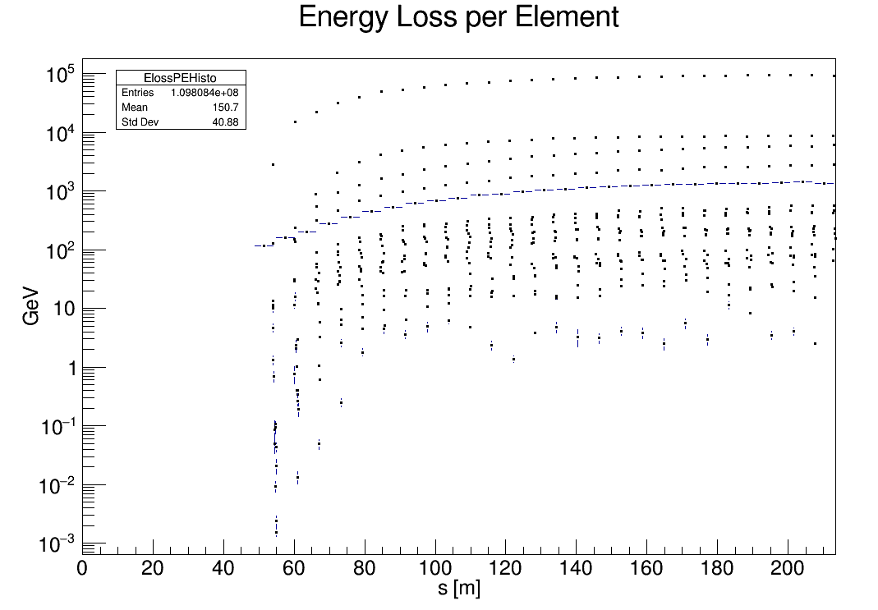
Simulated losses from SR with updated absorber geometry
3rd layer of absorber
(2a=9, 2b=8 mm ellipse, L=3mm)
undulator
L= 6+9+3+22.2 mm

Slide 14
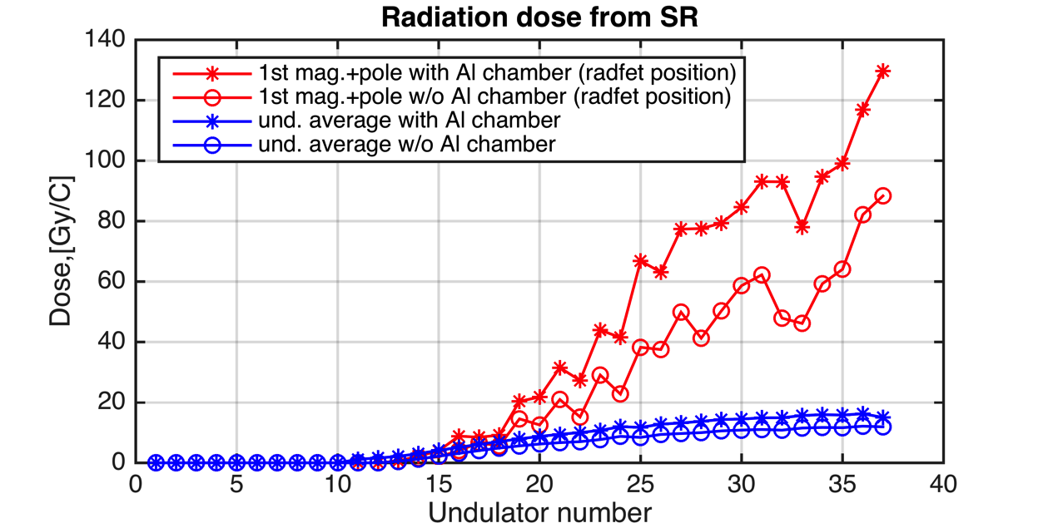
Simulated radiation dose from SR with updated absorber geometry
1st mag. & pole with vacuum chamber (taken as Radfet)
undulator with vacuum chamber
Significant radiation dose increase observed after updating absorber geometry!

Slide 15
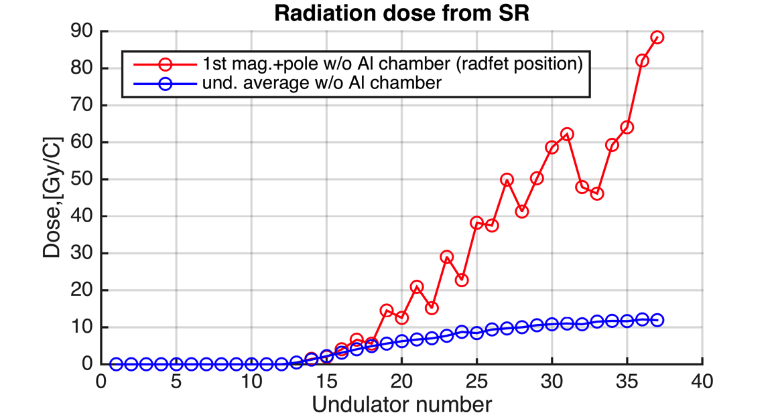
Comparison with measured radiation dose
Simulated radiation dose level is quite close to the measurements
Similar fluctuation of doses at Radfet position observed in measurements and simulation?
Averaged dose per undulator shows less fluctuation

Slide 16
Conclusions and discussions
First simulation results shows that SR can cause similar level of doses as measured by the Radfets;
Radiation doses at radfet position highly depends on the absorber thickness;
Adding more components in the intersection (phase shifter, BPMs and air coils) may change the results;
Dependence on the orbit or misalignment is not studied -> check the difference on upper and lower Radfet?
Dependence on optics mismatch not simulated yet -> may change the spectrum distribution.

Slide 17
You are welcome to join! Thank you!
Meeting with BDSIM developers on 28-29th May 2018:
introduction to BDSIM (seminar on 29th May)
discussions on 28th May:
update of BDSIM version
add hadronic process (damage due to neutrons)
event biasing and output space saving
adding more sampler point in one element (each mag. and pole w/o vacuum chamber)
add more components in the intersection of undulator (e.g. phase shifter, bpm)
simulation with SR, wakefield, beam-gas scattering, orbit offset or vacuum chamber misalignment

