Slide 1
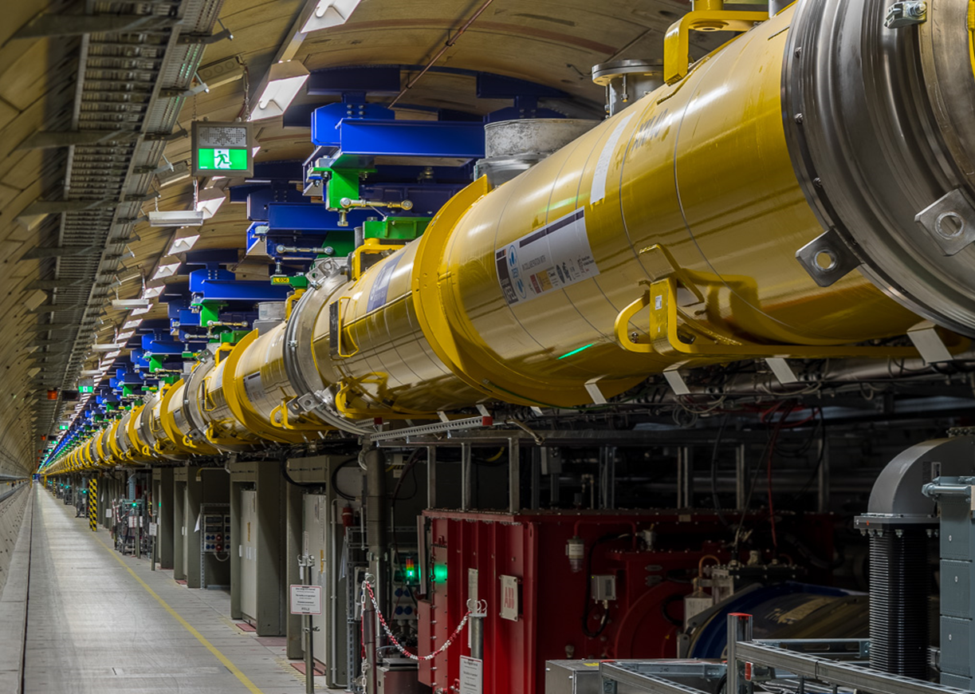
Beam Loss monitors in Undulator area
Thomas Wamsat
17.05.2018

Slide 2
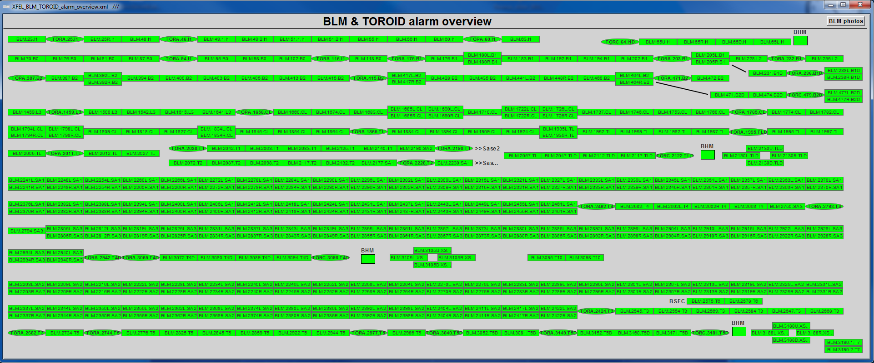
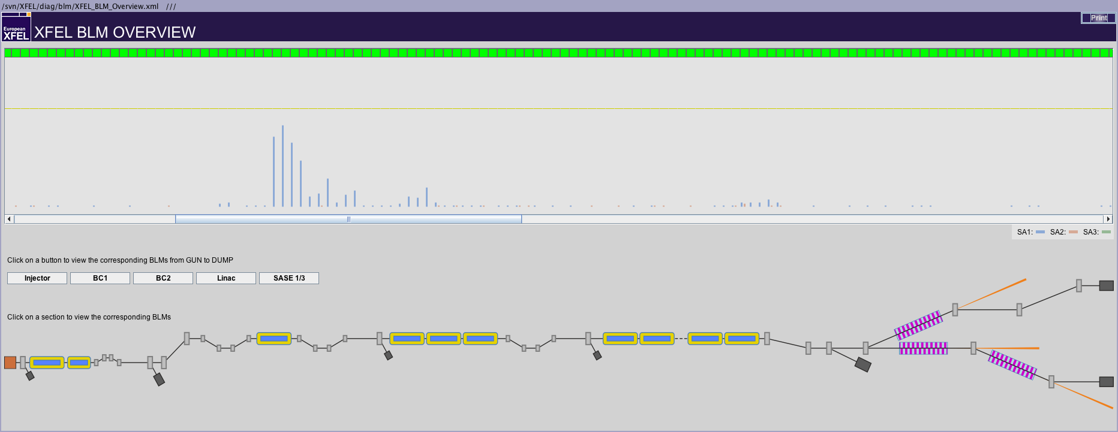
Overview
Each undulator cell equipped with two
Beam Loss Monitors (BLMs)
74 BLMs in Sase1
74 BLMs in Sase2
46 BLMs in Sase3

Slide 3
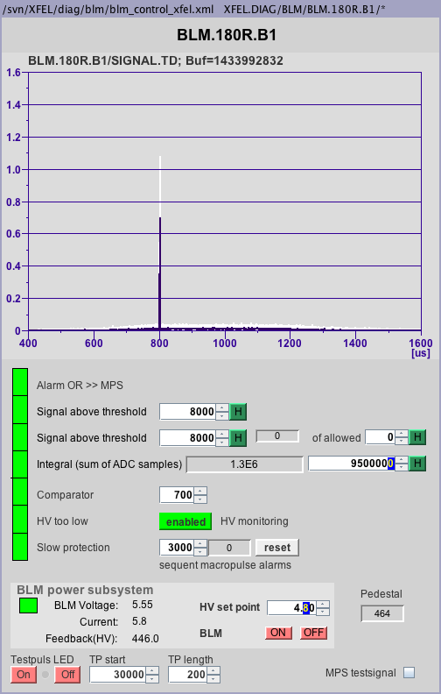
Alarm evaluation
Single pulse alarm
Triggers, as soon as the set limit is exceeded
Y-axis scaled to this value → amplitude of 1 → alarm threshold reached
Multi pulse alarm
Needs two terms to trigger:
1. Signal exceeds threshold
2. Number of allowed pulses over threshold reached
Integral alarm
Triggers if the number of integrated samples exceeds threshold
Comparator alarm
Analog backup, threshold is chosen thus it triggers a little bit above single threshold
HV tracing alarm
When the high voltage gets to low so the PMT cannot work properly it causes a permanent alarm, can be disabled
Slow protection alarm
Counts recurrent alarms from macropulse to macropulse, if alarm is gone the counter decreases. When number of recurrent alarms is exceeded it causes a permanent alarm → no beam possible; reset by operator is needed, switches back to single bunch operation
Latency undulator section to switch off beam ca. 100 to 130 bunches, depends on BLM position

Slide 4
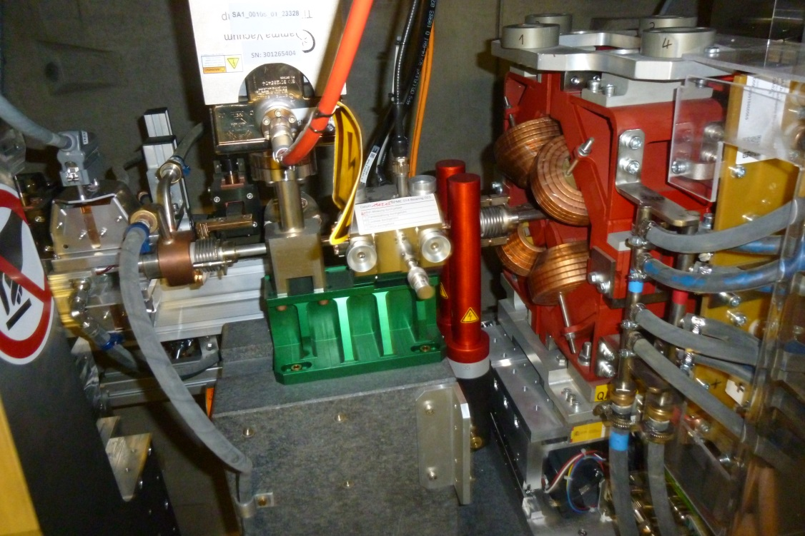
SQ1 Quarz glass
Scintillator vs. Quartz glass
EJ-200 Plastic-Scintillator
Quartz glass sensitive to charged particles only

