Slide 1
Tests on Chess 2 ASIC
Dionisio Doering, Yubo Han_{IHEP} , Pietro Caragiulo, Larry Ruckman, Camillo Tamma, Su Dong

Slide 2
Outline
A new board arrived: the original chip has fused wire bonds.
-> replaced with a 200Ohm-cm device.(wire bonded by UCSC)
Check the newly arrived board #01
-> the resistance on the connector and the voltage on the daughter board.
-> the IV curve
-> tests on the new board using previous readout.
Tests with the stream readout:
-> Decoding the raw data.
-> Develop an online viewer.
-> Try to find the signal using the stream readout.
-> (problems)

Slide 3
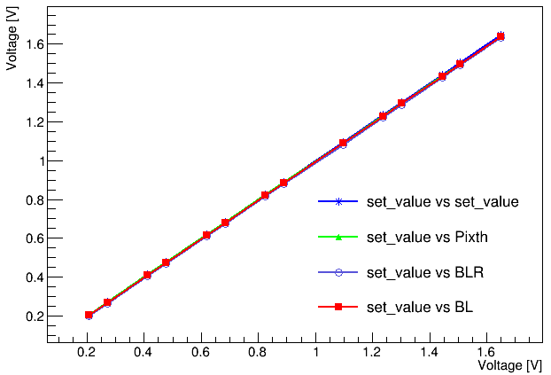
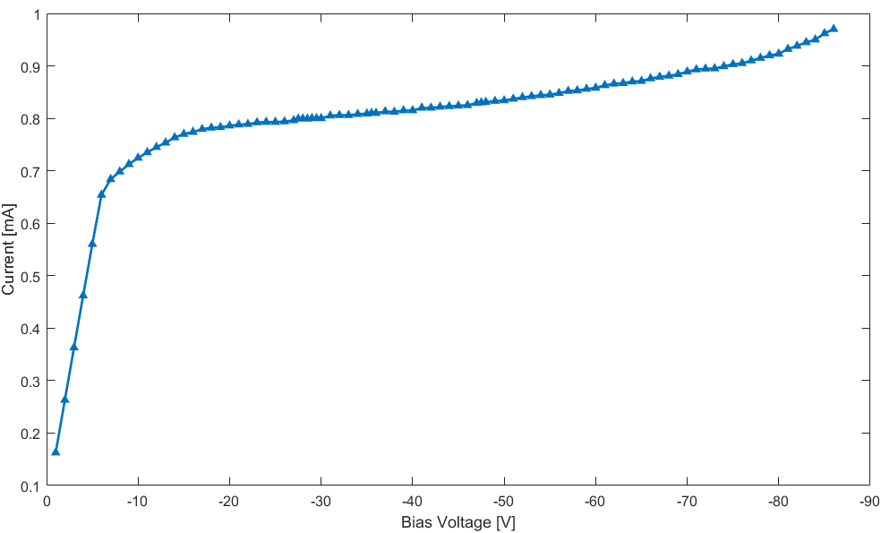
Check the board #01
Arrived at SLAC last month.
Some basic checking on the board:
the resistance of the ports to the GND. (data ports are all ~8MΩ, no obvious problem on the others)
the Threshold, BL and BLR are controllable.
the IV curve.
Could get a “healthier” IV curve compare to the results of other boards but still has high leakage current.
IV Curve of Board #01

Slide 4
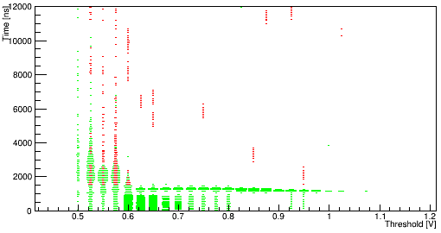
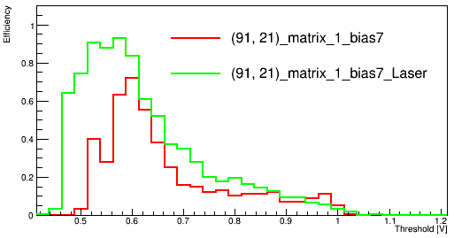
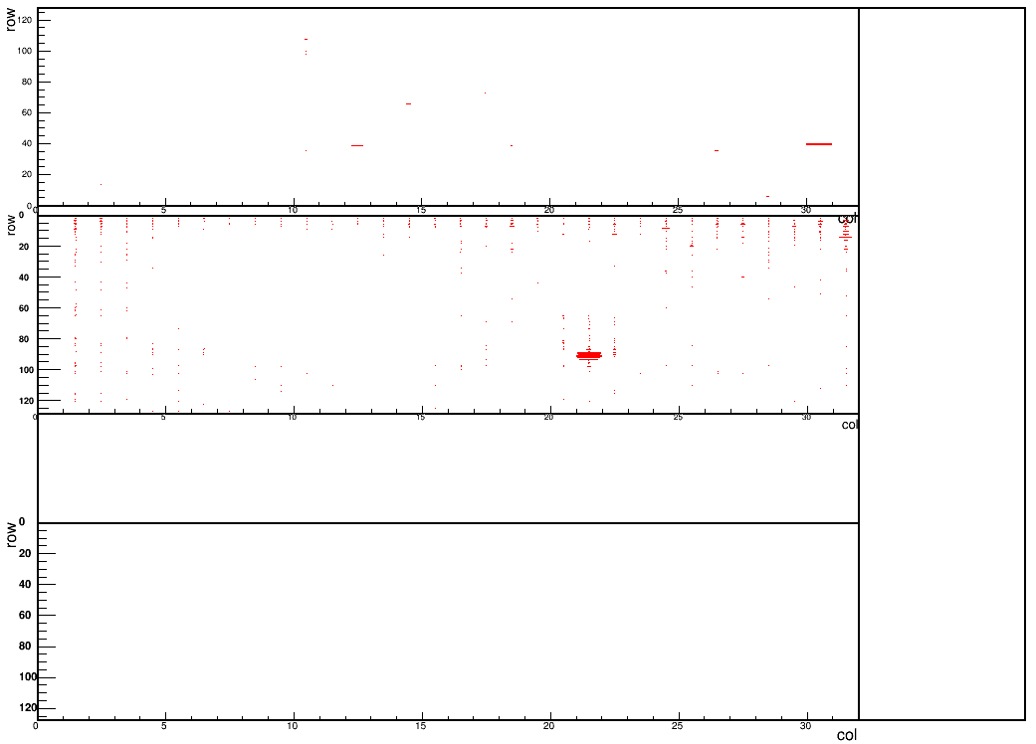
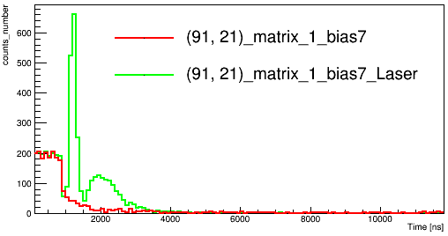
Tests on the new board #02
Hitmap:
Red laser BL=0.6V TH=0.7V
Bias voltage -7V( ~0.6mA)
Using Qinj pulse to trigger the laser.(no delay, 15μs width)
-> clearly see the location of the laser.
-> (127,31) on Matrix 2 response all the time with very fast time information.
-> problems on configure Matrix 0.
Threshold sweeping:
Choose pixel (one of the targeted pixels) (91,21)
BL=0.6V
-> Laser signal sharply peaked at time ~1.3μs over long stretch of threshold values.
-> Slow undershoot hit from laser pulse at t~2us when threshold<BL(0.6V)
Time vs threshold
Efficiency vs Threhsold
Time distribution

Slide 5
Register readout vs Stream readout
Previous way to read the data: Directly read from the register
Correctly configure the board -> Give the board a Trig signal-> Start waiting and checking the DataValid Flag in certain time window(200μs)
[if True: read and return the information directly from the register. Could give the information of 24hits(90 bytes) at most] -> Next Trigger
Time window
Trigger
Time
Stream readout : read a frame of data at with given runrate.
Correctly configure the board -> Give the board a Trig signal -> always latching the data and send the adjustable(up to 256 bytes) size of data with certain time window(like 6.5μs for 256 bytes) -> Next Trigger
Because the delay of time for laser to emit, setting the proper run parameters (delay [align the laser and the trigger], threshold, the frame size )is very import in stream readout.
Time

Slide 6
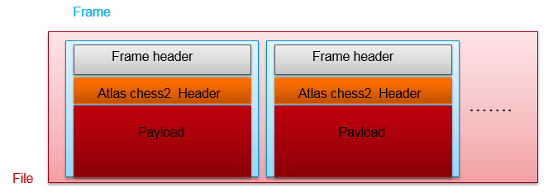
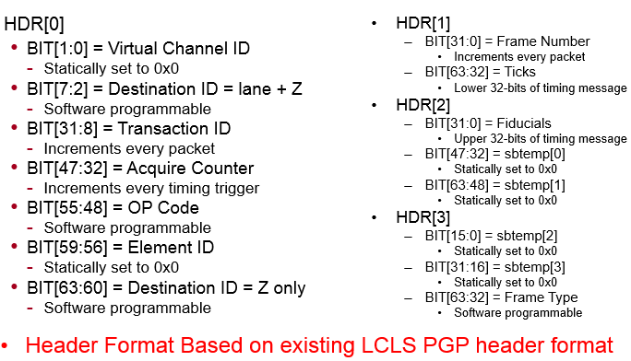
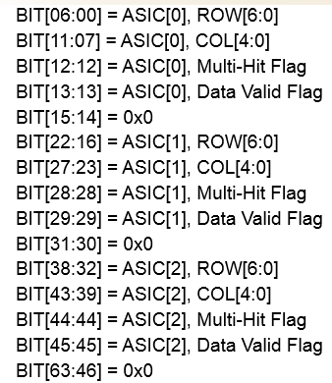
Raw data decoding
Structure of the data:
Fixed size of Frame Header: 64 bits
ATLAS Chess2 Header: 32*8 bits
Payload size: variable and accessible(first 32 bits of the Frame Header)
Could get the correct hitmap and timestamp according to the data format.

Slide 7
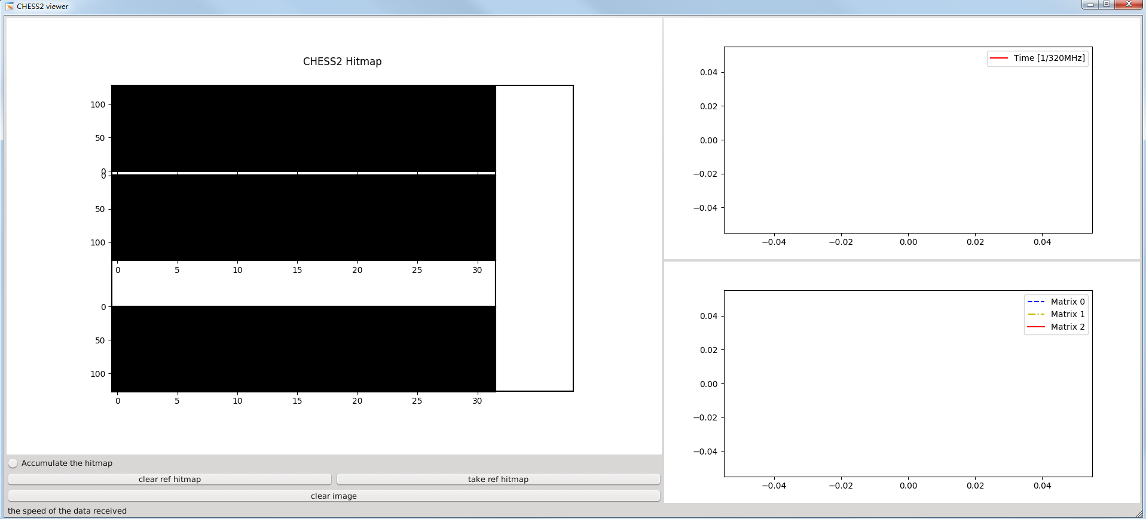
Online viewer
Hitmap of the chip
Time information of the frame received.
Efficiency vs frame/time (to be optimized)
Functions: Accumulate and show the hitmap OR real time update.
Simple online noise subtraction.(need to be optimized)
Run stably with runrate at 5Hz

Slide 8
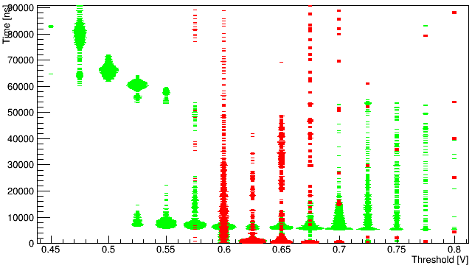
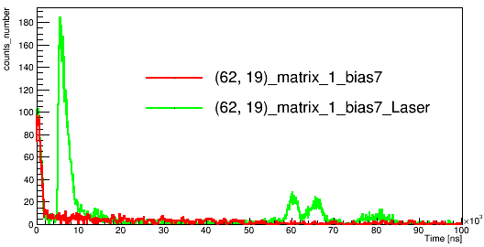
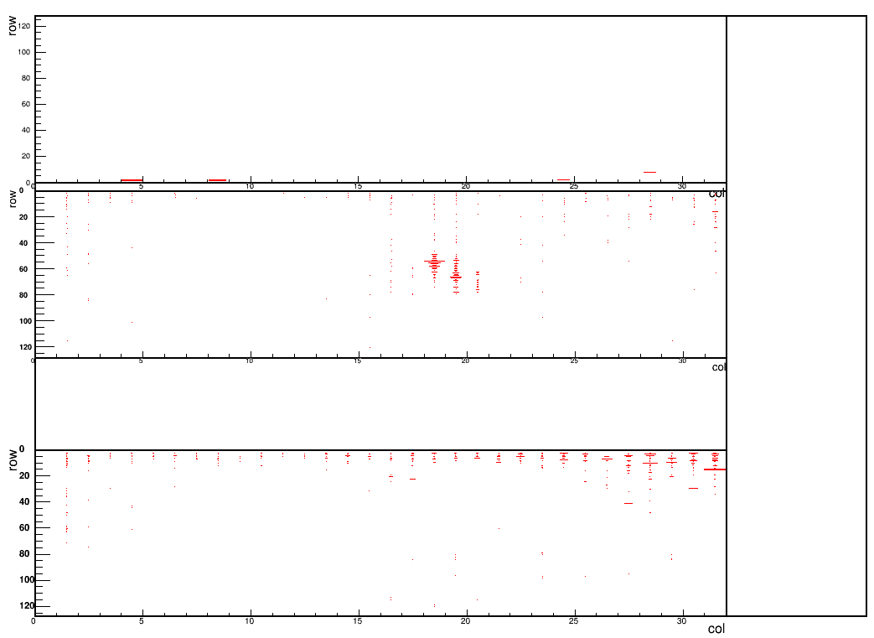
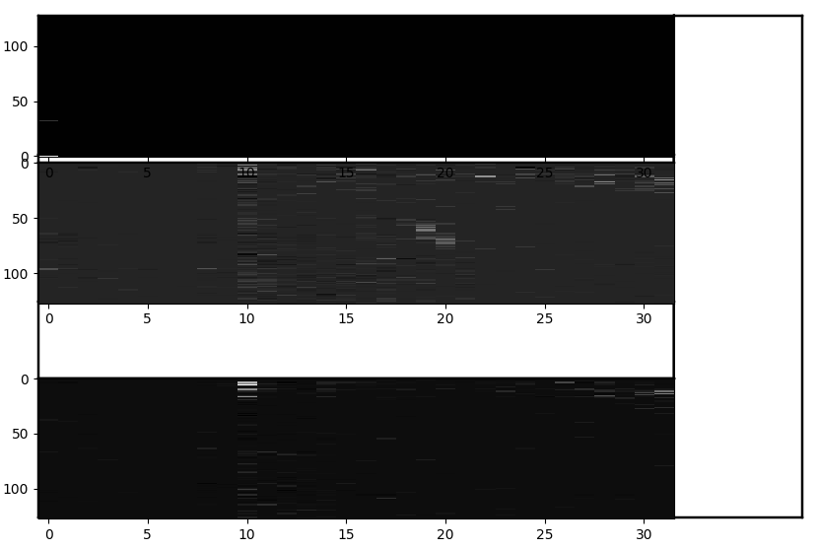
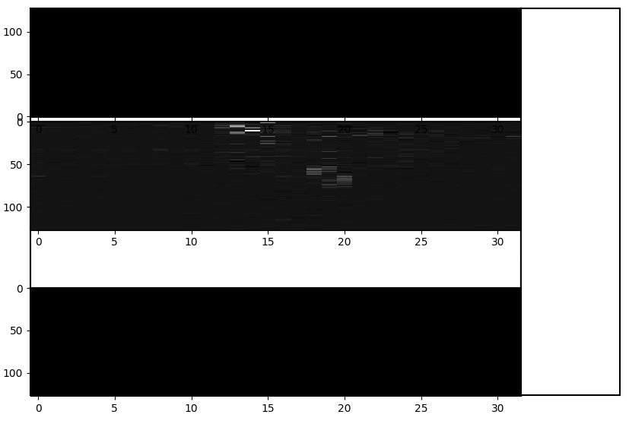
Try to find the signal using the stream readout.
Use previous readout way :
get the hitmap -> knowing where we should expect to see the signal.
Threshold scan -> with which threshold and delay time of the trigger to the board we will see the signal.
+ reduce the noise -> could see the correct position.
Hot pixels near to the edge, eg: col=10

Slide 9
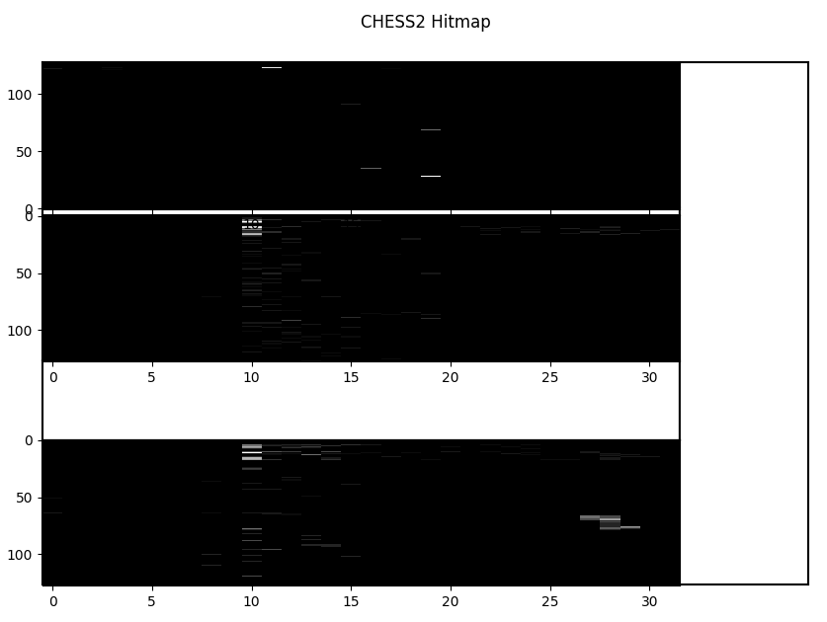
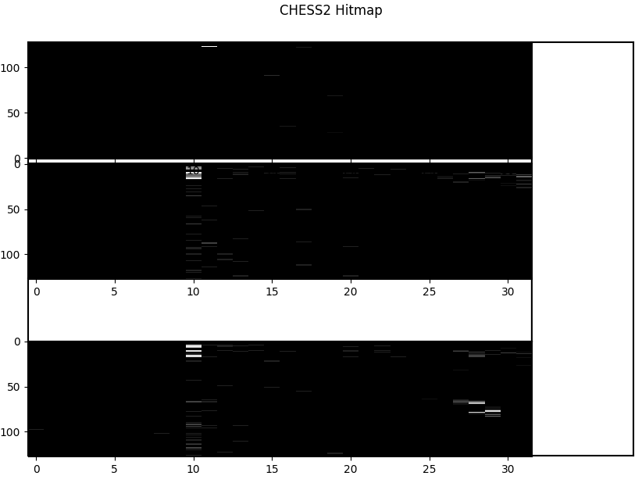
Summary
Board #01 has arrived but only Matrix 1 seems working for now.
The decoding of the raw data from the stream readout have been done.
Online viewer have been developed.
Finding the proper delay time of trigger to the board is a tricky part.
The performance of the stream readout still need to be optimized. (results in the figure: shorter time window )
Next:
Find proper way to optimize the performance.
Do the tests with the Cadmium source .
Tests with the test beam if possible.

