Slide 1
LUXE accelerator layout
First design considerations
Florian Burkart, Evgeny Negodin
DESY, Hamburg, 31.05.

Slide 2
Outline
Subheading, optional
01 Reminder: Location at the XFEL
02 Layout considerations

Slide 3
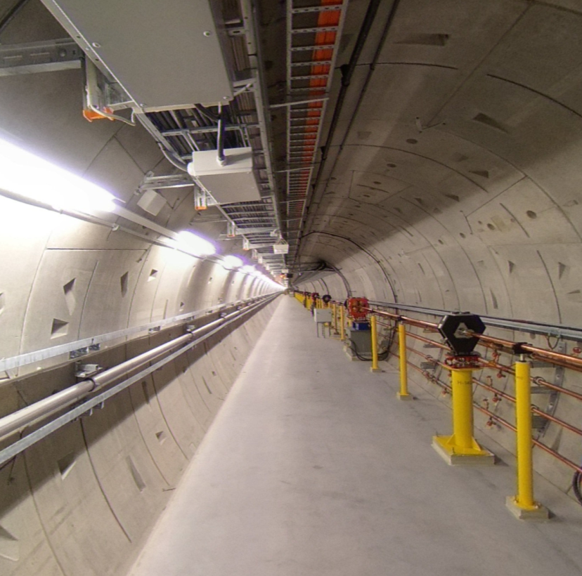
XTD Tunnels
~ 70 m
End of UN2 Begining of Dump
3039 m – 3145 m
~ 30 m
Exp. Hall
XS4
106 m
(660 m)
(137 m)
XTD7
XTD5
(204 m)
UN1
XS4
UN2
XTD8
(480 m)
XTD3
(263 m)
(365 m)
(595 m)
(546 m)
XS1
(301 m)
(221 m)

Slide 4
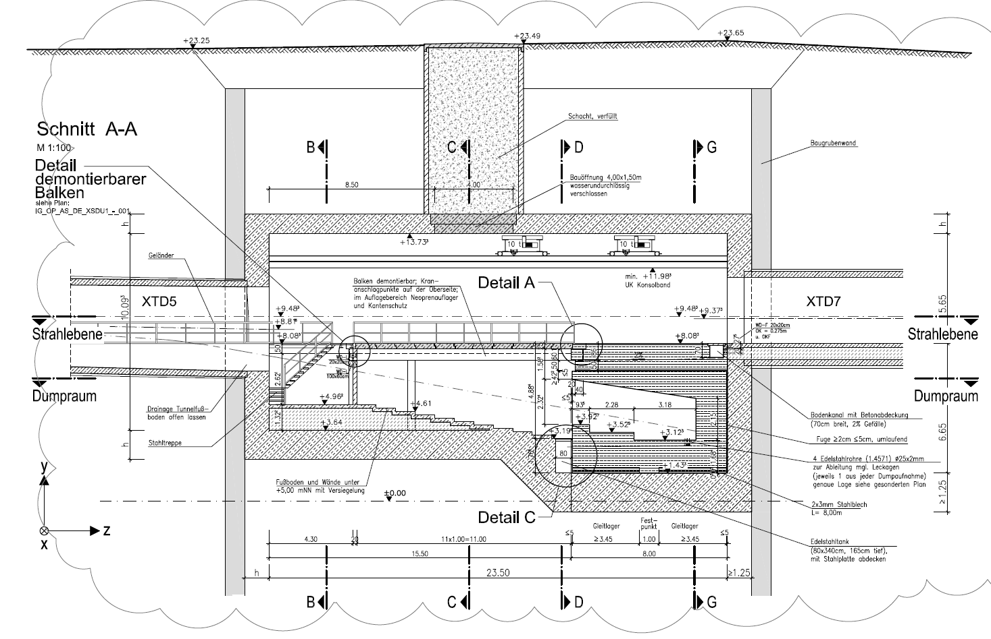
Dump Area

Slide 5
Design goals
Deliver the beam to the IP.
Length efficient design
Collect scattered electrons downstream of IP.
  Dump them on collimators
  Reduce RP impact
  Reduce background in the detectors.
Transport the beam properly to the sweeper dipoles.

Slide 6

Option 1
β collimation
photoconverter
Dillution magnets
e-/gamma separation
IP
Collection solenoid
e+
UN2
e+
dump
e-
gammas
δ collimation
Option 1:
Parasitic downstream of UN2
  Separation between Gammas and e- needed
  Maybe space constraints
e-
e+

Slide 7
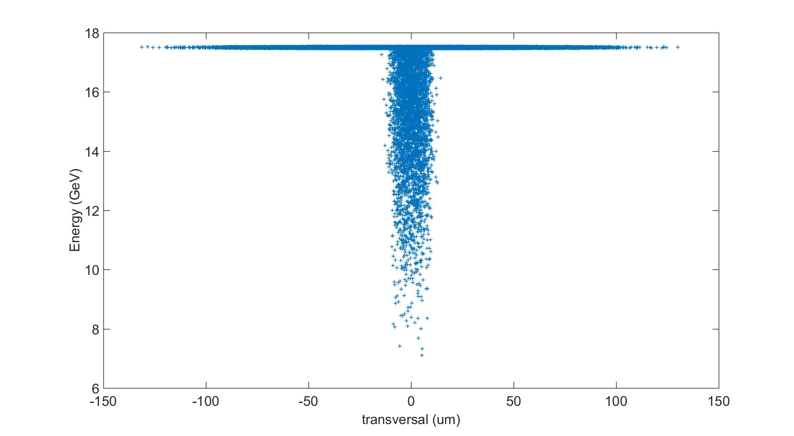
Electron distribution downstream of IP

Slide 8
Option 2
Can we use this area above the dump?
photoconverter
β collimation
IP
Collection solenoid
e+
e+
UN2
e-
Dillution magnets
δ collimation
dump
gammas
e-
e+
Option 2:
Separate experiments (UN2 and LUXE) in time

Slide 9
Experiment orientation
To keep the safety passage:
Experiment should be in the vertical plane.

Slide 10
Open questions
Option 1 or 2?
Design of IP
  Laser guiding
  Laser dumps
  IP removable?
  Final focussing needed?
Discussion with Winni:
  Optics
  Beam Instrumentation
  Magnet choice
  Length of LUXE?
  Do we need to shift UN2 upstream?
Required shielding.

Slide 11
Thank you

Slide 12
Name Surname
Department
E-mail
Phone

Slide 13
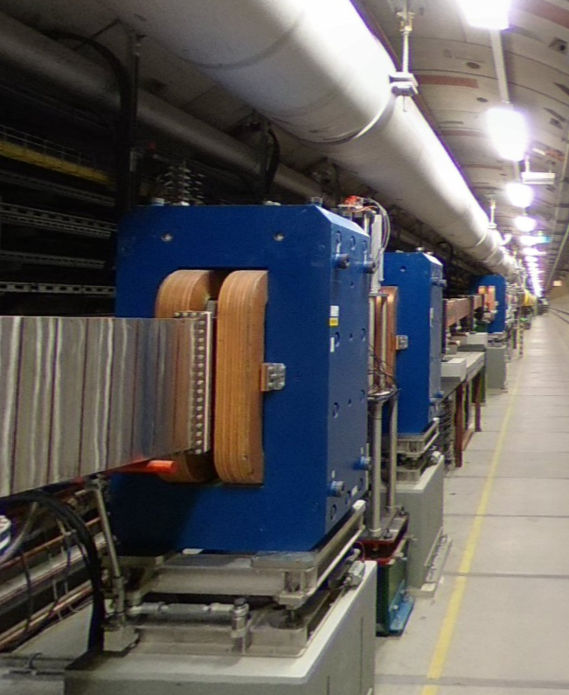
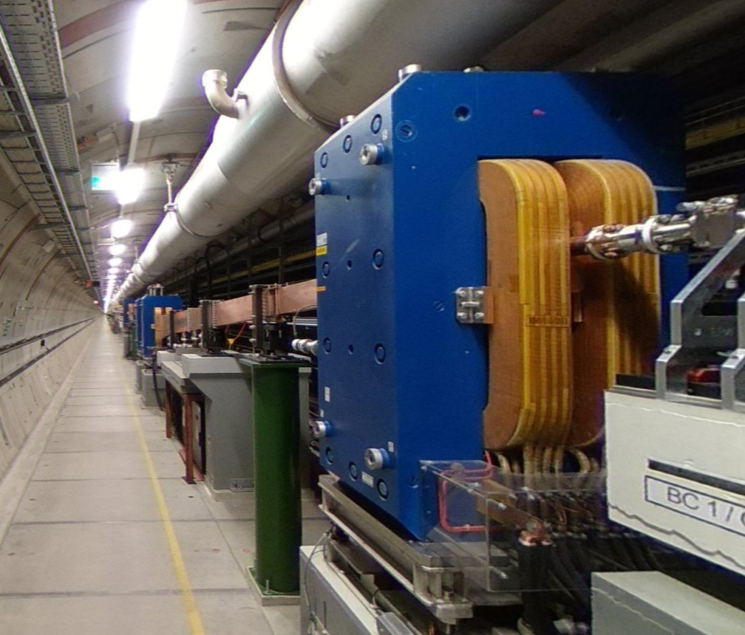
XFEL bunch compressor

