Slide 1
Shutdown June/July
Notes:
How to edit the title slide
Upper area: Title of your talk, max. 2 rows of the defined size (55 pt)
Lower area (subtitle): Conference/meeting/workshop, location, date,
your name and affiliation, max. 4 rows of the defined size (32 pt)

Slide 2
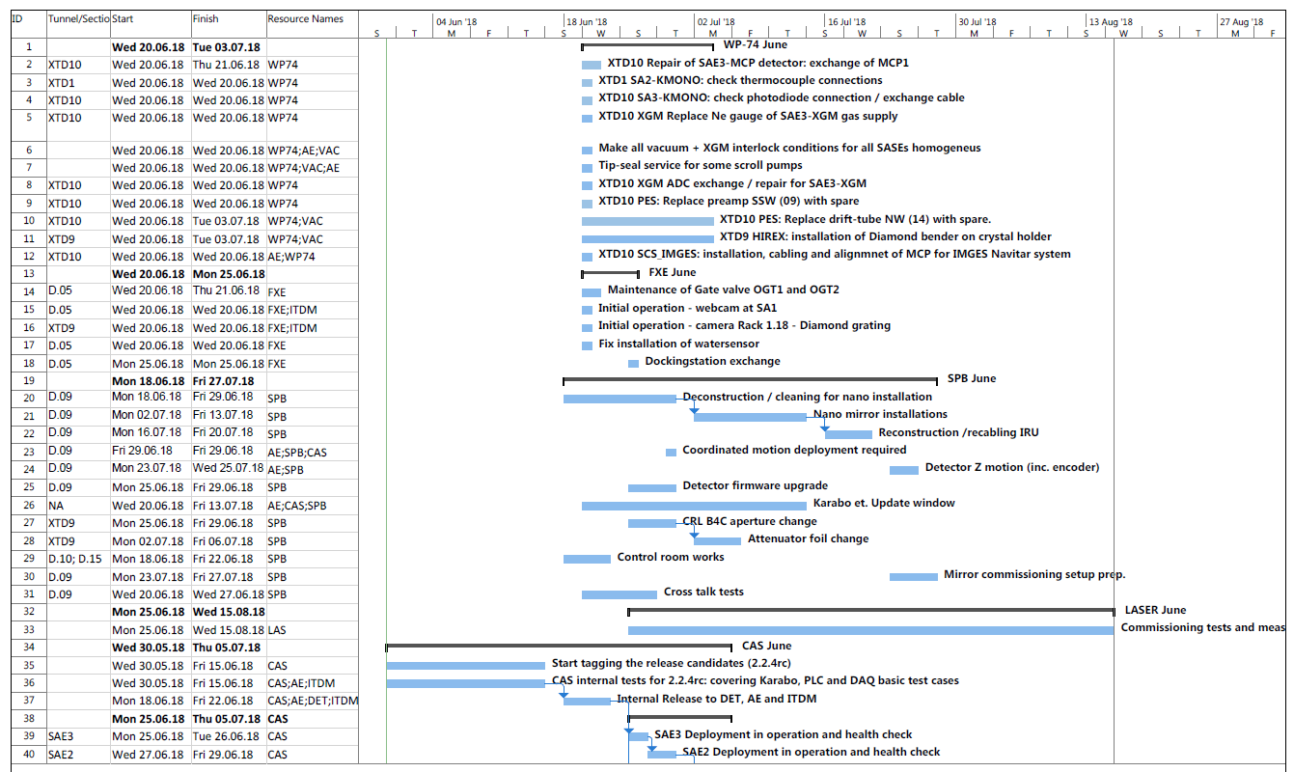
Shutdown June

Slide 3
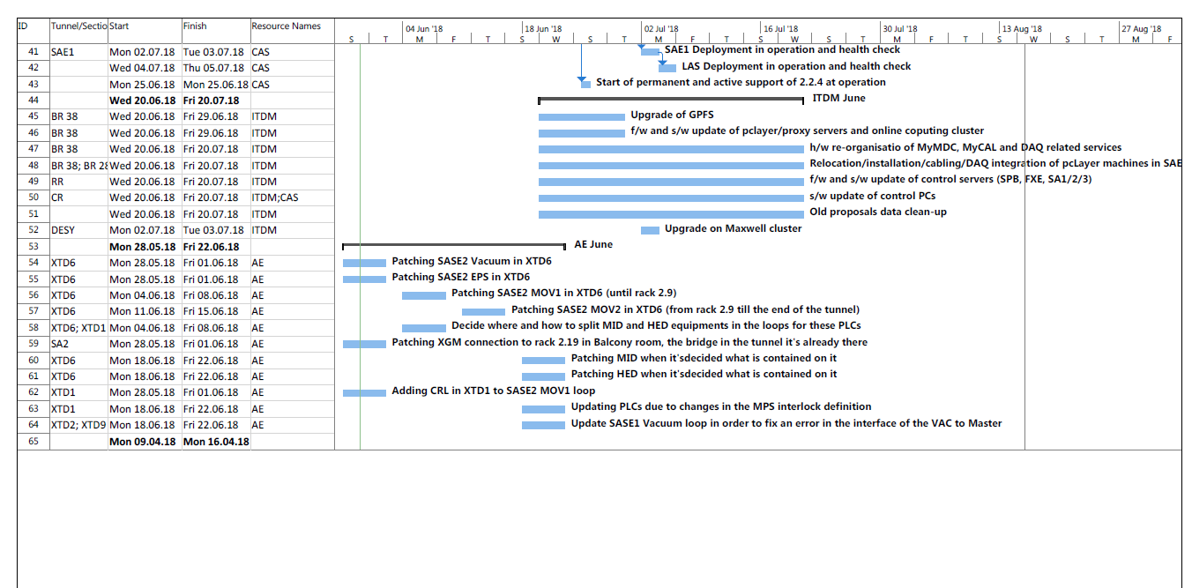
Shutdown June

Slide 4
Shutdown June
Emergency power-off test, dates to be proposed by the instruments (FXE, SPB)
MPS
  Interlock test
    20.06 and 26.06 all tunnels closed
    27.06 North branch closed
    02.07 South branch closed
    04.07 - 06.07 all tunnels closed
Karabo 2.2.4 deployment → Hugo Santos

