Slide 1
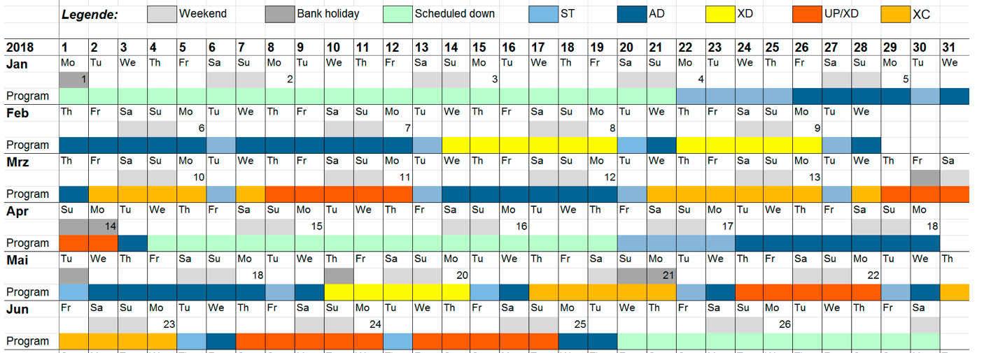

Karabo Rollout 2.2.4 – June Shutdown
Santos, Hugo
CAS, Agile Project Manager
Schenefeld, 01.06.2018

Slide 2
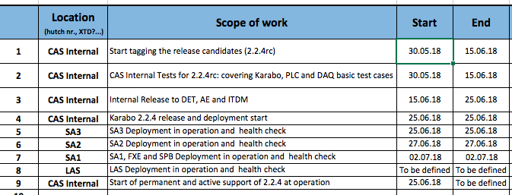
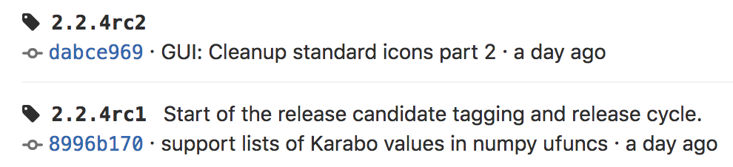

Slide 3
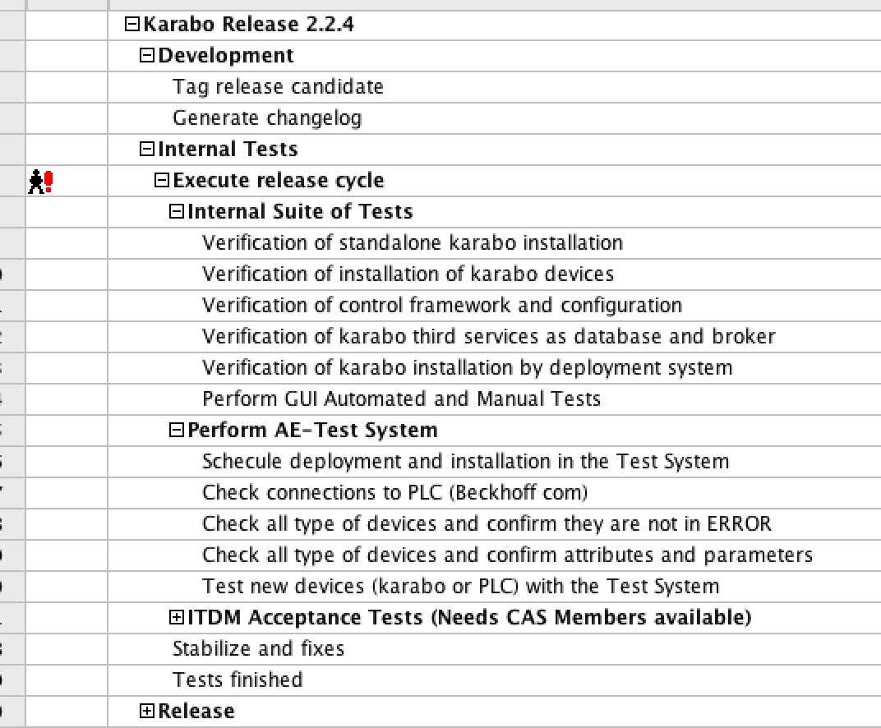

Slide 4
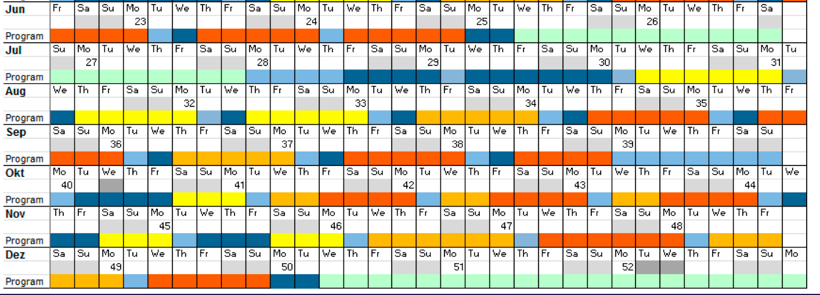
No impact on operation/production
CAS INTERNAL

Slide 5
ITDM, DET and AE feedbacks
Maybe LAS deployment

