Slide 1
W
From LWFA bunch durations to bunch profile and micro-structure
Longitudinal electron bunch diagnostics for LWFA based on broadband, spectral CTR measurements at single-shot
Omid Zarini^{1,2}, Alexander Debus¹, Jurjen Couperus^{1,2}, Alexander Koehler^{1,2}, Thomas Kurz^{1,2}, Susanne Schoebel^{1,2}, Maxwell LaBerge^{1,3}, Andrea Hannasch^{1,3}, Michael Downer^{1,3}, Ulrich Schramm¹, Arie Irman¹
¹ Helmholtz-Zentrum Dresden – Rossendorf , ² Technische Universität Dresden, ³ University of Texas at Austin

Slide 2
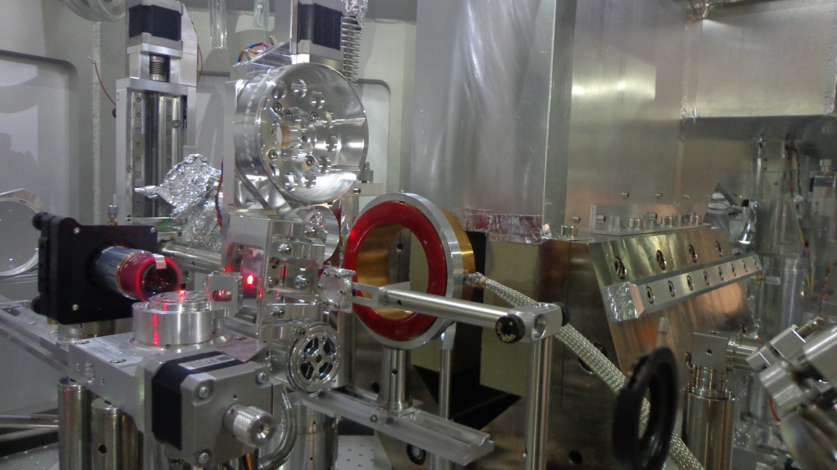
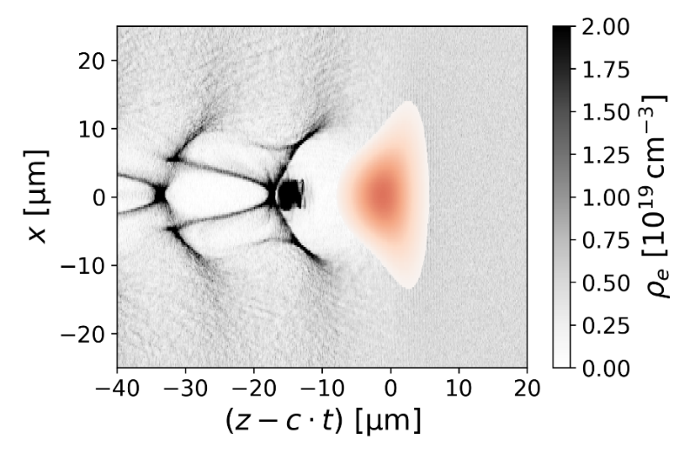
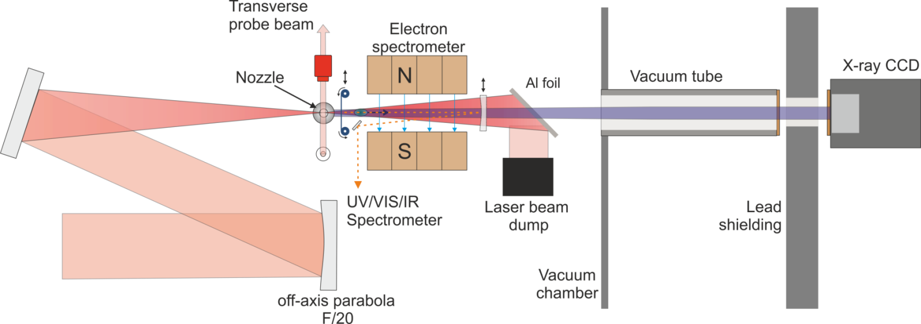
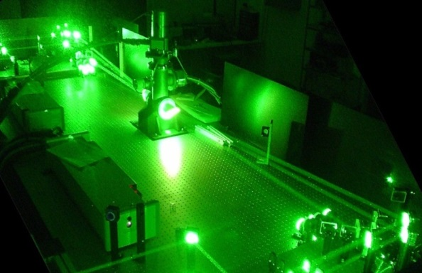
Short electron bunches in LWFA
Pulse duration?
Micro-structures?
Tape drive
Charge calibrated-electron spectrometer
DRACO
laser
gas jet
Ti:Sa Laser DRACO
λ₀ = 800 nm
up to 4 J on target
27 fs pulse width (FWHM)
Strehl-ratio > 0.9
20 μm FWHM

Slide 3
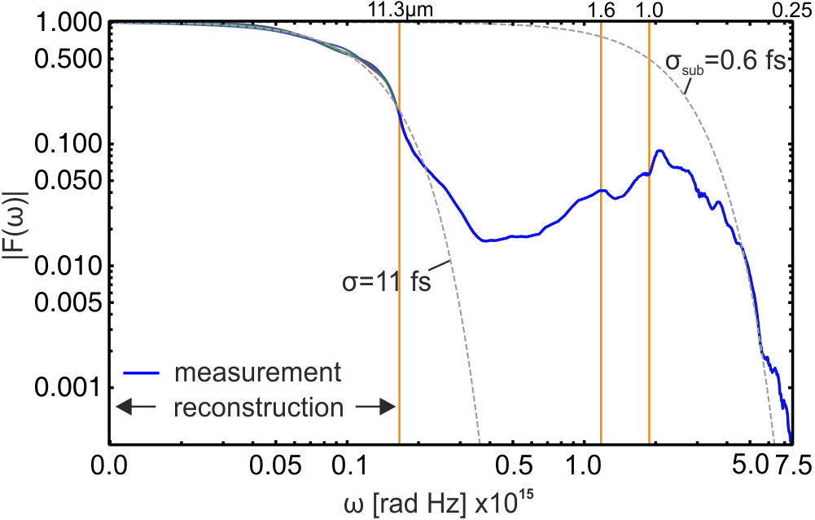
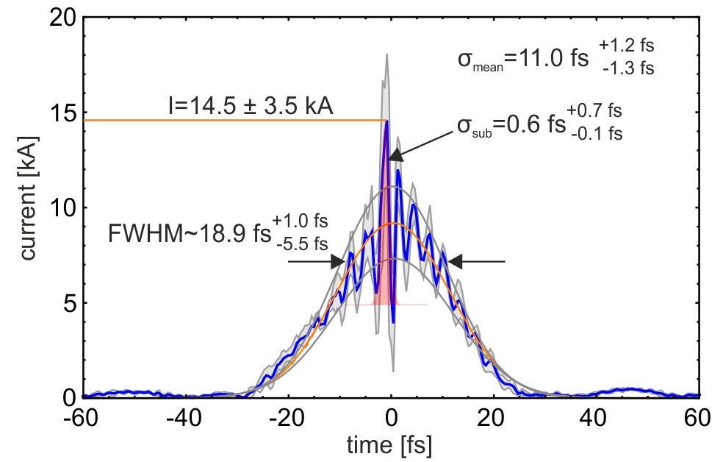
Typical reconstructed electron bunch profile
Form factor
Reconstructed electron bunch profile
λ_{p}/c ~ 57 fs
Bunch length: 11 fs (rms), 18.9 fs (FWHM)
Sub-structure 0.6 fs (rms)
Bunch within one LWFA bucket

