Slide 1
Power failure 7.6.
Notes:
How to edit the title slide
Upper area: Title of your talk, max. 2 rows of the defined size (55 pt)
Lower area (subtitle): Conference/meeting/workshop, location, date, your name and affiliation, max. 4 rows of the defined size (32 pt)

Slide 2
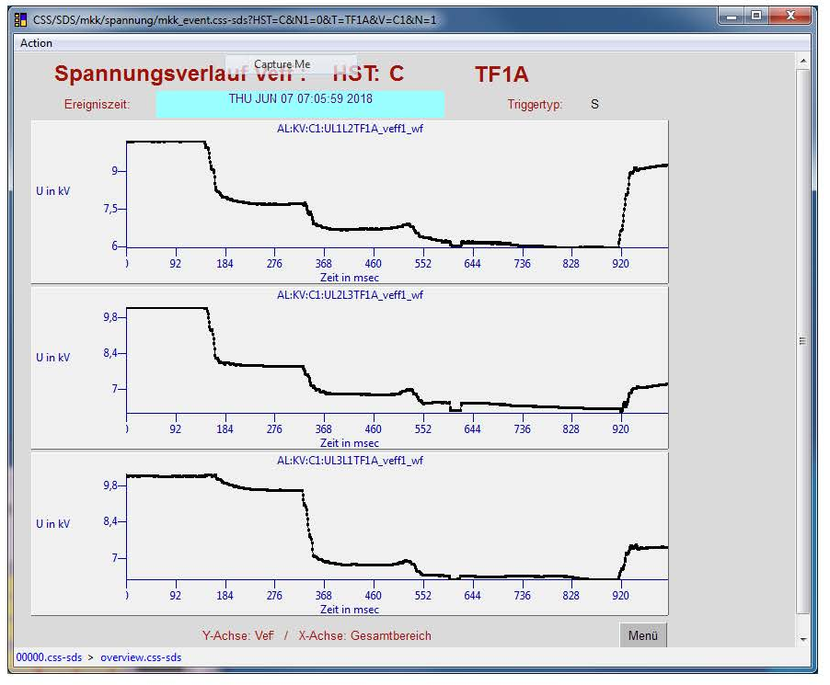
Power failure 7.6.
7.6., 7:06 there was a power glitch affecting Schleswig-Holstein and Hamburg, due to an error in „Umspann-werk Nord“
Voltage dropped from 10 → 6-7 kV for almost 600ms

Slide 3
Consequences
Machine was down, required restart
L. Kersting informed colleagues
TS checked systems in XHEXP1, XHQ etc.
Among other items:
1 shift of SPB beamtime was lost
Laser interlock SASE1 was affected
SASE1 PP-Laser was switched off, needs to be restarted, and run over the night to regain thermal stability
Few PCs were affected
Night shift @ FXE: ???

