Slide 1
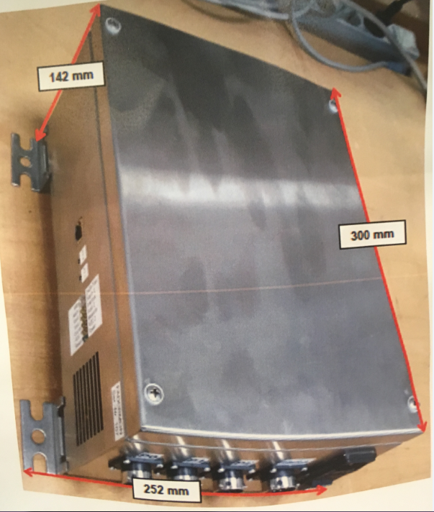
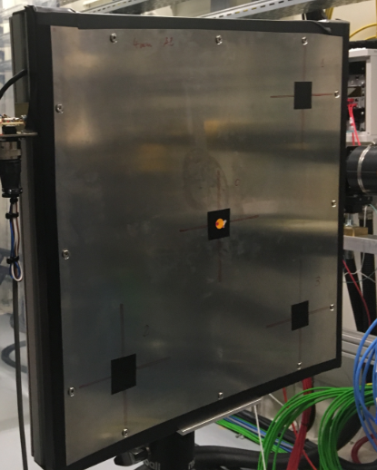
Area Detector
June 20th and 21st SASE 1,2and 3
1 in each Radiation Hutch
Place holders showing dimensions posted on 1Feb
300mm X 252mm X 142mm
Burnthrough Detektors
June 26th and 27th SASE 1 and 3
Installed directly in front of beamstop
520mm X 520mm X 60mm
Beamstopdeteckors
Installed same day as Burnthrough Detektors
Mounted to beamshutter
More details on exact location and size next week

