Slide 1
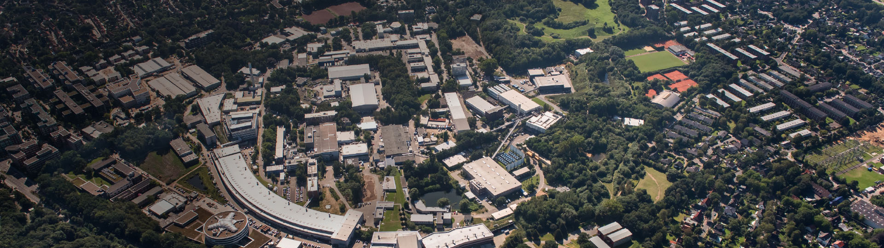
XUV Seeding at sFLASH
Christoph Lechner for the sFLASH team
Hamburg Alliance New Beams and Accelerators, 07 September 2018

Slide 2
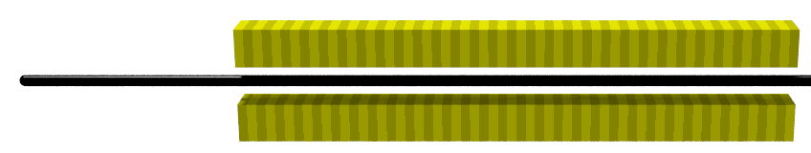
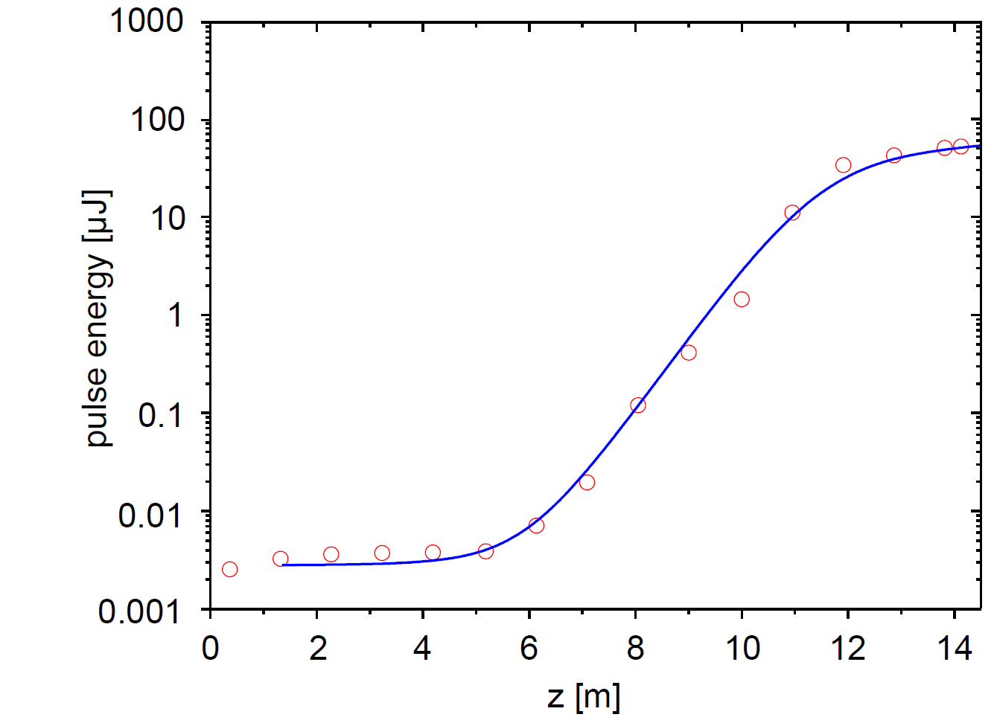

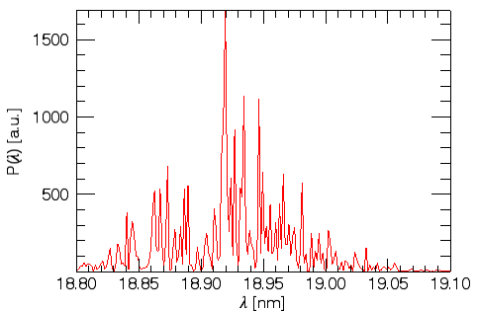
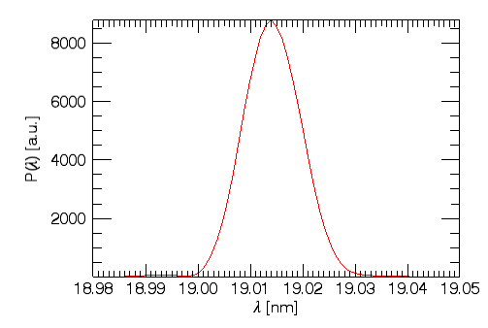



Introduction: Free-Electron Laser (FEL) & Seeding
Controlling and manipulating the FEL light pulses
=> ultra-short photon pulses with GW-peak power
Seeded operation
FEL controlled by external, coherent light pulse → from laser
3
SASE operation
Stochastic start-up
Noisy spectrum
2
simulation
simulation
1
Seeding transforms the FEL into a fully coherent light source

Slide 3
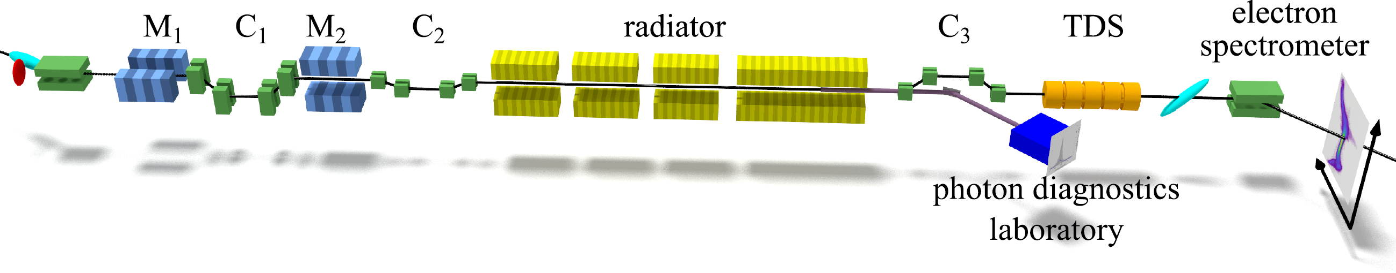
sFLASH – The Seeding Test Facility at FLASH
sFLASH as R&D experiment integrated into the FLASH user facility
RF Stations
Accelerating Structures
Fixed Gap Undulators
Photon Diagnostics
sFLASH
FLASH1
THz
RF Gun
Bunch Compressors
FLASH2
Albert Einstein
Lasers
Variable Gap
5 MeV
150 MeV
450 MeV
1250 MeV
FLASHForward
Kai Siegbahn
FEL Experiments
315 m
OUTLINE
High-gain harmonic generation (HGHG) seeding at sFLASH
Echo-enabled harmonic generation (EEHG) seeding studies at sFLASH
Future plans

Slide 4

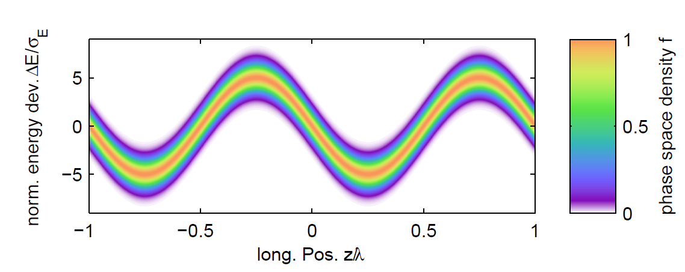
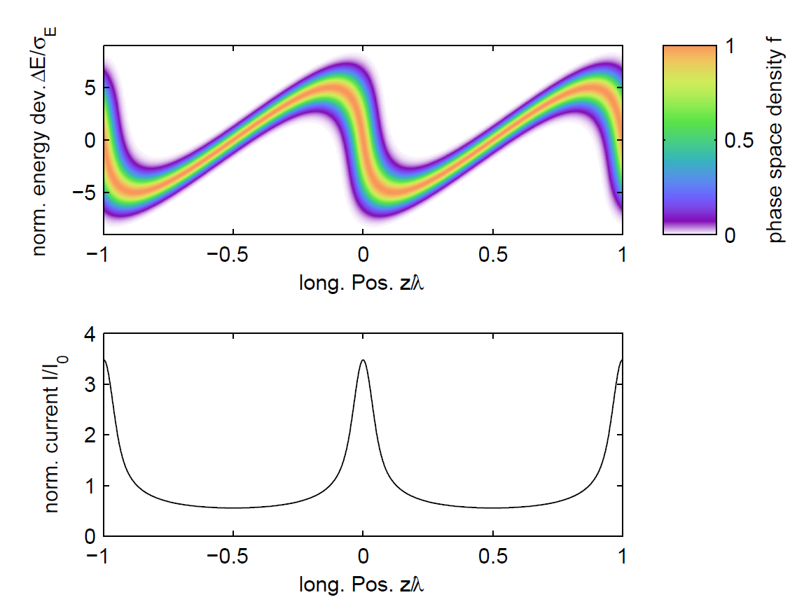

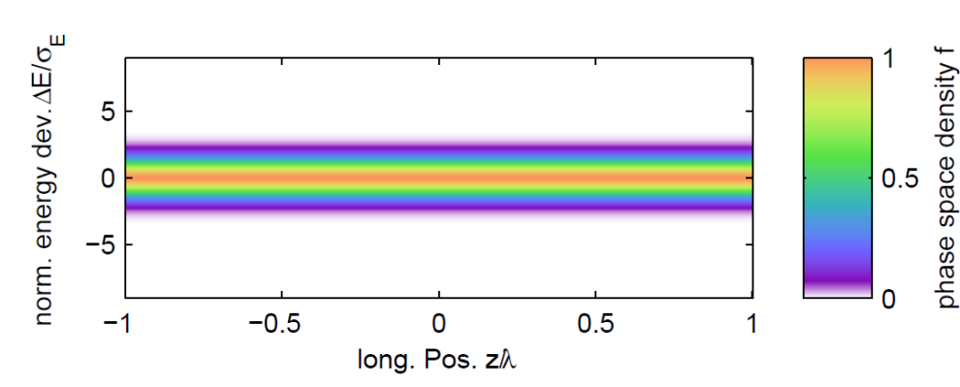
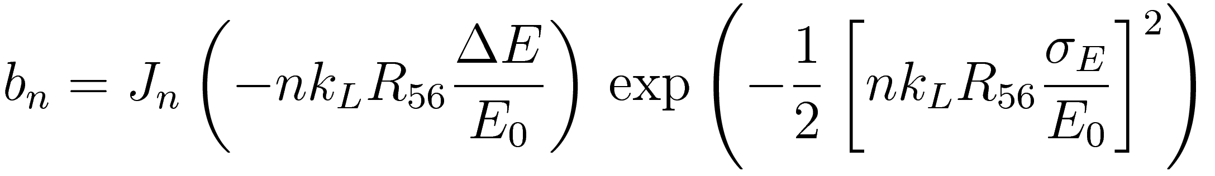
High-Gain Harmonic Generation (HGHG)
chicane
modulator
radiator
Bunching factor at harmonic n
Proposed by Yu in 1991:
L.H. Yu, Phys. Rev. A 44, 5178 (1991)

Slide 5
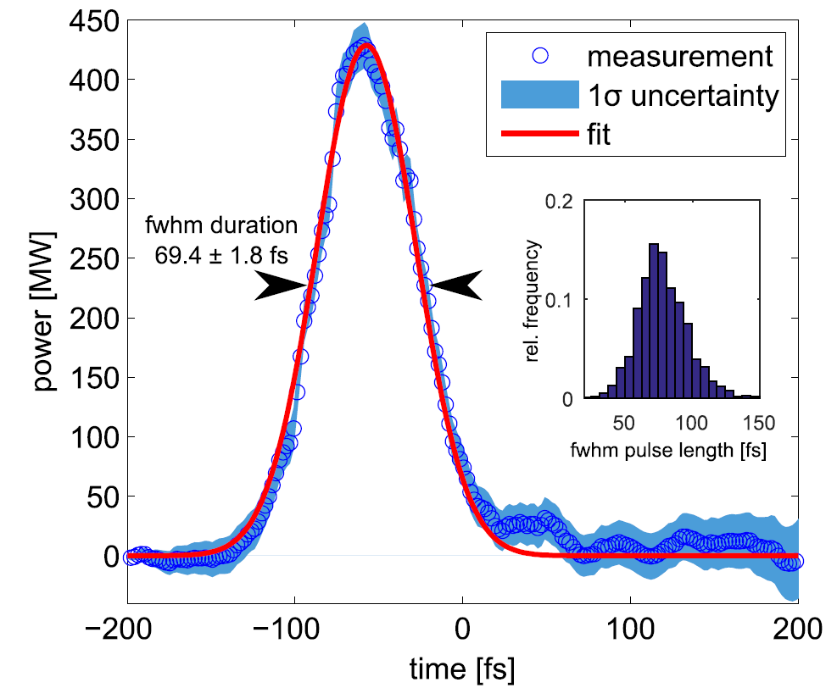
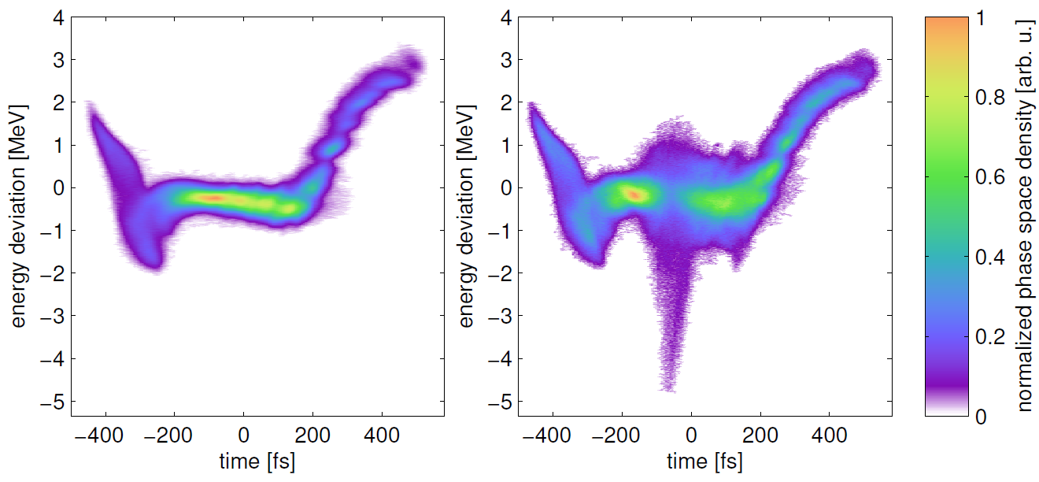
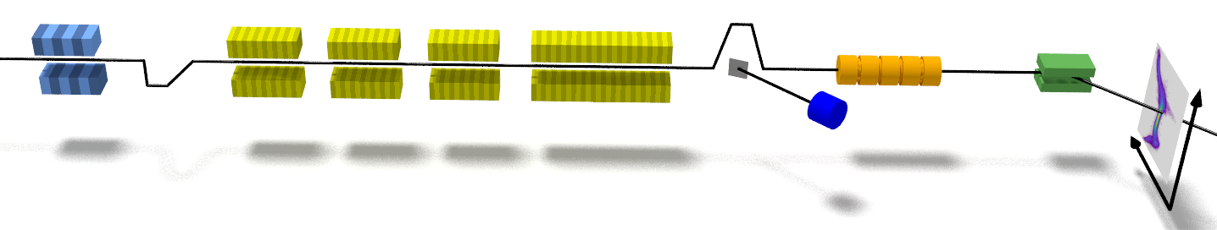
Generation and Analysis of Seeded FEL Pulses at sFLASH
Extraction from electron bunches with RF deflector
seeded area
Electron beam energy | 685 MeV
Peak current | 0.62 kA
Seed laser wavelength | 267 nm
Demonstrated for SASE FELs at LCLS
(DESY as co-author): C. Behrens, et al., Nat. Commun. 5, 4762 (2014)
modulator
radiator
TDS
sFLASH: first achieved for seeded FEL
T. Plath, et al., Sci. Rep. 7, 2431 (2017)
chicane
sFLASH

Slide 6
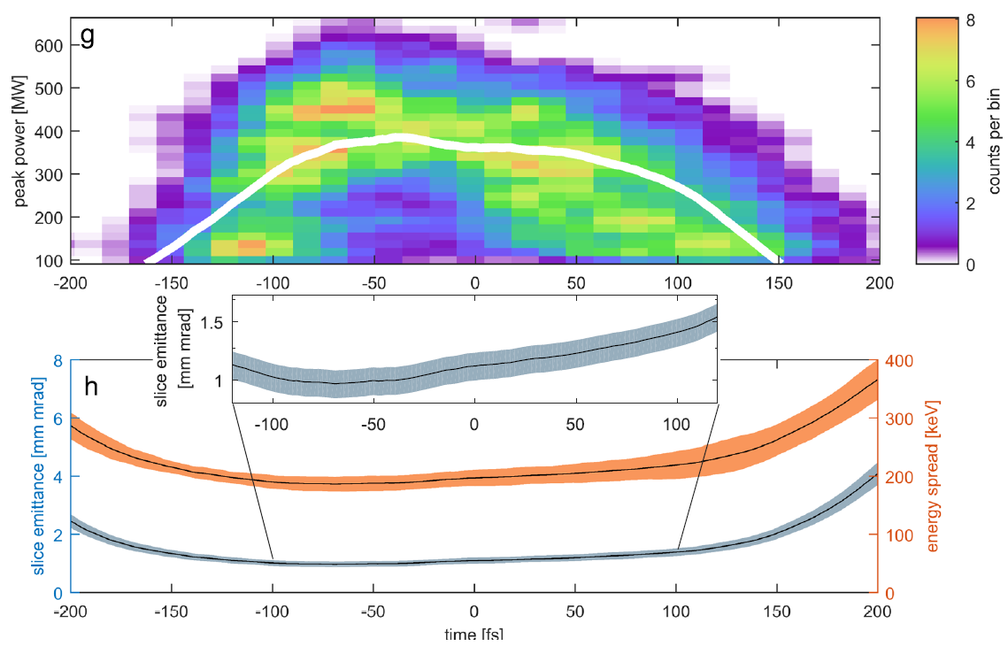
Generation and Analysis of Seeded FEL Pulses at sFLASH
Extraction from electron bunches with RF deflector
Measured emittance and current profiles and Ming Xie formalism very nicely model lasing in different regions of electron bunch
Unique hardware configuration (TDS setup at the exit of seeded FEL) enables detailed study of the seeded FEL
time [fs]
T. Plath, et al., Sci. Rep. 7, 2431 (2017)

Slide 7
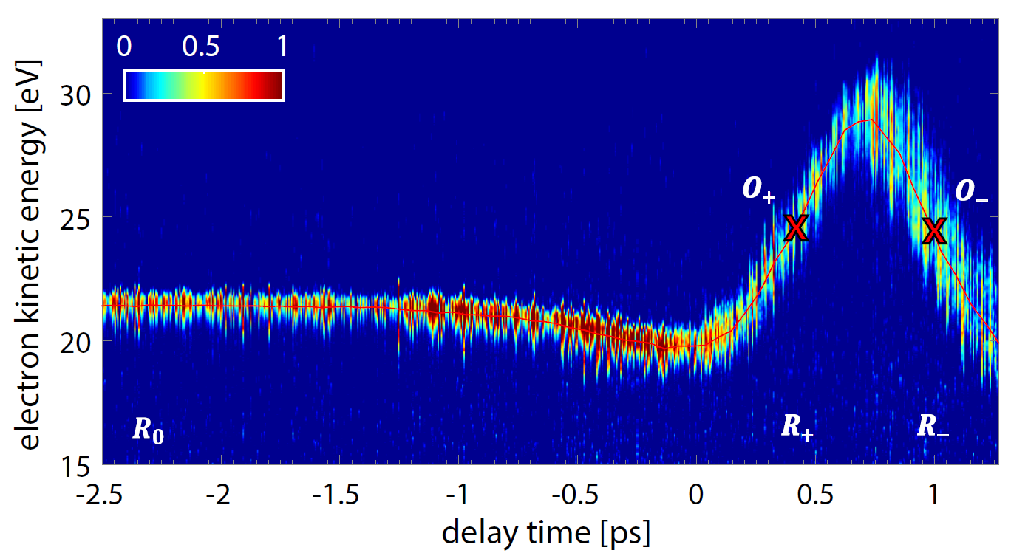
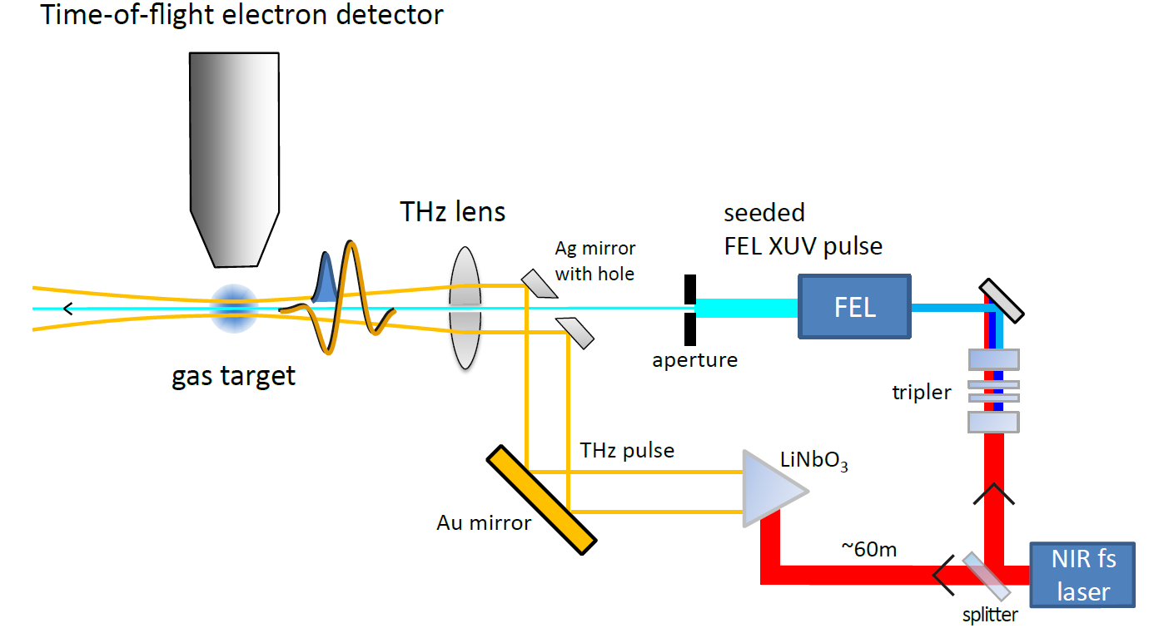
THz Streaking of Photon Pulses
Newly applied at DESY for seeded pulses
Time-of-flight electron detector
Combining measurements at both slopes gives access to
chirp
duration
of photon pulses
seed
source
THz
source
A. Azima, et al., New J. Phys. 20, 013010 (2018)

Slide 8
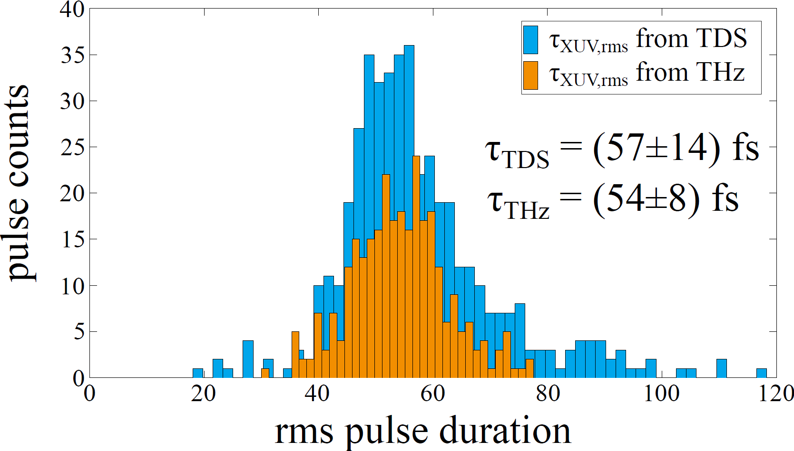
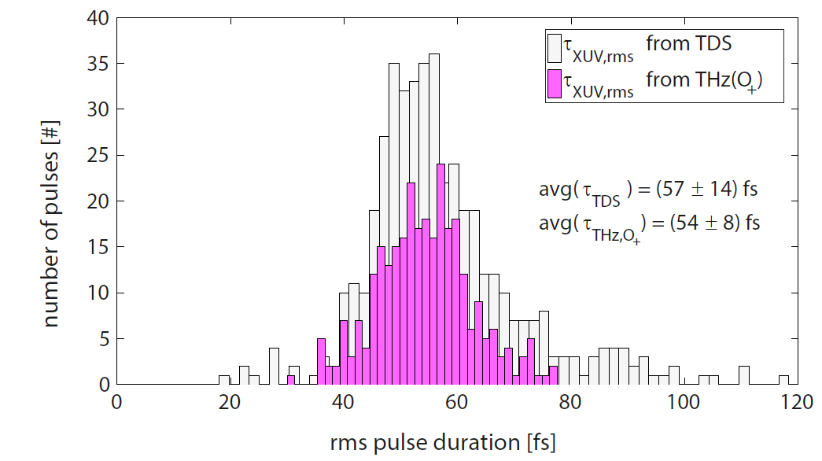
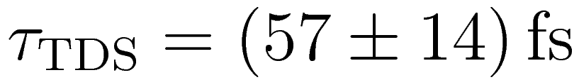
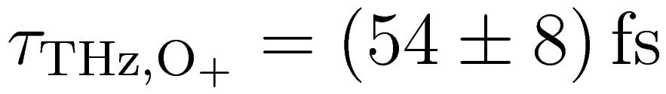
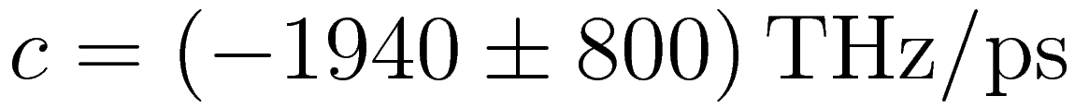
Measurement of FEL Pulse Duration
Using transverse-deflecting structure (TDS):
Extract duration of seeded FEL pulses
With THz streaking:
Access optical phase of FEL pulses
Chirp of seeded FEL pulses (only determined by THz streaking)
A. Azima, et al., New J. Phys. 20, 013010 (2018)

Slide 9
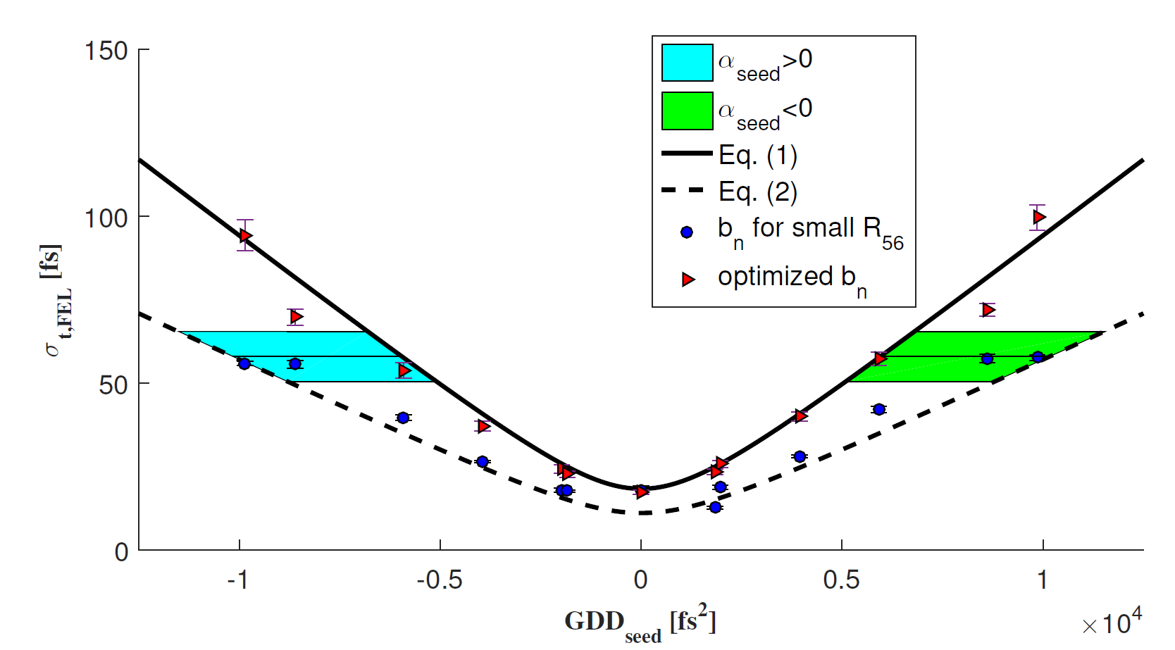
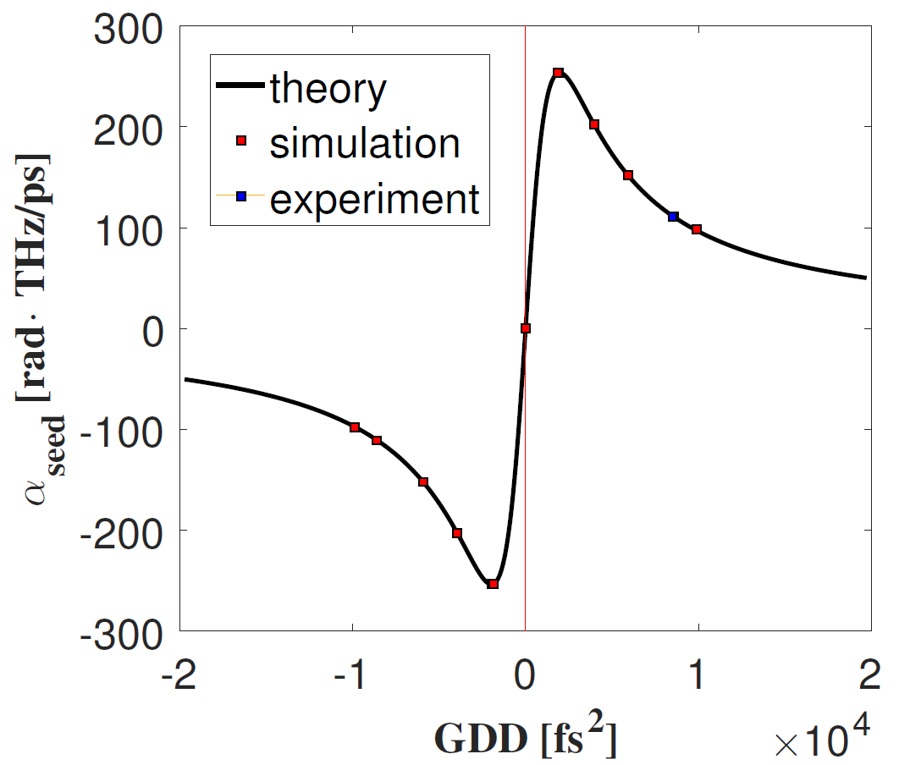
Next Step: Manipulation of UV Seed Laser Pulses
First step towards tailored seeded FEL pulses
α_{seed}<0
α_{seed}>0
optimized R₅₆
small R₅₆
Next talk by Vanessa Grattoni
group-delay dispersion GDD_{seed} [fs²]
Inserting material into seed laser beamline changes GDD
GENESIS
simulation

Slide 10

Echo-Enabled
Harmonic Generation

Slide 11
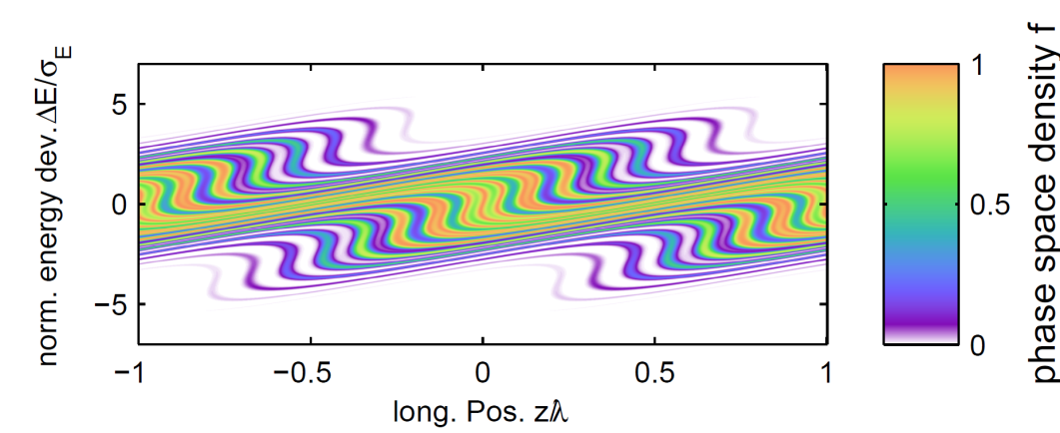
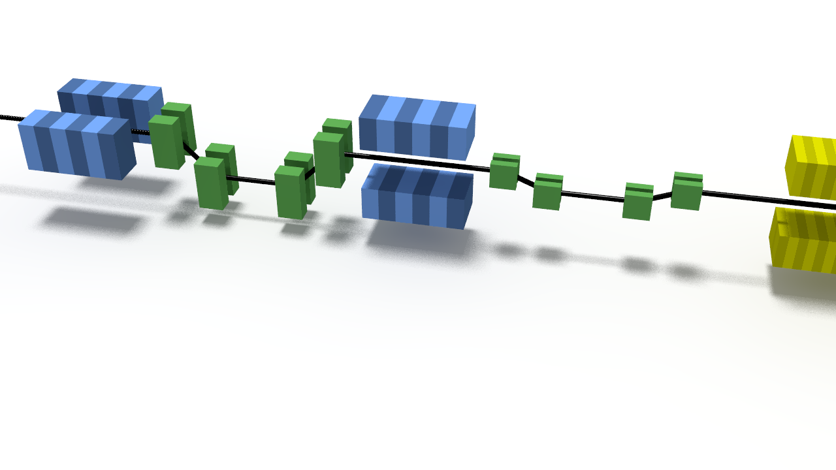
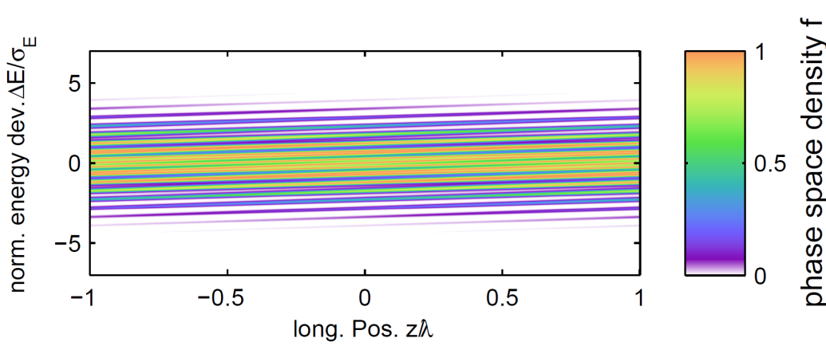
Echo-Enabled Harmonic Generation (EEHG)
Echo-enabled harmonic generation (EEHG):
Seeding adds less energy spread to electron beam
Electron beam imperfections have smaller impact on generated photons
Favorable bunching efficiency at high harmonics
FERMI@Elettra demonstrated EEHG seeding at h=45 (λ=5.9nm)
SLAC invention:
G. Stupakov, Phys. Rev. Lett. 102, 074801 (2009)

Slide 12
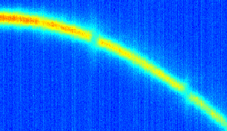
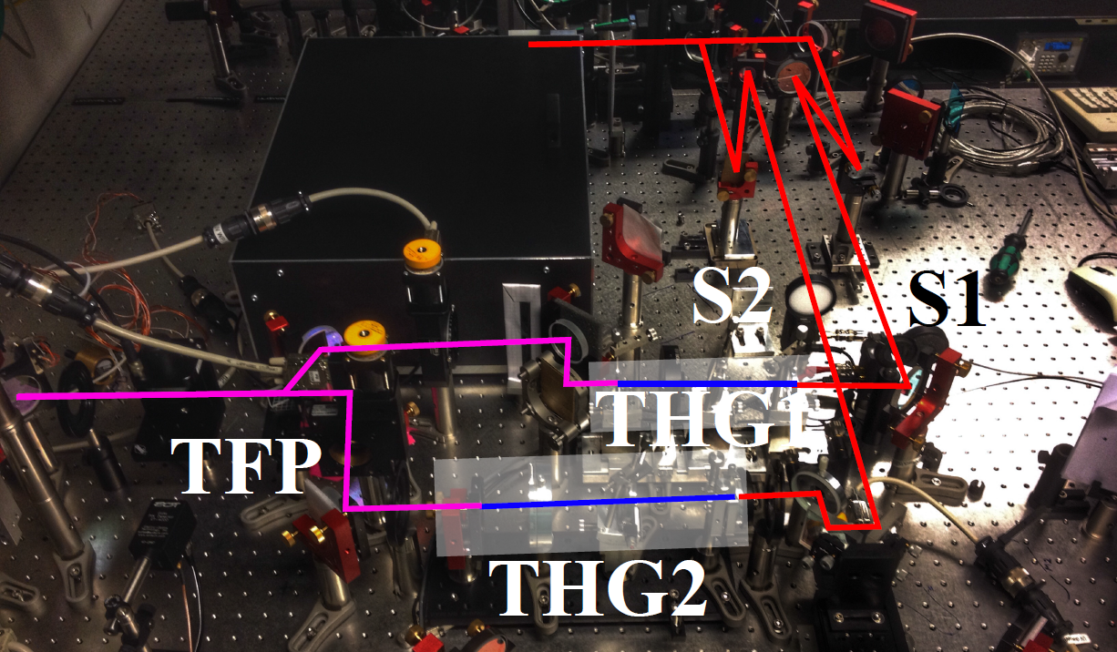
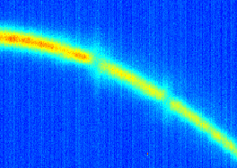
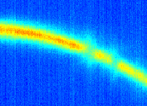
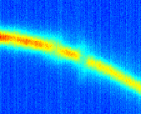
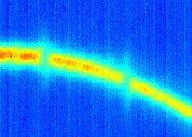
Preparations for EEHG Studies at sFLASH
Seed laser pulses have orthogonal polarization
  Pulse 1 interacts with bunch in 1st modulator
  Pulse 2 interacts with bunch in 2nd modulator
Demonstrated independent control in timing, modulation amplitude
  Global timing of seed laser pulses w.r.t. electron bunch controlled by vector modulator or OXC
  Delay stage controls relative timing of the two seed pulses

Slide 13
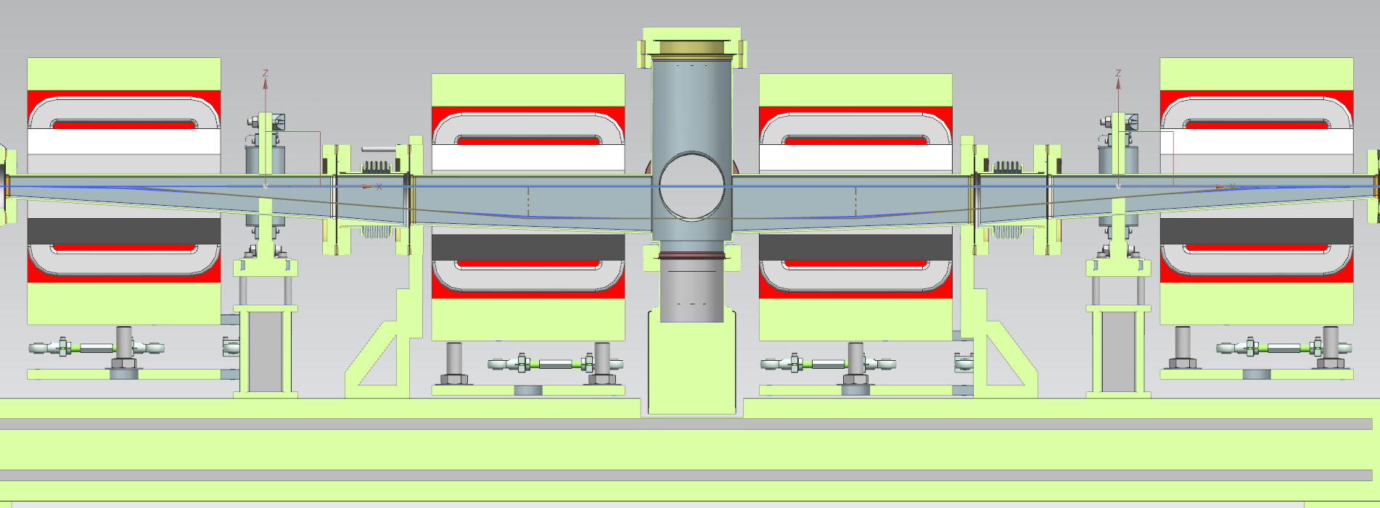
Upgrade Plans: 1st sFLASH Chicane
Current 1st sFLASH chicane is limited by vacuum chamber (R₅₆<700µm) => Upgrade is being designed (4mm at 700MeV)
Magnets with increased 1st field integral
Rectangular vacuum chamber

Slide 14
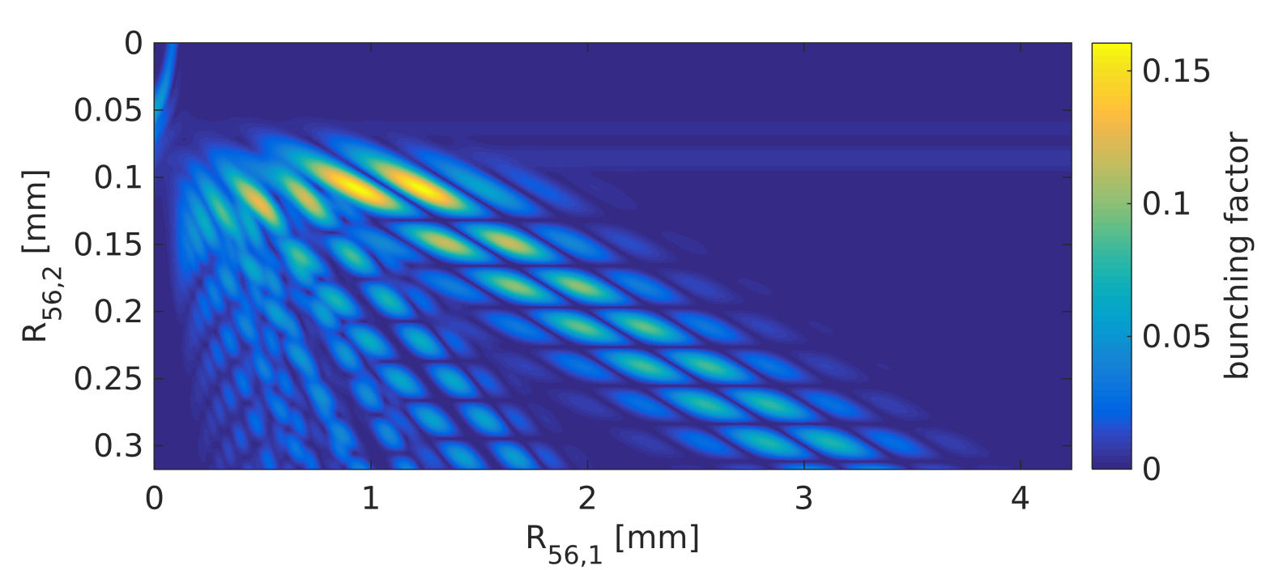

Upgrade Plans: 1st sFLASH Chicane
Current 1st sFLASH chicane is limited by vacuum chamber (R₅₆<700µm) => Upgrade is being designed (4mm at 700MeV)
Magnets with increased 1st field integral
Rectangular vacuum chamber
$$E_{0}=700 MeV$$
$$ΔE_{1}=350 keV$$
$$ΔE_{2}=350 keV$$

Slide 15
Seeding Design for FLASH2020+
Proposal for a seeded FEL beamline at FLASH
Key parameters:
Target wavelength range 4 – 60 nm
Variable FEL polarization (APPLE III undulators)
Burst repetition rate 100 kHz, matching the bunch pattern of the superconducting machine
EEHG seeding with two tunable UV seeds -> talk by Bastian Manschwetus (Thursday)

Slide 16

Summary
Seeding providing new insights and control for sFLASH FEL light pulses
sFLASH developed important new analysis methods (with HGHG seeding)
  World-wide first TDS measurements of seeded FEL process, providing insights into FEL light properties
  World-wide first THz streaking of seeded photon pulses: allows determining optical phase of FEL pulses, a critical information for frontier photon science
EEHG seeding
  Prepared seed laser setup for the study of EEHG seeding
  EEHG studies are on-going
Next steps:
  Demonstration of EEHG seeding at sFLASH
  HGHG with manipulated seed laser pulses -> next talk
  Seeding design for FLASH2020+ upgrade plans

Slide 17




Thank you for your attention
Sven Ackermann*, Armin Azima, Jörn Bödewadt*, Hauke Biss, Martin Dohlus, Nagitha Ekanayake*, Vanessa Grattoni, Kirsten Hacker*, Mehdi Kazemi, Leslie L. Lazzarino, Christoph Lechner, Hannah Limberg, Bastian Manschwetus, Theophilos Maltezopoulos*, Velizar Miltchev, Georgia Paraskaki, Tim Plath*, Andreas Przystawik, Yannik Ristau, Sergey Usenko, Mathias Vogt, Igor Zagorodnov, Johann Zemella,
Ralph Assmann, Markus Drescher, Bart Faatz, Ingmar Hartl, Wolfgang Hillert, Shaukat Khan, Tim Laarmann, Jörg Rossbach, Wilfried Wurth
* former team member

