Slide 1
Control of FEL radiation properties by tailoring the seed pulses
Hamburg Alliance New Beams and Accelerators
Vanessa Grattoni
Hamburg, 07.09.2018

Slide 2
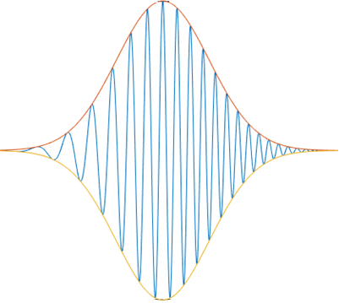
FEL control driven by seed laser
Importance of the control on the seed laser properties
Control on the seed laser phase permits to:
Correct and control the FEL phase
Eventually FEL phase control enables CPA (chirped pulse amplification*) and phase sensitive experiments (four-wave mixing, attosecond coherent control²).
¹Chirped pulse amplification in an extreme-ultraviolet free-electron laser, David Gauthier et al. Nat. Comm. 7, 13688 (2016)
²Coherent control with a short-wavelength free-electron laser, Nature Photonics volume 10, pages 176–179 (2016) K. Prince et al.
$$φ_{FEL}\left(t\right)=n\left(φ_{seed}\left(t\right)+φ_{electrons}\left(t\right)\right)+φ_{fel}(t)$$
$$φ_{seed}\left(t\right)=φ_{0}+ω_{0}t+\frac{1}{2}αt^{2}$$
$$φ_{electrons}\left(t\right) ∝\frac{1}{σ_{E}}E\left(t\right)$$
$$α=0$$
$$α≠0$$

Slide 3
Ultra-short pulses passing through dispersive materials
Introducing Group Delay Dispersion (GDD)
$$E(s)$$
Fourier-Transform limited pulse
Pulse with chirp
$$GDD$$
$σ_{t,seed}^{FL}∙σ_{ω,seed }=\frac{1}{2}$
$$σ_{t,seed}^{}∙σ_{ω,seed}=\frac{1}{2}\sqrt{1+{(2{σ_{t,seed}}^{2}α)}^{2}}$$
Dispersive
medium
$$s$$
$$s$$
$$s$$
$$v_{g}(ω)$$
Lower wavelengths
(blue)
Higher wavelengths
(red)
L
$$ω_{1}$$
$$ω_{1}$$
$$ω_{2}$$
$$ω_{2}$$
GDD depends on the material, on the distance travelled by the light in the material and the bandwidth of the considered light pulse
GDD quantifies the amount of chirp $α$ held from a light pulse ($φ_{seed}\left(t\right)=φ_{0}+ω_{0}t+\frac{1}{2}αt^{2}$)
Notes:
Begin: transform limited gaussian pulse➔ different frequencies are travelling at the same velocity:I have two pulses with different central frequency
As the pulses go through a dispersive medium the group velocity change for the different frequencies, so after the medium the distance between the initial common center wiill be different for the two frequencies and the final pulse will lengthen.
The GDD describes the amount of chirp gained trough a dispersive medium

Slide 4
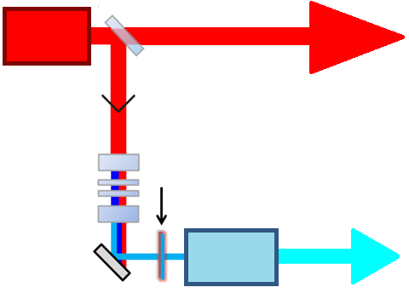
Controlling the chirp
NIR laser
Photon Diag. Laboratory
THz experiment
→ temporal profile of the FEL pulse
→ enables derivation of the seed laser chirp at the interaction point in MOD2
THG
FEL
UV pulse manipulation

Slide 5
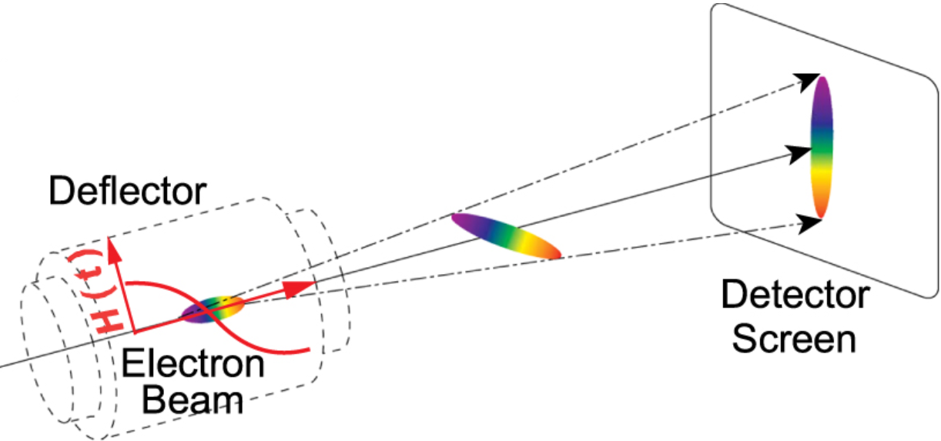
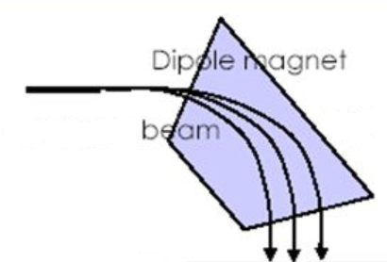
Longitudinal phase space distribution measured with TDS
Bending
magnet
Transverse deflecting structure TDS
Bending magnet
$$Bρ\sim m_{e}βc$$
Notes:
Say that knowing how much energy modulation is given by the seed laser is important because in this way we can estimate the bunching that is leading the FEL instability

Slide 6
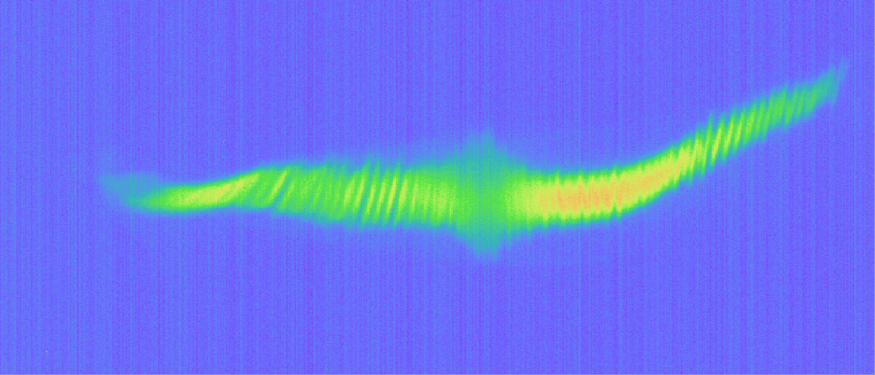
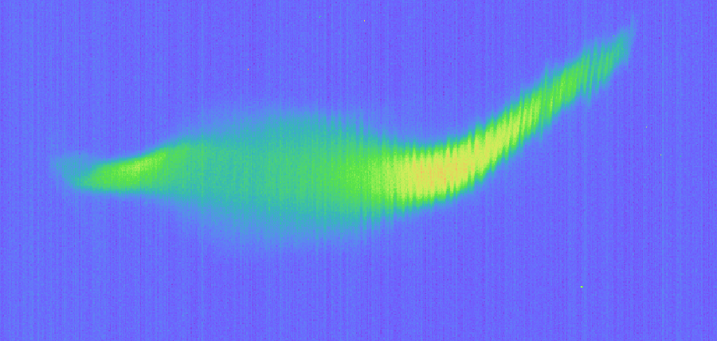
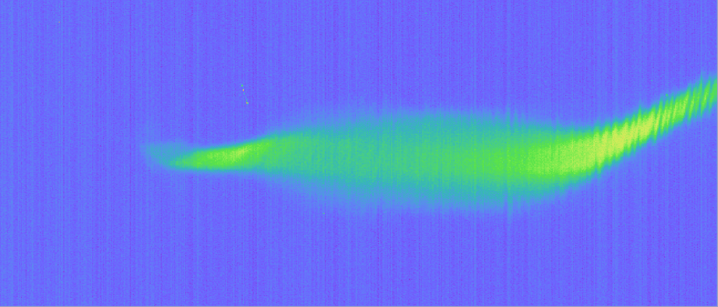
Impact of fused silica on energy modulation
Energy
No added fused silica
12 mm fused silica
$$GDD=2.3×{10}^{3} fs^{2}$$
Time
24 mm fused silica
36 mm fused silica
$$GDD=4.7×{10}^{3} fs^{2}$$
$$GDD=7.1×{10}^{3} fs^{2}$$
48 mm fused silica
60 mm fused silica
$$GDD=9.4×{10}^{3} fs^{2}$$
$$GDD=12×{10}^{3} fs^{2}$$

Slide 7
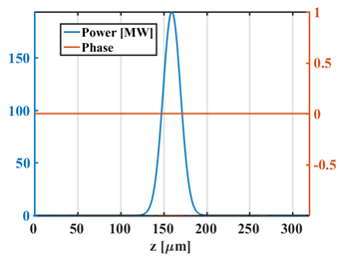
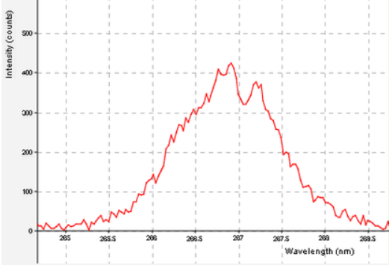
Characterization of seed laser chirp
Chirp gained by passing through seed laser beamline w/o any additional material
Vacuum window
Vacuum window
FLASH tunnel
$σ_{ω,seed }=14.7$ THz
$σ_{t,seed}^{FL}∙σ_{ω,seed }=\frac{1}{2}$
$σ_{t,seed}^{FL}=34$fs
Notes:
In my simulation I have simulated different points

Slide 8
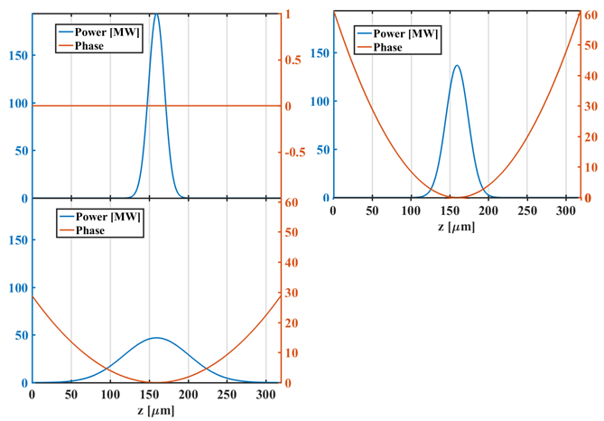
Simulated working points
Chirp of the seed laser $α$
Seed laser pulses at the modulator entrance
$$no chirp$$
$α=216$THz/ps
$α=102$THz/ps
$$φ_{seed}\left(t\right)=φ_{0}+ω_{0}t+\frac{1}{2}αt^{2}$$
$$σ_{t,seed}^{}∙σ_{ω,seed}=\frac{1}{2}\sqrt{1+{(2{σ_{t,seed}}^{2}α)}^{2}}$$
Seed laser energy and $σ_{ω,seed }$ is identical for all the simulated pulses.
$σ_{t,seed}$respect to the GDD of the seed laser
Notes:
In my simulation I have simulated different points

Slide 9
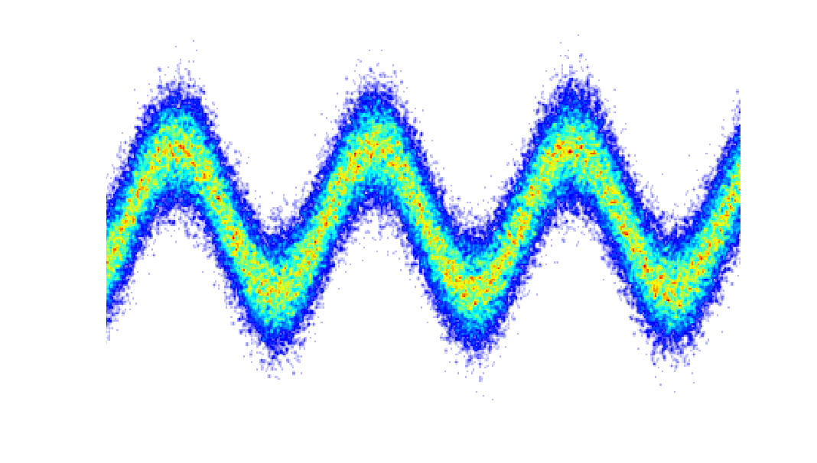
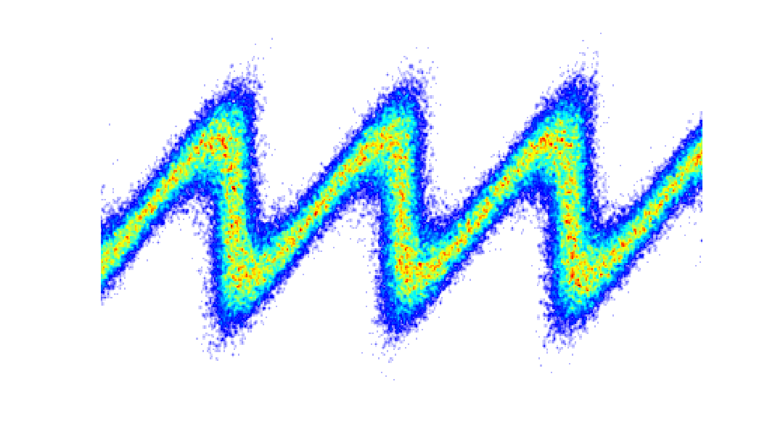
Initial GDD of the seed laser
Simulation results are compared with THz streaking measurement
Seeded FEL pulse depends on FEL optimization:
Seed laser power → energy modulation of the electron beam $Δγ$
Strength of dispersion R₅₆
$$Δγ$$
R₅₆
$$\frac{σ_{t,seed}}{\sqrt{n}}<σ_{t,FEL}<\frac{7}{6}\frac{σ_{t,seed}}{n^{1/3} }$$
THz streaking measurement: $σ_{t,FEL}=\left(58±7.5\right)$fs
Seed laser GDD in the modulator $GDD=\left(8.3±3.2\right)⋅10^{3} fs^{2}$
This GDD corresponds to the amount of chirp that a pulse gains passing through $\left(42±16\right)$ mm of fused silica.
Laser phase errors in FELs, D. Ratner et al. PR STAB 15, 030702 (2012)

Slide 10
Summary and Outlook
Summary
Setup of the sFLASH experiment used to characterize the seed laser chirp
GENESIS simulation of seeded FEL for different chirp of the seed laser
THz streaking reveals chirp and duration of the seeded FEL pulse
Combination of simulation outcome with the THz streaking experiment results enables the estimation of the GDD of the seed laser in front of the modulator
Outlook
Study the seeded FEL for different amounts of chirp on the seed laser.
First step towards FEL pulse tailoring driven by seed laser manipulation

Slide 11
Acknowledgement
Sven Ackermann*, Armin Azima, Jörn Bödewadt*, Hauke Biss, Martin Dohlus, Nagitha Ekanayake*, Vanessa Grattoni, Kirsten Hacker*, Mehdi Kazemi, Leslie L. Lazzarino, Christoph Lechner, Hannah Limberg, Bastian Manschwetus, Theophilos Maltezopoulos*, Velizar Miltchev, Georgia Paraskaki, Tim Plath*, Andreas Przystawik, Yannik Ristau, Sergey Usenko, Mathias Vogt, Igor Zagorodnov, Johann Zemella, Ralph Assmann, Markus Drescher, Bart Faatz, Ingmar Hartl, Wolfgang Hillert, Shaukat Khan, Tim Laarmann, Jörg Rossbach, Wilfried Wurth…
… as well as strong acknowledgment for
the continuous support by the people of FLASH.
* former team member

Slide 12
Thank you for the attention

Slide 13
Vanessa Grattoni
MPY-1
vanessa.grattoni@desy.de

Slide 14
Backup

Slide 15
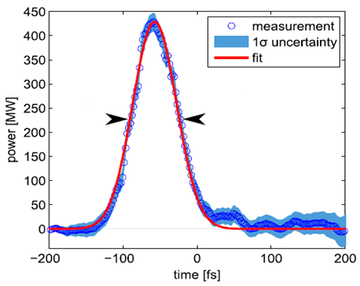
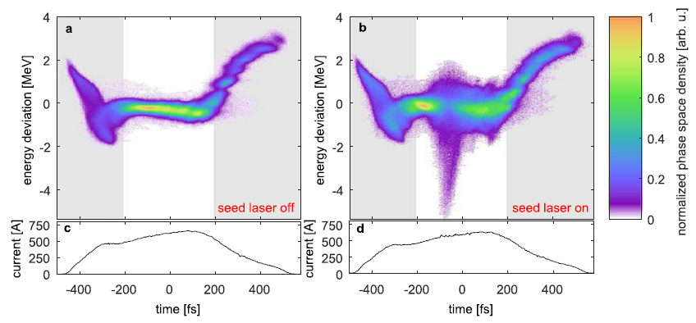
Characterization of the temporal profile of the FEL pulse
$$σ_{t,FEL}=\left(41±1\right)fs$$
$$ΔE_{i}\text{(}t_{i}\text{)}=E_{r}\left(t_{i}\right)−E_{s}(t_{i})$$
$P_{FEL}\left(t_{i}\right)=ΔE$($t_{i})\frac{\text{I}\text{(}t_{i}\text{)}}{e}$
Uncompressed electron beam and opened radiator
T. Plath et al., Scientific Reports, 7, 2431

Slide 16
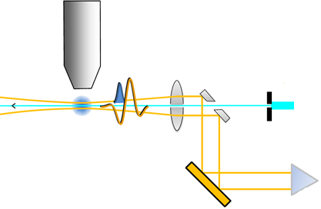
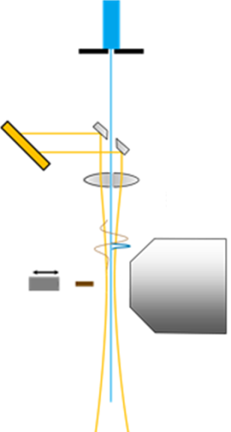
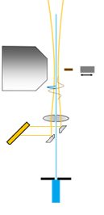
Characterization of seeded laser pulses at sFLASH
Experiment overview
Seed Laser Laboratory
Photon Diag. Laboratory
Gas target
TOF
THz lens
Au mirror
Ag-mirror with hole
THz pulse
LiNbO₃
Aperture
Seeded FEL 33 nm
Vacuum window
Vacuum window
Seed laser properties after (tripler) THG setup:
$σ_{ω,seed }=14.7$ THz
$σ_{t,seed}=140$fs
THz streaking
→ temporal profile of the FEL pulse
→ enables derivation of the seed laser chirp at the interaction point in MOD2
*A. Azima et al. “Direct measurement of the pulse duration and frequency chirp of seeded XUV free electron laser pulses”

Slide 17
TDS based longitudinal overlap
Used to adjust the longitudinal overlap between the e-beam and the seed laser pulse when they have been already coarsely overlapped: they are in a temporal window of 200 ps
Setup: modulator closed to resonance condition, radiator open, e-beam decompressed
Uncompressed electron beam and opened radiator
Energy modulation resulting from seed laser interaction
$${∆γ}_{seed}=\left(350±50\right) keV$$

Slide 18
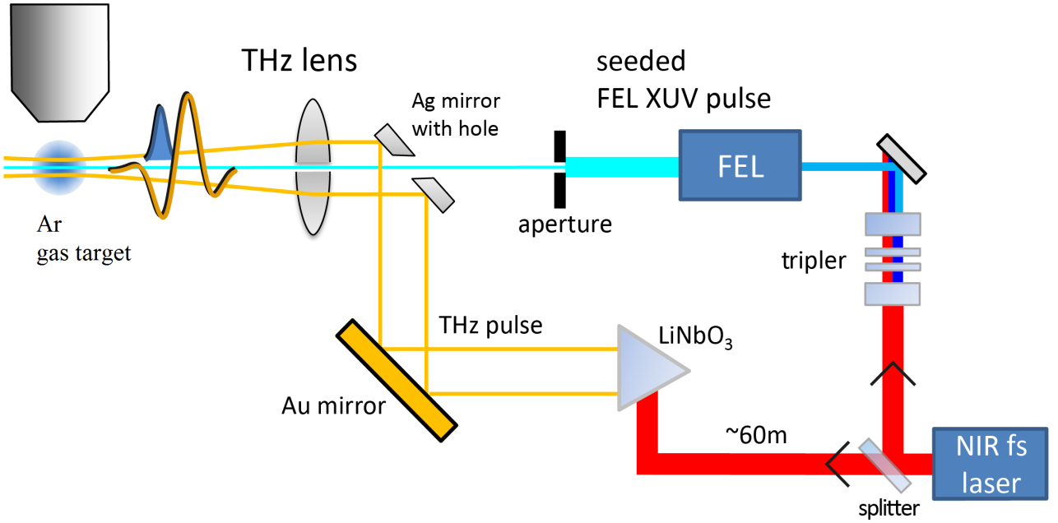
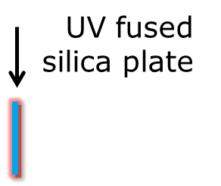
Controlling the chirp
TOF
1st ToF
Ag
mirror
4 mm
UV FS plate
Seeded XUV
THz
~ 0.42 µJ, 1200 fs
LiNbO₃
Au mirror
Optical
rectification

Slide 19
Tailoring electromagnetic pulses
Case of positive dispersion (GDD>0) $GDD=\frac{d}{dω}\left(\frac{1}{v_{g}(ω)}\right)$
$$φ\left(ω\right)=φ_{0}+ω_{0}∗(ω−ω_{0})+\frac{β}{2}∗({ω−ω_{0})}^{2}$$
$$E(s)$$
$$φ\left(t\right)=φ_{0}+ω_{0}∗(t−t_{0})+\frac{α}{2}∗({t−t_{0})}^{2}$$
$$σ_{t_{f},I}^{}=σ_{t_{i},I}^{}\sqrt{1+{\left(\frac{GDD}{2σ_{t_{i},I}^{2}}\right)}^{2}}$$
$$σ_{t_{i},I}^{}=\frac{σ_{t_{i},E}}{\sqrt{2}}$$
$$GDD=?$$
$$σ_{ω,I}$$
Dispersive medium
$$σ_{ω,I}$$
$$s$$
$$v_{g}(ω)$$
Higher wavelengths
(red)
Lower wavelengths
(blue)
L
$$α=\frac{GDD}{{\left(2σ_{t_{i},I}^{2}\right)}^{2}+{GDD}^{2}}$$
$$∆T≈\frac{L}{{v_{g}}^{2}}\left|∆v_{g}\right|=\frac{L}{{v_{g}}^{2}}\left|\frac{dv_{g}}{dω}\right|⋅Δω=|GDD|⋅Δω$$
$$TBP_{f}=σ_{ω,I}∙σ_{t_{f},I}=0.5⋅\sqrt{1+{\left(2σ_{t_{f},I}^{2}α\right)}^{2}}$$
$$GDD_{seed}⋅σ_{ω,I}^{2}=α_{seed}{⋅σ}_{t_{f},I}^{2}$$

Slide 20
Tailoring electromagnetic pulses
Group delay dispersion (case: GDD>0) $GDD=\frac{d}{dω}\left(\frac{1}{v_{g}(ω)}\right)$
$$φ\left(ω\right)=φ_{0}+ω_{0}∗(ω−ω_{0})+\frac{β}{2}∗({ω−ω_{0})}^{2}$$
$$E(s)$$
$$φ\left(t\right)=φ_{0}+ω_{0}∗(t−t_{0})+\frac{α}{2}∗({t−t_{0})}^{2}$$
$$σ_{t_{f},I}^{}=σ_{t_{i},I}^{}\sqrt{1+{\left(\frac{GDD}{2σ_{t_{i},I}^{2}}\right)}^{2}}$$
$$σ_{t_{i},I}^{}=\frac{σ_{t_{i},E}}{\sqrt{2}}$$
$$GDD$$
$$σ_{ω,I}$$
Dispersive medium
$$σ_{ω,I}$$
$$s$$
$$v_{g}(ω)$$
Higher wavelengths
(red)
Lower wavelengths
(blue)
L
$$ω(t)$$
$$α=\frac{GDD}{{\left(2σ_{t_{i},I}^{2}\right)}^{2}+{GDD}^{2}}$$
$$∆T≈\frac{L}{{v_{g}}^{2}}\left|∆v_{g}\right|=\frac{L}{{v_{g}}^{2}}\left|\frac{dv_{g}}{dω}\right|⋅Δω=|GDD|⋅Δω$$
$$ω_{f}\left(t\right)=ω_{0}+α\left(t−t_{0}\right)$$
$$TBP_{f}=σ_{ω,I}∙σ_{t_{f},I}=0.5⋅\sqrt{1+{\left(2σ_{t_{f},I}^{2}α\right)}^{2}}$$
$$ω_{i}\left(t\right)=ω_{0}$$
$$α=0⇒Transform limited pulse$$
$$t$$
$$TBP_{i}=σ_{ω,I}∙σ_{t_{i},I}=0.5$$
Notes:
Spectral components coming from two ends of the spectrum propagate with different velocities Delta_vg=d_vg/d_omega*Delta_omega .
La bandwidth non cambia perch’e all’interno del mezzo dispersivo si assume non ci sia assorbimento di lunghezze d’onda

