Slide 1
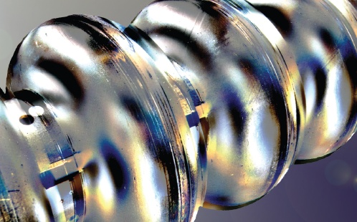
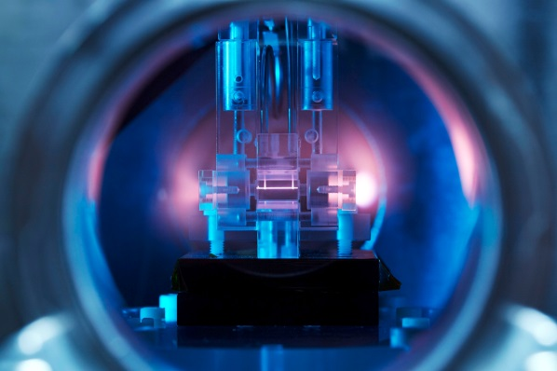
ARD Infrastructures at DESY
Brains and facilities for outstanding activities
Helmholtz Program: Matter & Technology (MT)
PoF III Topic: Accelerator Research & Development (ARD)
A structured LK I program supporting generic non-project driven R&D
Disclaimer: Performance category LK II (large-scale scientific facilities operation) R&D activities may be linked but are to be seen separately!
Hans Weise
Hamburg Alliance New Beams and Accelerators, DESY, 5 – 7 September 2018

Slide 2
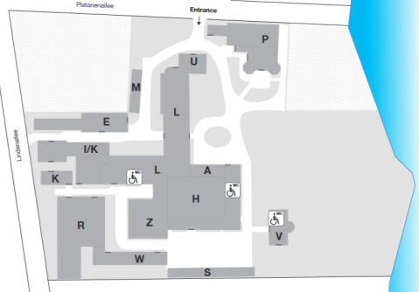
Accelerator Research at DESY
Ultra-short bunches & novel accelerators
ARD ST3 & ST4
ps & fs electron/photon beams
FEL seeding
SINBAD: ARES & AXSIS
beam and laser-driven plasma acceleration
prototype compact FELs
R&D needs infrastructure
SRF Technology
ARD ST1
niobium
material analysis
cavities / modules
SRF gun
FLASH1 & 2
FLASHForward
SINBAD
AXSIS
LUX
REGAE
PITZ
DESY, Zeuthen

Slide 3
Superconducting Technology
ARD ST1 emphasizes SRF cavities operated continuous wave
European XFEL high energy linac section
Superconducting radiofrequency (SRF) accelerators are a figurehead of DESY‘s engagement in the design, construction and operation of accelerators for science.
The European XFEL is the longest SRF linac worldwide.
The fully successful technology transfer to industry reached a point where other worldwide projects (LCLS-II, ESS, new SRF based FELs at e.g. SINAP, China) are profiting greatly from DESY efforts.
The ARD ST1 goal is to keep both expertise and top-ranking position in SRF technology.
Continuous wave (cw) SRF is of special interest. The time structure of cw FEL photon pulses is adopted to the needs of photon beam users. Almost any macro pulse structure can be offered.
Due to beam dynamic requirements the first sections of the European XFEL linac would need cw accelerator modules operated around 25 MV/m.
cw cavities – installed in the low-energy sections - at sufficiently high gradient would offer highest flexibility. The European XFEL would operate in pulsed / long pulse / cw mode.

Slide 4
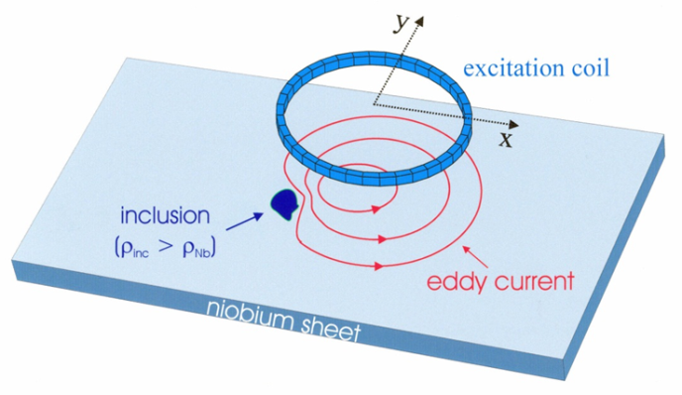
SRF Cavity Production
Niobium scanning and surface analysis
Detailed examination of niobium sheets is a sine qua non condition for large series production of superconducting cavities.
DESY operates a specially developed eddy current device to search for inclusions. For the European XFEL more than 16,000 sheets were scanned. Different vendors were qualified.
DESY’s ARD program aims for high performance and highest quality factor SRF cavities. Cavity production starts with the niobium specification.
Being active member in the worldwide SRF community DESY has taken over the scanning QC for the complete production of LCLS-II cavities. ESS cavity material is next.
The achieved visible sheet’s depth is approximately 500 µm, and the minimal detectable inclusion size is about 80 µm. The scanning result is used to decide on the RF active surface i.e. the later inner side of the accelerating structure.
Identified defects are studied in a well equipped metallurgy laboratory at DESY.

Slide 5
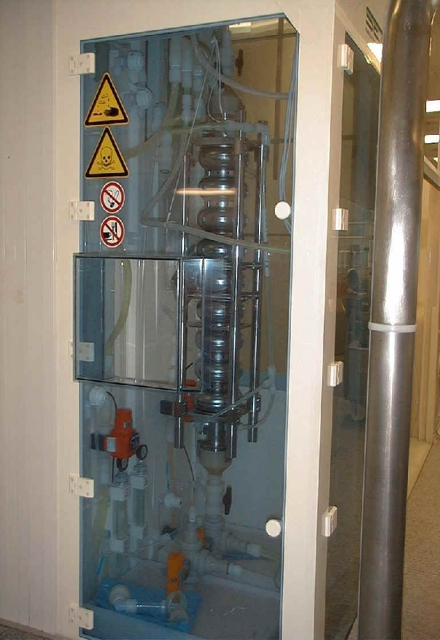
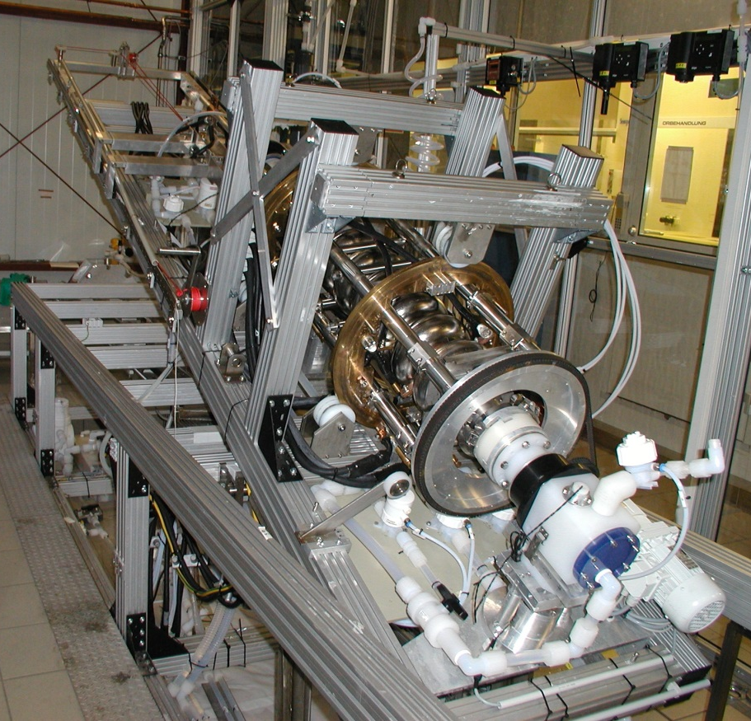
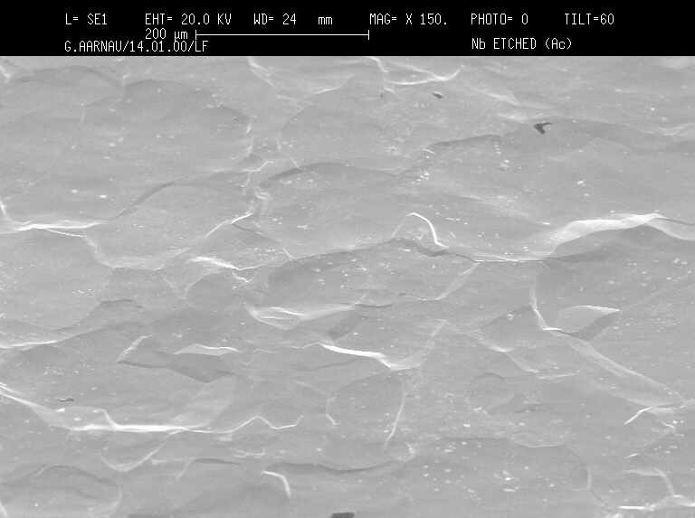
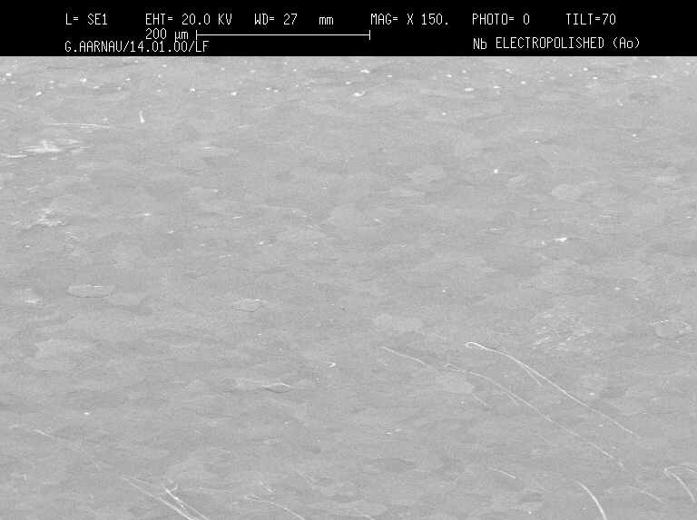
Chemical Treatment
Buffered Chemical Polishing (BCP) / Electro-polishing (EP) – used for SRF Cavities & Guns
Damage layer of about 150 µm caused by production is removed by chemical polishing.
Two processes have successfully been transferred to industry.
The DESY EP facility was setting the standards for todays state-of-the-art chemical treatment.
Buffered Chemical Polishing (BCP)
Electro-polishing (EP)
HNO₃ : HF : H₃PO₄
1 : 1 : 2
H₂SO₄ : HF
9 : 1
U ≈ 17 V
200 μm
200 μm

Slide 6
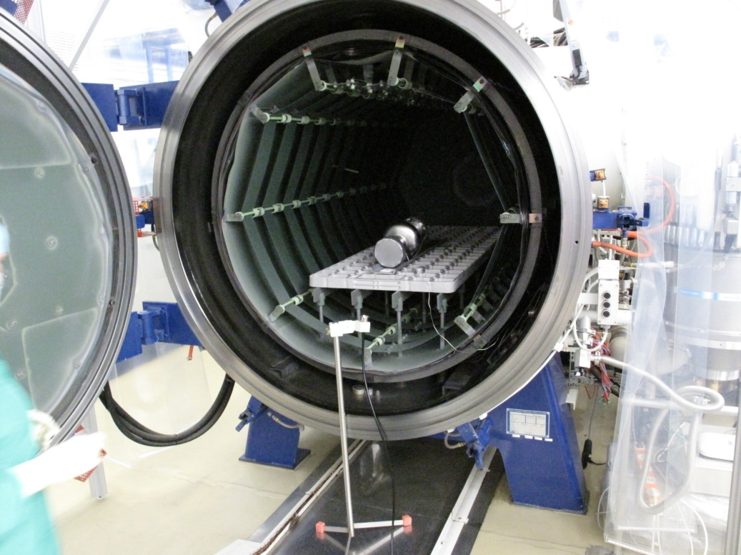
800°C Annealing
Cavity annealing and N-Infusion studies
During fabrication the Niobium-material is stressed by deep drawing and welding. Annealing serves the relaxation of the material.
During the chemical treatments hydrogen is introduced into the niobium. This impurity is known to decrease the Q-value at low gradients. Annealing reduces the hydrogen content to a harmless level.
Low temperature (120°C) Nitrogen doping, so called N-Infusion is a promising way to achieve high Q-values at high gradients.
We are improving the furnace for this treatment.
We compare DESY treatment with e.g. FNAL.

Slide 7
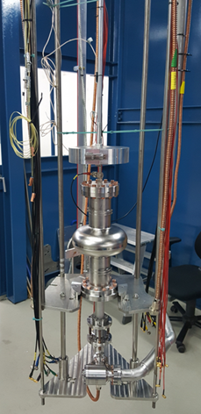
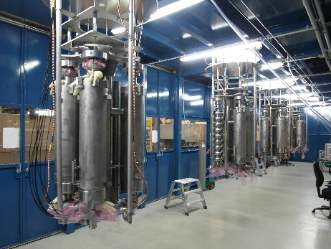
SRF Cavity Testing
RF testing after surface treatment
DESY operates several vertical test stands / dewars to characterize cavities. In total 6 inserts are used to take either up to 4 standard 1.3 GHz cavities, or other structures like SRF guns into the cryostat.
ARD ST1 profits strongly from the cavity test infrastructure. All DESY developed cavities were and are tested here.
For the European XFEL over 1200 cavity tests were carried out. Now DESY supports LCLS-II, ESS and others.
Meanwhile inserts
are adaptive for different cavity types, and
usually have an adjustable RF antenna.
We measure Q(E) incl. pass-band and locate quenches using second-sound and temperature map.
Sensors checking radiation caused by field emission and magnetic flux complete the picture.

Slide 8
Accelerator Module Assembly
From the cavity string to the finished module
At DESY dedicated assembly infrastructure for the assembly / dis-assembly and repair of superconducting accelerator modules is available.
ARD related R&D like CW tests of improved standard XFEL modules is only possible due to this infrastructure and the related expertise of many colleagues.
DESY has developed the respective infrastructure and uses it for standard European XFEL or FLASH modules. Other infrastructures worldwide e.g. at CE Saclay but also Fermilab and KEK mimic the DESY facilities.
While the string of accelerating cavities is assembled in ISO4 clean rooms, the further assembly of the closed vacuum system to the so-called cold mass which is the inner structure of the cryostat is done in dedicated assembly areas.
The outside clean room assembly work includes installation of frequency tuners, magnetic shields and others.
Skilled teams are responsible for all work.

Slide 9
Accelerator Module Testing
Module R&D includes extensive testing
Several horizontal test stands are available for the characterization of completely assembled superconducting accelerator modules. Three test stands were used for the European XFEL series testing.
The ARD ST1 program uses all test stands plus one additional test stand for more sophisticated studies including long pulse or even continuous wave operation.
Precise amplitude and phase control culminates in atto-second LLRF R&D.
CW asks for RF power coupler development (tuning range and copper thickness).
Established test procedures start with the initial incoming inspection of the modules.
Vacuum and cryogenic system of the test stand which is installed in a shielding enclosure are attached.
Waveguides connect to the radio frequency supply.

Slide 10
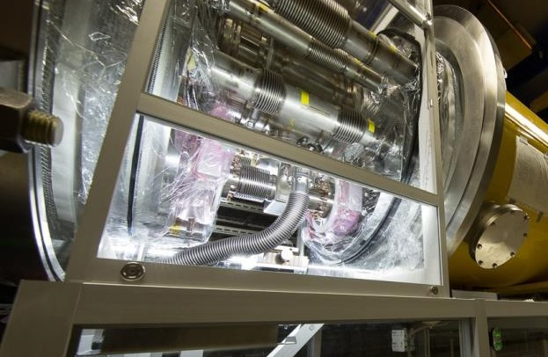
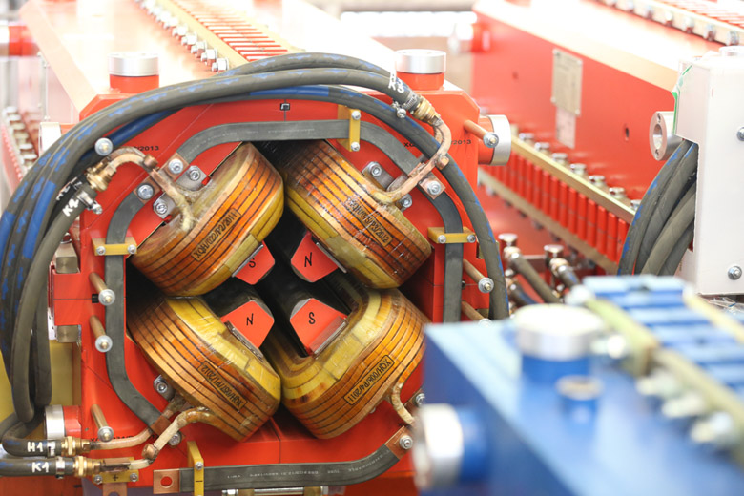
General DESY Infrastructure & Expertise
Highly developed infrastructure enables high-tech
Particle-clean vacuum is indispensable for the success of SRF technology.
All DESY vacuum systems benefit.
Superconducting magnets are measured in dedicated test stands.
XFEL series of 103 magnets.
Normal-conducting magnets are specified and measured at DESY.
Fabrication usually at partner labs.
RF laboratories can handle sophisticated power systems
RF guns, bunchers, transverse deflecting systems.

Slide 11
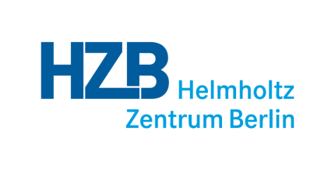
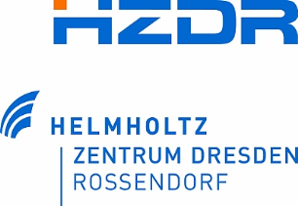
Sustainable Infrastructure
Collaborative use of ARD ST1 related infrastructure
Highly developed infrastructure is operated by skilled teams to the benefit of
ARD (DESY and partner laboratories e.g. HZDR, HZB, HIM Mainz)
European XFEL and DESY‘s FLASH facility
Major research facilities worldwide (LCLS-II, ESS, new FELs)
Access to DESY infrastructure guarantees
Sharing of expertise
Participation in new and recent developments
Sustainability by keeping a highly motivated team
support many SRF community members
DESY as brand name
discretionary budget due to service contracts

Slide 12
The Photo Injector Test Facility in Zeuthen (PITZ)
More than 15 years of experience in photo injector R&D with advanced diagnostics
PITZ is a test facility for RF guns, lasers, RF and diagnostic components
All RF guns for FLASH & XFEL were conditioned and characterized at PITZ.
dedicated diagnostics for in-depth electron beam characterization and optimization for a wide bunch charge range
new developments, e.g. most advanced photo cathode laser systems, plasma acceleration, THz, micro-bunch shaping with dielectric structures, …
ARD activities aim for
ultimate beams for short wavelength FELs + applications, e.g.
beam quality (3D gun laser shaping)
stability and reliability (gun system design)
basic studies on beam-driven plasma acceleration for particle and astro-particle physics, e.g.
self-modulation of long particle beams, high transformer ratios, laboratory astrophysics

Slide 13
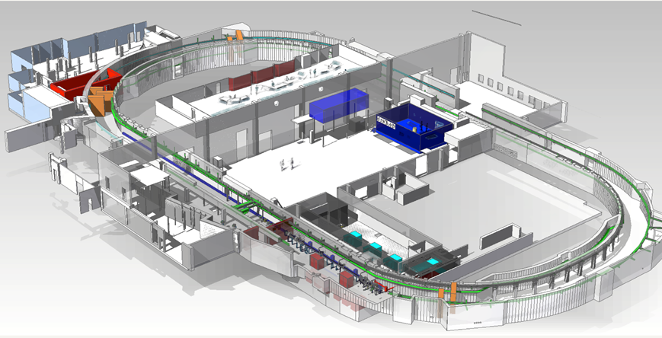
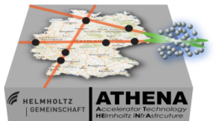
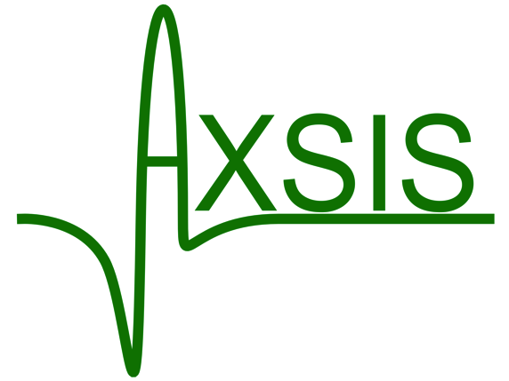
SINBAD (Short INnovative Bunches and Accelerators at DESY)
The long-term dedicated accelerator R&D facility at DESY
AXSIS
currently under construction (reusing the old DORIS tunnel)
Main science cases:
ultra-fast science (fs to as-regime electron pulses)
various laser-driven approaches aiming for high gradient acceleration with external or internal electron beam injection
100 MeV ARES linac for ultra short bunches (fs)
Study high brightness from RF photo injectors and ultra-short bunch production
Inject into various laser-driven approaches e.g. DLA
Start gun commissioning in fall 2018
Attosecond X-ray Science: Imaging and Spectroscopy (AXSIS)
ERC-funded collaboration on acceleration in dielectric loaded waveguides using THz lasers
Building construction/ basic infrastructure installation to be completed by end 2018
ARES linac

Slide 14
SINBAD in the ATHENA context
ATHENA: The Helmholtz-wide collaboration on laser plasma acceleration
funded by Helmholtz strategic investment funds
The electron flag-ship project will be located in SINBAD with contributions from all Helmholtz-partners and UHH
Timeframe for construction: 2018-2022
ARES-upgrades:
X-band TDS system
Dogleg to 2nd experimental area
Linac energy upgrade
Plasma accelerator with external injection
Undulators
LUX
Move and upgrade of the LUX experiment
High power laser lab
Move of Angus laser
40 TW laser system with Jena/KIT
Development lab
LUX
High Power Laser Lab
(ANGUS)
ARES upgrades

Slide 15
FLASH
User facility with dedicated accelerator R&D and FEL study blocks
A common accelerator part and three electron beamlines
FLASH1 & FLASH2: undulator beamlines with subsequent photon beamlines
FLASHForward a pioneering research plasma-wakefield acceleration experiment
FLASH1
FLASH2
The total available beam time is distributed:
photon user experiments (60%), parallel operation of FLASH1 and FLASH2
FLASH studies (30%) - machine and photon beamline development - this includes user preparation, but also improvement of diagnostics, optimization of FEL performance like single-spike operation, test of lasing schemes like frequency doubler and harmonic lasing self-seeding
general accelerator R&D (10%) - this includes seeding development, plasma-wakefield acceleration research
Multi beamline operation
first beam in FLASHForward - August 31, 2017

Slide 16
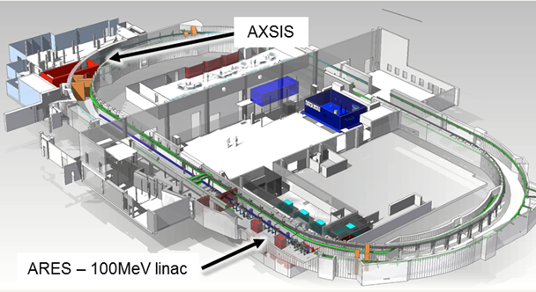
Summary
ARD Hamburg Alliance profits from brains and facilities
At DESY, accelerator design, construction and operation has a long tradition.
Consolidated knowledge is the basis for new R&D ideas.
Highly motivated teams operate existing and create new R&D infrastructures.
SRF activities include the most successful technology transfer story of DESY.
Within our ARD environment
we link enthusiastic brains – old stagers and young scientists
we profit from technical platforms – material studies and component development
we operate facilities – treatment, testing and beam
Within our ARD environment
we are all looking forward to seeing excellent results supporting the recently developed DESY strategy.

