Slide 1
Absorbed Doses Summary for RDTF – June 14th, 2018
Frederik Wolff-Fabris et Rad Task Force
European XFEL GmbH, Schenefeld, June 14th 2018

Slide 2
SASE1 Dose increase since April shutdown
DU with about 40 Gy;
5-m segments less than 20 Gy.

Slide 3
SASE3 Dose increase since April shutdown
- All cells with less than 10 Gy

Slide 4
SASE1 and SASE3 Total doses

Slide 5
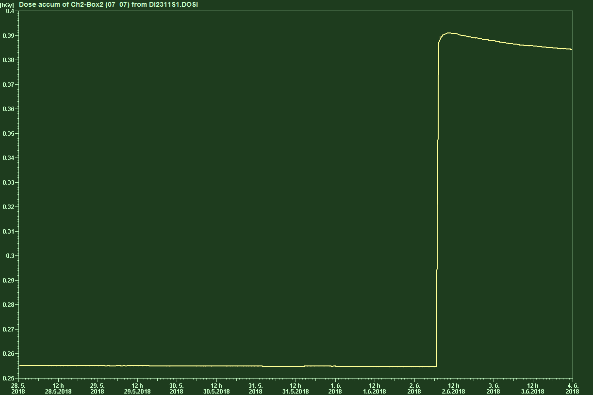
SASE1 selected events and continuously lasing
Cell#9 – Magnet failures on weekend of June 2nd, 2018 (week 28.5. – 4.6.): about 14 Gy.

Slide 6
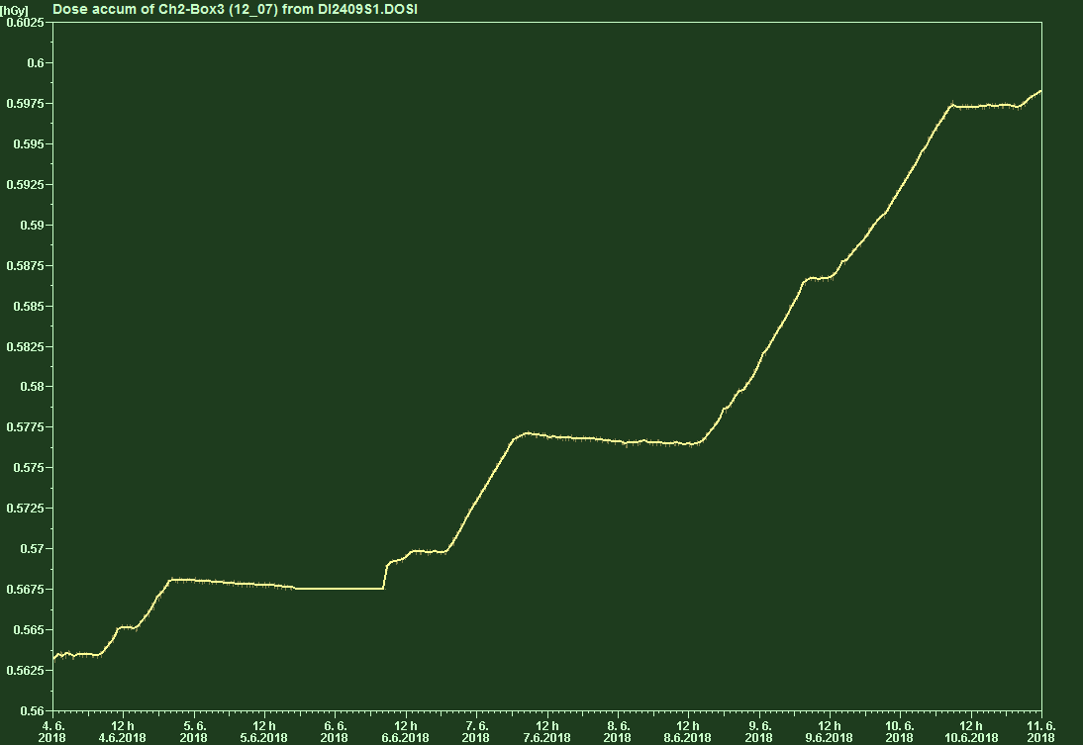
SASE1 selected events and continuously lasing
Cell#31 (up) – user operation on June 4th-11th: about 4 Gy
60 bunches
1 bunch

Slide 7
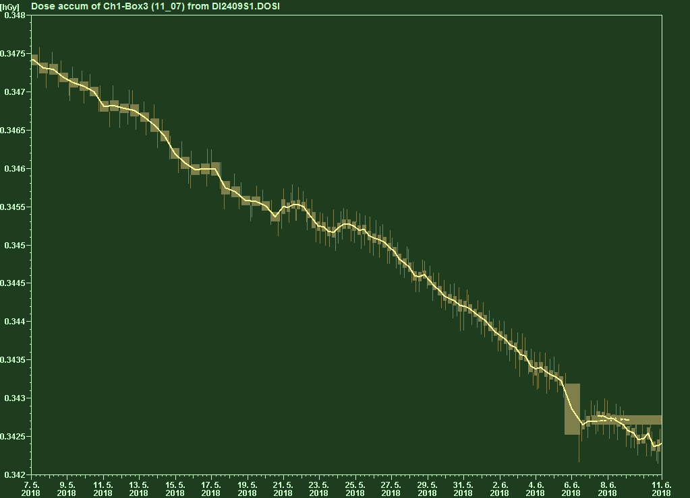
SASE1 Cell#31 lower Radfet (with 4mm Pb-Shield):
Data from May 7th to June 11th:
- Mostly fading: No absorbed doses by shielding Radfet and moving it down 10mm;
- Expected:
Cell#31 Up absorbs 9 Gy
Lower Radfet at original position and
not shielded (factor 1.45) ~ 6.2 Gy
Moving down 10mm (reduces by
factor 2) ~ 3.1 Gy
We observe virtually 0 Gy instead
of 3.1 Gy.

