Slide 1
“Tune up Dumps”
T. Wohlenberg
Radiation Task Force, Meeting, June 14th, 2018
Notes:
How to edit the title slide
Upper area: Title of your talk, max. 2 rows of the defined size (55 pt)
Lower area (subtitle): Conference/meeting/workshop, location, date, your name and affiliation, max. 4 rows of the defined size (32 pt)
Change the partner logos or add others in the last row.

Slide 2
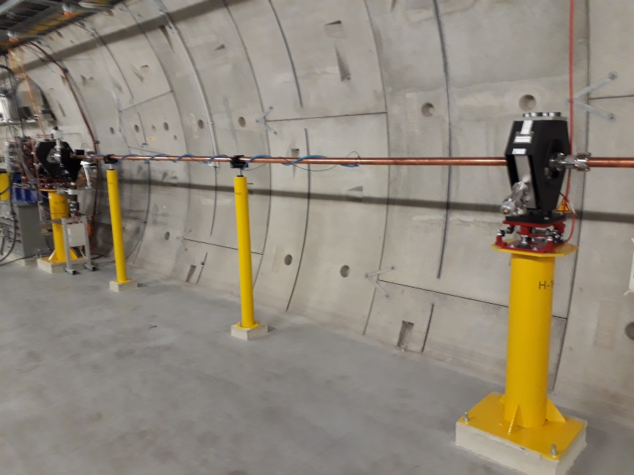
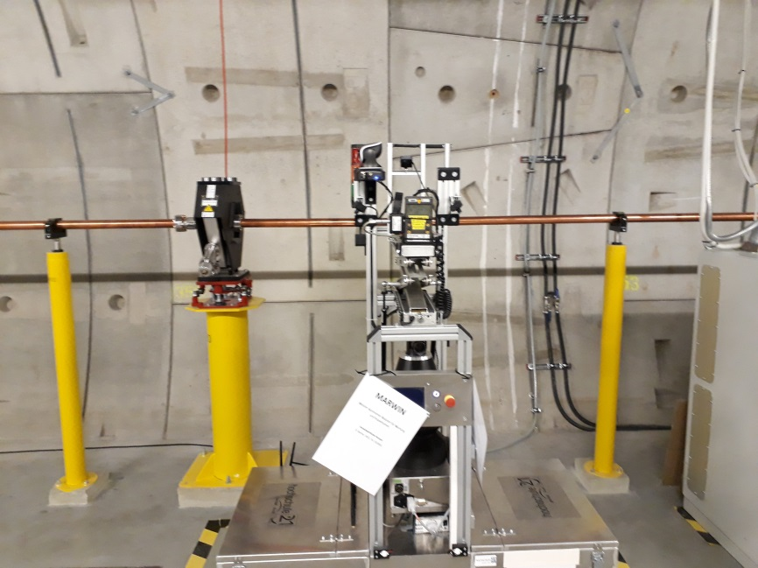
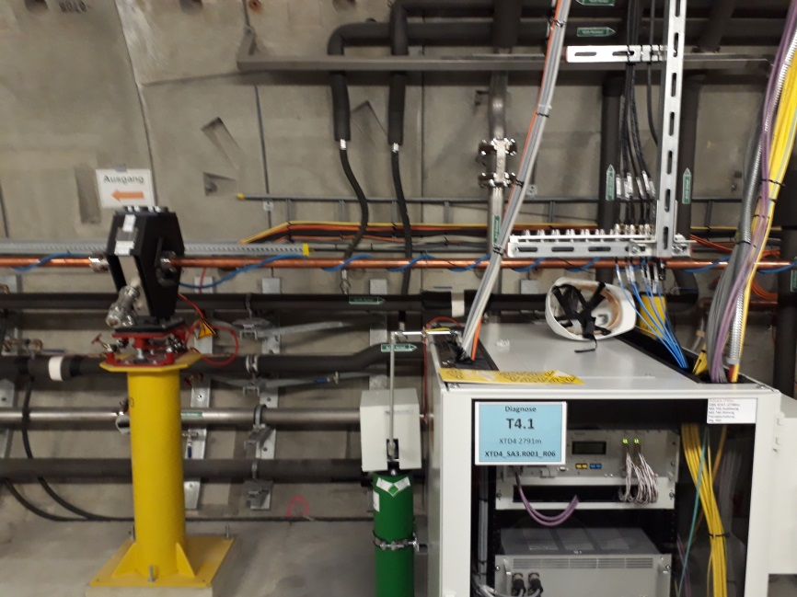
Idea from Winni: To have „Tune up dumps“ in the front of each SASE section. To have the possibility to run with one Bunch and low charge. Another possibility are to make wire scans in the front of the SASE section to avoid losses in the undulators.
Position in the XFEL Tunnel XDT1, XTD2, and XTD4
$e^{−}$
$e^{−}$
$e^{−}$
SASE2: 2185,5m
SASE1: 2224,0m
SASE3: 2791,2m

Slide 3
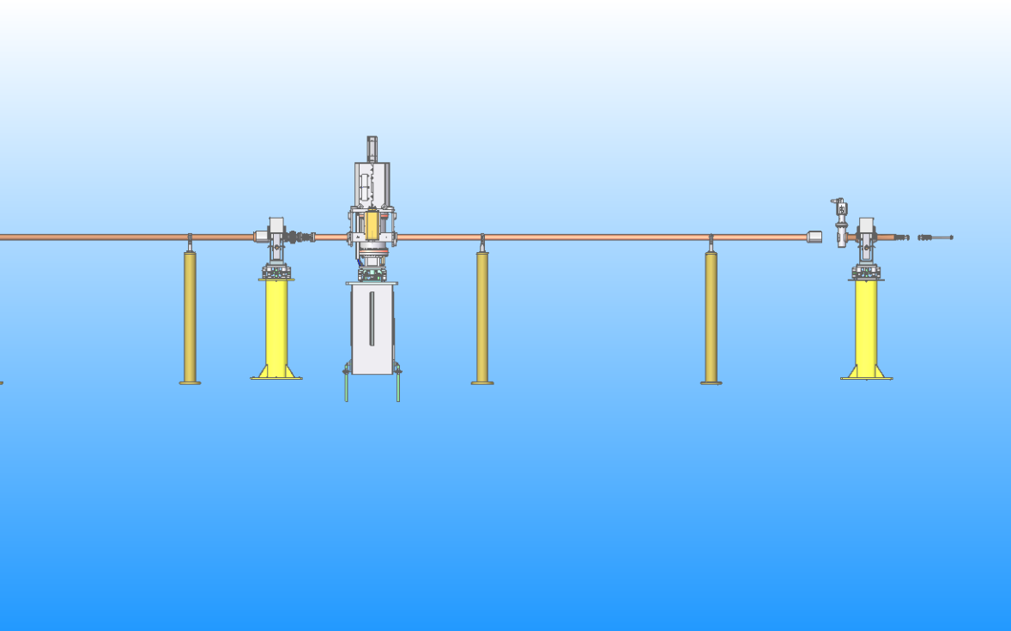
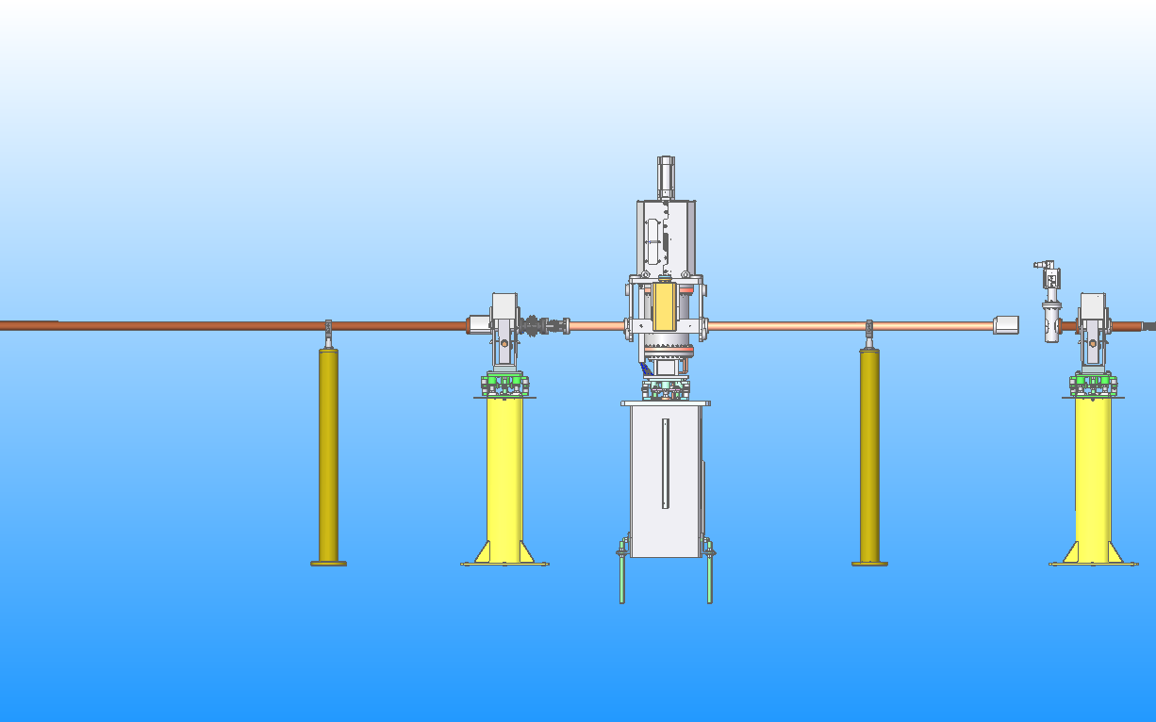
How it looks like
$e^{−}$
$e^{−}$
SASE 1 & 2
SASE3

Slide 4
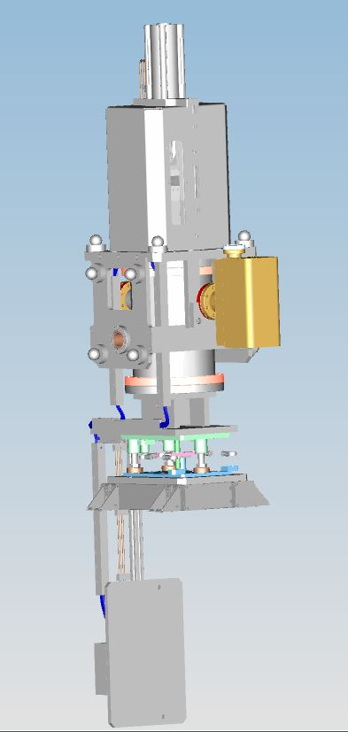
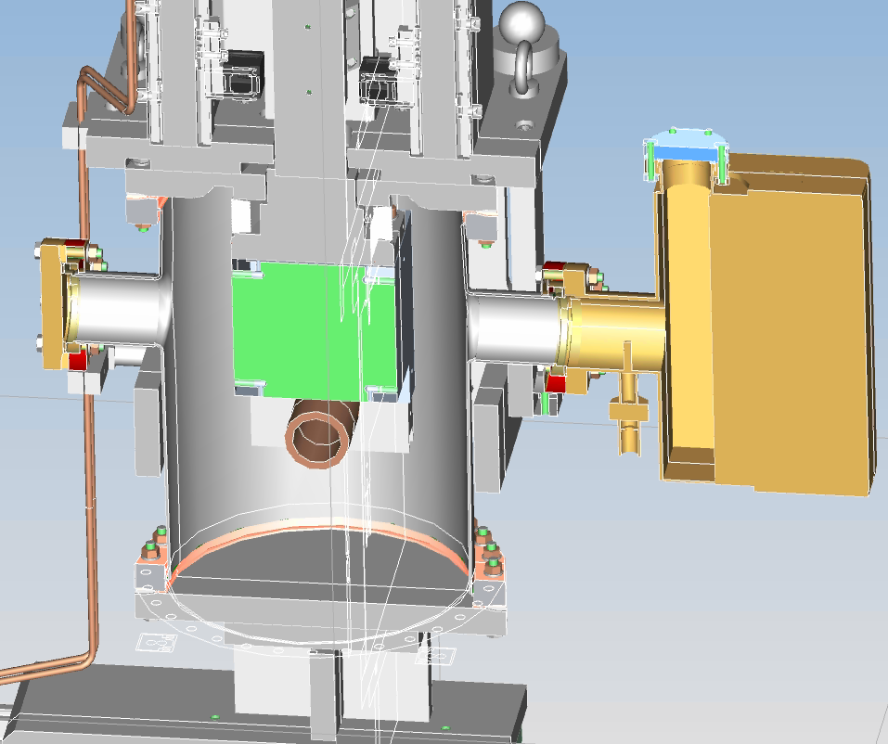
How it looks like:
Material: Tungsten
Geometrie: 139mm high, 134mm wide, 200mm length

Slide 5
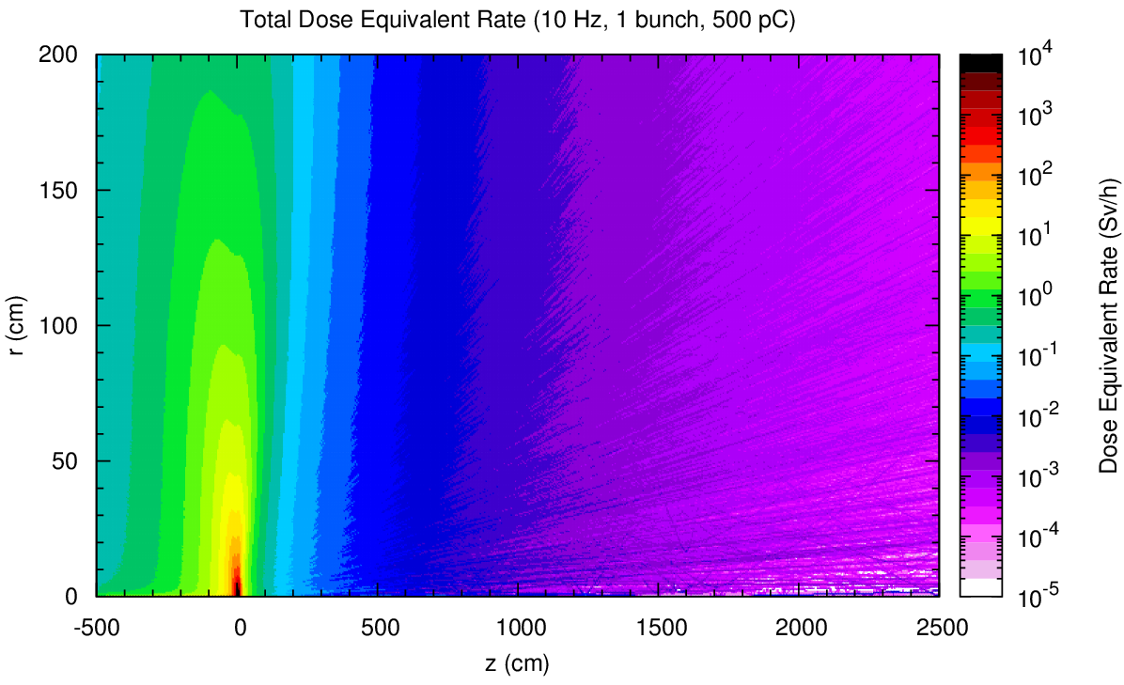
Calculation from Lars Froehlich: Beamstopper 100% tungsten Geometry: Cylinder 20cm long and radius of 14cm
Absorption 99,69% of the beam energy
$e^{−}$
Comment from Lars Froehlich : Around the Tune up dumps some shielding against neutrons and activation should be built.

Slide 6
Timetable and comments:
Installations of the „tune up dumps“ in the XFEL winter shutdown 2018
MVS will take care of the installation of the tune up dumps, but not of the shielding around the “tune up dumps“
The shielding concept needs to be handle by someone different
MDI already aware that we will install three additional BPM‘s one in the front of each “tune up dumps“
MPS (Martin Staack) already aware that we need additional MPS cable for the „tune up dumps“
Three concrete stone and three mini girder are available from MEA
Instruction from D3: It is only a few bunches allowed. We have to count the bunches on the “tune up dumps”. This is not another beam dump!

