Slide 1
RDTF Update 14.06.2018
Status of lead-shielding of dosimetry sensors in the SASE sections
Status of series chamber sensors in the SASE sections
Status of measurement with prototype lead-shielding at cell#31,SASE1

Slide 2
Status of lead-shielding of dosimetry sensors in the SASE sections
DESY ZM2 has been asked for manufacturing of full series lead caps asap after pre-decision at most recent RDTF meeting and quotation
After confirmation of price (approx. 7.7k€ for full number of lead caps), the order was given to DESY ZM2 on May 29,2018; delivery time 6 weeks from date of order; no partial deliveries possible
ZM2 claims, that the order for full series of lead caps has not arrived at external manufacturing company yet (status of Monday 11, 2018) => lead caps will not be delivered before calendar week 30.2018
Result: there will be no lead caps (neither full series, nor in part for SASE1 only) ready for installation in summer shutdown starting June 20, 2018
MDI would have been ready to start installation at the beginning of shutdown June 20, 2018.
Esimated installation time from MDI = approx. 80 man-hours (SASE1/3/2)

Slide 3
Status of series chamber sensors in the SASE sections
DESY ZM2 has been asked and ordered for manufacturing of full series mechanical holders for chamber sensors long time ago
ZM2 reports, full series of mechanical holders will not be delivered before Friday 22,2018. Special required mounting nuts will only be delivered on July 6, 2018
Required software update at device server and panel will not be ready by DESY MCS4 until end of shutdown. Based on experience and workload, MDI estimates delivery mid of July.
MDI would have been ready to start installation at the beginning of shutdown June 20, 2018.
Result: there will be no chamber sensors (neither full series, nor in part) installed in shutdown starting June 20, 2018

Slide 4
Status of series chamber sensors in the SASE sections
Moving Radfet down by 10mm (we have to properly define the original Radfet position)
10mm
23.5mm
Seems to have a dose reading of 50-60% when moving the sensitive spot of RadFets down by 10mm
(courtesy by F. Wolff-Fabris, WP71)

Slide 5
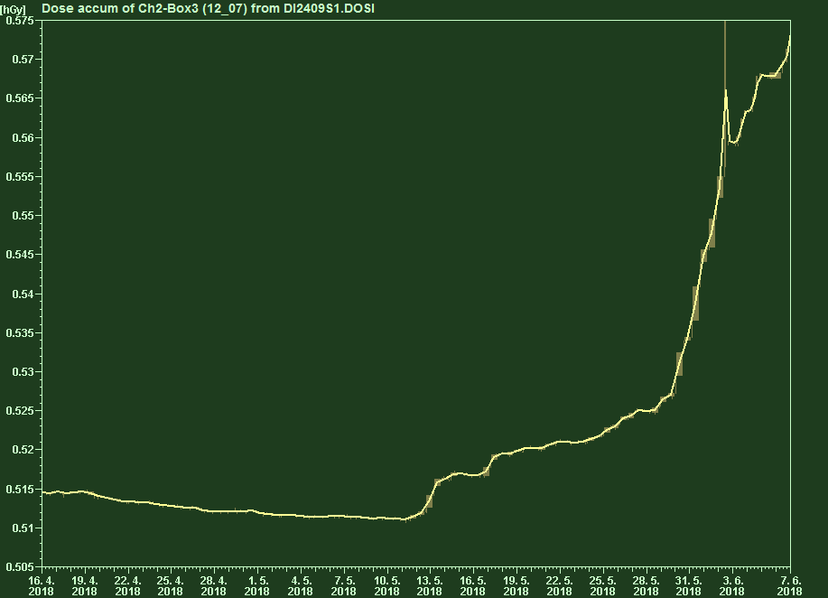
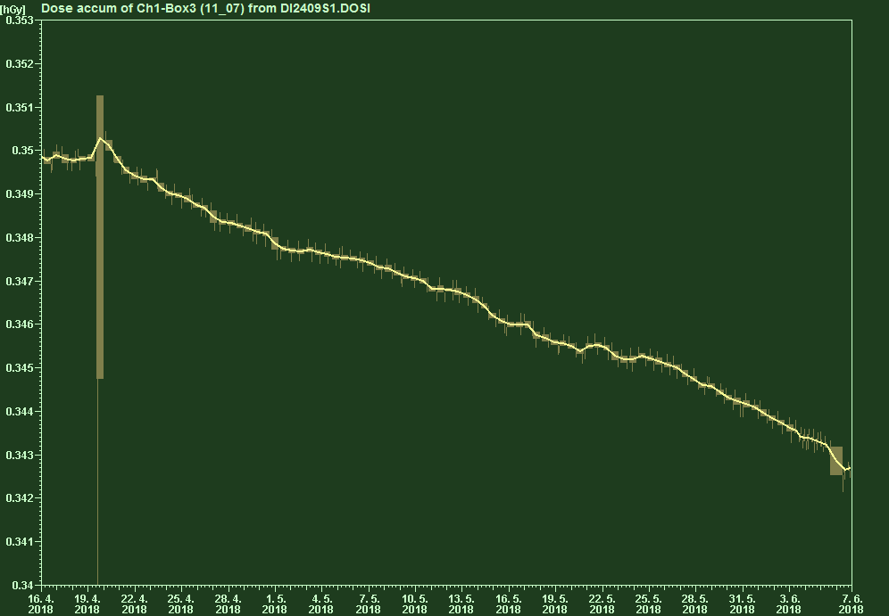
Status of measurement with prototype lead-shielding at cell#31,SASE1
Upper sensor (unshielded)
Cell#31, SASE1:
Up ≈ 5-6 Gy
Down ≈ 0 Gy
Lower sensor (shielded)

Slide 6
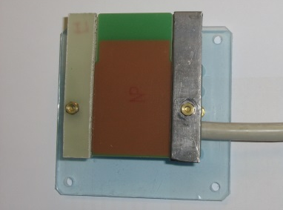
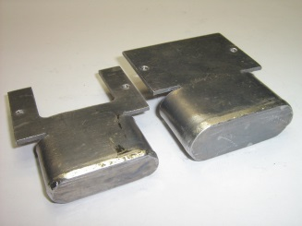
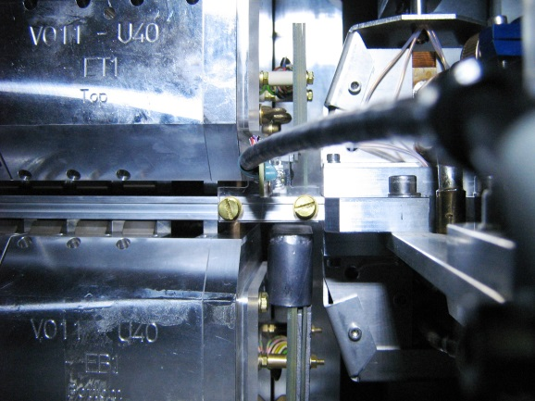
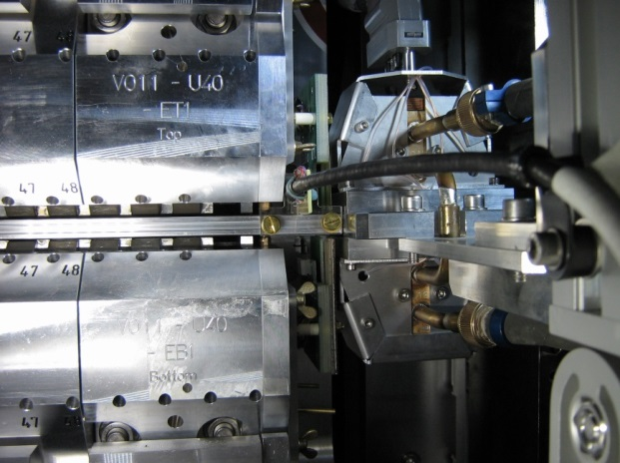
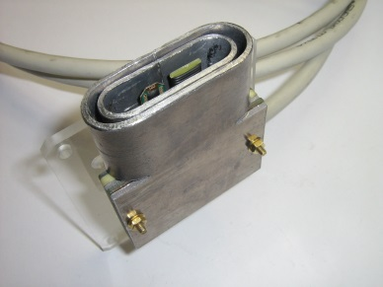
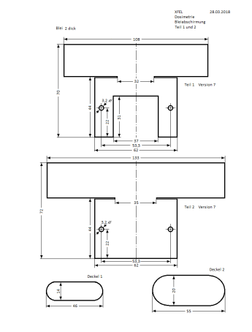
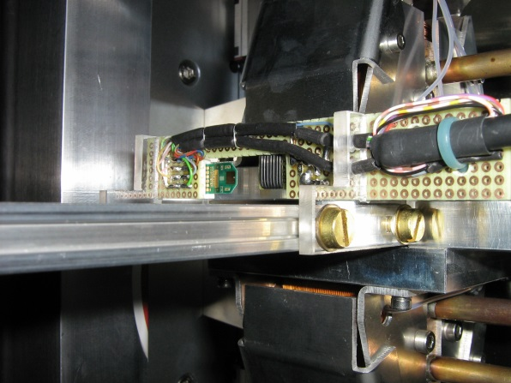
Thank you!
Questions?

Slide 7
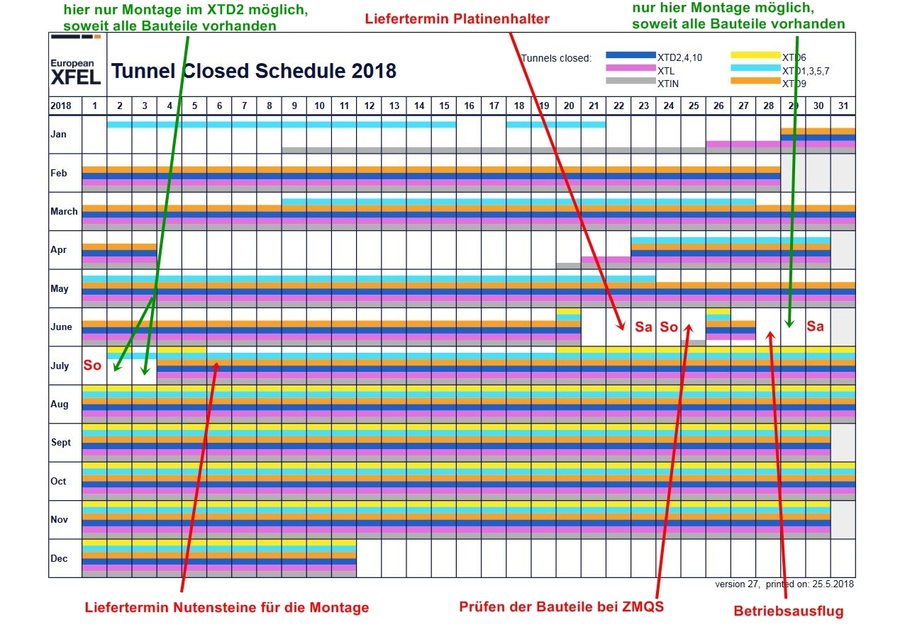
Installation planning vs shutdown working time MDI (mechanics)

