Slide 1

DESY Summer Student Program 2018
Welcome Session
17th July 2018
Orga-Team: Olaf Behnke, Doris Eckstein, Rainer Gehrke, Ute Micheelsen, Andrea Schrader

Slide 2
The 100 Summer students at DESY Hamburg come from 28 Nations
Armenia, Australia, Austria, Azerbaidshan, Belgium, Brazil
China, Cuba, Cyprus, Finland, Germany, India, Ireland, Italy
Japan, Mexico, Netherlands, Norway, Poland, Russia
Serbia, Sweden, Thailand, Turkey, Taiwan, United Kingdom, Ukraine, USA
NICE TO MEET YOU!

Slide 3
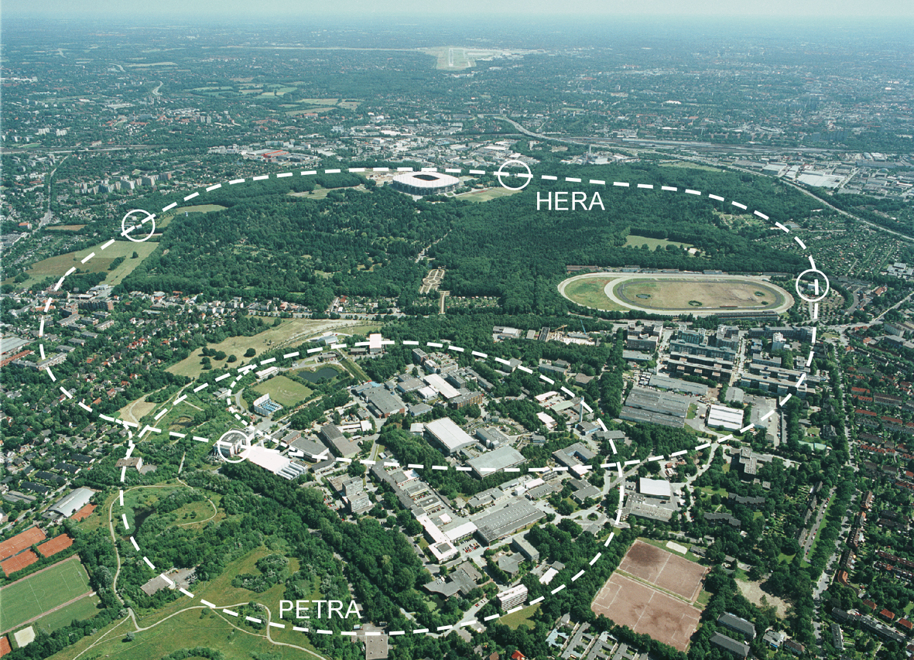
DESY Site at Hamburg
We are HERE now

Slide 4
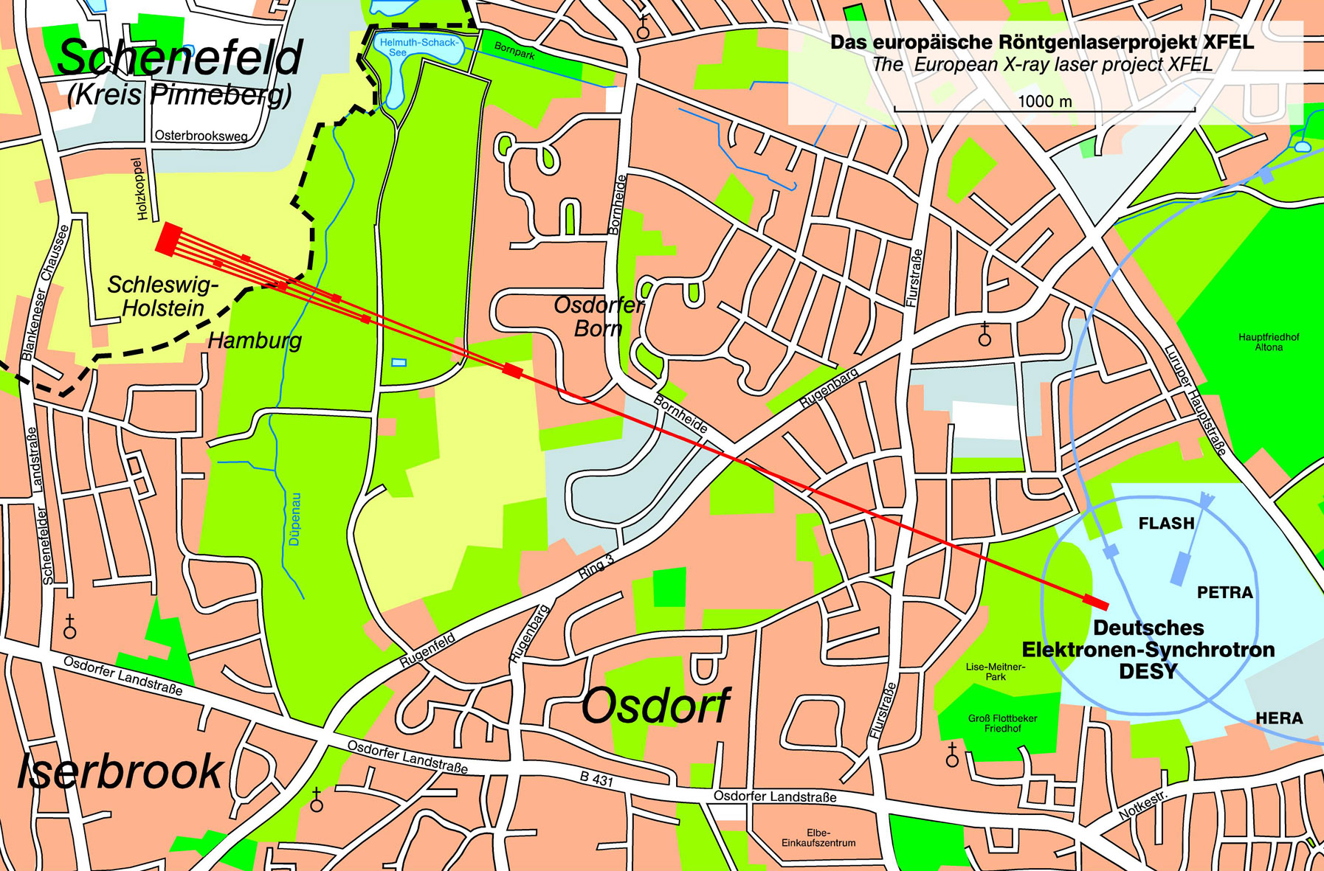
DESY and XFEL

Slide 6
Organisers (core team)
Olaf Behnke, Doris Eckstein, Andrea Schrader ← HEP (B)
Rainer Gehrke, Ute Micheelsen ← Photon Sci. (A)
For all communications with us, please write to
summie-org@desy.de

Slide 7
Your Research Projects at DESY
Program A:
Experiments with Synchrotron Radiation (Photon science)
  engage in fundamental and applied research in physics, biology,
chemistry, crystallography, material and geological science.
  Some few students will work in the European XFEL project.
Program B:
Research in Elementary Particle Physics (High energy Physics)
  experiments ATLAS, CMS, FLC (international
  linear e+e- collider) , Belle II, ALPS II at DESY
  Accelerator: e+e- linear collider , plasma wake field
  Theory: Collider phenomenology (QCD, Higgs, etc.)
  Scientific computing: grid, cloud, ..

Slide 8

Project work in local groups
You will be picked up later by your supervisor(s)
Your supervisor is your most important contact person at
DESY (you can ask her/him almost anything)
In case of questions related to your work ask your supervisors
or the group secretaries
What you can expect and recommendations
You will be fully integrated into your research team and work like
a “normal” DESY researcher, 39h per week (including lectures)
not shy, ask your supervisors or other members
of your team for help and advise,
give feedback, participate in
group meetings and present your results
At the end you will write/deliver a ~10 pages write-up of your
project work (with help by supervisors)

Slide 9
Computing infrastructure at DESY
DESY has its own computing centre in bld. 2B (worth a visit)
At the hostel use following WLANs:
  DESY Guest Net (a bit slow, easy registration with web interface)
  Eduroam (have to register)
Software: For Mathematica, Matlab and Origin DESY has
only a limited number of licenses:
  Discuss any needs with your supervisor
  Run only one process at a time and finally close the program

Slide 10
Lecture programme
By DESY researchers
Provide background on DESY scientific research
July 17 - 24 (and august 8,10 and 17) : Common lectures
https://summerstudents.desy.de/hamburg/lecture_programme_general_and_high_energy_physics_2017/
From 25th july on:
Separate lectures for Particle Physics (B1-B6) students
https://summerstudents.desy.de/hamburg/lecture_programme_general_and_high_energy_physics_2018/
Separate lectures for Photon Science (A) students
http://photon-science.desy.de/news__events/summer_students/lectures/program_2018_photon_science___sr/index_eng.html
Check regularly above webpages for programme updates!

Slide 11
Communication
via email and web
We will use email list summies2018@desy.de
for all announcements (contains your & orga team email addresses).
You may also write important announcements to this list
check your emails daily!
Facebook page:
→ Exchange social messages (please not for administrative issues)
https://www.facebook.com/groups/274292339802106/

Slide 12

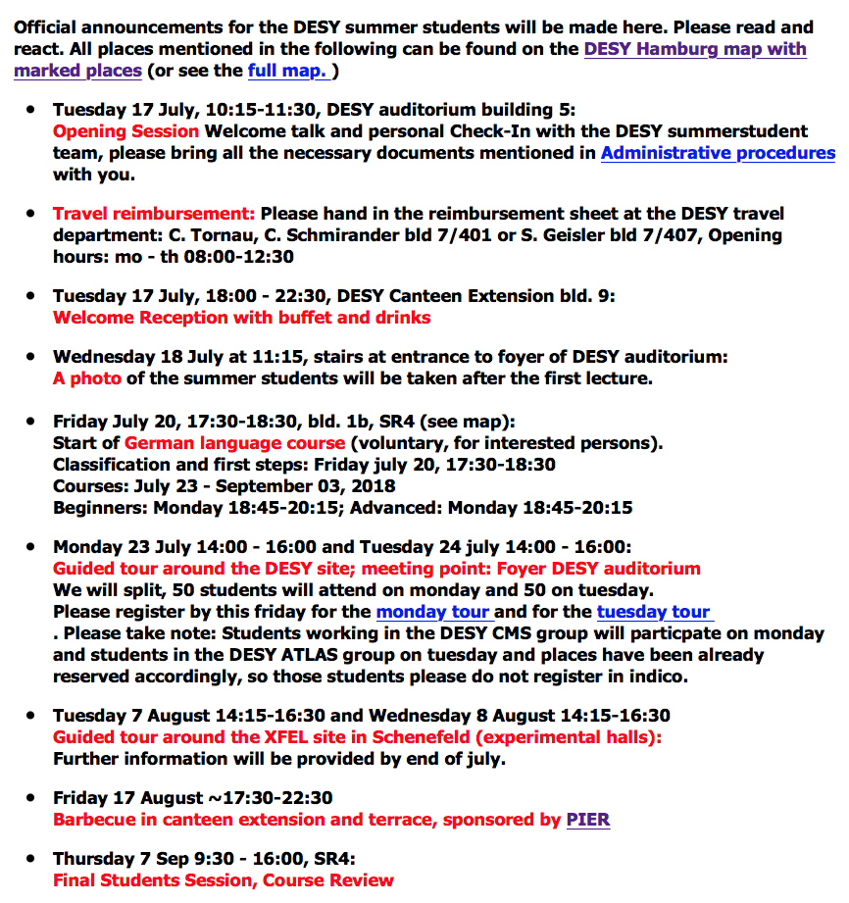
INFORMATION on WEB :
Main page
http://summerstudents.desy.de/hamburg/
Message board:
http://www.desy.de/f/students/summer_home_2018.html
Special events and announcements

Slide 13
INFORMATION on WEB :
Main page
http://summerstudents.desy.de/hamburg/
Message board:
http://www.desy.de/f/students/summer_home_2017.html
now

Slide 14
INFORMATION on WEB :
Main page
http://summerstudents.desy.de/hamburg/
Message board:
http://www.desy.de/f/students/summer_home_2017.html
Important!
For those receiving salary in cash:
Please claim travel costs this week or latest on Monday (otherwise costs can be only reimbursed with next salary)

Slide 15
INFORMATION on WEB :
Main page
http://summerstudents.desy.de/hamburg/
Message board:
http://www.desy.de/f/students/summer_home_2017.html
This evening

Slide 16
INFORMATION on WEB :
Main page
http://summerstudents.desy.de/hamburg/
Message board:
http://www.desy.de/f/students/summer_home_2017.html
tomorrow

Slide 17
INFORMATION on WEB :
Main page
http://summerstudents.desy.de/hamburg/
Message board:
http://www.desy.de/f/students/summer_home_2017.html
offer

Slide 18
INFORMATION on WEB :
Main page
http://summerstudents.desy.de/hamburg/
Message board:
http://www.desy.de/f/students/summer_home_2017.html
offer

Slide 19
INFORMATION on WEB :
Main page
http://summerstudents.desy.de/hamburg/
Message board:
http://www.desy.de/f/students/summer_home_2017.html
Last day

Slide 20
Life on the DESY campus
Practical information on the DESY campus:
→ DESY booklet
Printed version in your welcome bag :-)
http://guest-services.desy.de/e56138/Booklet_eng.pdf
Sports: Volleyball field in front of Hostel
Bycicles: cannot be rented at DESY :-(
One possibility is to rent
Germany, Greece, Hungary, India, Iran,
Ireland, Israel, Italy, Mexico,
Netherland, Pakistan, Poland
Romania, Russia, Singapore, Slovakia, Spain, Sweden
Thailand, Turkey,Ukraine, UK, USA
Some miscellaneous information:
Some miscellaneous information:

Slide 21
Life in the DESY Hostel – few hints
Missing equipment (kitchen, cleaning, etc.) or other requests/complaints → don’t hesitate to email hostel.service@desy.de (or visit them in their office 06/118)
Weekly laundry change: Wednesday 09:30-17:00
if lectures in the morning → do it during the afternoon
DESY salary payment end of august an September: hostel accommodation costs are deduced so total amount of paid out money may appear to be not so high
Sports: Volleyball field in front of Hostel
Bycicles: cannot be rented at DESY :-(
One possibility is to rent
Germany, Greece, Hungary, India, Iran,
Ireland, Israel, Italy, Mexico,
Netherland, Pakistan, Poland
Romania, Russia, Singapore, Slovakia, Spain, Sweden
Thailand, Turkey,Ukraine, UK, USA
Some miscellaneous information:
Some miscellaneous information:

Slide 22
Public transport routes/schedule
www.hvv.de/en/index.php
Public transport routes/schedule:
Sports: Volleyball field in front of Hostel
Bycicles: cannot be rented at DESY :-(
One possibility is to rent
Germany, Greece, Hungary, India, Iran,
Ireland, Israel, Italy, Mexico,
Netherland, Pakistan, Poland
Romania, Russia, Singapore, Slovakia, Spain, Sweden
Thailand, Turkey,Ukraine, UK, USA
Some miscellaneous information:
Some miscellaneous information:

Slide 23
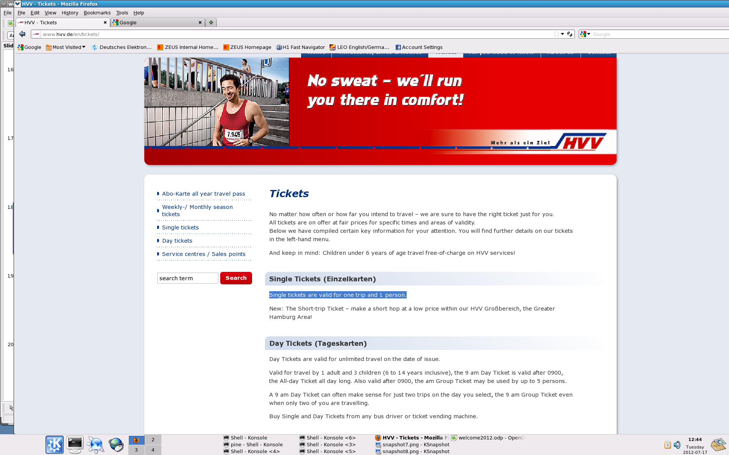
Public transport Tickets
HVV Grossbereich
group day ticket:
12 Euro/5 persons
(valid from 09 am on)
Day tickets
Sports: Volleyball field in front of Hostel
Bycicles: cannot be rented at DESY :-(
One possibility is to rent
Germany, Greece, Hungary, India, Iran,
Ireland, Israel, Italy, Mexico,
Netherland, Pakistan, Poland
Romania, Russia, Singapore, Slovakia, Spain, Sweden
Thailand, Turkey,Ukraine, UK, USA
Some miscellaneous information:
Some miscellaneous information:

Slide 24
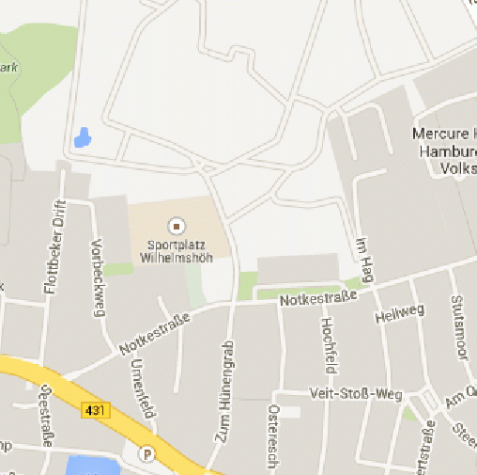
Some (cheap!) supermarkets nearby
General shop opening hours:
Mo-Sa ~07-2x, x=0-3
Su only few convenience stores opened e.g. in Altona railway st.
Lidl
Aldi
Weekly market: we + sa 08-13 → fresh products (more expensive)
Sports: Volleyball field in front of Hostel
Bycicles: cannot be rented at DESY :-(
One possibility is to rent
Germany, Greece, Hungary, India, Iran,
Ireland, Israel, Italy, Mexico,
Netherland, Pakistan, Poland
Romania, Russia, Singapore, Slovakia, Spain, Sweden
Thailand, Turkey,Ukraine, UK, USA
Some miscellaneous information:
Some miscellaneous information:

Slide 25
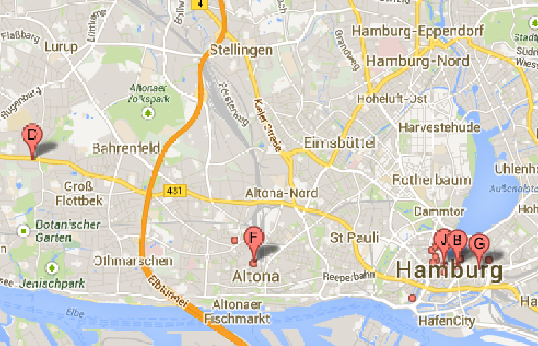
Shopping centers (selection)
Elbe Einkaufs
zentrum
Mercado
City centre
Sports: Volleyball field in front of Hostel
Bycicles: cannot be rented at DESY :-(
One possibility is to rent
Germany, Greece, Hungary, India, Iran,
Ireland, Israel, Italy, Mexico,
Netherland, Pakistan, Poland
Romania, Russia, Singapore, Slovakia, Spain, Sweden
Thailand, Turkey,Ukraine, UK, USA
Some miscellaneous information:
Some miscellaneous information:

Slide 26
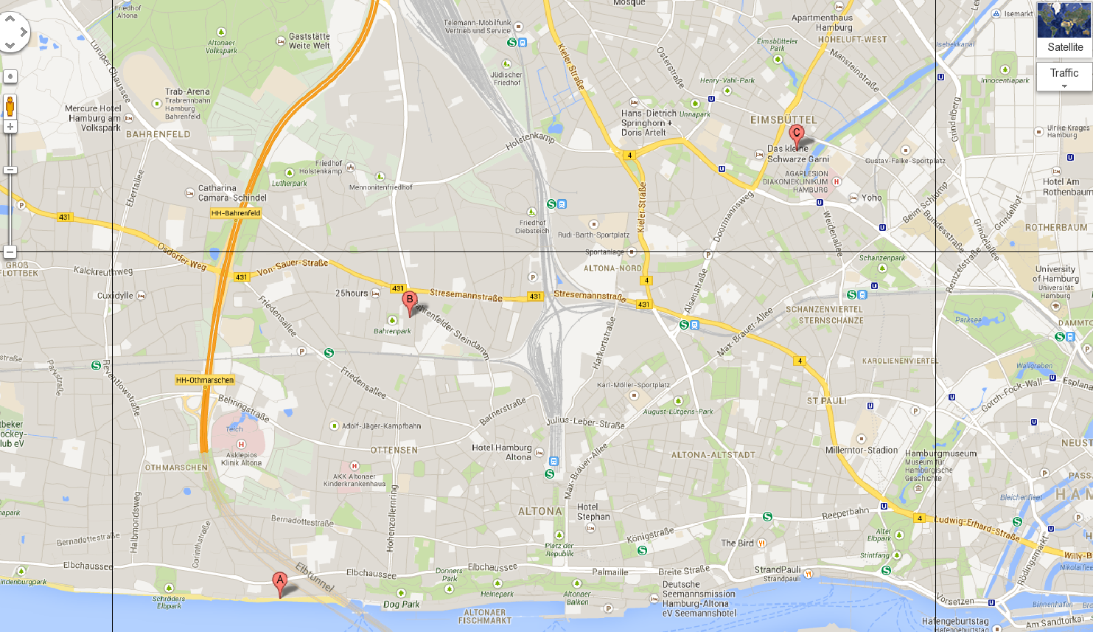
Cool places, Dinner, Nightlife
DESY
Schanzenviertel (e.g. Schulterblatt)
Ottensen
(e.g. Ottenser Hauptstrasse)
Portuguese quarter (e.g. Dietmar Koehlstrasse)
Oevelgoenne beach
(Strandperle)
St. Pauli (e.g. Hamburger Berg)
Sports: Volleyball field in front of Hostel
Bycicles: cannot be rented at DESY :-(
One possibility is to rent
Germany, Greece, Hungary, India, Iran,
Ireland, Israel, Italy, Mexico,
Netherland, Pakistan, Poland
Romania, Russia, Singapore, Slovakia, Spain, Sweden
Thailand, Turkey,Ukraine, UK, USA
Some miscellaneous information:
Some miscellaneous information:

Slide 27
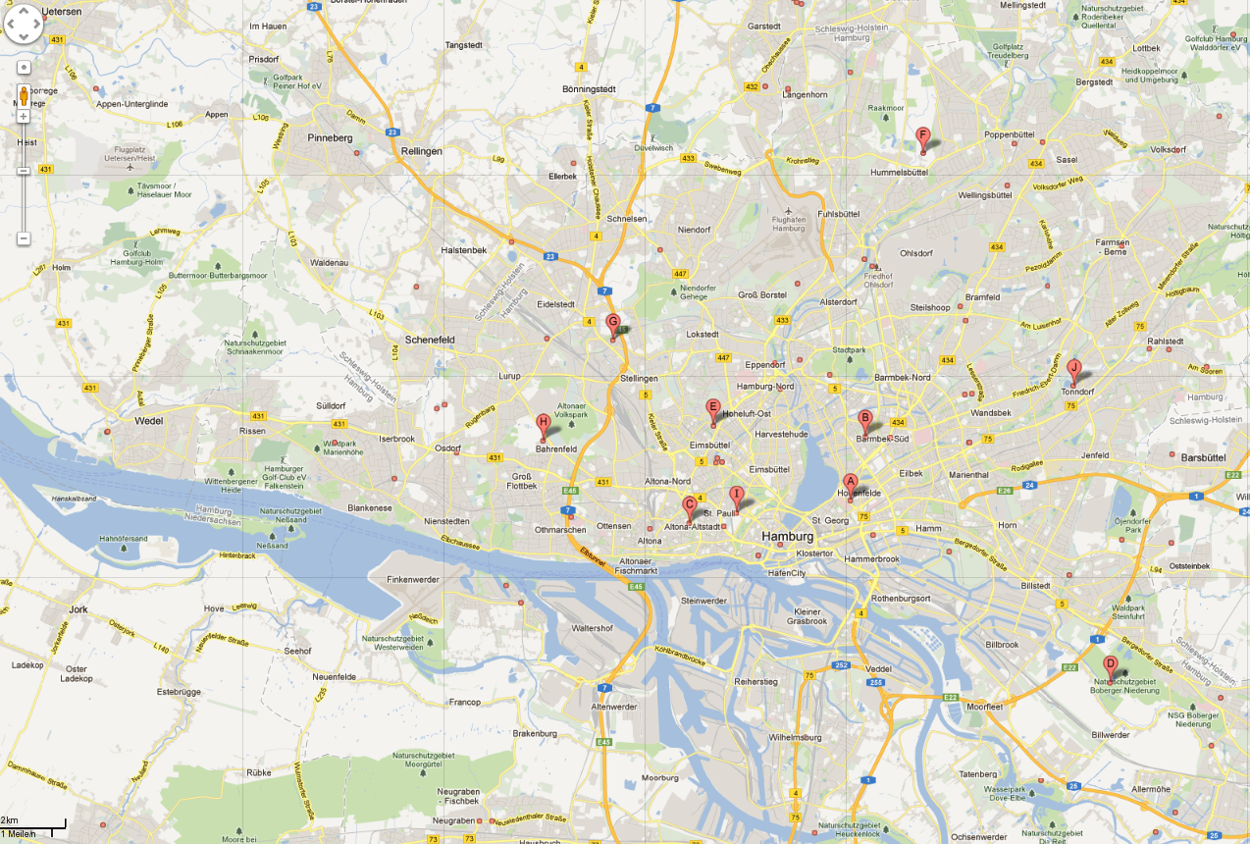
Sports: swimming pools in Hamburg: google 'Hamburg Schwimmbad'
Sports: Volleyball field in front of Hostel
Bycicles: cannot be rented at DESY :-(
One possibility is to rent
Germany, Greece, Hungary, India, Iran,
Ireland, Israel, Italy, Mexico,
Netherland, Pakistan, Poland
Romania, Russia, Singapore, Slovakia, Spain, Sweden
Thailand, Turkey,Ukraine, UK, USA
Some miscellaneous information:
Some miscellaneous information:

Slide 28
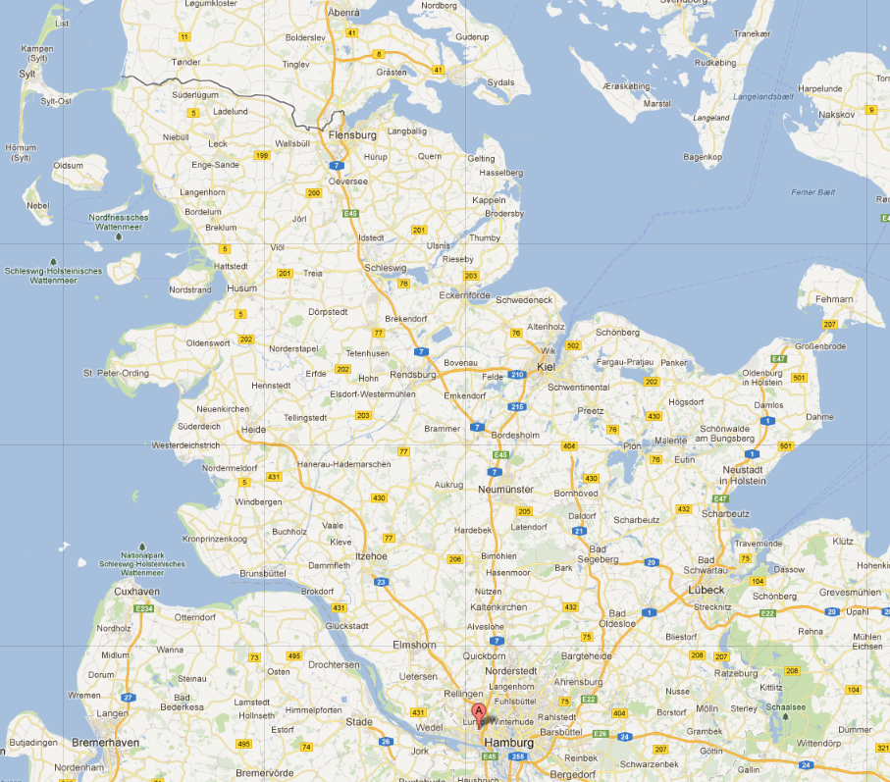
Beaches in Schleswig Holstein
Sports: Volleyball field in front of Hostel
Bycicles: cannot be rented at DESY :-(
One possibility is to rent
Germany, Greece, Hungary, India, Iran,
Ireland, Israel, Italy, Mexico,
Netherland, Pakistan, Poland
Romania, Russia, Singapore, Slovakia, Spain, Sweden
Thailand, Turkey,Ukraine, UK, USA
Some miscellaneous information:
Some miscellaneous information:

Slide 29
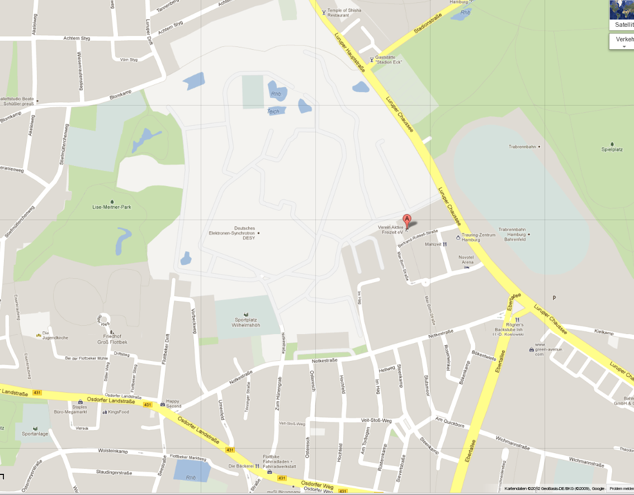
One out of many possibilities for fitness: vafev.de
Volkspark: Recreational
Area, jogging etc.
Sports field which can be booked,
send an email with name phone number, date and time to sportplatz@desy.de
Vafev has some swimming pool!
Jogging to/at the Elbe (its 2-3 km to there and very beautiful to run along the Elbe river)
Sports: Volleyball field in front of Hostel
Bycicles: cannot be rented at DESY :-(
One possibility is to rent
Germany, Greece, Hungary, India, Iran,
Ireland, Israel, Italy, Mexico,
Netherland, Pakistan, Poland
Romania, Russia, Singapore, Slovakia, Spain, Sweden
Thailand, Turkey,Ukraine, UK, USA
Some miscellaneous information:
Some miscellaneous information:

Slide 30
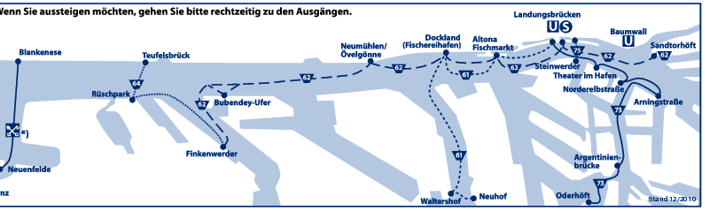
Dit & Dat
Bikes: at DESY there is a Stadtrad station
Discover Hamburg with a boat – take ferry line 62, you can use
standard public transport tickets
http://stadtrad.hamburg.de
Drinking water: in Germany you can drink the water from the tab,
it has highest purity, better than mineral water, no need to boil it
Sports: Volleyball field in front of Hostel
Bycicles: cannot be rented at DESY :-(
One possibility is to rent
Germany, Greece, Hungary, India, Iran,
Ireland, Israel, Italy, Mexico,
Netherland, Pakistan, Poland
Romania, Russia, Singapore, Slovakia, Spain, Sweden
Thailand, Turkey,Ukraine, UK, USA
Some miscellaneous information:
Some miscellaneous information:

Slide 31
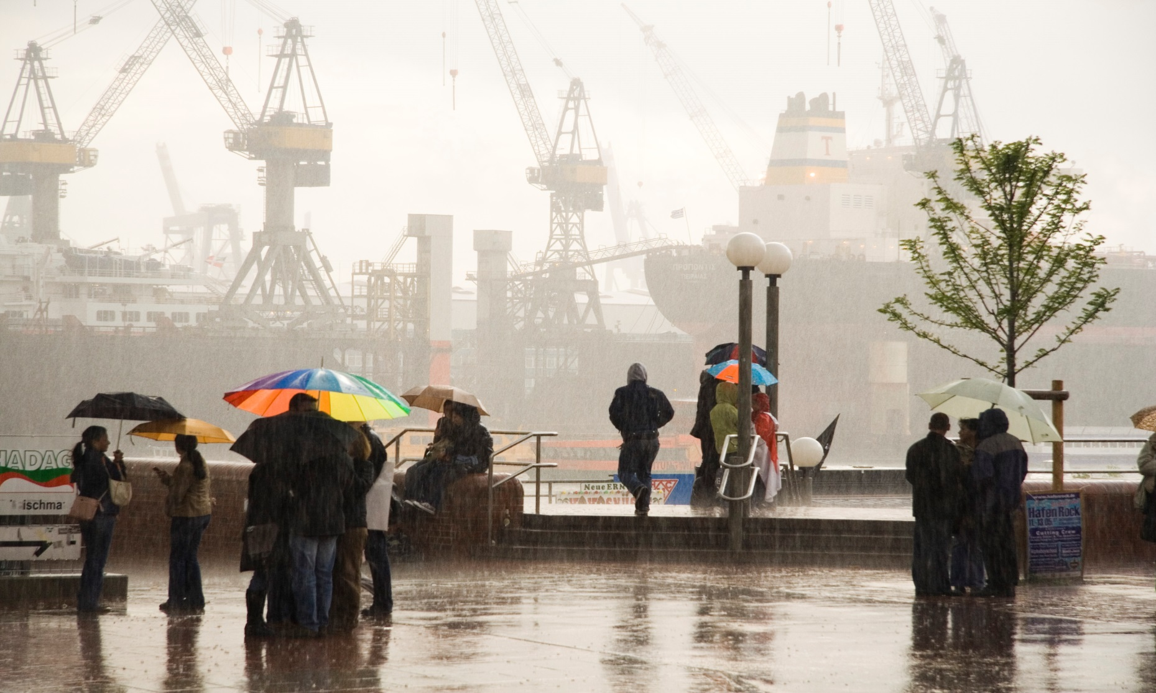
We have to talk about …
The picture file is named “Typical_Hamburg_weather.jpg”
Weather can change quickly here, please check weather
forecasts, e.g. search for “wetteronline.de Hamburg”
Sports: Volleyball field in front of Hostel
Bycicles: cannot be rented at DESY :-(
One possibility is to rent
Germany, Greece, Hungary, India, Iran,
Ireland, Israel, Italy, Mexico,
Netherland, Pakistan, Poland
Romania, Russia, Singapore, Slovakia, Spain, Sweden
Thailand, Turkey,Ukraine, UK, USA
Some miscellaneous information:
Some miscellaneous information:

Slide 32


Typical Hamburg Dishes
Labskaus
Rote Gruetze mit Vanillesauce
Sports: Volleyball field in front of Hostel
Bycicles: cannot be rented at DESY :-(
One possibility is to rent
Germany, Greece, Hungary, India, Iran,
Ireland, Israel, Italy, Mexico,
Netherland, Pakistan, Poland
Romania, Russia, Singapore, Slovakia, Spain, Sweden
Thailand, Turkey,Ukraine, UK, USA
Some miscellaneous information:
Some miscellaneous information:

Slide 33
Next steps today
Registration in Foyer:
General check-in (if you have not yet done it) and get your welcome bag (all)
Personnel Department (all)
International office (all non-german citizen)
Travel Reimbursement
  Today: ask questions
  During next days/weeks: hand in filled form + receipts (at bld. 7/401)
Tip: visit first the person
with the shortest queue
of waiting students
~10h50 Meet your Supervisor in the foyer, chat, visit workplace
14h00 Library introduction (here in auditorium)
14h30 Safety instructions for all B1-B6 students (here)
- Sign attendance sheet during session
Do not forget to join the Welcome Party 18h in the DESY Canteen extension
You will meet them all:
So visit first the person
with the shortest queue
of waiting students
Registration (after this talk in the foyer of the Auditorium)
~11h00 Meet your Supervisor at the marked meeting points
in the foyer, chat, visit your work place, have lunch
14h00 Library introduction (here in auditorium)
14h15 Safety instructions for B1-B6 students (here)
- They are essential -
Lectures start Tomorrow 11h00 (here)
International Office (Steffi Killough et al)
Administration (Annette Petterson,
Ieva Gylite-Robertson )
General (Andrea Schrader, Ute Micheelsen)

Slide 34
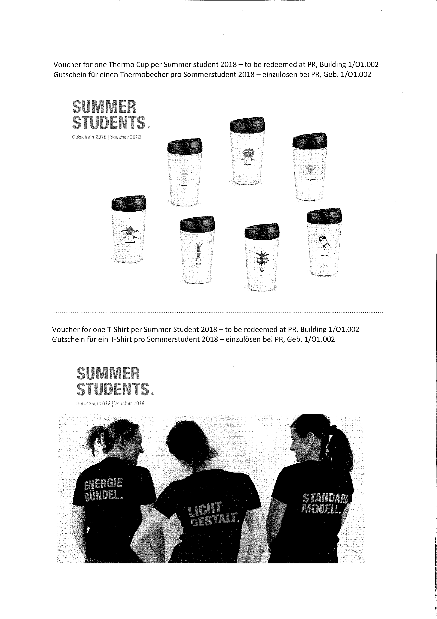
In your bags:
Voucher for a T-shirt and a Thermo cup
Pick up at PR
Only for Summies

