Slide 1
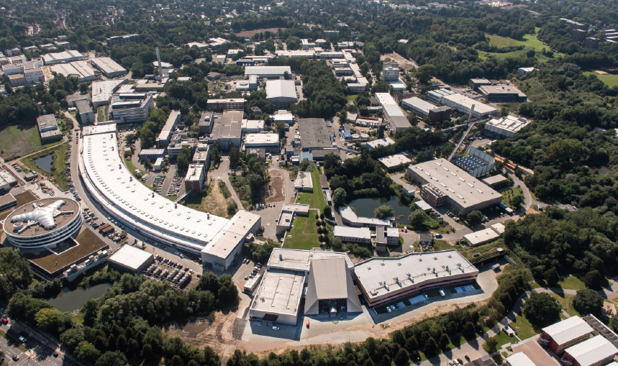
The challenge of filtering photons in a cold environment.
Elena Mazzeo
Summer Student session
6-09-2018
Summer project in ALPS group.
Special thanks to Axel Lindner & Friederike Januschek

Slide 2
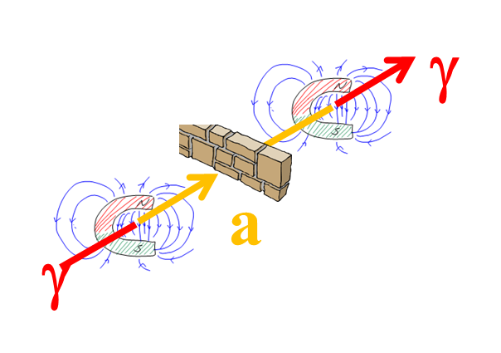
How to build a light shining through a wall experiment
Ingredients:
A laser and two cavities.
Two strings of magnets.
A light-tight wall.
A single-photon detector.

Slide 3
ALPS II’s optical system
The production cavity is where a 1064 nm light is injected and amplified. The first conversion photon to axion or axion-like particle happens here.
After crossing the wall, the axions end up in the regeneration cavity where they are turn back into photons.
In order to enhance the conversion probability and to amplify the reconverted light, the two cavities need to be locked to the exact same frequency and spatial mode.

Slide 4
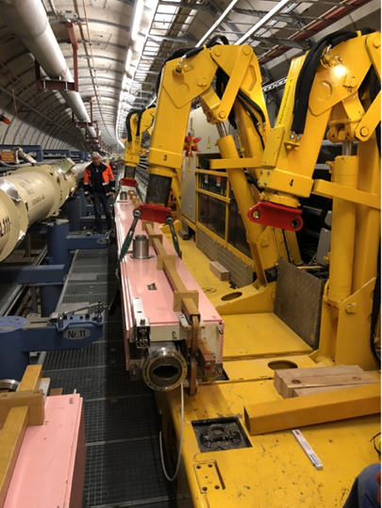
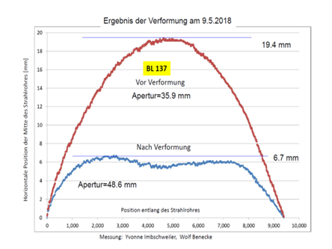
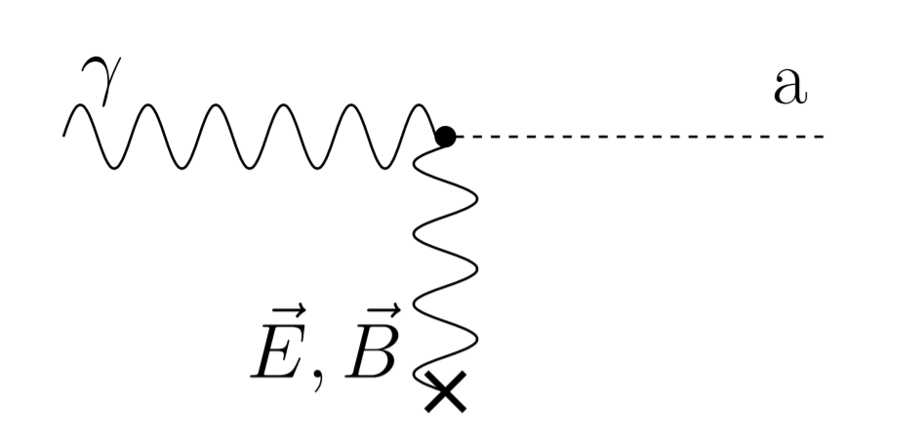
ALPS II’s magnets
ALPS Iic will employ 10+10 HERA’s dipole magnets.
The magnets are in the process of being straightened (11 magnets successfully straightened out of 20!)
To exploit the Primakoff effect, two strings of magnets surround the production and the regeneration cavities.

Slide 5
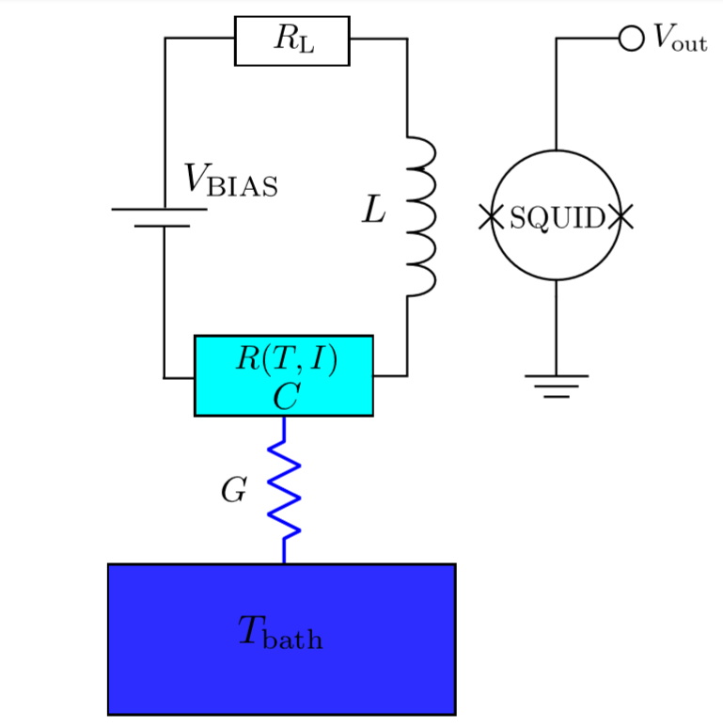
ALPS II’s single-photon detector
ALPS II’s detector of choice is a tungsten transition-edge sensor (TES).
When a photon hits the sensor, it heats up a bit.
Exploiting the strong resistance’s dependence from temperature in the transition edge between the conducting and the superconducting phases we can measure the change in temperature and thus the energy deposited by the incoming photon.
The read-out is carried out by the SQUID

Slide 6
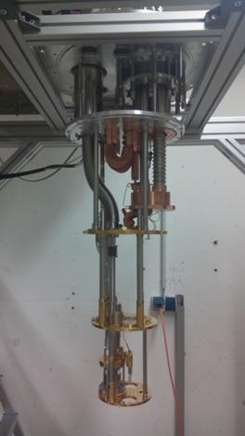
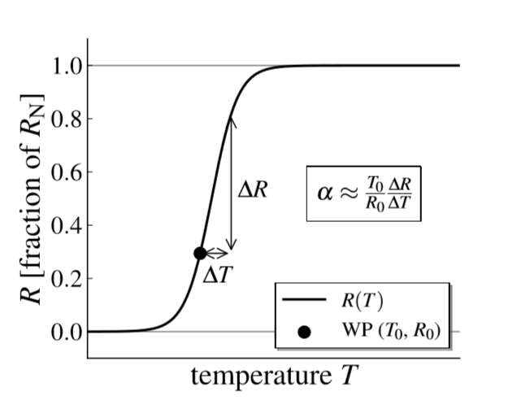
ALPS II’s single-photon detector
Tungsten becomes superconducting at ̴100 mK.
The TES sensor’s working point is between the conducting and the superconducting phases.
An extremely cold enviroment is needed to employ this detector!
An optical fiber brings the reconverted photons to the TES detector.

Slide 7
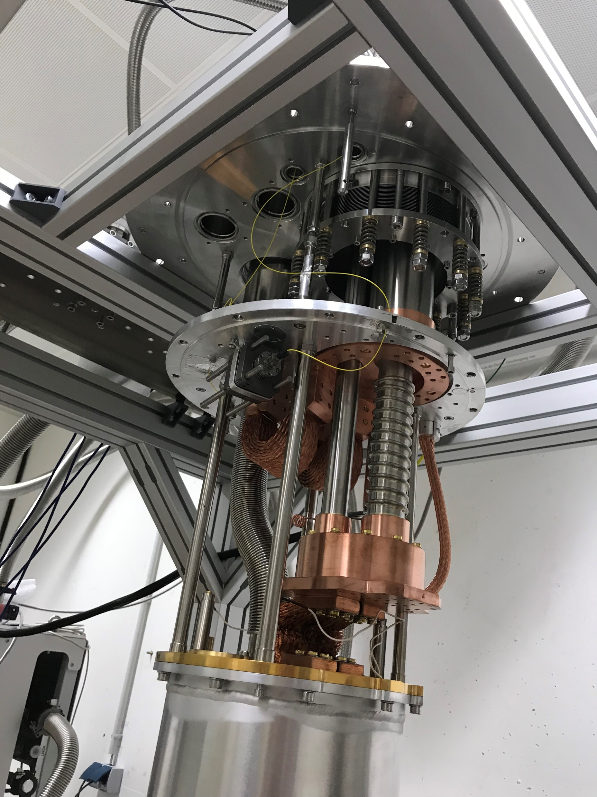
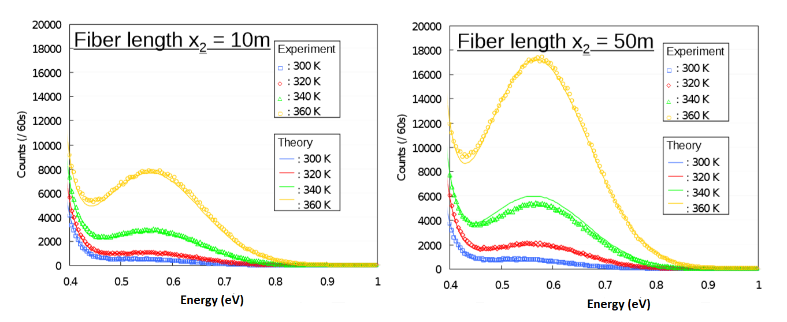
A filter for thermal photons
The fiber coupled to the TES has one end at room temperature.
Black body photons emitted by the warm end of the fiber can cause pile-up in the TES sensor and mimic a 1064 nm photon.
A filter for black body photons is needed!

Slide 8
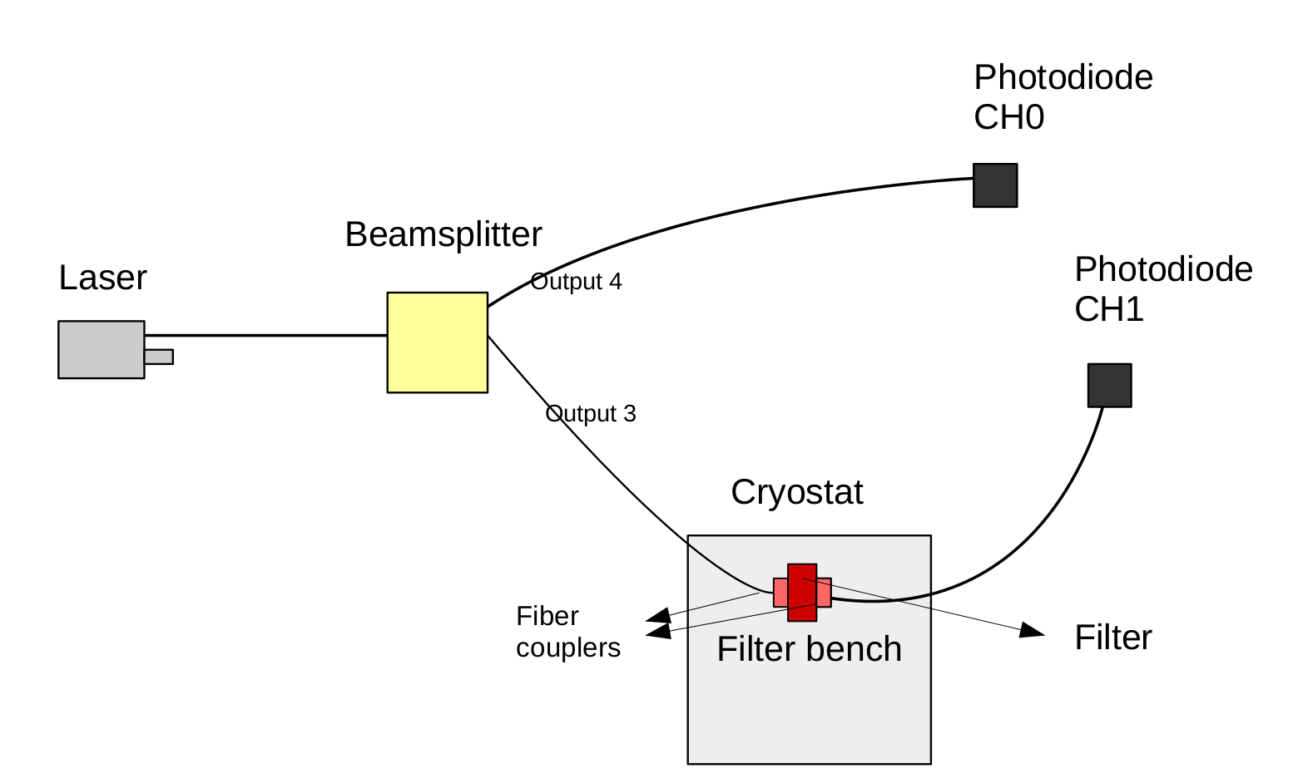
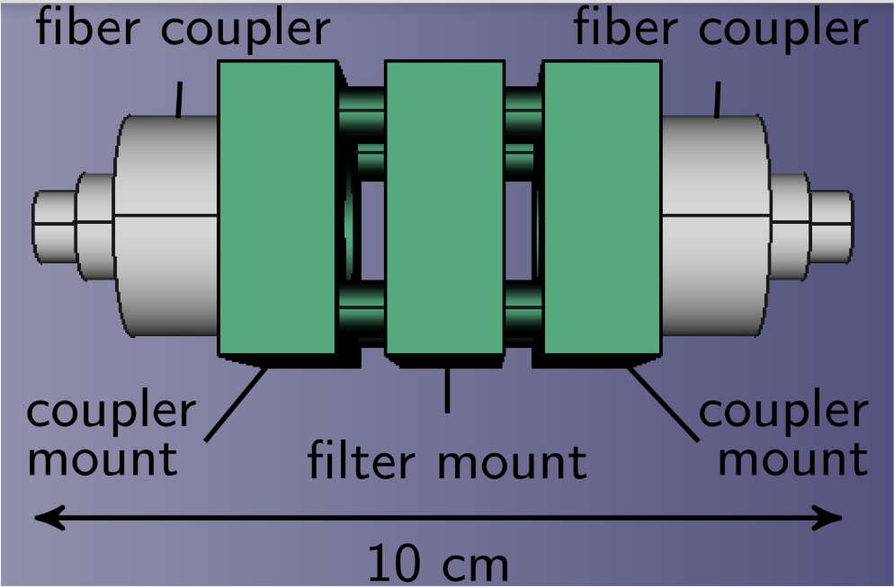
The filter bench set-up

Slide 9
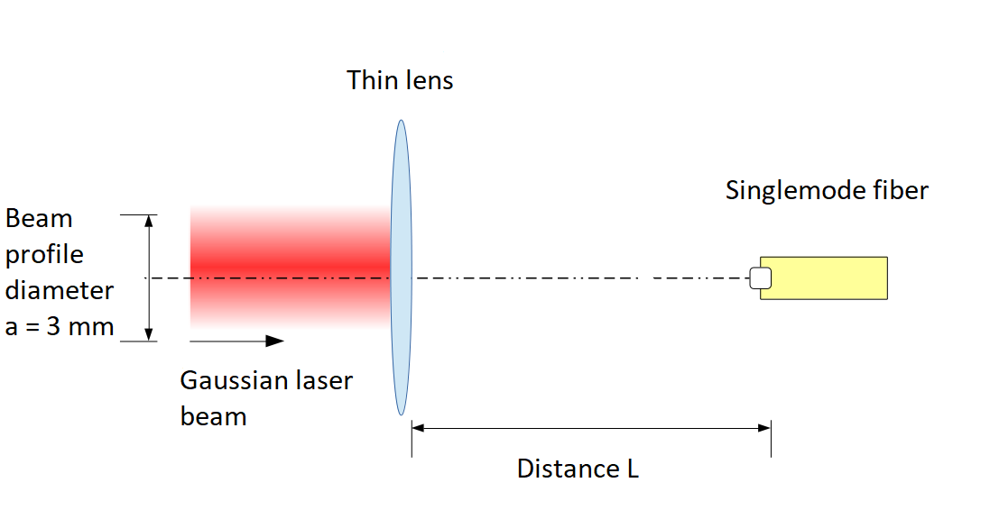
Tackling signal losses due to cold environment
Previous tests on the filter bench in absence of the filter (only the couplers are present) show a drop in transmittance from 0.9 to 0.679 during a cool down.
This drop could be due to the titanium couplers’ thermal shrinkage.
Computing the transmittance of this simple set-up as a function of L, one could find the width ΔL of the window where the transmittance is above 0.679.

Slide 10
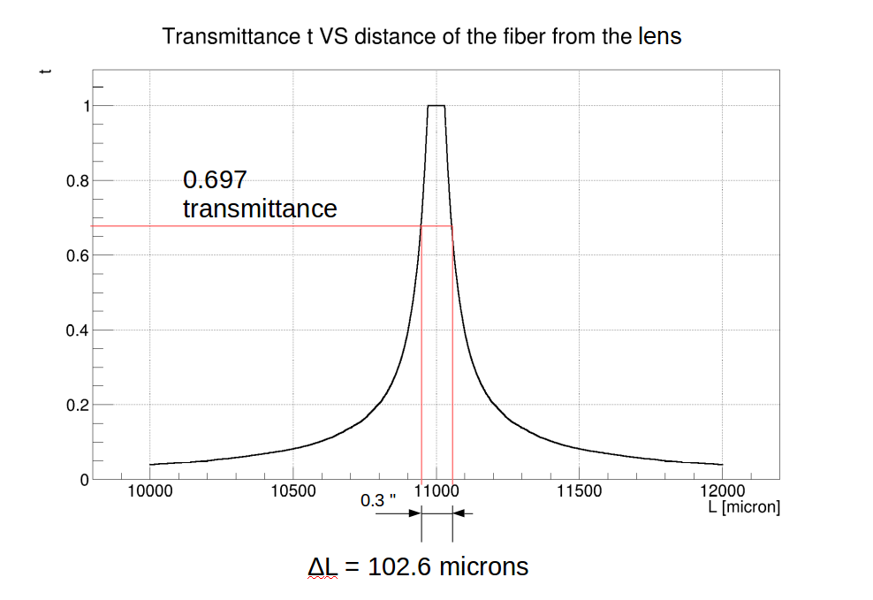
Tackling signal losses due to cold environment
$$∆l≈αlΔT$$
Coupler’s length at room temperature l [mm] | 27.9
Coefficient of thermal expansion of titanium [K⁻¹] | ≤ 8.5 ∙ 10⁻⁶
Temperature gradient during cool down [K] | 257
Thermal shrinkage of the coupler Δl [um] | ≤ 60.8
ΔL/2 [um] | 51.3

Slide 11
Backup

Slide 12
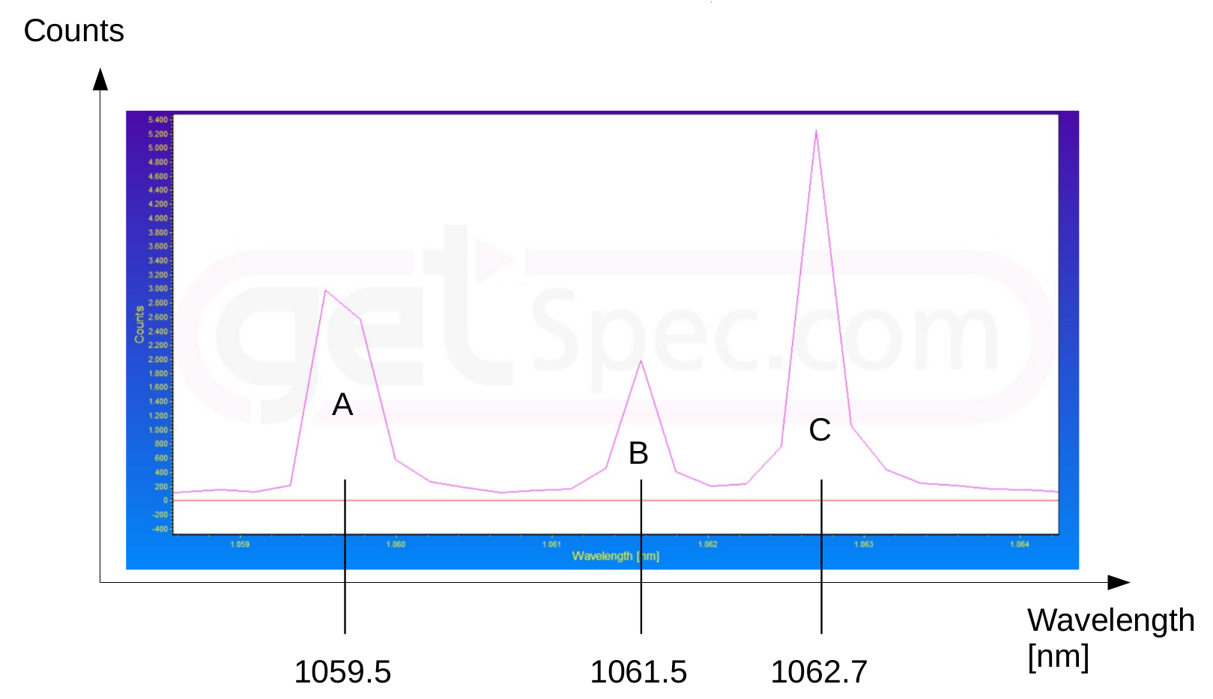
Tests on the filter bench
We observe anti-correlation (!) between the laser power and the injected power.
The reason was that the laser used for testing the filter wasn’t after all a 1064 nm laser.

Slide 13
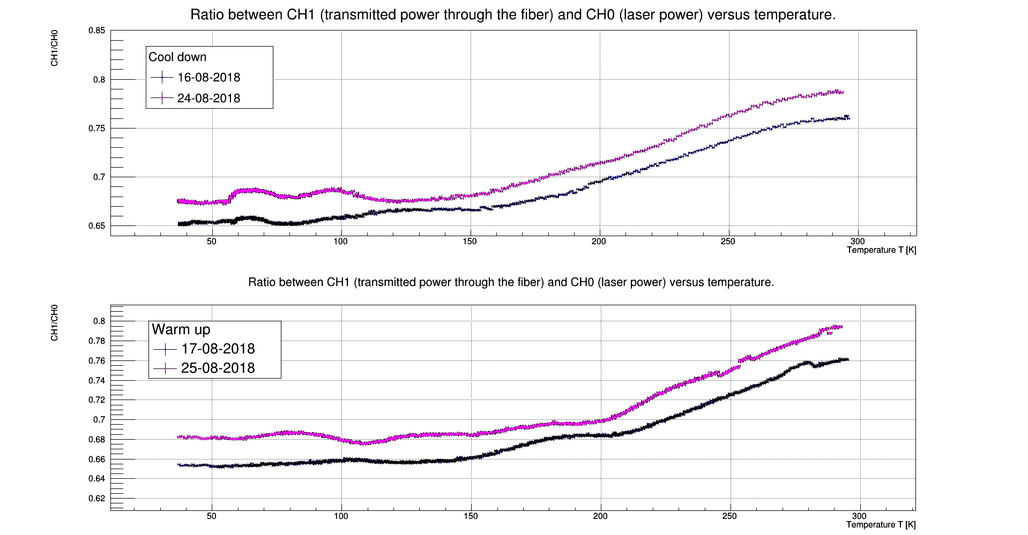
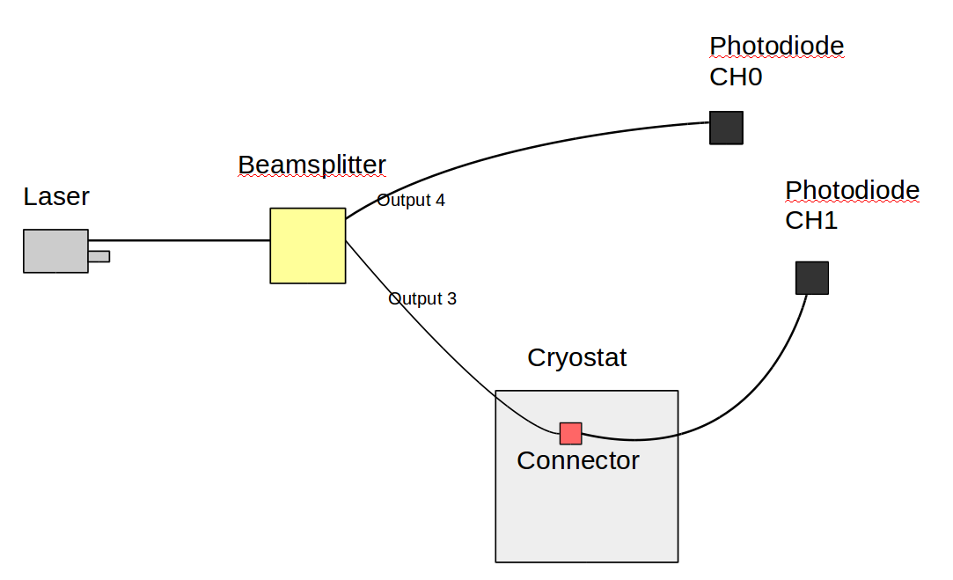
Tests on optical fibers and mating sleeves
Tests on the transmittance of this simple set-up show a 11% drop during the cool down.
During the warm up, the transmittance returns to its original value.

Slide 14
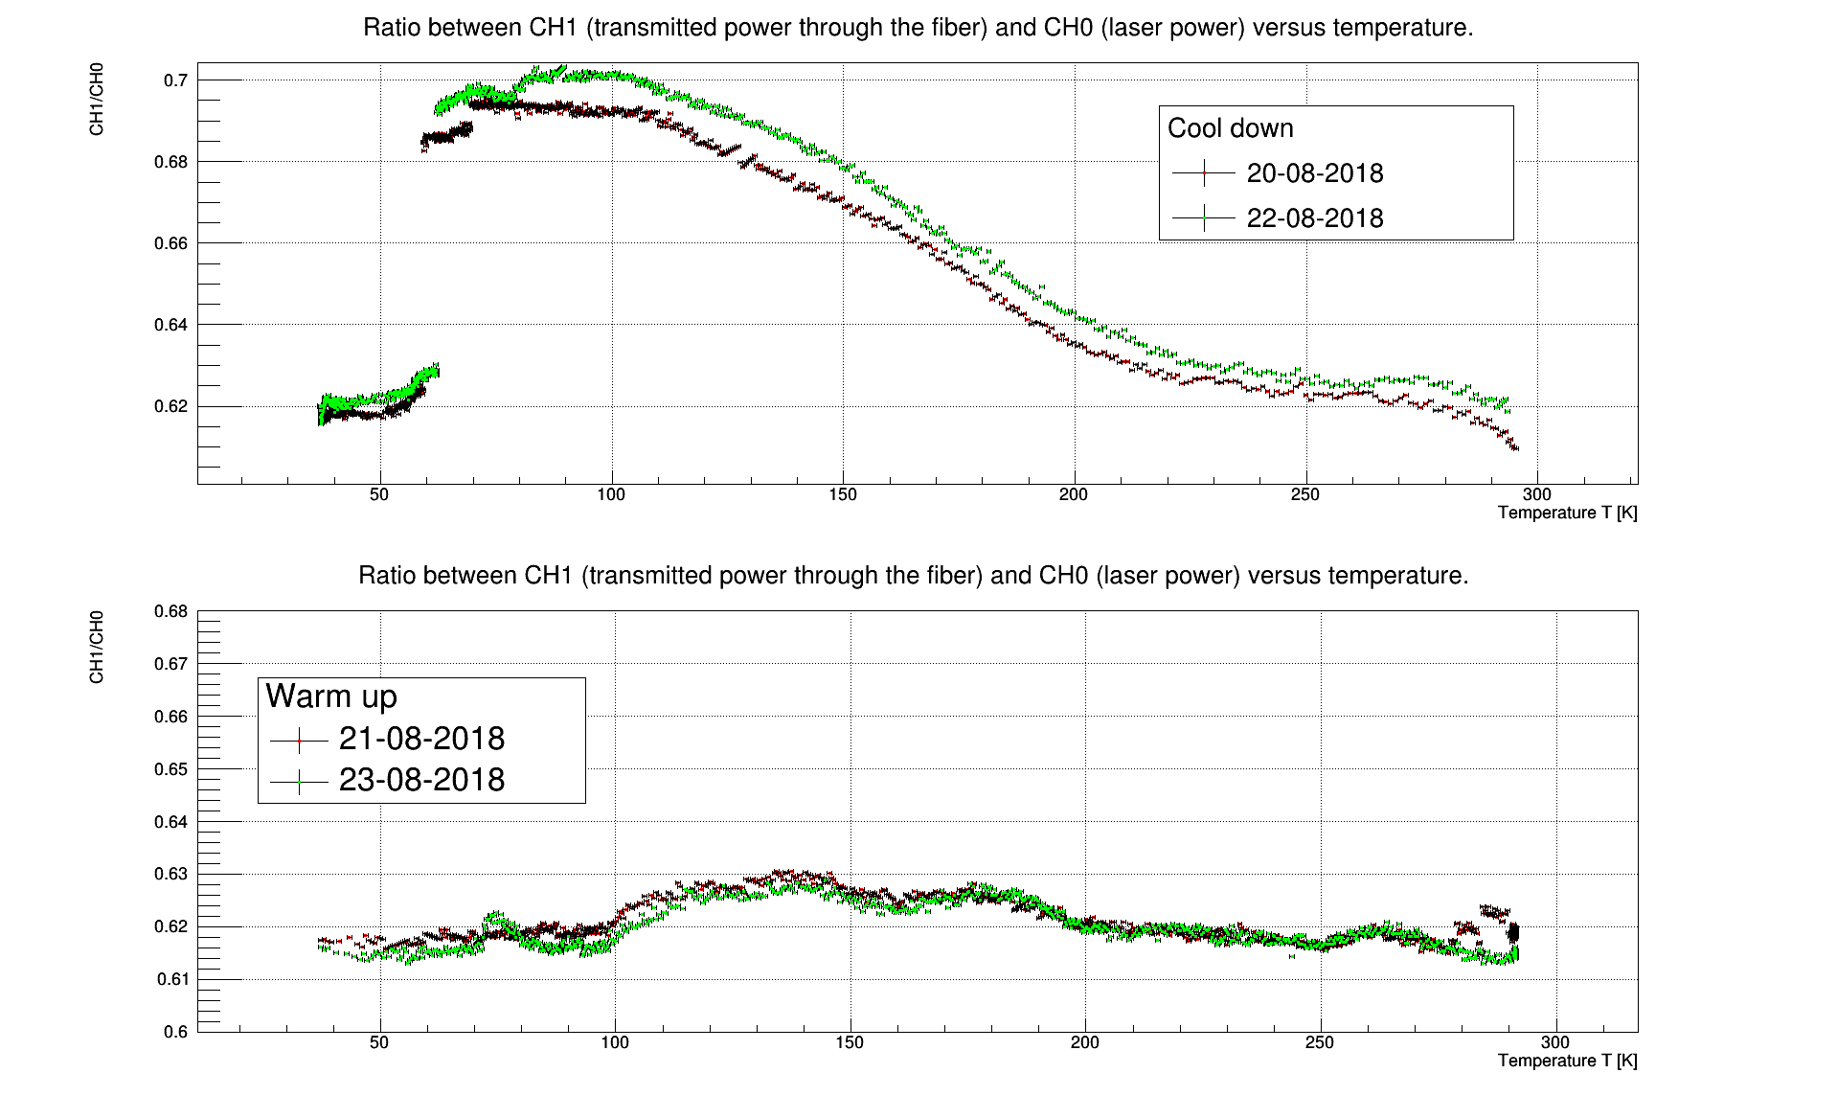
Tests on optical fibers and mating sleeves
Tests on the transmittance of this slightly different set-up show a 9% rise and a sudden jump (!) to the room temperature value during the cool down.
During the warm up, the transmittance is stable.

