Slide 1
BDT vs NN in ttH(bb)
- A study of performance and bias
Liv Helen Våge
Supervisors: Paul Glaysher, Judith Katzy
29.08.2018

Slide 2
ttH(bb)
What, why and how
ttH(bb)
Machine Learning
Neural nets
Performance metrics
ML
Content
Bias
Bias and performance
Keras
Comparison NN and BDT
NN in Keras
Comparison TMVA and
Keras

Slide 3
ttH(bb)
1. ttH(bb)
1.

Slide 4
What?
t
t
q
g
H
b
H
b
b
b
g
t
q
t
Rare production – 1%
Notes:
4

Slide 5
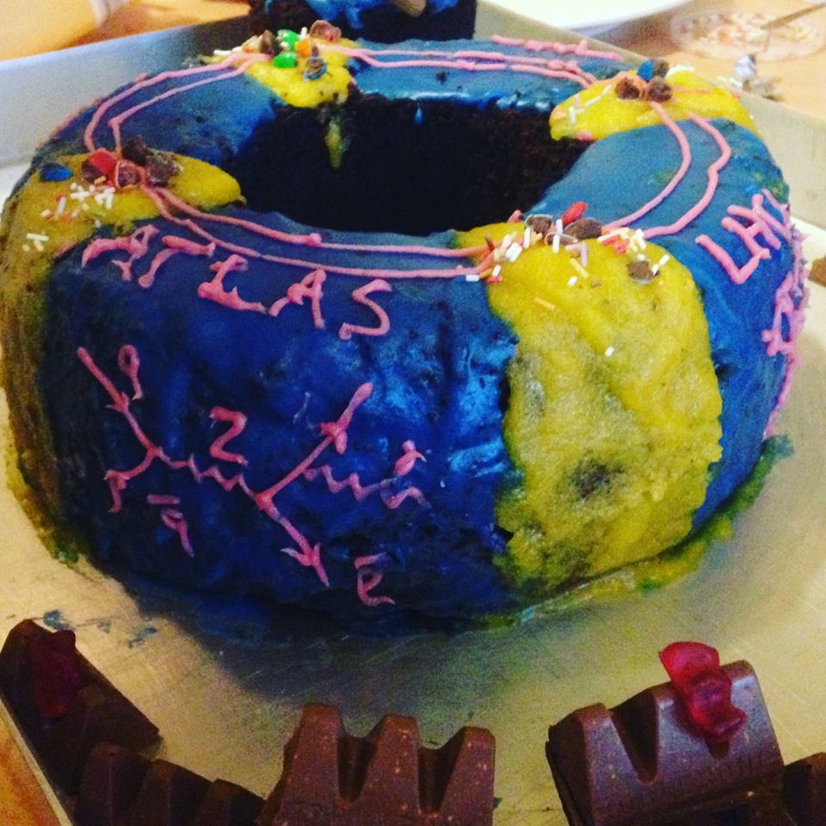
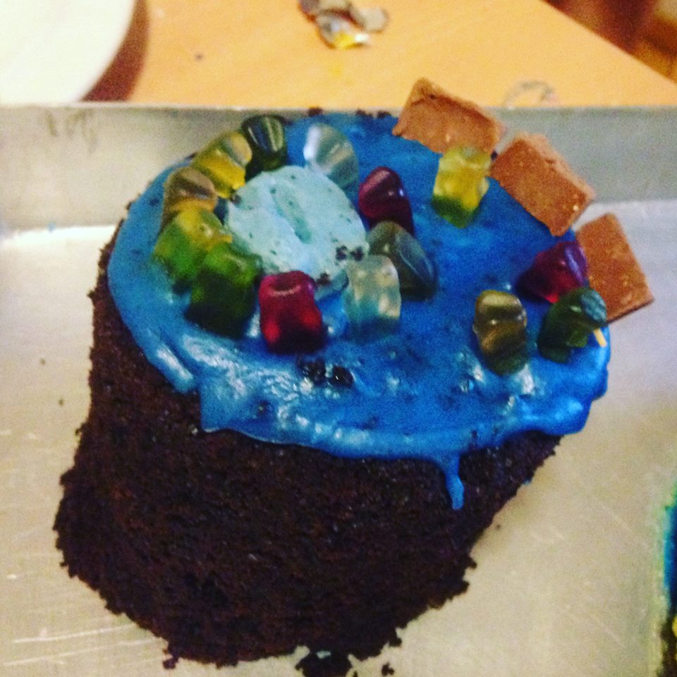

Slide 6
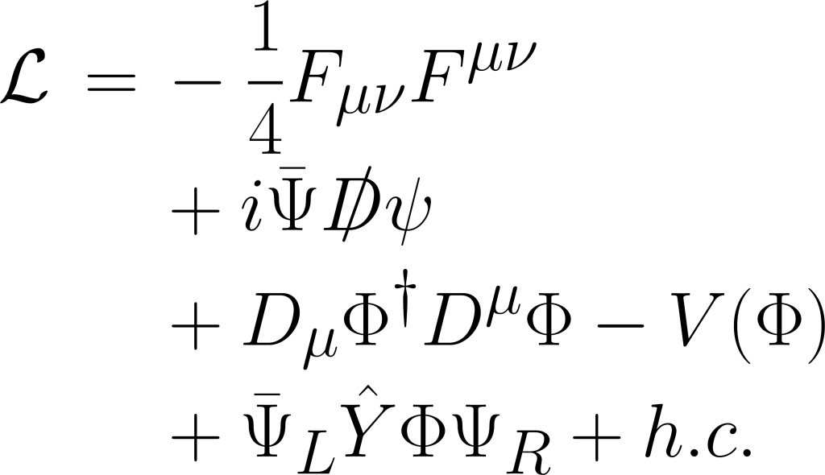
Why?
Boson coupling
Fermion coupling
g
t
H
b
b
g
t
"at the present moment the only quantity which can help us get an idea about the scale of new physics is the top Yukawa coupling."
Notes:
6

Slide 7
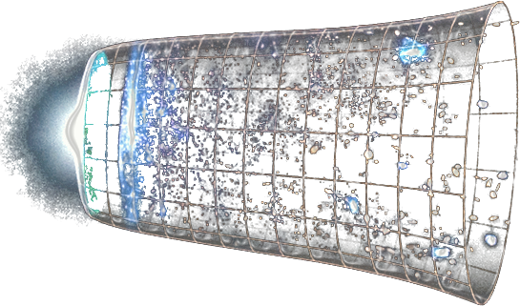
Why?
Higgs field might be responsible for inflation
Notes:
7

Slide 8
How?
Simulate collisions and label events
Use correlated physical variables
Create BDT or NN
Apply cuts
Monte Carlo
Remove background
Prepare variables
Machine learning
Real data
Notes:
8

Slide 9
g
b
Challenge
t
b
t
g
ttH has been confirmed to 4.2 σ
Uncertainty depends on MC simulations
Reduce bias to increase sensitivity
Notes:
9

Slide 10
Bias and performance of BDT and NN
BDT
NN
- Quick training
- Low bias
- Good performance
- Slow training
- Expect higher bias
- Expect high performance
Notes:
10

Slide 11
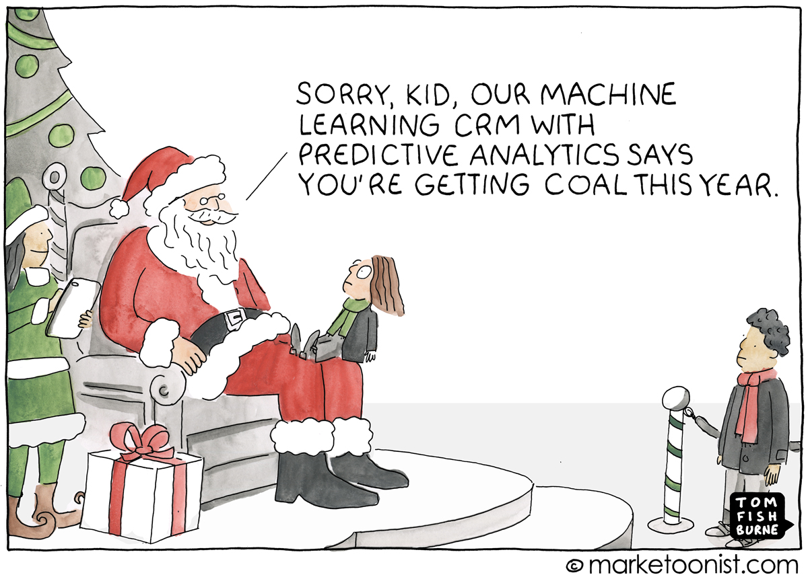
1. ttH(bb)
Machine Learning
2.
1.

Slide 12
Boosted decision tree (BDT)
Mass of b-pair
(2,5,6,2...)
Sum of momentum
(5,8,10,2...)
Number of jets
(5,5,1,7...)
S
S
B
B
B
B
S
S
S
S
S
S
B
B
S
S
B
B
B
S
S
S
B
S
B
B
S
S
B
S
S
S
S
B
S
B
S
S
B
S
S
S
B
B
B
S
S
B
B
B
B
B
S
S
S
S
S
B
Notes:
12

Slide 13
Neural Net (NN)
X₁w₁+X₂w₂ +b
> threshold
Mass of b-pair
w₁
tanh
w₃
(2,5,6,2...)
tanh
w₂
Momentum
S
S
(5,8,10,2...)
tanh
Number of jets
B
B
(5,5,1,7...)
tanh
Notes:
13

Slide 14
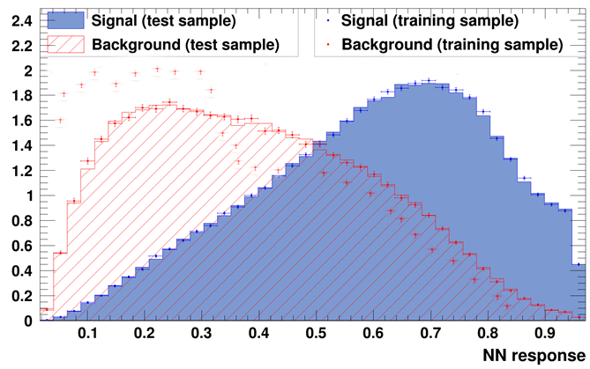
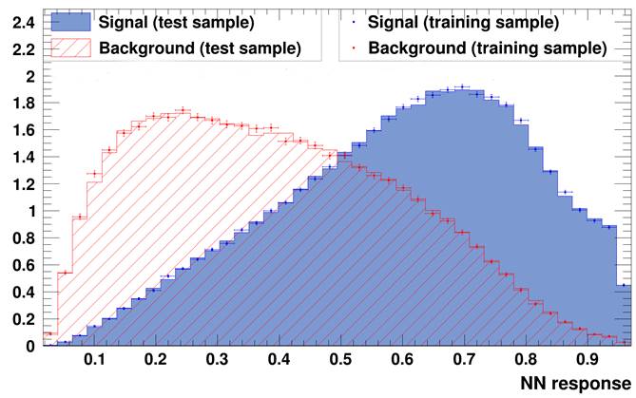
Measuring bias
Overtraining plot
- Different Monte Carlo simulations
- If trained on one sample, will it classify another sample poorly?
Notes:
14

Slide 15
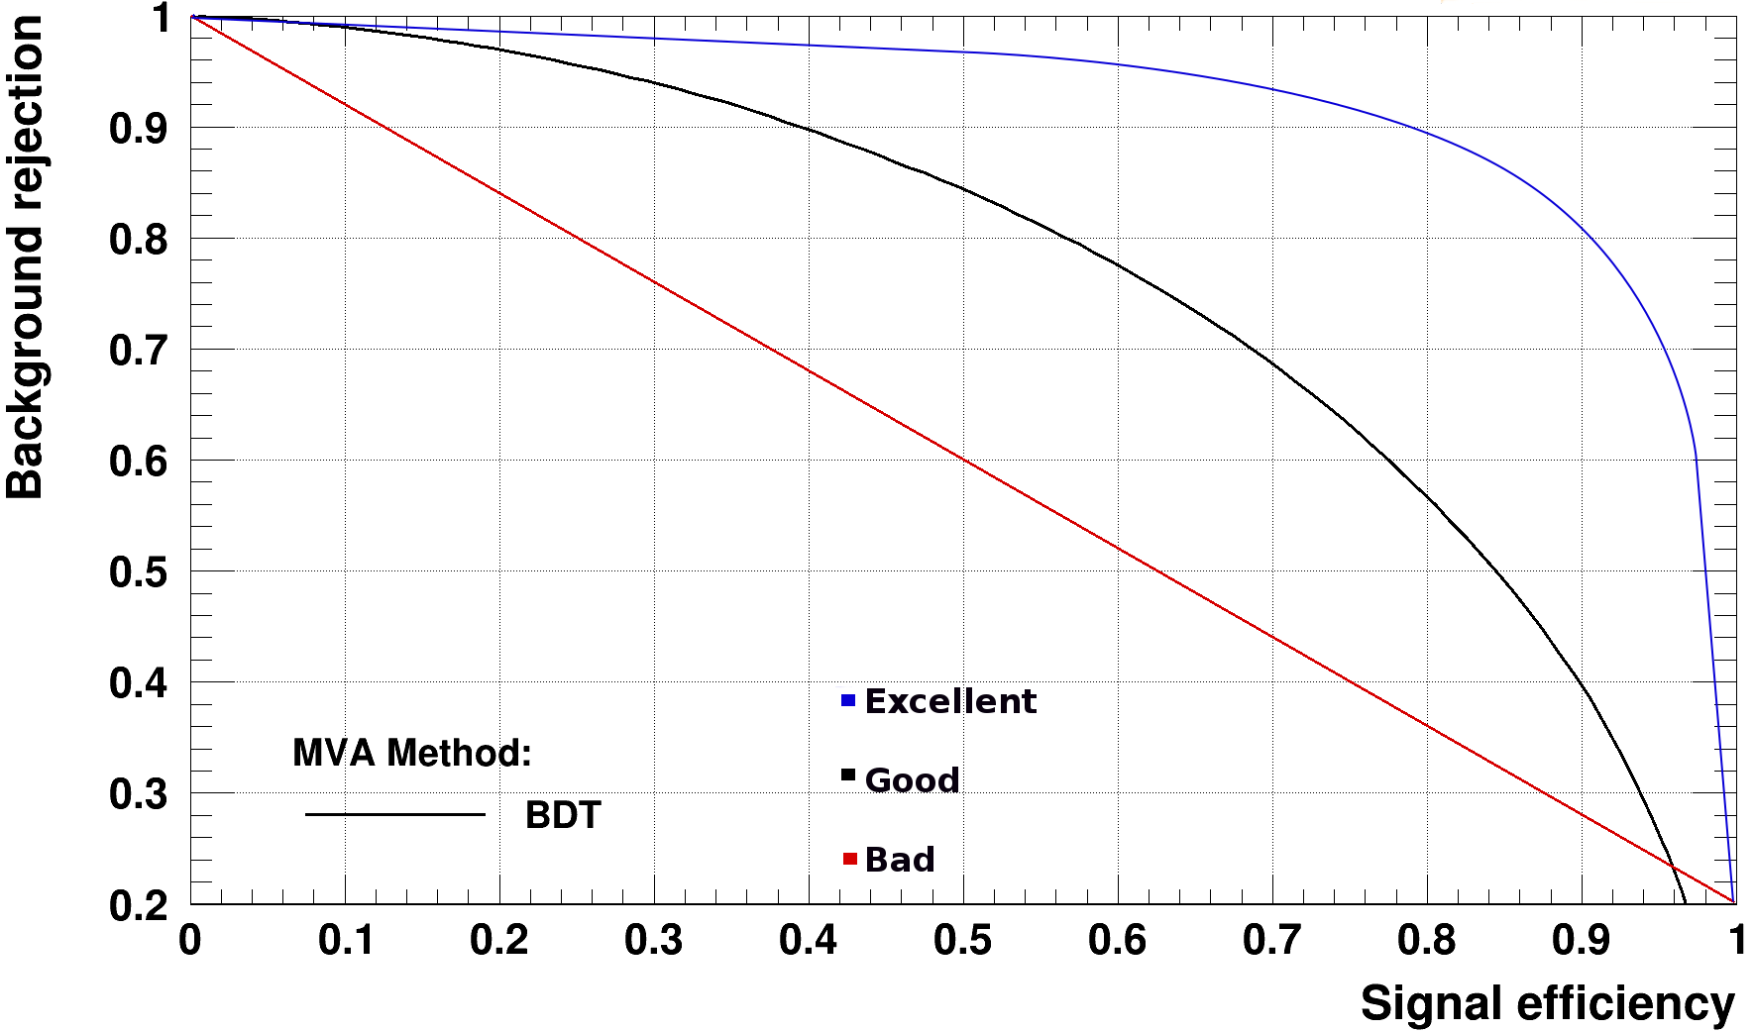
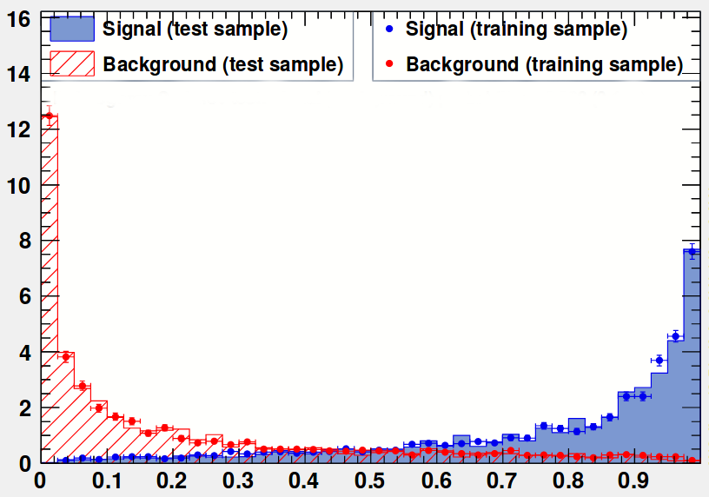
Measuring performance
Integral under ROC curve
Notes:
15

Slide 16
ttH(bb)
1. ttH(bb)
3.
Bias and performance

Slide 17
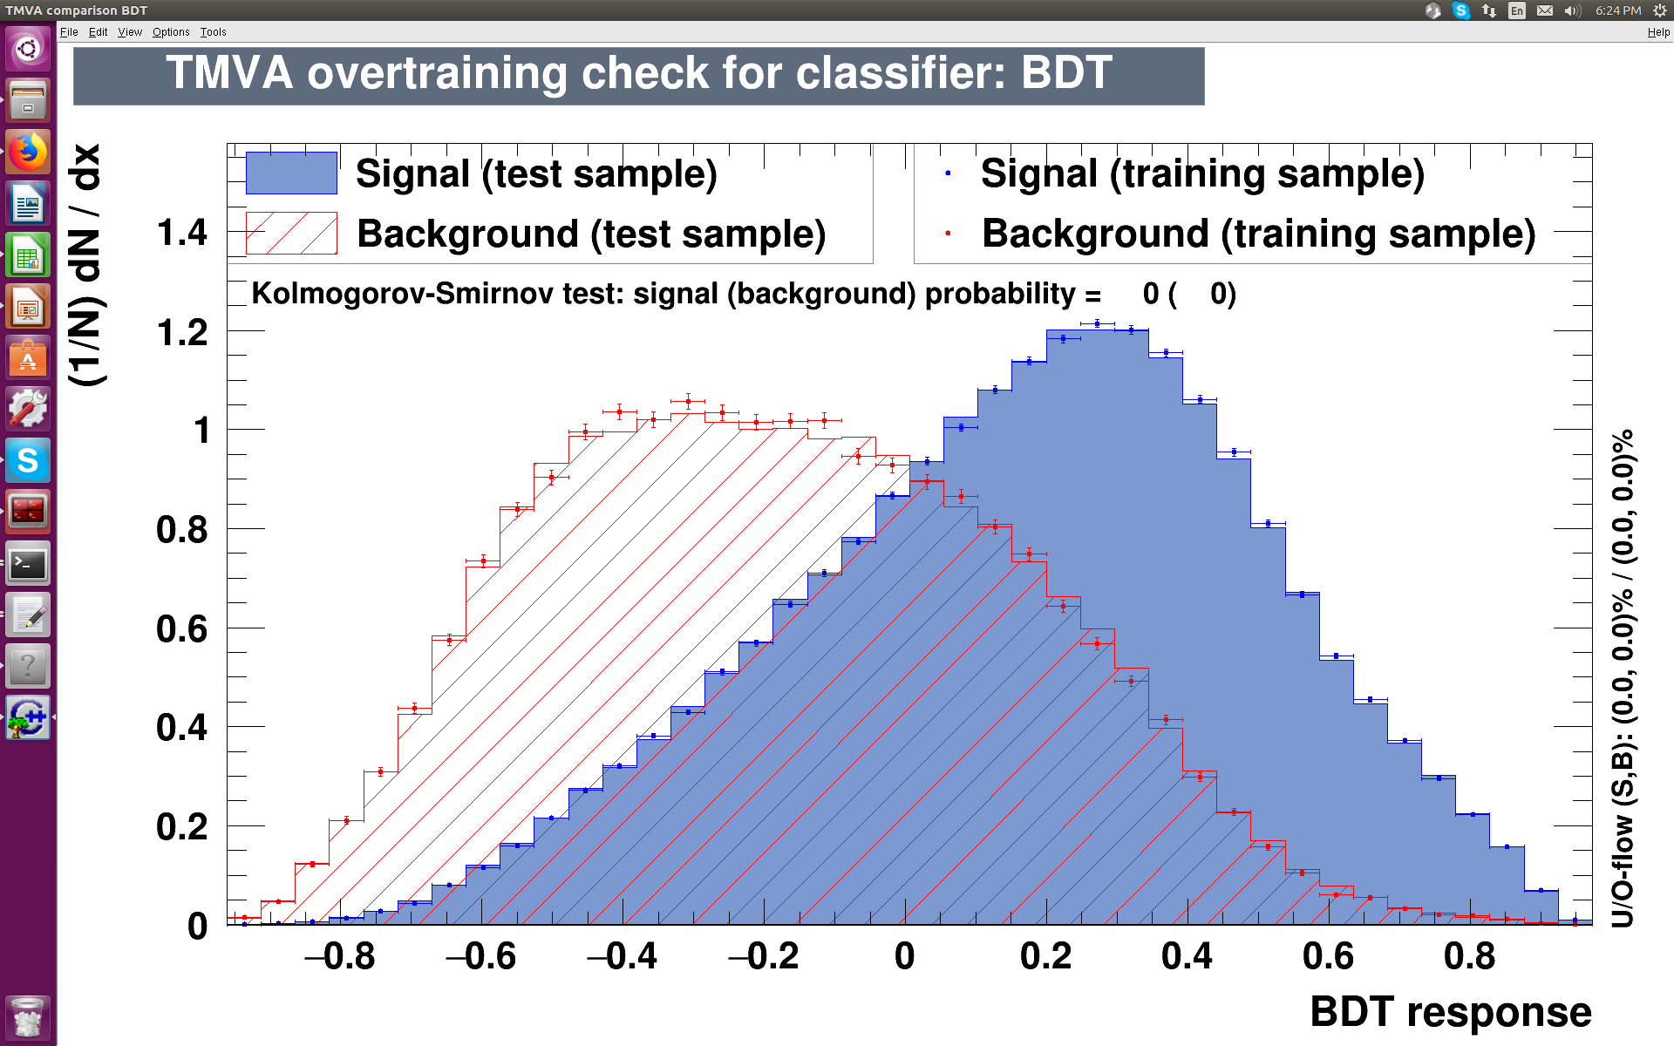
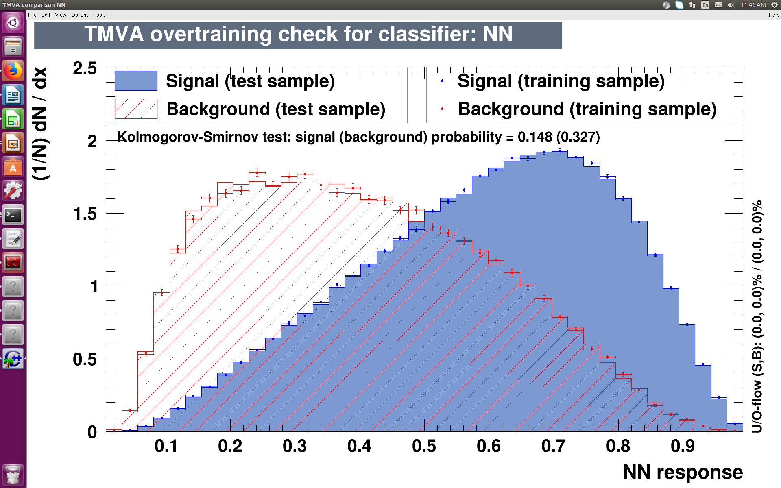
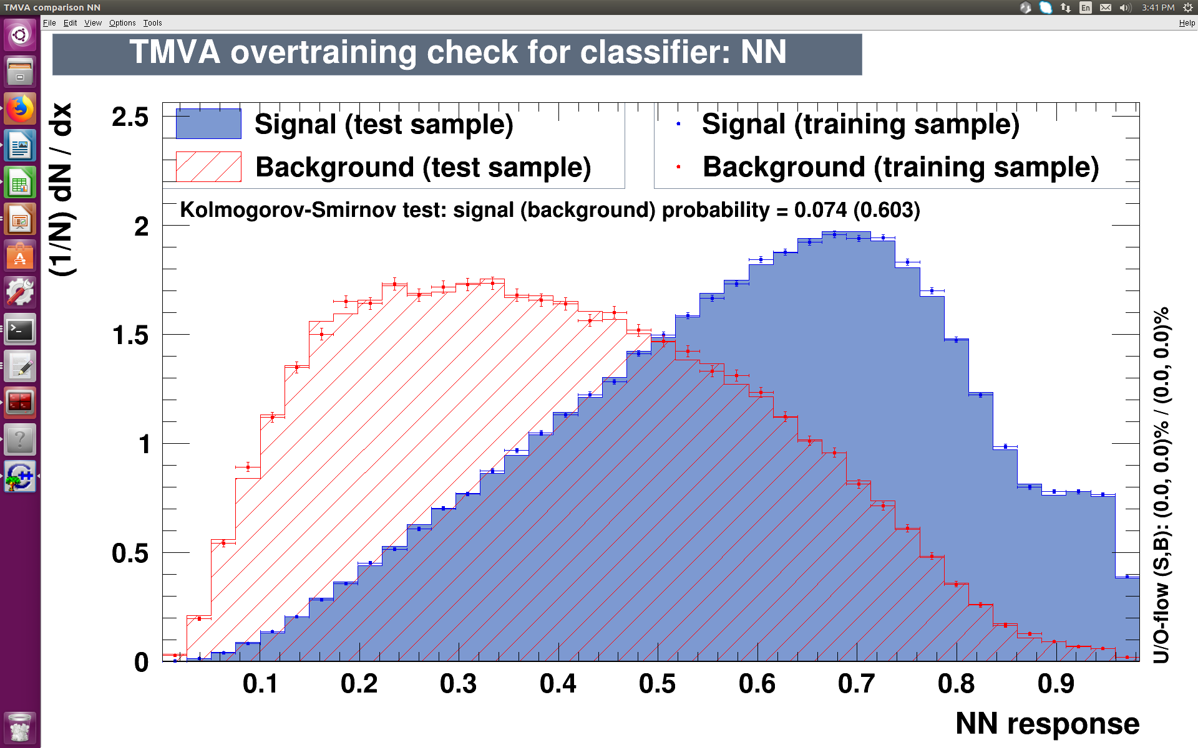
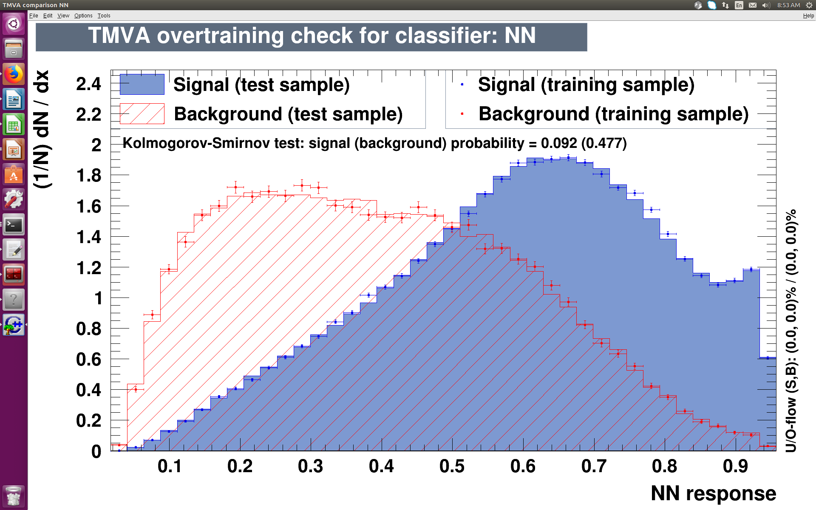
Performance
BDT
NN
ROC 0.763
ROC 0.751
- Neural nets take longer
- If training time over 1 hour, different architectures have similar performance
- BDT superior to NN in TMVA
Depth 5 – 6 min
4 layers- 4 hours
NN
NN
ROC 0.753
ROC 0.757
1 layer - 2hours
6 layers - 4 hours*
Notes:
17

Slide 18
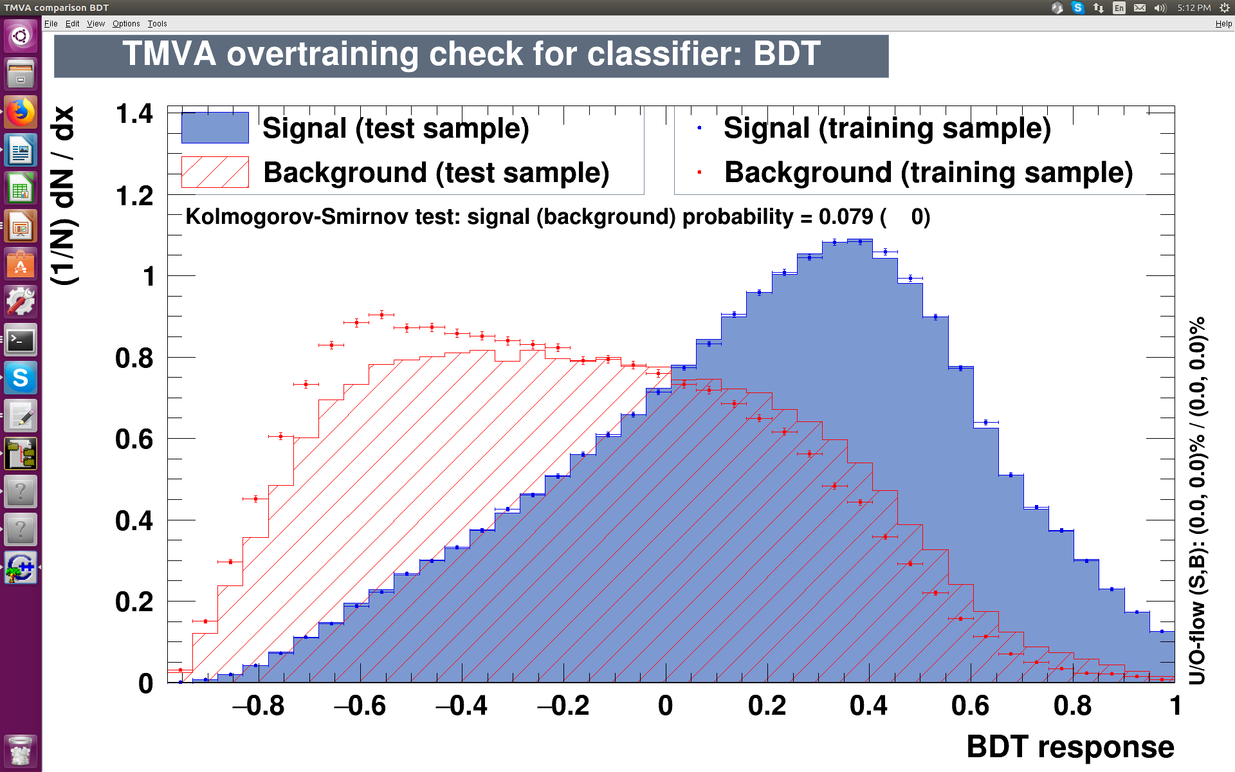
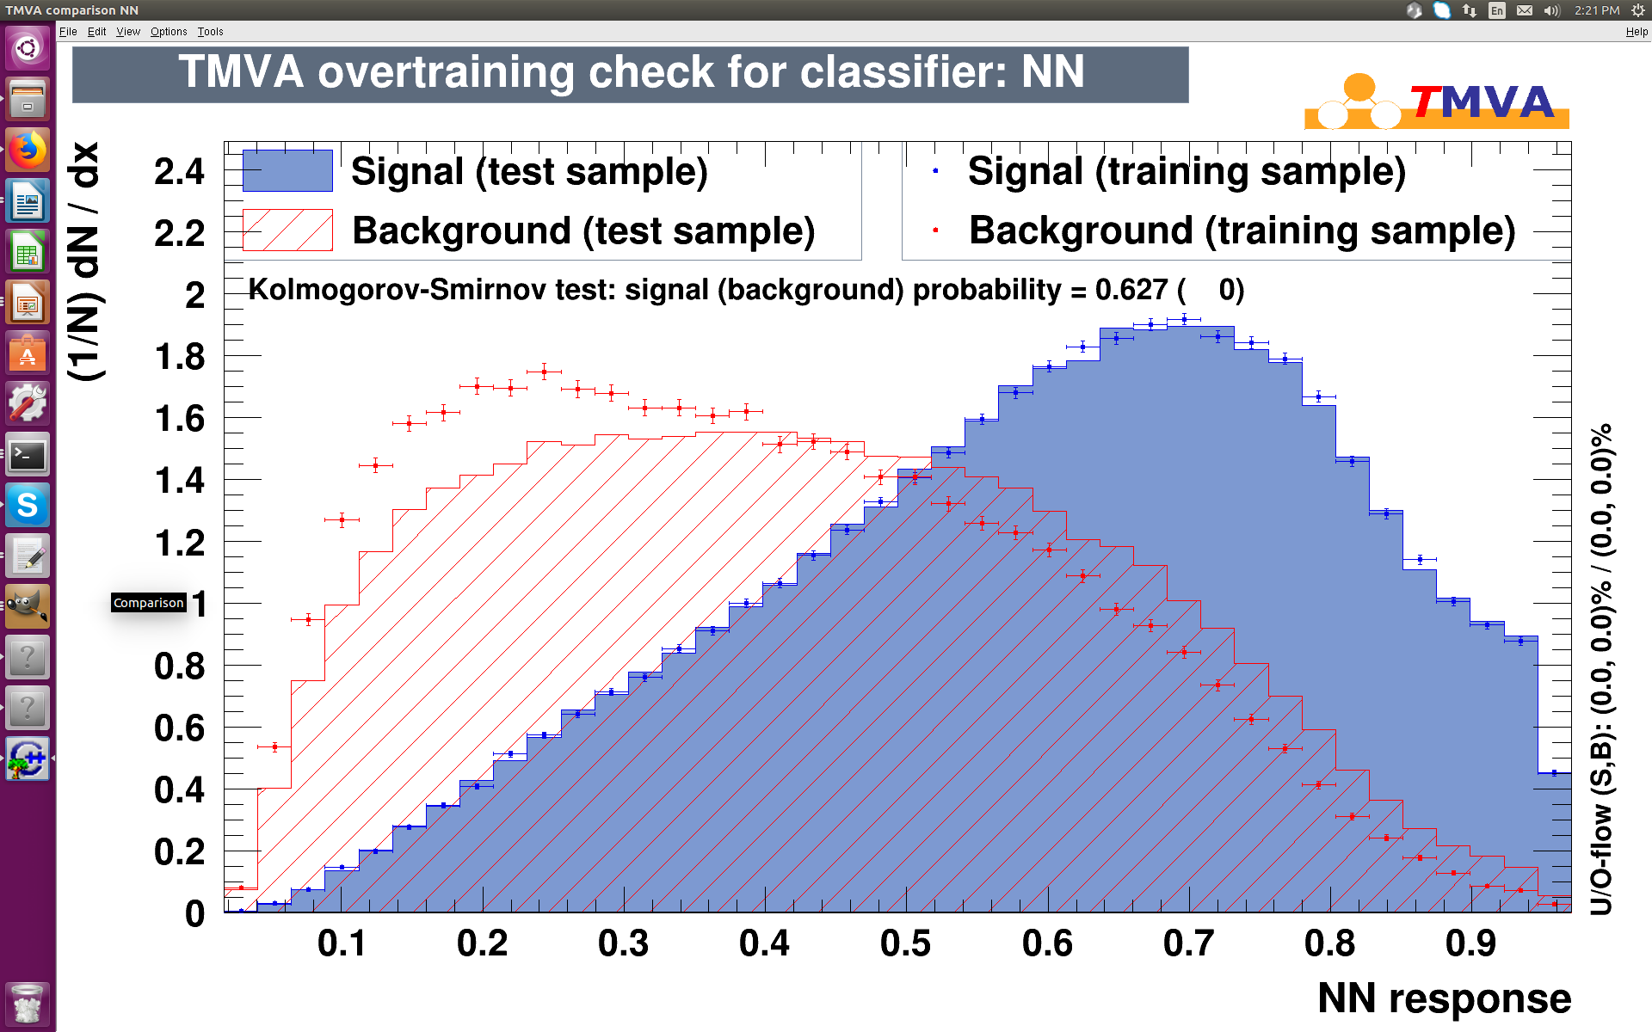
Bias – training on PP8, testing on aMC
BDT
ROC 0.728
Depth 5
NNs are not more biased
NN
ROC 0.722
6 layers
Notes:
18

Slide 19
ttH(bb)
ML
4.
Keras

Slide 20
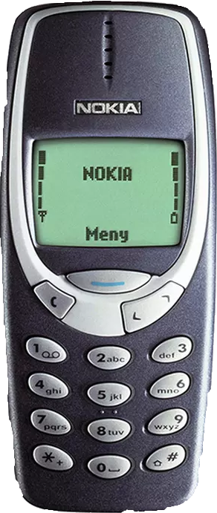
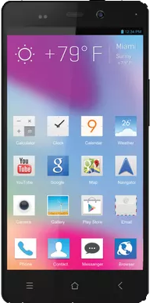
Why Keras?
Written for physics analysis
A part of Root
State of the art
Integrates with TMVA
Gives same output as TMVA
Faster
Only basic tools
Advanced functions not available
Notes:
20

Slide 21
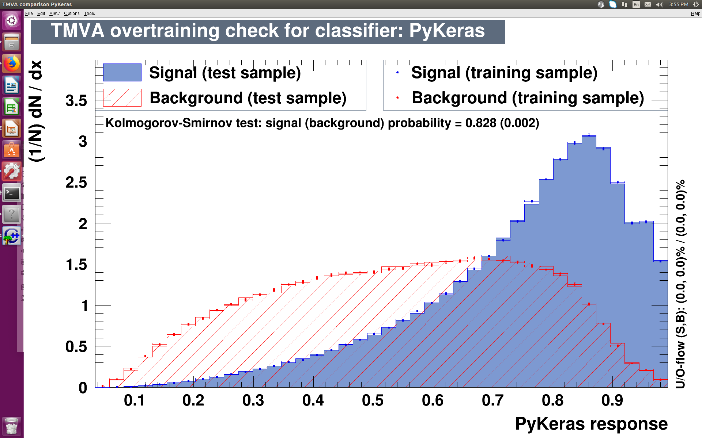
Performance
BDT
ROC 0.763
NN Keras
Depth 5 – 6 min
ROC 0.779
NN
ROC 0.779
4 layers – 4 min
ROC 0.757
6 layers - 4 hours*

Slide 22
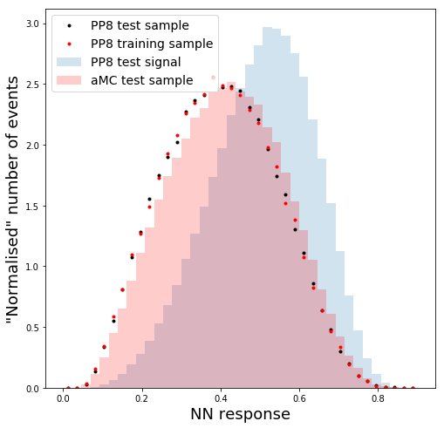
Bias – training on PP8, testing on aMC
BDT
Keras
ROC 0.728
Keras NN does not seem more biased than BDT
Depth 5
NN
ROC 0.722
5 layers
6 layers
Notes:
22

Slide 23
ttH(bb) let us explore Lagrangian and probe for new physics
ttH(bb)
Expected high performing, biased NN
ML
Summary
Bias
Keras
NN takes longer to train, but there is no evidence it is more biased
Keras seems to have higher performance and not more bias. Promising option.

Slide 25
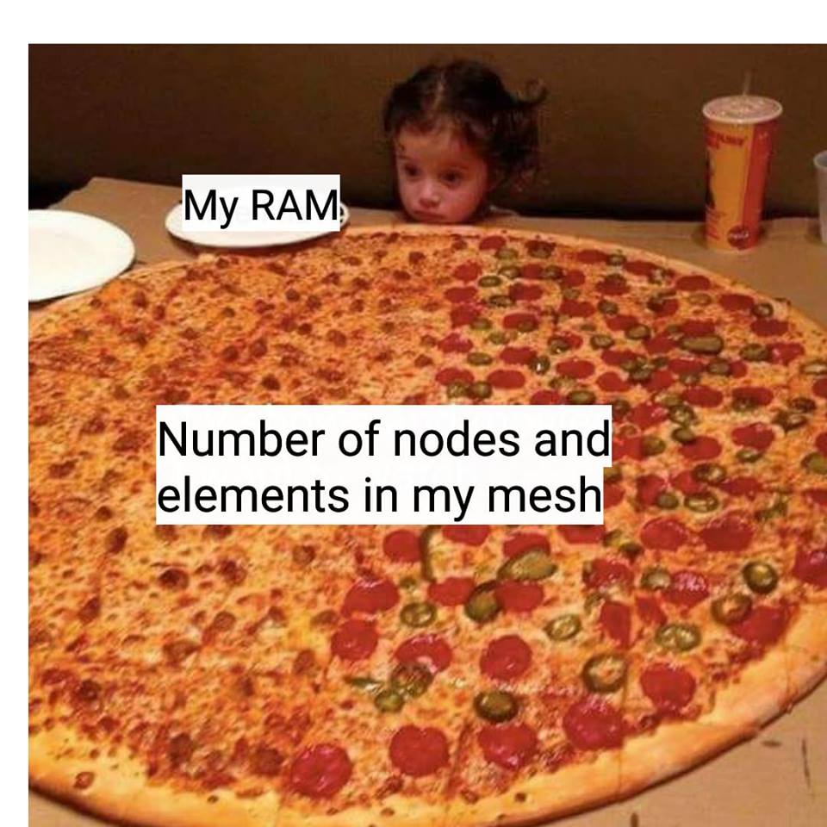
Additional material

Slide 26
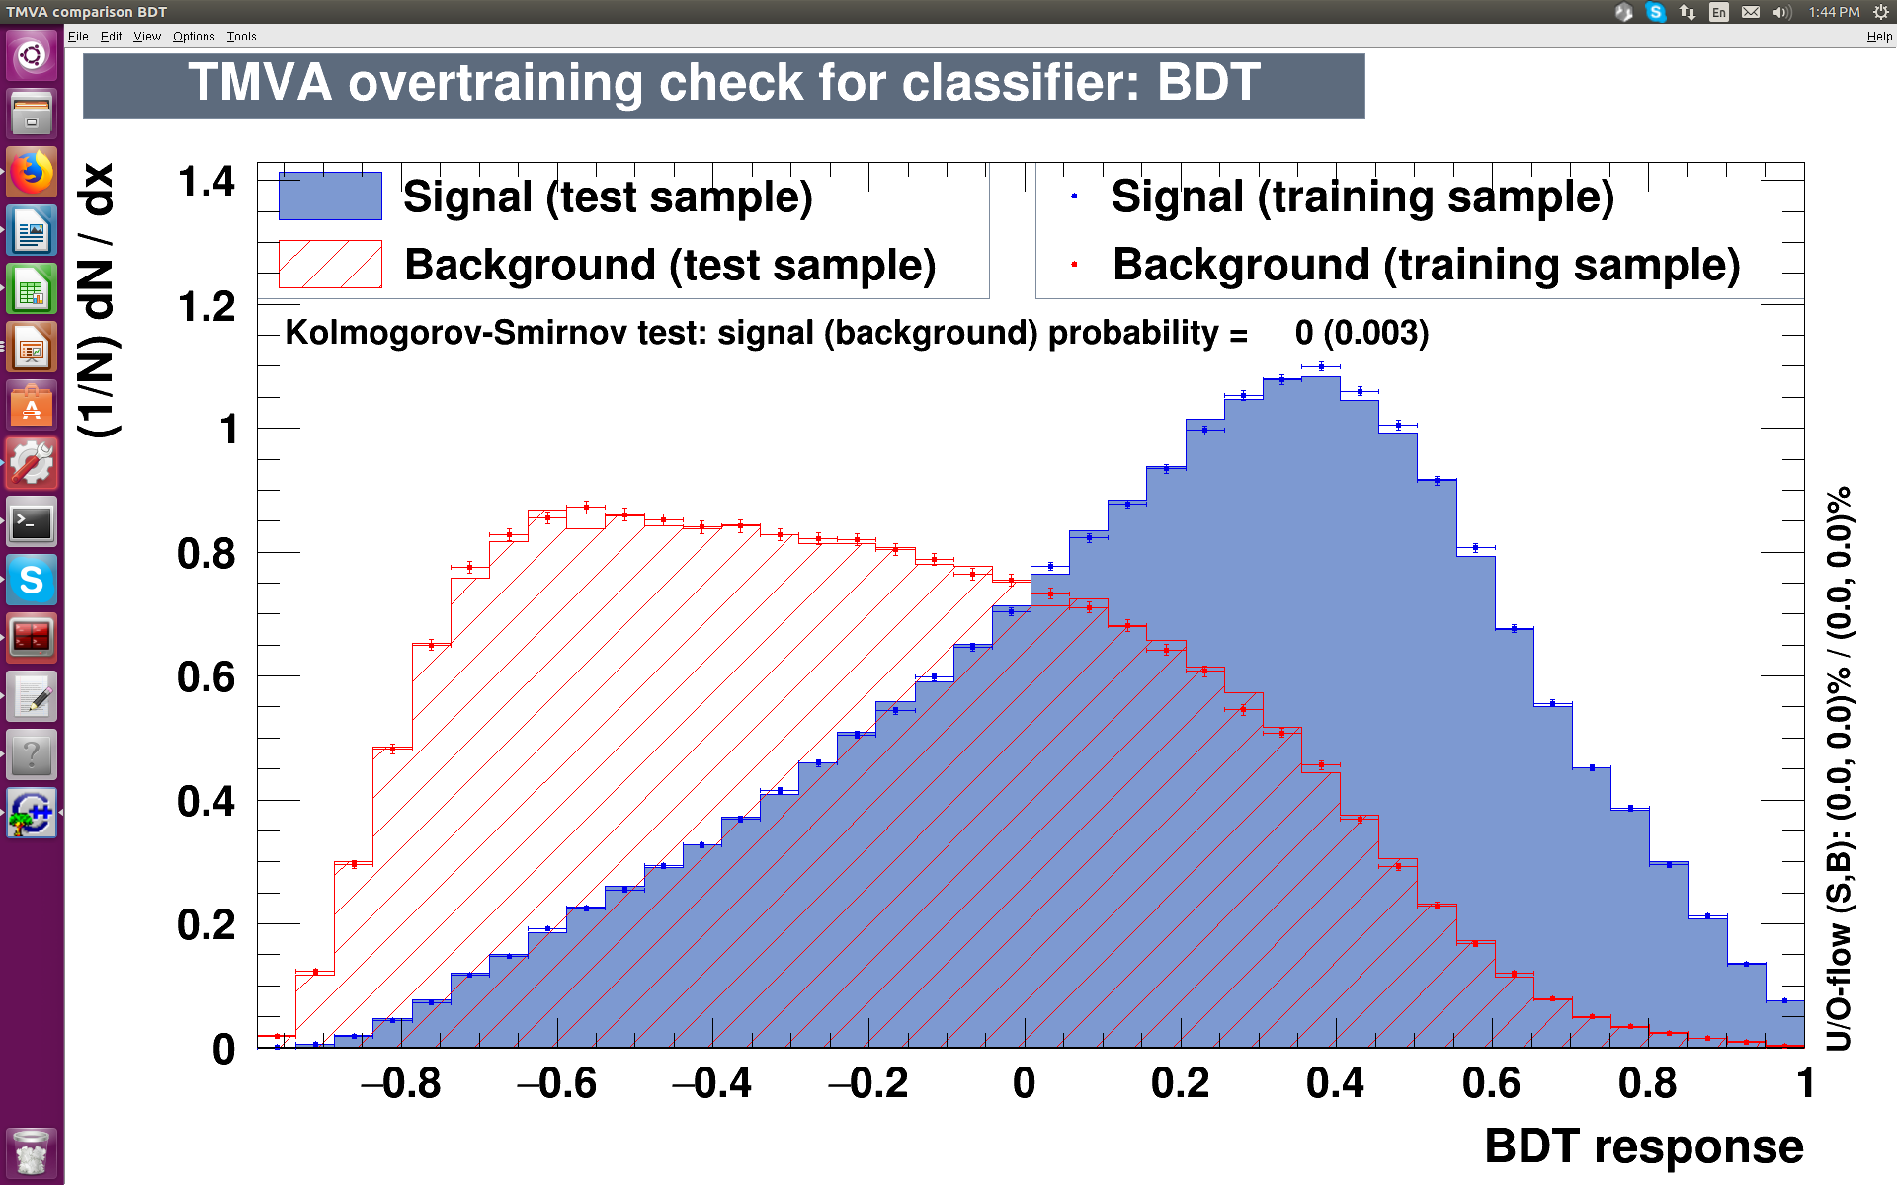
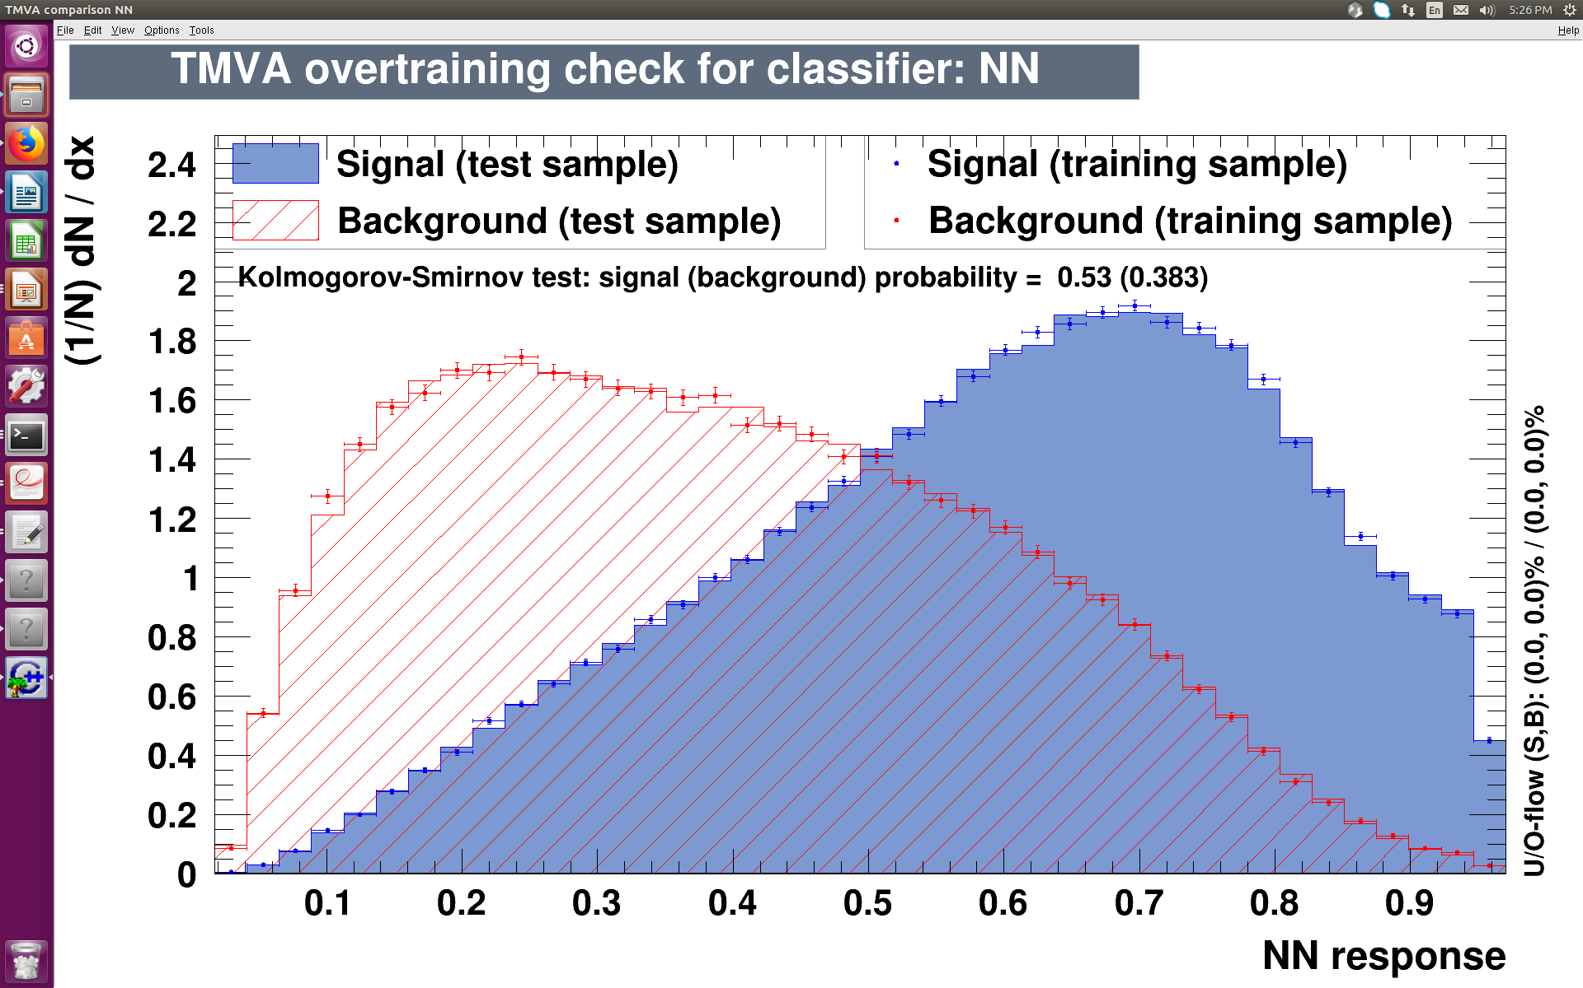
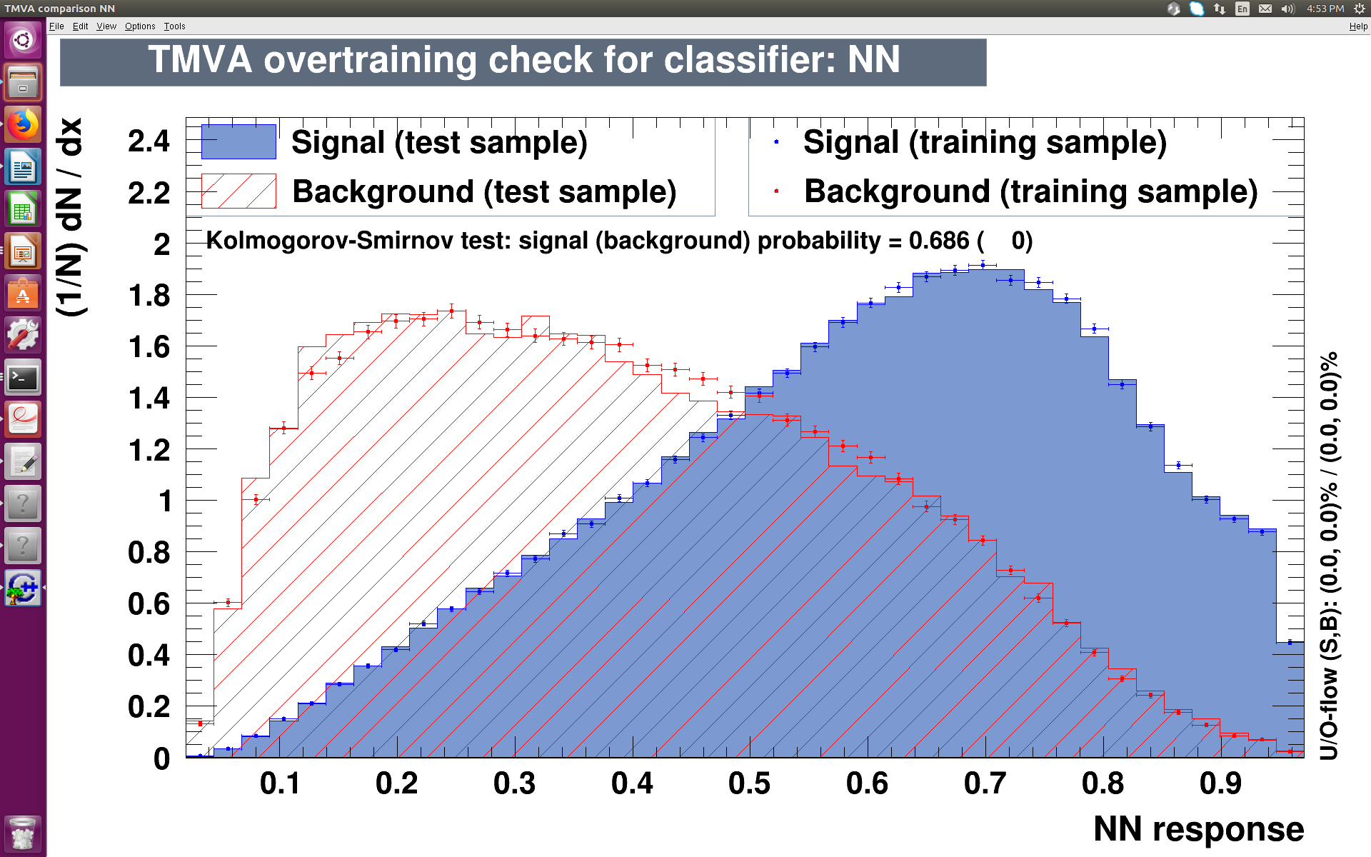
Bias – PP8/Sherpa
BDT
BDT
BDT
ROC 0.765
ROC 0.765
Depth 5
Depth 5
NN
NN
ROC 0.761
ROC 0.762
6 layers
6 layers
Notes:
26

Slide 27
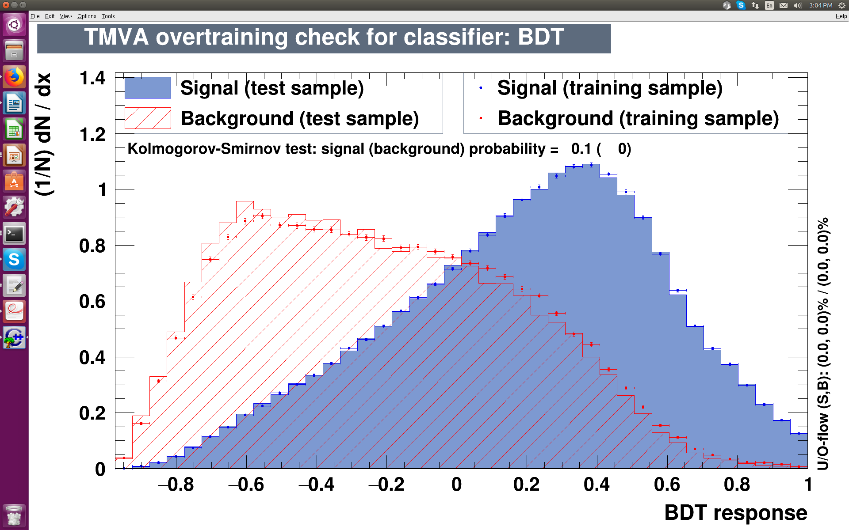
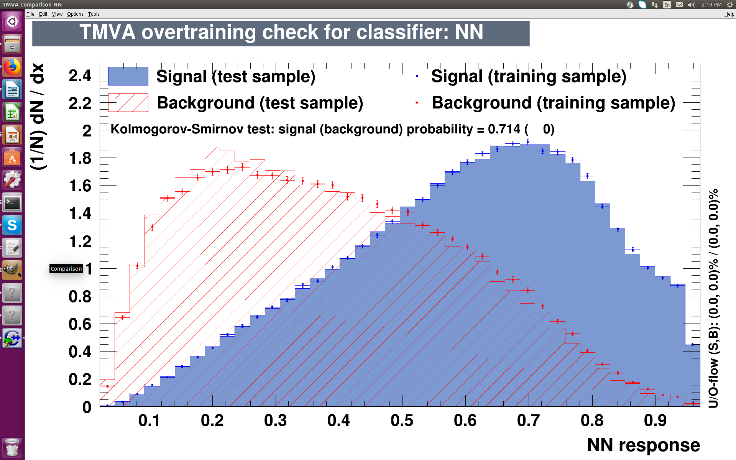
Bias – PP8/PoH7
BDT
BDT
BDT
ROC 0.765
ROC 0.771
Depth 5
Depth 5
NN
NN
ROC 0.761
ROC 0.774
6 layers
6 layers
Notes:
27

Slide 28
Bias – PP8/aMC
BDT
BDT
BDT
ROC 0.765
ROC 0.728
Depth 5
Depth 5
NN
NN
ROC 0.761
ROC 0.722
6 layers
6 layers
Notes:
28

