Slide 1
X-ray Cross-Correlation Analysis of Mesocrystals
Elizaveta Morozova
Summer Student
Supervised by Nastasia Mukharamova,
Ivan Vartaniants

Slide 2
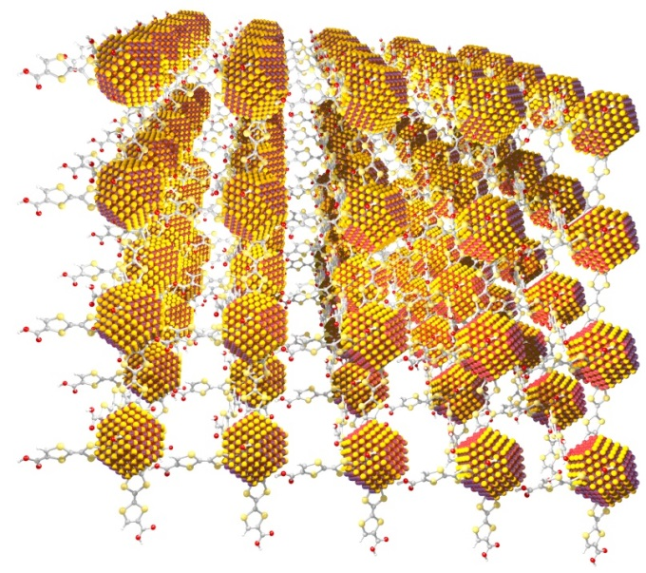
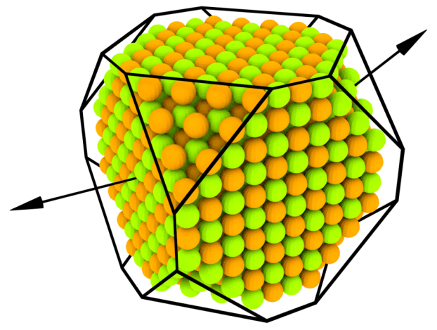
COINS: Coupled organic-inorganic nanostructures
Coupled organic-inorganic nanostructures (COIN) provide a new approach to applications of semiconductor nanocrystals (NC) for power conversion. A typical COIN consists of periodically alternating NCs and organic semiconductor molecules, promoting carrier transport across the lattice.
PbS
111
Cu4PAc
100
5 nm

Slide 3
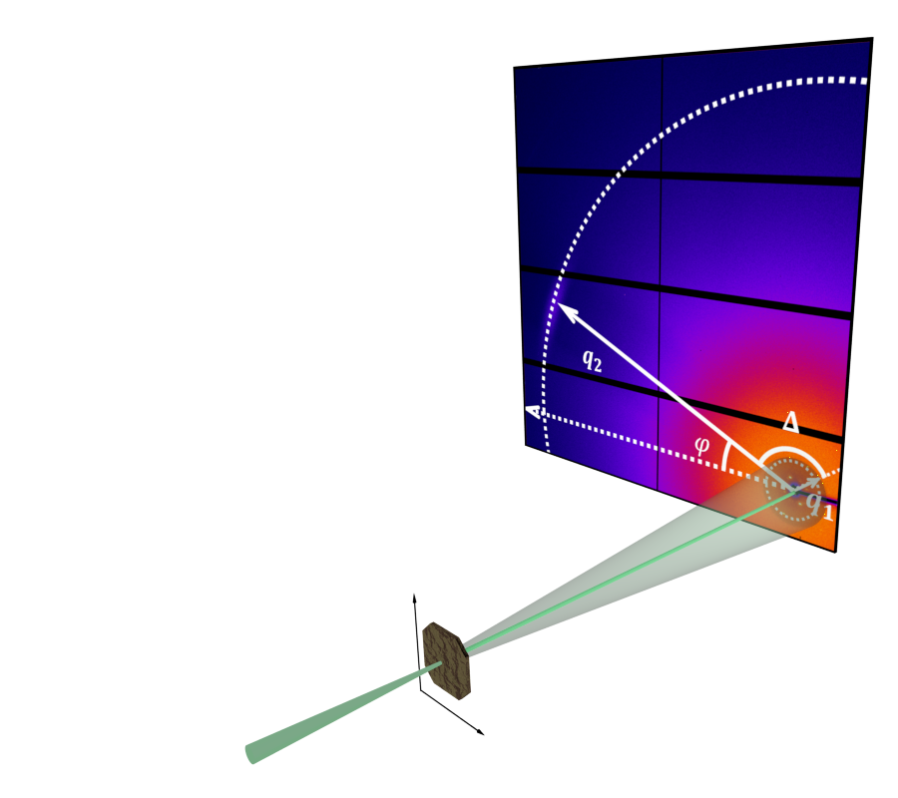
Experimental setup (P10 beamline, PETRA III)
Substrate: Si₃N₄-membrane, 0.5x0.5 mm², 50 nm thick
X-ray beam: E = 13.8 keV Size = 400x400 nm² (GINIX endstation) Flux = 10¹⁰-10¹¹ ph/sec
Spatial scanning:
1) 21x21 points
2) 61x61 points
with 1 μm resolution.
Detector Eiger 4M Size = 2070x2167 pixels Pixel size = 75x75 μm Sample-detector distance = 38 cm

Slide 4
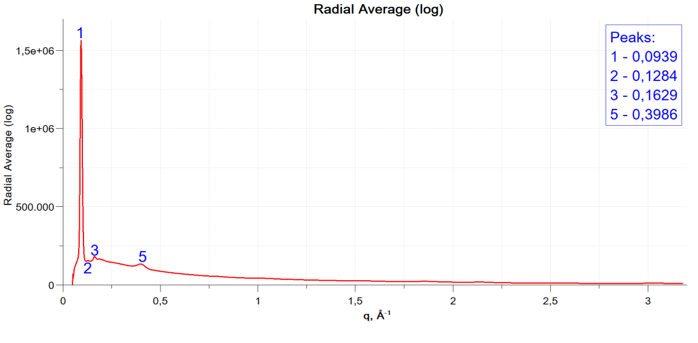
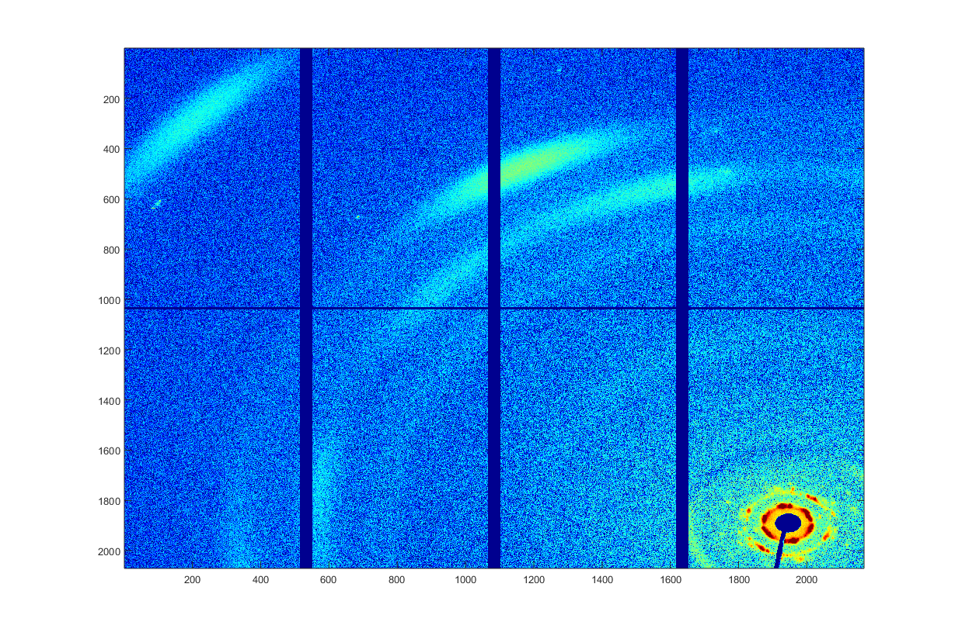
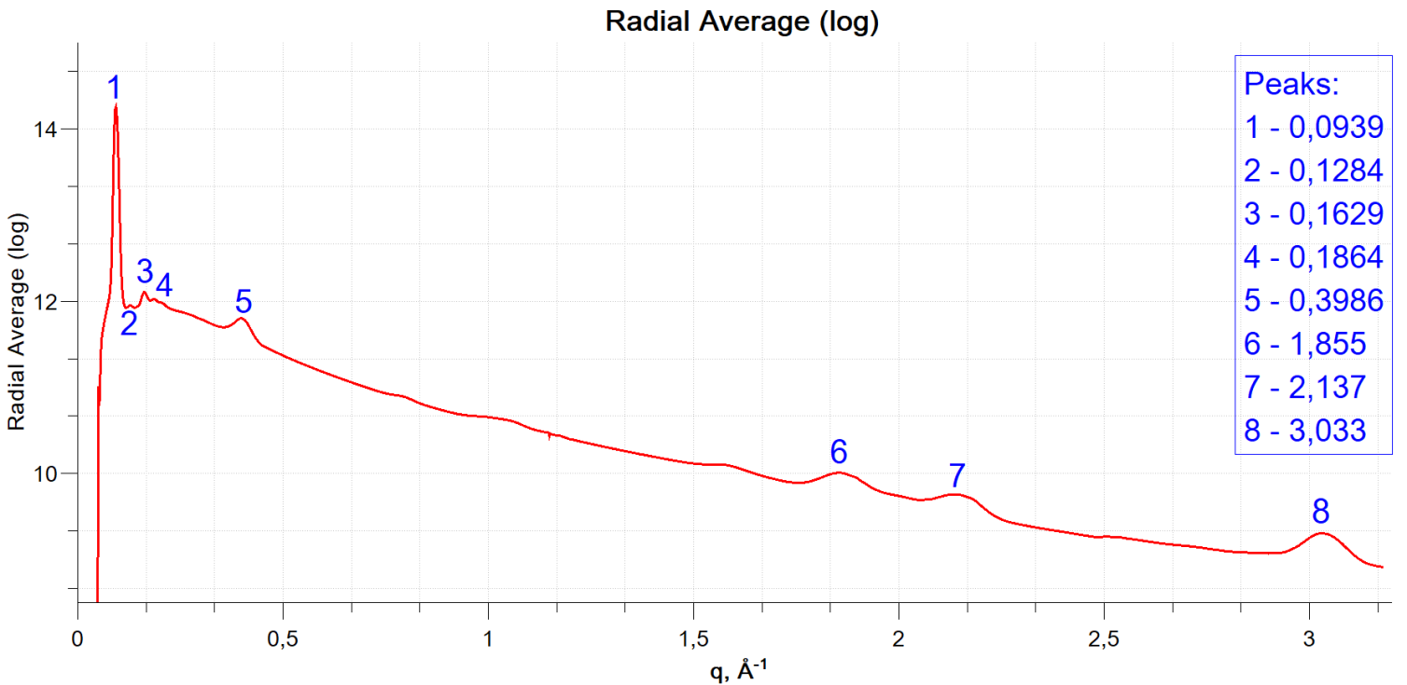
Radial average

Slide 5
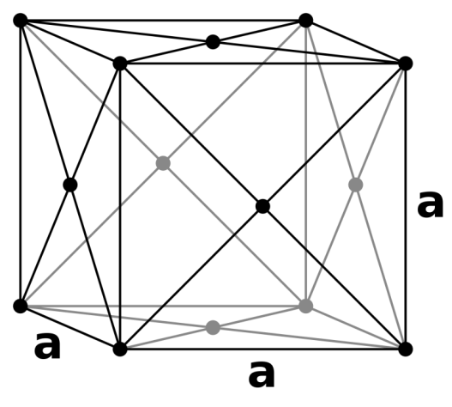
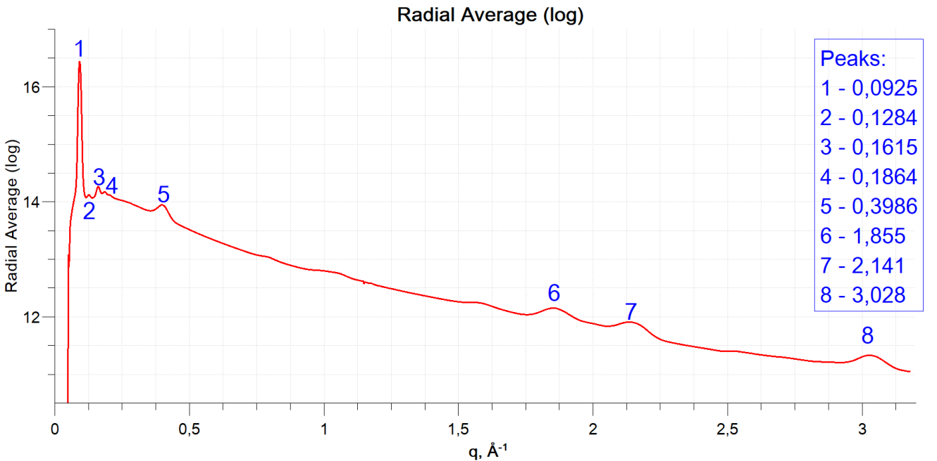
Atomic Lattice (scan 1, scan 2)
q (exp1) | q (exp2) | q(th) | (hkl) | h+k+l
1,855 | 1,855 | 1,8436 | {111} | 3
2,137 | 2,141 | 2,1288 | {002} | 2
3,033 | 3,028 | 3,01 | {022} | 4
a=5,9 Å

Slide 6
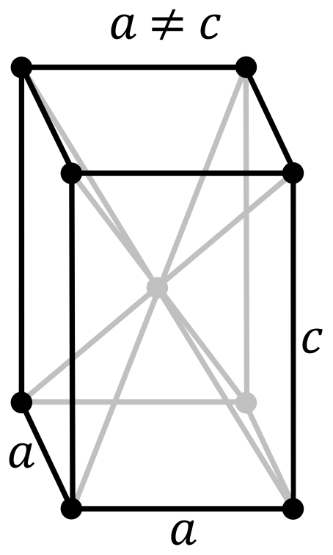
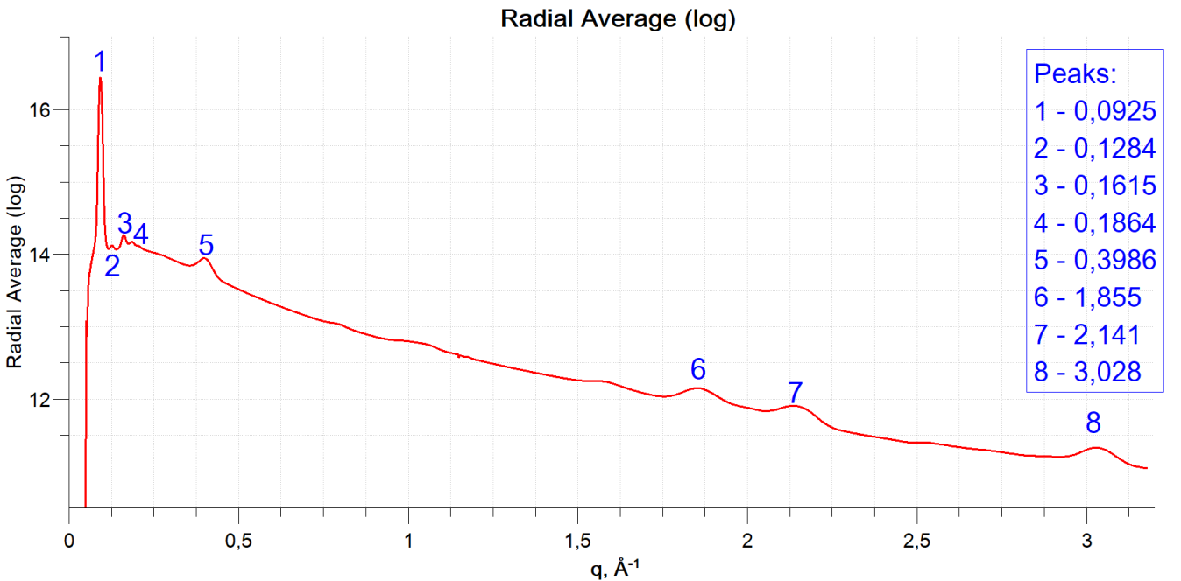
Superlattice (scan 1, scan 2)
q (exp1) | q (exp2) | q(th) | (hkl) | h+k+l
0,0939 | 0,0925 | 0,093 | {002} | 2
0,1284 | 0,1284 | 0,1263 | {112} | 4
0,1629 | 0,1615 | 0,1701 | {220} | 4
0,1864 | 0,1864 | 0,187 | {031} | 4
Unit cell parameters
a=104 Å
c=135 Å
c/a=1,298

Slide 7
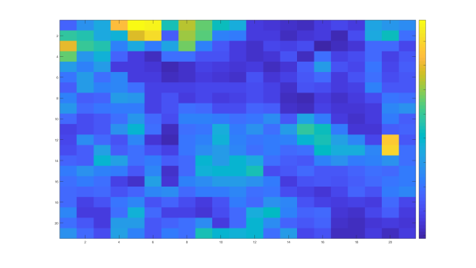
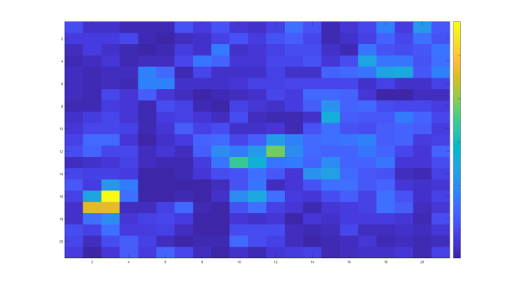
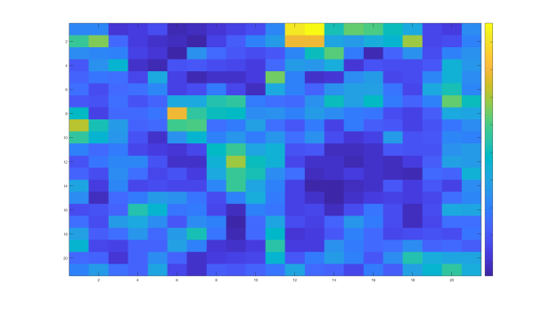
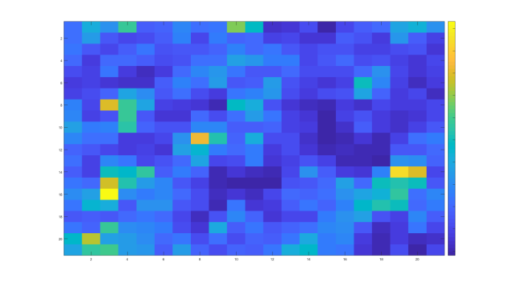
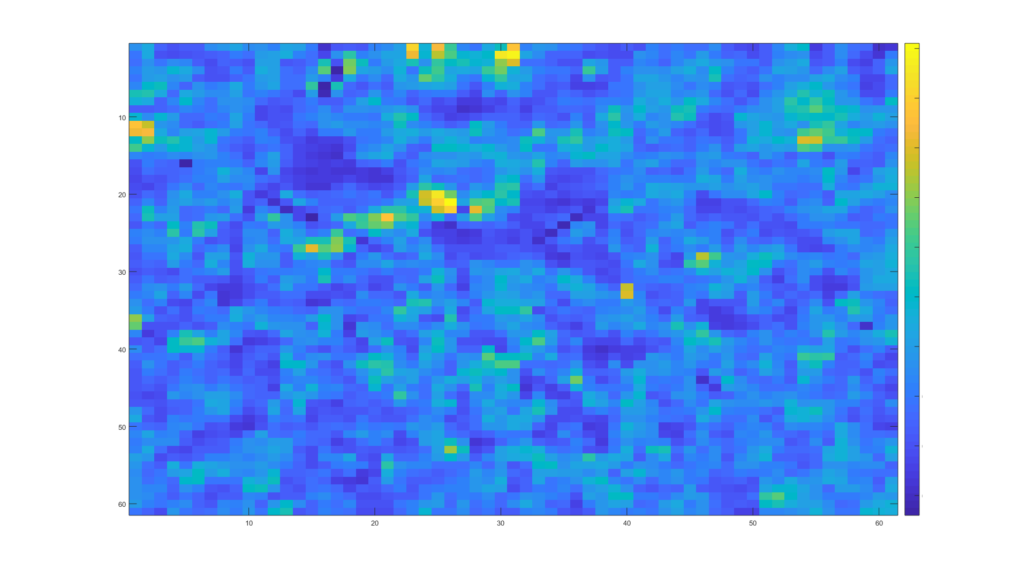
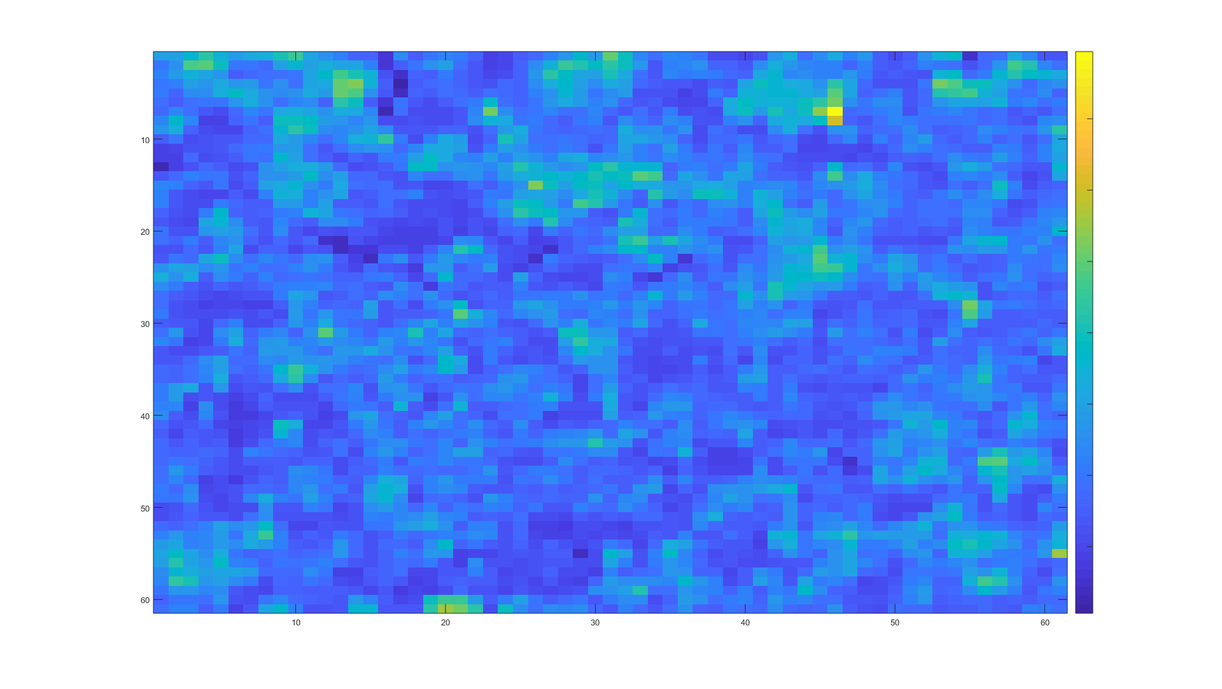
Average intensity of diffraction on the lattice
3
x10⁷
x10⁷
1,25
1
2,5
Scan 1
(002)/(020)/(200)
0,85
4
0,5
x10⁷
x10⁶
4
1,2
2
2,15
3
(111)
Scan 1
0,8
1,65
x10⁷
Atomic lattice
x10⁷
3
1,3
1
0,2
Scan 2
Scan 2
2
(220)
0,85
0,5
x10⁷
x10⁶
4
1,4
(200)
2
1,9
1
Superlattice
0,8
1,1

Slide 8
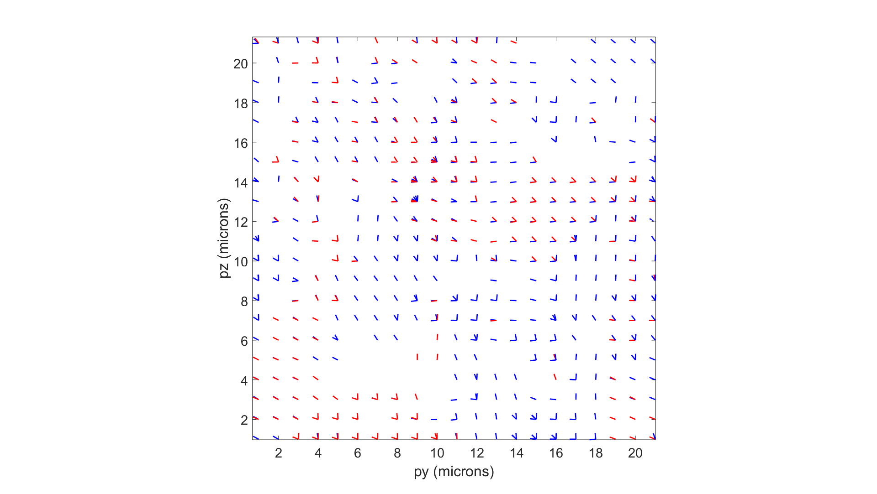
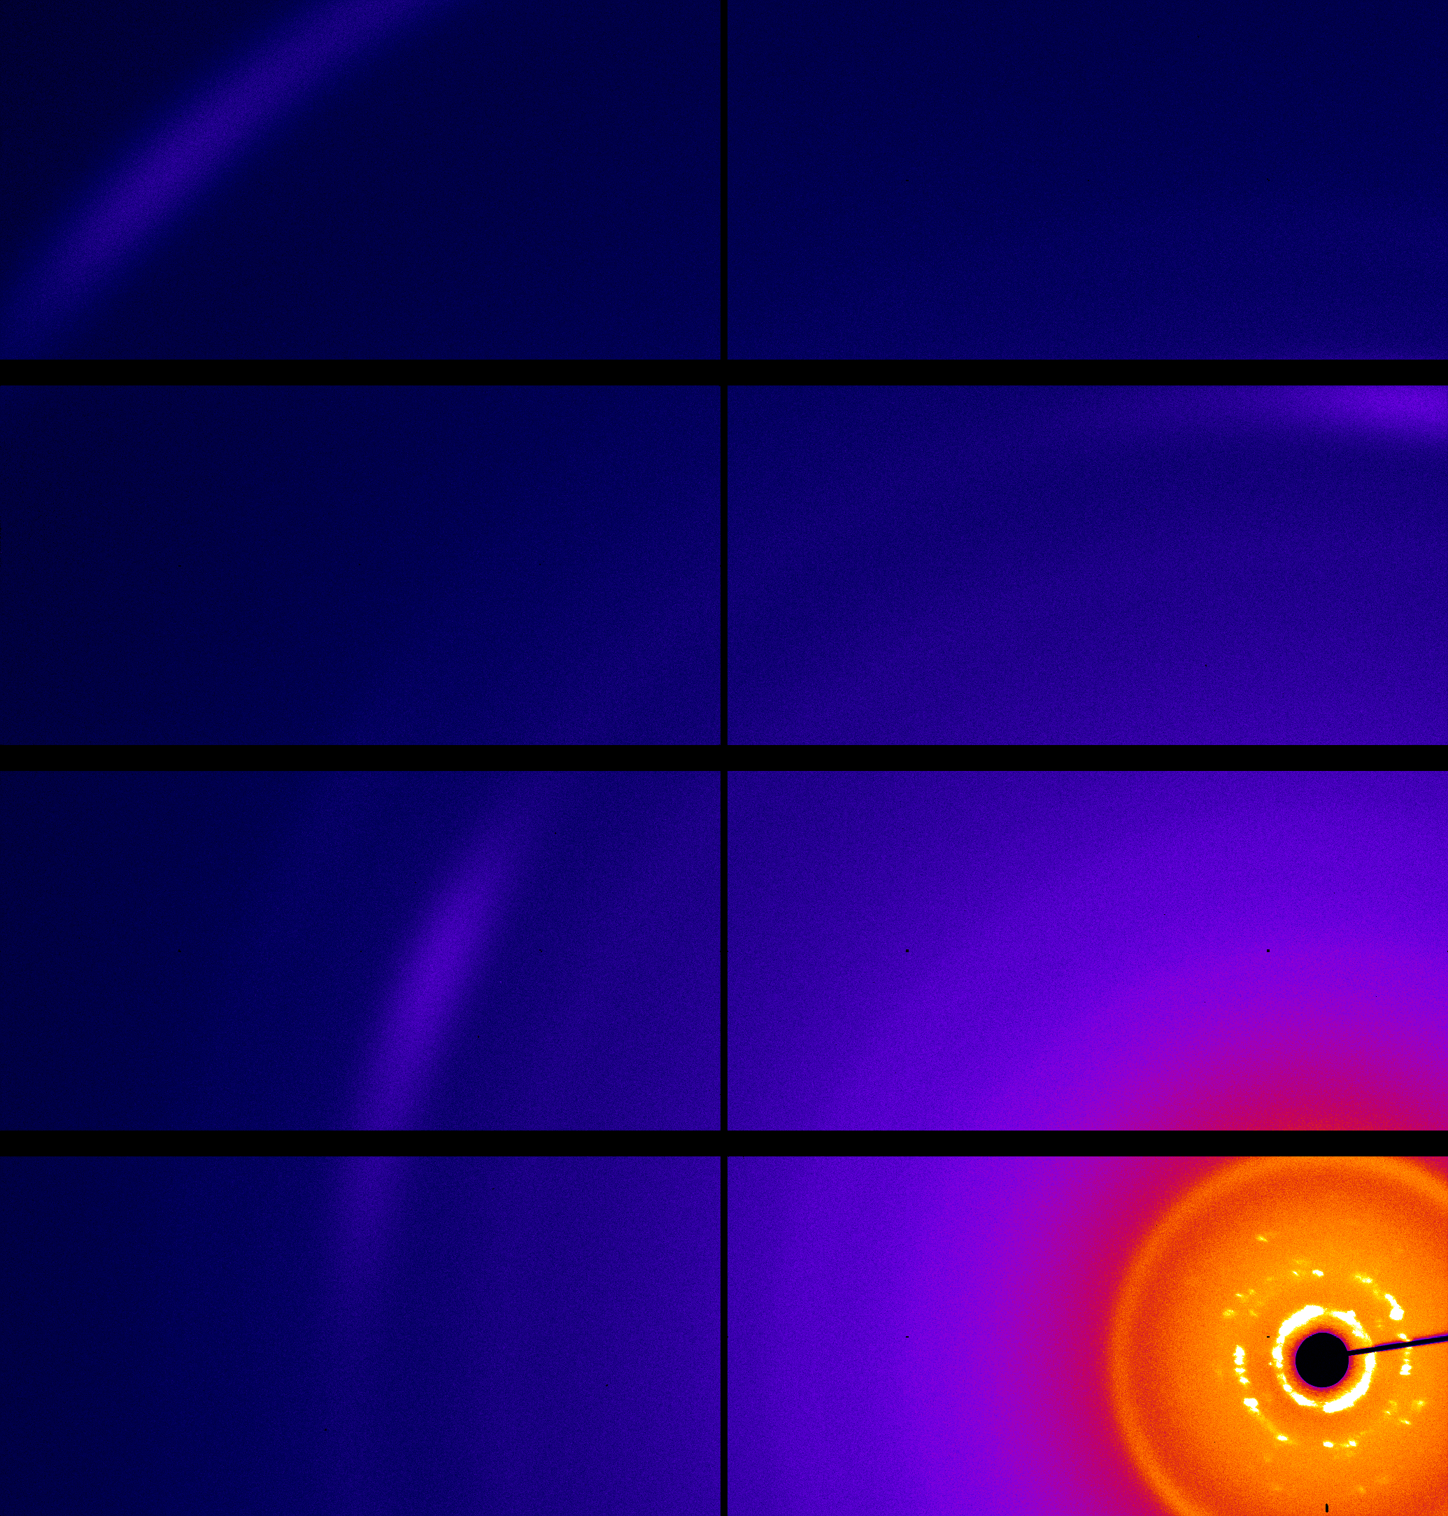
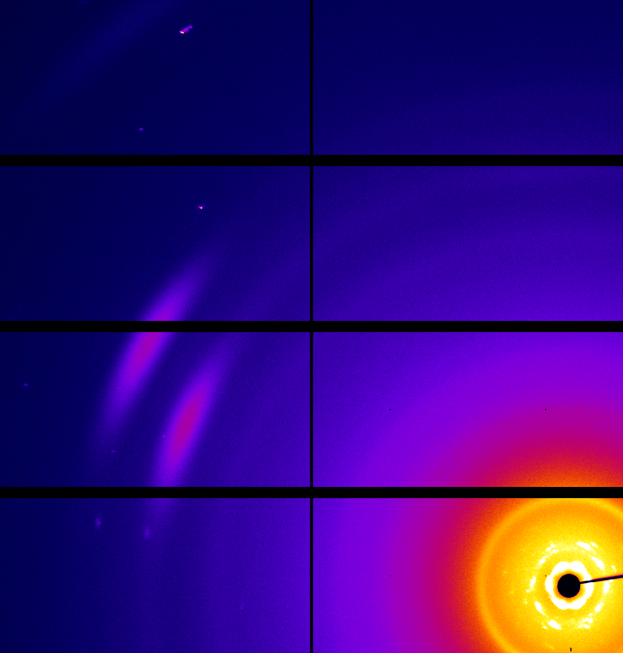
WAXS spatial resolved map (scan 1)
Blue lines correspond to peaks with q in the range (2,0; 2,2) Å⁻¹;
red – to (1,7;1,9) Å⁻¹.
(111)
(002)
(111)

Slide 9
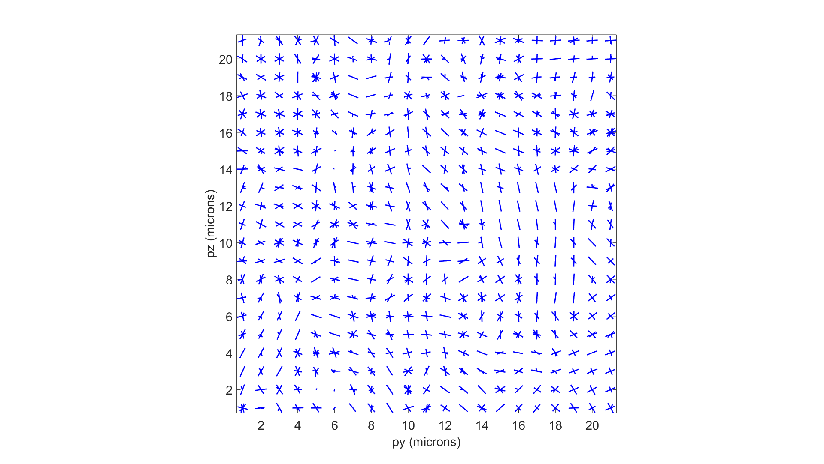
SAXS spatial resolved map (scan 1)
Blue lines correspond to peaks with q in the range (0,9; 1,0) Å⁻¹
(002)
(110)

Slide 10
Cross-Correlation Analysis
CCF calculation
$$C\left(q_{1},q_{2},Δ\right)=\int_{−π}^{π}{I\left(q_{1},φ\right)I\left(q_{2},φ+Δ\right)dφ=}$$
$$=\frac{\int_{−π}^{π}{I(q_{1},φ)W(q_{1},φ)I\left(q_{2},φ+Δ\right)W(q_{2},φ+Δ)dφ}}{\int_{−π}^{π}{W(q_{1},φ)W(q_{2},φ+Δ)dφ}}.$$
Mask
$$W\left(q,φ\right)=\left\{\begin{aligned}0, gaps, beamstop, detector edges \\ 1, otherwise\end{aligned}\right.$$
$$q_{1}$$
$$∆$$
$$q_{2}$$
$$φ$$
Averaging
$${〈C\left(q_{1},q_{2},Δ\right)〉}_{M}=\frac{1}{M}\sum_{i=1}^{M}{C^{i}\left(q_{1},q_{2},Δ\right)}$$

Slide 11
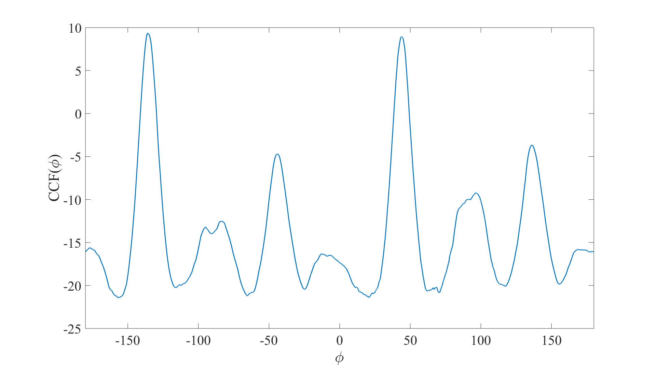
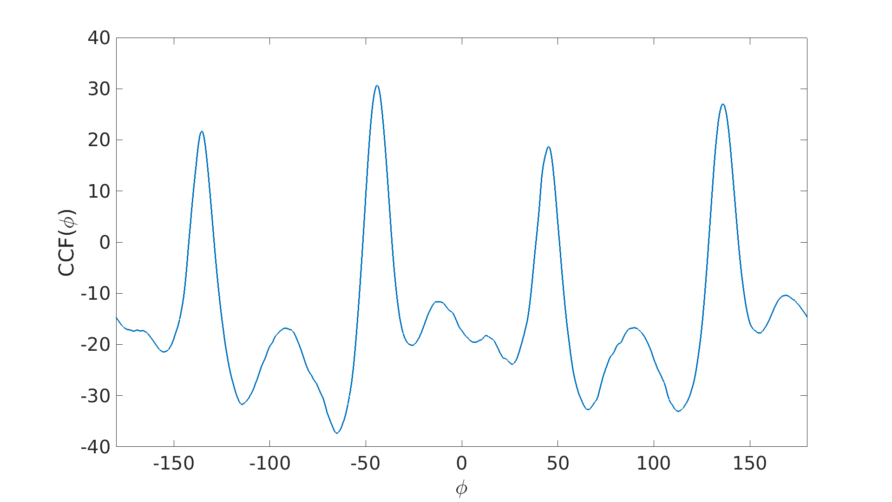
Cross-Correlation Analysis (q_{saxs-waxs1,} q_{saxs-waxs2})
Scan 1
-136° | 136°
-95° | 96°
-84° | 89°
-44° | 44°
Scan 2
-135° | 136°
-92° | 89°
-44° | 45°

Slide 12
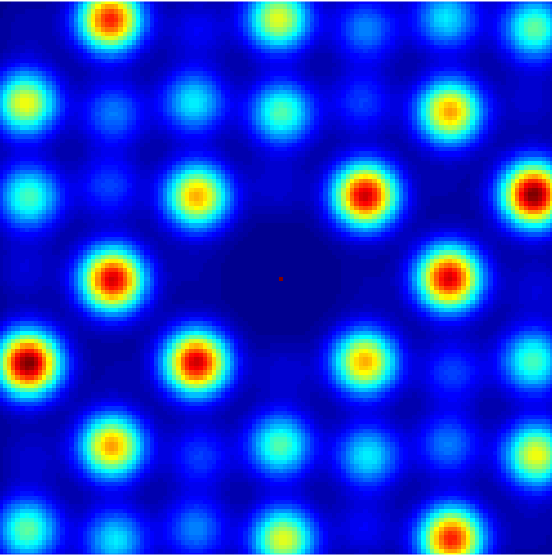
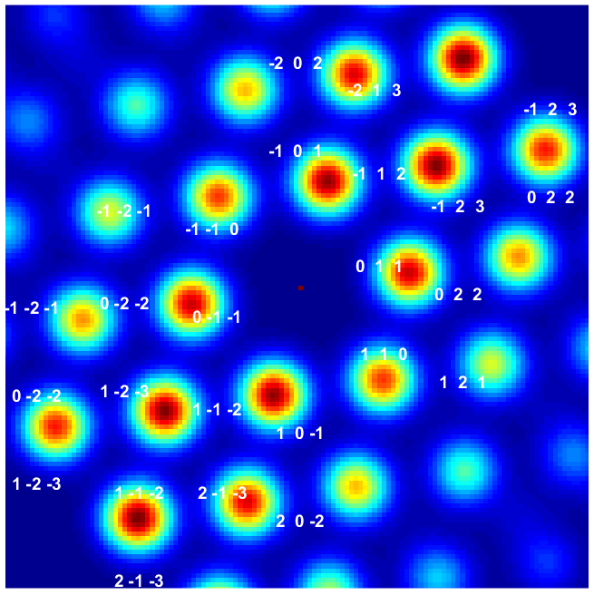
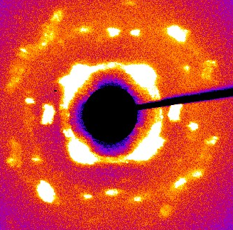
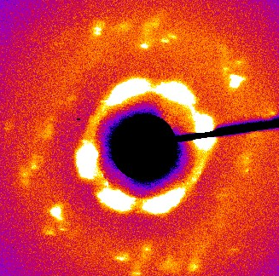
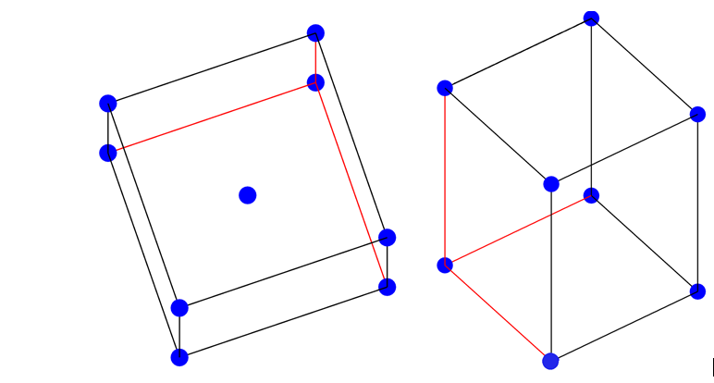
Two typical structures forming the sample
φ=54°
ψ=41°
φ=161°
ψ=80°
-2 2 0
-2 0 0
-1 -1 0
-1 1 0
-1 3 0
0 -2 0
0 2 0
1 -3 0
1 -1 0
1 1 0
2 0 0
2 -2 0

Slide 13
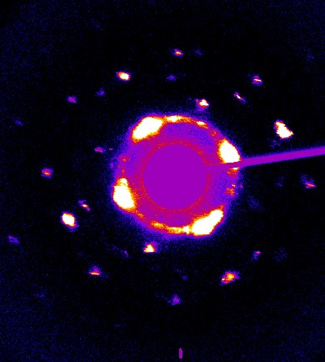
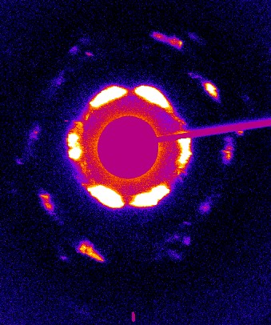
Peaks of diffraction patterns
($\overline{2}$02)
($\overline{31}0$)
($\overline{22}0$)
($\overline{3}1$0)
($\overline{13}0$)
($\overline{2}$00)
($\overline{1}$12)
(0$\overline{4}0$)
($\overline{2}$20)
(0$\overline{22}$)
(0$\overline{2}$0)
($\overline{11}$0)
($\overline{1}$01)
($\overline{11}$0)
($\overline{1}$10)
(011)
(022)
($1\overline{3}0$)
(0$\overline{11}$)
(1$\overline{1}$0)
(10$\overline{1}$)
(110)
(110)
($\overline{2}4$0)
($2\overline{4}0$)
(2$\overline{2}$0)
($1\overline{12}$)
(200)
($3\overline{1}$0)
(220)
($20\overline{2}$)
($4\overline{2}$0)
($3$10)

Slide 14
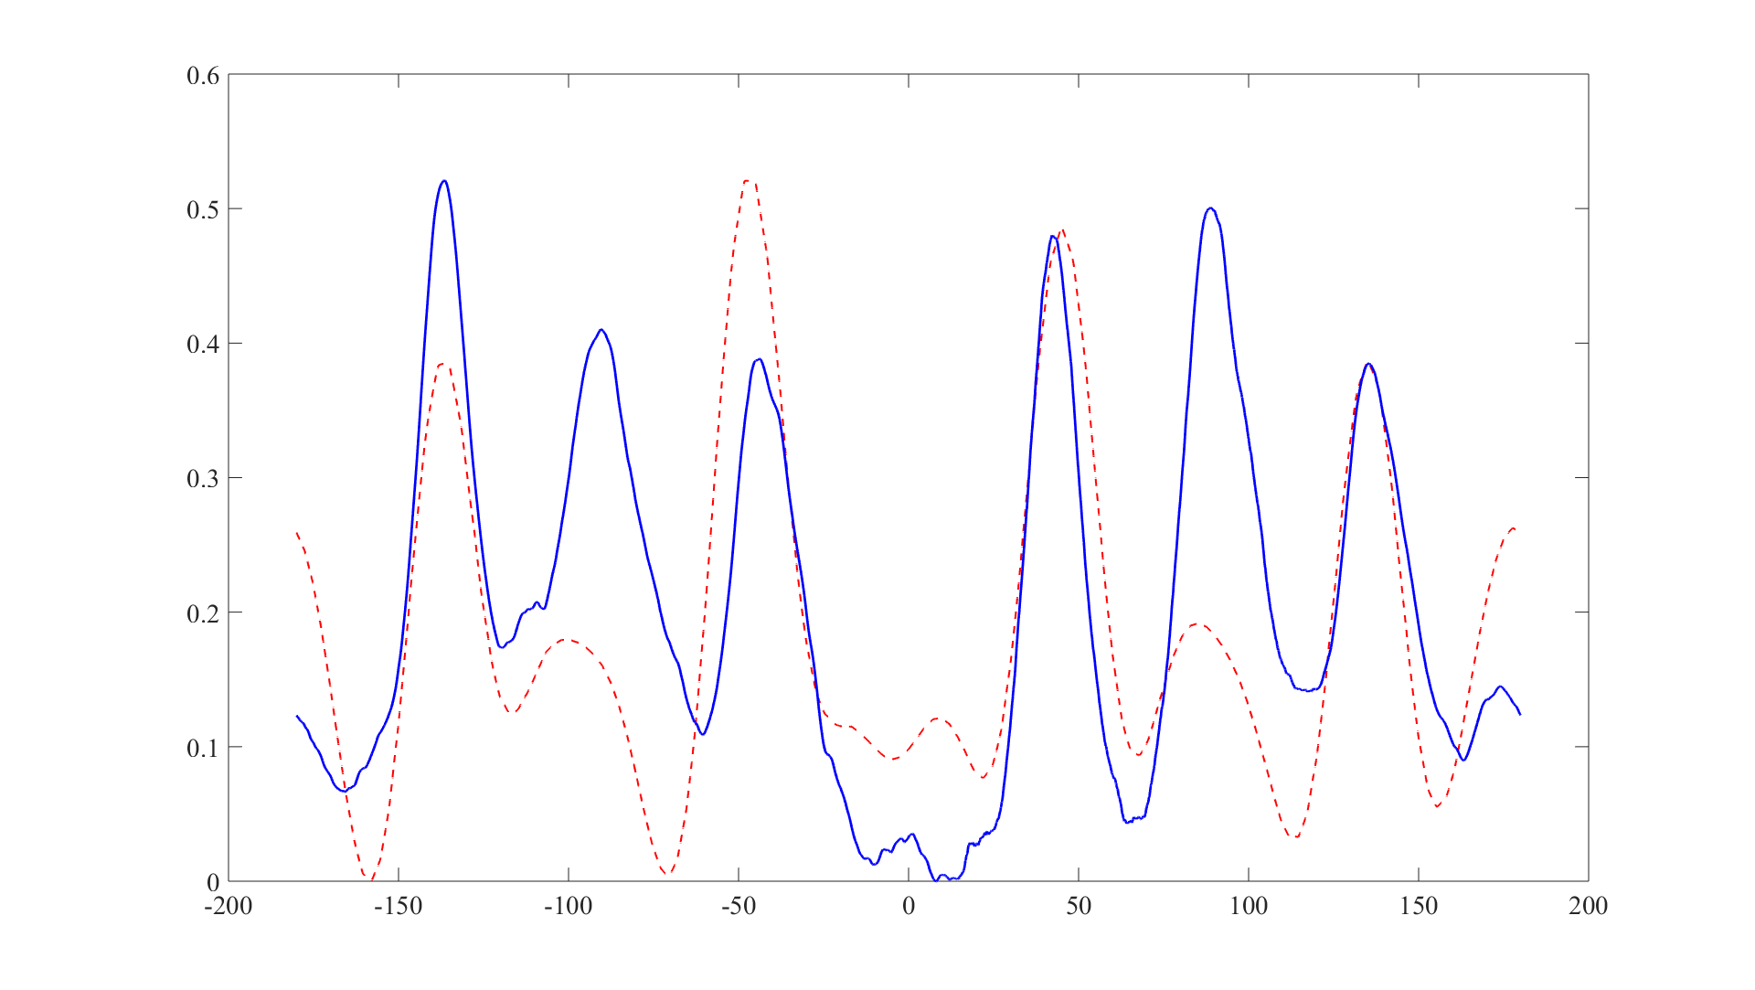
Model of CCF
CCF(φ)
φ

Slide 15
Results
We analysed two scans: 21x21 µm, 61x61 µm;
Calculated unit cell parameters and tetragonal distortion;
(104 Å, 135 Å; c/a=1,3);
No domains were observed;
XCCA was performed and CCFs show some structure and look similar for both scans;
We created models of two structures the sample mostly consists of;
Model of CCF and real CCF look the same what means that conclusions about structure, atomic lattice and sizes of unit cells are truthful;
Despite we cannot see any structure, XCCA shows that there are two preferable orientations of the lattice in the sample and in general the orientation between AL and SL is conserved.

Slide 16
Thank you for your attention!

