Slide 1
Analysis of Access and Transfer data for the dCache
mass storage systems at DESY
using Apache Spark
Presenter: Gunay Abdullayeva
Supervisors: Thomas Hartmann and Christian Voss

Slide 2
Content
Introduction to dCache
Introduction to Apache Spark
Parsing billing data(used Apache Spark)
Some analysis on billing data
Working with Kafka stream
Some analysis on stream data
Conclusion

Slide 3
Content
Introduction to dCache
Introduction to Apache Spark
Parsing billing data(used Apache Spark)
Some analysis on billing data
Working with Kafka stream
Some analysis on stream data
Conclusion

Slide 4
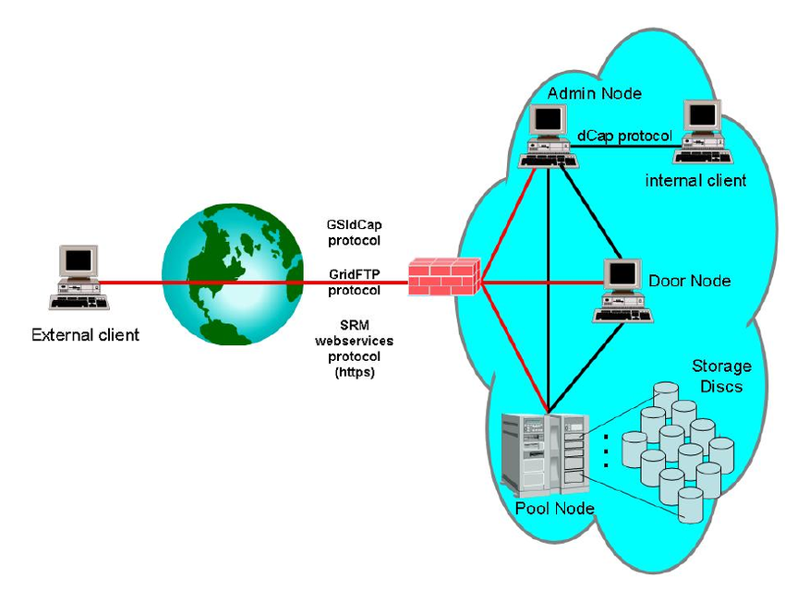
What is dCache?
dCache is a system which is used to store and retrieve large amounts of data.

Slide 5
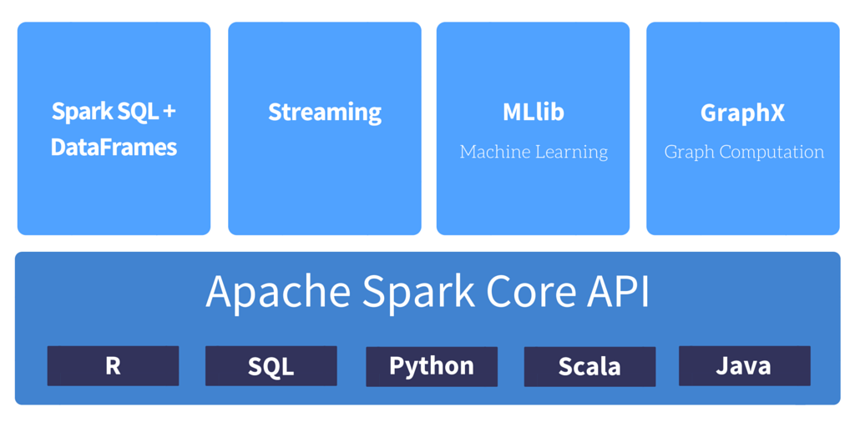
Apache Spark
Apache Spark is a fast and general-purpose cluster computing system

Slide 6
Billing Data
Transfer
Request
Remove

Slide 7
PySpark
sc_conf = SparkConf().setMaster('spark://os-spark-dev01.desy.de:9618') .set('spark.executor.memory','14G')
.set('spark.driver.memory','5G')
.set('spark.driver.maxResultSize','2G')
sc = SparkContext(conf = sc_conf)
sqlContext = SQLContext(sc)
data = convert_data('/Billing-Data/ATLAS/2018/*/billing-2018.*.*')
data.createOrReplaceTempView("dcache")
data.cache()

Slide 8
Data Frame

Slide 9
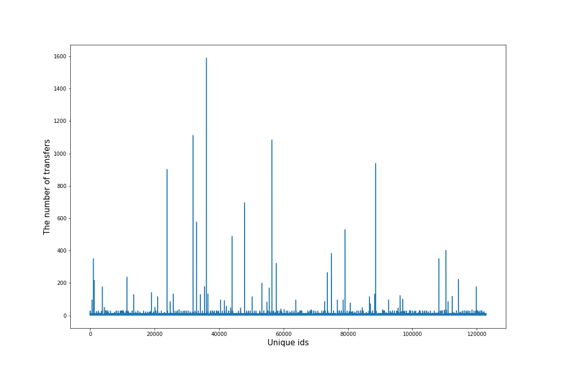
Analysis of Transfers in billing-2017.11.01

Slide 10
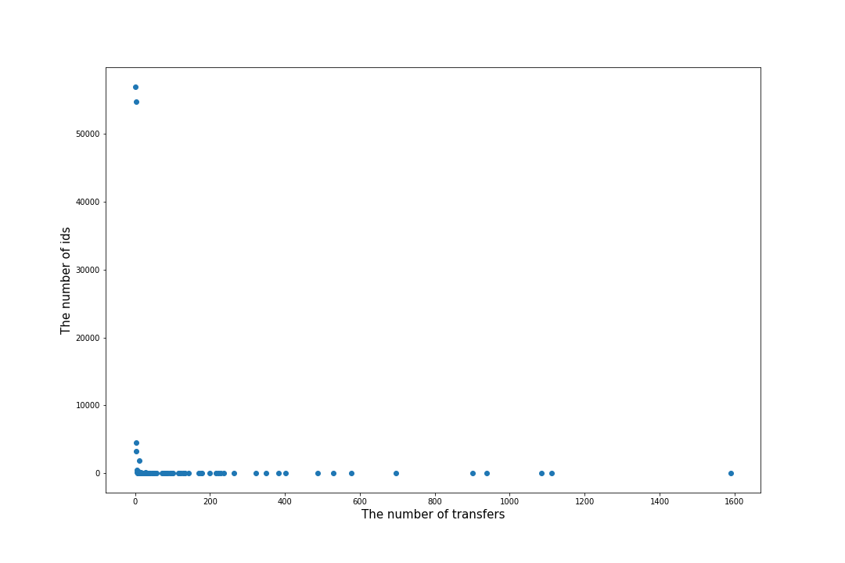
Analysis of Transfers in billing-2017.11.01

Slide 11
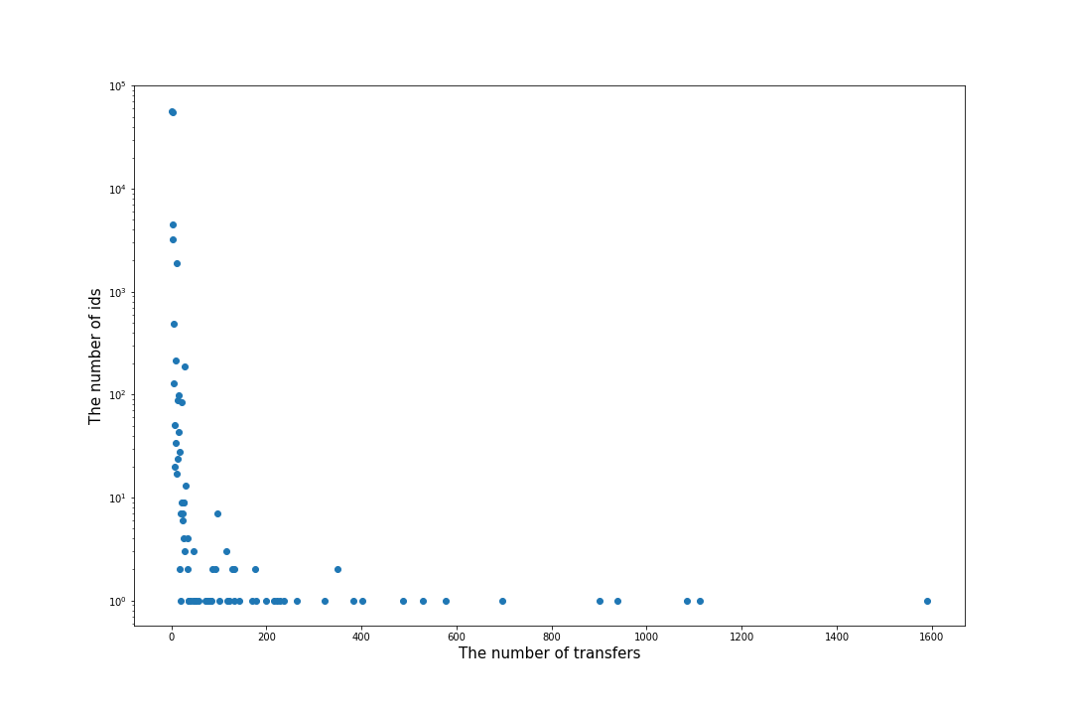
Analysis of Transfers in billing-2017.11.01

Slide 12
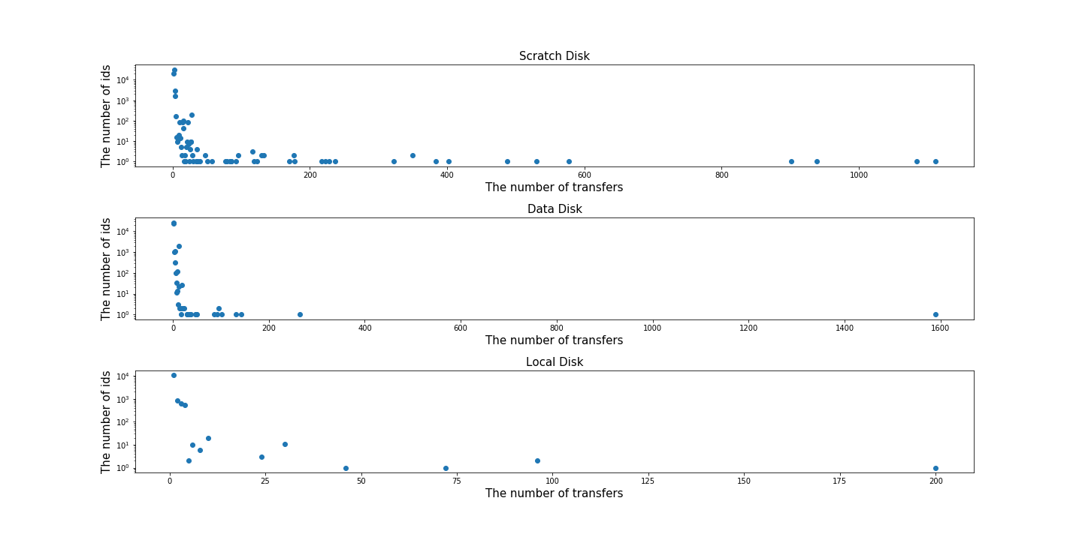
Analysis of Transfers in billing-2017.11.01

Slide 13
IP versions in the billing files
'131.169.161.229'
'2001:6a8:1080:0:0:0:b:154'
'2a00:8a60:1030:a00:0:0:863d:1a38:54398'

Slide 14
JSON structure
{ 'msgType': 'transfer',
'fileSize': 942200,
'transferSize': 942200,
'status':{'msg': '', 'code': 0},
'cellType': 'pool',
'transferPath': 'Unknown',
'session': 'pool:dcache-dot7-08@dcache-dot7-08Domain:15339-1390',
'protocolInfo':
{'host': '131.169.191.240',
'protocol': 'Http',
'versionMajor': 1,
'port': 0,
versionMinor': 1},
'initiator': 'pool:dcache-dot8-05@dcache-dot8-05Domain',
'meanReadBandwidth': 801808915.4950517,
'pnfsid': '0000DFE174F3A8594C5FB8429C7CC1D0AE67',
'date': 'Tue Aug 21 16:34:47 CEST 2018',
'billingPath': 'Unknown',
}

Slide 15
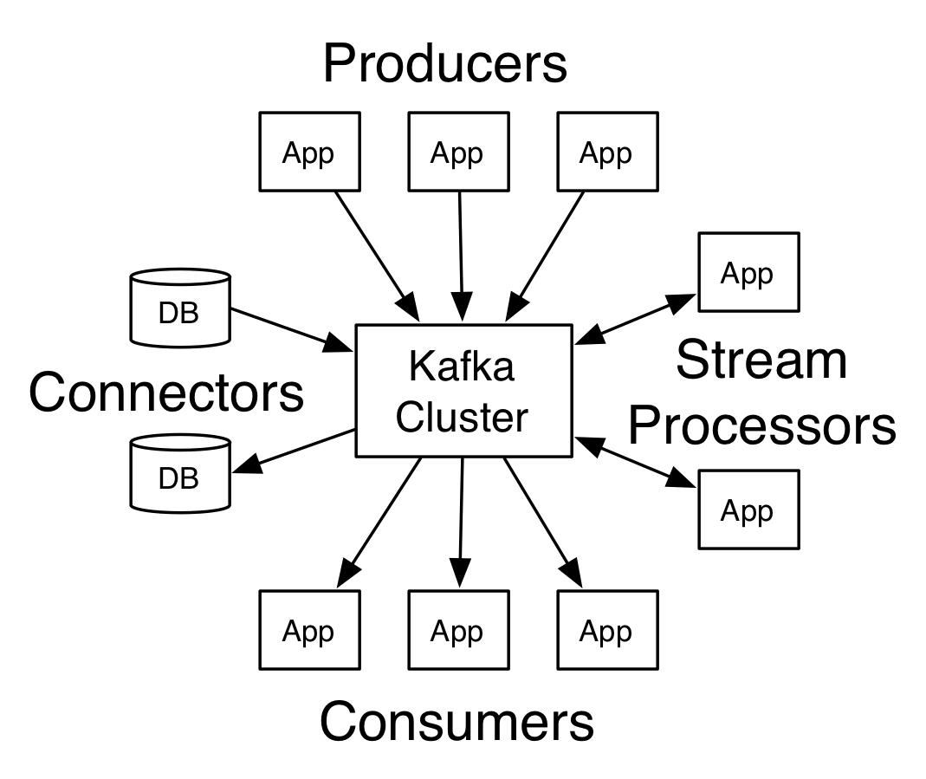
Kafka is generally used for building real-time streaming applications that transform or react to the streams of data.
Core APIs
Producer API
Consumer API
Connector API
Stream API

Slide 16
Kafka Stream Consumer
sc = SparkContext(appName="PythonStreaming")
sqlContext = SQLContext(sc)
sc.setLogLevel("WARN")
spark = SparkSession.builder.appName("ReadStream").getOrCreate()
ssc = StreamingContext(sc, 1)
kvs = KafkaUtils.createDirectStream(ssc, [“billing”],{"metadata.broker.list": "dcache-dot3:9092", 'auto.offset.reset': 'smallest'})

Slide 17
Stream data

Slide 18
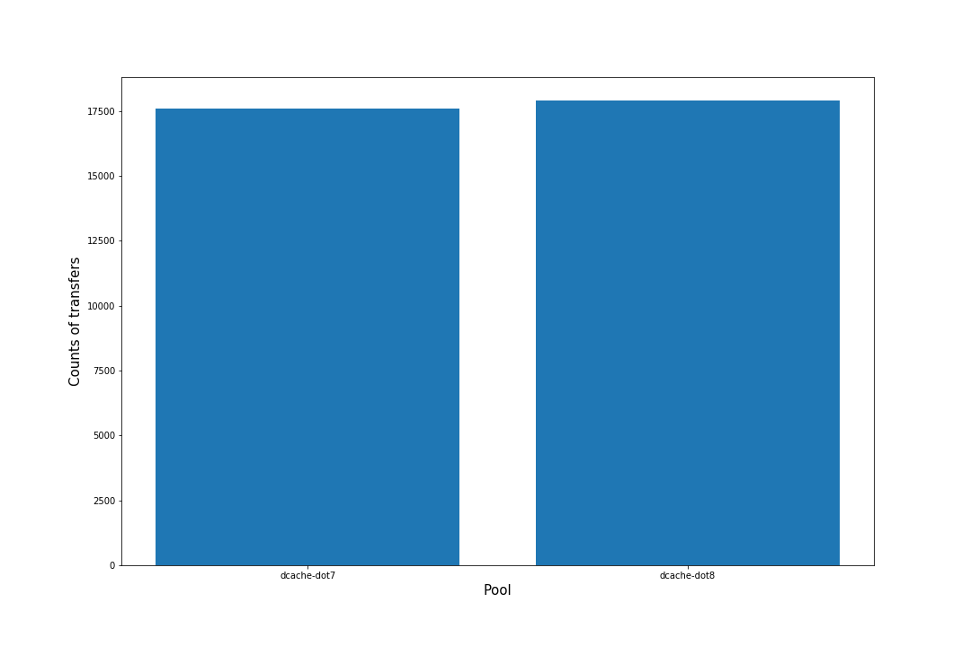
Analysis of Transfers on Stream data

Slide 19
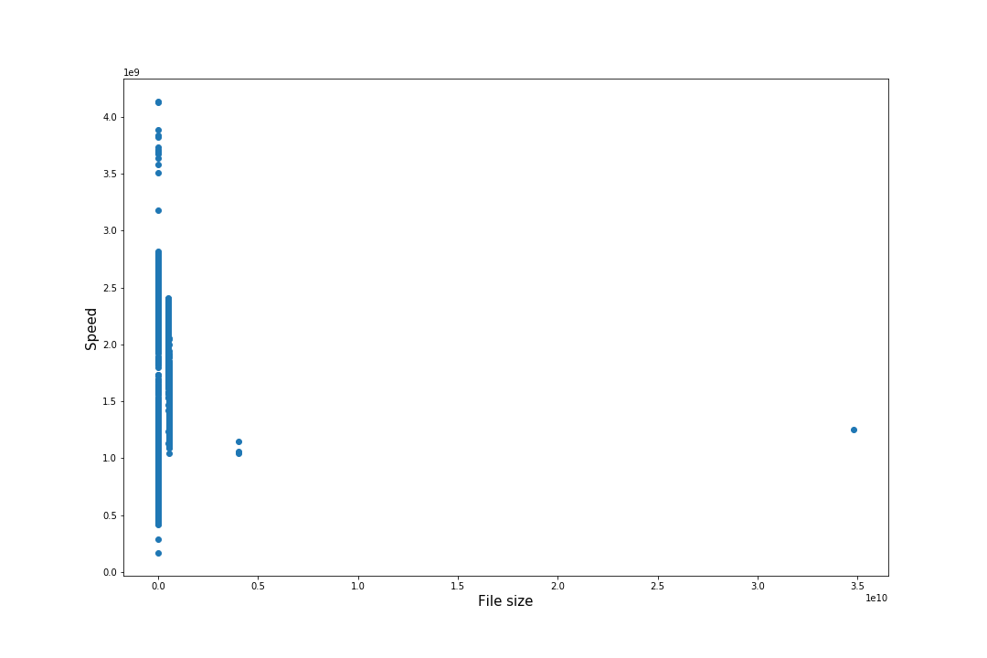
Analysis of Transfers on Stream data(store pool group)

Slide 20
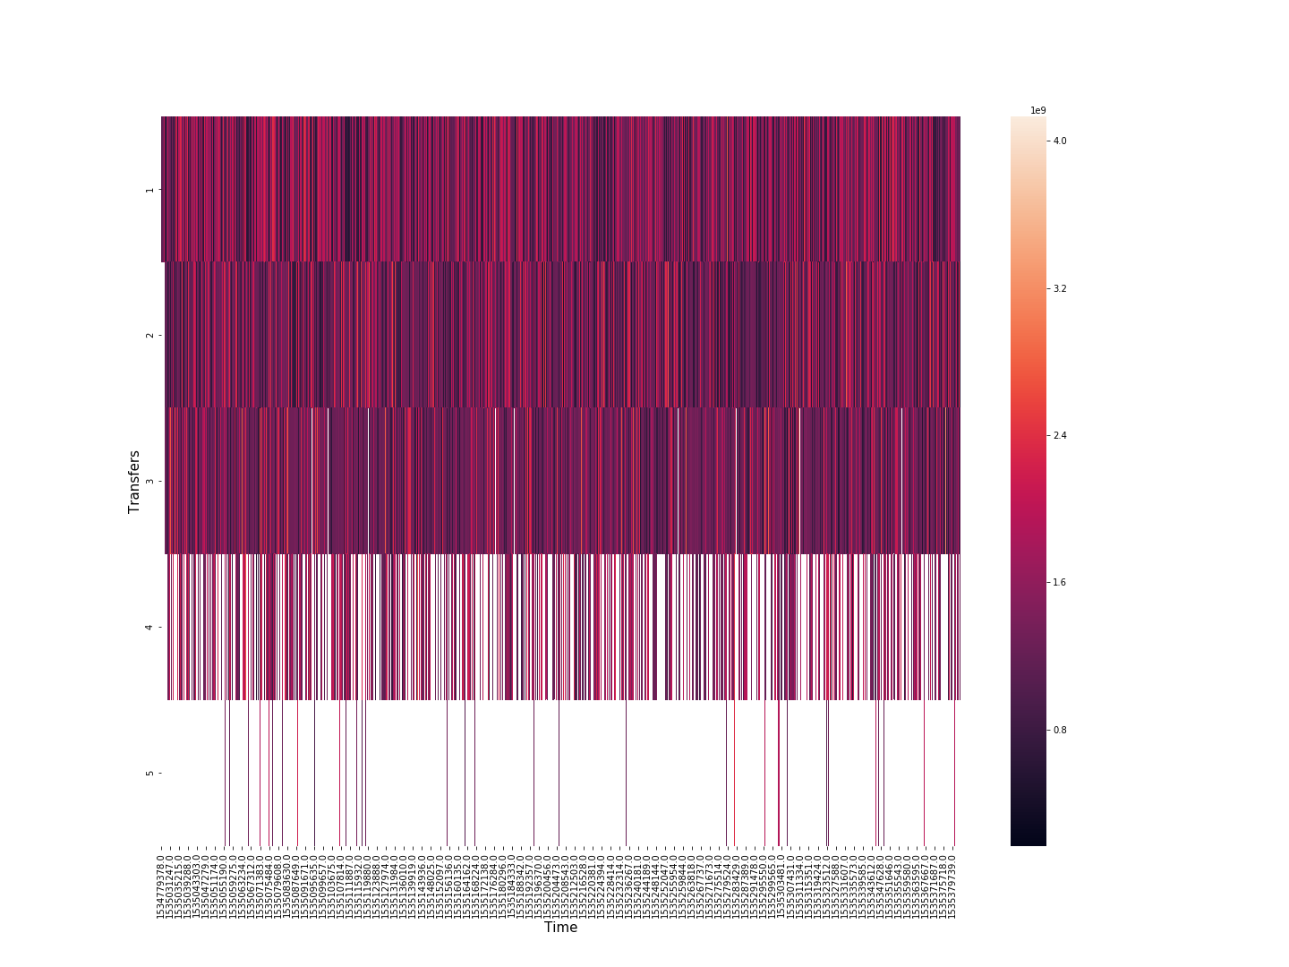
Analysis of Transfers on Stream data

Slide 21
Conclusion
Apache Spark is able to parallelize all processes on the executor nodes equally.
Apache Spark consume less memory and fast.
Parsing billing files took several weeks.
Using Kafka stream is better to work with JSON format.

Slide 22
Thanks for your attention :)

