Slide 1
Generation of narrow spectrum IR radiation for production of THz radiation.
Boris v. rumiantsev, Moscow state university, Russian federation
Supervisor: nicholas h. matlis, senior scientist leading experimental implementation of axsis project, cfel.

Slide 2
AXSIS project concept
> 5 keV X-rays
Acceleration of photoemitted electrons by singlecycle THz gun
Acceleration of electrons by multicycle THz wave
Undulation of electrons by IR-frequency radiation
Acceleration to the speed that is close to the speed of light
Increase of electrons energy
Inverse Compton scattering of IR photons

Slide 3
Why is the THz?
Microwave radiation
THz radiation
IR radiation
No damage under high field gradients.
Doesn’t require precision timing
Damage of metal details of a setup under high energy of a wave
Use of this radiation requires a very precise timing in a system

Slide 4
How to generate THz radiation
Difference frequency generation (DFG)
$$w_{THz}$$
$$w_{1}$$
$$w_{2}$$
$$w_{THz}$$
$$w_{1}$$
$$w_{2}$$
$$w_{THZ}$$
$$w_{3}$$
$$w_{1}$$
$$w_{2}$$
$$w_{4}$$
$$w_{THz}$$
$$w_{THz}$$
$$w_{THz}$$
$$w_{THz}$$

Slide 5
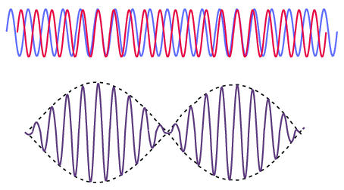
Required properties of IR radiation
Narrow spectrum
Many peaks in spectrum
$$I$$
$$A$$
$$τ_{1/e}$$
$$w_{THz} \sim 300 THz$$
$$Δλ_{1/e}$$
$$w_{1}\sim 300 GHz$$
$${10}^{−3}$$
$$w_{1}$$
$$w_{2}$$
$$w$$
$$w_{2} \sim 300 GHz$$
$$t$$
To make efficient amplification of a beat signal
100% of converted photons
0.1% of energy conversion
$$τ_{1/e}=500ps$$
$Δλ_{1/e}=3 pm$ – should make a narrow spectrum
Many peaks in spectrum for DFG

Slide 6
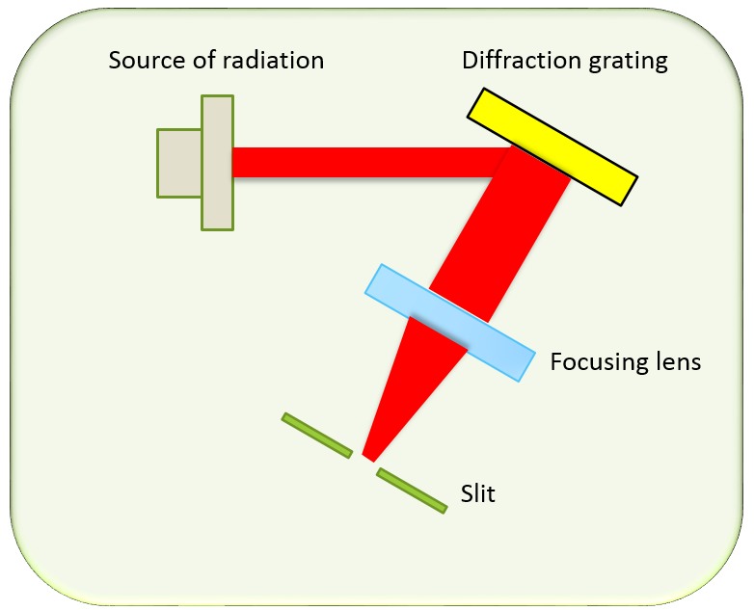
Methods of generation required IR radiation
Spectral filter
Cascaded Four wave mixing process
$$w_{THZ}$$
$$w_{1}$$
$$w_{2}$$
$$w_{THz}$$

Slide 7
Methods of generation required IR radiation
Spectral filter
Cascaded Four wave mixing process
$$w_{THZ}$$
$$w_{3}$$
$$w_{1}$$
$$w_{2}$$
$$w_{4}$$
$$w_{THz}$$
$$w_{THz}$$
$$w_{THz}$$

Slide 8
Methods of generation required IR radiation
Spectral filter
Cascaded Four wave mixing process
$$w_{THZ}$$
$$w_{5}$$
$$w_{3}$$
$$w_{1}$$
$$w_{2}$$
$$w_{4}$$
$$w_{6}$$
$$w_{THz}$$
$$w_{THz}$$
$$w_{THz}$$
$$w_{THz}$$
$$w_{THz}$$

Slide 9
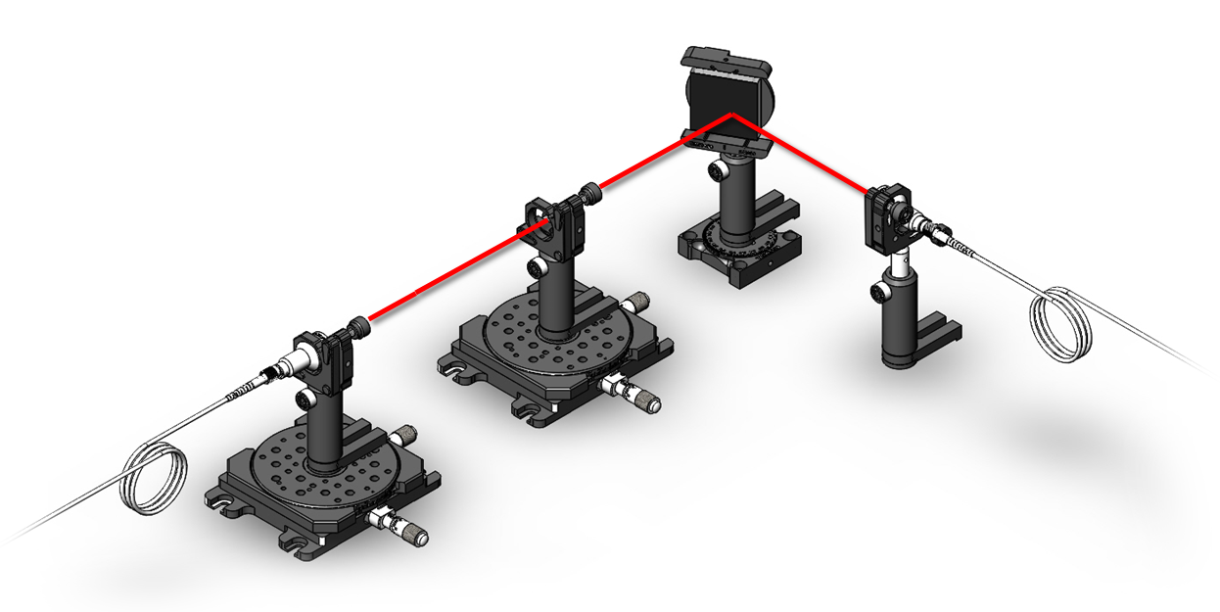
1st method: spectral filter
$$X_{focal plane}$$

Slide 10
1st method: spectral filter
$$X_{focal plane}$$

Slide 11
Experimental data
Parameters of a setup:
$Focal length of lens F=1 m$
$Radius of a slit R_{slit}=50 μm$
$Initial beam diameter w_{in}=0.9 mm$
Incident angle $θ_{i}={84}^{∘}$
Results:
Output spectrum width by experiment:
$$Δλ_{1/e^{2}}=750.9±3.4 pm$$
Output spectrum width by calculations:
$$Δλ_{1/e^{2}}=692 pm$$

Slide 12
Calculated parameters
For generation of narrow spectrum IR radiation one can use following parameters:
Density of lines on grating: $d^{−1}=1900 lines/mm$
Length of a grating = 75 cm
Size of a beam on grating is equal to length of grating
Focal length F = 10 cm
Radius of a slit is 2 times smaller than spot size of a wave with wavelength λ = 1030 nm

Slide 13
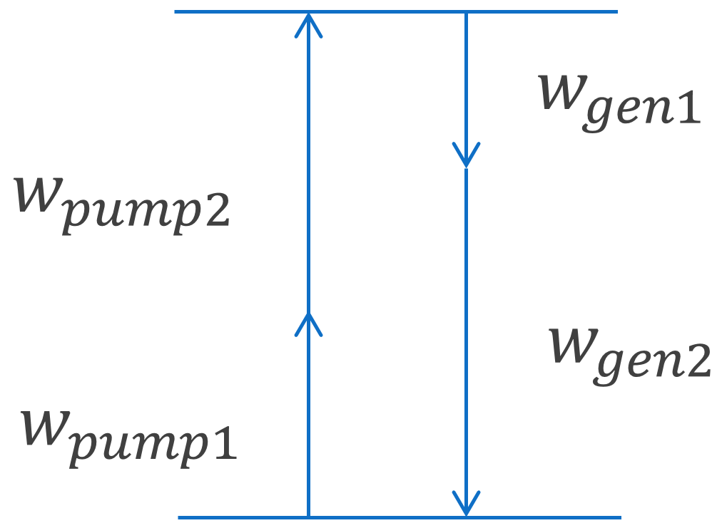
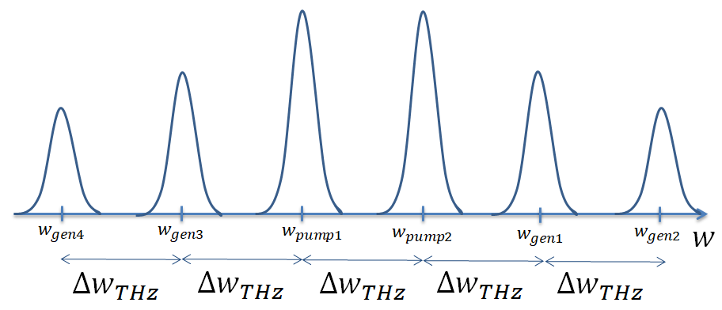
2nd method: cascaded four-wave mixing

Slide 14
Theory of cascaded four-wave mixing
Phase-matching conditions in a photonic crystal fiber:
Input:
two pump harmonics
Output:
N(L) generated harmonics
Length of a fiber L

Slide 15
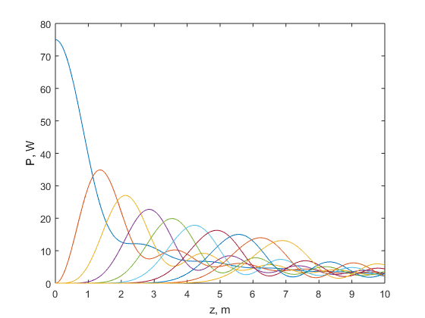
Results of calculation
Nonlinear Shroedinger equation near zero dispersion frequency of a fiber ($β=0$):
Dependence of one pump harmonic and nine generated harmonics on propagation distance in a fiber.

Slide 16
Thank you for your attention!

