Slide 1
LUXE
Laser Und XFEL Experiment
Tests of QED in strong-field regime with electron-photon interactions

Slide 2
Location at the XFEL
End of UN2 Begining of Dump
3039 m – 3145 m
(660 m)
(137 m)
XTD7
(204 m)
XTD5
UN1
XS4
UN2
XTD8
XTD3
(263 m)
(365 m)
(480 m)
(595 m)
(546 m)
XS1
(301 m)
(221 m)

Slide 3
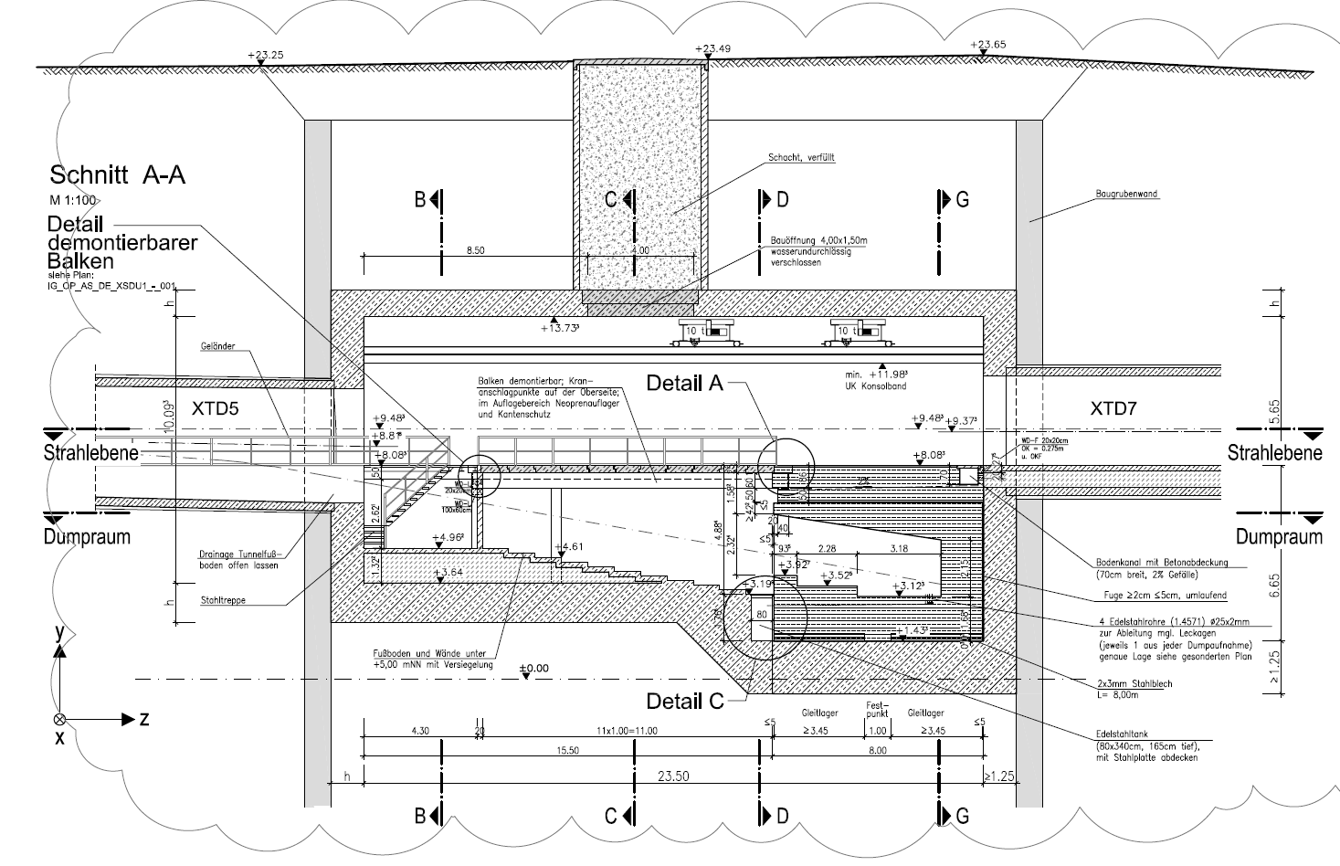
Dump Area

Slide 4
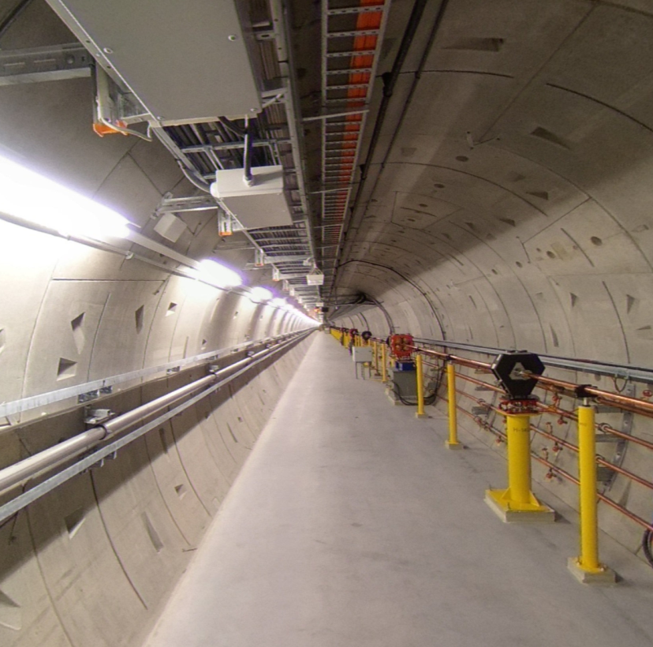
XTD5 tunnel
http://xfelmd.desy.de/vtour/

Slide 5
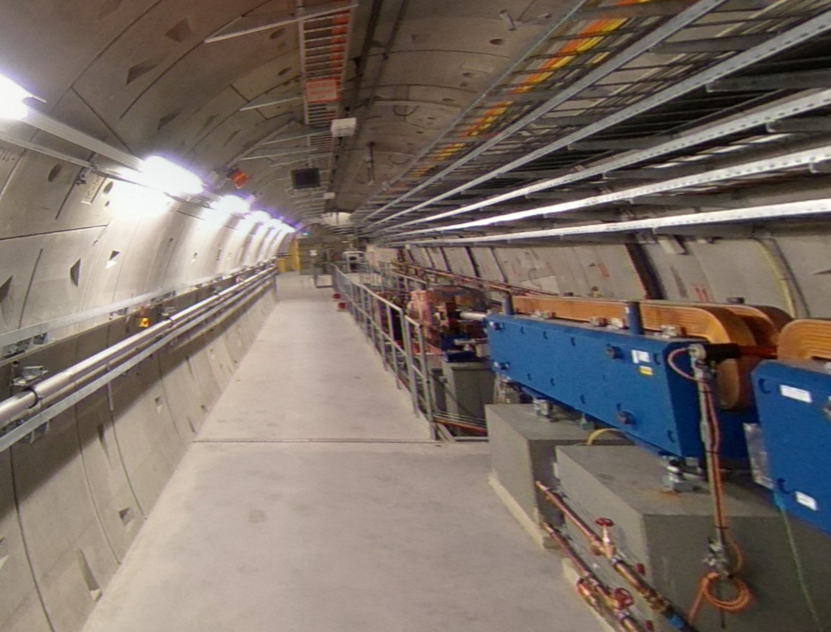

Slide 6
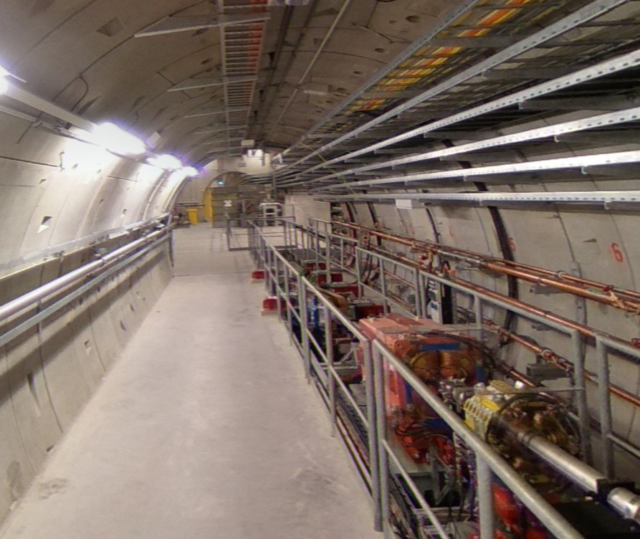

Slide 7
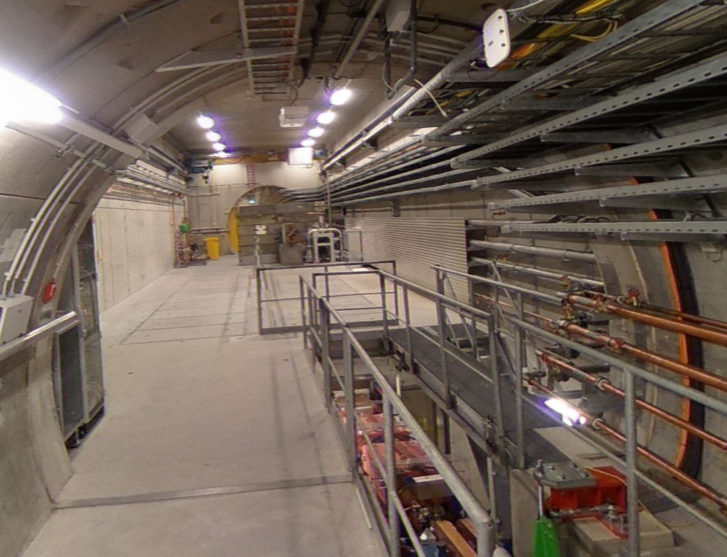

Slide 8
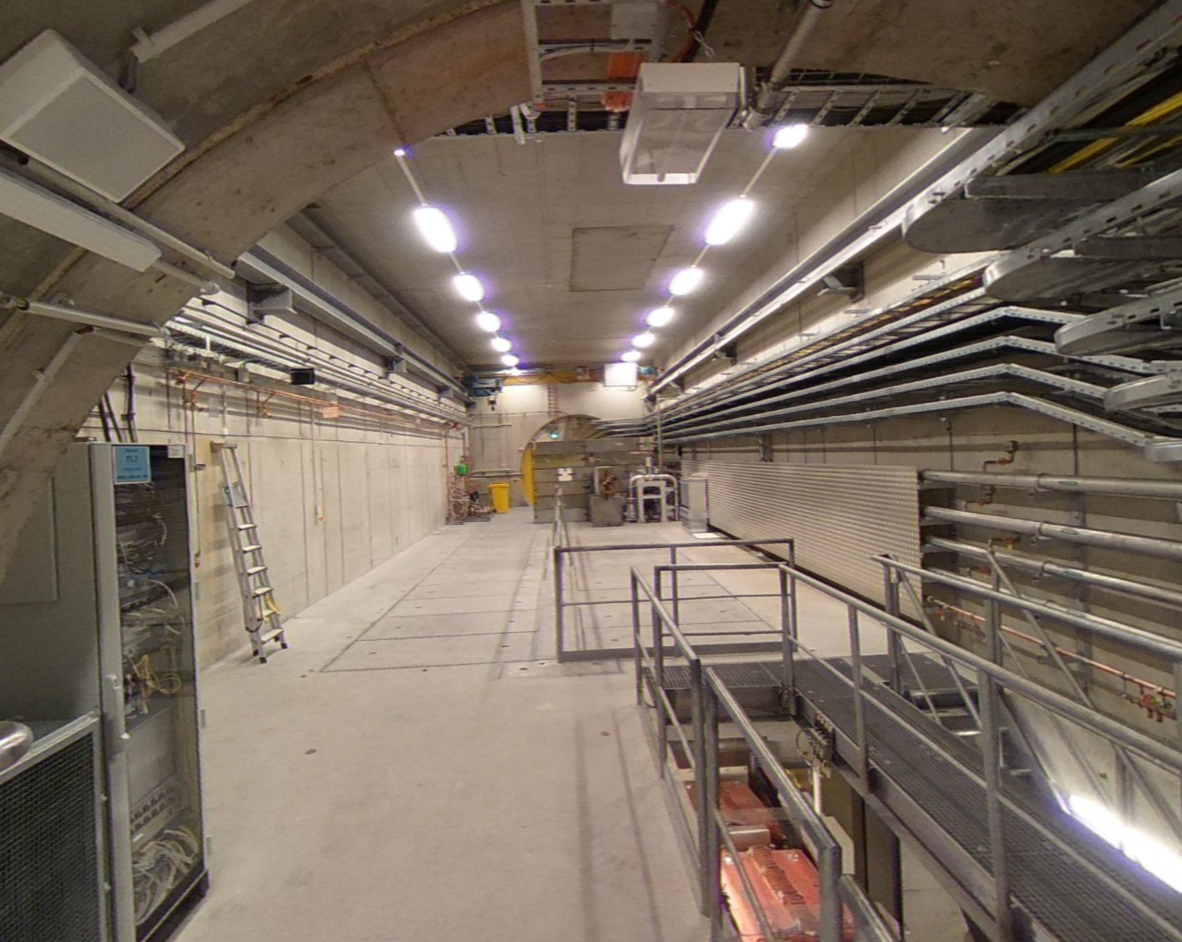

Slide 9
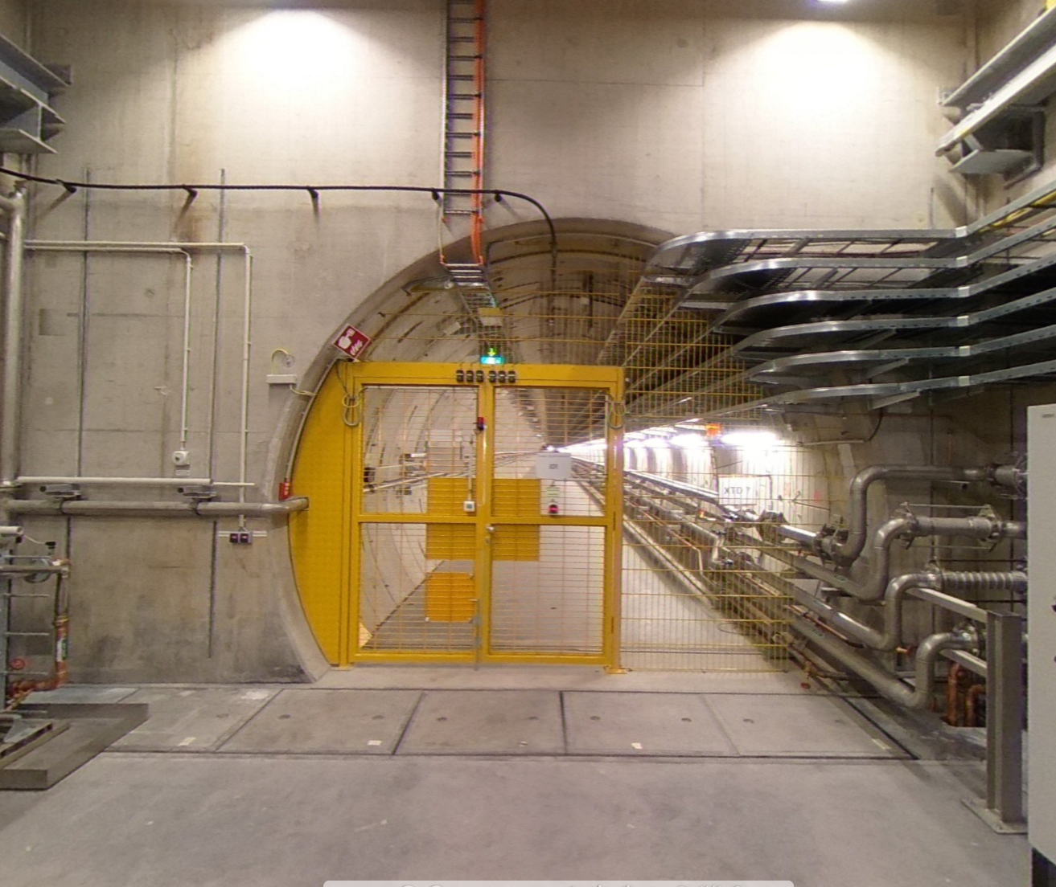

Slide 10

Old layout
β collimation
photoconverter
Dillution magnets
e-/gamma separation
IP
Collection solenoid
e+
UN2
e+
dump
e-
Option 1:
Parasitic downstream of UN2
  Separation between Gammas and e- needed
  Space constraints ( to UN2 and dump line)
  Machine protection issues.
photons
δ collimation
e-
e+

Slide 11
Dump Area
http://xfelmd.desy.de/vtour/

Slide 12
Option 1
β collimation
photoconverter
Collection solenoid
e+
Fast Kicker Magnet
e+
Final Focus
IP
XTD5
e-
dump
Dillution magnets
photons
e-
Single bunch kicker helps machine protection.
Space efficient design – new location with crane.
Kicker and Septa design can be copy-pasted.
e+

Slide 13
Option 2
photoconverter
e+
e+
Fast Kicker Magnet
IP
γ
XTD5
e-
dump
Dillution magnets
photons
e-
e+
Photoconverter: Foil

Slide 14
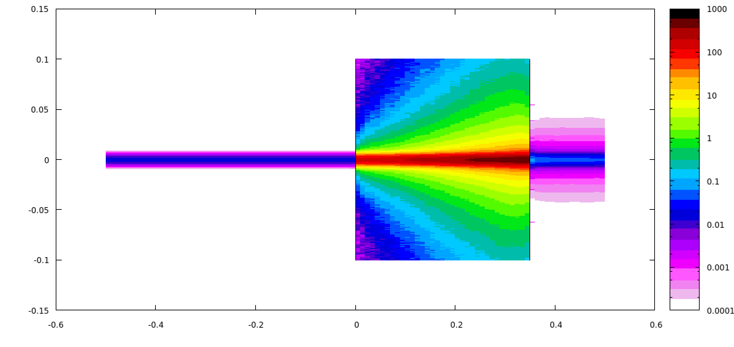
Foil survival
Tungsten, 0.35 cm, 30 μm e- spot size
T: 350 K
Pressure waves??
Transversal (cm)
E_{dep} (GeV/cm³/e⁻)
Cp, Tungsten: 133.9 J kg-1 K-1
beam direction (cm)

Slide 15
Next steps
Option 1 or 2 or both?
  Easy installation
  Safety passage
Optics
  Beam quality after UN2.
  Final focussing needed?
  Optics
  Beam Instrumentation
Magnet choice
  Fast kicker
  Septa needed?
IP design
  Laser beamlines and laser lab?
Required shielding
  Single Bunch Dump
  Radiation protection
  Background

Slide 16
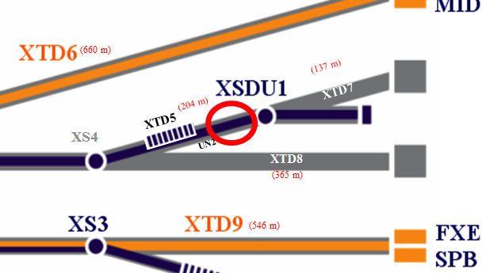
Questions to be solved
from TC point of view
Laser
Laser position
e-Beam
Beam parameters
Magnet structure
Vacuum system
Infrastructure requirements
Space availability
Power
Cooling water
IT
Laser duct
Further Infrastructure planning
List of components/electronics (Racks Inventory)
Dump, MPS and Personnel Safety requirements
Radiation protection for electronics
IT (LWL), Cabling and Cooling Water

Slide 17





Acknowledgements
R. Assmann, T. Behnke, R. Brinkmann, W. Decking, A. Hartin, I. Hartl, B. Heinemann, J. List, E. Negodin, A. Ringwald, M. Wing, …
Thank you

