Slide 1





Searching for new physics with displaced vertices: Technical Challenges at the Lifetime Frontier
$$b$$
$$\overline{b}$$
$$π_{v}$$
H
G. Watts (UW/Seattle)
July 4, 2018

Slide 2
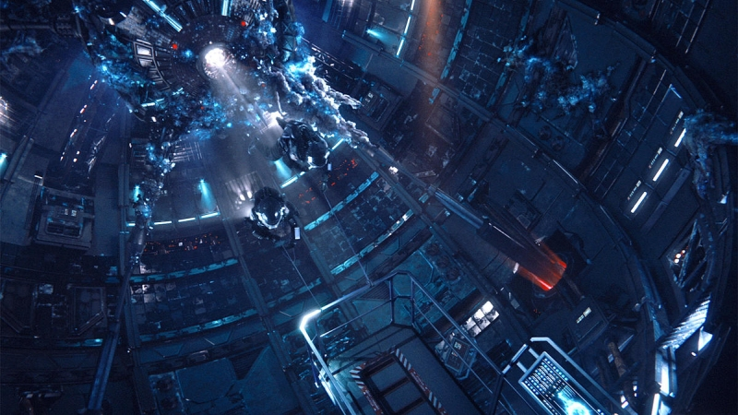
Introduction

Slide 3
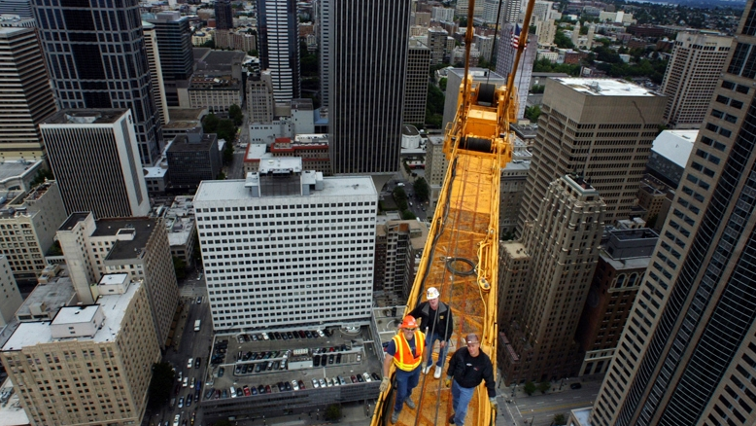
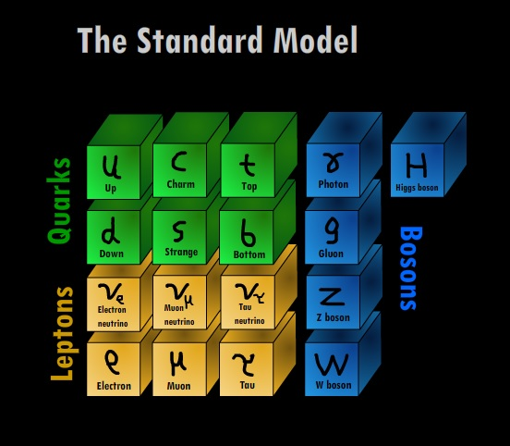
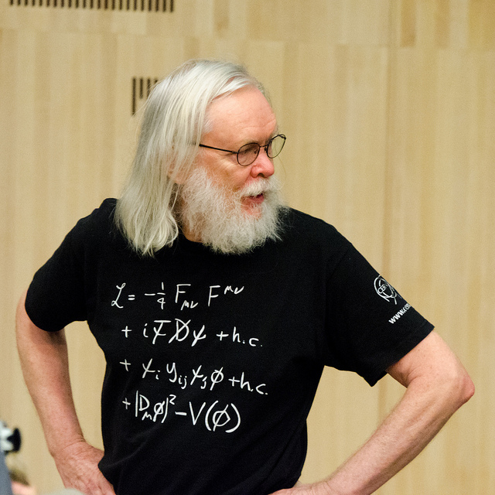
2012 We completed the Standard Model
Notes:
We live in a world surrounded by things we’ve built, and matter we understand. This extends even to the stars, where we understand almost everything we can see. This is all, of course, encoded in the Standard Model – the particles and the Lagrangian. And while there is a lot of work left to do on this, I want to concentrate on things we know we don’t understand in the context of the Standard Model.
BUT

Slide 4
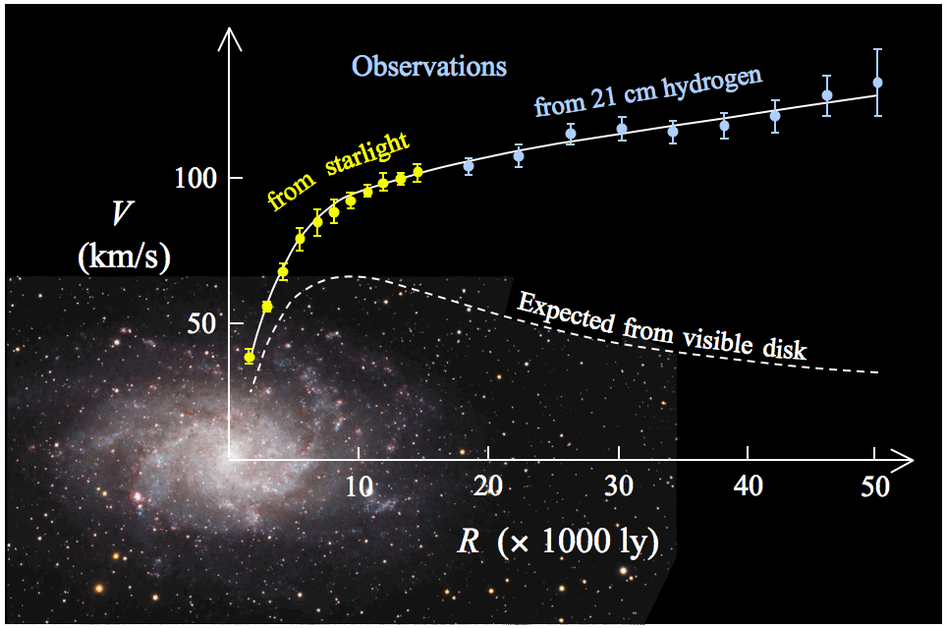
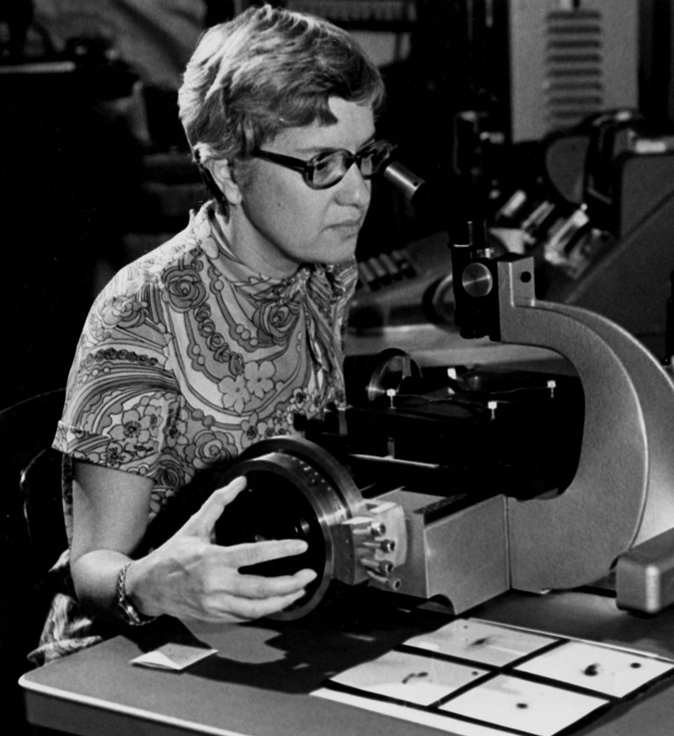
Milky way (100K l.y.)
Dark Matter
Notes:
Dark matter is perhaps the largest known oversight in the SM (and there is also dark energy). That is a younger Vera Rubin, died in 2016, before she got a nobel prize many people thought she should have gotten.

Slide 5

Super Symmetry
Little Higgs Model
String Theories
Extra Dimensions
Supergravity
Grand Unified Theories
MSSM
WIMPS
Higgs Doublet
Hidden Sector Models
$$SU{\left(3\right)}^{3}$$
Axions

Slide 6
Why Massive Neutral Long Lived Particles?
Almost every BSM theory accommodates them (some require them).
Some recent papers:
Mini split supersymmetry (arXiv:1212.6971)
Gauge mediation (arXiv:hep-ph/9801271)
RPV (R-parity violating) SUSY (arXiv:1309.5957)
Models of Baryogenesis (arXiv:1409.6729)
Hidden Valleys (arXiv:hep-ph/0605193)
Dark Photons/Z (arXiv:1604.00044)
Theories of Neutral Naturalness (arXiv:1512.05782)
Models generating neutrino masses (arXiv:1604.06099)
Exotic Decays of the Higgs Boson (arXiv:1312.4992)
Lots of different possible detector signatures!
Motivated by the signal model

Slide 7
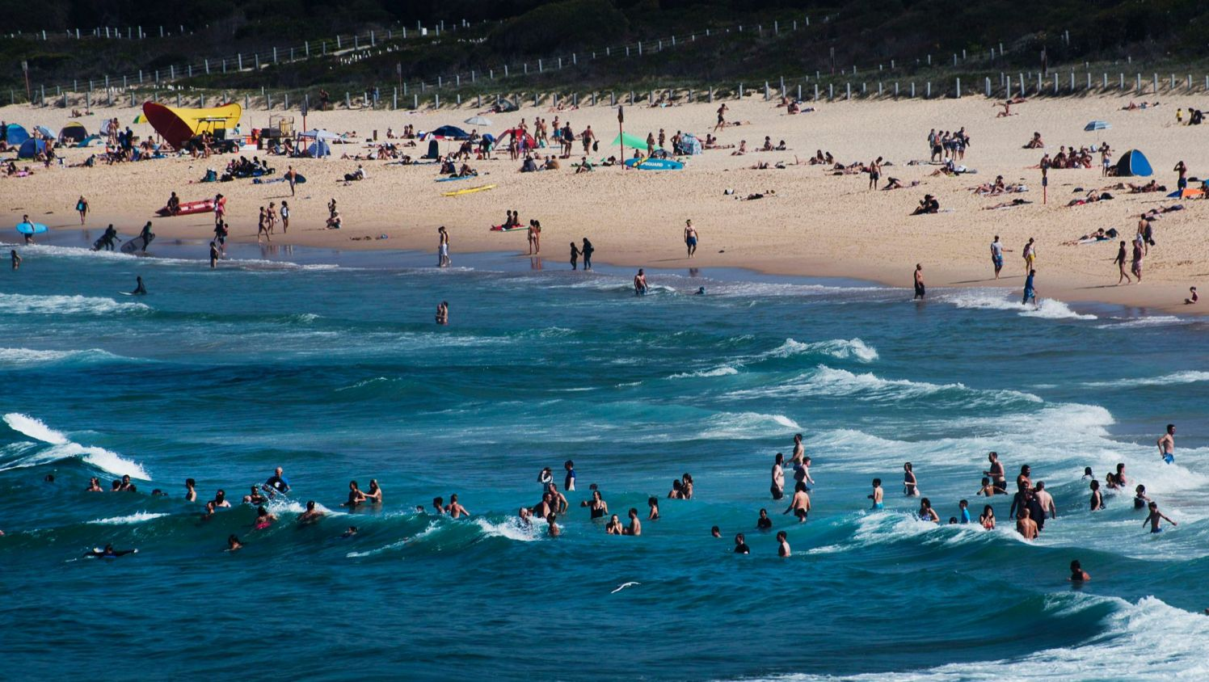
Why Massive Neutral Long Lived Particles?
SUSY
LLPs
Notes:
Fix up with more arrows

Slide 8
What Governs the Detector Signatures?
Mixing
LHC (Run 2)
Physics of the Hidden Sector/Valley
Energy
SM
Tunneling/Mixing
Standard Model Particles
Notes:
And to have some sort of SM result – so they weren’t just a MET signature.

Slide 9

Analysis Strategy
Driven by the production and decay operators in the theory
Have We Covered Them All?
This was the slide I used a few years ago…
LLP Only Production
$$φ→π_{v}π_{v}$$
Often produced in pairs
LLP’s were relatively unexplored
Hidden Valley
Neutral Naturalness
Associated Production and Decay
LLP is produced in association, or the decay contains other objects
Theorists have been active…
Jets – Colored Object
Leptons – EW interactions
Weak Bosons – Associated production
etc.
Notes:
Life-time is a free parameter - essentially

Slide 10






What Governs the Detector Signatures?
Mass of the long-lived scalar
Is $f$ a lepton? B-quark?
$$f$$
Hidden Sector phenomenology
$$\overline{f}$$
$$X$$
Missing $E_{T}$?
$Φ$ pair produced? Quadruplets?
Do all $Φ$ have same proper $cτ$?
What is the lifetime of the $Φ$?
$$Φ$$
We started with “is it displaced lepton-jets or hadronic jets?”

Slide 11
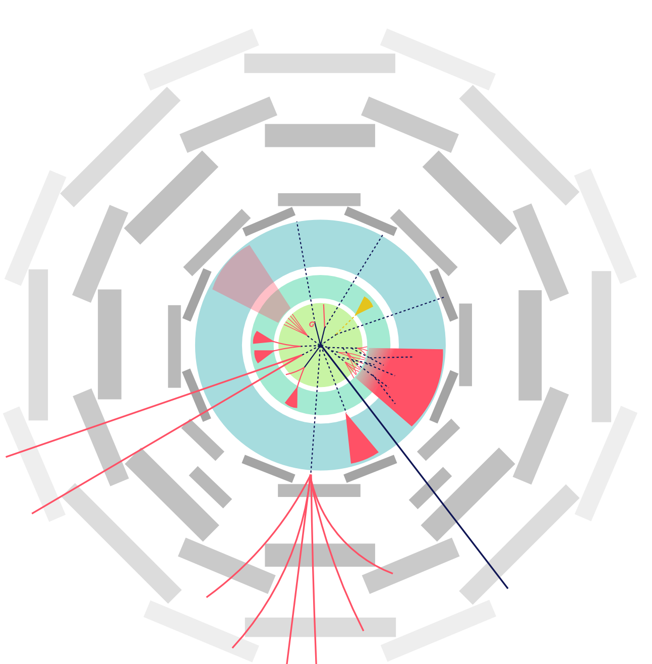
What Governs the Detector Signatures?
Inner Tracker green
EM Calorimeter Blue/green
Hadronic calorimeter Blue
Muon system Grey
7
5
8
Displaced decay signatures
Decay in muon system - jet
Two body decay (lepton jet)
Decay in HCAL to h-jet
Emerging jets
Inner Tracker decay – EM jets
Decay to h-jets in the IT
Disappearing (invisible) LLP
Non-pointing γ -> e⁺e⁻
Decay in the ECal
6
2
4
9
3
1
Any one of these would be a signal for new physics!

Slide 12




Long Lived Particles
Lifetime is both a blessing an a curse
$cτ$ (proper lifetime)
0 m
${10}^{1}$ m
${10}^{7}$ m
Big Bang Nucleosynthesis Limit
No real constraint on their proper lifetime from theoretical bounds…
Production in the early universe can alter relative abundances of heavy elements
Observation of current universe leads to an upper limit of $\sim {10}^{7}$ m.

Slide 13



Long Lived Particles
$cτ$ (proper lifetime)
0 m
${10}^{1}$ m
${10}^{7}$ m
Big Bang Nucleosynthesis Limit
Lifetime of each LLP is a falling exponential of the proper lifetime
$cτ=2$ m
$cτ=1$ m
We are sensitive to more than what we detect
$cτ=0.5$ m
Calorimeter
Extrapolation is tricky!

Slide 14



Long Lived Particles
$cτ$ (actual lifetime)
0 m
${10}^{1}$ m
${10}^{7}$ m
ATLAS/CMS/LHCb Potential Coverage
Big Bang Nucleosynthesis Limit
Calorimeter
Muon Detector
Inner Detector
Significant Detector Challenges:
A different strategy is required in each region

Slide 15
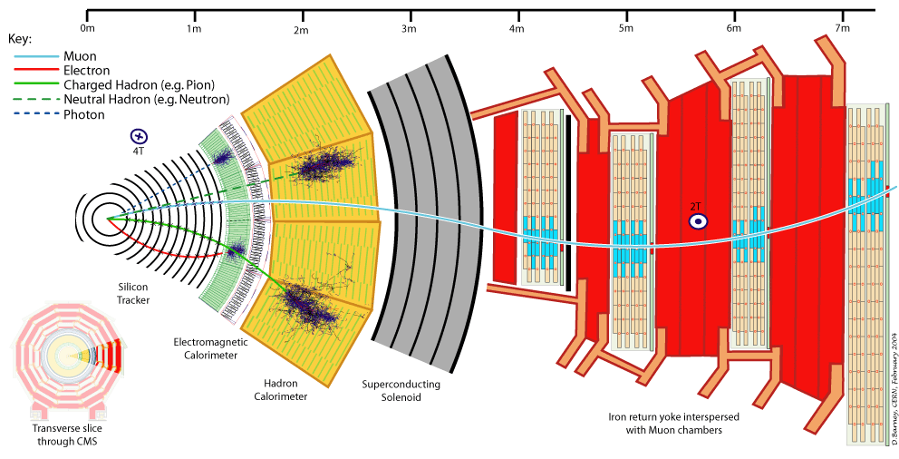


Slide 16
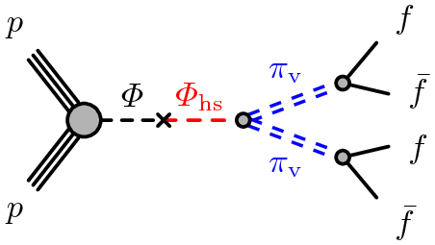
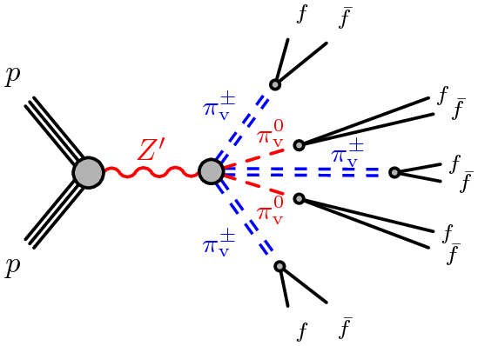
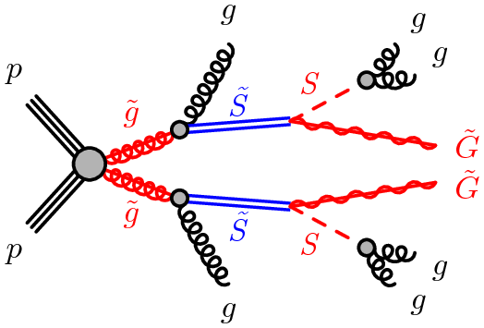



Benchmark Models
Hidden Valley – Scalar
$Φ→π_{v}π_{v}→b\overline{b}b\overline{b}$
The $Φ$ could be the Higgs in a rare decay search
Final state are displaced jets, low missing $E_{T}$
Normally two as the $b$ and $\overline{b}$ do not have time to separate
Hidden Valley – Z’
$Z^{′}→{Nπ}_{v}^{±}Mπ_{v}→f\overline{f}f\overline{f}…$
Large number of hidden valley pions
Final state contains jets, missing $E_{T}$.
Large number of objects means isolation criteria often fails
Stealth SUSY
Stealth means low missing $E_{T}$
$\tilde{g}\tilde{g}→ggSS→gggg\tilde{G}\tilde{G}$
A pair of gluinos decay to long-lived singlinos, which in turn each decay to a low-mass gravitino and a pair of hadronic jets.
Low missing $E_{T}$ because back-to-back, two displaced jets, and other jets

Slide 17

Displaced Vertex Detection

Slide 18
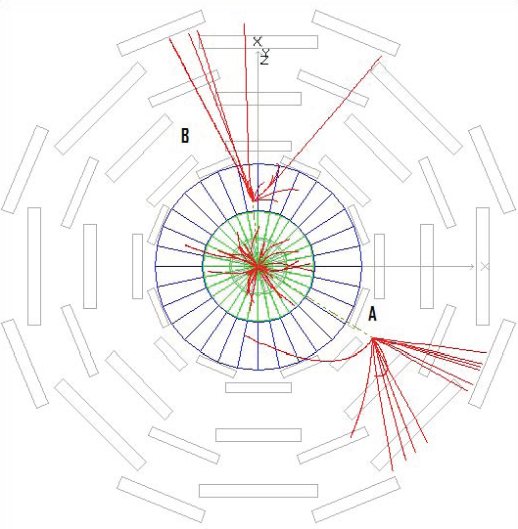
Decays in the Inner Detector
Increased impact-parameter tracking
Vertex Reconstruction

Slide 19
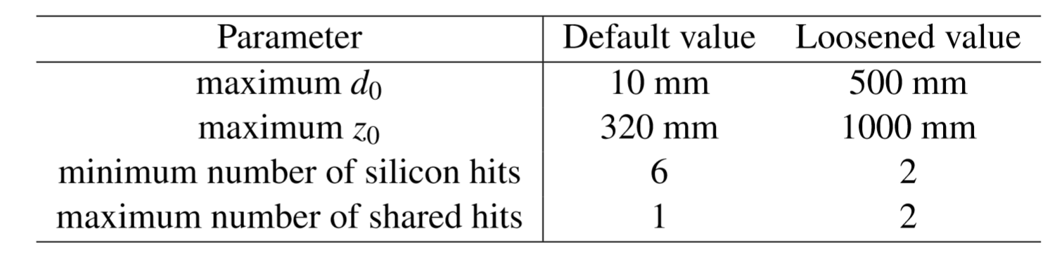
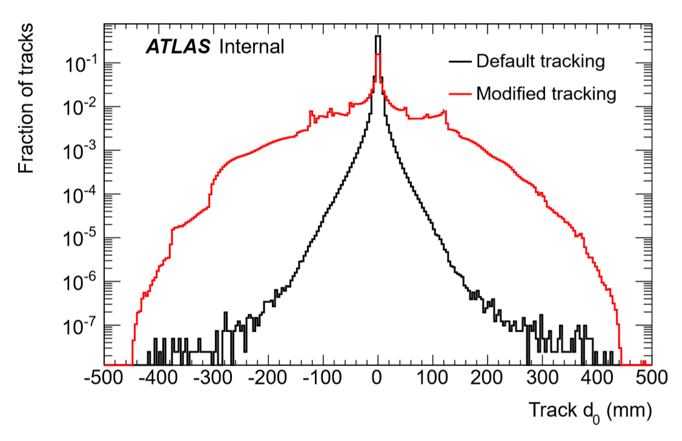
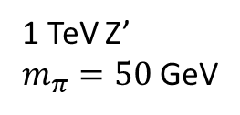
High Impact Parameter Tracking
1 TeV Z’
$m_{π}=50$GeV
Expensive operation to re-track
Unused hits considered
Hit sharing allowed – uniqueness requirement reduced
Working to make high impact parameter tracks part of our reconstruction

Slide 20
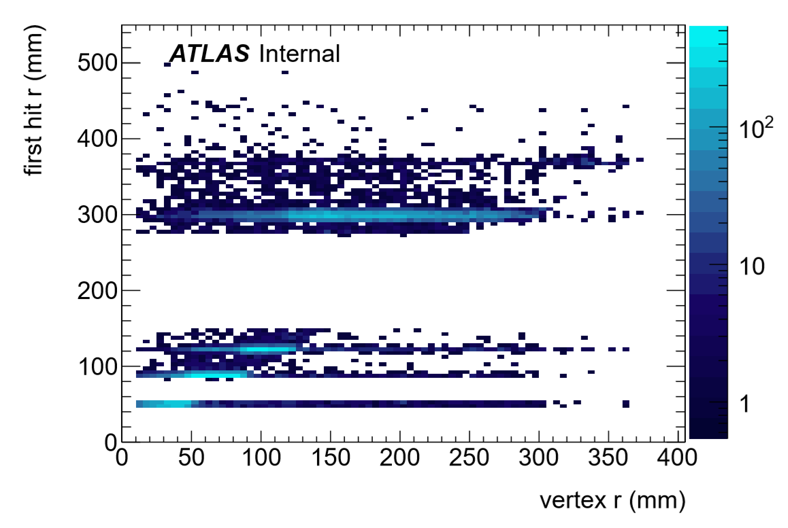
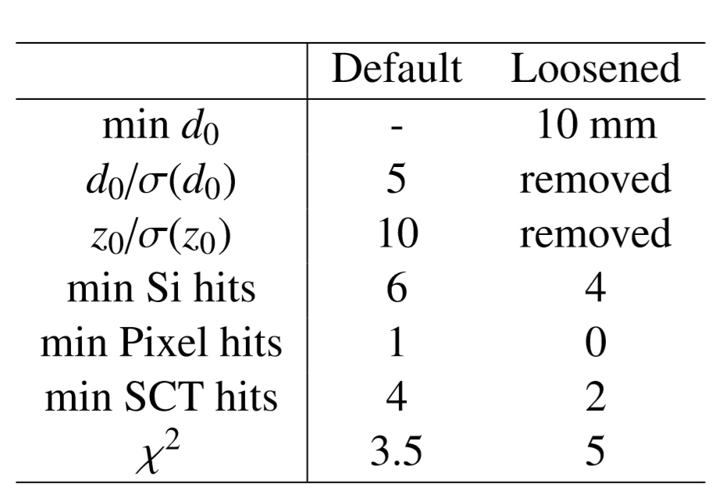
Vertex Reconstruction
Reused the ATLAS primary vertex reconstruction code!
Of course this increases background!
Must use event-level quantities to keep it under control!

Slide 21
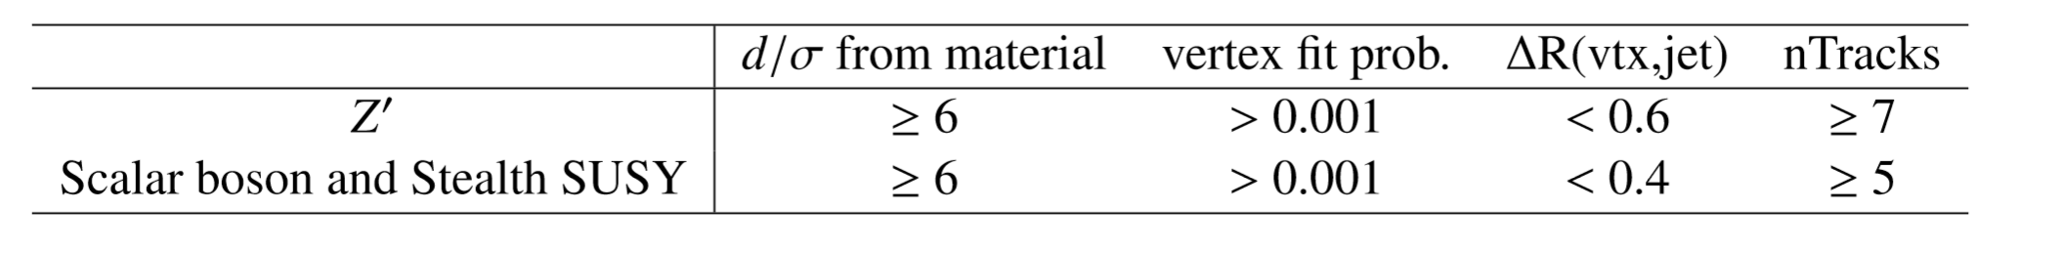
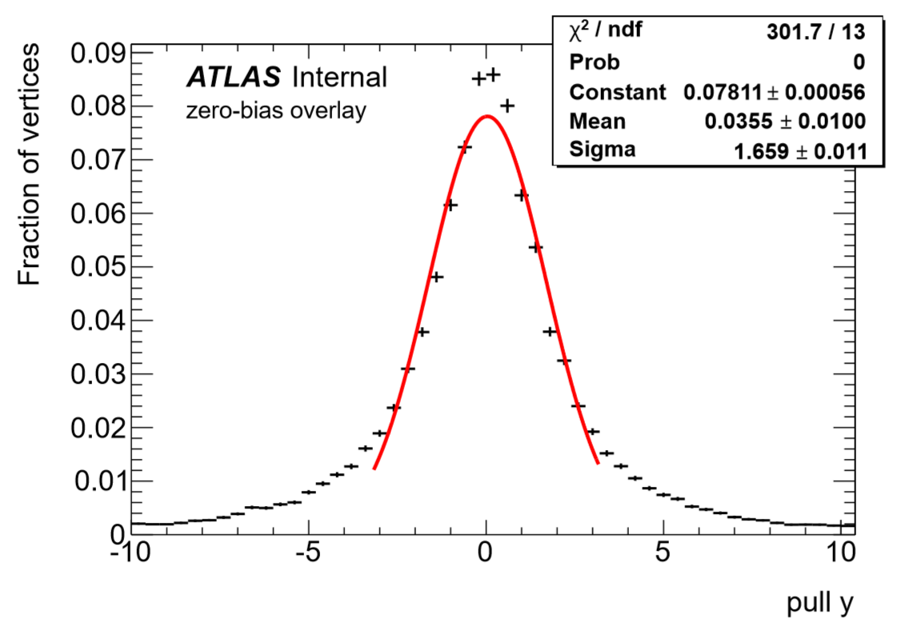
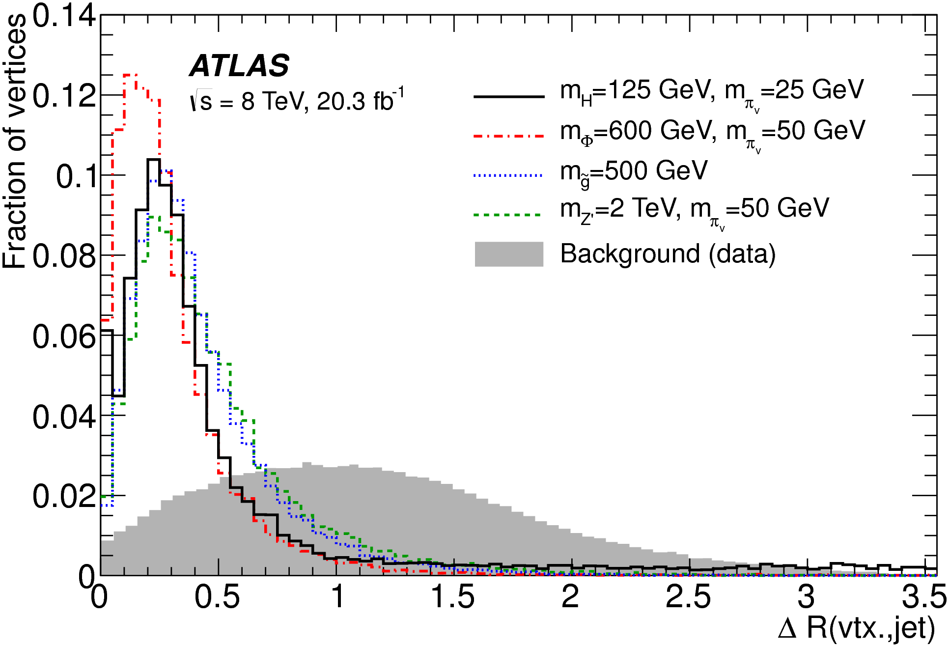


Vertex Reconstruction
Backgrounds:
Material interaction vetoed with Geant4 Material model ($\frac{d}{σ_{d}}<6$)
Vertex quality cuts to reject $K_{S}$, etc., along with extra by-chance track from emulating a trigger
Quality cuts adjusted for type of signal model!
$K_{S}^{0}$ reconstruction used to establish systematic errors on vertex finding efficiency
Efficiencies vary widely depending on kinematics!

Slide 22
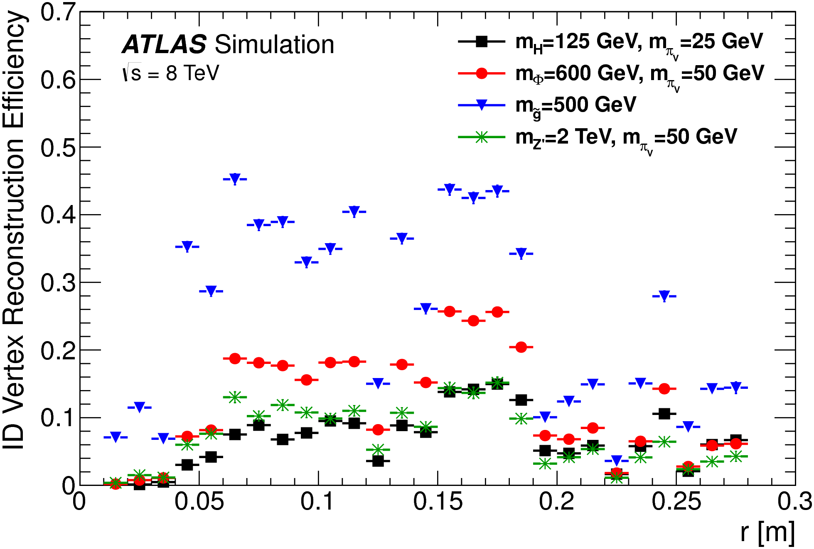
Vertex Reconstruction

Slide 23
Decays in the Calorimeter
Look for the “appearance” of energy the Calorimeter
Little or no activity in the tracker

Slide 24
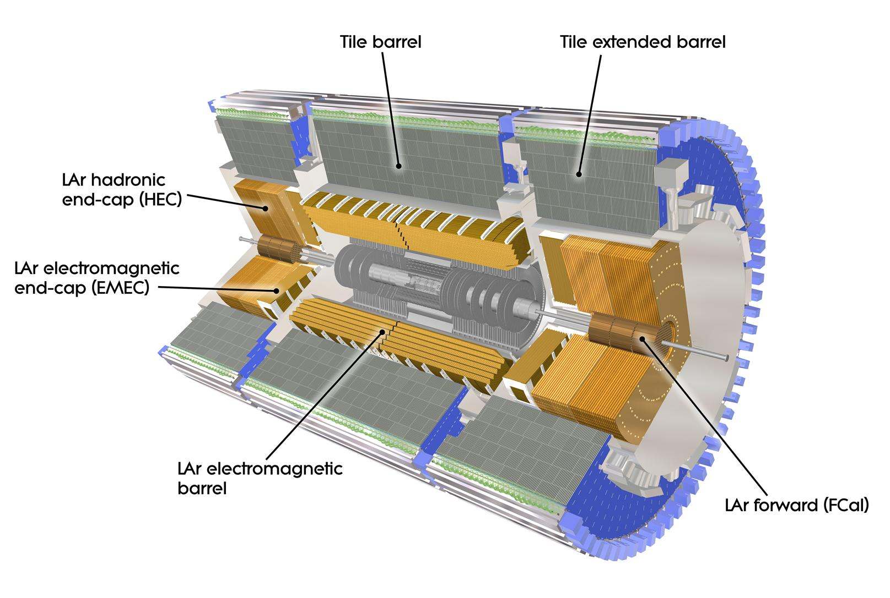
Notes:
We have per-layer information, so we need to look at the “shape” of the jet, and see where it shows up.
Just looking for a trackless jet was not, unfortunately, powerful enough. Too much QCD.
The trigger couldn’t handle that either. So we have so far been forced to look further on – near the transition between the EM calorimeter and the Hadronic calorimeter.
Thus, the key cut will be on “EMF”…

Slide 25
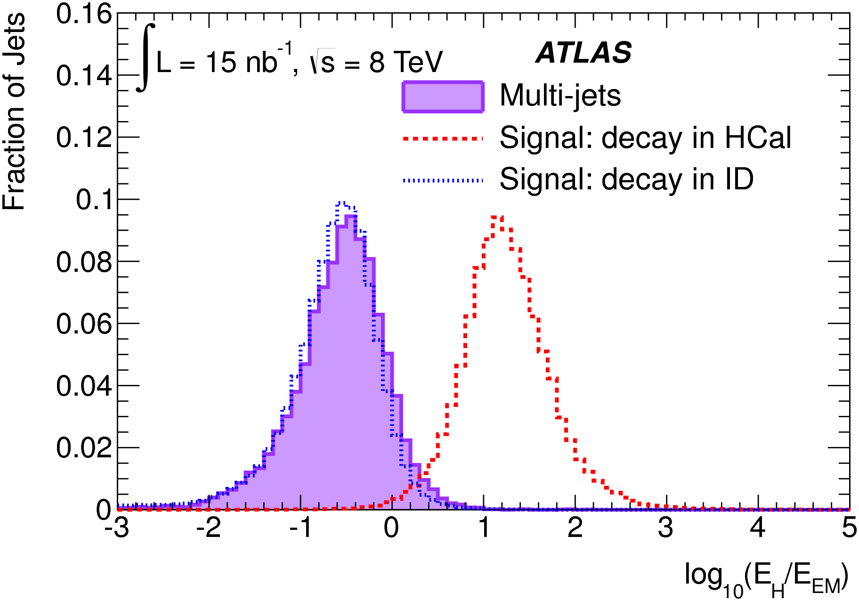
Calorimeter Decays Are Kinematically Different
What is different about a late decaying jet?
Calorimeter Boundary
Kinematic Differences:
Jet Width
Energy fraction in EM and HAD
Tracking in front of the jet
Notes:
Keep in mind that these tails though they look small, are actually HUGE because this is QCD background we are talking about here!

Slide 26
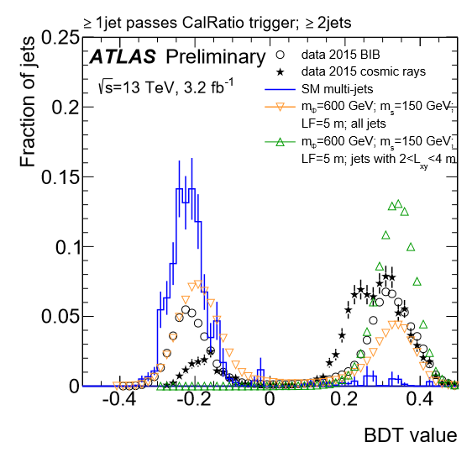

Calorimeter Decays Are Kinematically Different
There are lots of differences in shape to take advantage of
$\log_{10}{(\frac{E_{H}}{E_{EM}})}$
Jet Width
Longitudinal Length
Jet $p_{T}$
Lateral Width
Shower Center (radial)
$ΔR$ to closest 2 GeV track
Cluster Energy Density
Number of Tracks with $p_{T}>2$ GeV
$Σp_{T}$ of all tracks
Layer 1 HAD Energy Fraction
Max track $p_{T}$
A 30% improvement in performance over straight cuts
Notes:
13 input variables

Slide 27
Decays in the Muon Spectrometer
Look for hit segments in the Muon Spectrometer
Vertex reconstruction

Slide 28
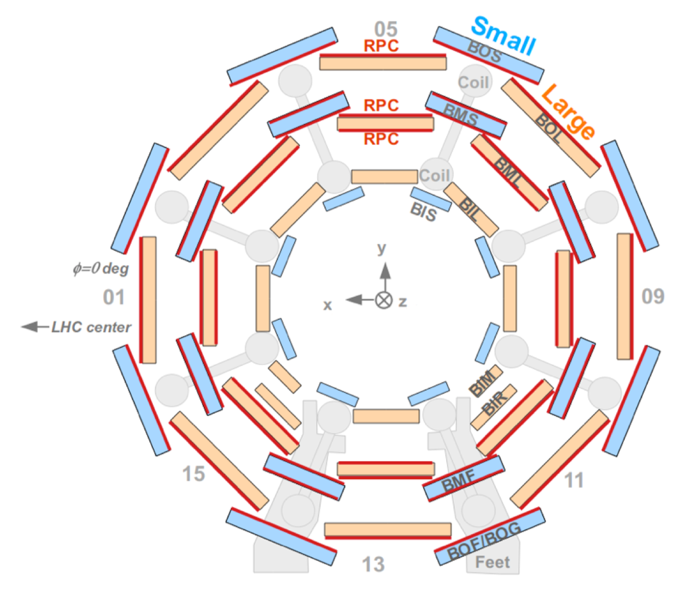
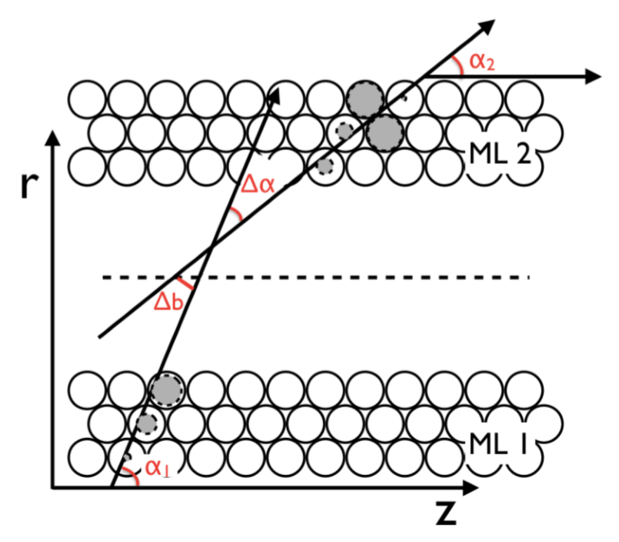
The ATLAS Muon Spectrometer
Simplified tracklet reconstruction:
B Field
BIL

Slide 29
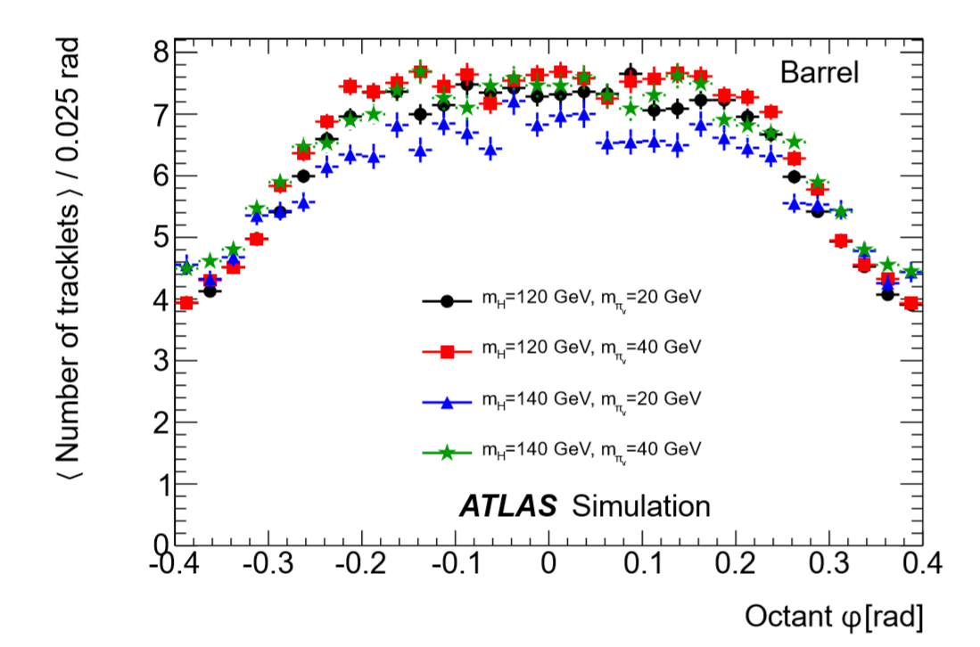

MS Tracklet Reconstruction
Tracklets are used to reconstruct extrapolated tracks
Cone algorithm is used to cluster the tracklets
Tracklets are ligned up by looking at $η,φ$ lines of “sight”
Propagation takes into account the muon B field in the barrel, and no B field in the endcaps.
Vertexing algorithm is applied
Basic quality cuts applied
Scan is repeated with different possible guesses for the vertex location and best one is chosen.

Slide 30
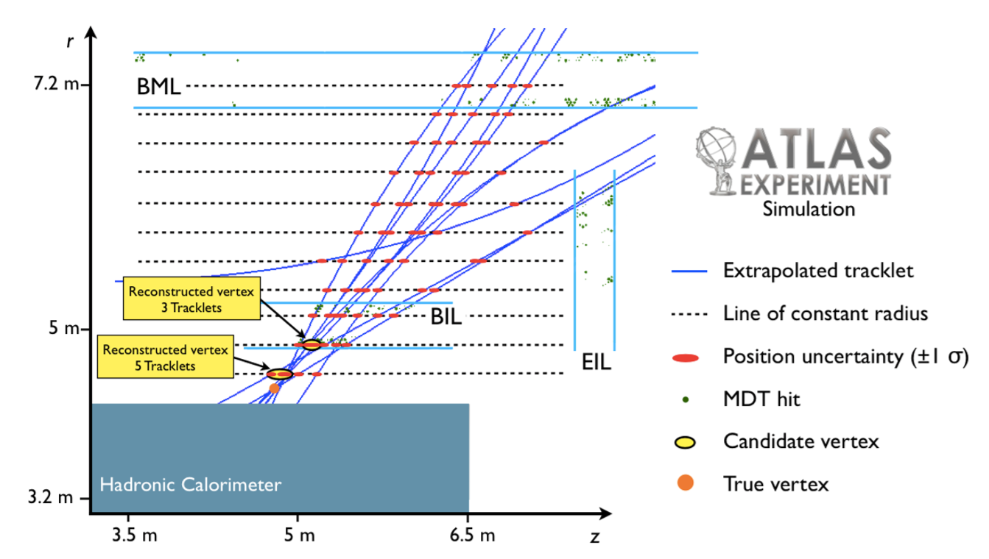
MS Vertex Finding

Slide 31
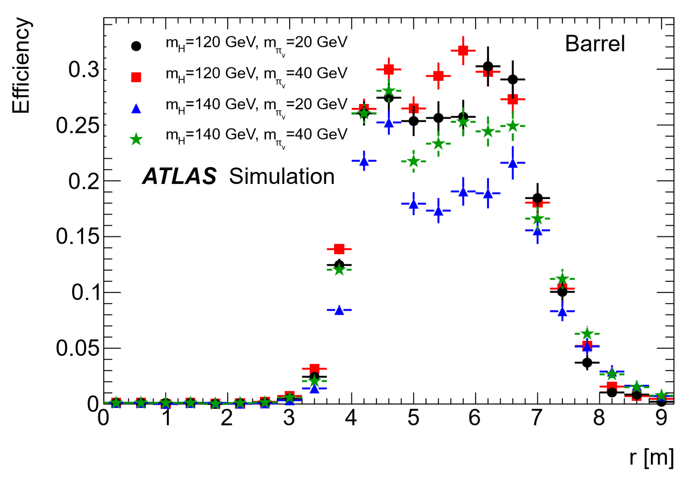
MS Vertex Finding
How do we cross check?
Use muon punch-through data
Cracks in the calorimeter give us a decent size sample of high muon activity
Used to establish systematic errors
Good match with data
Cavern Background
Detailed studies very difficult
Overlay simulation is expensive!!
Effect was small for this analysis

Slide 32

Building An Event Cut Flow

Slide 33



Triggers!
1
Associated Production/Associated Decay
e.g. WH production
Trigger on isolated muon or missing $E_{T}$
e.g. jets, missing $E_{T}$, etc.
2
Signature Driven Trigger
ATLAS has 3 signature driven triggers running since the start of 2011:
Trackless Jet Trigger
CalRatio trigger
Muon RoI Cluster Trigger
All triggers must be below 1 Hz!
Also make use of more traditional triggers
Jet trigger + missing $E_{T}$ triggers
CMS has done this to better effect than we have
Notes:
Note there is no trigger to match the ID vertexing. Instead we will supplement with a Jet + MET trigger
Just call out some highlights

Slide 34



Event Selection
Acceptance
A single displaced vertex
Displaced vertex + (jet, muon, missing $E_{T}$, etc.)
$$X$$
Two displaced vertices
$$X$$
Small Backgrounds
Notes:
Theorists would love us to be as general and model independent as possible.

Slide 35

Background Estimation
Data Driven
1
Inner Detector Vertices: fakes = $f(p_{T})$
Estimated on a sample that is orthogonal with signal kinematics
2
Calorimeter Vertices: “It’s complicated”
3
MS Vertices: Simple fake rate taking trigger effect into account
Estimated on minimum bias and triggered sample

Slide 36
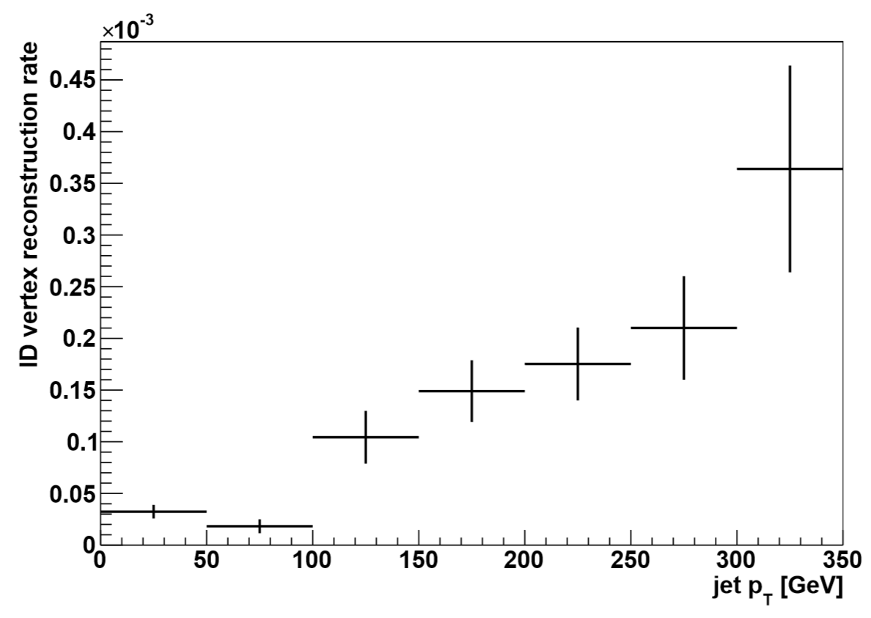
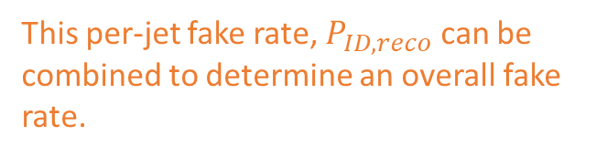
Inner Detector Fake Rate
Use single jet triggers
Low and high threshold to populate with enough statistics
Trigger prescale is tricky when combining the two samples
This per-jet fake rate, $P_{ID,reco}$ can be combined to determine an overall fake rate.

Slide 37



Inner Detector Fake Rate: Jet + missing $E_{T}$ trigger + 2 ID verticies
The ID vertices mean our signature driven triggers won’t help us!
The trigger requires a jet with 110 GeV and missing $E_{T}>75$ GeV
Require at least two jets in the event
Standard quality cuts
Fake rate/probability for each event:
The trigger is not correlated with the fake rate!
Except in $p_{T}$ which is easy to determine in the control samples
No correlation between jets either
Makes background calculation fairly straight forward
$$N_{Fake}=\left(1.4±0.2\right)×{10}^{−4}$$

Slide 38


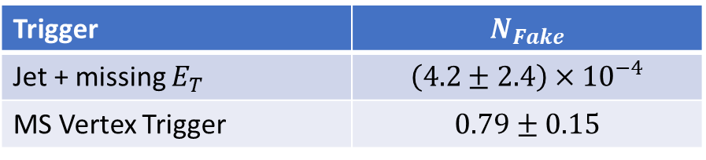
MS + ID: MS Vertex + ID vertex
Topology is used for both triggers
Jet + missing $E_{T}$
MS Vertex Trigger
$$N_{Fake}=\sum_{i}^{\begin{aligned}events passing \\ trigger\end{aligned}}{nJet_{i}∗P_{ID,reco}}$$
Assume trigger + reconstructed MS Vertex are all fakes
Trigger | $$N_{Fake}$$
Jet + missing $E_{T}$ | $$\left(4.2±2.4\right)×{10}^{−4}$$
MS Vertex Trigger | $$0.79±0.15$$

Slide 39


MS Fake Rate
P(MS Vertex|MS Trigger)
P(MS Vertex|No MS Trigger)
Out of all events that have a ROI cluster
How many have a reconstructed MS Vertex?
Minimum bias event sample used
(~ 6 million)
Found 19,184 MS Verticies in 1,512,030 events
Zero vertices found
P =$\left(1.27±0.01\right)×{10}^{−2}$
P = $\left(4.86±4.86\right)×{10}^{−7}$
(x4 bigger in end caps)

Slide 40
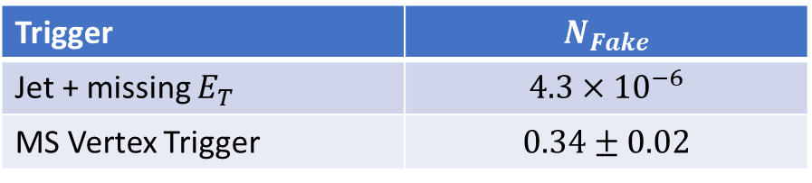
MS + MS: 2 MS Verticies
$$N_{Fake}=N\left(1 MS Trigger+MS Vertex\right)∗P\left(MS Vertex, no trigger\right)$$ $+N\left(2 MS Trigger+1 MS Vertex\right)∗P(MS Vertex, trigger)$
(Second term takes endcap/barrel into account!)
Trigger | $$N_{Fake}$$
Jet + missing $E_{T}$ | $$4.3×{10}^{−6}$$
MS Vertex Trigger | $$0.34±0.02$$

Slide 41
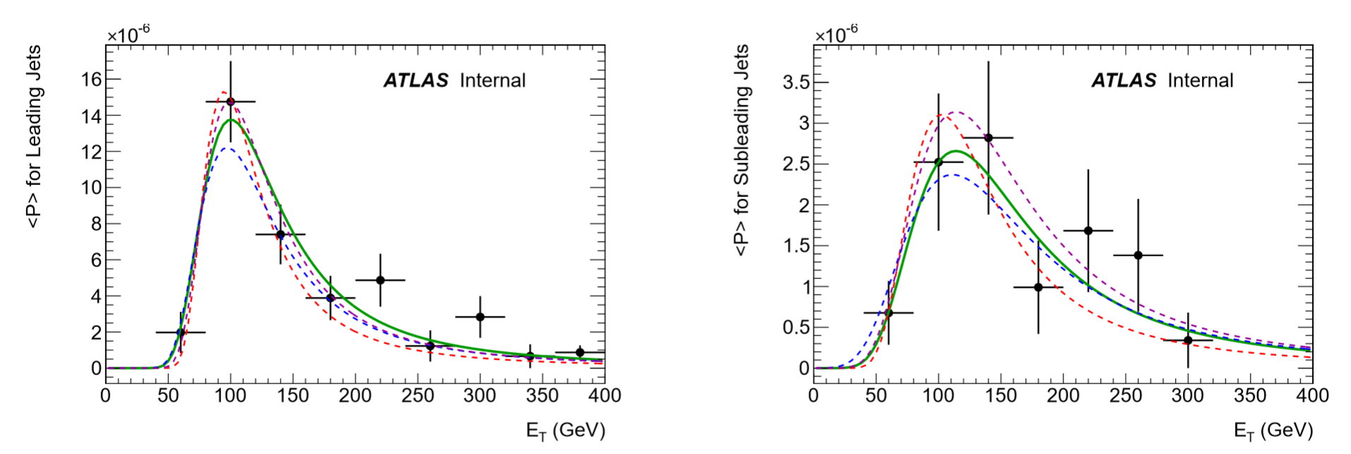


Calorimeter Fake Rate: Method 1
Estimate each background individually
Cosmic Ray & beam induced background:
Use empty bunch crossings or single beam bunch crossings
Scale factor for trigger live time
Release timing cut when looking at cosmic ray background
Account for pileup and track veto
Cosmics: $0.33±0.22$ events
Beam Halo: $0.07±0.07$
Beam halo is a much worse problem in the current analysis!
QCD/Multijet:
Use single jet trigger sample to determine rate as a function of $p_{T}$
Leading jet and second-leading jet have different rates, trigger matched and not too!
Using simple combinatorics apply to final sample before the displaced vertex cut
A lot of very low statistics fits!
Leading
SubLeading

Slide 42
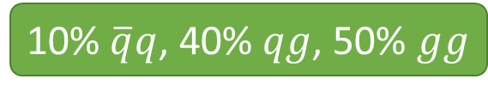



Calorimeter Fake Rate: Method 1 Fail
On a small datasets we were about $0.8σ$ low in our prediction
In the larger dataset we were almost x2 low!!!
LHC Interaction Multijet Production @ 8 TeV
Fake rate, calculated on this sample of jets
10% $\overline{q}q$, 40% $qg$, 50% $gg$
CalRatio Selection cuts hard on CalRatio and $N_{tracks}$. Favors quark jets!
Sample enriched in quark jets
Derive a correction factor of 1.8 based on trends in $N_{tracks}$ and CalRatio
$$N_{Fake}=23.24±8.03$$

Slide 43
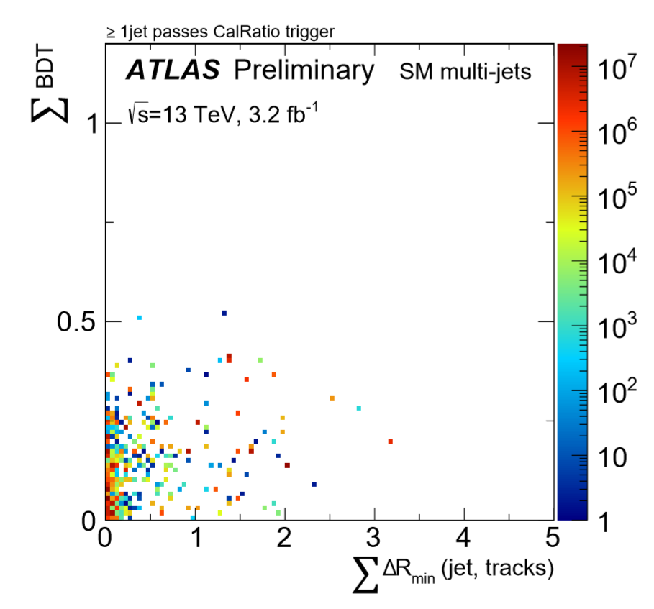

Calorimeter Fake Rate: Method 2 - ABCD
ABCD method requires two uncorrelated variables
The BDT is designed to maximize the difference between signal and background
Have to purposely leave variables out of it in order to satisfy the ABCD method!
Sum of BDT output of to most signal-like jets
Sum over all jets with $p_{T}>50$ GeV of the $ΔR$ between the jet axis and the closest track with $p_{T}>2$ GeV

Slide 44
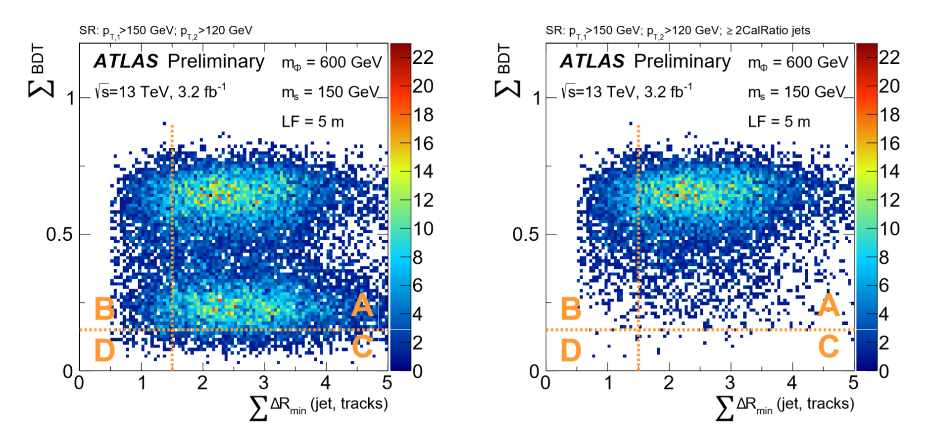

Calorimeter Fake Rate: Method 2 - ABCD
All Signal Events
Events with 2 8 TeV CalRatio Jets
Simultaneous ABCD Method Fit
Success – the background matched at unblinding!
$$N_{Fake}=18.0±6.3$$

Slide 45
Final Limit Plots
MC Samples are generated at a single proper lifetime
Extrapolation to other lifetimes are possible because the actual lifetime is a falling exponential!
$cτ=2$ m
$cτ=1$ m
Reweight by Decay Length
Carefully track statistics in tails!
Cross check method!
Be aware of the convolution of boost, lifetime, and detector efficiency
Since analysis requires 2 objects, reweight in 2D
$cτ=0.5$ m

Slide 46
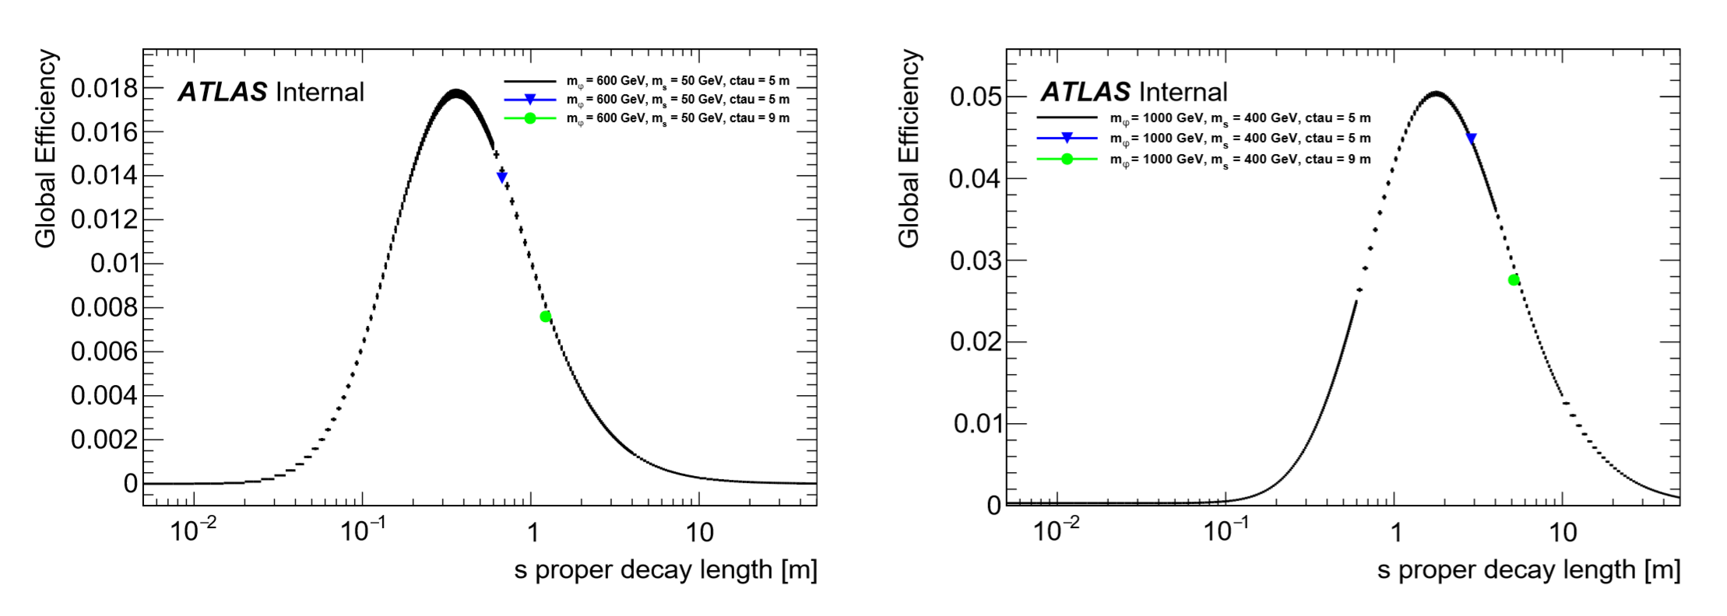
Final Limit Plots

Slide 47
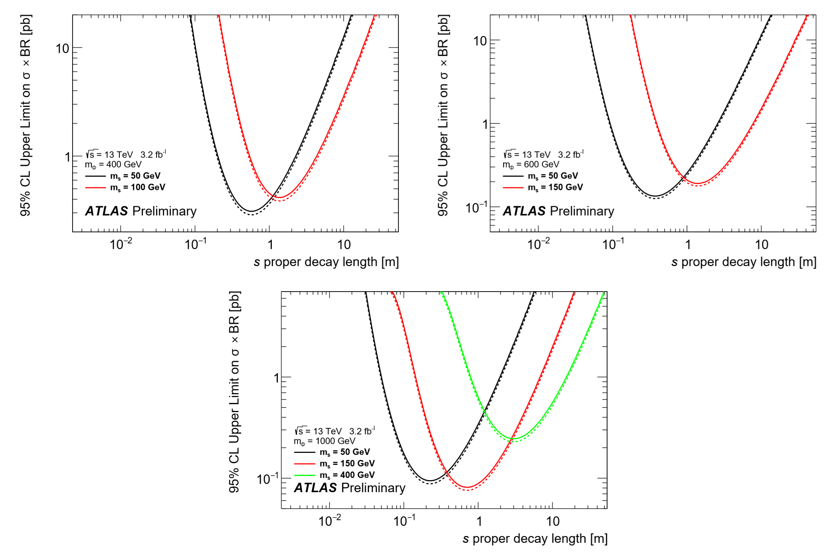
Final Limit Plots: 2 CalRatio
Note: No Low Mass!

Slide 48
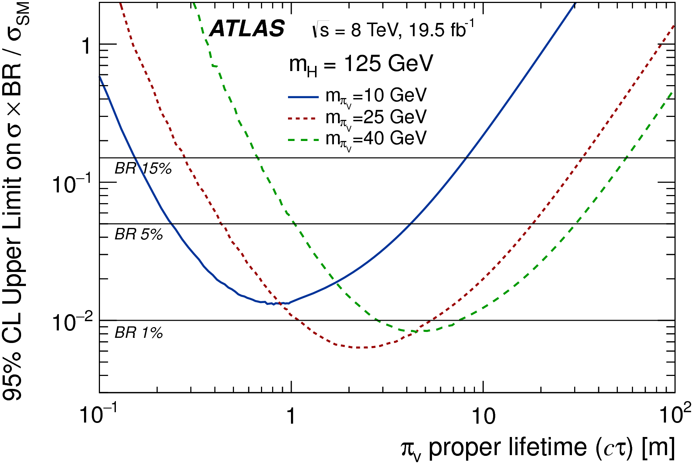
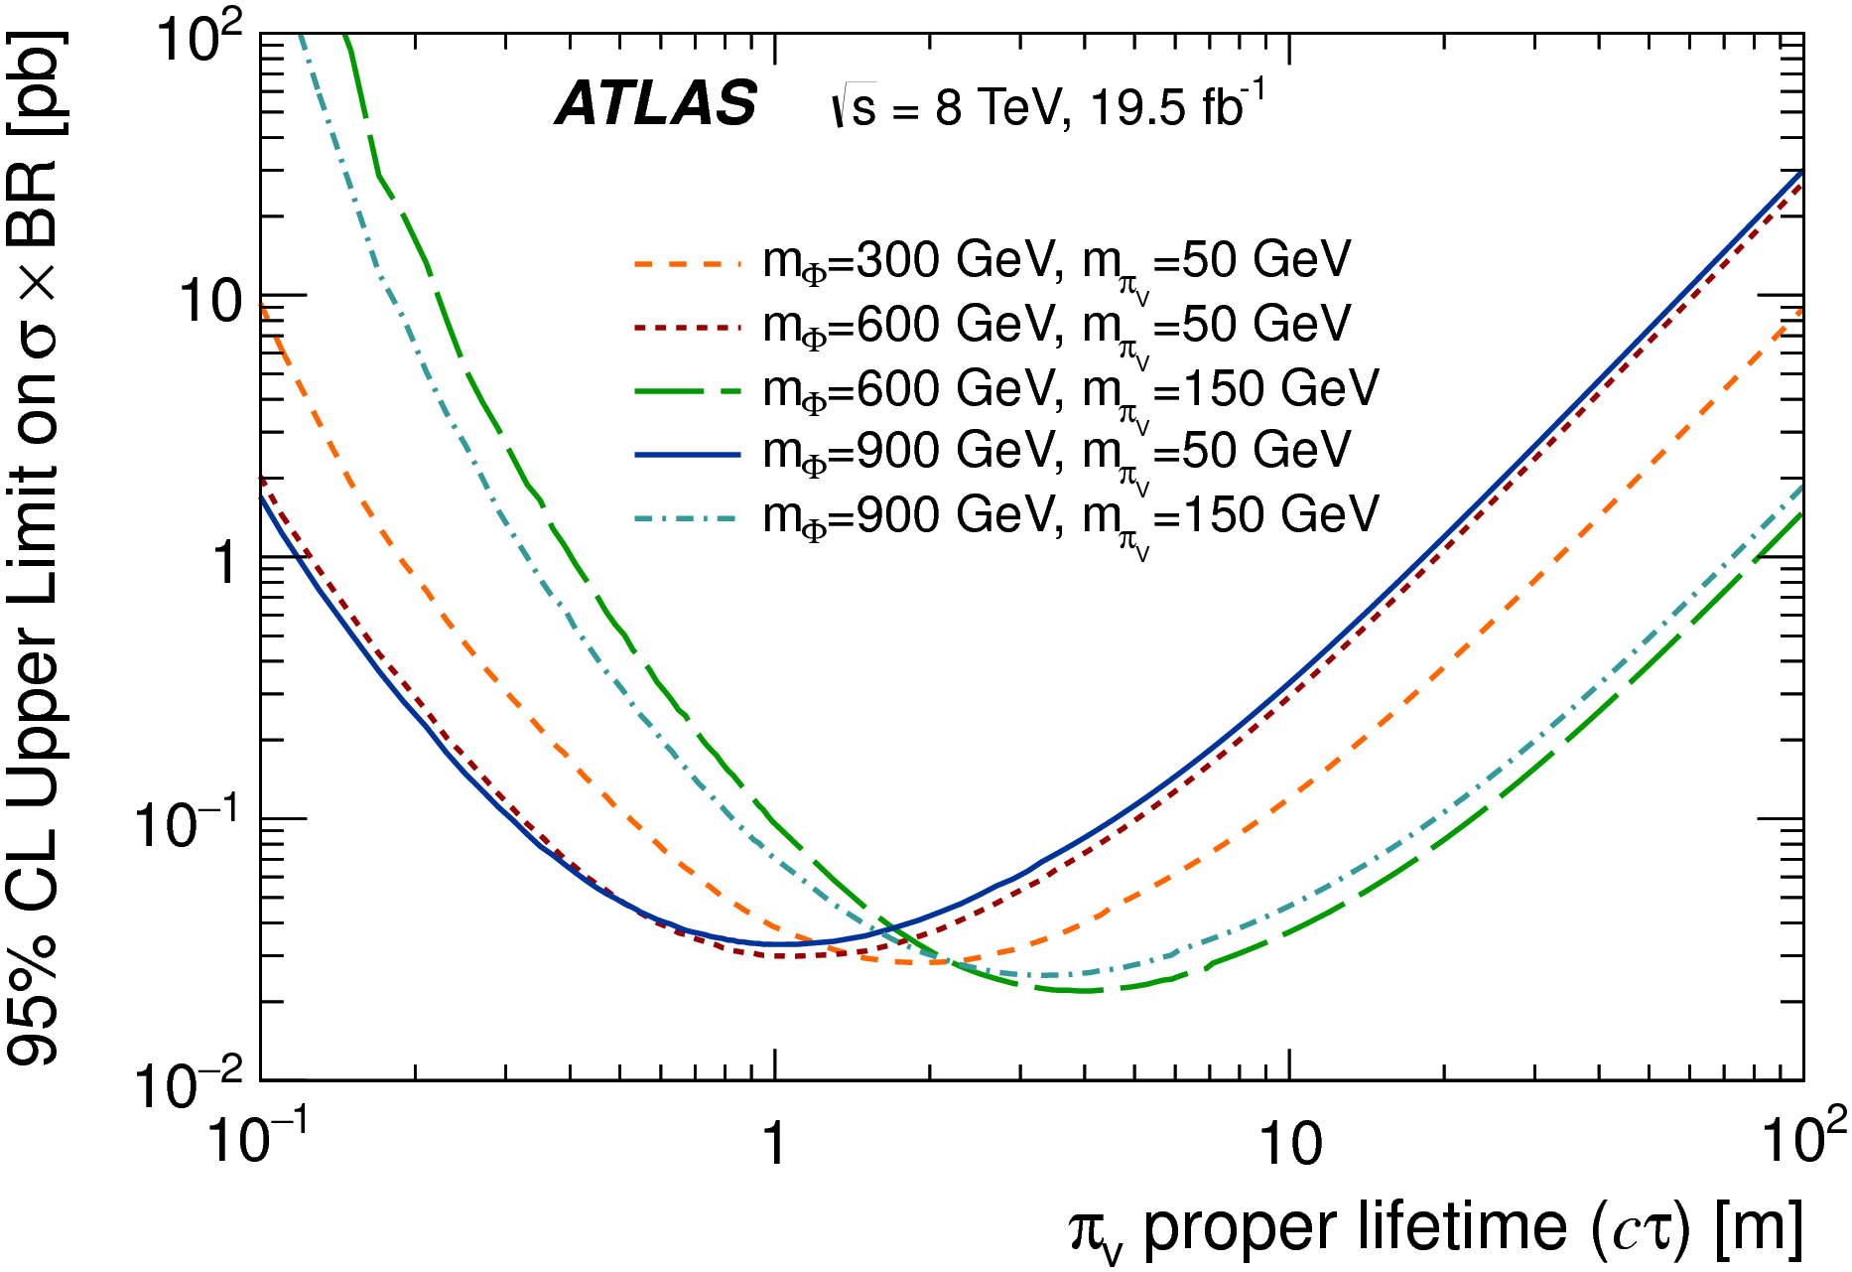
Final Limit Plots: MS + ID (Hidden Sector)

Slide 49
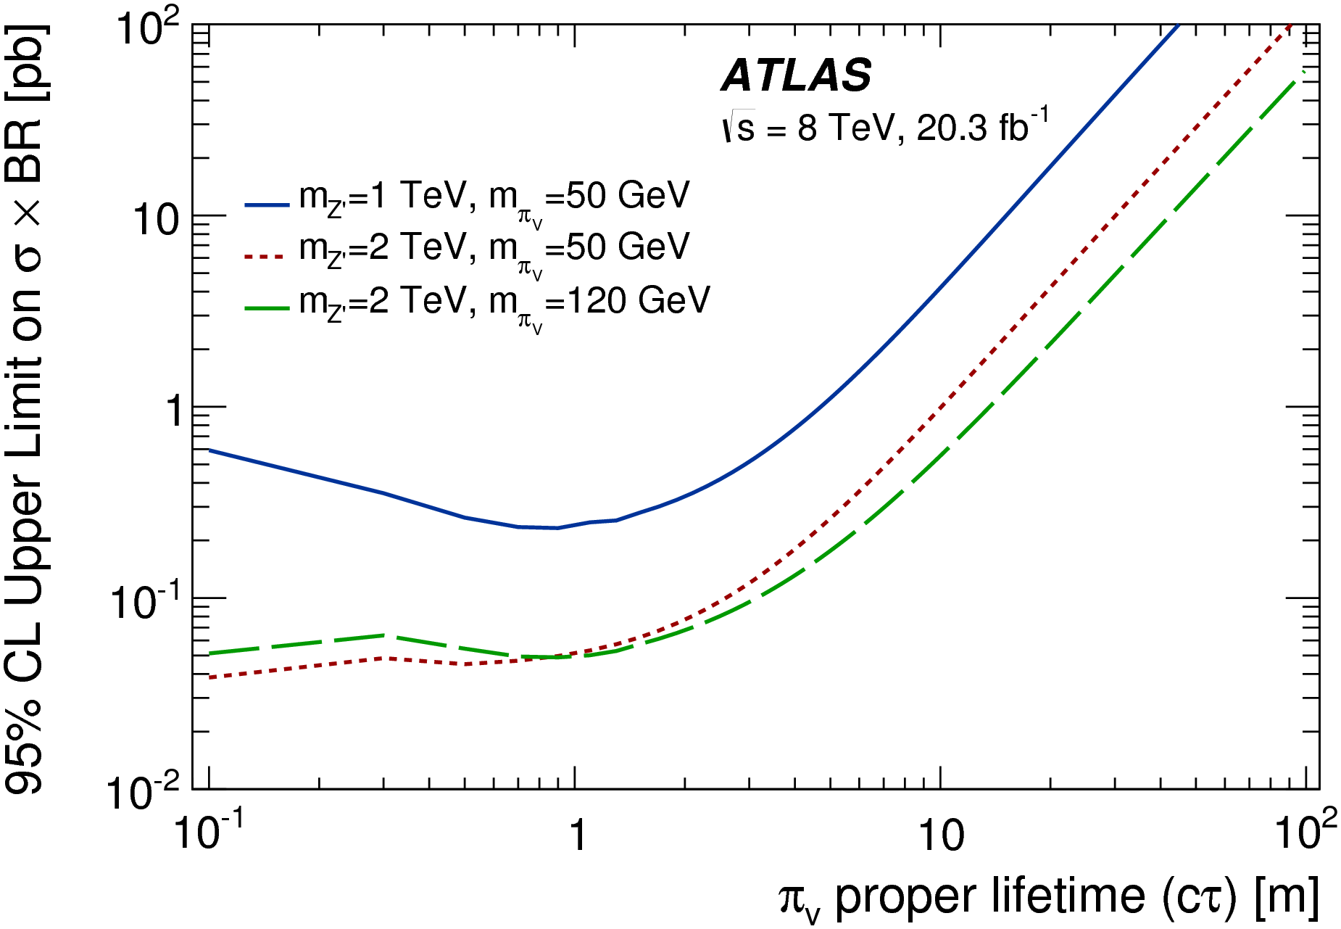
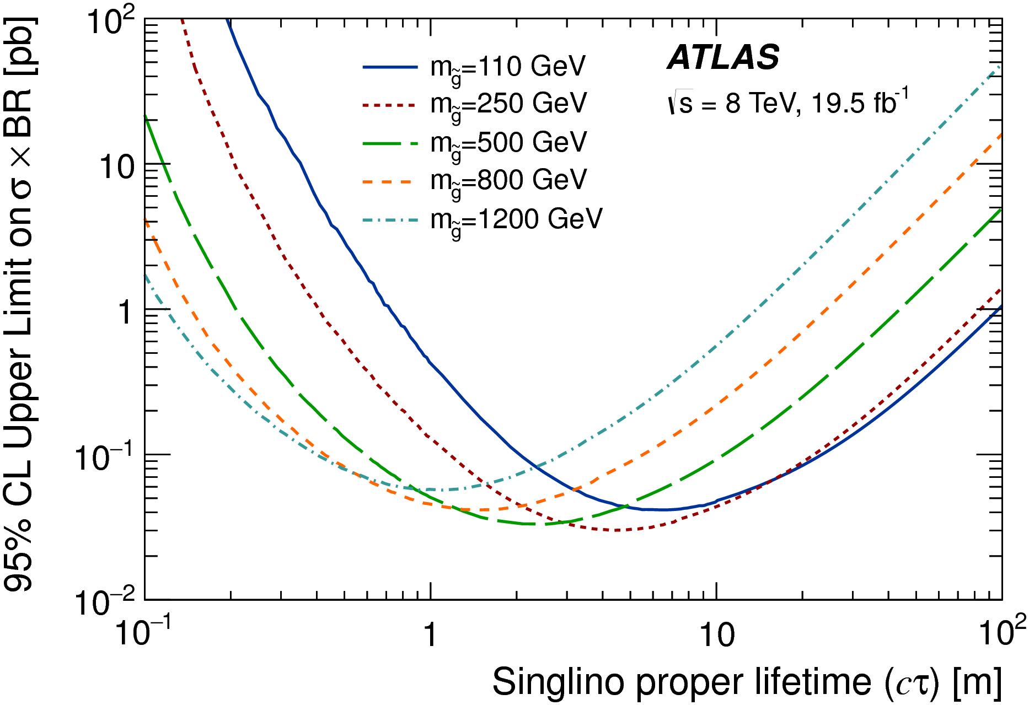
Final Limit Plots: MS + ID (Z’ + STEALTH SUSY)

Slide 50

And Beyond
LLP + other Objects
LLP’s from different detectors
Ultra Long Lived Particles

Slide 51
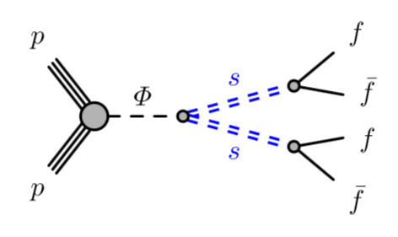
Expanding Final States
The current strategy works only for a two (or more) displaced vertices.
In a single detector
Expand to using different detectors

Slide 52
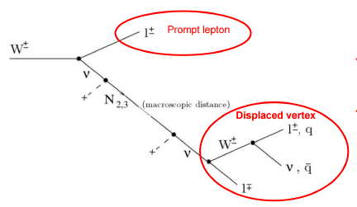
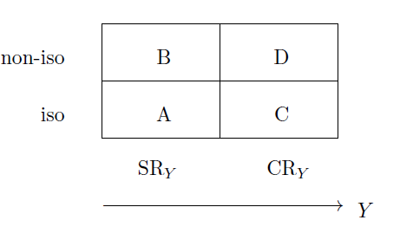

LLP + Object
Theorists have a matrix…
The backgrounds are too large with a single LLP
Look for a second object in the event!
Use ABCD method to calculate backgrounds
Iso/Non-Iso: Displaced object with nothing else near it
The uncorrelated Y variable will depend on the analysis
Missing $E_{T}$, jet $p_{T}$, etc.
arXiv:1605.02742

Slide 53
Plenty more work to do with other signatures!

Slide 54
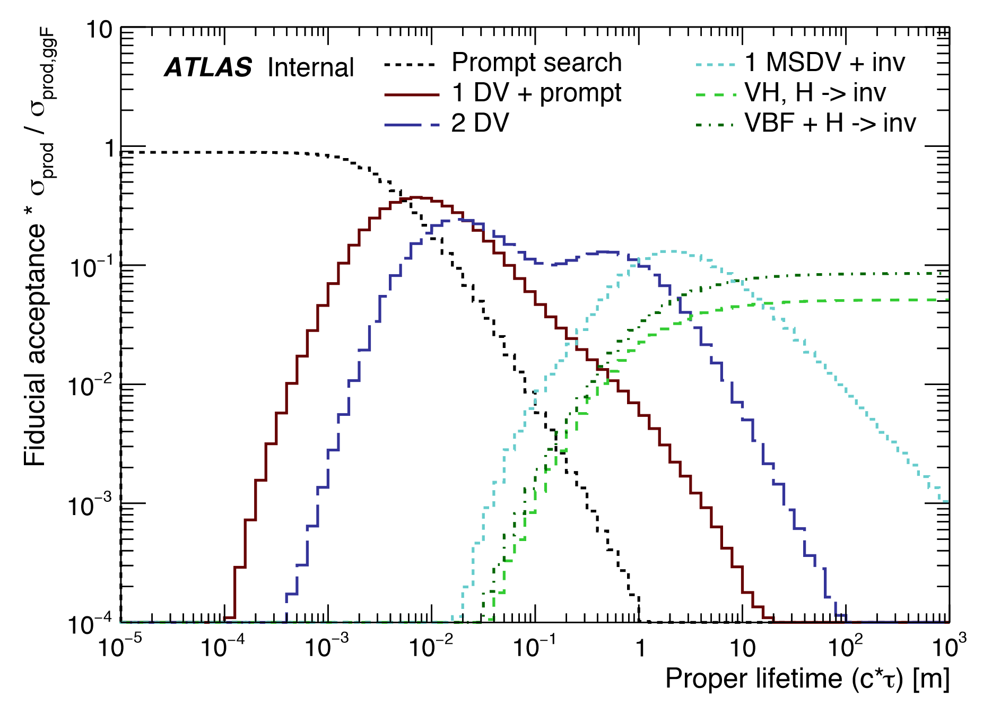
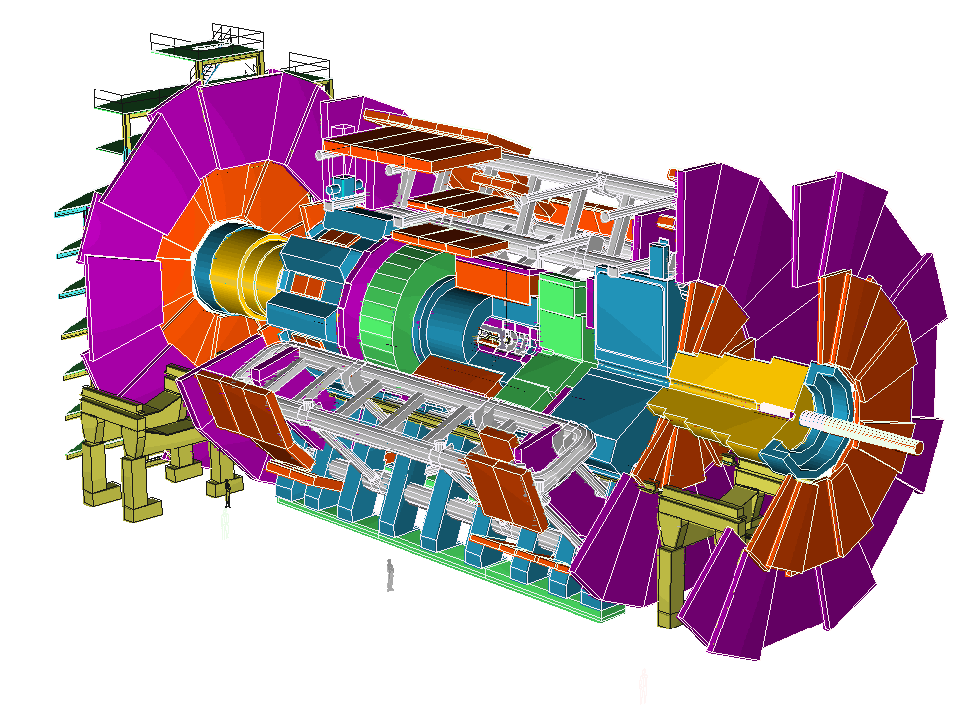



What about life-time sensitivity?
Lifetime is a free parameter…
But it is constrained by Big Bang Nucleosyntheses - $cτ\sim {10}^{7}$ m
ATLAS/CMS Detectors can only see to $cτ\sim 100$ m
Escaped Particles become missing $E_{T}$…
Acceptance isn’t great
Can’t tell if they are stable or large $cτ$…

Slide 55




Increasing The Base Line
MATHUSLA Detector (~100x100 sq m)
Decay distance is about $100\sqrt{2}$ m
Surface
Gives one access to much longer decay lifetimes.
~100 m
To be sensitive to $cτ\sim {10}^{7}$ m we must have zero background.
Cosmic Rays
Upward going muons
Neutrino Interactions
~100 m

Slide 56
Minimizing the Background
Scintillator for 1.5 ns timing resolution
RPC layers for track reconstruction (and vertex finding)
Scintillator
Resistive Plate Chambers (RPCs) have great timing resolution as well
70 ns travel time
The LLP must decay within the Decay Volume (Air)
Decays before the Decay Volume are vetoed

Slide 57



Vetoing Backgrounds
Cosmic Muons
Precision timing from scintillators & RPC’s
Tracking from RPC’s
May also be some interesting physics
Upward going LHC Muons
Precision timing from scintillators
Bottom of Decay Volume veto
Upward going cosmic neutrinos
Irreducible?
Rate expected to be very low
RPCs
Most have a low momentum proton - reject time-of-flight measurement in RPCs
IP
ν

Slide 58

Test Stand
Do these rejection techniques work?
Scintillator from DZERO end-station muon chambers (thank you D. Denisov!)
RPC’s from Rome (Argo experiment)
Ran in November, being set up again at ATLAS P1
Great Learning Platform for Graduate Students!
Timing in portions of the detector
Learning how finicky RPC’s can be

Slide 59



RPCs
Scintillator planes

Slide 60






Goal is to have comprehensive document finished
by end of 2018
Contributions from broad spectrum of theory community

Slide 61


FASER
Forward cylindrical detector in ATLAS tunnel with 0.1 Tesla field
Advantage – large forward pp cross sections for light particles decaying to lepton
Original concept considered three locations: near and far on axis and off axis

Slide 62

CODEX-b
Instrument current LHC-b DAQ space ~ 1000 m³
Part of LHC-b detector
Physics goals similar to MATHUSLA
Requires more shielding
LHC-b luminosity lower than pp CMS /ATLAS
Has some attractive features

Slide 63



CODEX-b

Slide 64
Physics Beyond Colliders
PBC (Physics Beyond Colliders) at CERN study group to evaluate proposals for detectors to go beyond current LHC detectors
report expected by end of 2018
http://pbc.web.cern.ch/
Charge is to evaluate various new proposals
SHIP 400 GeV beam dump - weakly coupled particles in the few GeV mass range
FASER (1708.09389) proton inelastic scattering in HL-LHC collisions to produce light LLPs (dark photons)
CODEX-b (1708.09395) physics goal similar to MATHUSLA
MATHUSLA
MilliQan (1410.6816 Haas, Hill, Izaguirre, Yavin, 1506.04760 Izaguirre, Yavin, Letter of Intent: 1607.04669) Search for milli-charged particles at Point-5 (CMS)

Slide 65

Conclusions
The LHC has completed a fairly comprehensive set of searches for long lived particles decaying to jets!
SUSY searches not discussed here!
Substantial parts of phase space for exotic Higgs decays have been ruled out
As well as heavier mass scalar decays
A lot of room for improvement in Run 2
Combined analyses, better results for theorists
Include other objects besides displaced vertices
A huge amount of work already done… just not public. ☹
ULLP Searches
MATHUSLA detector, test stand
Initial collaboration of 5 or 6 institutions formed (and growing)
Looking for interested parties!
Around DESY today and tomorrow for further discussions!

Slide 66


Thanks!
And the LHC!
And to ATLAS

