Slide 1
SCS - 1
Progress
Activities:
KB tank bake out stopped.
ALAS bake out stopped.
Roughing lines installation upstream nearly completed.
MEA2 aligned the floor anchor points for the experiment station and followed by the grouting by SCS.
Issues:
Pressurized air needed in hutch but VOB approval and hand-over to instrument not done yet. Company Dräger has to be more pushed. latest information is: 1-2 weeks. This is too late for doing radiation safety tests as the beam line cannot be operated without the media.
MEA2 had not the time to prepare for the TIM alignment as the alignment requires transfer measurement (too tight schedule). For performing the transfer measurement more space is eventually needed (under discussion) and the TIM cannot be installed in its final position. Therefore testing and installation of MCP detectors and cwd diamond detector has to be delayed until MEA2 is again available.

Slide 2
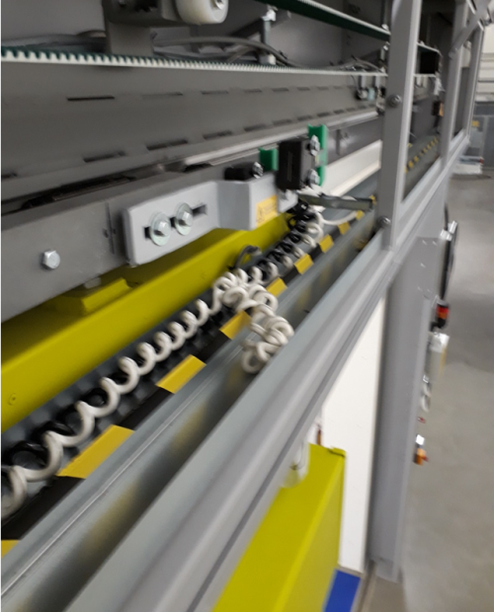
SCS - 2
MEA2: more tasks to be completed: FFT experiment station, downstream part of the beam transport. all tasks to be completed by August 10th or instrument cannot proceed further with x-ray commissioning.
Cable issue list is with AE but no progress achieved. needs to be resolved to put the DPS & ALAS … into operation with interlocks etc. needs to be done before radiation safety tests 26.7
Experiment hutch door interlock cables: the twisted cables form large balls when operating the door this leads to
  1) suddenly unwinding of the cable under considerable
  tension
  2) the cables/ knots run into the moving mechanics of the door
this is a safety issue and it is a matter of time that the cables
break and the hutch cannot be put into operation with x-rays.

Slide 3
SCS - 2

Slide 4
SQS
Progress
Continuation of LIC installation and testing
Continuation of KB vacuum commissioning
Assembly of VMI spectrometer
Move of AQS chamber to the hutch
Configuration and test of motors ongoing (loop 1-4)
Loop 5 needed by 16.07.

Slide 5
MID
Progress

Slide 6
HED
Progress
Too little rack space:U Brüggmann identified tall racks with 56 HE (instead of 42).2 racks would likely fit on the platform of OPT hutch AC devices without modifying the platform waiting for expert opinion regarding fire safety
On Monday 2.7., SRP + Ubrüggmann cut power to rack room A.22
  reason is unsafe electrical installations, damaged cable tray, and wrong grounding
  group leader was not informed prior to/about power cut
  a report explaining the reasons was filed by Friday noon only
  unclear if Amplitude can continue installation next week, laser installation schedule might be compromised
HED waits for MEA to align: OPT hutch components, and HiBEF rails (most of our installation work is stuck because of waiting for MEA)
large roughing pump installed opposite of control room, now need to find company to route a CF100 vacuum pipe to IC1

Slide 7
SASE2 XTD6

Slide 8
Laser
SASE3
Under table installation is going well, cabling is almost finished
SASE2
No further progress. Minor works still need to be finished by the schedule is a bit ambiguous.

Slide 9
Vacuum
- MCP an M2 chamber are under vacuum, M2 leak test today
- MID branch is under vacuum, local tests are ongoing
- XTD6 XGM differential pumping: local test done, ready for XGM operation

Slide 10
Optics

Slide 11
Photon Diagnostics
XGMs
XTD6 XGM: Control Keithleys, SRG, HV crate, and full range gauge in DOOCS
Next: HV and signal cabling and later HV tests
MCP in XTD6:
- is now connected to beamline vacuum, leak check ok. Cabling almost done.
- More technical commissioning next two weeks (HV and detector testing, optics tower installation etc.)

Slide 12
Advanced Electronics
Introduction into parameters of MC2 motors for SQS and SCS colleagues
setting up motors for usage
Local tests in SASE2 tunnels of different components (as far as access to tunnels were possible)
Work on further PLC loops for SCS and SQS

Slide 13
ITDM

Slide 14
Detectors
2nd AGIPD MID
  Motion system tests successfully completed, information about the minimum possible hole/gap size missing
  AGIPD is expected be ready for transportation to XFEL end of August
  It has been communicated to the AGIPD consortium that we transport the detector to XFEL as soon as all modules have seen X-rays at DESY (requires detector to be present at DESY)
DSSC
  Testing of the DSSC vessel
    New RGA be performed on Wednesday-Thursday, analysis to be performed
    Document summarizing the missing information/components needed from CFEL finalised and sent to CFEL and DSSC management on Wednesday. However, we might have delays as the holiday season is approaching (key engineer already left for holidays at CFEL)
    Access to XFEL engineer to the CFEL laboratory granted if either CFEL responsible persons are there. No access in the last three weeks, no further testing could be performed.
    New version of collision switches designed at XFEL, now asking for offers
    Transport box for DSSC (vessel) transport designed
  PLC System
    Change request submitted related to upgrade to include the chiller control in the system, EETF looking into that
  DAQ
    First successful data transfer of 800 frames per train to the PC layer
FastCCD
  First Fe-K calibration data taken, analysis presently ongoing
  Further calibration data to be acquired this week

Slide 15
CAS
Unfortunately the Karabo upgrade has to be redone ! The target version is 2.2.4.1 which fixes a bug in the last deployed 2.2.4. The schedule is:
SA3 - Friday (6.7.2018) 7:00 - 9:00
SA2 - Monday (9.7.2018) 7:00 - 9:00
SA1 - Tuesday (10.7.2018) 7:00 - 9:00

Slide 16
SRP

