Slide 1
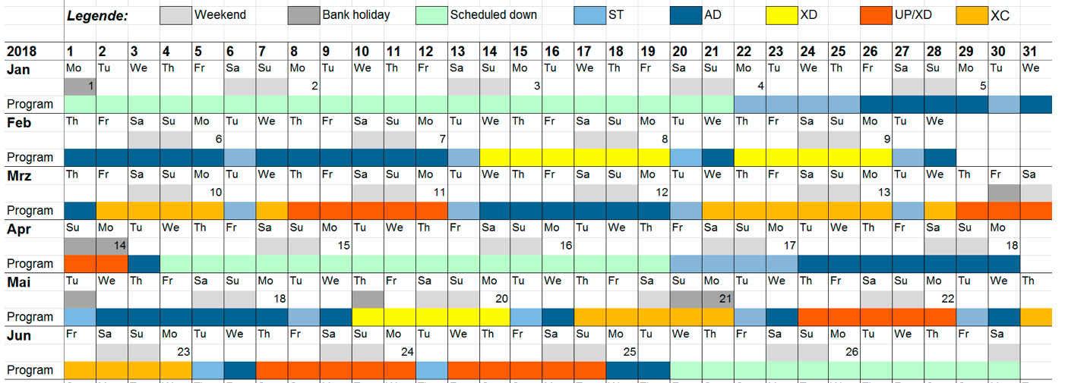

Karabo 2.3.0
Santos, Hugo
CAS, Agile Project Manager
Schenefeld, 13/07/2018

Slide 2
From: Karabo 2.2.4.x
To: Karabo 2.3.0
Karabo will have only three digits again: X.Y.Z
X = MAJOR version when you make incompatible API changes
Y = MINOR version when you add functionality in a backwards-compatible manner, and
Z = PATCH version when you make backwards-compatible bug fixes.

Slide 3
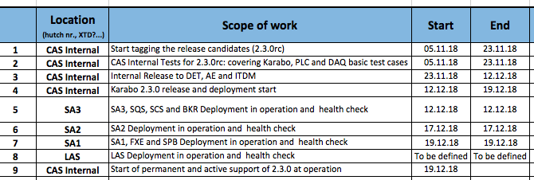

Slide 4
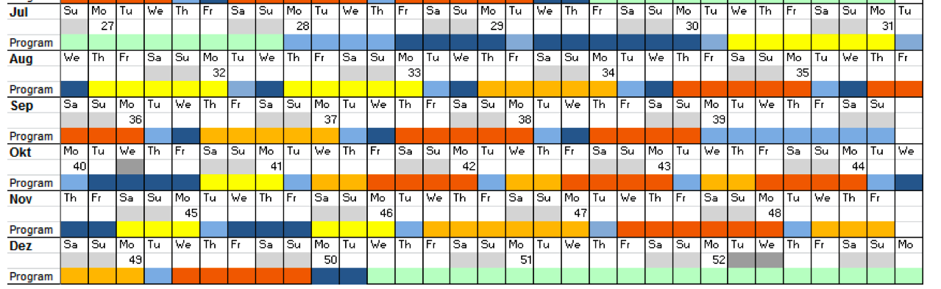
Only bugfixes/patches (Z) can be deployed in operation (SAs and Instruments)
Internally in CAS, 2.3.0 development is ongoing.

