Slide 1
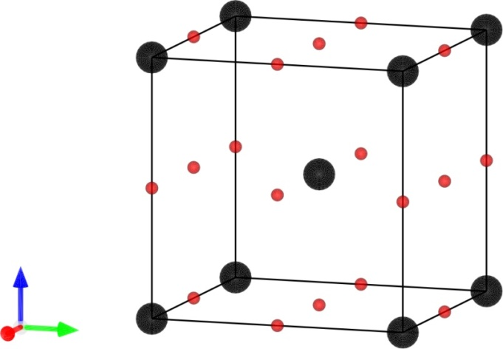
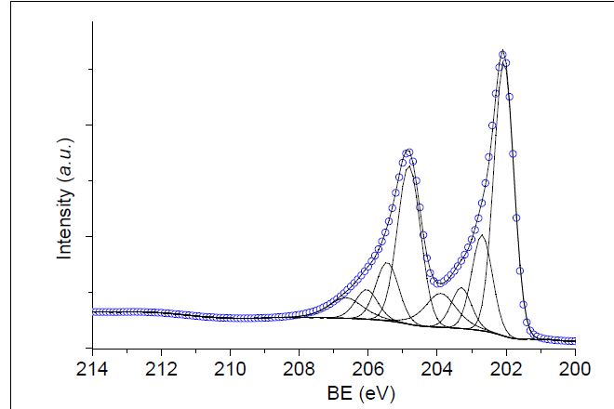
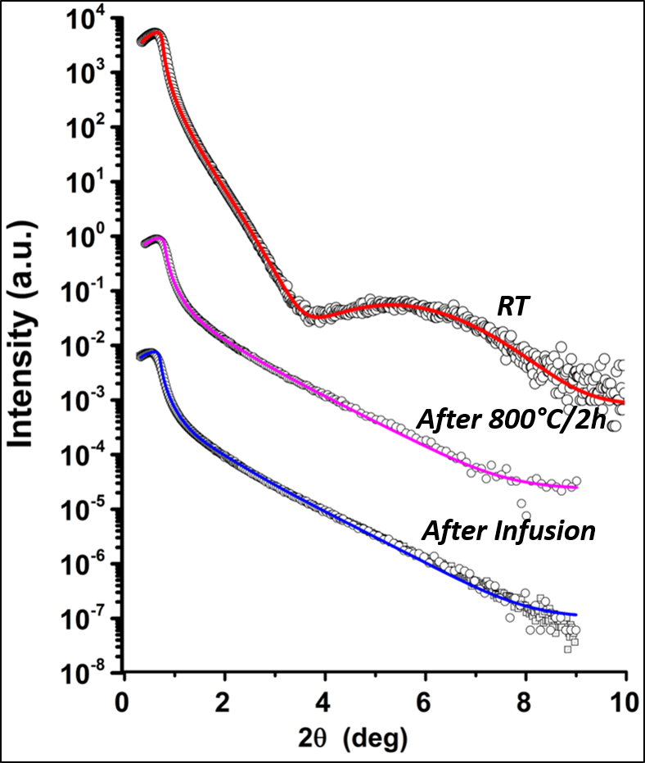
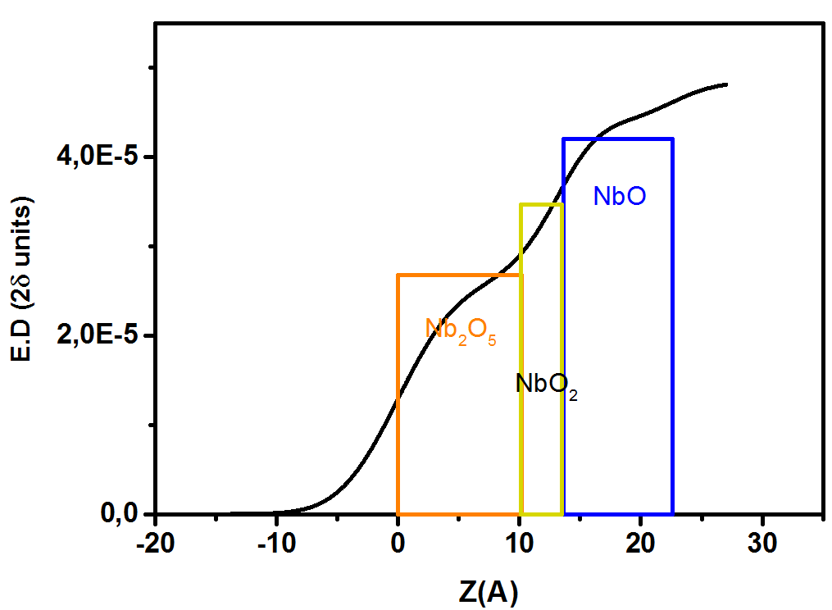
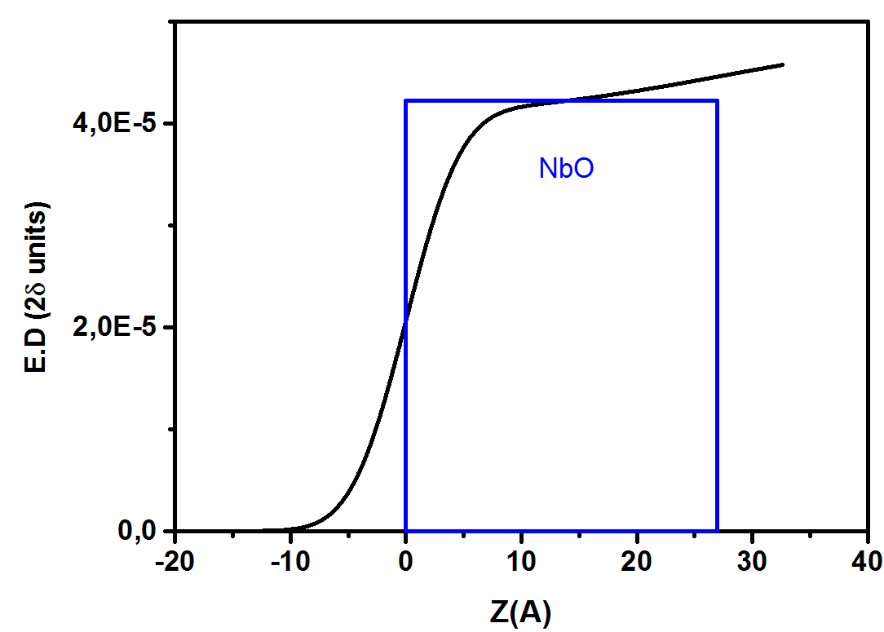
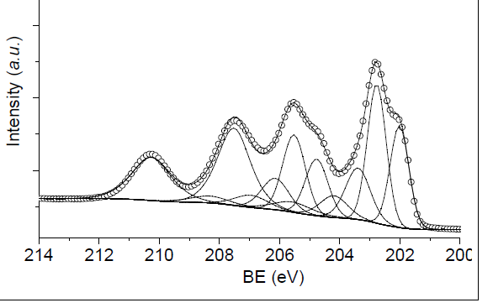
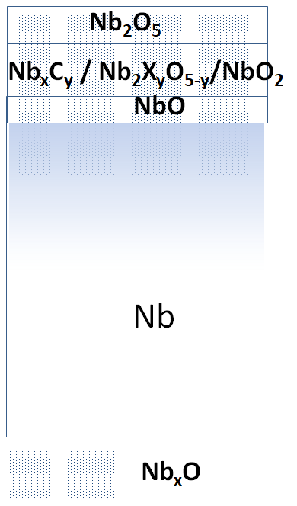
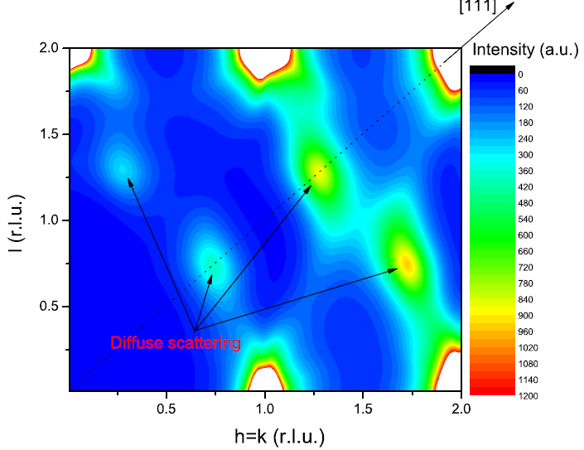
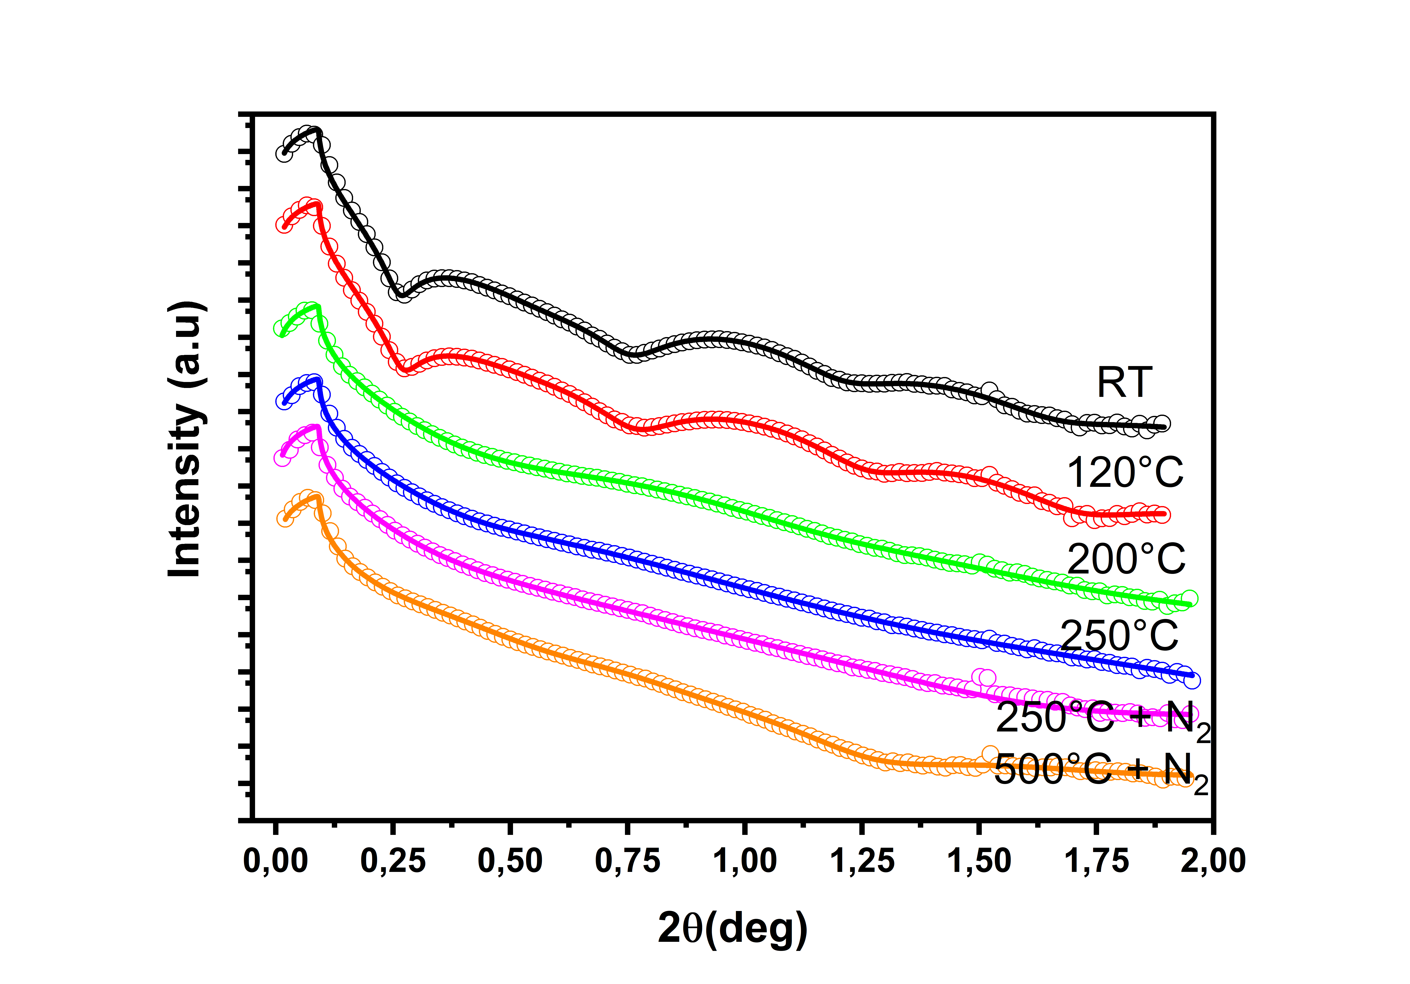
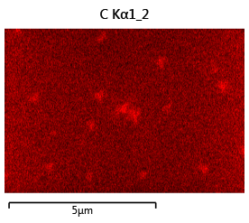
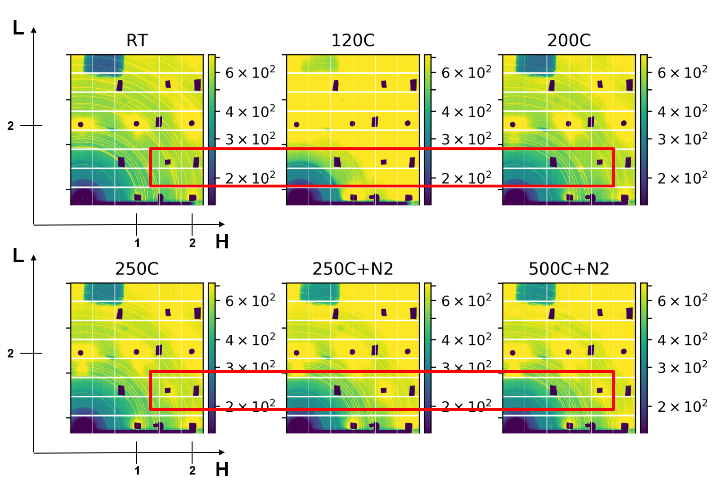
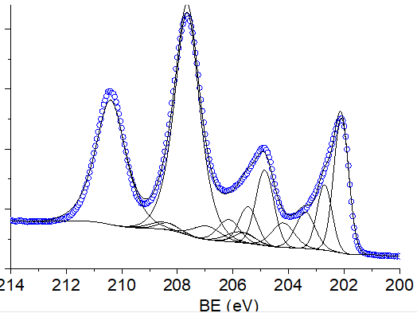
Niobium surface investigation for RF cavity applications.
Arti Dangwal Pandey, Guilherme Dalla Lana Semione, Christopher Bate, Marc Wenskat, Jörn Schraffan, Thomas F. Keller, Vedran Vonk, Heshmat Noei, Detlef Reschke, Hans Weise, Andreas Stierle
Introduction
Methods
Thermal treatments of SRF cavities in vacuum and nitrogen partial pressures are known to increase the performance of niobium cavities. [1,2] However, the physical and chemical processes as well as the phenomena involved are not clearly understood [3-5];
Goal: In-situ tracking of the changes in surface layer during Nb thermal treatment by means of surface-sensitive techniques.
A much simpler system of single-crystal Nb were selected: heated in different vacuum conditions and nitrogen partial pressures.
X-ray reflectivity (XRR): to retrieve the layered structure of the surface based on electron density profile;
X-ray photoelectron spectroscopy (XPS) to identify the chemical entities present on the surface;
N, O and C interstitials occupy octahedral sites in the Nb bcc lattice; Give rise to diffuse scattering intensities;
Grazing Incidence X-Ray Diffraction (GIXRD) for tracking the changes in thermal diffuse scattering (TDS) and Interstitial induced diffuse scattering intensities during the treatment
a
c
b
Nitrogen infusion
UHV-annealing vs N-infusion
Nanopolished, cavity material (large-grain Nb)
ΔT = 800°C (2 hours); Cooldown to 120°C
ΔP_{N2} = 0.033 mbar (48 hours) while @120°C
800°C UHV-annealed
Nb 3d, 0°
UHV annealed + 1 hr. air-exposure
Nb
Nb_{x}O
Nb₂O₅
~2.3 nm
Nb_{x}O
Nb
NbO₂
NbO
Nb-C
NbO₂
Nb-C
Nb₂O₅
NbO
Nb
NbO
RT
~2.7 nm
UHV annealed + 1 hr. air-exposure
800°C/2 hours
NbO
Nb 3d, 70°
N-infused + 1 hr. air-exposure
Nb
Nb 3d, 70°
Nb_{x}O
Nb
During ‘N- infusion’
@ 120 °C
Nb
Nb_{x}O
Nb-C
NbO₂
NbO
Nb-C
NbO₂
NbO
800°C annealing partially consumes native oxides, NbO remains;
Addition of N₂ doesn’t form new layers, effect also not time dependent within the proposed time scales;
Similar results obtained for single-crystal samples.
Nb₂O₅
Nb₂O₅
Nb₂X_{y}O_{5-y}
Interstitial diffuse scattering
N1s, 70°
N1s
N, O atoms can occupy octahedral sites in the Nb bcc lattice; Give rise to diffuse scattering intensities ;
Simulation and experiments confirm such intensities for the (110) Nb surface [6];
surfaces changes on N-infused compared to UHV-annealed Nb(100):
slower Nb₂O₅ growth on N-infused Nb sample
Increased NbO and NbC phases
Hint for a new phase: NbX_{x}O_{5-x} ; X: O, C, N
Nb-N bond: signal too week to identify a Nb-N phase
Samples infused with SRF cavity
Natural oxides dissolve upon annealing
N₂ injection does not promote layer growth
Diffuse intensity as a tool to retrieve concentration profile
Nb(111)
Nb(100)
Nb 3d, 70°
Nb₂O₅
Nb_{x}O
Nb
NbO₂
NbO
Nb-C
Electropolished Nb samples: N-infused with a SRF cavity
C-rich precipitates: Nb orientation dependent
XPS: difficult to detect phases below thick Nb penta-oxide
Ongoing: XPS depth-profiling
Nb₂X_{y}O_{5-y}
Summary
In-situ investigation of the near-surface region during thermal treatments with and without N₂;
XRR reveals dissolution of natural oxides, NbO remains at the surface after 800°C annealing step;
Thermal diffuse scattering and interstitial diffuse scattering under evaluation from HEGIXRD;
XPS: No Nb-N containing phase in Nb-infused Nb, significant changes in NbO and NbC phases.
[1] A. Grassellino et al, Supercond. Sci. Technol. 26 102001 (2013),
[2] A. Grassellino et al, Supercond. Sci. Technol. 30 094004 (2017),
[3] A. D. Pandey et al, Journ. of Mat. Sci. 53 10411 (2018),
[4] P. Dhakal et al, IEEE Tran. on App. Superc. 25 3500104 (2015),
[5] F. Barkov et al, Journ. Of App. Phys. 114 164904 (2013),
[6] M. Delheusy et al, Appl. Phys. Lett. 92 101911 (2008).
Acknowledgments
For HR-EDX measurements and analysis: Thobias Krekeler, BEEM, TUHH.
This work was partially funded by the Bundesministerium für Bildung und Forschung (BMBF) project “Performance improvement of SRF cavities by surface treatment including mechanical polishing and nitrogen thermal treatment” and DSF.

