Slide 1
Generic tools for particle and nuclear physics experiments
Mohammad Al-Turany
GSI-IT

Slide 2

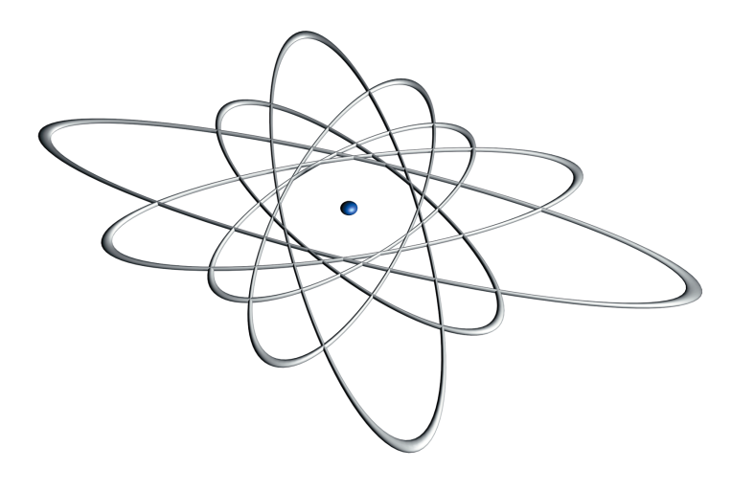
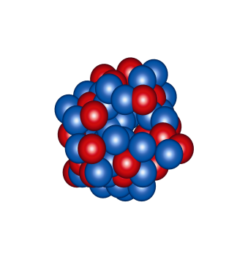
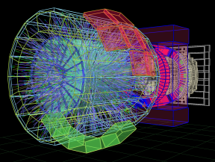
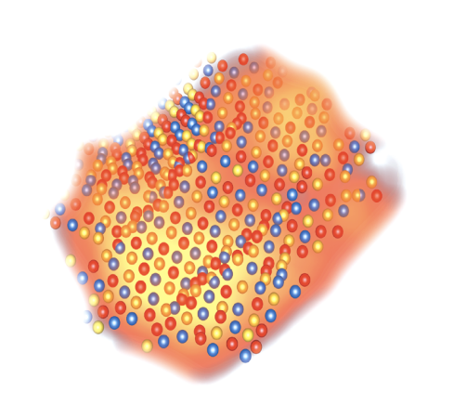
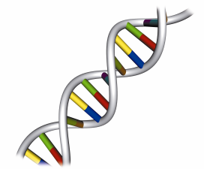
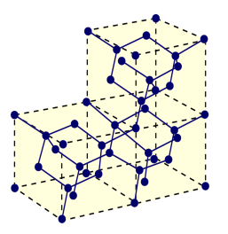
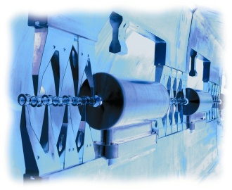
Research Areas at GSI
Nuclear Physics
Nuclear reactions
Superheavy elements
Hot dense nuclear matter
Atomic Physics
Alice
Atomic Reactions
Precision spectroscopy of highly
charged ions
Biophysics and radiation medicine
Radiobiological effect of ions
Cancer therapy with ion beams
Plasma Physics
Hot dense plasma
Ion-plasma-interaction
Materials Research
Accelerator Technology
Ion-Solid-Interactions
Structuring of materials with ion
beams
Linear accelerator
Synchrotrons and storage
rings

Slide 3
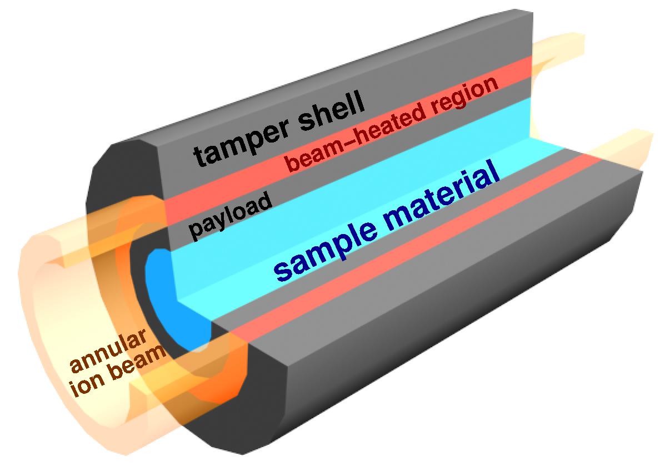
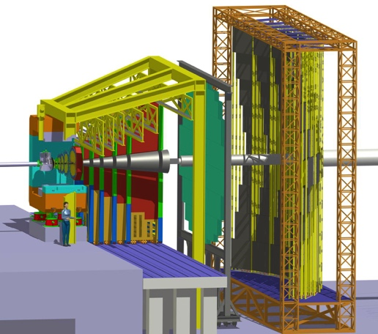
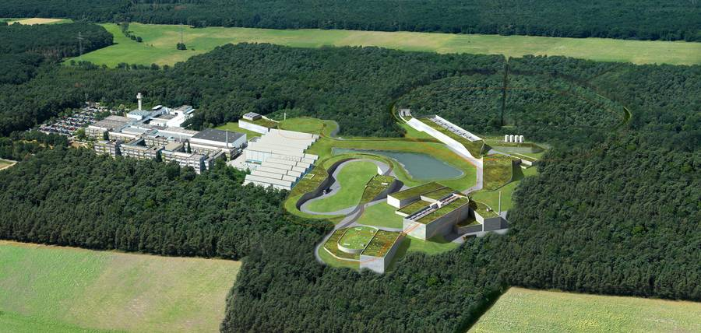
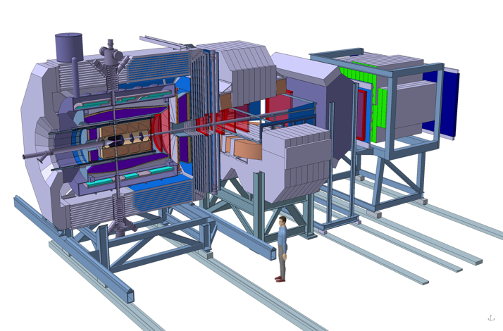
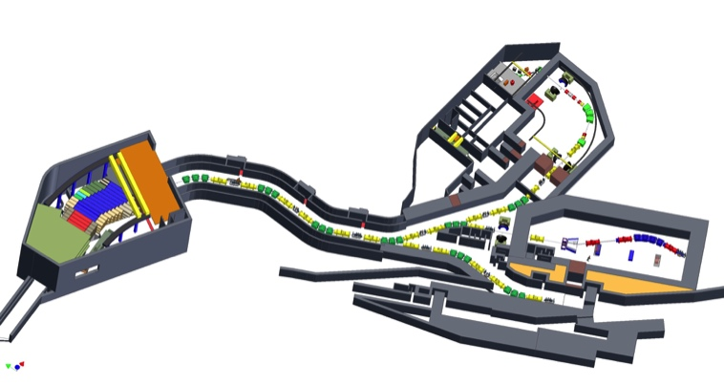
FAIR – four research pillars
CBM
APPA
PANDA
NUSTAR

Slide 4
FAIR – four research pillars
CBM
APPA
CBM & PANDA
More than 500 members each
HEP like detector systems
APPA & NUSTAR
700-800 members each
Many small detectors / sub-collaborations
PANDA
NUSTAR

Slide 5
Computing at FAIR
CBM
APPA
1 TByte/s into online farms
35 PByte/year on disk
~300.000 cores at Tier 0
~100.000 cores distributed
PANDA
NUSTAR

Slide 6
LHC Upgrade
PHASE I Upgrade
ALICE, LHCb major upgrade
ATLAS, CMS ‚minor‘ upgrade
Heavy Ion Luminosity from 10²⁷ to 7 x10²⁷
PHASE II Upgrade
ATLAS, CMS major upgrade
HL-LHC, pp luminosity
from 10³⁴ (peak) to 5 x10³⁴ (levelled)

Slide 7

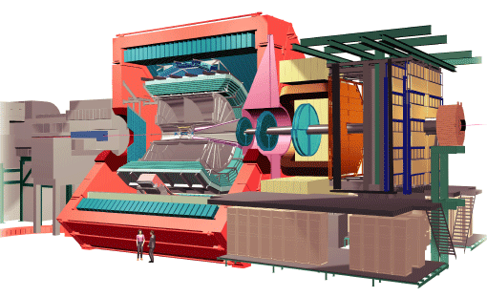
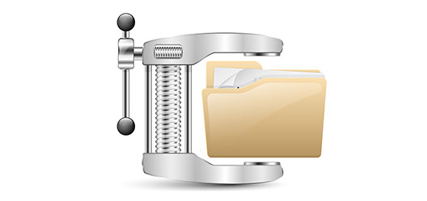

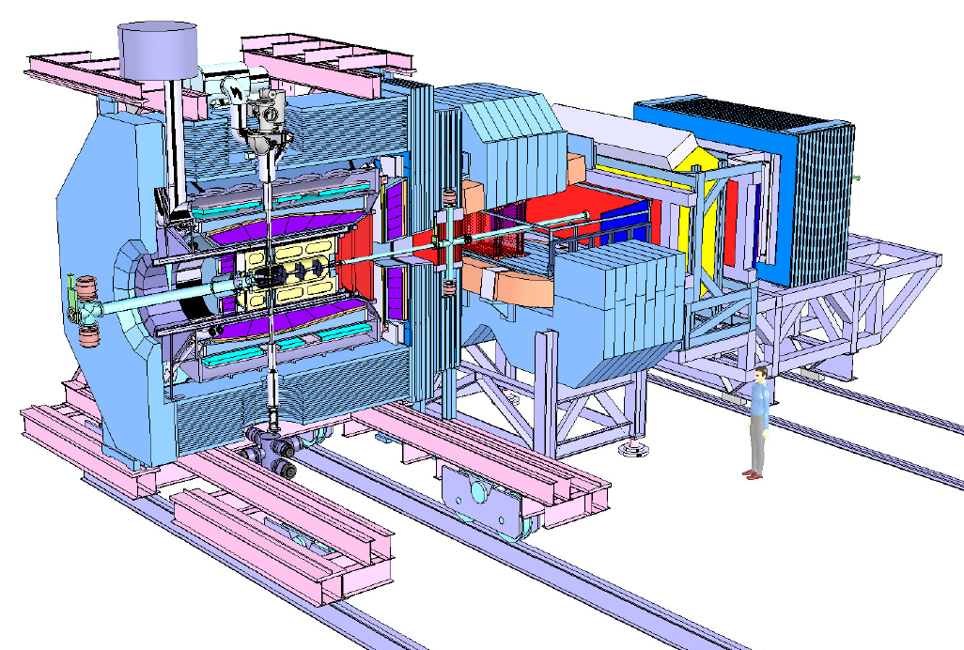
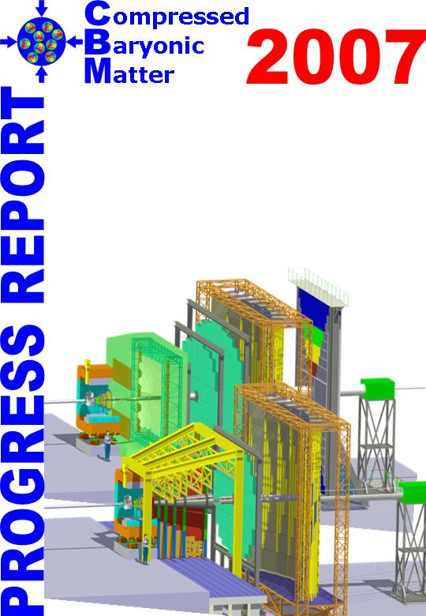
Different experiment similar requirements!
3 TB/s
90 GB/s
1 TB/s
1 GB/s
FLES
0.3 TB/s
1 GB/s

Slide 8

Different experiment similar requirements!
3 TB/s
90 GB/s
1 TB/s
1 GB/s
FLES
0.3 TB/s
1 GB/s

Slide 9
Alice O²
463 FPGAs
  Detector readout and fast cluster finder
100’000 CPU cores
  To compress 3.4 TB/s data stream by overall factor 14
3000 GPUs
  To speed up the reconstruction
  3 CPU¹⁾ + 1 GPU²⁾ = 28 CPUs
60 PB of disk
  To buy us an extra time and allow more precise calibration

Slide 10
Different experiment similar requirements!
3 TB/s
90 GB/s
1 TB/s
1 GB/s
FLES
0.3 TB/s
1 GB/s

Slide 11
CBM FLES
60’000 CPU cores
  To perform online a full event reconstruction on the 1 TB/s input data stream
? GPUs
  To speed up the reconstruction

Slide 12
Different experiment similar requirements!
3 TB/s
90 GB/s
1 TB/s
1 GB/s
FLES
0.3 TB/s
1 GB/s
Online
Cluster

Slide 13
Panda online
66’000 CPU cores
  To perform online a full event reconstruction on the 300 GB/s input data stream
? GPUs
  To speed up the reconstruction

Slide 14

Different and large infrastructures but what about software? Tools and Frameworks?

Slide 15


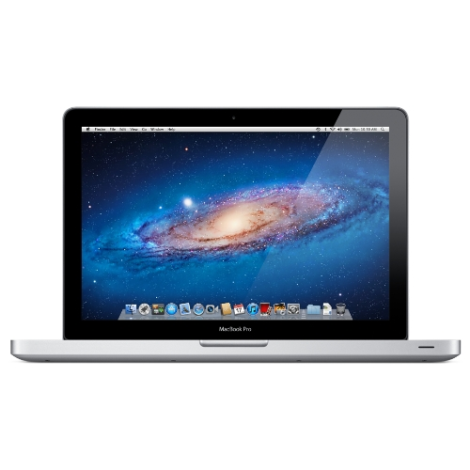
You have to support all these cases
60 000
cores
100 000
cores
66 000 cores
Grid Computing

Slide 16
AliceO2
http://alice-o2.web.cern.ch/
CbmRoot
https://fair-center.eu/for-users/experiments/cbm.html
PandaRoot
https://panda.gsi.de/
R3BRoot
https://www.gsi.de/r3b
FairShip
http://ship.web.cern.ch/ship/
SofiaRoot
AsyEosRoot
MPDRoot
http://mpd.jinr.ru
ExpertRoot
http://er.jinr.ru/
EnsarRoot
http://igfae.usc.es/satnurse/ensarroot.html
ATTPCRootv2
https://github.com/ATTPC/ATTPCROOTv2
BNMRoot
http://mpd.jinr.ru
ALFA
FairRoot
FairMQ
Geometry
Detector Response
Magnetic Field
Topology Editor
Event Generators
DDS
(Dynamic Deployment)
Parameter/ Condition Management
. . .
Testing
Software Stack
Network
(ZeroMQ, nanomsg, OFI libfabric)
Google Test
ROOT
. . .
Boost
Simulation Engines
VGM
CMake
Serialization
(Protocol Buffers, msgpack, FlatBuffers, ROOT)

Slide 17
Microservices architecture
  Small in scope. Each application has one single purpose.
  Self contained. Usually (but not necessarily) deployed using containers.
  Designed for horizontal scaling. Extra capacity by adding new instances.
  Disposable. Distributed nature of the system makes each application instance non-fundamental.

Slide 18
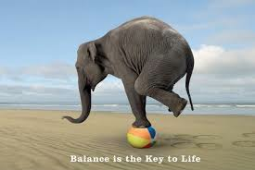
Correct balance between reliability and performance
Each "Task" is a separate process, which:
  Can be multithreaded, SIMDized, …etc.
  runs on different hardware (CPU, GPU, …, etc.)
  Be written in an any supported language (Bindings for 30+ languages)
Different topologies of tasks can be adapted to the problem itself, and the hardware capabilities

Slide 19
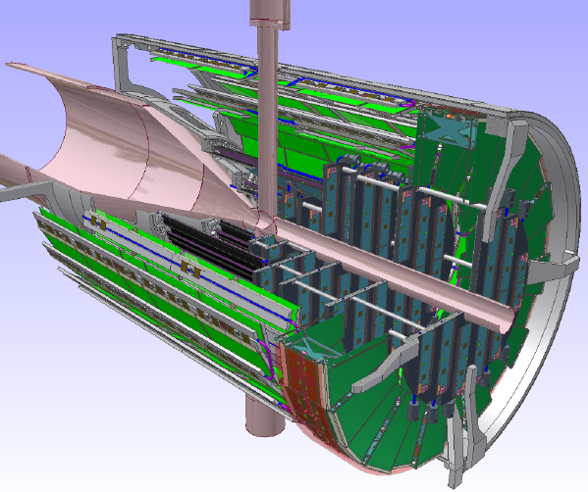
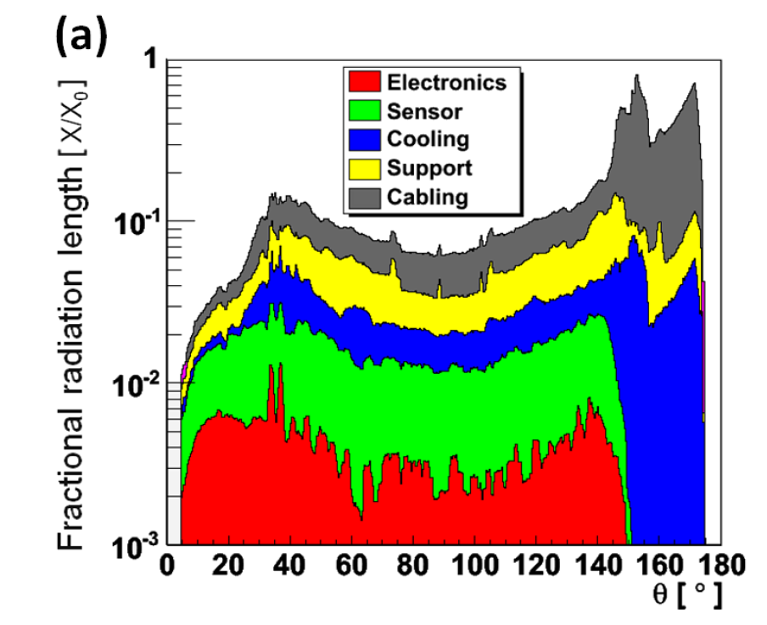
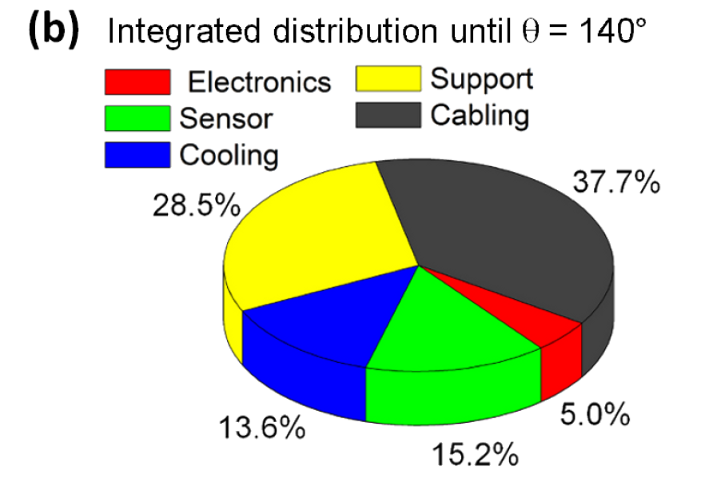
Example: Contributions of different functional parts of the MVD to the overall material budget
Generic tools available in FairRoot:
Radiation length Manager

Slide 20
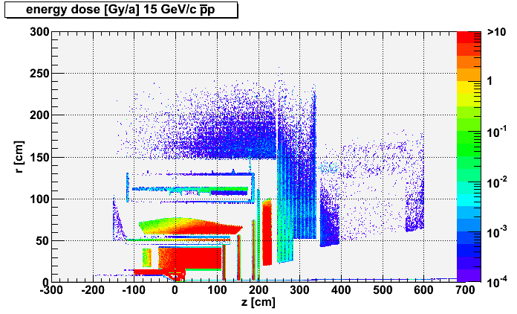
What energy dose will be accumulated during a certain time of operation?
Generic tools available in FairRoot:
Radiation map Manager
Create all physical volumes with correct material assignment
Run the simulation engine
FairRadMapManager will sum up every deposited energy in each volume in the geometry

Slide 21
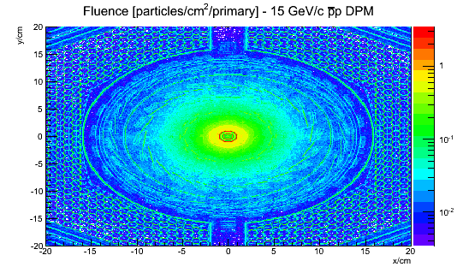
Generic tools available in FairRoot:
Radiation Grid Manager
What dose rate is expected at a certain space point/region?
Determine the particle fluence through a certain boundary (surface) and deduce a map. Knowing the volume and density of the object of interest and the specific energy loss doses can be estimated

Slide 22
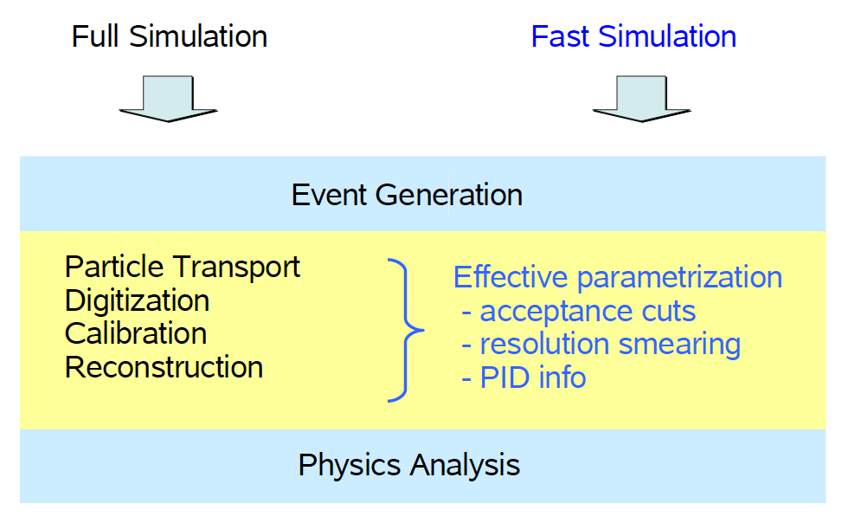
Generic tools available in FairRoot:
Fast simulation

Slide 23
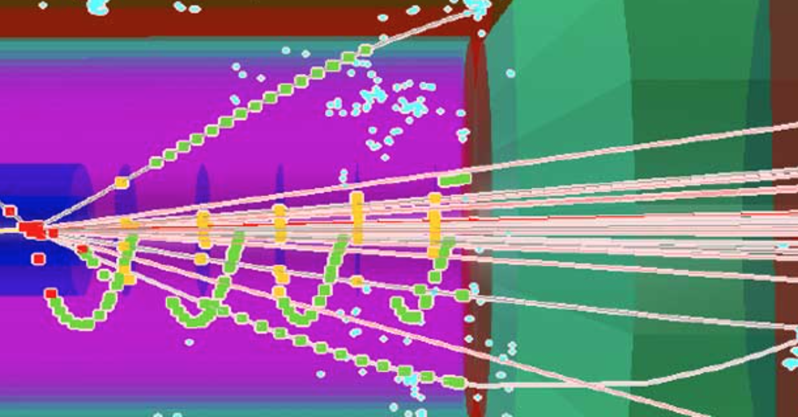
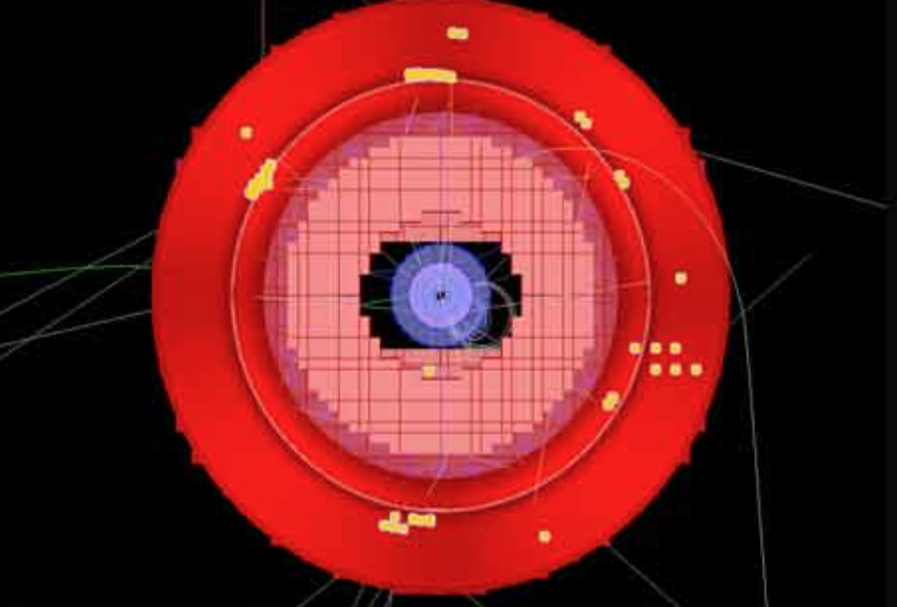
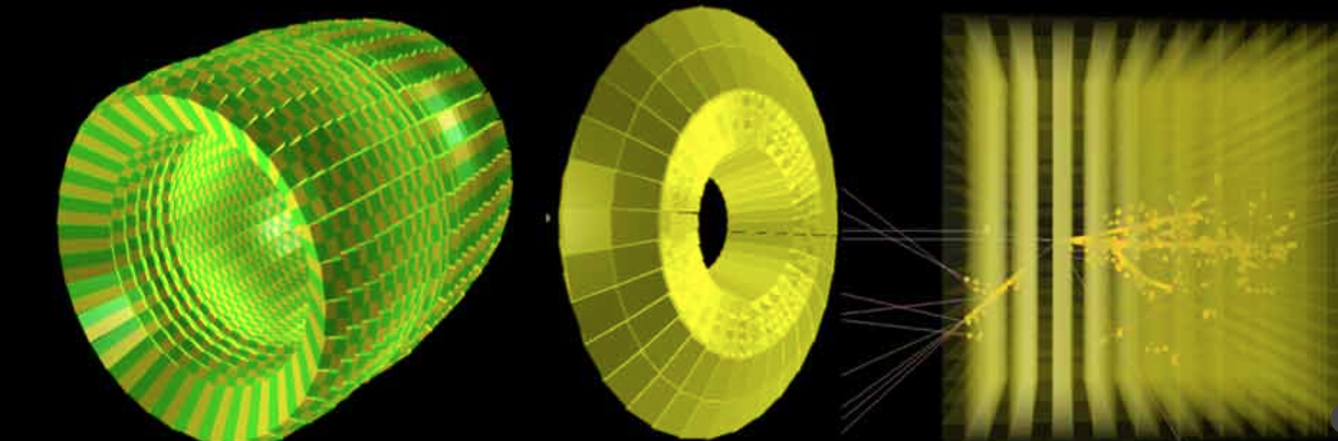
Generic tools available in FairRoot:
Event Display based on ROOT EVE package
Runs out of the box for track visualization in simulation

Slide 24

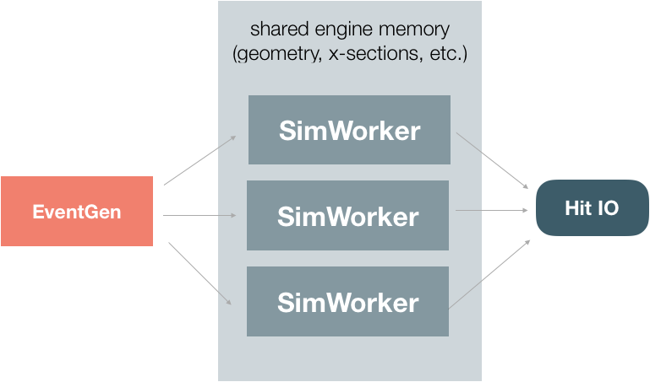
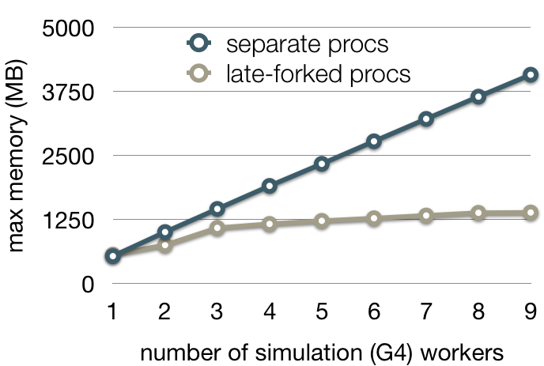
Parallel high-performance simulation framework
Simulation
Development of a scalable and asynchronous parallel simulation system based on independent actors and FairMQ messaging
Supports parallelization of simulation for any VMC engine
Supports sub-event parallelism
  Make simulation jobs more fine-granular for improved scheduling and resource utilization
Demonstrated strong scaling speedup (24 core server) for workers collaborating on few large Pb-Pb event
Small memory footprint due to particular ”late-forking” technique (demonstrated with Geant4)
In result, reduce wall-time to treat a Pb-Pb events from O(h) to few minutes and consequently gain access to opportunistic resources
S.Wenzel @ CHEP18

Slide 25

Vc: Portable and intuitive data parallelism
Vc implements SIMD types, making SIMD programming easy and portable
Vc is used and taught internationally
Vc to improve C++
A proposal based on Vc is making progress in the C++ committee (Matthias Kretz)
Explicit SIMD programming is a stated goal for a future C++ standard

Slide 26
Using common tools:
Developer productivity is improved by allowing developers to focus on the unique requirements of their application instead of spending time on application infrastructure (“plumbing”).
Developers focus their time on how to execute a process recipe (e.g reconstruction, analysis, ..) instead of worrying about how recipes are stored, retrieved, organized, … etc.

